Slide 1
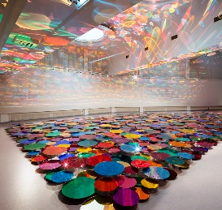
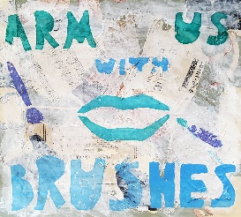
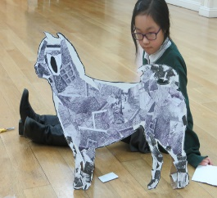
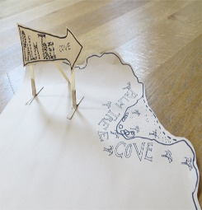
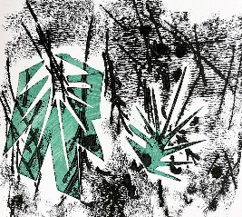
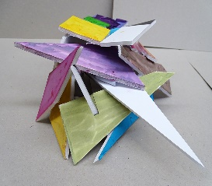
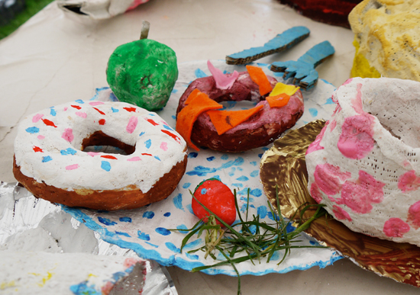
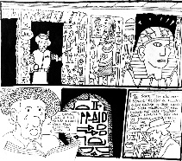
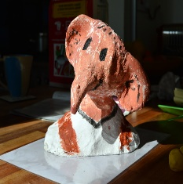
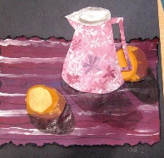
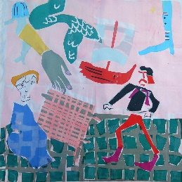
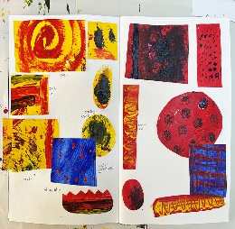
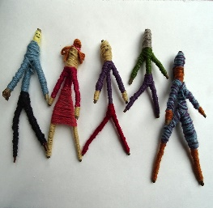
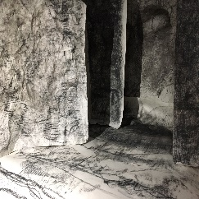
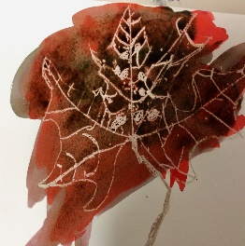
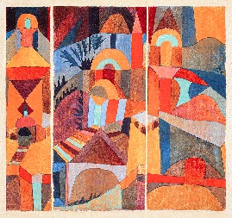
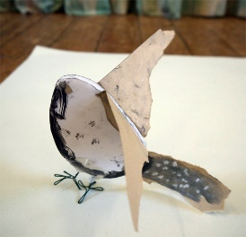
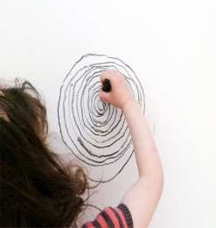
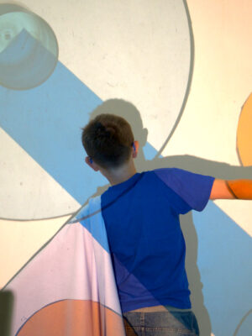
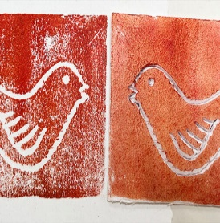
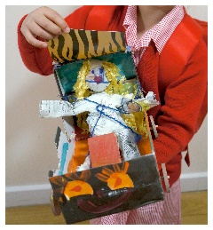
Ashurst Wood Art Learning Journey
KS1 - YR
SURFACE & COLOUR
DRAWING & SKETCHBOOKS
WORKING IN THREE DIMENSIONS
KS2 – Y6
KS2 – Y6
KS2 – Y6
PRINT & ACTIVISM
2D DRAWING TO 3D MAKING
BRAVE COLOUR
KS2 – Y5
KS2 – Y5
KS2 – Y5
KS2 – Y4
TYPOGRAPHY & MAPS
MAKING MONOTYPES
ARCHITECTURE: DREAM BIG OR SMALL?
KS2 – Y4
KS2 – Y3
KS2 – Y4
FESTIVAL FEASTS
KS2 – Y3
EXPLORING STILL LIFE
STORY TELLINMG THROUGH DRAWING
TELLING STORIES THROUGH DRAWING & MAKING
KS1 – Y2
KS1 – Y2
KS2 – Y3
WORKING WITH SHAPE & COLOUR
KS1 – Y2
EXPRESSIVE PAINTING
STICK TRANSFORMATION PROJECT
KS1 – Y1
GESTERAL DRAWING WITH CHARCOAL
KS1 – Y1
KS1 – Y1
EXPLORE & DRAW
KS1 - YR
KS1 - YR
EXPLORING WATERCOLOUR
KS1 - YR
MAKING BIRDS
SPIRALS
HOW CAN WE USE OUR BODIES TO MAKE ART?
SIMPLE PRINT MAKING
PLAYFUL MAKING

