Slide 1
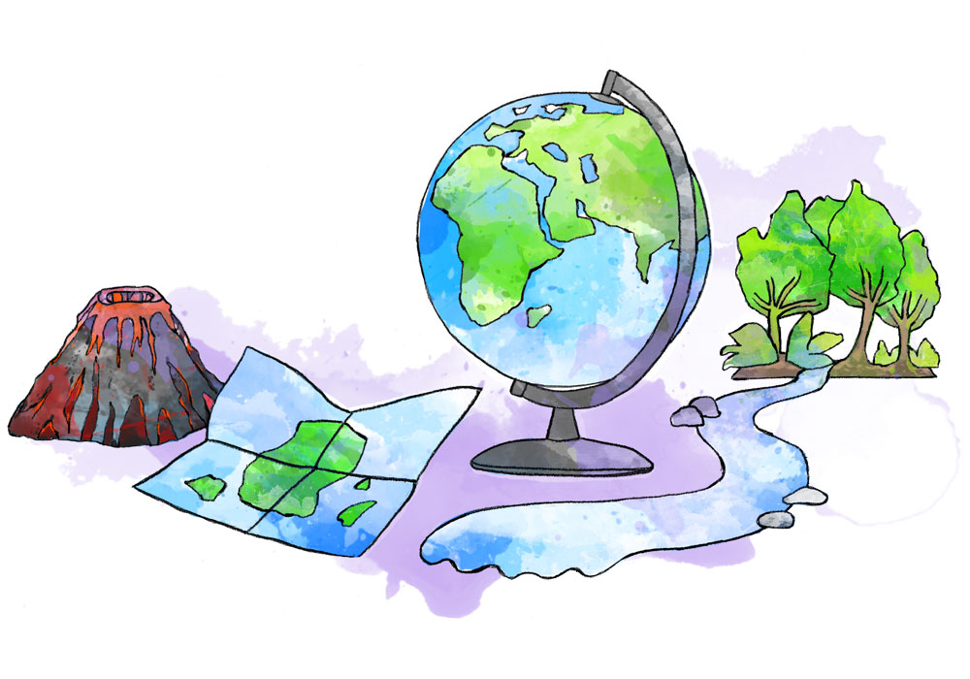
Geography at Ashurst Wood Primary

Slide 2
Geography at Ashurst Wood Primary

Slide 3
Geography at Ashurst Wood Primary
The national curriculum for geography aims to ensure that all pupils:
Develop contextual knowledge of the location of globally significant places – both terrestrial and marine – including their defining physical and human characteristics and how these provide a geographical context for understanding the actions of processes
Understand the processes that give rise to key physical and human geographical features of the world, how these are interdependent and how they bring about spatial variation and change over time
Are competent in the geographical skills needed to:
Collect, analyse and communicate with a range of data gathered through experiences of fieldwork that deepen their understanding of geographical processes
Interpret a range of sources of geographical information, including maps, diagrams, globes, aerial photographs and Geographical Information Systems (GIS)
Communicate geographical information in a variety of ways, including through maps, numerical and quantitative skills and writing at length.

Slide 4
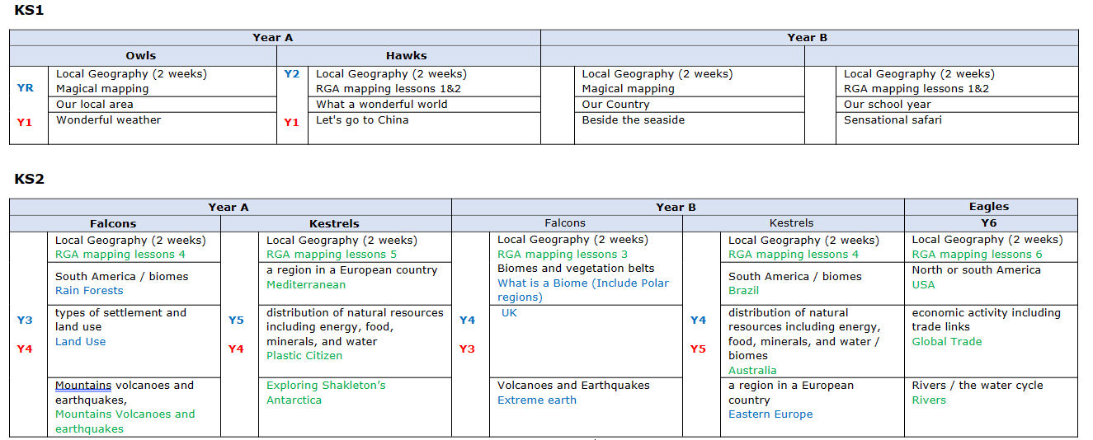
Geography at Ashurst Wood Primary
At Ashurst Wood we have developed a two-year rolling programme to ensure the national curriculum is covered as well underpinning our eco work.
We are very proud to be an Eco Schools green flag holder.

Slide 5
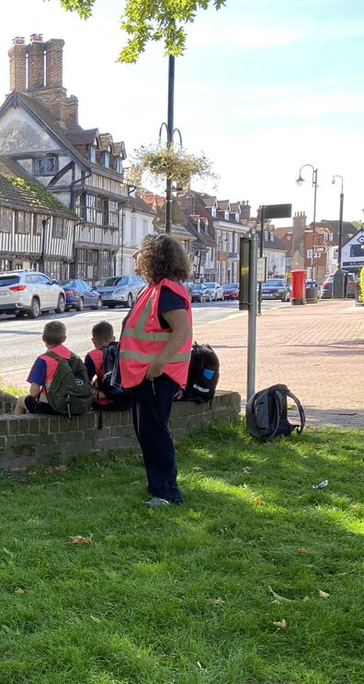
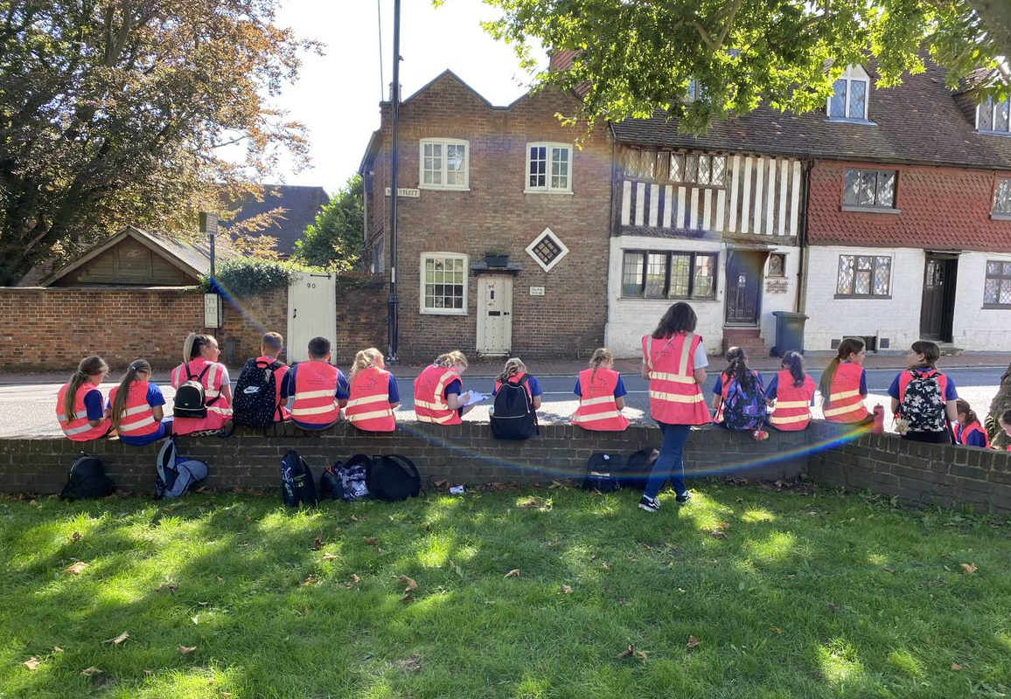
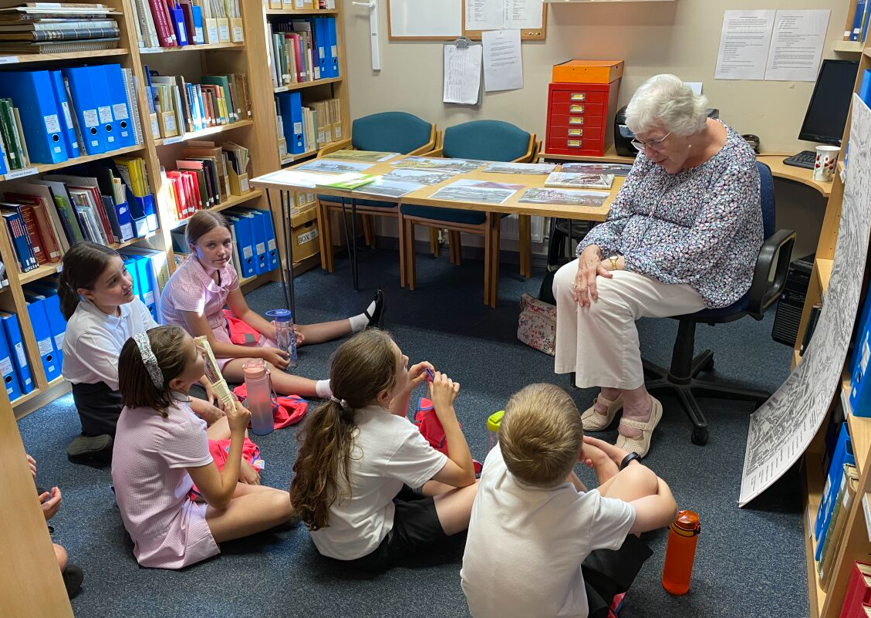
Geography at Ashurst Wood Primary
We start every academic year with a two-week local Geography project.
KS1 study the area around the school and the village of Ashurst Wood.
KS2 travel into East Grinstead on the bus and study different aspects of the town.

Slide 6
Geography at Ashurst Wood Primary
Through the regular Forest School sessions our children are immersed in geographical learning.
Key geographical learning that is covered in the sessions are:
Reception
Follow rules and boundaries
Promote free exploration
Talk about some of the things they have observed.
Respect the plants and animals that live in our forest school area.
Have some knowledge about the wildlife within our FS site and how to look after them.
• Describe where they live and the surrounding area – shops, roads, parks etc.
Understand that the weather changes with the seasons. (linked to walks in school/local area)
Make observations of plants and weather in their environment and talk about changes.
Describe vegetation in a variety of different photographs from around the world and comment on sizes, shapes and weather
Walk around the local area noticing features
Describe their immediate environment using knowledge from observation, discussion, stories, non-fiction texts and maps
Devise simple maps and sketches-not to scale- and create own symbols to represent features on the map
Use a magnifying glass.
Use a camera to take still and moving images
Key Stage One
Using simple compass directions (North, South, East and West).
Using directional language (near and far; left and right) Describing the location of features and routes on a map.
Recognise landmarks and human and physical features.
Understanding the signs of wildlife within our FS site (droppings, nests, burrows etc.) creating habitats for them to live in.
Name animals within our environment.
Contrast a place they know well with another they are not familiar with, using maps, photographs, and videos to help make comparisons
Know some of the advantages and disadvantages of living in a city or village
Know why is it important to recycle
Begin to appreciate the different weather patterns in the UK
Devise a simple map
Talk about the features in their local environment
Talk about the features in their local environment and compare it with another they know
Take photographs of locally interesting geographical features
Lower Key Stage Two
Demonstrate understanding of the concept of a basic map
Build trust with a partner and work together when orienteering
Name some common garden birds and talk about their features
Looking at creating a habitat to attract more wildlife within Forest School.
Know the main differences between city, town and village
Identify seasonal and daily weather patterns in the UK
Know why recycling is important
Understand how ideal settlements may have changed over time
Understand what is meant by being environmentally friendly
Talk about the features in their local environment and compare it with another they know
Create a report after a fieldwork activity that focuses on geographical features observed
Upper Key Stage Two
What makes a perfect habitat for wildlife and what changes could we make both in school and at home to encourage more wildlife within our settings.
I can use a key to identify trees and animal tracking signs.
Know about climate change and its potential impact on our lives
Understand the consequence of ignoring climate change
Understand why their village/ town or city exists and what brought people to live there
Understand some of the arguments put forward in relation to green energy
Set up a geographical fieldwork enquiry, starting with a hypothesis
To review, apply and consider next steps as a result of their geographical enquiry

Slide 7
What do our pupils say?
Geography is helpful. It is useful to know where you are going and where things are!
We have been learning about maps and continents; we use maps, globes and computers to help us.
It is interesting to find out things about other places in the world.

