Slide 1
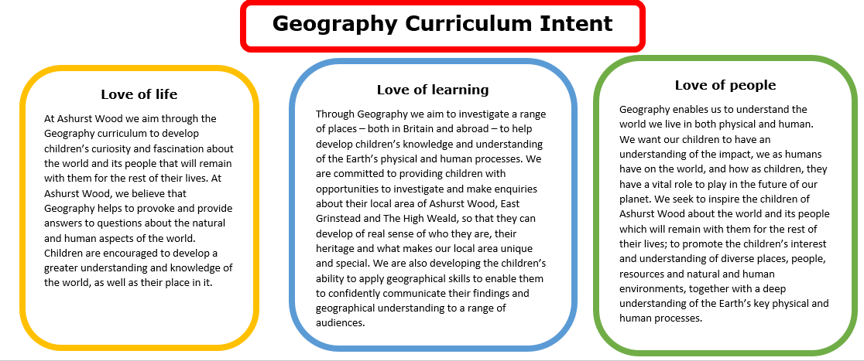
Essential Characteristics
An excellent knowledge of where places are and what they are like.
An excellent understanding of the ways in which places are interdependent and interconnected and how much human and physical environments are interrelated.
An extensive base of geographical knowledge and vocabulary.
Fluency in complex, geographical enquiry and the ability to apply questioning skills and use effective analytical and presentational techniques.
The ability to reach clear conclusions and develop a reasoned argument to explain findings.
Significant levels of originality, imagination or creativity as shown in interpretations and representations of the subject matter.
Highly developed and frequently utilised fieldwork and other geographical skills and techniques.
A passion for and commitment to the subject, and a real sense of curiosity to find out about the world and the people who live there.
The ability to express well-balanced opinions, rooted in very good knowledge and understanding about current and contemporary issues in society and the environment.

Slide 2
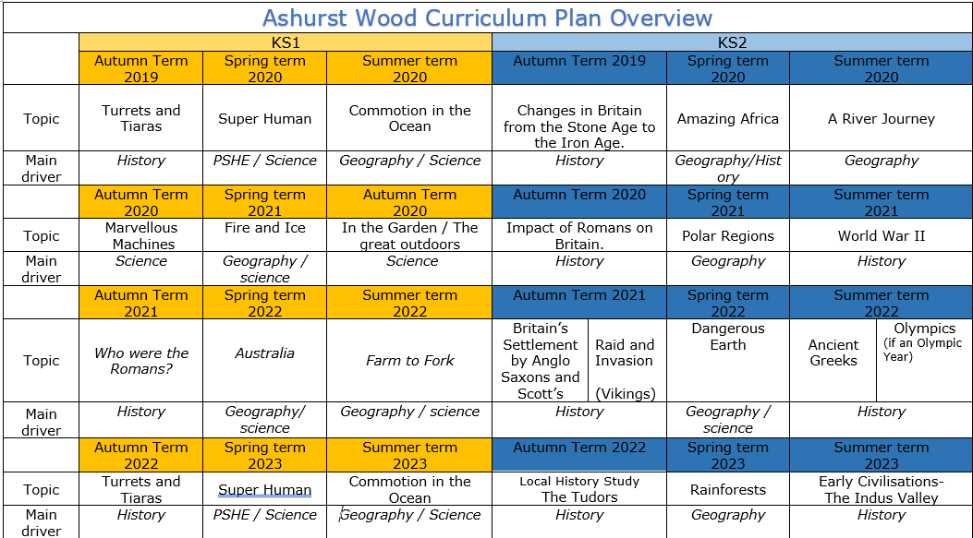
Commotion in the Ocean
Geography / Science
Amazing Africa
Geography / History
A river journey
Geography
Fire & Ice
Geography / Science
Polar Regions
Geography
Geography
Australia
Geography / Science
Farm to Fork
Geography / Science
Dangerous Earth
Geography / science
Commotion in the Ocean
Geography / Science
Rainforests
Geography
https://www.arthurbugler.com/uploads/Curriculum/Autumn%202%20Planning/Y6%20Frozen%20Kingdom.pdf

Slide 3
KS1
GEOGRAPHY TEACHING AND LEARNING AT ASHURST WOOD
Our topic planning is designed so that some topics are Geography led and the key knowledge and skills are captured in the planning and knowledge organisers. Other topics may contain geographical knowledge in addition to the main driver. All children in KS1 will study the same topic and so expectations will be different for a YR Y1 and a Y2 child. For this reason and to ensure that there is no ceiling placed on a child’s learning we have identified outcomes for all children Must (End of Y1) Should (end of Y2) Inspire a rich and deep understanding.
In the Garden
GEOGRAPHY
At Ashurst Wood
What will children Know by the end of this topic ?
EYFS
MUST
To know what a bird's eye view is
They will know that there are four main compass points N S E W
SHOULD
Children will be able to name and locate the countries of the UK and the surrounding seas.
Identify the key features of a location in order to say whether it is a city, town, village, coastal or rural area
Use aerial images and plan perspectives to recognise landmarks and basic physical features. To create maps using symbols and a map key Use simple grid references (A1, B1).
They will know and use the four main compass points and use them to describe locational features and routes on a map.
Be able to identify seasonal and daily weather patterns.
They will use and understand the vocabulary on the knowledge organiser.
Identify seasonal and daily weather patterns in the United Kingdom
Identify land use around the school.
Use basic geographical vocabulary to refer to:
key human features, including: city, town, village, factory, farm, house, office and shop.
ELG: People, Culture and Communities Children at the expected level of development will: - Describe their immediate environment using knowledge from observation, discussion, stories, non-fiction texts and maps; - Know some similarities and differences between different religious and cultural communities in this country, drawing on their experiences and what has been read in class; - Explain some similarities and differences between life in this country and life in other countries, drawing on knowledge from stories, non-fiction texts and when appropriate maps. ELG: The Natural World Children at the expected level of development will: - Explore the natural world around them, making observations and drawing pictures of animals and plants; - Know some similarities and differences between the natural world around them and contrasting environments, drawing on their experiences and what has been read in class; - Understand some important processes and changes in the natural world around them, including the seasons and changing states of matter.
Enrichment
A visit by a Seasonal walks in the village
Forest Schools
Visit a garden in the village
Skills
Children will be able to use atlases and globes to find UK and the different continents.
Be able to create simple maps of the school and their route around the school.
They will be able to answer geographical questions (such as: What is this place like? What or who will I see in this place? What do people do in this place?).
Skills
They will be able to ask geographical questions
Use simple fieldwork and observational skills to study the geography of the school and the key human and physical features of its surrounding environment
COULD
Be able to plan a garden using grid references.
Identify types of plants that grow in different climates e.g. cacti in deserts, rain forests near the equator

Slide 4
Year / Class KS1 |  | Topic Title: Farm to fork - Geography sub focus | Topic Title: Farm to fork - Geography sub focus
Pre learning Links. In KS1 prior knowledge will depend on which year group the child is in. Farm to fork– what do plants need to grow Science – life cycles |  |  | Stunning Start: Have a farm animal such as a sheep visit the school. Fantastic Finish: visit to a farm or
The Big Question: ? |  | Creative Arts and Forest School Links Habitats Making prints with leaves Fruit observational drawing Healthy eating
Small Question | Can you grow a pizza?
Small Question | How does the weather effect the plants in the garden? | Literacy links https://www.booksfortopics.com/growing-ks1 |  | Vocabulary Keys Harvest Crops Transport River Sea Field Distance North, south ,east, west Left, right up, down Snow, wind, rain, ice Hail, fog House | Spring Summer Autumn Winter Seasons Seasonal Shops Supermarket Factory Dry, wet Fruit vegetables Beach Coast Hill Mountain | Journey Landscape Hedge Travel Village Town City Ocean River Valley Vegetation City Town Village | Coastal Rural Factory Farm Atlas globe Map Key Directions route Shop Supermarket Market office
Small Question | What difference does it make to a plant if they are planted at the north or south point in the garden?
Useful Links

Slide 5
Year / Class KS1 |  | Topic Title: Farm to fork - Science
Pre learning Links. In KS1 prior knowledge will depend on which year group the child is in. Farm to fork– what do plants need to grow Science – life cycles |  | Stunning Start: Fantastic Finish: Garden party
The Big Question: What makes a a space a garden ? |  |  | Creative Arts and Forest School Links Habitats Making prints with leaves Fruit observational drawing Healthy eating
Small Question | Can you name some wild pants?
Small Question | How to wild plants spread?
Small Question | Are trees plants? Are vegetables plants? |  | Literacy links https://www.booksfortopics.com/growing-ks1 | Vocabulary Root Stem Trunk Leaves Flowers Deciduous Evergreen Garden plants Wild plants Seeds Bulbs Pollination Seed dispersal Light Water Soil Twig | Branch
Small Question | Can you classify different types of tree in the locality?
Small Question | Do all fruit and vegetables grow below the ground?
Small Question | What is the difference between fruit and vegetables?
Small Question | What is the lifecycle of a plant? How is this similar to other lifecycles? |  | Literacy links https://www.booksfortopics.com/growing-ks1 | Vocabulary
Small Question | How can we protect our environment?
Small Question | What do plants do for the environment and how can we help?
Small Question | What does a plant need to grow? |  | Literacy links https://www.booksfortopics.com/growing-ks1 | Vocabulary
Small Question | Can you label the parts of a plant and describe its function?
Useful Links

Slide 6
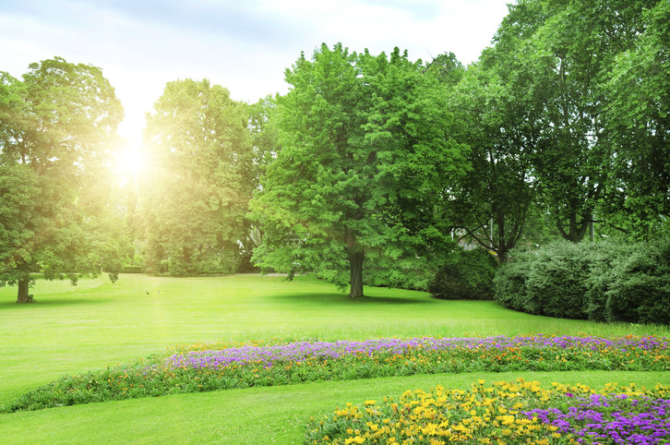
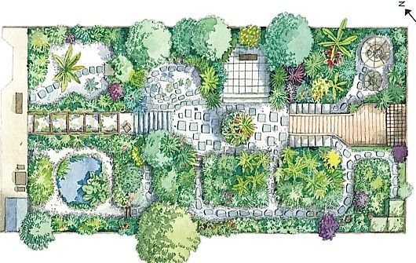
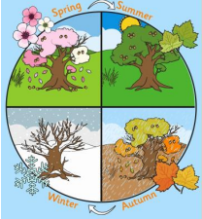
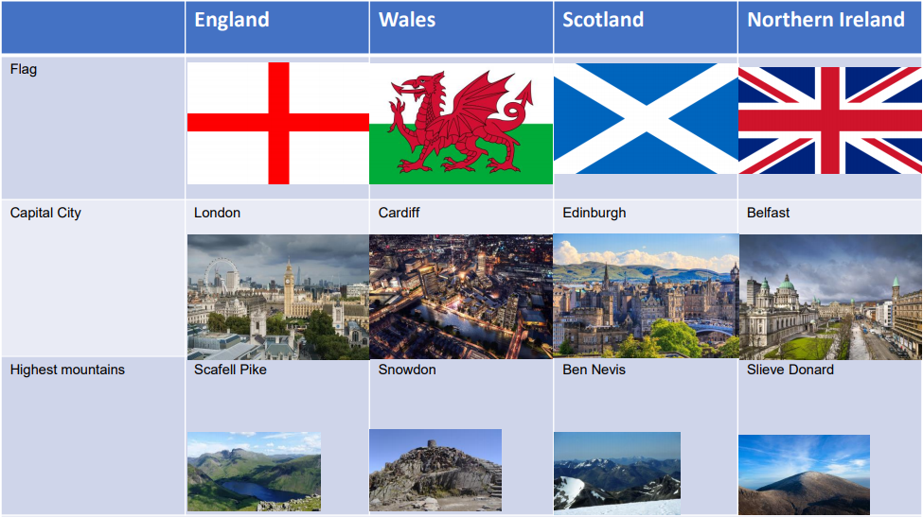
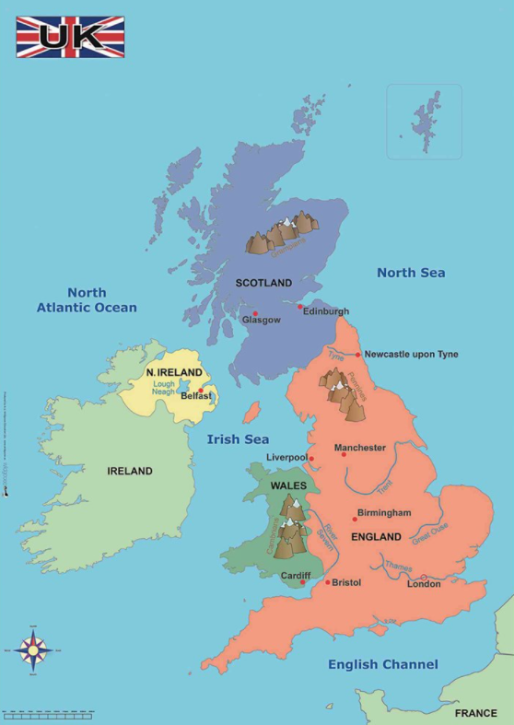
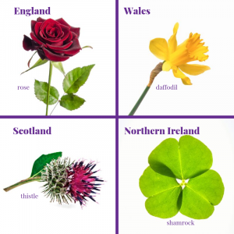
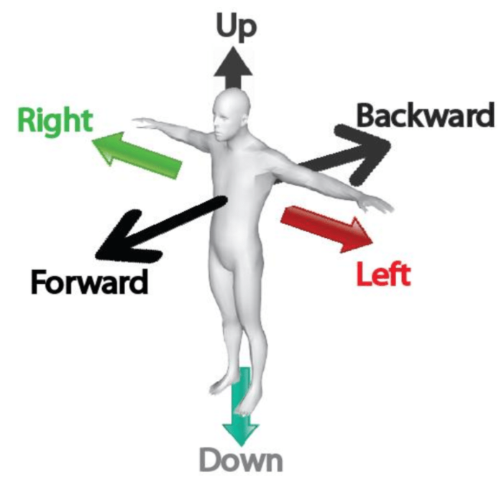
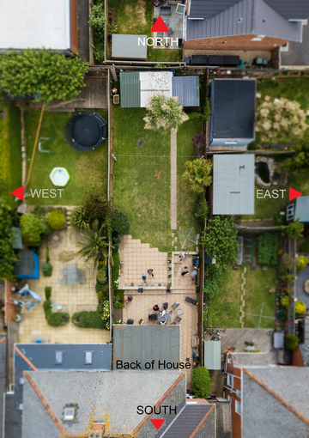
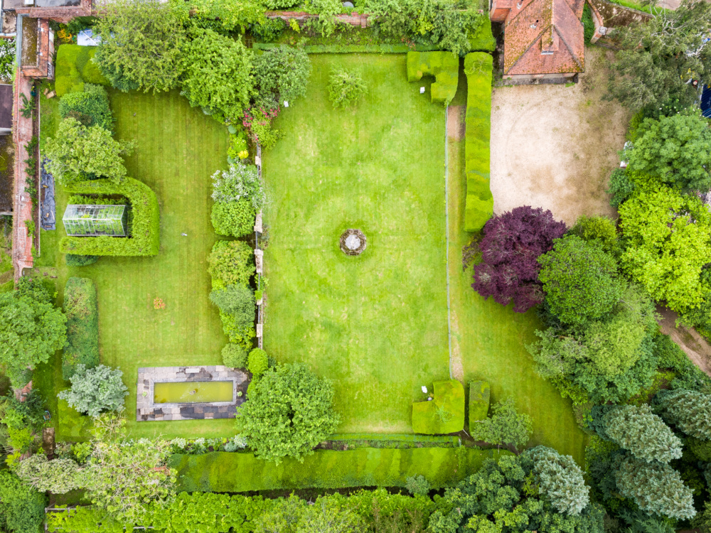
In the Garden
Geography
VOCABULARY
Seasons | a time of year marked by certain conditions: spring, summer, autumn, winter
England | England is a country that is part of the United Kingdom
Scotland | Scotland is a country that is part of the United Kingdom. Covering the northern third of the island of Great Britain.
Wales | Wales is a country in southwest Great Britain
Ireland | Ireland is an island in the North Atlantic. It is separated from Great Britain to its east by the North Channel, the Irish Sea, and St George's Channel.
Sea | a body of salt water not as large as an ocean and often nearly surrounded by land
Soil | Soil is the loose upper layer of the Earth's surface where plants grow.
Climate | The pattern of weather conditions in a particular area over a period of time
Village | A community made up of a small number of houses, usually in a country area.
Town | a place with many streets and buildings, where people live and work. Towns are larger than villages and smaller than cities
City | is a place where many people live closely together. Cities bring together a great variety of people from different backgrounds. They offer more jobs, more schools, and more kinds of activities than smaller towns and villages
Location | place or position
Country | Political area defined by physical, human or cultural features
Aerial view | A picture taken from above. This could be from a high building, aeroplane or drone.
Bird’s eye view
North, South, East, West | compass points, locational vocabulary
Symbol | picture on a map to show a feature on a map
Weather | conditions in the atmosphere on a particular day, such as temperature, windiness, rainfall, hours of sunshine or cloud cover.
Wild | land not farmed, used for parks or gardens, or built on
Local | Near by

Slide 7
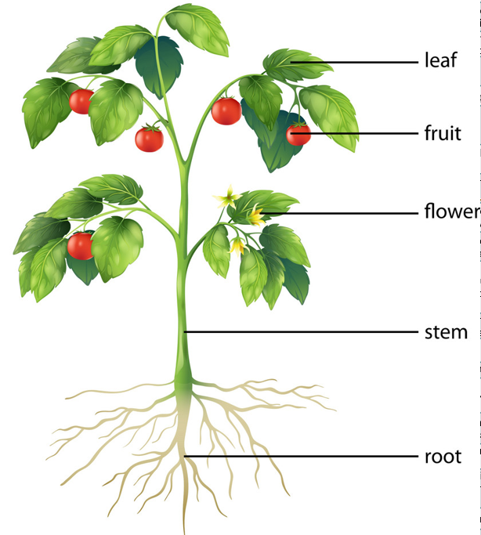
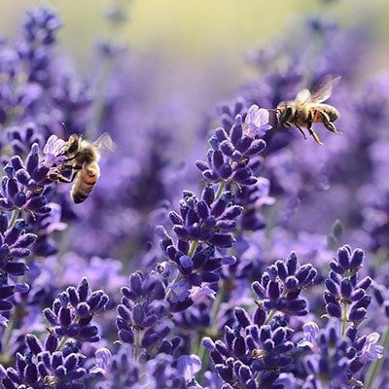
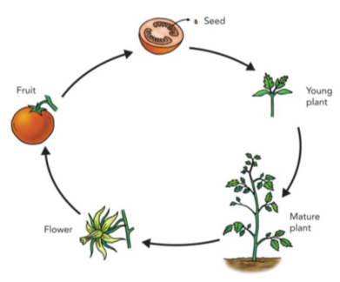
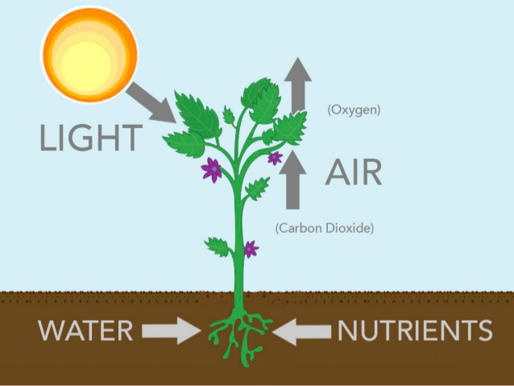
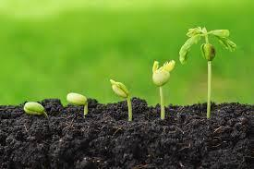
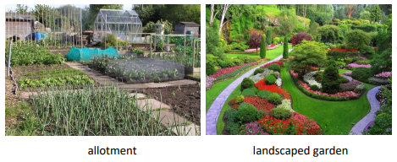
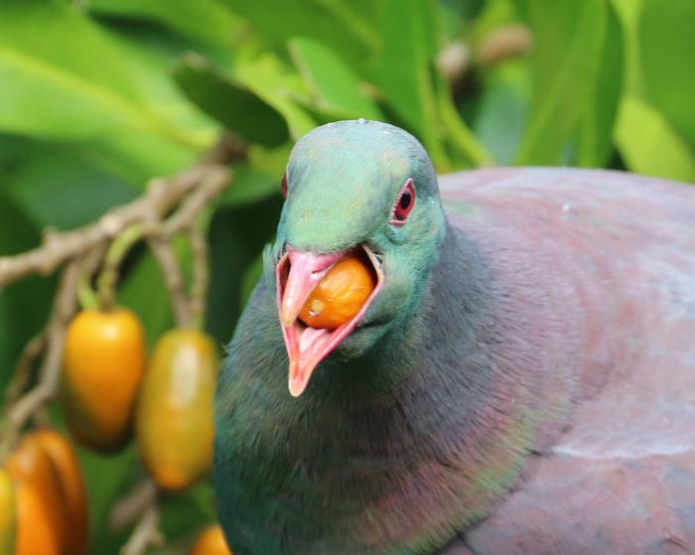
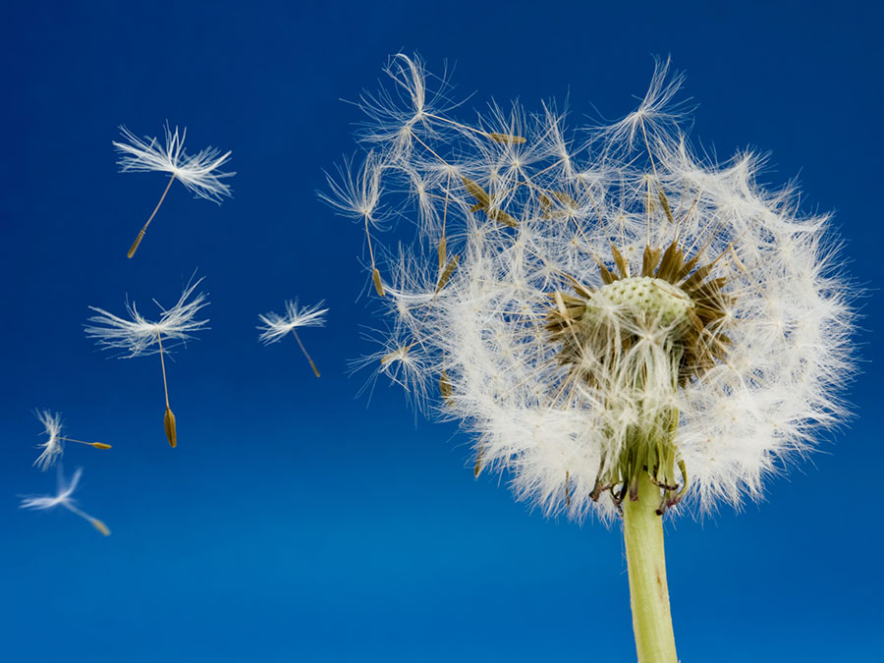
In the Garden
Science
VOCABULARY
Seasons | a time of year marked by certain conditions: spring, summer, autumn, winter
Plant | a living thing gown by a seed or bulb that grows into a tree, shrub, herb, flower, grass, fern or moss that has roots and leaves
Petal | usually the coloured leaf part of a flower
Reproduce | create offspring that can grow
Leaf | a part of a plant attached to the stem or stalk, plants use it to make their food through photosynthesis
Soil | Soil is the loose upper layer of the Earth's surface where plants grow.
Climate | The pattern of weather conditions in a particular area over a period of time
Stem | the main body or stalk of a plant or shrub, typically rising above ground, gives plant stability
Flower | the seed-bearing part of a plant that is typically surrounded by colourful petals
Bulb | a rounded underground storage organ present in some plants , some plants grow from bulbs
Seed | unit of reproduction of a flowering plant, capable of developing into another plant like it
Root | part of a plant which attaches it to the ground
Deciduous tree | tree that drops its leaves every year
Evergreen tree | trees that keep their leaves throughout the year
landscaped garden | a garden laid out with plants, ornamental features, etc. by a garden designer
Allotment | a plot of land rented by an individual for growing vegetables or flowers
Weather | conditions in the atmosphere on a particular day, such as temperature, windiness, rainfall, hours of sunshine or cloud cover.
Wild | land not farmed, used for parks or gardens, or built on
Environment | surroundings where animals, plants and people live

