Slide 1
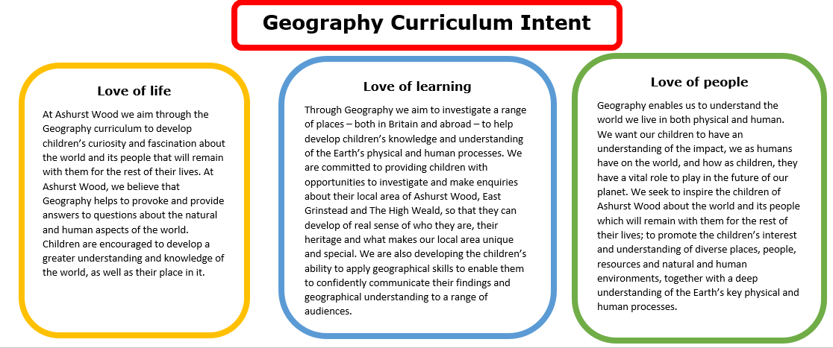
Essential Characteristics
An excellent knowledge of where places are and what they are like.
An excellent understanding of the ways in which places are interdependent and interconnected and how much human and physical environments are interrelated.
An extensive base of geographical knowledge and vocabulary.
Fluency in complex, geographical enquiry and the ability to apply questioning skills and use effective analytical and presentational techniques.
The ability to reach clear conclusions and develop a reasoned argument to explain findings.
Significant levels of originality, imagination or creativity as shown in interpretations and representations of the subject matter.
Highly developed and frequently utilised fieldwork and other geographical skills and techniques.
A passion for and commitment to the subject, and a real sense of curiosity to find out about the world and the people who live there.
The ability to express well-balanced opinions, rooted in very good knowledge and understanding about current and contemporary issues in society and the environment.

Slide 2
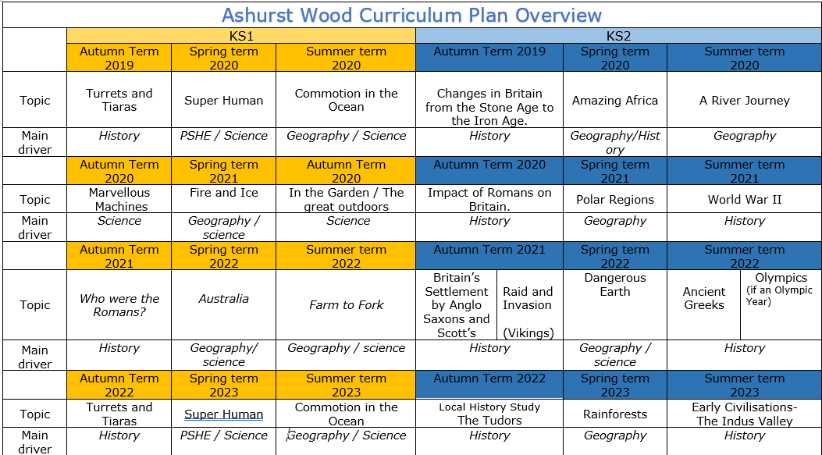
Commotion in the Ocean
Geography / Science
Amazing Africa
Geography / History
A river journey
Geography
Fire & Ice
Geography / Science
Polar Regions
Geography
Australia
Geography / Science
Farm to Fork
Geography / Science
Dangerous Earth
Geography / science
Commotion in the Ocean
Geography / Science
Rainforests
Geography
https://www.arthurbugler.com/uploads/Curriculum/Autumn%202%20Planning/Y6%20Frozen%20Kingdom.pdf

Slide 3
KS1
GEOGRAPHY TEACHING AND LEARNING AT ASHURST WOOD
Our topic planning is designed so that some topics are Geography led and the key knowledge and skills are captured in the planning and knowledge organisers. Other topics may contain geographical knowledge in addition to the main driver. All children in KS1 will study the same topic and so expectations will be different for a YR Y1 and a Y2 child. For this reason and to ensure that there is no ceiling placed on a child’s learning we have identified outcomes for all children Must (End of Y1) Should (end of Y2) Could a rich and deep understanding.
GEOGRAPHY
At Ashurst Wood
Australia
Enrichment
A visit by a Seasonal walks in the village
Forest Schools
EYFS
What will children Know by the end of this topic ?
MUST
Children will be able to use atlases and globes to find UK and the different continents.
Make comparisons between the UK and Australia
To know what a bird's eye view is
Be able to create simple maps
They will know that there are four main compass points - N S E W
SHOULD
Children will be able to name and locate studied countries, continents and seas.
Use aerial images and plan perspectives to recognise landmarks and basic physical features.
Understand geographical similarities and differences between the UK and Australia.
They will know and use the four main compass points and use them to describe locational features and routes on a map.
Be able to identify seasonal and daily weather patterns and make comparisons with other countries.
They will use and understand the vocabulary on the knowledge organiser and use vocabulary to describe
key physical features, including: beach, coast, forest, hill, mountain, ocean, river, soil, valley, vegetation and weather.
key human features, including: city, town, village, factory, farm, house, office and shop
ELG: People, Culture and Communities Children at the expected level of development will: - Describe their immediate environment using knowledge from observation, discussion, stories, non-fiction texts and maps; - Know some similarities and differences between different religious and cultural communities in this country, drawing on their experiences and what has been read in class; - Explain some similarities and differences between life in this country and life in other countries, drawing on knowledge from stories, non-fiction texts and when appropriate maps. ELG: The Natural World Children at the expected level of development will: - Explore the natural world around them, making observations and drawing pictures of animals and plants; - Know some similarities and differences between the natural world around them and contrasting environments, drawing on their experiences and what has been read in class; - Understand some important processes and changes in the natural world around them, including the seasons and changing states of matter.
Skills
Find the United Kingdom on a map or globe
They will be able to identify why there is plastic in the ocean.
They will be able to answer geographical questions (such as: What is this place like? What or who will I see in this place? What do people do in this place?).
Skills
They will be able to identify why there is plastic in the ocean and what damage it is causing
Use simple grid references (A1, B1).
Devise a simple map; and use and construct basic symbols in a key.
They will know and use the four main compass points
They will be able to ask geographical questions (such as: What is this place like? What or who will I see in this place? What do people do in this place?).
To create maps using symbols and a map key the key Use simple grid references (A1, B1).
Identify features of a location in order to say whether it is a city, town, village, coastal or rural area
ASPIRE
Know that the equator and the North and South Poles influence climate and temperature
Describe how the Rainforests are in danger and their importance to the world.

Slide 4
Year / Class 2021-2022 KS1 |  | Topic Title: Australia
Pre learning Links. In KS1 prior knowledge will depend on which year group the child is in. Commotion in the ocean – oceans and continents / Great barrier reef |  | Stunning Start: Fantastic Finish:
The Big Question: Can you walk to Australia? |  | Creative Arts and Forest School Links Aboriginal art Habitats Animal art (focus on feet) patterns footprints Making prints with foam and fabric
Small Question | What is Australia nearby?
Small Question | What is the weather like in Australia? | Literacy links Wombat goes walkabout. Diary of a wombat The Koala who could Where the forest meets the sea | Vocabulary Keys Harvest Crops Transport River Sea Field Distance North, south ,east, west Left, right up, down Snow, wind, rain, Hail, fog, | Lorry Spring Summer Autumn Winter Seasons Seasonal Shops Supermarket Factory Dairy Dry, wet | Journey Farm Landscape Travel Village Town City Opera house Sydney Habitat Equator Australian bush
Small Question | How are the seasons the same or different in Australia?
Small Question | What landmarks can you see in Australia?
Small Question | Can the weather be dangerous? ( link to key physical features and climate change)
Small Question | What is the great barrier reef and why is it dying?
Small Question
Small Question
Useful Links http://www.nicurriculum.org.uk/curriculum_microsite/SEN_PMLD_thematic_units/dep/docs/AU_WEB_Files/AU_Overview/Australia_Here_We_Come.pdf https://www.bidfordonavon.warwickshire.sch.uk/pdfs/homelearning/ks1-topic-200605.pdf

Slide 5
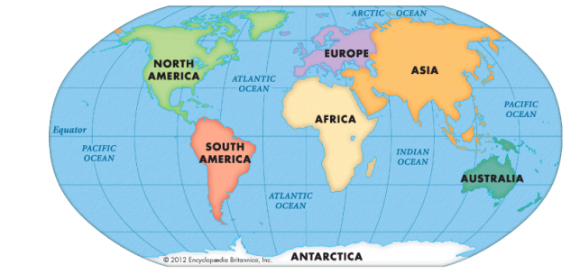
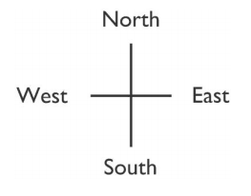
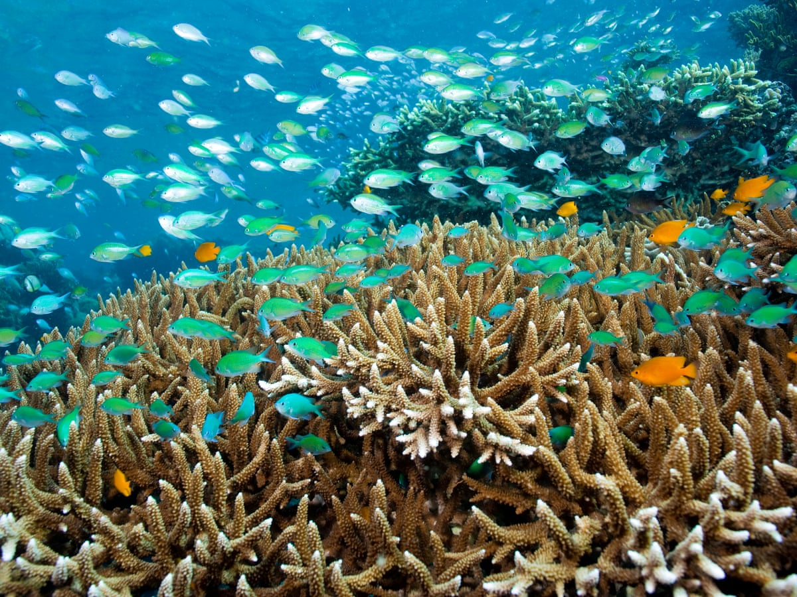
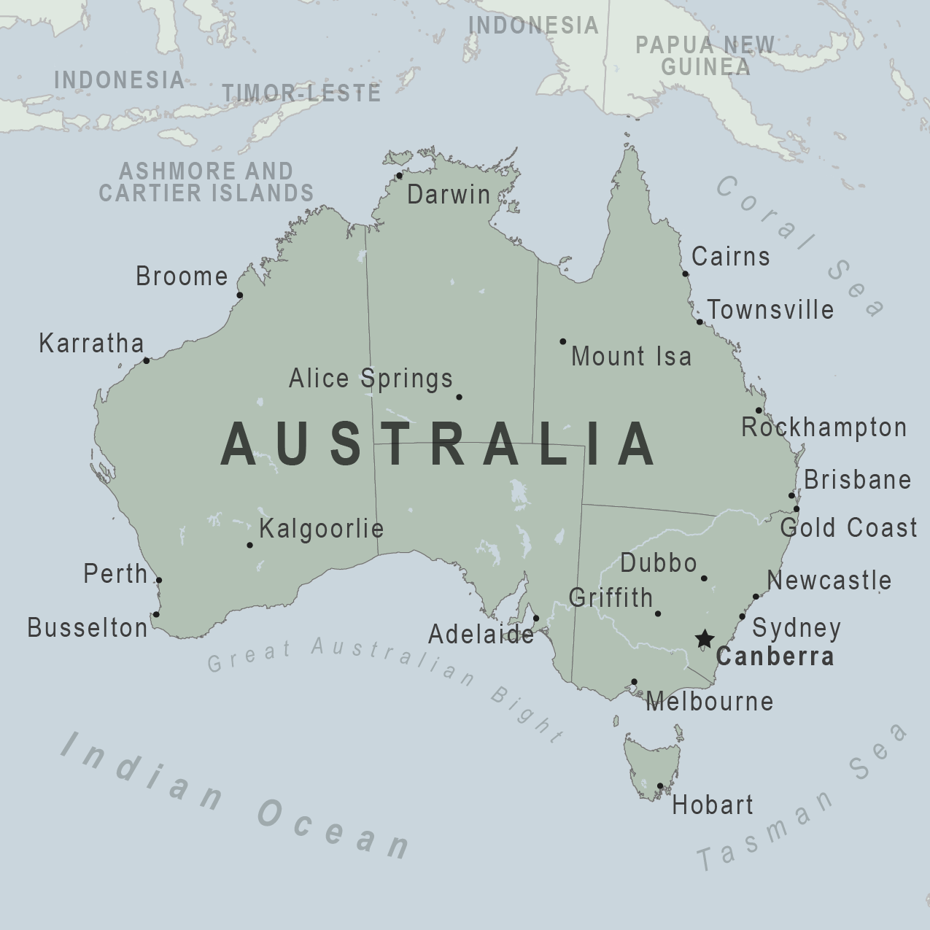
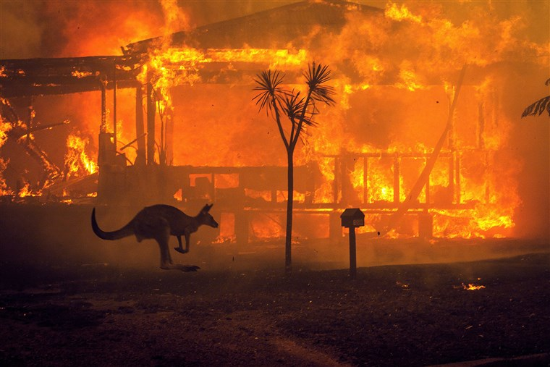
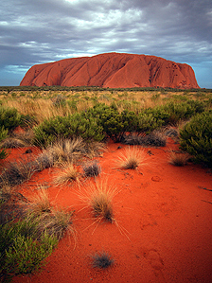
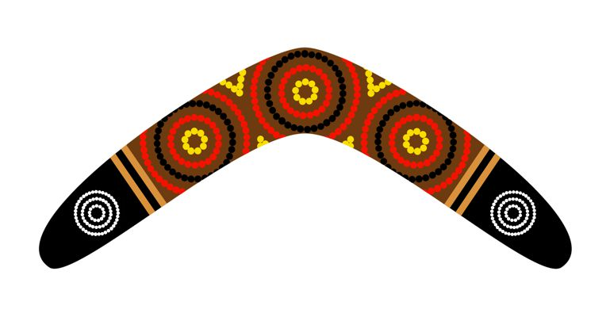
VOCABULARY
Equator | An invisible line drawn around the centre of the earth, which divides the earth into two hemispheres
Continent | land mass defined by physical, human, or cultural features: Europe, Africa, Antarctica, Asia, Oceania, North America or South America
Climate | The pattern of weather conditions in a particular area over a period of time
Ocean | A huge area of salt water that covers nearly ¾ of the surface of the earth. There are different oceans surrounding the continents
Season (al) | One of the four divisions of the year (spring, summer, autumn, winter) that change according to the position of the earth in space. Each season has its own climate.
Northern / Southern Hemisphere | The half of the Earth that is north/south of the Equator. The UK is situated in
Bush | In Australia, the phrase, the bush, has a special symbolic meaning in Australian life. When used to describe the land, the bush means a wooded area, but not dense forest. It is usually dry and nitrogen-poor soil, mostly grassless, with thin to thick woody shrubs and bushes, with some eucalypt trees.
Country | Political area defined by physical, human or cultural features
Endangered | a species which is at risk of becoming extinct
Equator | imaginary line around the middle of the Earth where day and night are almost equal, and there is little change in season; some areas have a dry season and wet season
Migration | the movement of people or animals from one place to another
North, South, East, West | compass points, locational vocabulary
Symbol | picture on a map to show a feature on a map
Weather | conditions in the atmosphere on a particular day, such as temperature, windiness, rainfall, hours of sunshine or cloud cover.
Vegetation | Vegetation means the plant life of a region or the plant community.
Aerial View | A view from a great height
Landscape | The area that can be seen from one point
Environment | All the things together that surround animals and humans in the natural world, including the air, the water, and the soil
Aboriginal | The native people who live in Australia
Australia

