Slide 1
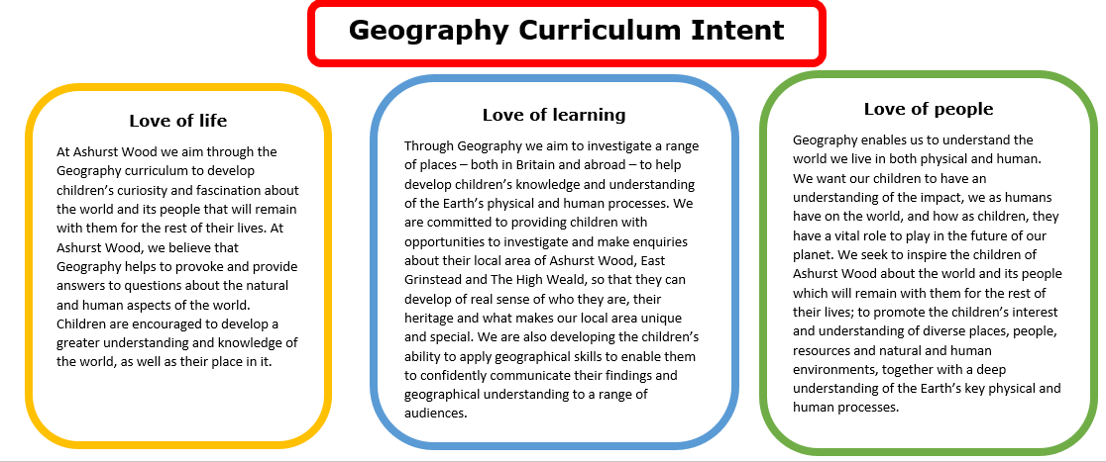
Essential Characteristics
An excellent knowledge of where places are and what they are like.
An excellent understanding of the ways in which places are interdependent and interconnected and how much human and physical environments are interrelated.
An extensive base of geographical knowledge and vocabulary.
Fluency in complex, geographical enquiry and the ability to apply questioning skills and use effective analytical and presentational techniques.
The ability to reach clear conclusions and develop a reasoned argument to explain findings.
Significant levels of originality, imagination or creativity as shown in interpretations and representations of the subject matter.
Highly developed and frequently utilised fieldwork and other geographical skills and techniques.
A passion for and commitment to the subject, and a real sense of curiosity to find out about the world and the people who live there.
The ability to express well-balanced opinions, rooted in very good knowledge and understanding about current and contemporary issues in society and the environment.

Slide 2
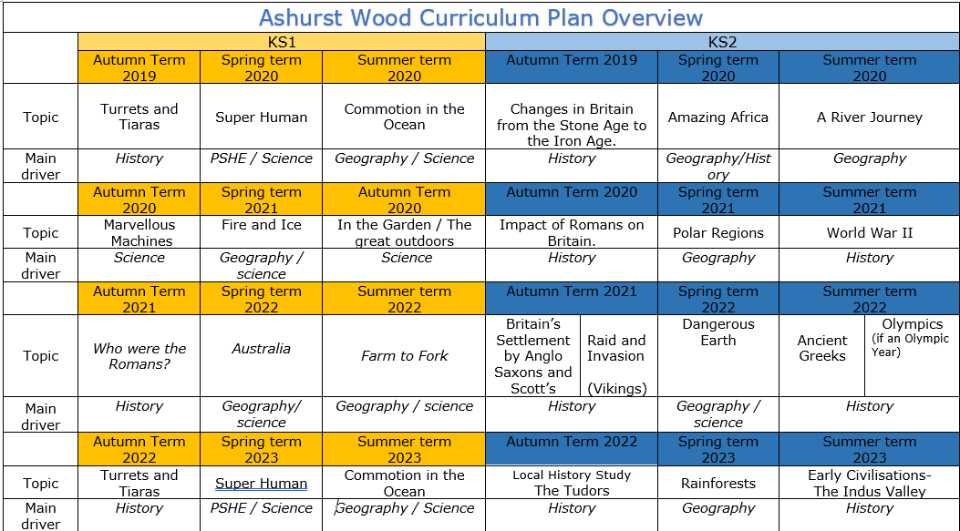
Commotion in the Ocean
Geography / Science
Amazing Africa
Geography / History
A river journey
Geography
Fire & Ice
Geography / Science
Polar Regions
Geography
Australia
Geography / Science
Farm to Fork
Geography / Science
Dangerous Earth
Geography / science
Commotion in the Ocean
Geography / Science
Rainforests
Geography
https://www.arthurbugler.com/uploads/Curriculum/Autumn%202%20Planning/Y6%20Frozen%20Kingdom.pdf

Slide 3
KS1
GEOGRAPHY TEACHING AND LEARNING AT ASHURST WOOD
Our topic planning is designed so that some topics are Geography led and the key knowledge and skills are captured in the planning and knowledge organisers. Other topics may contain geographical knowledge in addition to the main driver. All children in KS1 will study the same topic and so expectations will be different for a YR Y1 and a Y2 child. For this reason and to ensure that there is no ceiling placed on a child’s learning we have identified outcomes for all children Must (End of Y1) Should (end of Y2) Could a rich and deep understanding.
GEOGRAPHY
At Ashurst Wood
Fire and Ice
What will children Know by the end of this topic ?
Enrichment
A visit by an explorer or mountain climber
Seasonal walks in the village
Forest Schools
EYFS
SHOULD
They will be able to name and locate the world’s continents on a map or globe
Name the four countries of the United Kingdom
To be able to identify key differences between the North and South poles.
They will know and use the four main compass points and use them to describe locational features and routes on a map.
They will use and understand the vocabulary on the knowledge organiser and use vocabulary to describe
key physical features, including: beach, coast, forest, hill, mountain, ocean, river, soil, valley, vegetation and weather.
MUST
Identify the countries within the United Kingdom
To know what a bird's eye view is
They will know that there are four main compass points
N S E W
ELG: People, Culture and Communities Children at the expected level of development will: - Describe their immediate environment using knowledge from observation, discussion, stories, non-fiction texts and maps; - Know some similarities and differences between different religious and cultural communities in this country, drawing on their experiences and what has been read in class; - Explain some similarities and differences between life in this country and life in other countries, drawing on knowledge from stories, non-fiction texts and when appropriate maps. ELG: The Natural World Children at the expected level of development will: - Explore the natural world around them, making observations and drawing pictures of animals and plants; - Know some similarities and differences between the natural world around them and contrasting environments, drawing on their experiences and what has been read in class; - Understand some important processes and changes in the natural world around them, including the seasons and changing states of matter.
Skills
Find the United Kingdom and the continents on a map or globe
Be able to locate the North and South poles.
Be able to create simple maps
They will be able to answer geographical questions (such as: What is this place like? What or who will I see in this place? What do people do in this place?).
Skills
Use aerial images and plan perspectives to recognise landmarks and basic physical features. Identify the key features of a location in order to say whether it is a city, town, village, coastal or rural area
To create maps using symbols and a map key
Use simple grid references (A1, B1).
They will be able to ask geographical questions
Be able to identify seasonal and daily weather patterns and make comparisons with other countries.
COULD
Know that the polar regions are melting due to Global warming.
Know that the equator and the North and South Poles influence climate and temperature

Slide 4
Year / Class 2020-2021 KS1 |  | Topic Title: Fire and Ice
Pre learning Links. In KS1 prior knowledge will depend on which year group the child is in. Map work – Turrets and Tiaras |  | Stunning Start: Messages in ice. Fantastic Finish: setting junk modelling houses on fire. Visit by the fire brigade.
The Big Question: Why do we need ice? |  | Creative Arts and Forest School Links Northern lights chalk pictures Fire collage pictures on black paper.
Small Question | Where in the world do we find ice?
Small Question | What’s the difference between the two poles? | Literacy links The great explorer Poetry – Jack Frost Ice Bear Nicola Davis Lost and found penguin | Vocabulary Keys insulation Ocean North and south pole Antarctica Antarctic Ice berg Distance North, south ,east, west Left, right up, down Snow, wind, rain, ice Hail, fog | ship Spring Summer Autumn Winter Seasons Seasonal Endangered Journey Landscape Dangerous Warmth Route Map Globe England Scotland | Ireland Wales United Kingdom London Belfast Glasgow Cardiff
Small Question | Where would you rather live Ashurst Wood or the north pole?
Small Question | What landmarks are in the two North Poles and our local area?
Small Question | Do you need sunglasses in the South Pole?
Small Question | What is an iceberg? (geographical features)
Small Question | Are the North and South Pole’s melting? (Global warming)
Useful Links https://www.booksfortopics.com/frozen topic books https://ypte.org.uk/lesson-plans/cold-areas-the-arctic fact sheets

Slide 5
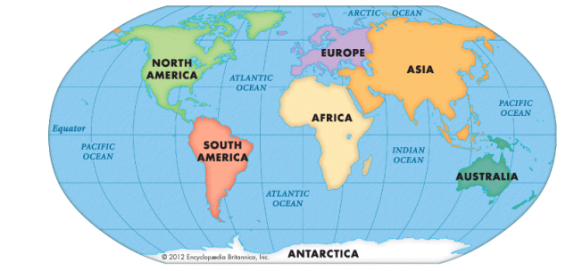
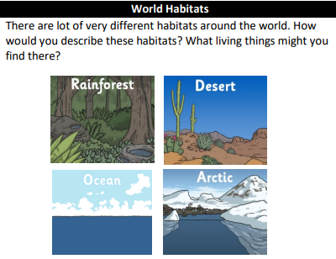
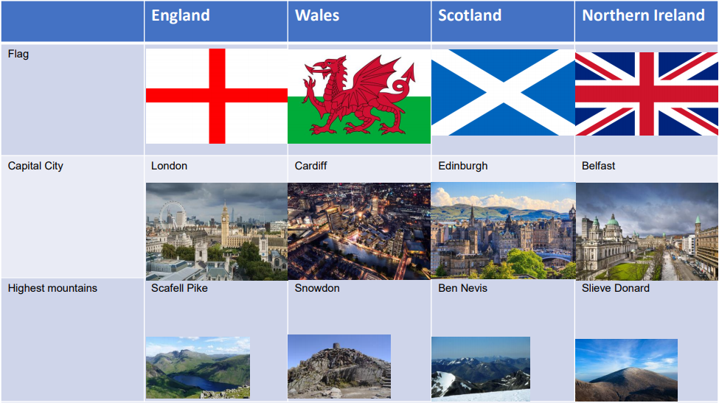
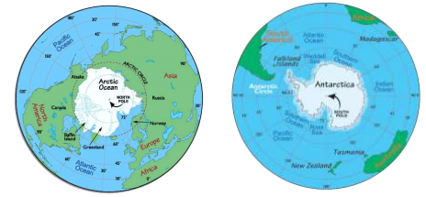
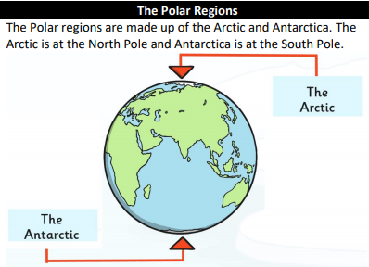
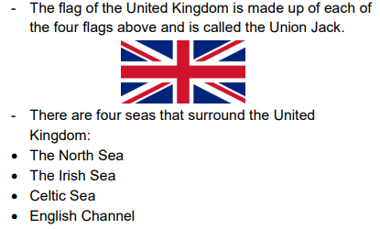
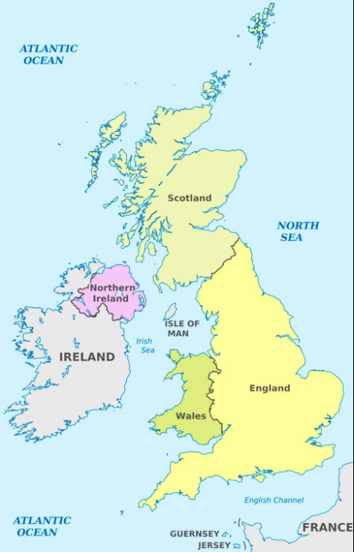
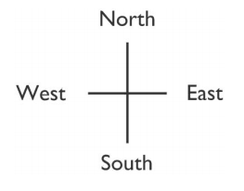
Fire and Ice
VOCABULARY
Equator | An invisible line drawn around the centre of the earth, which divides the earth into two hemispheres
Antarctica | The most southern continent, where the South Pole is located and home to many penguin species
Arctic | A polar region, located in the most northern part of the earth. This includes some countries and the Arctic Ocean
Continent | land mass defined by physical, human, or cultural features: Europe, Africa, Antarctica, Asia, Oceania, North America or South America
Polar Regions | The areas of the planet that surround the North and South Poles. These are also called the “Frigid Zones”
Climate | The pattern of weather conditions in a particular area over a period of time
Ocean | A huge area of salt water that covers nearly ¾ of the surface of the earth. There are different oceans surrounding the continents
Season (al) | One of the four divisions of the year (spring, summer, autumn, winter) that change according to the position of the earth in space. Each season has its own climate.
Adapt | Make something suitable for a new use or purpose Become adjusted to new conditions or situations
Northern / Southern Hemisphere | The half of the Earth that is north/south of the Equator. The UK is situated in
Country | Political area defined by physical, human or cultural features
Endangered | a species which is at risk of becoming extinct
Equator | imaginary line around the middle of the Earth where day and night are almost equal, and there is little change in season; some areas have a dry season and wet season
Migration | the movement of people or animals from one place to another
North, South, East, West | compass points, locational vocabulary
North Pole | the most northerly place of the Earth
South Pole | The most southernly place of earth
Seasons | a time of year markedby certain conditions: spring, summer, autumn, winter
Symbol | picture on a map to show a feature on a map
Weather | conditions in the atmosphere on a particular day, such as temperature, windiness, rainfall, hours of sunshine or cloud cover.
Wild | land not farmed, used for parks or gardens, or built on

