Slide 1
Essential Characteristics
• An excellent knowledge and understanding of people, events, and contexts from a range of historical periods and of historical concepts and processes.
• The ability to think critically about history and communicate ideas very confidently in styles appropriate to a range of audiences.
• The ability to consistently support, evaluate and challenge their own and others’ views using detailed, appropriate and accurate historical evidence derived from a
range of sources.
• The ability to think, reflect, debate, discuss and evaluate the past, formulating and refining questions and lines of enquiry.
• A passion for history and an enthusiastic engagement in learning, which develops their sense of curiosity about the past and their understanding of how and why
people interpret the past in different ways.
• A respect for historical evidence and the ability to make robust and critical use of it to support their explanations and judgments.
• A desire to embrace challenging activities, including opportunities to undertake high-quality research across a range of history topics.

Slide 2
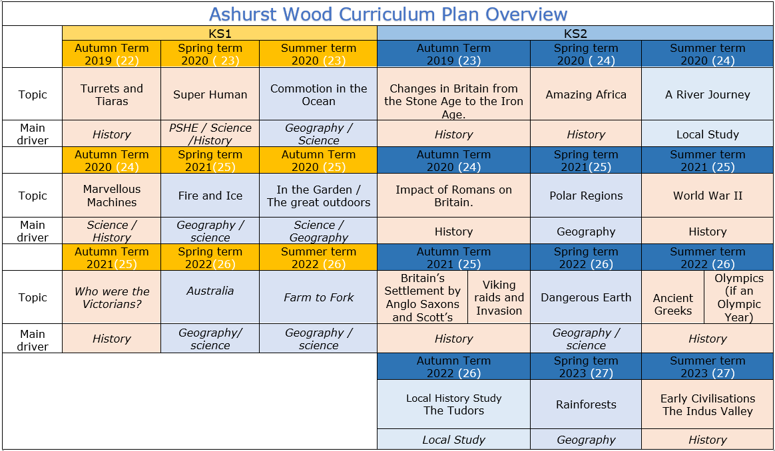

Slide 3
KS1
HISTORY TEACHING AND LEARNING AT ASHURST WOOD
Our topic planning is designed so that some topics are History led and the key knowledge and skills are captured in the planning and knowledge organisers. Other topics may contain historical knowledge in addition to the main driver. All children in KS1 will study the same topic and so expectations will be different for a YR Y1 and a Y2 child. For this reason and to ensure that there is no ceiling placed on a child’s learning we have identified outcomes for all children Must (End of Y1) Should (end of Y2) Could a rich and deep understanding.
History
At Ashurst Wood
What will children Know by the end of this topic ?
Marvellous Machines
Must
Recognise the difference between ‘old’ and ‘new’
Know where some basic events fit on a timeline, relating to their topic
Begin to understand why events being studied are important.
Use phrases such as now, after, before, modern, new, old, a long time ago, in my lifetime, before I was born, when I was younger.
Begin to recognise different ways we can learn about the past (eg. from images, objects, stories, first-hand witnesses).
Should
Know where some key people fit on a timeline.
Remember a few significant names and dates.
Use common words and phrases related to the passing of time (now, then, before).
Understand why people and events being studied are important.
Use historical vocabulary (eg. past, present, recently, years, decades, centuries).
Should
Imagine how the world would be different without modern inventions and use this to begin imagining what it would have been like to live in the past.
Focus on the first aeroplane flight - consider why people had been trying to fly (& risking their lives) for so long. How would life have been different before aeroplanes?
Understand the basic history / dates / facts of the Wright Brothers first aircraft and their first flight.
EYFS
Children at the expected level of development will:
Talk about the lives of the people around them and their roles in society;
- Know some similarities and differences between things in the past and now, drawing on their experiences and what has been read in class;
- Understand the past through settings, characters and events encountered in books read in class and storytelling.
ENRICHMENT
Visit to Bodium Castle and artifacts workshop
Local Study (Geography)
Skills
• Look at photos and use these as an historical source - what can we learn about their aircraft / lives from these images?
• Discuss how was life different when the class’ parents / grandparents were young. Identify and sort things that did and didn’t exist.
• Begin to explore the spread of flight around the world - key first flights in Britain, across the Channel, across the Atlantic etc. and plot timelines.
Skills
Record some events onto a timeline.
Say how lifestyles (work, school, play etc.) were the same or different in the past.
Describe differences between ‘then’ and ‘now’.
Discuss the speed of change - sometimes in slow increments, sometimes in leaps
Recount key events from the past in their own words and begin to explain why these events happened.
Begin to think about the impact that historical events have had on modern life.
Begin to express preferences and justify them with evidence / facts (eg. Who was the greatest explorer?
Ask and answer historically relevant questions.
Compare events from different periods in history (eg. different discoveries/voyages).
Use a range of sources (eg. pictures, photos, artefacts, stories, text books, field trips etc.) to extract some information about the past.
Begin to piece together clues from a variety of different sources.
Skills
• Place some basic events onto a timeline and use this to support the retelling of past events.
• Say how something is the same or different in the past.
• Develop a sense of time and how fast things change (eg. differences between changes in their / their parents / their grandparents lifetimes).
• Show an understanding of some key events.
• Start to think about the reasons why things might change (eg. improvements in technology / making life easier / more fun).
Ask and answer some historical questions.
• Sort pictures / objects / events into ‘old’ and ‘new’.
• Use pictures and photographs to extract some information about the past.
Enrich
Interview family members or staff about changes in machines in the home. (Telephones, music systems)
Additional Historical coverage
St Georges Day
Remembrance day

Slide 4
Year / Class 2021 KS1 |  | Topic Title: Marvellous Machines
Pre learning Links. In KS1 prior knowledge will depend on which year group the child is in. |  | Stunning Start: picture cards of telephones and put in chronological order. Fantastic Finish:
The Big Question: How have machines changed the world? (Link famous people the right brothers) |  | Creative Arts and Forest School Links Art – Kandinsky (circles / wheels) Turner the fighting tamari Science – electricity / push + pulls forces DT design a model car
Small Question | What do you think the Wright brothers did to make them famous?
Small Question | How did the Wright brother manage to be the first to launch powered flight? | Literacy links The story machine Terrific Trains The Tin forest | Vocabulary Steam train Vehicles Communication Internet Computer Mobile Text Messages Telegram Semaphore Morse code Wire Battery Electricity Household Current Dyson | Remember Today Yesterday Tomorrow The present The past The future What? When? Where? Why? Past / Present Month Long ago Recent Parent Grand parent Clue | Timeline Date order Similar Different Important Living memory Inventions Homes The older generation Photograph Camera Painting Portrait Artifact Detective Opinion Artefact Week Year | Diary Websites Investigate Research Historians Experts Camera Chronological order Memory Lifetime Calendar Decade Century Day
Small Question | Why did the brother succeed where others had failed?
Small Question | How did flight change as a result of the Wright brothers?
Small Question | How should the Write brothers be remembered?
Small Question
Small Question
Useful Link The invention of the vacuum cleaner, from horse-drawn to high tech | Science Museum Alexander Graham Bell - BBC Bitesize

Slide 5
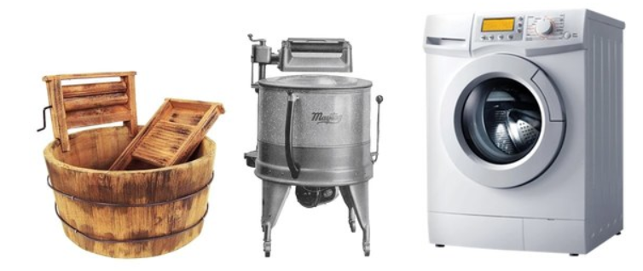
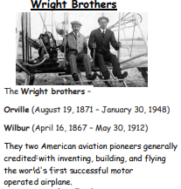
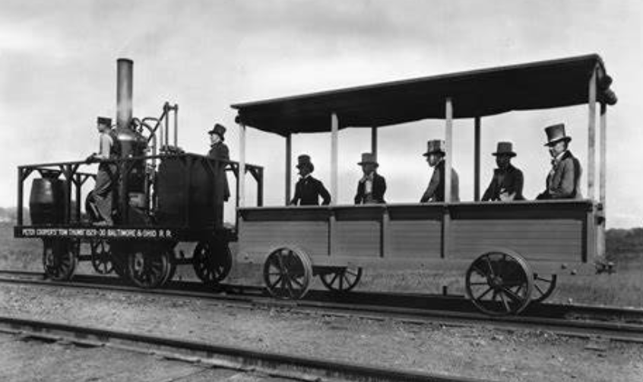
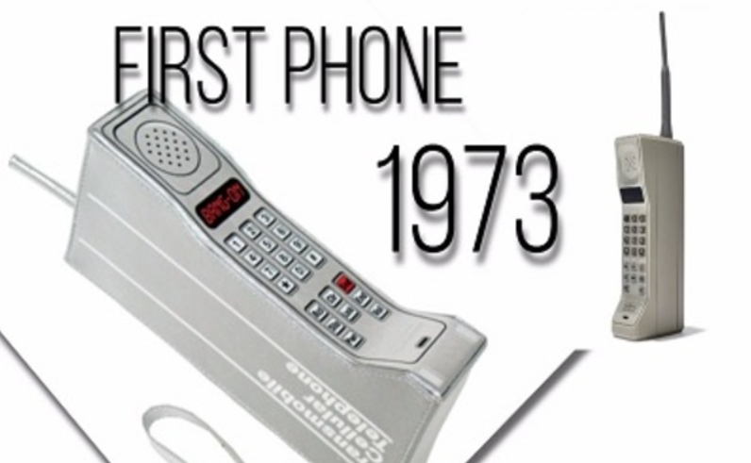
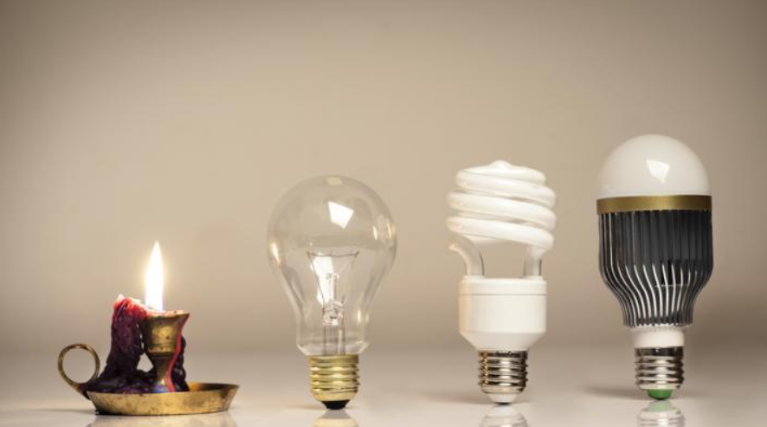
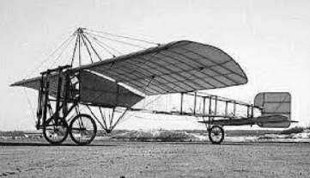
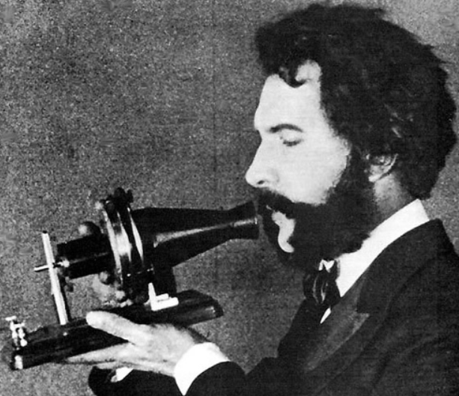
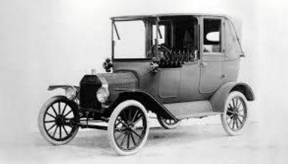
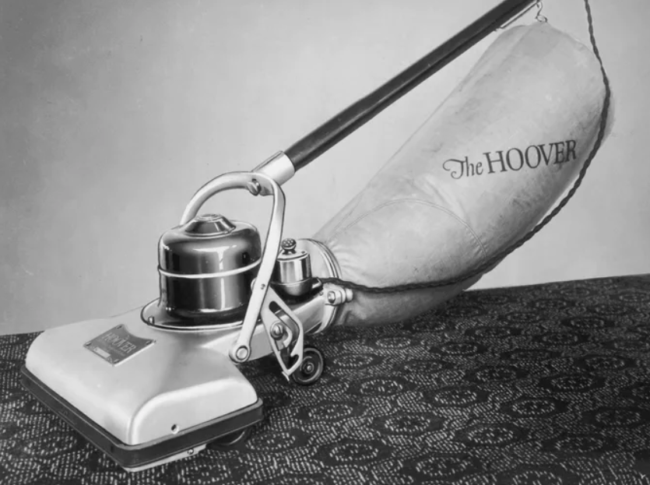
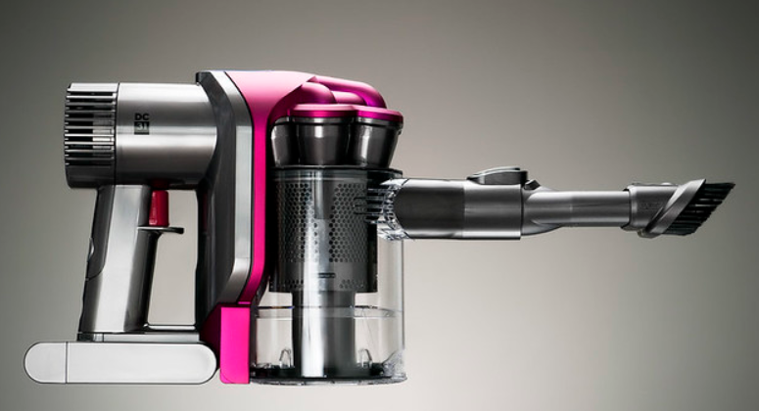
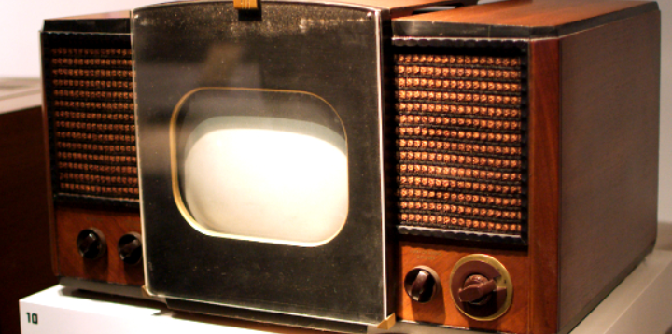
Marvellous Machines
VOCABULARY
Battery | a cell that creates electricity
Compare | looking at differences and similarities
Bridge | a structure to allow you to cross over something
The Underground | a train that travels below the ground
Vehicle | a thing that takes you from one place to another
Transport | a way of travelling from one place to another
Traffic | lots of vehicles on the road
Inventor | Someone who is the first to think of or make something
Past | Something that happened in the past or was made in the past/ a long time ago.
Present | Something that is happening now. -’ I am jumping’
Future | Something that has not yet happened
Alexander Graham Bell | Invented the telephone.
The Wright Brothers | Built and flew the first plane.
George Stephenson | Invented and built the first Steam Locomotive.

