Slide 1
Essential Characteristics
• An excellent knowledge and understanding of people, events, and contexts from a range of historical periods and of historical concepts and processes.
• The ability to think critically about history and communicate ideas very confidently in styles appropriate to a range of audiences.
• The ability to consistently support, evaluate and challenge their own and others’ views using detailed, appropriate and accurate historical evidence derived from a
range of sources.
• The ability to think, reflect, debate, discuss and evaluate the past, formulating and refining questions and lines of enquiry.
• A passion for history and an enthusiastic engagement in learning, which develops their sense of curiosity about the past and their understanding of how and why
people interpret the past in different ways.
• A respect for historical evidence and the ability to make robust and critical use of it to support their explanations and judgments.
• A desire to embrace challenging activities, including opportunities to undertake high-quality research across a range of history topics.

Slide 2
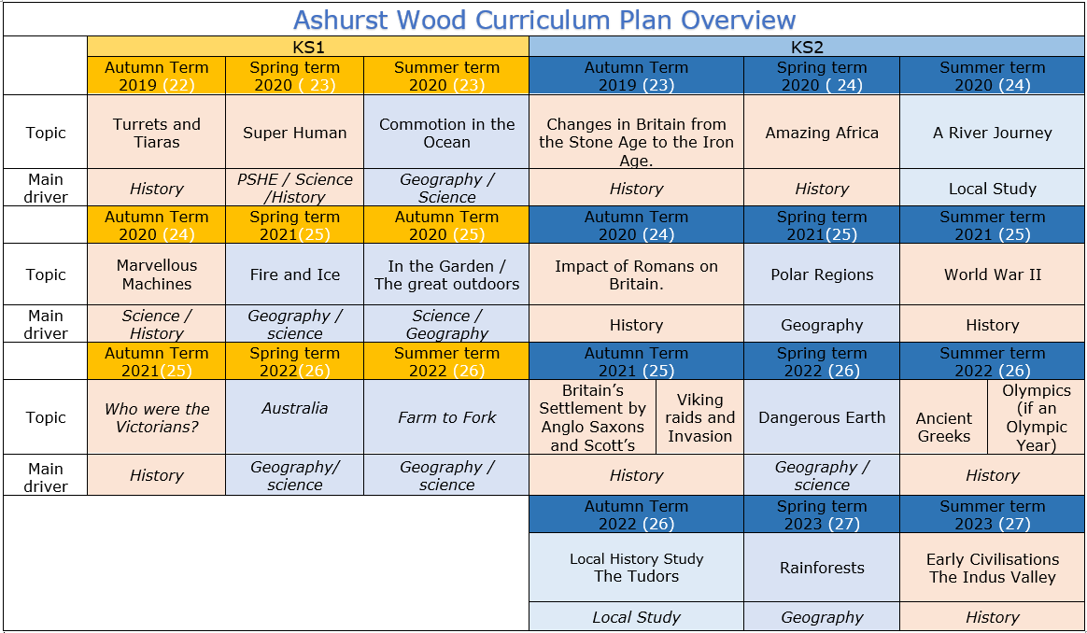

Slide 3
KS1
HISTORY TEACHING AND LEARNING AT ASHURST WOOD
Our topic planning is designed so that some topics are History led and the key knowledge and skills are captured in the planning and knowledge organisers. Other topics may contain historical knowledge in addition to the main driver. All children in KS1 will study the same topic and so expectations will be different for a YR Y1 and a Y2 child. For this reason and to ensure that there is no ceiling placed on a child’s learning we have identified outcomes for all children Must (End of Y1) Should (end of Y2) Could a rich and deep understanding.
History
At Ashurst Wood
What will children Know by the end of this topic ?
Turrets and Tiaras
Must
Recognise the difference between ‘old’ and ‘new’
Know where some basic events fit on a timeline, relating to their topic Begin to understand why events being studied are important.
Use phrases such as now, after, before, modern, new, old, a long time ago, in my lifetime, before I was born, when I was younger.
Begin to recognise different ways we can learn about the past (eg. from images, objects, stories, first-hand witnesses).
Should
• To know that most castles were built long ago and that castles existed in Medieval Times.
• To know what castles were, some features of them and why they were built.
• To know who lived in a castle and can describe their roles (Lord, Lady, Servant, Cook, Jester, Farmer).
• To know how life for people living in castles in Medieval times was different to our home lives today (no electricity, toilets).
• To know what happened at medieval banquets and can compare them to modern day parties (food and where it comes from, music, entertainment, clothing, decorations).
• To know that Richard I was a king of England and I know about what his life would have been like.
Should
Know where some key people fit on a timeline.
Remember a few significant names and dates.
Use common words and phrases related to the passing of time (now, then, before).
Understand why people and events being studied are important.
Use historical vocabulary (eg. past, present, recently, years, decades, centuries).
EYFS
Children at the expected level of development will:
Talk about the lives of the people around them and their roles in society;
- Know some similarities and differences between things in the past and now, drawing on their experiences and what has been read in class;
- Understand the past through settings, characters and events encountered in books read in class and storytelling.
Skills
Record some events onto a timeline.
Say how lifestyles (work, school, play etc.) were the same or different in the past.
Describe differences between ‘then’ and ‘now’.
Discuss the speed of change - sometimes in slow increments, sometimes in leaps
Recount key events from the past in their own words and begin to explain why these events happened.
Begin to think about the impact that historical events have had on modern life.
Begin to express preferences and justify them with evidence / facts (eg. Who was the greatest explorer?
Ask and answer historically relevant questions.
Compare events from different periods in history (eg. different discoveries/voyages).
Use a range of sources (eg. pictures, photos, artefacts, stories, text books, field trips etc.) to extract some information about the past.
Begin to piece together clues from a variety of different sources.
Skills
• To ask and answer questions related to different pictures and object.
• To use artefacts as clues to find out about the past.
• To label different artefacts.
• To sequence events into a chronological order.
• To use Topic Specific Vocabulary castle, medieval, banquet, keep, portcullis, arrow loops, moat, drawbridge, tower, battlements, feast, platter, tournament, tapestry, goblet, jousting, peacock, swan after, past, present, then, now.
ENRICHMENT
Visit to Bodium Castle and artifacts workshop
Local Study (Geography)
Skills
• Place some basic events onto a timeline and use this to support the retelling of past events.
• Say how something is the same or different in the past.
• Develop a sense of time and how fast things change (eg. differences between changes in their / their parents / their grandparents lifetimes).
• Show an understanding of some key events.
• Start to think about the reasons why things might change (eg. improvements in technology / making life easier / more fun).
Ask and answer some historical questions.
• Sort pictures / objects / events into ‘old’ and ‘new’.
• Use pictures and photographs to extract some information about the past.
Additional Historical coverage
St Georges Day
Remembrance day

Slide 4
Year / Class 2021 KS1 |  | Topic Title: Turrets and Tiaras
Pre learning Links. In KS1 prior knowledge will depend on which year group the child is in. |  | Stunning Start: Dress up Day Fantastic Finish: Visit a castle
The Big Question: What are castles for? |  | Creative Arts and Forest School Links DT – Catapults / Milk bottle Dragons
Small Question | Who lives in a castle?
Small Question | How many rooms are in a castle? | Literacy links Fairy Tales Saint George and the Dragon Tell me a dragon – descriptive writing Knight’s handbook Book Lists for Topics: Castles, Dragons, Princesses & Knights (booksfortopics.com) | Vocabulary Castle Queen / King Princess Prince Turret Chivalry St Georges Day Royalty Past / Present Armour Lance Month Long ago Recent Parent Grand parent Clue | Politeness Helpful Servant Poor / Rich Drawbridge Moat Count Earl Countess Duchess Remember Today Yesterday Tomorrow The present The past The future What? When? Where? Why? | Timeline Date order Similar Different Important Living memory Inventions Homes The older generation Photograph Camera Painting Portrait Artifact Detective Opinion Artefact Week Year | Ancient Long ago Wea / period Royal Treason Diary Websites Investigate Research Historians Experts Significant Survive Camera Chronological order Memory Lifetime Calendar Decade Century Day
Small Question | What is the purpose of each room?
Small Question | What is the difference between Queens now and then?
Small Question | Who will be the next King or Queen?
Small Question | Can anyone be royal?
Small Question | What is the difference between a Castle and a Palace?
Teaching the Seaside and Castles at KS1 | Keystage History
Useful Link https://www.youtube.com/watch?v=xwyoOWbZoP8 https://www.youtube.com/watch?v=GYD5IJhidM4

Slide 5
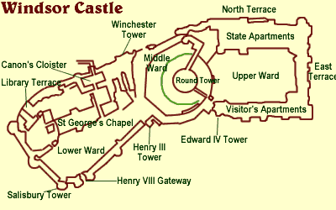
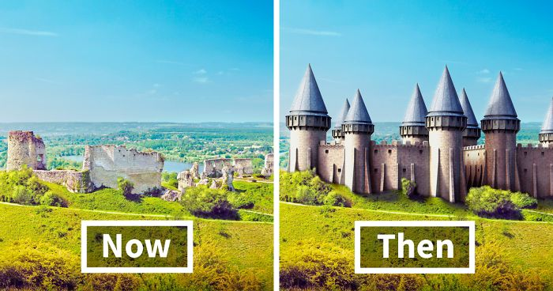
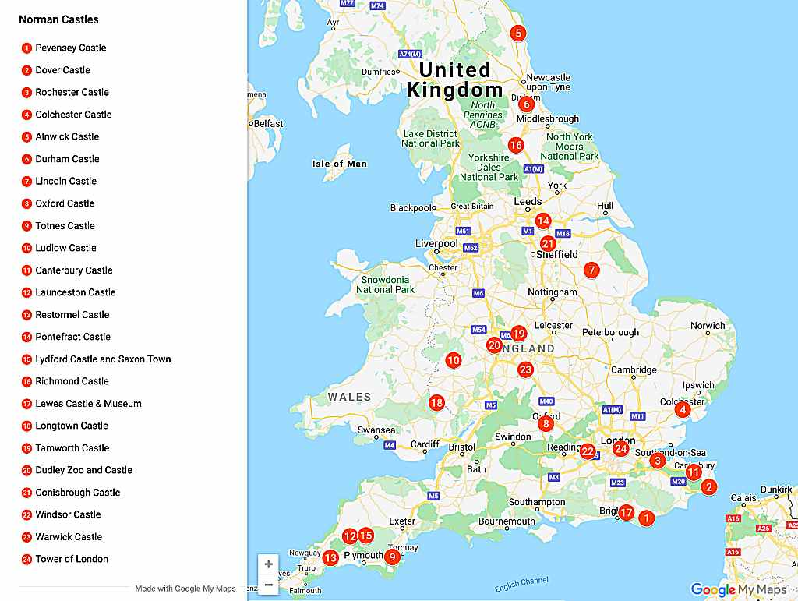
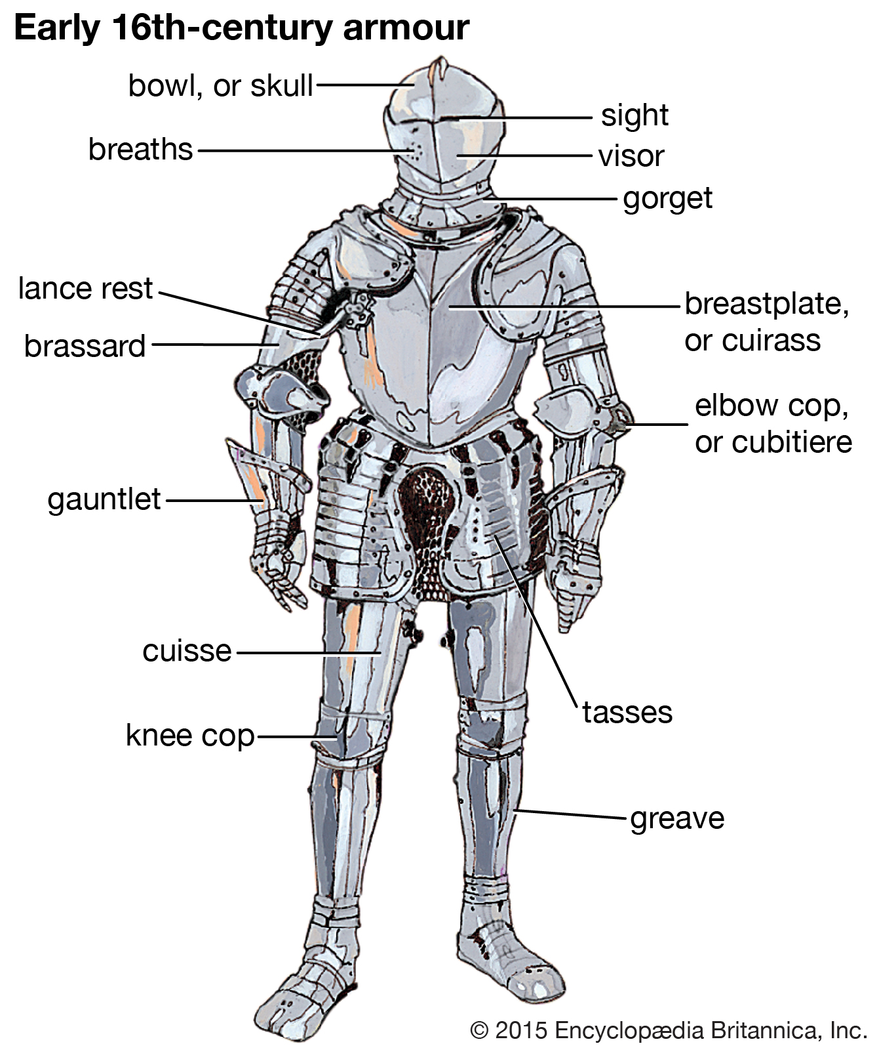
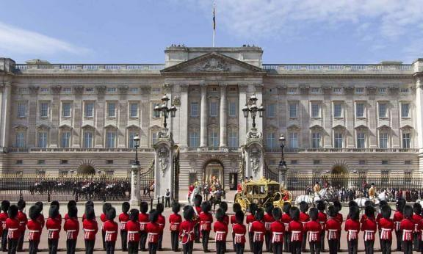
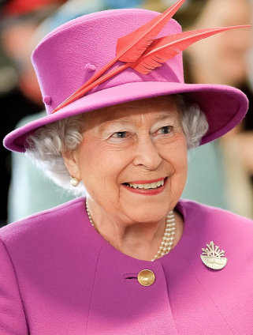
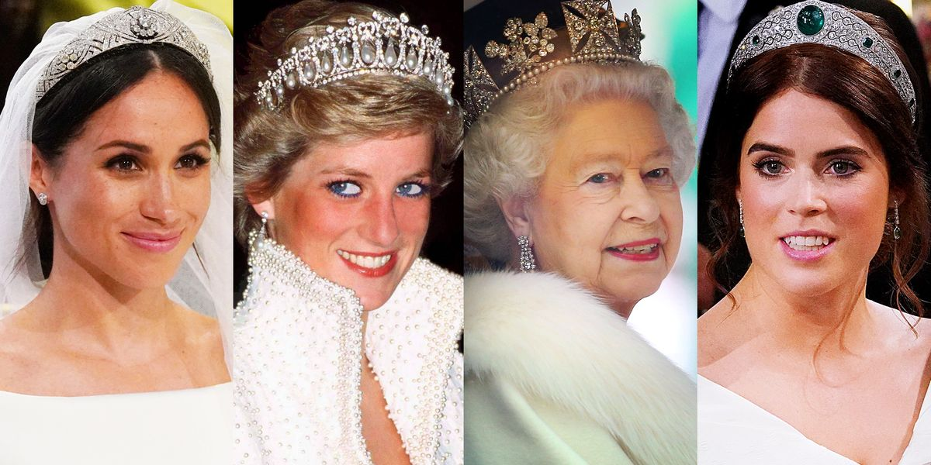
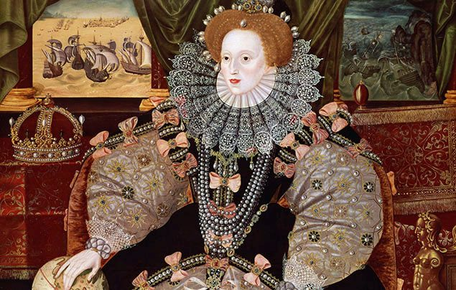
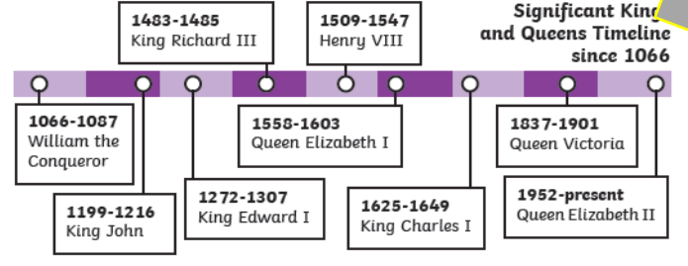
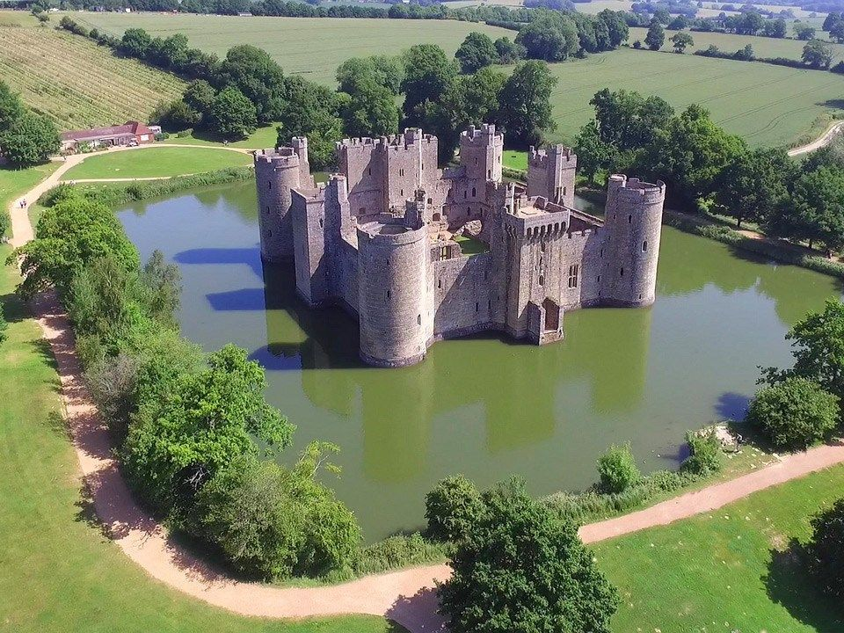
VOCABULARY
Castle | Castles are a type of home that was built to protect the people inside. People who lived in the castle included lords, who were in charge, as well as soldiers to defend it from enemy invaders, and even cooks and cleaners to keep everyone fed and tidy up.
Knight | In the middle ages a knight was defined as a nobleman who served a king as a mounted man-of-arms.
Prince | An important male member of a royal family, especially a son or grandson of a king or queen.
Princess | An important female member of a royal family, especially a daughter or granddaughter of a king or queen, or the wife of a prince.
Portcullis | The portcullis was an important feature for defence. It was a very heavy gate made of metal and very strong wood. It had jagged ‘teeth’ at the bottom. It lifted vertically, but could also be dropped very quickly, to stop people getting in or easily breaking their way in through the gateway.
Moat | The moat was a deep trench or ditch that was dug all around the outside of the castle walls. Then it was filled with water.
Arrow loops | Arrow loops, or slits, were used to defend the castle from invaders. These narrow slits were cut into the stone walls and used to shoot arrows through. The flying arrows would come as a big surprise to the invaders down below!
Battlements | Battlements were the square-shaped part of the walls around the top of the castle. They were useful for spying across the fields to check no one was coming to attack the castle. They were also useful for soldiers firing arrows through the gaps, as they offered protection from arrows coming from the enemy.
Turrets | The castle turrets rested on the main towers and were used to see far across the land to warn them when enemies were coming. Small slit-like windows allowed anyone inside to see out and shoot arrows at their enemies, but protected those inside from arrows being shot back.
Banquet | A formal evening meal for lots of people
Servants | A person who performs duties for others
Dungeon | A strong underground prison cell
Drawbridge | A bridge over a castle’s moat which can be raised to stop people crossing.
Palace | Where Royal families live.
Armour | Metal coverings worn to protect the body
Tiara | A jewelled ornamental band worn at the front of a woman's head.
Duchess | A female holding the highest title other than the Queen.
Duke | A male holding the highest rank other than the King.
King | A male ruler
Queen | A female ruler
Turrets and Tiaras

