Slide 1
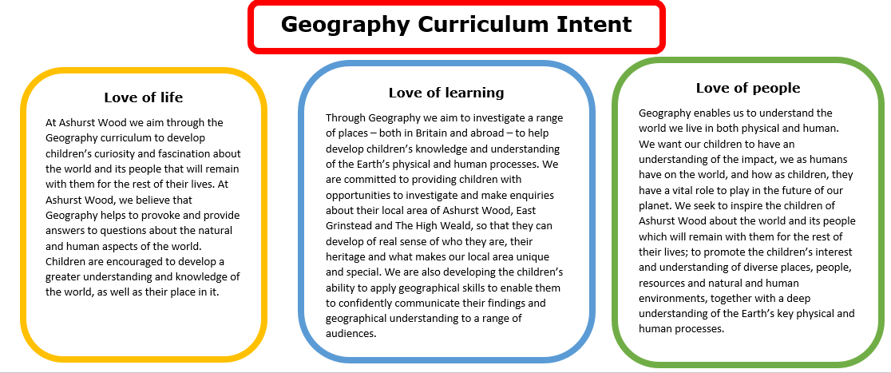
Essential Characteristics
An excellent knowledge of where places are and what they are like.
An excellent understanding of the ways in which places are interdependent and interconnected and how much human and physical environments are interrelated.
An extensive base of geographical knowledge and vocabulary.
Fluency in complex, geographical enquiry and the ability to apply questioning skills and use effective analytical and presentational techniques.
The ability to reach clear conclusions and develop a reasoned argument to explain findings.
Significant levels of originality, imagination or creativity as shown in interpretations and representations of the subject matter.
Highly developed and frequently utilised fieldwork and other geographical skills and techniques.
A passion for and commitment to the subject, and a real sense of curiosity to find out about the world and the people who live there.
The ability to express well-balanced opinions, rooted in very good knowledge and understanding about current and contemporary issues in society and the environment.

Slide 2
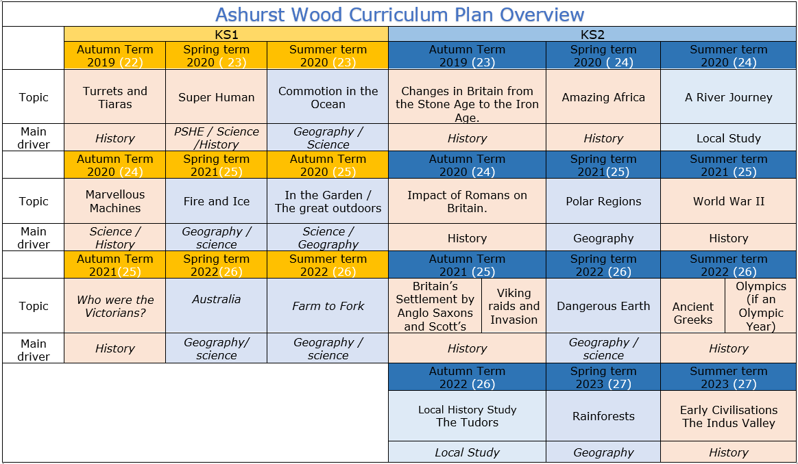
https://www.arthurbugler.com/uploads/Curriculum/Autumn%202%20Planning/Y6%20Frozen%20Kingdom.pdf

Slide 3
KS1
GEOGRAPHY TEACHING AND LEARNING AT ASHURST WOOD
Our topic planning is designed so that some topics are Geography led and the key knowledge and skills are captured in the planning and knowledge organisers. Other topics may contain geographical knowledge in addition to the main driver. All children in KS1 will study the same topic and so expectations will be different for a YR Y1 and a Y2 child. For this reason and to ensure that there is no ceiling placed on a child’s learning we have identified outcomes for all children Must (End of Y1) Should (end of Y2) Aspire a rich and deep understanding.
Commotion in the Ocean
GEOGRAPHY
At Ashurst Wood
EYFS
What will children Know by the end of this topic ?
Enrichment
Seasonal walks in the village
Forest Schools
Visit to aquarium
ELG: People, Culture and Communities Children at the expected level of development will: - Describe their immediate environment using knowledge from observation, discussion, stories, non-fiction texts and maps; ELG: The Natural World Children at the expected level of development will: - Explore the natural world around them, making observations and drawing pictures of animals and plants; - Know some similarities and differences between the natural world around them and contrasting environments, drawing on their experiences and what has been read in class; - Understand some important processes and changes in the natural world around them, including the seasons and changing states of matter.
MUST
Know that there are seven continents.
Identify the countries within the United Kingdom
They will know that there are four main compass points
N S E W
SHOULD
Name the four countries of the United Kingdom
They will understand the positional language near and far and use it to describe locational features and directions
They will use and understand the vocabulary on the knowledge organiser and use vocabulary to describe key physical features, including beach, coast,, ocean, river, and weather.
Skills
Find the United Kingdom on a map or globe
They will be able to identify why there is plastic in the ocean.
They will be able to answer geographical questions (such as: What is this place like? What or who will I see in this place? What do people do in this place?).
Skills
They will be able to name and locate the world’s continents on a map or globe
They will be able to identify why there is plastic in the ocean and what damage it is causing
Use simple grid references (A1, B1).
Devise a simple map; and use and construct basic symbols in a key.
They will know and use the four main compass points
They will be able to ask geographical questions (such as: What is this place like? What or who will I see in this place? What do people do in this place?).
ASPIRE
They will be able to name features of the countries of the United Kingdom
They will identify how plastic is impacting the environment and the wildlife in the oceans.
They will be able to describe key features of the continents.
They will be able to explain why oceans are important

Slide 4
Year / Class 2022 - 2023 KS1 |  | Topic Title: Commotion in the ocean
Pre learning Links. In KS1 prior knowledge will depend on which year group the child is in. Knowledge of the oceans and what an ocean is. What and where the equator is. Understanding of hot and cold countries. The 4 countries of the UK and what sees surround them. |  | Stunning Start: Watch Underwater Film of Various Sea Life in the Pacific: Video https://www.youtube.com/watch?v=9kj_vwleR6Q Fantastic Finish: Visit an aquarium (Brighton sea life centre)
 |  | Creative Arts and Forest School Links Hokusai (wave picture) – art Boat making – Science & DT Hooray for fish – art & contrasting colours Fish pictures layering paint Grace Darling - History
The Big Question: What makes an ocean an ocean?
Small Question | What is the difference between an Ocean and a Sea?
Small Question | What are the oceans called? | Literacy links Commotion in the ocean – poetry The Rainbow Fish – PSHE Hooray for fish – art Dear Greenpeace The little Boat (Kathy Henderson) | Vocabulary Ocean Sea Equator Lifeboat Cotenant Floating / sinking Amphibians Mammals Island | Keys Harvest Crops Transport River Sea Distance North, south ,east, west Left, right up, down Storm Tides Waves | Spring Summer Autumn Winter Seasons Seasonal Ships Boat Sail Journey Coast Pollution Habitat
Small Question | What creatures live in the ocean?
Small Question | Why is there plastic in the ocean?
Small Question | Why are there waves in the ocean?
Small Question | How much of the world is water?
Small Question | What lives in the Pacific Ocean?
Useful Links Geography Quizzes https://www.educationquizzes.com/ks1/geography/ https://wordwall.net/resource/206737/geography/seas-around-uk Map games https://www.sheppardsoftware.com/World_Continents.htm https://kids.britannica.com/kids/article/ocean/346185 Clam Waves https://www.youtube.com/watch?v=yri9AuoyHNo fierce waves https://www.youtube.com/watch?v=Xhlx9wbs-0c Five facts about the pacific ocean https://www.youtube.com/watch?v=fmtivFaEXIk

Slide 5
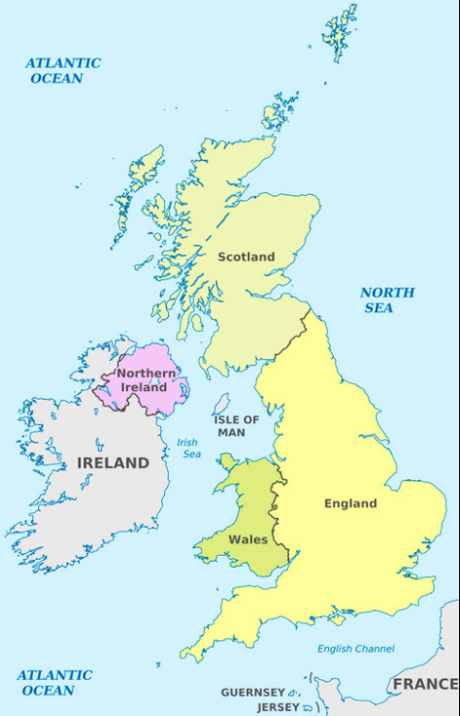
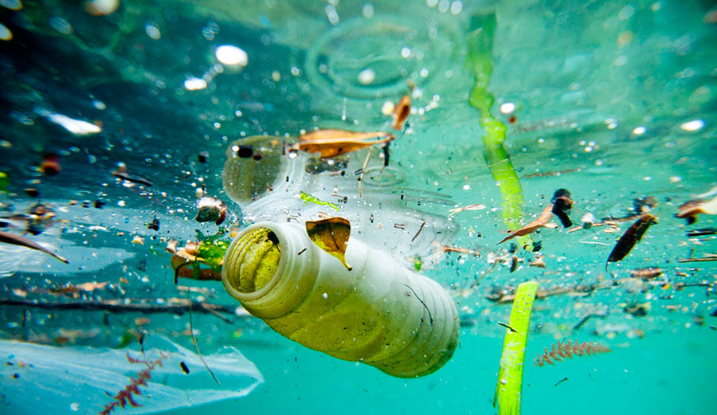
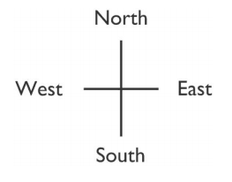
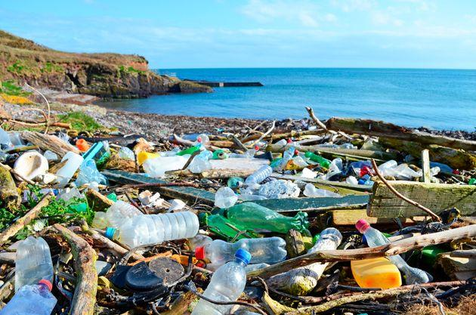
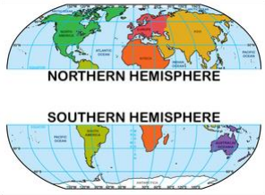
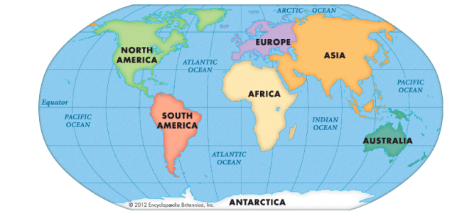
Commotion in the Ocean
VOCABULARY
Beach | a landform by the sea, usually sand and/or rock
Cliff | a vertical or near vertical rock feature, usually on the coast
Harbour | is a deep body of water that protects boats near land.
Coast | the region where land meets sea
Continent | land mass defined by physical, human, or cultural features: Europe, Africa, Antarctica, Asia, Oceania, North America or South America
Country | Political area defined by physical, human or cultural features
Endangered | a species which is at risk of becoming extinct
Equator | imaginary line around the middle of the Earth where day and night are almost equal, and there is little change in season; some areas have a dry season and wet season
Migration | the movement of people or animals from one place to another
North, South, East, West | compass points, locational vocabulary
North Pole | the most northerly place of the Earth
Seasons | a time of year marked by certain conditions: spring, summer, autumn, winter
Symbol | picture on a map to show a feature on a map
Weather | conditions in the atmosphere on a particular day, such as temperature, windiness, rainfall, hours of sunshine or cloud cover.
Wild | land not farmed, used for parks or gardens, or built on
Ocean | A huge area of salt water that covers nearly ¾ of the surface of the earth. There are different oceans surrounding the continents

Slide 6
ELG: People, Culture and Communities Children at the expected level of development will: - Describe their immediate environment using knowledge from observation, discussion, stories, non-fiction texts and maps; - Know some similarities and differences between different religious and cultural communities in this country, drawing on their experiences and what has been read in class; - Explain some similarities and differences between life in this country and life in other countries, drawing on knowledge from stories, non-fiction texts and when appropriate maps. ELG: The Natural World Children at the expected level of development will: - Explore the natural world around them, making observations and drawing pictures of animals and plants; - Know some similarities and differences between the natural world around them and contrasting environments, drawing on their experiences and what has been read in class; - Understand some important processes and changes in the natural world around them, including the seasons and changing states of matter.

