Slide 1
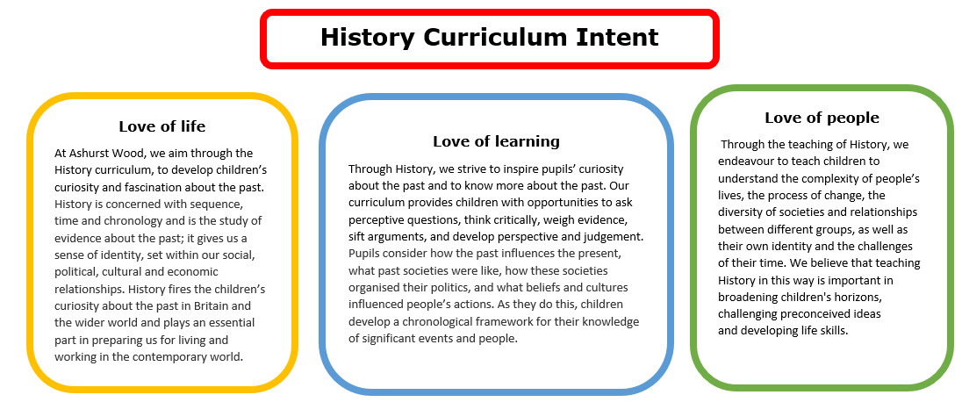
Essential Characteristics
• An excellent knowledge and understanding of people, events, and contexts from a range of historical periods and of historical concepts and processes.
• The ability to think critically about history and communicate ideas very confidently in styles appropriate to a range of audiences.
• The ability to consistently support, evaluate and challenge their own and others’ views using detailed, appropriate and accurate historical evidence derived from a
range of sources.
• The ability to think, reflect, debate, discuss and evaluate the past, formulating and refining questions and lines of enquiry.
• A passion for history and an enthusiastic engagement in learning, which develops their sense of curiosity about the past and their understanding of how and why
people interpret the past in different ways.
• A respect for historical evidence and the ability to make robust and critical use of it to support their explanations and judgments.
• A desire to embrace challenging activities, including opportunities to undertake high-quality research across a range of history topics.

Slide 2
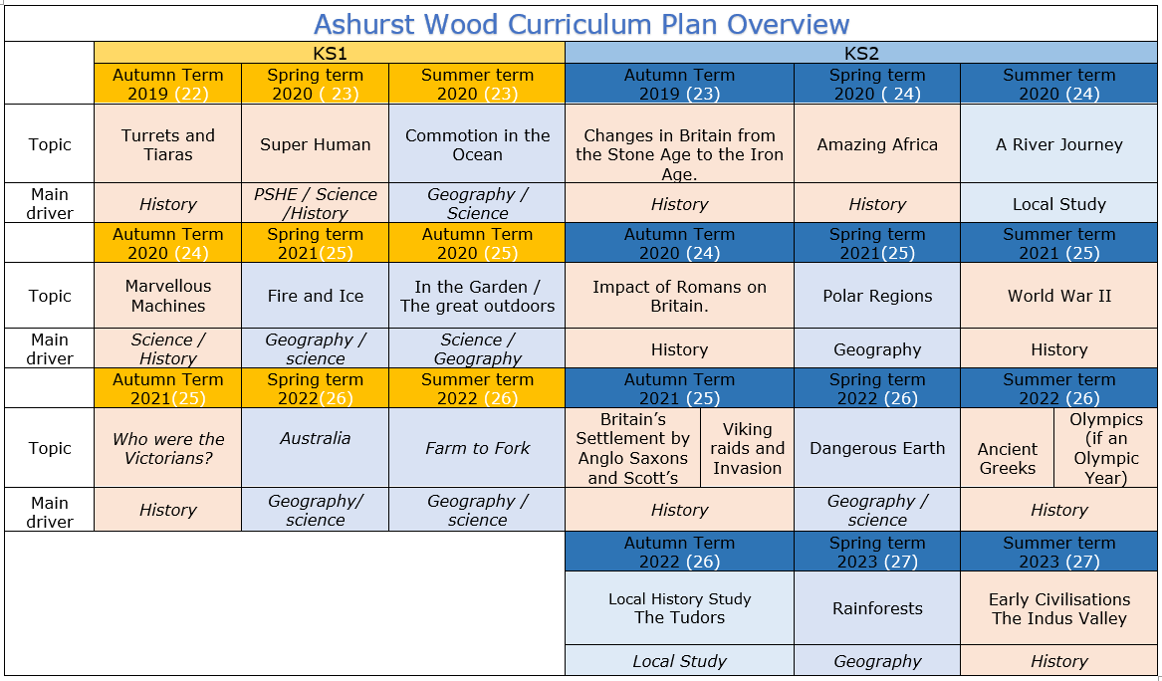

Slide 3


KS1
HISTORY TEACHING AND LEARNING AT ASHURST WOOD
Our topic planning is designed so that some topics are History led and the key knowledge and skills are captured in the planning and knowledge organisers. Other topics may contain historical knowledge in addition to the main driver. All children in KS1 will study the same topic and so expectations will be different for a YR Y1 and a Y2 child. For this reason and to ensure that there is no ceiling placed on a child’s learning we have identified outcomes for all children Must (End of Y1) Should (end of Y2) Could a rich and deep understanding.
History
At Ashurst Wood
What will children Know by the end of this topic ?
Must
To know where some key events fit onto a timeline e.g. Industrial Revolution, when certain inventions were created.
• To know who the Victorians were and what life looked like for them (e.g. lives for children, schools, and Victorian inventions, including transport).
• To know that ways of life began to change in Victorian times because steam started to be used to create power. This changed lots of things about life in Britain, including transport and how things were made.
• To know how life in Victorian times was changed by inventions that people created, including the development of transport (steam ships, trains, development of roads).
• To know how school life has changed from the Victorian era until now and how the lives of children in Britain have changed.
Who were the Victorians?
Should
Know where some key people fit on a timeline.
Remember a few significant names and dates.
Use common words and phrases related to the passing of time (now, then, before).
Understand why people and events being studied are important.
Use historical vocabulary (eg. past, present, recently, years, decades, centuries).
EYFS
Must
Recognise the difference between ‘old’ and ‘new’
Know where some basic events fit on a timeline, relating to their topic Begin to understand why events being studied are important.
Use phrases such as now, after, before, modern, new, old, a long time ago, in my lifetime, before I was born, when I was younger.
Begin to recognise different ways we can learn about the past (eg. from images, objects, stories, first-hand witnesses).
Children at the expected level of development will:
Talk about the lives of the people around them and their roles in society;
- Know some similarities and differences between things in the past and now, drawing on their experiences and what has been read in class;
- Understand the past through settings, characters and events encountered in books read in class and storytelling.
Skills
Record some events onto a timeline.
Say how lifestyles (work, school, play etc.) were the same or different in the past.
Describe differences between ‘then’ and ‘now’.
Discuss the speed of change - sometimes in slow increments, sometimes in leaps
Recount key events from the past in their own words and begin to explain why these events happened.
Begin to think about the impact that historical events have had on modern life.
Begin to express preferences and justify them with evidence / facts (eg. Who was the greatest explorer?
Ask and answer historically relevant questions.
Compare events from different periods in history (eg. different discoveries/voyages).
Use a range of sources (eg. pictures, photos, artefacts, stories, textbooks, field trips etc.) to extract some information about the past.
Begin to piece together clues from a variety of different sources.
Skills
• To use a range of sources to find out about the past, including photographs and artefacts. Historical Vocabulary before, after, past, present, then, now, chronological, event, compare, change, artefact Key Concepts before/after similar, different Topic Specific Vocabulary Schools- slates, chalk, blackboard, strict teachers, drills, abacus, Sunday School, read and copy, chants Children – rich, poor, work, factories, disease, rocking horse, dolls, hopscotch, marbles,
• To begin to discuss which sources of information are the most useful.
• To ask and answer questions about the past to find out answers.
• To sequence events, photographs and artefacts into chronological order.
• To compare photos of people or events in the past, to identify differences in the ways of life.
• To imagine how people in the past thought or felt.
• Can make some comparisons between aspects of life in different periods by comparing the lives of different people (Queen Victoria to Richard the First).
Enrich
Explain why an invention is important and how it has changed the way people live. This could involve independent research.
Skills
• Place some basic events onto a timeline and use this to support the retelling of past events.
• Say how something is the same or different in the past.
• Develop a sense of time and how fast things change (eg. differences between changes in their / their parents / their grandparents' lifetimes).
• Show an understanding of some key events.
• Start to think about the reasons why things might change (eg. improvements in technology / making life easier / more fun).
Ask and answer some historical questions.
• Sort pictures / objects / events into ‘old’ and ‘new’.
• Use pictures and photographs to extract some information about the past.
ENRICHMENT
Visit to a Victorian living history
Additional Historical coverage
Remembrance day
Bonfire Night

Slide 4
Year / Class 2021 KS1 |  | Topic Title: Who were the Romans?
Pre learning Links. In KS1 prior knowledge will depend on which year group the child is in. Chronology in Y1 & 2 Tudor houses Florence Nightingale Using artefacts Historical farming |  | Stunning Start: What’s in the bag Fantastic Finish: Wealden and downland Victorian experience / Preston Mannor servant experience
 |  | Creative Arts and Forest School Links
The Big Question: Who were the Victorians?
Small Question | Who was Queen Victoria and how do we know what she was like?
Small Question | Did Victorian children go to school? | Literacy links Children's Books: Victorians Topic (booksfortopics.com) | Vocabulary Timeline Chronology Archaeologist Centuary Long ago Diary Websites Investigate Research Historians Experts Significant Survive | Poor / Rich Drawbridge Today Yesterday Tomorrow The present The past The future What? When? Where? Why? | Timeline Date order Similar Different Important Living memory Inventions Homes The older generation Photograph Camera Painting Portrait Artifact | Chronological order Memory Lifetime Calendar Decade Week Year Day Detective Opinion
Small Question | Was there a difference between rich and poor Victorians?
Small Question | How does a Victorian child’s life differ from yours?
Small Question | What did the Victorians invent?
Small Question | How did the Victorians get from one place to another?
Small Question | Teaching Victorian Britain at KS2 - Year 5 & 6 | Keystage History
Useful Link Horrible Histories Vile Victorians A little girl must wash in dirty water Parliamenta - Bing video Victorian Childhood from Turton Tower - Toys - Bing video That History Bloke Explains Victorian Toys (1) - Thaumatrope - Bing video Victorian Servants KS1 – Preston Manor (brightonmuseums.org.uk) Famous Victorians - Primary Facts Victorian homelife - BBC Bitesize School - BBC Bitesize Leisure and holidays in Victorian Scotland - BBC Bitesize Horrible Histories - Victorian Inventions - Bing video The Victorians - The School Room - Bing video

Slide 5

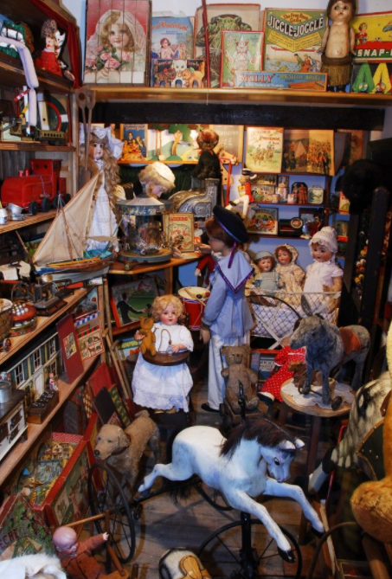
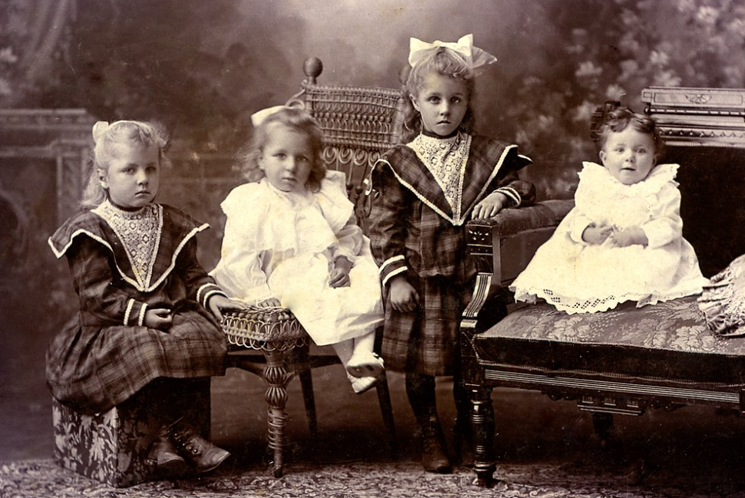
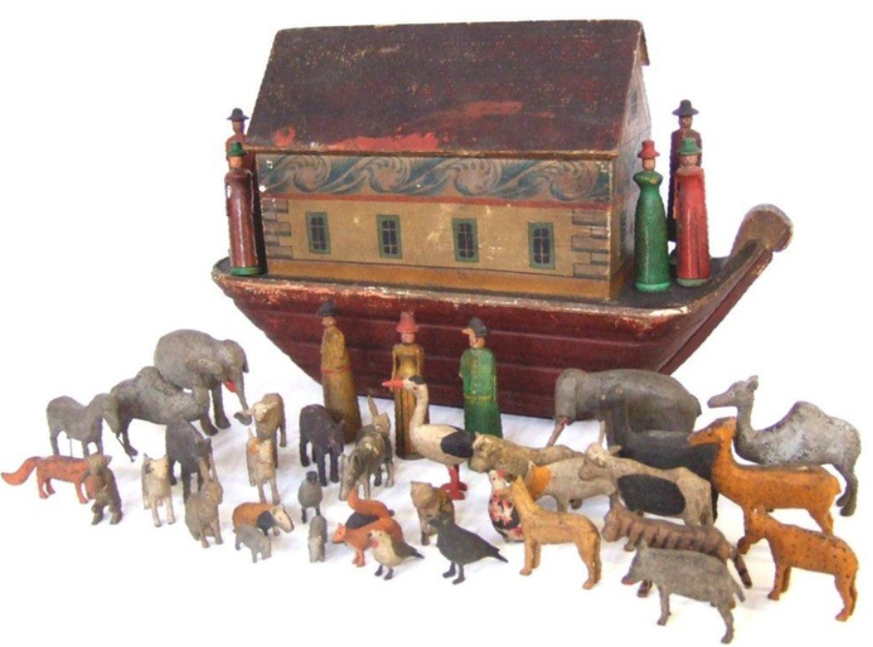
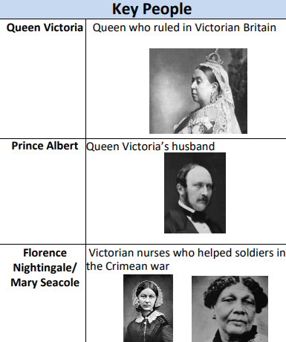
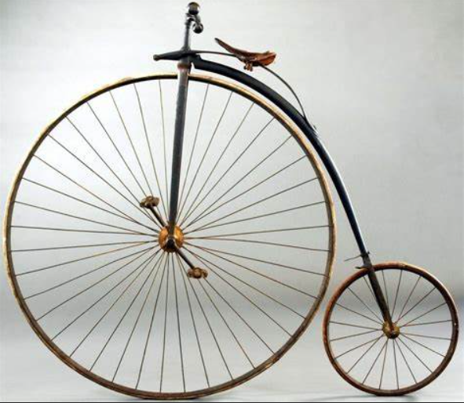
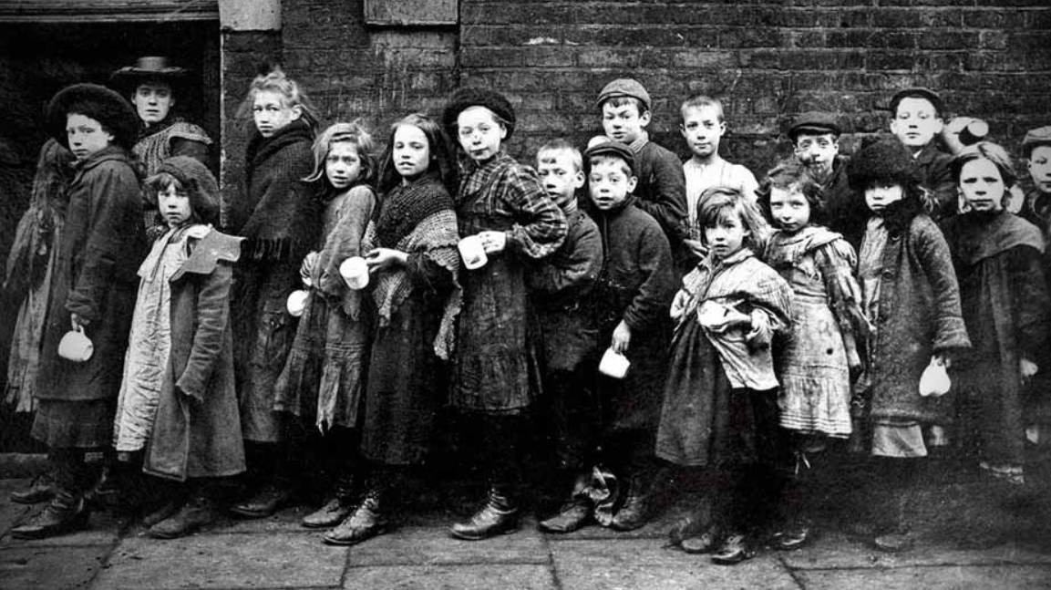
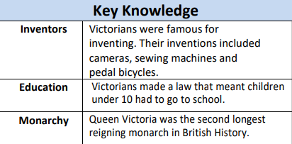
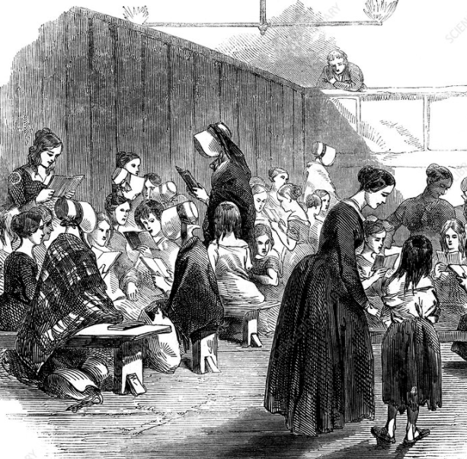
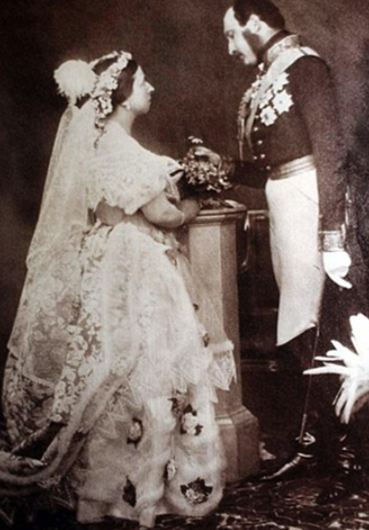
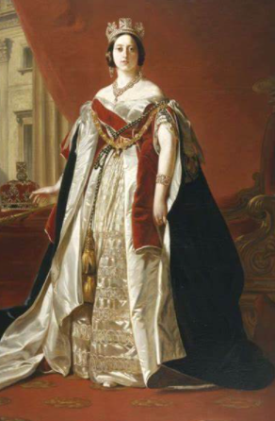
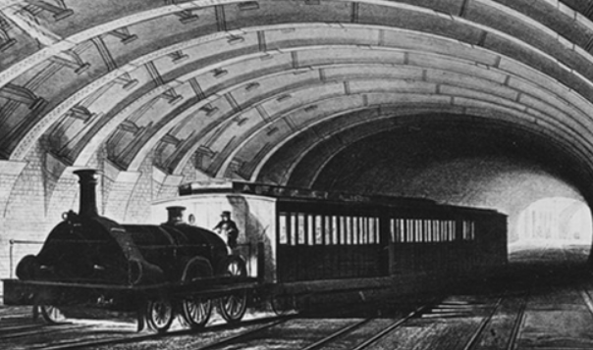
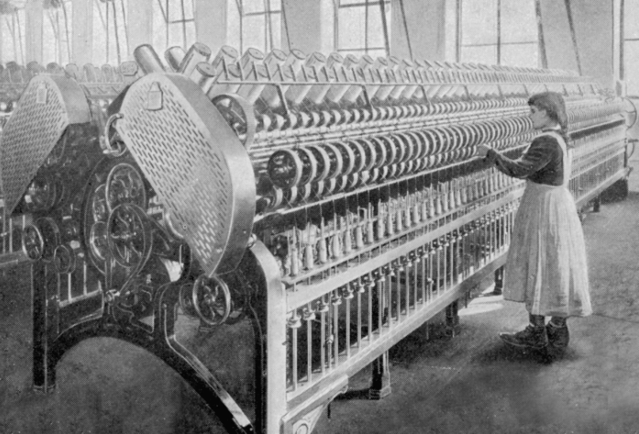
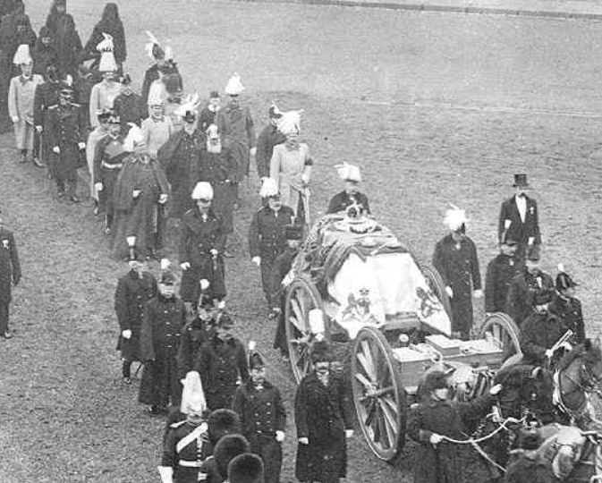
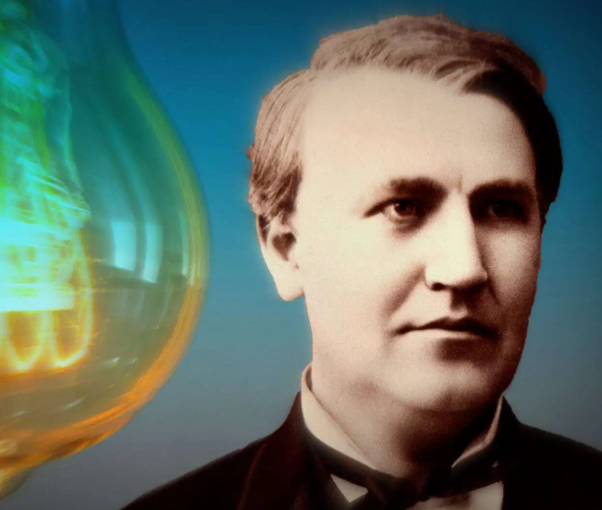
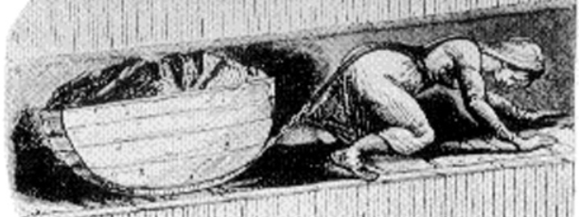
Who were the Victorians?
VOCABULARY
British | To come from Britain
Chimney sweep | A small child who used to clean chimneys
Chronology | Putting events in date order
Coronation | When a person is crowned King or Queen
Empire | Countries around the world that belonged to Britain
Future | A period of time that hasn’t happened yet
Inventor | A person who invents things
Monarchy | The king or queen
Marbles | Small glass balls that you play a game with
Primary source | Evidence created during the time being studied by the people of that time
Past | A period of time when something has already happened
Present | A period of time that is happening now
Queen | A female who is the head of a royal family
Reign | A period of time when a person rules
Rocking horse | A wooden toy that is shaped like a horse. A rocking horse rocks backwards and forwards
Royal | To be related to a king or queen
Secondary source | Evidence created by other people based on primary evidence
Victorian | A person that lived at the time of Queen Victoria’s reign
Whip and top | A Victorian wooden toy
1819
Victoria was born at Kensington Palace, London
1837
Victoria became queen at the age of 18 after the death of her uncle
1844
factory act states children could start work from age 8 but had to have 2 hours schooling daily.
1861
Prince Albert dies.
1863
First underground railway opens in London
1878
Thomas Edison invents the light bulb.
1891
Education made free and compulsory for children 5-13
1840
First ragged school set up
1901
Queen Victoria dies.

