Slide 1
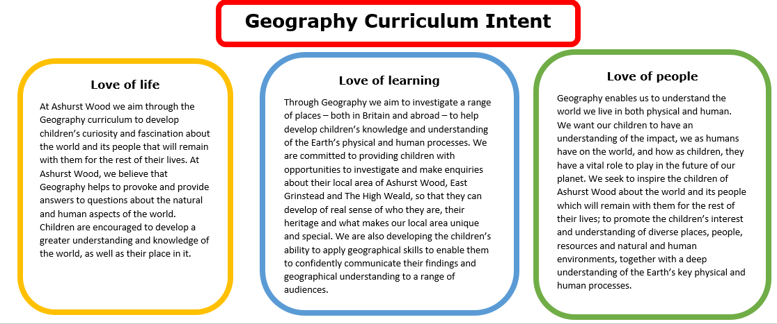
Essential Characteristics
An excellent knowledge of where places are and what they are like.
An excellent understanding of the ways in which places are interdependent and interconnected and how much human and physical environments are interrelated.
An extensive base of geographical knowledge and vocabulary.
Fluency in complex, geographical enquiry and the ability to apply questioning skills and use effective analytical and presentational techniques.
The ability to reach clear conclusions and develop a reasoned argument to explain findings.
Significant levels of originality, imagination or creativity as shown in interpretations and representations of the subject matter.
Highly developed and frequently utilised fieldwork and other geographical skills and techniques.
A passion for and commitment to the subject, and a real sense of curiosity to find out about the world and the people who live there.
The ability to express well-balanced opinions, rooted in very good knowledge and understanding about current and contemporary issues in society and the environment.

Slide 2
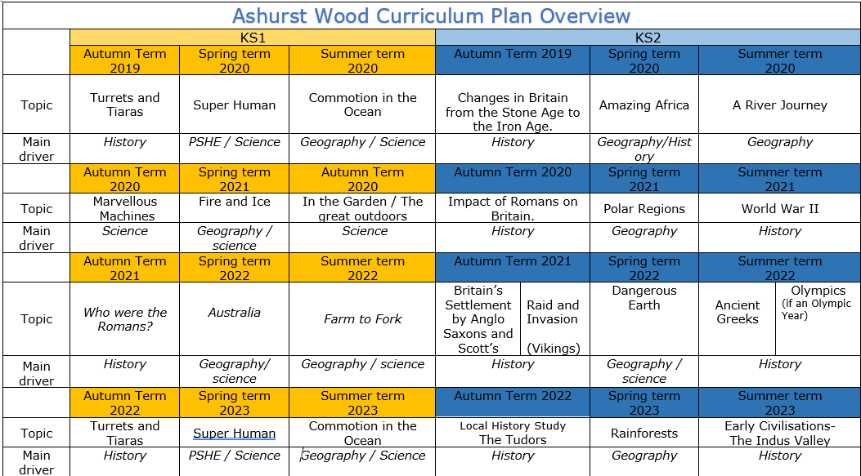
Commotion in the Ocean
Geography / Science
Amazing Africa
Geography / History
A river journey
Geography
Fire & Ice
Geography / Science
Polar Regions
Geography
Australia
Geography / Science
Farm to Fork
Geography / Science
Dangerous Earth
Geography / science
Commotion in the Ocean
Geography / Science
Rainforests
Geography
https://www.arthurbugler.com/uploads/Curriculum/Autumn%202%20Planning/Y6%20Frozen%20Kingdom.pdf

Slide 3
KS 2
GEOGRAPHY TEACHING AND LEARNING AT ASHURST WOOD
Our topic planning is designed so that some topics are Geography led and the key knowledge and skills are captured in the planning and knowledge organisers. Other topics may contain geographical knowledge in addition to the main driver. All children in KS1 will study the same topic and so expectations will be different for a YR Y1 and a Y2 child. For this reason and to ensure that there is no ceiling placed on a child’s learning we have identified outcomes for all children Must (End of Y4) Should (end of Y6) Could a rich and deep understanding.
GEOGRAPHY
At Ashurst Wood
What will children Know by the end of this topic ?
SHOULD
Name and locate some of Africa’s and cities and identify Africa’s human and physical characteristics, including hills, mountains, rivers, key topographical features and land-use patterns; and understand how some of these aspects have changed over time.
Identify and describe the geographical significance of latitude, longitude, Equator, Northern Hemisphere, Southern Hemisphere, the Tropics of Cancer and Capricorn, Arctic and Antarctic Circle, and time zones (including day and night).
Describe geographical diversity across the world.
Identify and understand African land use and economic activity including trade links, and the distribution of natural resources including energy, food, minerals, and water supplies.
Create maps of locations identifying patterns (such as: land use, climate zones, population densities, height of land
Amazing Africa
MUST
Use maps, atlases, globes and digital/computer mapping to locate Africa and describe features.
Name and locate the Equator, Northern Hemisphere, Southern Hemisphere, the Tropics of Cancer and Capricorn, Arctic and Antarctic Circle and date time zones.
Describe some of the characteristics of these geographical areas.
Describe geographical similarities and differences between countries.
Understand some of the reasons for geographical similarities and differences between countries.
SKILLS
Collect and analyse statistics and other information in order to draw clear conclusions about locations.
Use a range of geographical resources to give detailed descriptions and opinions of the characteristic features of a location.
Compare two locations in Africa identifying and describe how the physical features affect the human activity within a location.
Analyse and give views on the effectiveness of different geographical representations of a location (such as aerial images compared with maps and topological maps - as in London’s Tube map).
Enrichment
Forest Schools
Drumming workshop
SKILLS
Ask and answer geographical questions about the physical and human characteristics of Africa.
Explain own views about Africa, giving reasons.
Use a range of resources to identify the key physical and human features of a location.
COULD
Undertake an independent study of an African country demonstrating all their geographical knowledge and understanding.
Understand how climate change is affecting Africa and what we can do to help.

Slide 4
Year / Class 2023- 2024 KS2 |  | Topic Title: Amazing Africa
Pre learning Links. In KS1 prior knowledge will depend on which year group the child is in. Continents and names of oceans / UK countries names / equator Map and globe work |  | Stunning Start: Africa Day – Mask making / Food / Dancing Fantastic Finish:
The Big Question: What is it like to live in Africa? |  | Creative Arts and Forest School Links African art – textiles, tribal, clay mud huts
Small Question | Where is Africa located in the world? (Continents and sub continents)
Small Question | What geographical features can you see from the sky?
Small Question | Where do people live in Africa? (Types of settlements rich / poor)
Small Question | What are the climate zones? | Literacy links Journey to Joburg (Apartheid) | Vocabulary Indigenous / native Settlements Community Urban / rural Warm Hemisphere – northern & southern Population Continent Settlement Community Landscape | Relief map Political map Ocean North East South East North west South west Climate zone Longitude Vegetation Soil Transport Weather Equator Latitude Weathering | Settlement patterns Urban / rural Humid Grid reference Settlement Excursion Population Terrain Scale (Maps) Tourist Migrate Urban Rural Congestion Pollution Survey | Export Conservation Location hemisphere Biodomes Distance Satellite Northern hemisphere Southern Industry Tropical Environment
Small Question | Are cities in Africa the same as our cities?
Small Question | How did Benin trade with Europe
Small Question | What is a Biome?
Small Question
Useful Links https://3dgeography.wixsite.com/maps/earthquake-maps https://www.ks2history.com/benin-childrens-books Key books for Benin https://www.kids-world-travel-guide.com/africa-quiz.html quiz https://www.ducksters.com/geography/africa.php http://news.bbc.co.uk/cbbcnews/hi/world/newsid_2688000/2688437.stm quiz https://www.actionaid.org.uk/school-resources/search/s/country/0-3018 Action aid teaching resources https://www.britishmuseum.org/learn/schools/ages-7-11/africa/classroom-resource-art-benin https://www.rgs.org/schools/teaching-resources/africa-a-continent-of-contrasts/ African Geography resources https://www.globalschools.org.uk/teaching-resources https://www.kids-world-travel-guide.com/africa-facts.html fact file https://primarysite-prod-sorted.s3.amazonaws.com/st-andrews-church-of-england-oxford/UploadedDocument/6f32b2a88a61469e8a7549cad5c6899a/geography-activities-year-5.pdf

Slide 5
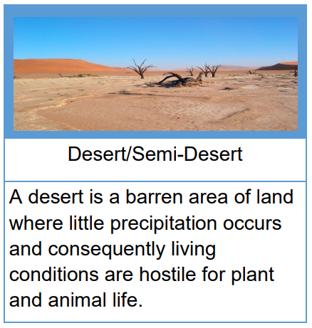
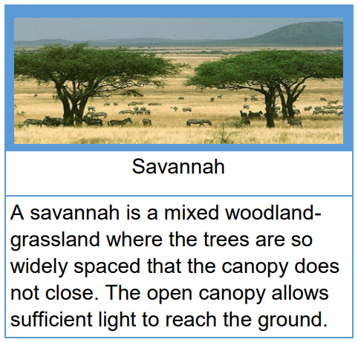
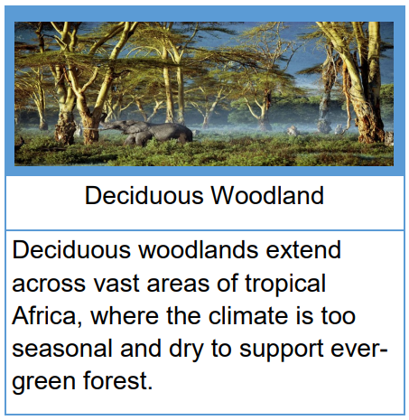
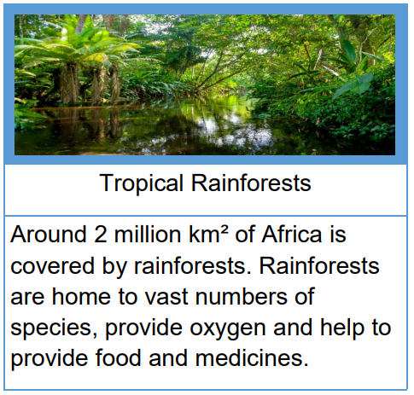
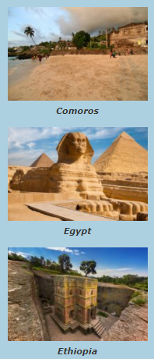
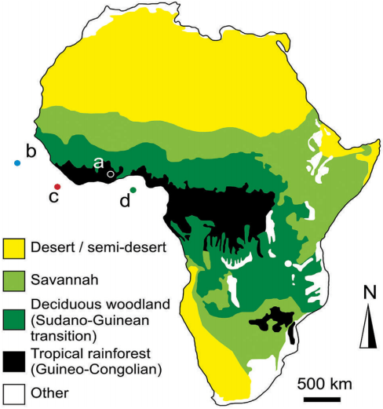
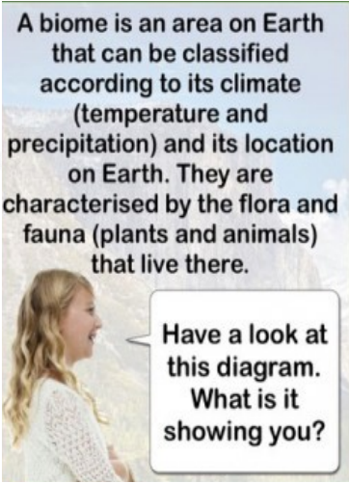
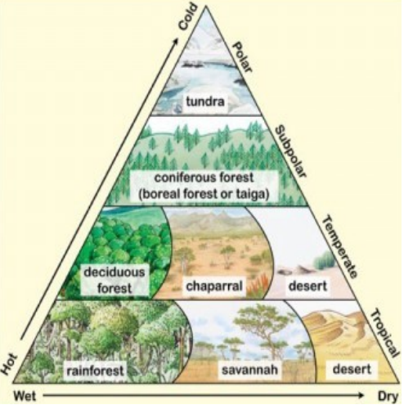
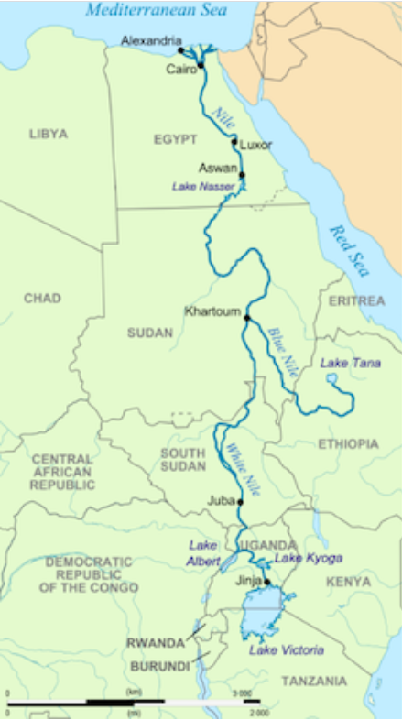

Slide 6
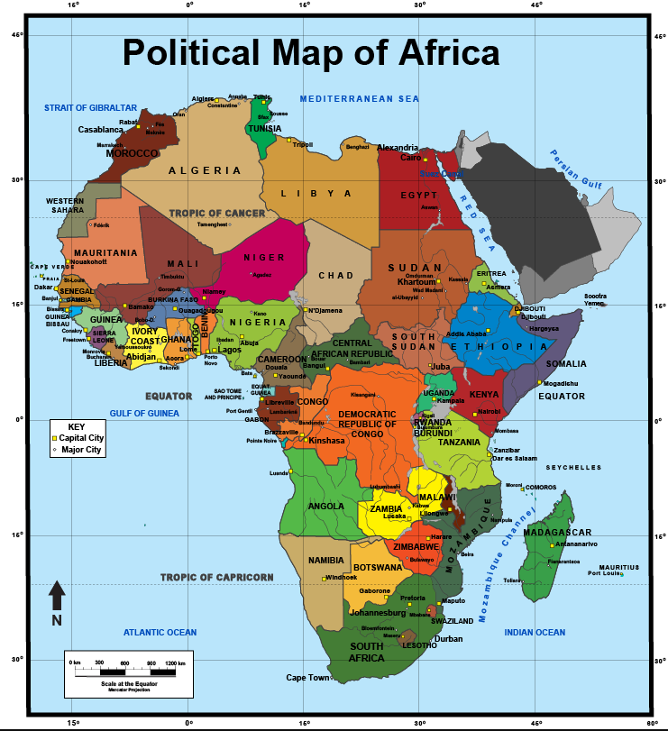
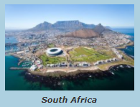
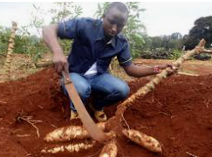
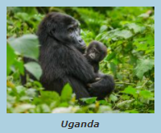
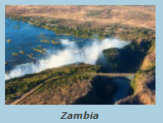
VOCABULARY
Natural resources | the land, forests, energy sources and minerals existing naturally in a place that can be used by people
Biome | a natural area of the living world which has its own climate, vegetation and animals
Climate | The pattern of weather conditions in a particular area over a period of time
Climate zone | There are three main climate zones; polar, temperate and tropical.
Topography | the arrangement of the natural and artificial physical features of an area.
Distribution | delivering goods to a number of places.
Economy | A country’s economy is the wealth that it gets from business and industry.
Equator | An invisible line drawn around the centre of the earth, which divides the earth into two hemispheres
Export | to export products or raw materials means to sell them to another country.
Import | to import products or raw materials means to buy them from another country for use in your own country
Global | something that happens in all parts of the world or affects all parts of the world.
Continent | land mass defined by physical, human, or cultural features: Europe, Africa, Antarctica, Asia, Oceania, North America or South America
Adapt | Make something suitable for a new use or purpose Become adjusted to new conditions or situations
Temperate | The climate or region which usually has mild temperatures
Equator | imaginary line around the middle of the Earth where day and night are almost equal, and there is little change in season; some areas have a dry season and wet season
Migration | the movement of people or animals from one place to another

