Slide 1
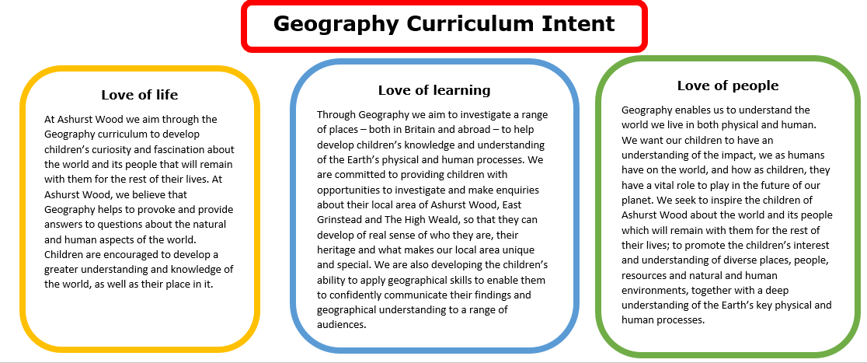
Essential Characteristics
An excellent knowledge of where places are and what they are like.
An excellent understanding of the ways in which places are interdependent and interconnected and how much human and physical environments are interrelated.
An extensive base of geographical knowledge and vocabulary.
Fluency in complex, geographical enquiry and the ability to apply questioning skills and use effective analytical and presentational techniques.
The ability to reach clear conclusions and develop a reasoned argument to explain findings.
Significant levels of originality, imagination or creativity as shown in interpretations and representations of the subject matter.
Highly developed and frequently utilised fieldwork and other geographical skills and techniques.
A passion for and commitment to the subject, and a real sense of curiosity to find out about the world and the people who live there.
The ability to express well-balanced opinions, rooted in very good knowledge and understanding about current and contemporary issues in society and the environment.

Slide 2
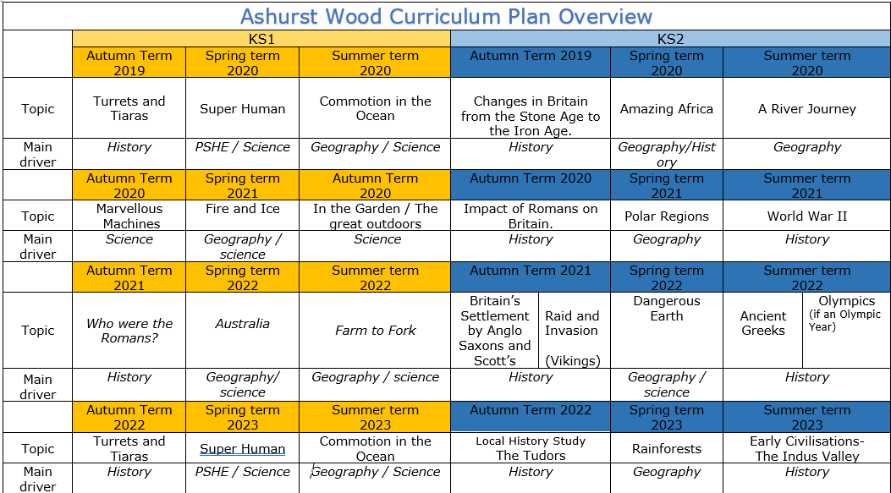
Commotion in the Ocean
Geography / Science
Amazing Africa
Geography / History
A river journey
Geography
Fire & Ice
Geography / Science
Polar Regions
Geography
Australia
Geography / Science
Farm to Fork
Geography / Science
Dangerous Earth
Geography / science
Commotion in the Ocean
Geography / Science
Rainforests
Geography
https://www.arthurbugler.com/uploads/Curriculum/Autumn%202%20Planning/Y6%20Frozen%20Kingdom.pdf

Slide 3
KS 2
GEOGRAPHY TEACHING AND LEARNING AT ASHURST WOOD
Our topic planning is designed so that some topics are Geography led and the key knowledge and skills are captured in the planning and knowledge organisers. Other topics may contain geographical knowledge in addition to the main driver. All children in KS1 will study the same topic and so expectations will be different for a YR Y1 and a Y2 child. For this reason and to ensure that there is no ceiling placed on a child’s learning we have identified outcomes for all children Must (End of Y4) Should (end of Y6) Could a rich and deep understanding.
GEOGRAPHY
At Ashurst Wood
Dangerous Earth
What will children Know by the end of this topic ?
SHOULD
Identify and describe how the physical features affect the human activity within a location and whether the wealth of a county changes the impact.
Identify how locations around the world have been changed by natural disasters. UK floods / US wildfires /Haiti earthquake
Make inks between global warming and natural disasters
Create maps of locations identifying patterns (such as: land use, climate zones, population densities, height of land
Understand how scientists predict earthquakes and volcanoes.
Name and locate the Equator, Northern Hemisphere, Southern Hemisphere, the Tropics of Cancer and Capricorn. Describe some of the characteristics of these geographical areas.
describe and understand key aspects of:
physical geography, including: volcanoes and earthquakes
Understand how scientists predict earthquakes and volcanoes.
Identify how locations around the world have been changed by natural disasters. UK floods / US wildfires /Haiti earthquake
MUST
Use topographic maps & digital/computer mapping to locate volcanoes. Describe these describe features
describe and understand key aspects of: physical geography, including: volcanoes and earthquakes
Use a map to locate the active fault lines and the ring of fire.
Name and locate the Equator, Northern Hemisphere, Southern Hemisphere, the Tropics of Cancer and Capricorn. Describe some of the characteristics of these geographical areas.
Describe how a volcano is formed.
SKILLS
Discuss the impact of natural disasters on humans and nature in the area.
Collect and analyse statistics and other information in order to draw clear conclusions about locations. – Iceland
Use a map to locate the active fault lines and the ring of fire.
Use topographic maps & digital/computer mapping to locate volcanoes
Make inks between global warming and natural disasters
Ask and answer geographical questions about the physical and human characteristics of the location
Use a range of sources to identify the impact of earthquakes / Tsunamis on a locality (Human and physical)
Explain own views about the location, giving reasons
SKILLS
Ask and answer geographical questions about the physical and human characteristics of the location
Use a range of sources to identify the impact of earthquakes / Tsunamis on a locality (Human and physical)
Explain own views about the location, giving reasons.
Enrichment
Forest Schools
COULD
Debate for or against a settlement in Iceland near a volcanic site.

Slide 4
Year / Class 2023- 2024 KS2 |  | Topic Title: Dangerous Earth
Pre learning Links. In KS1 prior knowledge will depend on which year group the child is in. |  | Stunning Start: Making Volcanoes Fantastic Finish:
The Big Question: Are Natural Disasters Evil? |  | Creative Arts and Forest School Links Dance
Small Question | What is a natural disaster and why do they occur?
Small Question | How do earthquakes occur?
Small Question | What is a Tsunami?
Small Question | Can you predict where a Tsunami will occur? | Literacy links Pompei Topic books Book Lists for Rocks & Soils, Volcanoes, Mountains... (booksfortopics.com) | Vocabulary Magma Natural disaster Tectonic plate Volcano Earthquake Ocean Contour Lines Landscape Mountain | settlement community landscape relief map political map cliff ocean North East South West Longitude valley vegetation soil peat loam clay | mountain weathering compass North West Environment distance scale grid reference satellite settlement patterns inland urban/ rural valley contour natural disaster coastal | features natural population continent sub-continent development Tectonic Plates lake transport [carry] diagram South East weather equator latitude natural resources
Small Question | Are there any active volcanoes?
Small Question | Are there volcanoes on other planets?
Small Question | Are natural disasters happening more often?
Small Question | Do Natural disaster impact us?
Small Question | How have Volcanoes shaped Iceland? understand geographical similarities and differences through the study of human and physical geography of a region of the United Kingdom, a region in a European country,
Useful Links https://3dgeography.wixsite.com/maps/earthquake-maps https://www.philosophy-foundation.org/enquiries/view/natural-disasters Philosophical questions about natural disasters. https://www.dynamicearth.co.uk/media/1257/natural-disasters.pdf https://www.tes.com/resource-detail/download/11075839 Natural disaster pack https://www.youtube.com/watch?v=dY_3ggKg0Bc (time-lapse of Vesuvius)

Slide 5
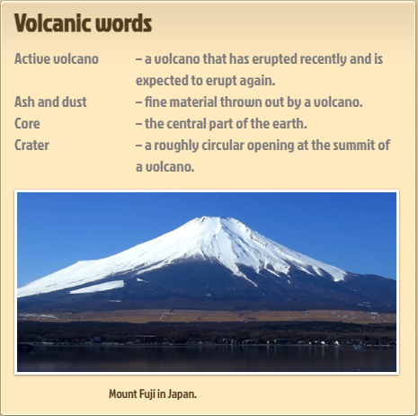
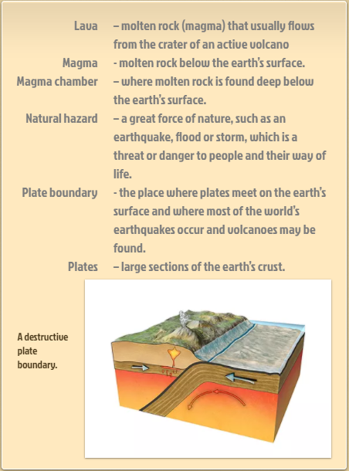
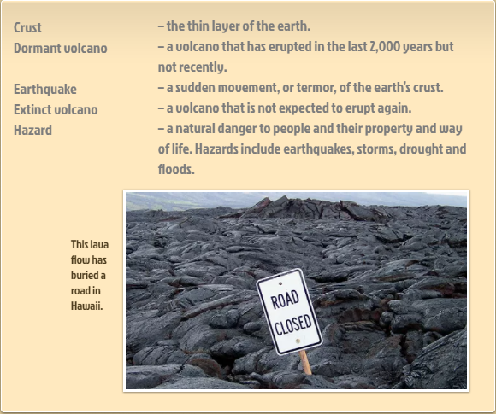
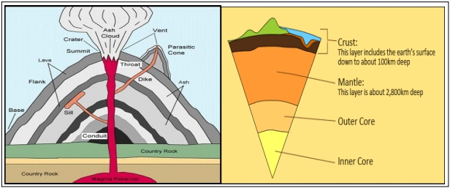
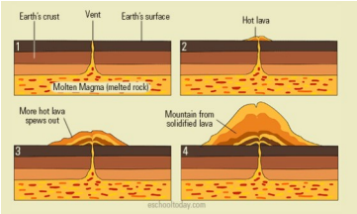

Slide 6
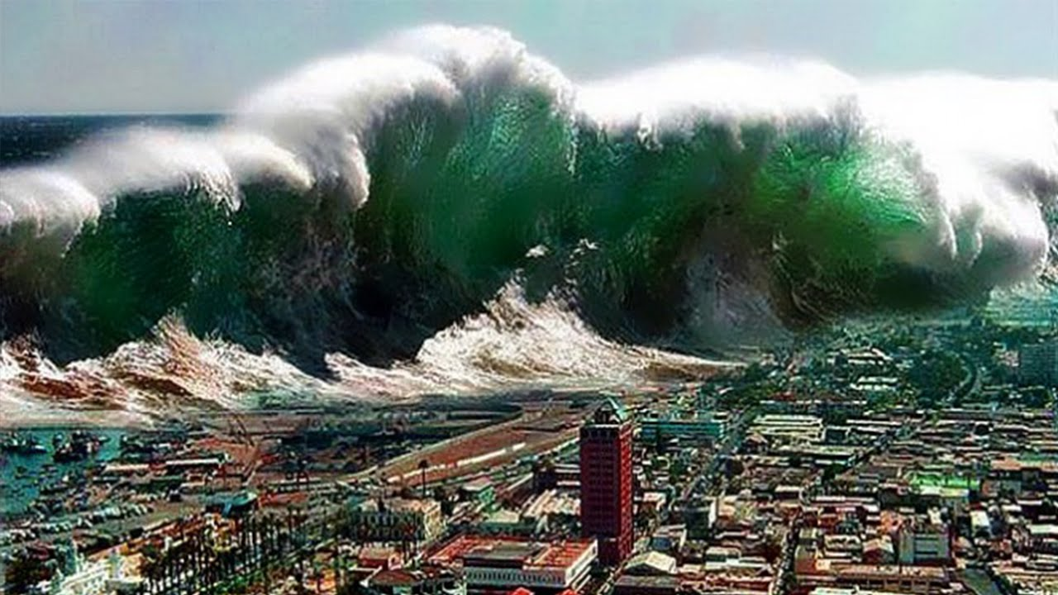
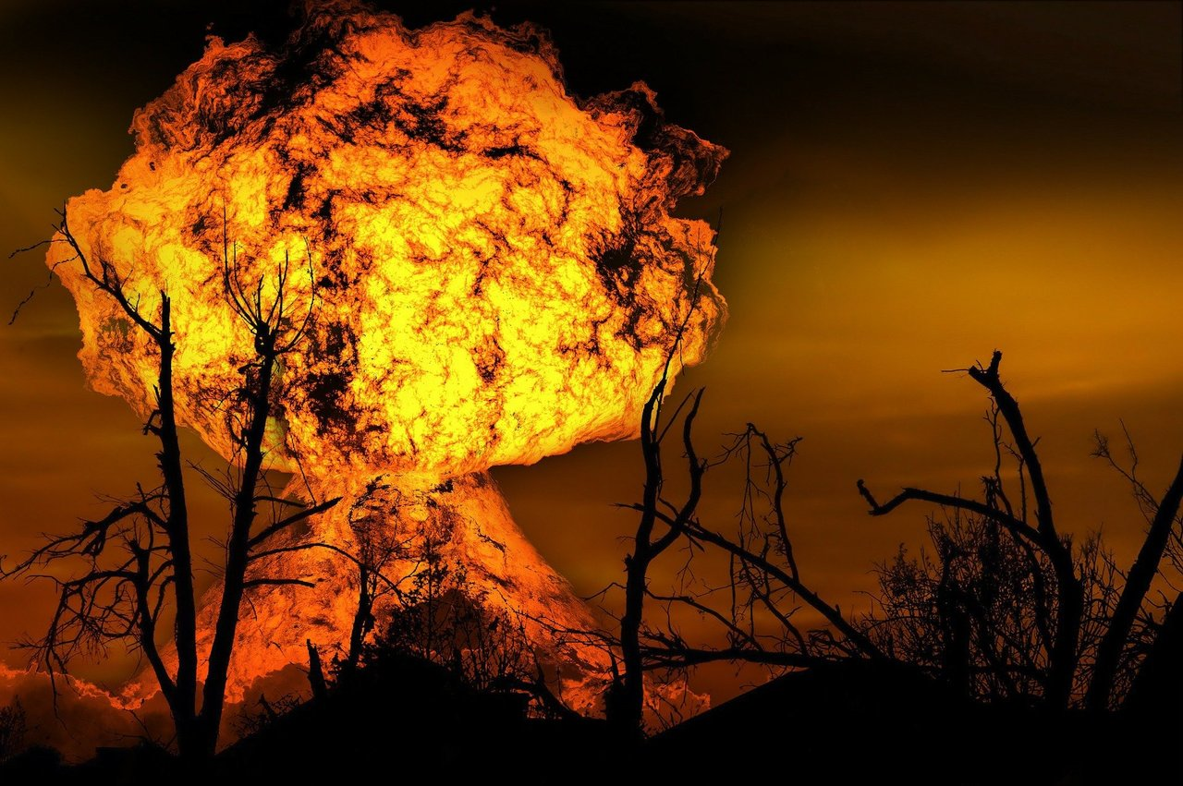
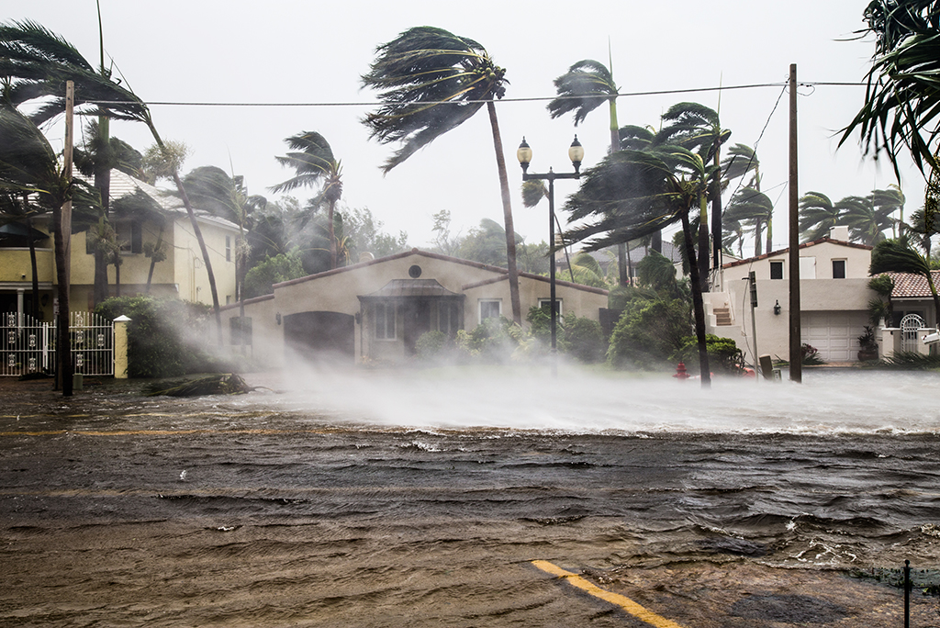
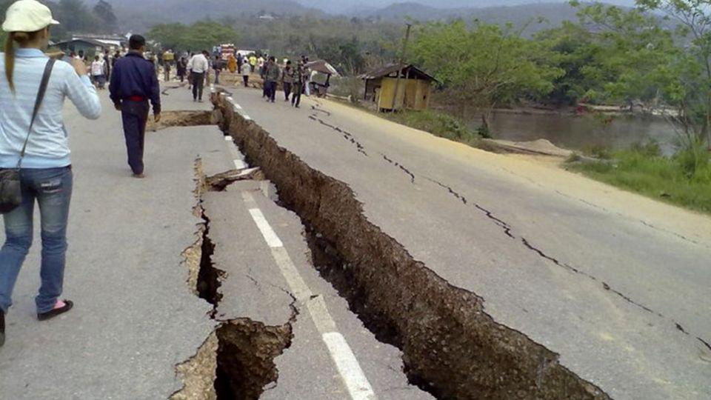
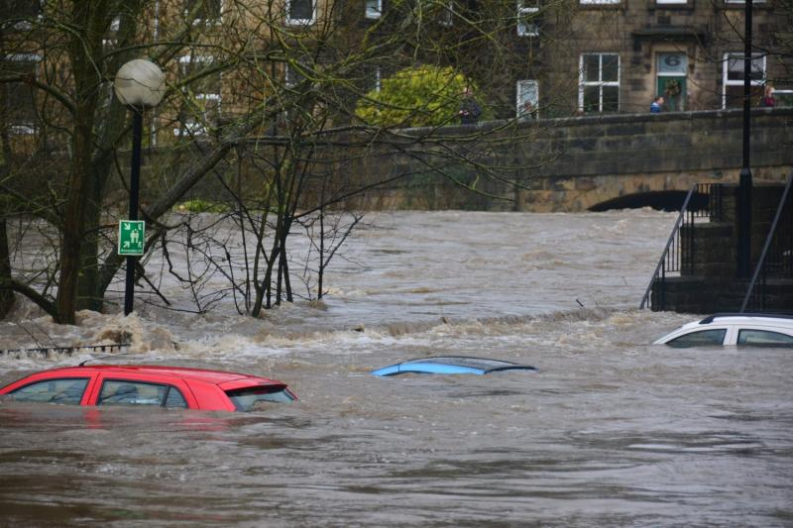
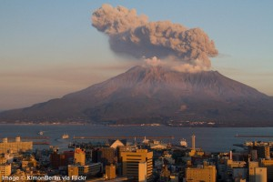
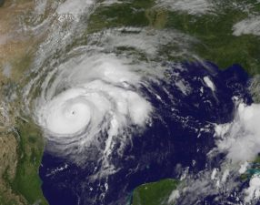
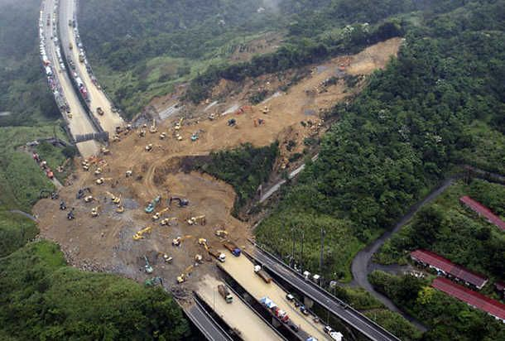
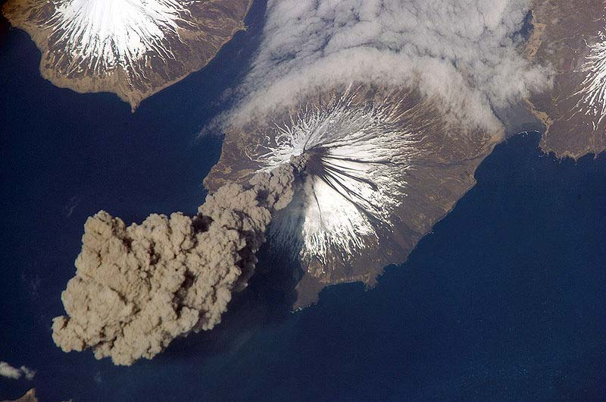
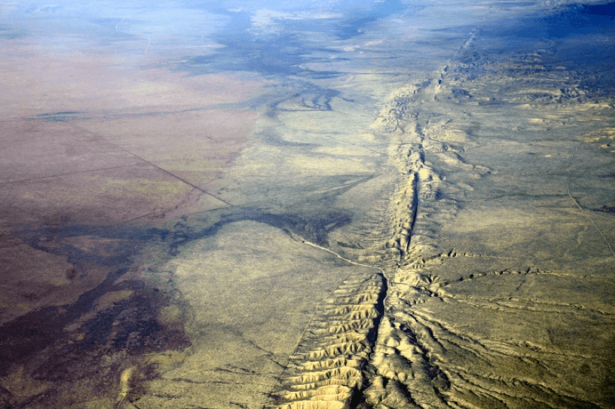
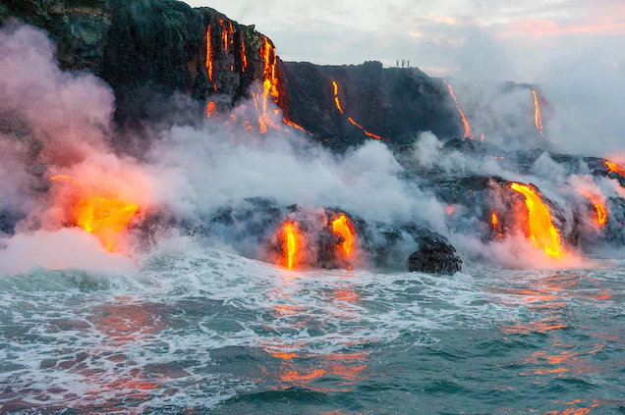
VOCABULARY
Tsunami | is a large ocean wave usually caused by an underwater earthquake or a volcanic explosion
volcano | is a landform (usually a mountain) where molten rock erupts through the surface of the planet.
earthquake | are the shaking, rolling or sudden shock of the earth's surface
Equator | the imaginary line around the earth halfway between the North and South Poles
tremor | a shaking motion of the earth during an earthquake
hurricane | a large rotating storm with high speed winds that forms over warm waters in tropical areas
drought | when there is a lack of precipitation over an extended period of time, usually a season or more, resulting in a water shortage for some activity, group, or environmental sector.
Richter scale | is a scale of numbers used to tell the size of earthquakes
disaster | a sudden event causing much damage or suffering
Forest Fire | are large uncontrolled fires that take place in the forest
Climate | The weather and temperature usually found in an area over a long period of time.
fatal | causing death : mortal fatal injuries.
Flood | s when water covers land that is usually dry, while flash floods are floods that happen very quickly
Evacuation | it means emptying. Most of the time it means that people leave an area or a zone because of an imminent danger or threat.

Slide 7
Vocabulary Ninja believes that words can unlock the doors to a whole new world of understanding. Taking the time to unpick, discuss and understand the meaning of a word is guaranteed to excite and engage your learners! Combining exciting vocabulary with an enthralling topic, it’s main characters and most historic events. Not only focusing on typical noun topic vocabulary, but exploring all other word classes that can bring a topic to life! Words carefully selected to enhance understanding and subsequently children’s reading and writing.
Page 3 – NATURAL DISASTERS TO REMEMBER.
Vocabulary lists, great for writing!
Page 4 - NATURAL DISASTERS NOUNS.
A selection of GPP nouns.
Page 5 - NATURAL DISASTERS VERBS.
Being, doing, having verbs!#DoIt!
Page 6 – NATURAL DISASTERS ADJECTIVES.
Describe away with these beauties!
Page 7 and 15 - SYNONYM ALLEY.
Match the up levelled meaning.
Page 8 - VOCABULARY LABORATORY.
Explore definitions, rehearse and explore.
Page 9 - ENTHRALLING ETYMOLOGY.
Where did it come from? No way! Really?
Page 10 - NINJA CERTIFICATES.
Celebrate success! Ninja style.
Page 11 and 12 - VOCAB TEACHING TECHNIQUES.
How to make this pack have impact!
Page 13 - DISPLAY SLIPS
Print, write on, display, discuss, use!
2
© Vocabulary Ninja Ltd 2021

Slide 8
Tsunami | Earthquake | Hurricane | Avalanche
earthquake | tectonic | air pressure | snow
seismic | aftershock | vortex | snow storm
location | fault | latitude | unstable
tidal wave | amplitude | longitude | underneath
ocean | core | low pressure | layers
hotspot | tremor | high pressure | hurtling
saltwater | velocity | cyclone | risk
current | mantle | typhoon | warning
debris | crust | tropical storm | unpredictable
refuge | energy | tornado | slab
safety | recurrence | equator | still
flooded | magnitude | eye of the storm | frozen
higher ground | epicenter | evaporate
coast | Richter
3
© Vocabulary Ninja Ltd 2021

Slide 9
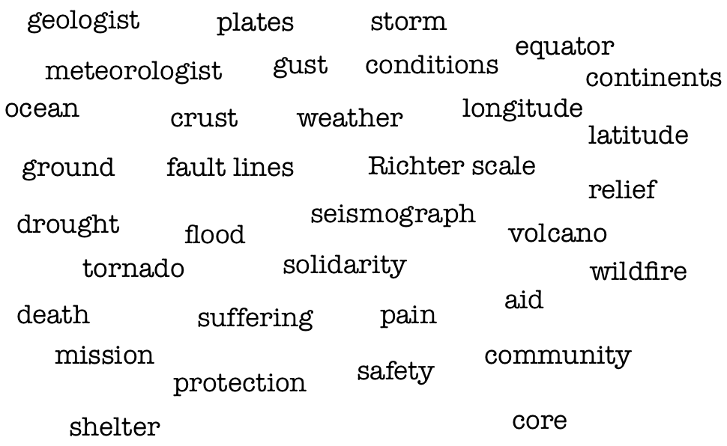
Vocabulary Ninja Grammar Focus: Discuss proper, common, abstract and collective nouns. Which features are needed for proper nouns? Can you identify any below?
4
© Vocabulary Ninja Ltd 2021

Slide 10
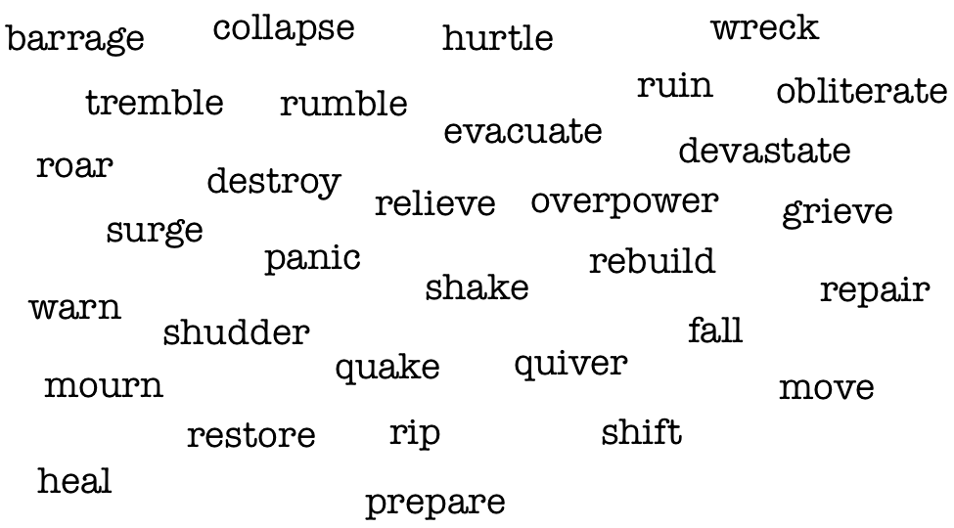
Remember: Depending on how you use these words, they may not act as verbs, but as another word class.
5
© Vocabulary Ninja Ltd 2021

Slide 11
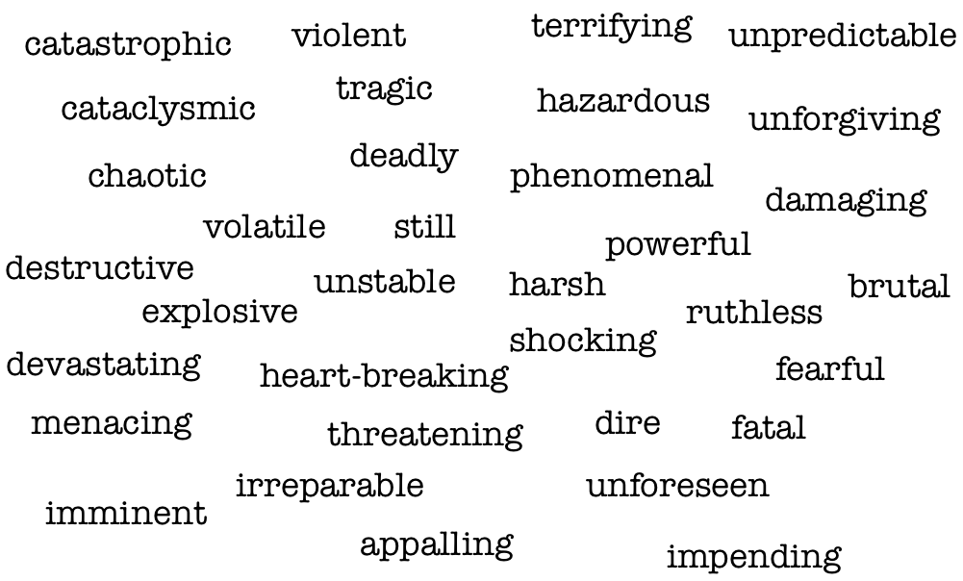
6
© Vocabulary Ninja Ltd 2021

Slide 12
3 sets with space to create
your own.
Draw a line from the words on the left to its synonym on the right.
tremble
annihilate
deadly
fatal
restore
judder
chaos
looming
ruin
renovate
imminent
bedlan
dire
merciless
cruel
volatile
unpredictable
calamitous
7
© Vocabulary Ninja Ltd 2021

Slide 13
Describe / Definition:
Use it in a sentence (add picture too):
Focus Word (write below):
Word Class:
Draw your sentence:
Synonyms: (words with same / similar meaning) | Antonyms: (words with opposite meaning)
Rhymes: (words that sound the same) | Link Words: (Example: football = pitch, team, player)
© Vocabulary Ninja Ltd 2021

Slide 14
The Enthralling Etymology section of Vocabulary Ninja resource packs selects specific words with interesting heritage. Understanding how and why words are what they are today!
tsunami - The word itself is Japanese. ‘Tsu’ means harbour, and ‘nami’ means wave. In Japan, they write tsunami like this: つ- tsu, な- na, み- mi. The origin is unsurprising considering many tsunamis occur near Japan.
disaster- From Middle French ‘désastre’, from Italian ‘disastro’ meaning ‘ill-starred’. It’s first sense relates to astrology, and was used to describe a calamity blamed on an undesirable planet position.
typhoon - There are a few fascinating possible stories for this word. The Ninja’s favourite is from Greek ‘typhon’, meaning ‘whirlwind’. It was personified as a father of the winds, a giant. Interestingly, the Arabic word ‘al-tufan’ appears many times in the Koran to mean ‘a flood or storm’.
9
© Vocabulary Ninja Ltd 2021

Slide 15
Signed
Vocabulary Ninja
Date
This little ninja has shown unrivalled levels of commitment, guile and creativity in their use of vocabulary! Vocabulary used in discussion, writing, reading and everyday life. They are a true vocabulary ninja!

Slide 16
As the Ninja has alluded to earlier, these vocabulary resources need to be supported by direct teaching. Teaching where misconceptions can be addressed and the correct meaning, spelling and varied forms of each word can be discussed, modelled and shared.
HELLO - A logical place to start with the word banks might be to identify which words the children already understand. If you are confident they can use a word with accuracy and control, then great! Let’s investigate the rest.
ADJECTIVES - These words will take your pupil’s descriptive powers to a new level! You must teach them first, be selective and think carefully about what you are teaching and context - discuss why pupils think these words might have been chosen. Pupil’s subject knowledge will need to be secure to effectively use these words.
PEOPLE TO REMEMBER - This section could be used in a variety of ways. Topic bookmarks, writing checklists, topic report writing aids, it’s really up to you. Each list of words have been carefully selected to help pupils create and enhance understanding of each specific area.
NOUNS, VERBS AND ADJECTIVES
These resources could be used in an unlimited amount of ways. One specific way you might choose to unlock a specific word, is to use the Vocabulary Laboratory sheet on page 8. This activity is specifically designed to breakdown a pupil’s understanding of a single word!
NOUNS - This section provides nouns (words that identify people, groups, objects, places, emotions) associated with the topic. Great for reports or any type of writing linked to your topic. Dive deeper and discuss the type of nouns - proper, common, collective and abstract - Remember to ask WHY. Can you discover more?
SYNONYM ALLEY - Synonym Alley has been created to help explore topic vocabulary synonyms (words that share the same meaning). Simply draw a line from the word on the left to the right. The ninja has also provided a blank template on page 15 for you to create your own.
VERBS - This section provides verbs (being, doing and having type words) associated with the topic. Believe it or not, verbs are also amazing for describing, adjectives are great, but verbs rock! These words have been specifically selected to enhance pupil’s description. Remember to discuss verb forms, past, present, perfect, linking to subject verb agreements.
11
© Vocabulary Ninja Ltd 2021

Slide 17
VOCABULARY LABORATORY - The Vocabulary Lab is a word technician’s dream. Like Frankenstein himself, words have many forms, pieces and meanings. The Vocabulary Laboratory is the perfect activity to operate on a word, dissect it and see exactly how it works! Preparation is key here, know what each word has to offer! Choose from the Ninja’s extensive banks or choose your own!
ENTHRALLING ETYMOLOGY - The Ninja loves discovering the history behind a word, some have fabulous stories behind them, whereas others are made up of several parts from Latin, Greek etc. The Ninja has painstakingly selected words that are sure to get your etymological whistle wet and hopefully excite pupils to discover the etymology of more words on their own.
LITTLE NINJA VOCABULARY AWARD - Reward your pupils with this simple Vocabulary Ninja certificate, signed by the Ninja. Remember to tweet your pupils’ success @VocabularyNinja and use our hashtags #VocabularyNinja #Certificate #LittleNinja.
DISPLAY SLIPS - Display slips can be used in a variety of ways such as displaying vocabulary, laminate them and use them in topic work, word banks, the world is your oyster. All branded neatly with Vocabulary Ninja, sure to engage pupils! Print, trim and use!
12
© Vocabulary Ninja Ltd 2021

Slide 18
Draw a line from the words on the left to its synonym on the right.
© Vocabulary Ninja Ltd 2021

