Slide 1
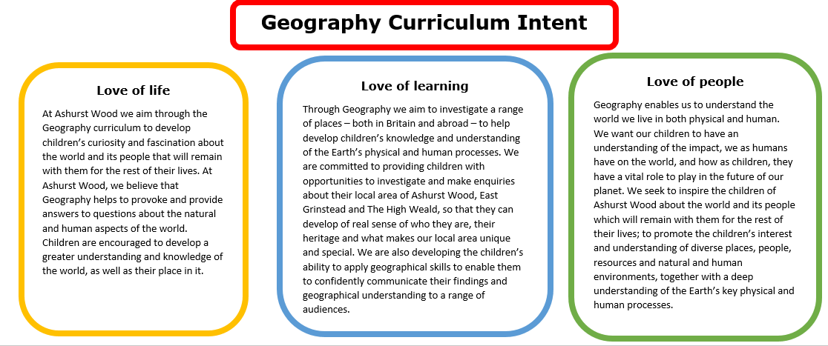
Essential Characteristics
An excellent knowledge of where places are and what they are like.
An excellent understanding of the ways in which places are interdependent and interconnected and how much human and physical environments are interrelated.
An extensive base of geographical knowledge and vocabulary.
Fluency in complex, geographical enquiry and the ability to apply questioning skills and use effective analytical and presentational techniques.
The ability to reach clear conclusions and develop a reasoned argument to explain findings.
Significant levels of originality, imagination or creativity as shown in interpretations and representations of the subject matter.
Highly developed and frequently utilised fieldwork and other geographical skills and techniques.
A passion for and commitment to the subject, and a real sense of curiosity to find out about the world and the people who live there.
The ability to express well-balanced opinions, rooted in very good knowledge and understanding about current and contemporary issues in society and the environment.

Slide 2
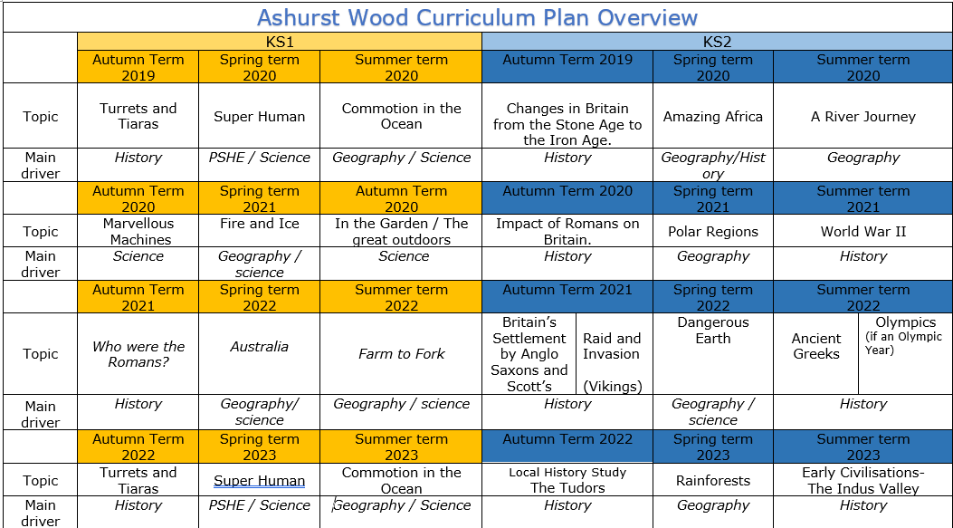
Commotion in the Ocean
Geography / Science
Amazing Africa
Geography / History
A river journey
Geography
Fire & Ice
Geography / Science
Polar Regions
Geography
Australia
Geography / Science
Farm to Fork
Geography / Science
Dangerous Earth
Geography / science
Commotion in the Ocean
Geography / Science
Rainforests
Geography
https://www.arthurbugler.com/uploads/Curriculum/Autumn%202%20Planning/Y6%20Frozen%20Kingdom.pdf

Slide 3


KS 2
GEOGRAPHY TEACHING AND LEARNING AT ASHURST WOOD
Our topic planning is designed so that some topics are Geography led and the key knowledge and skills are captured in the planning and knowledge organisers. Other topics may contain geographical knowledge in addition to the main driver. All children in KS1 will study the same topic and so expectations will be different for a YR Y1 and a Y2 child. For this reason and to ensure that there is no ceiling placed on a child’s learning we have identified outcomes for all children Must (End of Y4) Should (end of Y6) Could a rich and deep understanding.
GEOGRAPHY
At Ashurst Wood
Polar Regions
What will children Know by the end of this topic ?
SHOULD
• Identify and describe how the physical features affect the human activity within a location.
• Use a range of geographical resources to give detailed descriptions and opinions of the characteristic features of a polar region.
• identify how, key topographical features and land-use patterns have changed over time.
• Identify and describe the geographical significance the Arctic and Antarctic Circle, and time zones (including day and night).
• Understand some of the reasons for geographical similarities and differences between the polar regions.
• Describe how locations around the world are changing and explain some of the reasons for change.
• Now how countries and geographical regions are interconnected and interdependent.
• human geography,- understand the significance of the Artic treaty in protecting the regions natural resources.
MUST
Name and locate the Equator, Northern Hemisphere, Southern Hemisphere, the Tropics of Cancer and Capricorn, Arctic and Antarctic Circle and date time zones. Describe some of the characteristics of these geographical areas.
Describe geographical similarities and differences between the two polar regions.
SKILLS
Create maps of locations identifying patterns (such as: land use, climate zones, population densities, height of land
Describe geographical diversity across the world.
SKILLS
Ask and answer geographical questions about the physical and human characteristics of the polar regions
Explain own views about the polar region's locations, giving reasons.
Use maps, atlases, globes and digital/computer mapping to describe features of the polar regions.
Use a range of resources to identify the key physical and human features of a location.
Enrichment
Forest Schools
Visit by an explorer
COULD
Present a case to the class in any form for the reduction of Global warming and the impact on the Polar regions.

Slide 4

Year / Class 2023- 2024 KS2 |  | Topic Title: Polar Regions
Pre learning Links. In KS1 prior knowledge will depend on which year group the child is in. Fire and ice topic – North and South Pole / Ashurst Wood weather |  | Stunning Start: Make a giant iceberg! Freeze water in a large balloon or clear plastic bag overnight. Once frozen, remove and place in a large container of water. Observe how the iceberg sits in the water and how it changes over time Fantastic Finish: Explorer visit
The Big Question: Why are the Polar regions important? |  | Creative Arts and Forest School Links DT – design a sledge / Make a glove
Small Question | Where in the world are the polar regions?
Small Question | What features can you find from a birds eye view? | Literacy links Shackleton's Journey https://www.booksfortopics.com/frozen - list of good books for the topic | Vocabulary landscape Ocean Polar Weather Longitude Environments Sea level Artic Antarctic Time Zone Artic Circle Antarctic Circle Permafrost climate/ weather climate zones grid reference Landscape population biomes conservation pollution | settlement community landscape ocean North East South West polar Longitude vegetation diagram South East weather equator Latitude native/ indigenous hemisphere migrate sustainability distance Scale Arctic renewable | compass North West climate zone distance scale grid reference satellite settlement inland natural resources polar trade continent sub-continent development tourist symbols survey Northern hemisphere Southern hemisphere Tropic of Capricorn Tropic of Cancer Equator
Small Question | What is a time zone?
Small Question | How is the climate changing in the Polar regions? | Literacy links Shackleton's Journey https://www.booksfortopics.com/frozen - list of good books for the topic | Vocabulary landscape Ocean Polar Weather Longitude Environments Sea level Artic Antarctic Time Zone Artic Circle Antarctic Circle
Small Question | How are the Inuit’s lives different from yours?
Small Question | How are the two poles different?
Small Question | How is the night sky different?
Small Question | Why are icebergs important?
Small Question | Why is Antarctica considered a desert?
Useful Links https://3dgeography.wixsite.com/maps/earthquake-maps https://willerbycarrlaneprimary.org.uk/wp-content/uploads/2020/01/Geography-Year-6-The-Polar-Regions.pdf knowledge organiser Arctic-and-Antarctic-with-David-Attenborough.pdf https://www.teachitgeography.co.uk/searchresults/environment-atmosphere-and-climate/polar-regions-and-mountain-environments/tags/2463

Slide 5
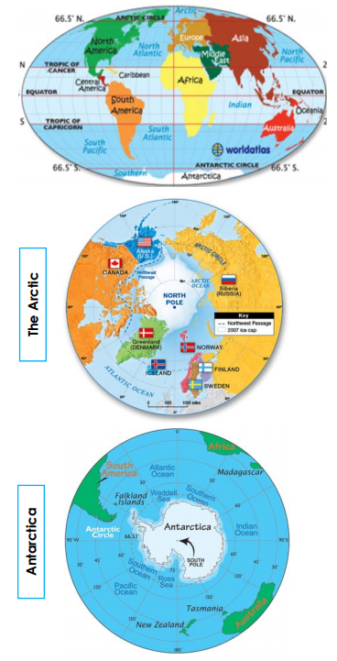
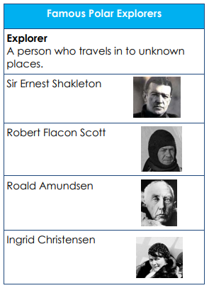
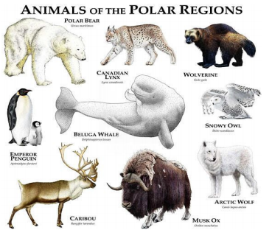
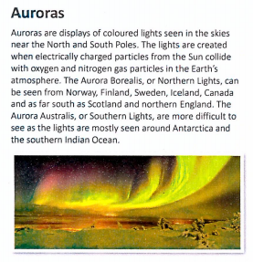
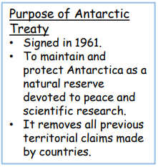
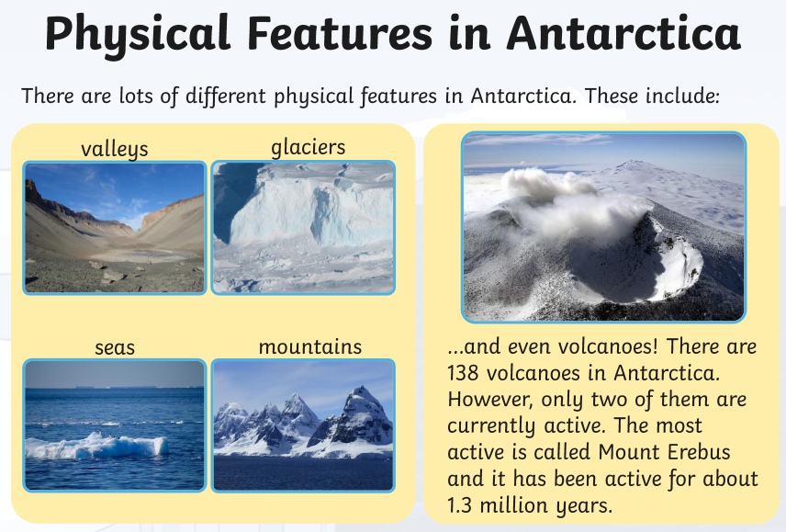
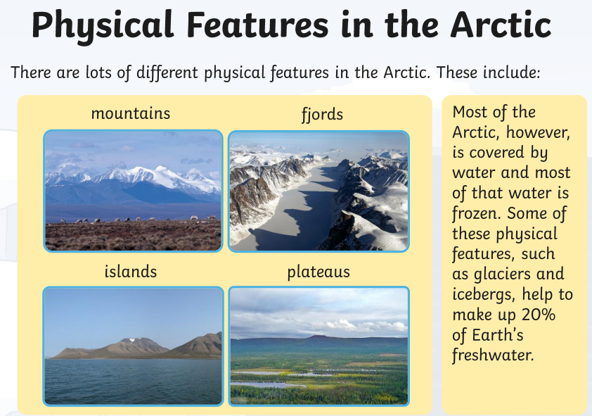
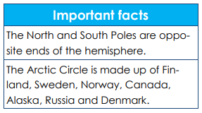

Slide 6
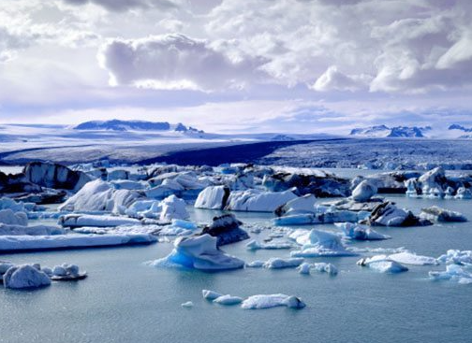
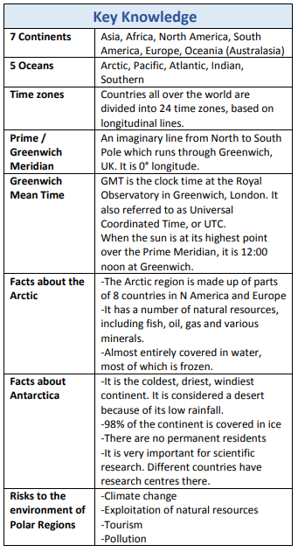
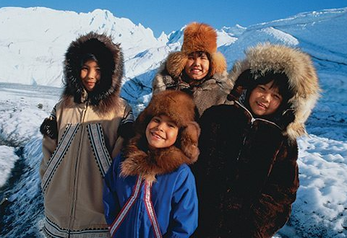
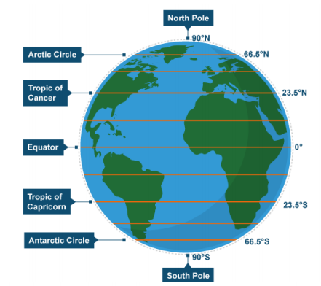
VOCABULARY
Antarctic Circle | imaginary line/circle about 66.5° south of the Equator
Antarctic Peninsula | a large peninsula of Antarctica that extends some 1200 miles north toward South America; separates the Weddell Sea from the South Pacific
Arctic Circle | imaginary line/circle about 66.5° north of the Equator
Biodiversity | The variety of life in the world or a particular habitat
Ecosystem | A particular environment, large or small, with characteristic physical conditions and types of organisms living there
Glacier | a slowly moving mass or river of ice formed by the accumulation and compaction of snow on mountains or near the poles.
Inuit | a member of an indigenous people of northern Canada and parts of Greenland and Alaska.
Mineral extraction | The removal of solid mineral resources from the earth. These resources include ores, which contain commercially valuable amounts of metals, such as iron and aluminium; precious stones, such as diamonds; building stones, such as granite; and solid fuels, such as coal and oil shale.
North Pole | point where the northern end of the Earth’s axis of rotation meets the Earth’s surface
Permafrost | Permanently frozen ground, found in polar and tundra regions
Polar | The regions of Earth surrounding the North and South Poles
Sustainable development | development that meets the needs of the present without limiting the ability of future generations to meet their own needs.
Tundra | The flat, treeless Arctic regions of Europe, Asia and North America, where the ground is permanently frozen.
Vegetation | plant life or total plant cover (as of an area)

Slide 7
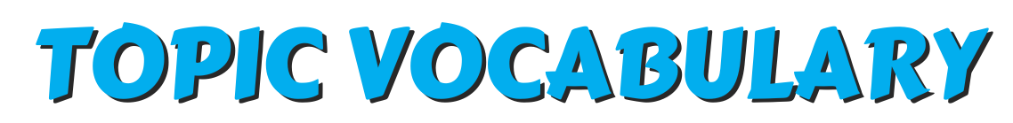

Vocabulary Ninja believes that words can unlock the doors to a whole new world of understanding. Taking the time to unpick, discuss and understand the meaning of a word is guaranteed to excite and engage your learners! Combining exciting vocabulary with an enthralling topic, it’s main characters and most historic events. Not only focusing on typical noun topic vocabulary, but exploring all other word classes that can bring a topic to life! Words carefully selected to enhance understanding and subsequently children’s reading and writing.
Page 3 – ARCTIC & ANTARCTIC TO REMEMBER.
Vocabulary lists, great for writing!
Page 4 -ARCTIC & ANTARCTIC NOUNS.
A selection of GPP nouns.
Page 5 - ARCTIC & ANTARCTIC VERBS.
Being, doing, having verbs!#DoIt!
Page 6 – BUDDHISM ADJECTIVES.
Describe away with these beauties!
Page 7 and 15 - SYNONYM ALLEY.
Match the up levelled meaning.
Page 8 - VOCABULARY LABORATORY.
Explore definitions, rehearse and explore.
Page 9 - ENTHRALLING ETYMOLOGY.
Where did it come from? No way! Really?
Page 10 - NINJA CERTIFICATES.
Celebrate success! Ninja style.
Page 11 and 12 - VOCAB TEACHING TECHNIQUES.
How to make this pack have impact!
Page 13 - DISPLAY SLIPS
Print, write on, display, discuss, use!
2
© Vocabulary Ninja Ltd 2021

Slide 8
Arctic | Antarctic | climate | topic words
Arctic fox | caribou | blizzard | chill
glacier | global warming | bitter | sledge
Arctic hare | husky | wintery | barren
skis | iceberg | brisk | numb
igloo | inuit | snowflake | bleak
penguin | puffin | ice | shiver
polar | reindeer | snow | explorer
thermometer | thaw | severe | temperature
Polar bear | treacherous | polar | migrate
seal | South Pol | frostbite | isolate
walrus | Antarctica | freezing | frosty
3
© Vocabulary Ninja Ltd 2021

Slide 9

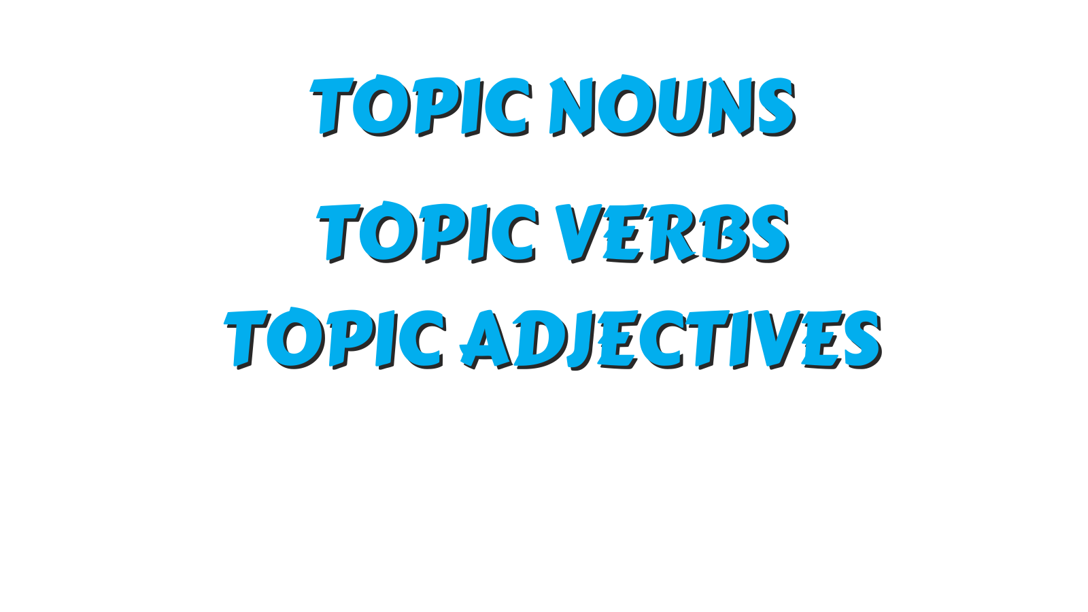
Vocabulary Ninja Grammar Focus: Discuss proper, common, abstract and collective nouns. Which features are needed for proper nouns? Can you identify any below?
glacier | Arctic Circle | igloo | frostbite | seal
snow | Antarctica | snowflake | reindeer | Arctic fox
polar bear | Siberia | conservationist | snowy owl | explorer
caribou | South Pole | winter | iceberg | blizzard
Eskimo | puffin | Arctic | thermometer | husky
sledge | global warming | skis | climate | penguin
Arctic hare | ocean | ice | walrus | Inuit
4
© Vocabulary Ninja Ltd 2021

Slide 10
Remember: Depending on how you use these words, they may not act as verbs, but as another word class.
cover | hibernate | circling | haze | blast
migrate | floating | trek | nesting | freeze
inhabiting | sledge | frozen | thawing | discover
circumnavigate | drift | contrast | tour | isolate
surveying | warming | sledging | whaling | rage
melting | shrink | voyaging | howling | visit
5
© Vocabulary Ninja Ltd 2021

Slide 11
biting | vast | white | frozen | freezing
sub | icy | cool | Siberian | polar
fresh | brisk | frosty | blustery | distant
arctic | remote | uninhabited | sharp | severe
treacherous | bleak | chilly | snappy | marine
alpine | glacial | raw | wintry | cold
6
© Vocabulary Ninja Ltd 2021

Slide 12

3 sets with space to create
your own.
Draw a line from the words on the left to its synonym on the right.
caribou
thawing
ice
dangerous
blizzard
explorer
melting
deer
glacier
treacherous
snowstorm
discover
biting
frostbite
husky
serve
remote
hibernate
7
© Vocabulary Ninja Ltd 2021

Slide 13


Describe / Definition:
Use it in a sentence (add picture too):
Focus Word (write below):
Word Class:
Draw your sentence:
Synonyms: (words with same / similar meaning) | Antonyms: (words with opposite meaning)
Rhymes: (words that sound the same) | Link Words: (Example: football = pitch, team, player)
© Vocabulary Ninja Ltd 2021

Slide 14
The Enthralling Etymology section of Vocabulary Ninja resource packs selects specific words with interesting heritage. Understanding how and why words are what they are today!
blizzard– “strong, sustained storm of wind and cold, dry driving snow .”
climate – From Old French ‘climat,’ meaning “region, part of the earth.”
glacier – From Latin ‘glacies’ meaning “ice.”
9
© Vocabulary Ninja Ltd 2021

Slide 15

Signed
Vocabulary Ninja
Date
This little ninja has shown unrivalled levels of commitment, guile and creativity in their use of vocabulary! Vocabulary used in discussion, writing, reading and everyday life. They are a true vocabulary ninja!

Slide 16
As the Ninja has alluded to earlier, these vocabulary resources need to be supported by direct teaching. Teaching where misconceptions can be addressed and the correct meaning, spelling and varied forms of each word can be discussed, modelled and shared.
HELLO - A logical place to start with the word banks might be to identify which words the children already understand. If you are confident they can use a word with accuracy and control, then great! Let’s investigate the rest.
ADJECTIVES - These words will take your pupil’s descriptive powers to a new level! You must teach them first, be selective and think carefully about what you are teaching and context - discuss why pupils think these words might have been chosen. Pupil’s subject knowledge will need to be secure to effectively use these words.
PEOPLE TO REMEMBER - This section could be used in a variety of ways. Topic bookmarks, writing checklists, topic report writing aids, it’s really up to you. Each list of words have been carefully selected to help pupils create and enhance understanding of each specific area.
NOUNS, VERBS AND ADJECTIVES
These resources could be used in an unlimited amount of ways. One specific way you might choose to unlock a specific word, is to use the Vocabulary Laboratory sheet on page 8. This activity is specifically designed to breakdown a pupil’s understanding of a single word!
NOUNS - This section provides nouns (words that identify people, groups, objects, places, emotions) associated with the topic. Great for reports or any type of writing linked to your topic. Dive deeper and discuss the type of nouns - proper, common, collective and abstract - Remember to ask WHY. Can you discover more?
SYNONYM ALLEY - Synonym Alley has been created to help explore topic vocabulary synonyms (words that share the same meaning). Simply draw a line from the word on the left to the right. The ninja has also provided a blank template on page 15 for you to create your own.
VERBS - This section provides verbs (being, doing and having type words) associated with the topic. Believe it or not, verbs are also amazing for describing, adjectives are great, but verbs rock! These words have been specifically selected to enhance pupil’s description. Remember to discuss verb forms, past, present, perfect, linking to subject verb agreements.
11
© Vocabulary Ninja Ltd 2021

Slide 17
VOCABULARY LABORATORY - The Vocabulary Lab is a word technician’s dream. Like Frankenstein himself, words have many forms, pieces and meanings. The Vocabulary Laboratory is the perfect activity to operate on a word, dissect it and see exactly how it works! Preparation is key here, know what each word has to offer! Choose from the Ninja’s extensive banks or choose your own!
ENTHRALLING ETYMOLOGY - The Ninja loves discovering the history behind a word, some have fabulous stories behind them, whereas others are made up of several parts from Latin, Greek etc. The Ninja has painstakingly selected words that are sure to get your etymological whistle wet and hopefully excite pupils to discover the etymology of more words on their own.
LITTLE NINJA VOCABULARY AWARD - Reward your pupils with this simple Vocabulary Ninja certificate, signed by the Ninja. Remember to tweet your pupils’ success @VocabularyNinja and use our hashtags #VocabularyNinja #Certificate #LittleNinja.
DISPLAY SLIPS - Display slips can be used in a variety of ways such as displaying vocabulary, laminate them and use them in topic work, word banks, the world is your oyster. All branded neatly with Vocabulary Ninja, sure to engage pupils! Print, trim and use!
12
© Vocabulary Ninja Ltd 2021

Slide 18
Draw a line from the words on the left to its synonym on the right.
© Vocabulary Ninja Ltd 2021

