Slide 1
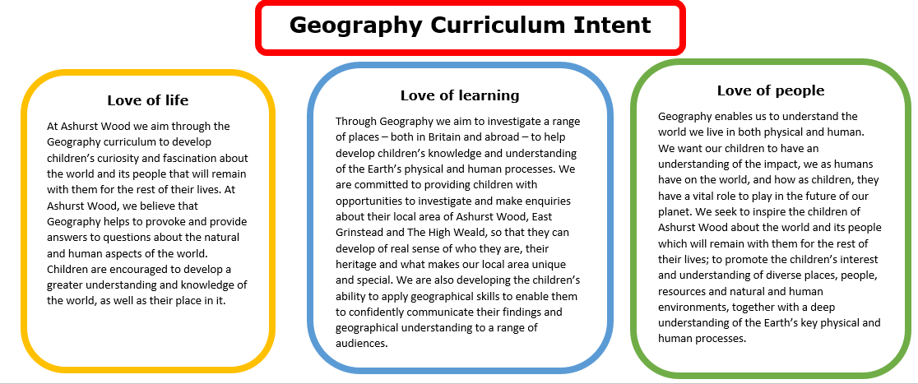
Essential Characteristics
An excellent knowledge of where places are and what they are like.
An excellent understanding of the ways in which places are interdependent and interconnected and how much human and physical environments are interrelated.
An extensive base of geographical knowledge and vocabulary.
Fluency in complex, geographical enquiry and the ability to apply questioning skills and use effective analytical and presentational techniques.
The ability to reach clear conclusions and develop a reasoned argument to explain findings.
Significant levels of originality, imagination or creativity as shown in interpretations and representations of the subject matter.
Highly developed and frequently utilised fieldwork and other geographical skills and techniques.
A passion for and commitment to the subject, and a real sense of curiosity to find out about the world and the people who live there.
The ability to express well-balanced opinions, rooted in very good knowledge and understanding about current and contemporary issues in society and the environment.

Slide 2
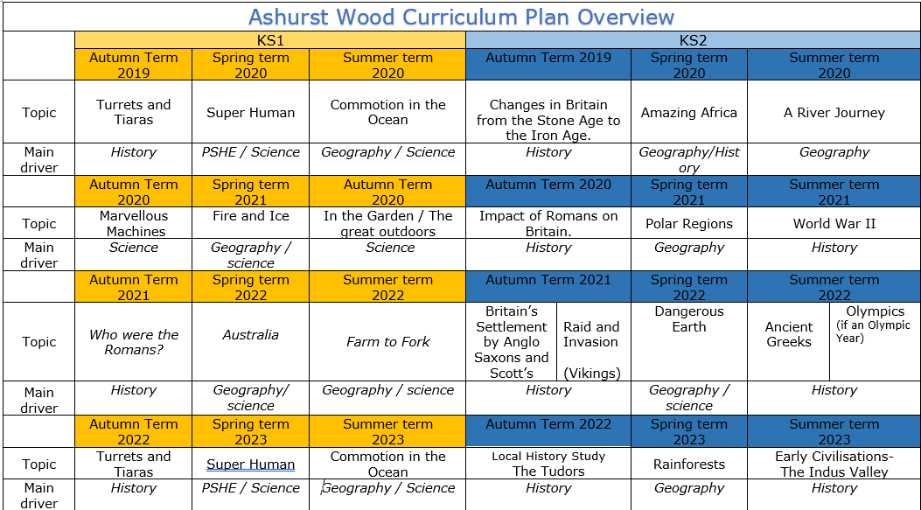
Commotion in the Ocean
Geography / Science
Amazing Africa
Geography / History
A river journey
Geography
Fire & Ice
Geography / Science
Polar Regions
Geography
Australia
Geography / Science
Farm to Fork
Geography / Science
Dangerous Earth
Geography / science
Commotion in the Ocean
Geography / Science
Rainforests
Geography
https://www.arthurbugler.com/uploads/Curriculum/Autumn%202%20Planning/Y6%20Frozen%20Kingdom.pdf

Slide 3
KS 2
GEOGRAPHY TEACHING AND LEARNING AT ASHURST WOOD
Our topic planning is designed so that some topics are Geography led and the key knowledge and skills are captured in the planning and knowledge organisers. Other topics may contain geographical knowledge in addition to the main driver. All children in KS1 will study the same topic and so expectations will be different for a YR Y1 and a Y2 child. For this reason and to ensure that there is no ceiling placed on a child’s learning we have identified outcomes for all children Must (End of Y4) Should (end of Y6) Could a rich and deep understanding.
GEOGRAPHY
At Ashurst Wood
Rain Forests
What will children Know by the end of this topic ?
SHOULD
Identify the impact the humans have on the rainforest and the impact that the Rain forest has on humans.
Identify and name topographical features and land use patterns – and how these have changed over time.
Name and locate the countries of North and South America and identify their main physical and human characteristics.
Describe how locations around the world are changing and explain some of the reasons for change.
locate the world’s countries, using maps to focus on Europe (including the location of Russia) and North and South America, concentrating on their environmental regions, key physical and human characteristics, countries, and major cities
identify the position and significance of latitude, longitude, Equator, Northern Hemisphere, Southern Hemisphere, the Tropics of Cancer and Capricorn, Arctic and Antarctic Circle, the Prime/Greenwich Meridian and time zones (including day and night)
understand geographical similarities and differences through the study of human and physical geography of a region of the United Kingdom, a region South America
describe and understand key aspects of:
physical geography, including: climate zones, biomes and vegetation belts, rivers, mountains,
human geography, including: types of settlement and land use, economic activity including trade links, and the distribution of natural resources including energy, food, minerals and water
MUST
Use maps, atlases, globes and digital/computer mapping to describe features of rain forests.
Use a range of resources to identify the key physical and human features of a rainforest.
Name and locate the Equator, Northern Hemisphere, Southern Hemisphere, the Tropics of Cancer and Capricorn, Arctic and Antarctic Circle and date time zones. Describe some of the characteristics of these geographical areas.
Use maps, atlases and globes to locate the rain forests of the world and their relationship to the equator.
Explain how land use is impacting the rain forests.
Enrichment
Forest Schools
Sponsor an area of the rain forest.
SKILLS
Ask and answer geographical questions about the physical and human characteristics of the rain forest.
Explain own views about the Rain Forest Locations , giving reasons.
Explain their views about the rainforest and give reasons why (Deforestation)
Explain how land use is impacting the rain forests.
SKILLS
Collect and analyse statistics and other information to draw conclusions about the rain forests.
Use a range of geographical resources to give and form opinions of the characteristics of a Rainforest.
Explain why rainforests are found near the equator
COULD
Collect and analyse statistics and other information to draw conclusions about the rain forests. From this debate for or against deforestation.

Slide 4
Year / Class 2023- 2024 KS2 |  | Topic Title: Rumble in the Jungle
Pre learning Links. In KS1 prior knowledge will depend on which year group the child is in. Globe and Atlas work Australia – Rainforests |  | Stunning Start: Turn the classroom into a Rainforest Fantastic Finish: Environmental debate with Parents
The Big Question: Why are rainforests important? |  | Creative Arts and Forest School Links P4C Art sketching animal species Collage Forest Schools – Comparison of plants Music – sounds of rainforest
Small Question | Where is the Amazon rainforest?
Small Question | What is special about rainforests?
Small Question | What is Deforestation? | Literacy links Topic book list https://www.booksfortopics.com/rainforests | Vocabulary Tropical Natural resources Climate zones Biomes Conservation Canopy (trees) Equator Land use Latitude Longitude Deforestation Climate intensive farming distance scale satellite distribution import export Sustainable environment | settlement community landscape relief map political map North East South West South East North West valley vegetation transport [carry] diagram weather equator Latitude mountain industry compass North West climate zone tropical | warm humid evaporation precipitation condensation hemisphere productivity natural resources hemisphere tropical Trade climate/ weather climate zones vegetation belts grid reference landscape evaporation terrain features industry Continent settlement patterns | migrate distance scale land use Pollution naturalised indigenous immigrant latitude longitude Greenwich/Prime Meridian Time zone Northern hemisphere Southern hemisphere Tropic of Capricorn Tropic of Cancer Equator sub-continent development
Small Question | Where are the rainforests located?
Small Question | Do we need rainforests?
Small Question | Why are people attracted to settle on the Amazon riverbanks?
Small Question | How does the Rainforest habitat compare with UK forests? (endangered species)
Useful Links https://www.actionaid.org.uk/school-resources/resource/ks2-rainforest-in-trouble https://www.actionaid.org.uk/school-resources/resource/ks2-amazon-rainforest-brazil-package https://www.hamilton-trust.org.uk/topics/lower-key-stage-2-topics/rainforests/ https://ypte.org.uk/lesson-plans/rainforests

Slide 5
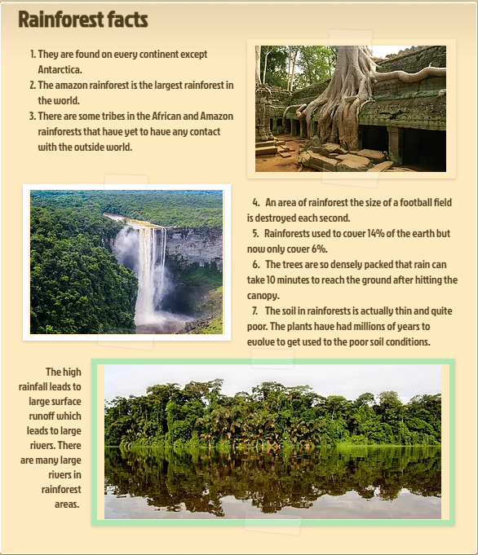
VOCABULARY
Biodiversity | many different kinds of life
Canopy | a thick, overhead layer of the forest made by the tops of tall trees and vines
Conservation | careful preservation and protection of something
Equator | the imaginary line around the earth halfway between the North and South Poles
Understory | the layer of the forest below the canopy where small trees, shrubs, and herbs grow
Forest floor | the bottom layer of the rainforest
Parasite | plant or animal that grows and feeds on another
Endangered species | an animal or plant that is threatened with extinction deforestation- the process of stripping an area of trees and other vegetation
Camouflage | The way that an animal hides itself by changing its body shape or colour to blend into its surroundings.
Carbon dioxide | A gas (also called CO2) that is released when fuel burns and when animals breath. Plants absorb it.
Climate | The weather and temperature usually found in an area over a long period of time.
Cloud Forest | a forest that gets all of its moisture from mist rather than rain.
Colony | A group of the same animals that live and work closely together
Crown | The very top of a tree
Deforestation | The destruction of trees over large areas.
Liana | Rope –like plants that grow up trees
Tropical | Around the middle of the world in the region called the tropics, where it is warm all year
Monsoon | Wind that changes direction with the seasons
Drip tips | Pointed tips on leaves that help water to run off them.

Slide 6
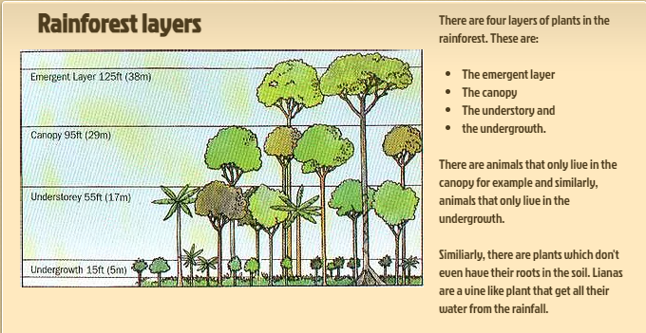
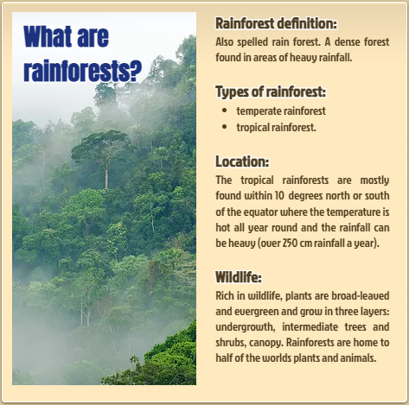
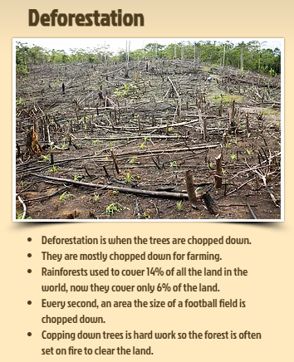
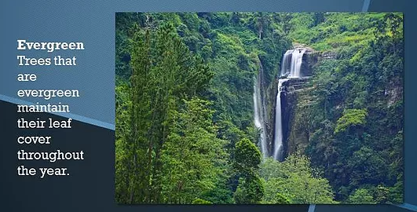
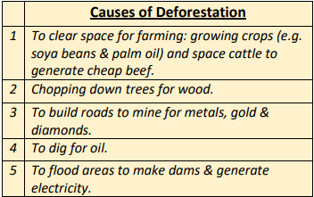

Slide 7
Vocabulary Ninja believes that words can unlock the doors to a whole new world of understanding. Taking the time to unpick, discuss and understand the meaning of a word is guaranteed to excite and engage your learners! Combining exciting vocabulary with an enthralling topic, it’s main characters and most historic events. Not only focusing on typical noun topic vocabulary, but exploring all other word classes that can bring a topic to life! Words carefully selected to enhance understanding and subsequently children’s reading and writing.
Page 3 – RAINFOREST TO REMEMBER.
Vocabulary lists, great for writing!
Page 4 - RAINFOREST NOUNS.
A selection of GPP nouns.
Page 5 - RAINFOREST VERBS.
Being, doing, having verbs!#DoIt!
Page 6 – RAINFOREST ADJECTIVES.
Describe away with these beauties!
Page 7 and 15 - SYNONYM ALLEY.
Match the up levelled meaning.
Page 8 - VOCABULARY LABORATORY.
Explore definitions, rehearse and explore.
Page 9 - ENTHRALLING ETYMOLOGY.
Where did it come from? No way! Really?
Page 10 - NINJA CERTIFICATES.
Celebrate success! Ninja style.
Page 11 and 12 - VOCAB TEACHING TECHNIQUES.
How to make this pack have impact!
Page 13 - DISPLAY SLIPS
Print, write on, display, discuss, use!
2
© Vocabulary Ninja Ltd 2021

Slide 8
Orangutan | Boa Constrictor | Red-Eyed Tree Frog | Great Hornbill
ape | snake | amphibian | impressive
leaves | reptile | frog | tribal
insects | large | vibrant | eyelashes
mammal | larger female | sticky pads | casque
bulky | camouflage | foliage | serrated beak
reckless | swimmer | insectivore | near threatened
opposable thumb | nocturnal | insects | heavy wings
solitary | solitary | rivers | hilly forest
forager | shed cycle | ponds | water from fruit
nesting | birds and rodent | clutch | mammals
intelligent | ovoviviparous | tadpoles | reptiles
creative | captivity | vertebrate | feathers
conservation | burrows | camouflage
threats
3
© Vocabulary Ninja Ltd 2021

Slide 9
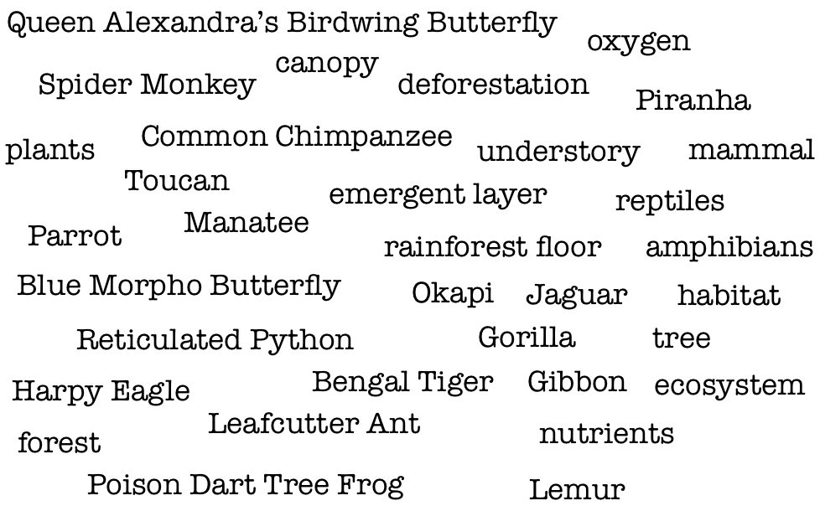
Vocabulary Ninja Grammar Focus: Discuss proper, common, abstract and collective nouns. Which features are needed for proper nouns? Can you identify any below?
4
© Vocabulary Ninja Ltd 2021

Slide 10
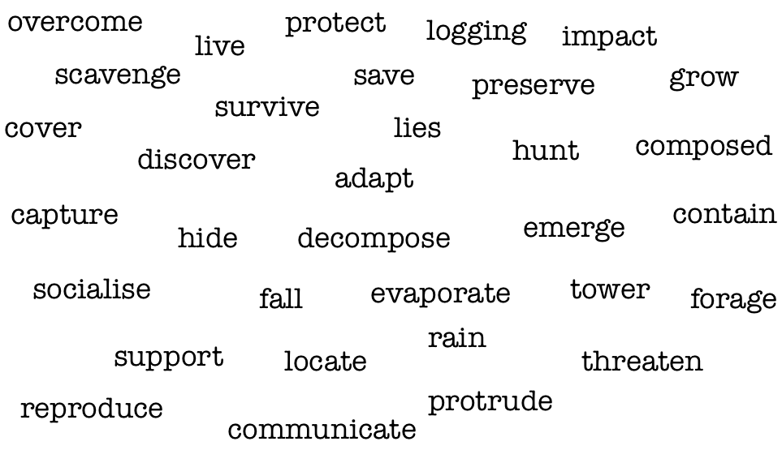
Remember: Depending on how you use these words, they may not act as verbs, but as another word class.
5
© Vocabulary Ninja Ltd 2021

Slide 11
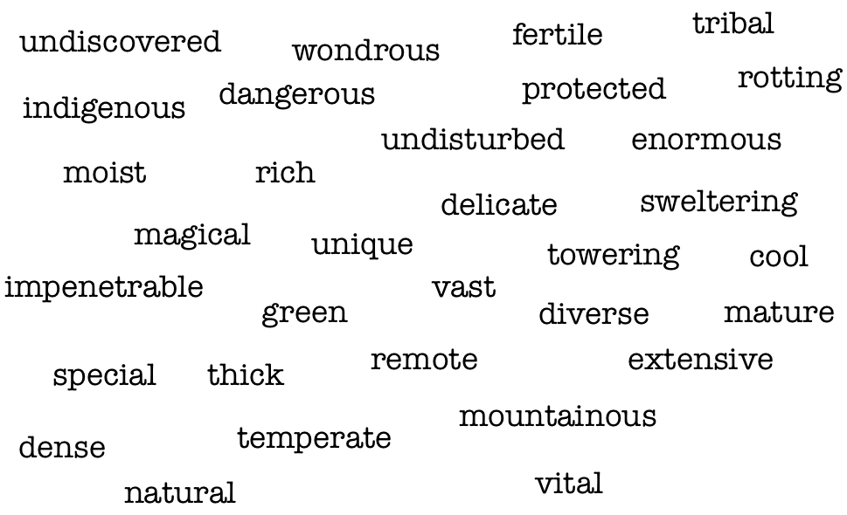
6
© Vocabulary Ninja Ltd 2021

Slide 12
3 sets with space to create
your own.
Draw a line from the words on the left to its synonym on the right.
thick
stalk
save
reside
hunt
substantial
live
rescue
hide
conceal
moist
humid
fall
plummet
vast
immeasurable
grow
flourish
7
© Vocabulary Ninja Ltd 2021

Slide 13
Describe / Definition:
Use it in a sentence (add picture too):
Focus Word (write below):
Word Class:
Draw your sentence:
Synonyms: (words with same / similar meaning) | Antonyms: (words with opposite meaning)
Rhymes: (words that sound the same) | Link Words: (Example: football = pitch, team, player)
© Vocabulary Ninja Ltd 2021

Slide 14
The Enthralling Etymology section of Vocabulary Ninja resource packs selects specific words with interesting heritage. Understanding how and why words are what they are today!
Red-Eyed Tree Frog -Agalychnis callidryas (red-eyed tree frog) is native to rainforests where it ranges from Mexico, through Central America, to Colombia. It is sometimes kept in captivity. The specific name of the red-eyed tree frog, A. callidryas, comes from Greek words “kalos” (beautiful) and “dryas” (a tree or wood nymph). The Greeks certainly knew beautiful when they saw it!
orangutan -1690s, from Dutch orang utan, literally "man of the woods," from orang "man" + utan, hutan "forest, wild." It is possible that the word originally was used by town-dwellers on Java to describe savage forest tribes of the Sunda Islands and that Europeans misunderstood it to mean the ape.
lemur - The lemur received its name from Latin. In Roman mythology, the plural ‘lemures’ was used to describe the spirits of the departed. Their name is a reference to their spectre-like face.
ecosystem - Etymologically the word ecosystem derives from the Greek oikos, meaning "home," and systema, or "system."
9
© Vocabulary Ninja Ltd 2021

Slide 15
Signed
Vocabulary Ninja
Date
This little ninja has shown unrivalled levels of commitment, guile and creativity in their use of vocabulary! Vocabulary used in discussion, writing, reading and everyday life. They are a true vocabulary ninja!

Slide 16
As the Ninja has alluded to earlier, these vocabulary resources need to be supported by direct teaching. Teaching where misconceptions can be addressed and the correct meaning, spelling and varied forms of each word can be discussed, modelled and shared.
HELLO - A logical place to start with the word banks might be to identify which words the children already understand. If you are confident they can use a word with accuracy and control, then great! Let’s investigate the rest.
ADJECTIVES - These words will take your pupil’s descriptive powers to a new level! You must teach them first, be selective and think carefully about what you are teaching and context - discuss why pupils think these words might have been chosen. Pupil’s subject knowledge will need to be secure to effectively use these words.
PEOPLE TO REMEMBER - This section could be used in a variety of ways. Topic bookmarks, writing checklists, topic report writing aids, it’s really up to you. Each list of words have been carefully selected to help pupils create and enhance understanding of each specific area.
NOUNS, VERBS AND ADJECTIVES
These resources could be used in an unlimited amount of ways. One specific way you might choose to unlock a specific word, is to use the Vocabulary Laboratory sheet on page 8. This activity is specifically designed to breakdown a pupil’s understanding of a single word!
NOUNS - This section provides nouns (words that identify people, groups, objects, places, emotions) associated with the topic. Great for reports or any type of writing linked to your topic. Dive deeper and discuss the type of nouns - proper, common, collective and abstract - Remember to ask WHY. Can you discover more?
SYNONYM ALLEY - Synonym Alley has been created to help explore topic vocabulary synonyms (words that share the same meaning). Simply draw a line from the word on the left to the right. The ninja has also provided a blank template on page 15 for you to create your own.
VERBS - This section provides verbs (being, doing and having type words) associated with the topic. Believe it or not, verbs are also amazing for describing, adjectives are great, but verbs rock! These words have been specifically selected to enhance pupil’s description. Remember to discuss verb forms, past, present, perfect, linking to subject verb agreements.
11
© Vocabulary Ninja Ltd 2021

Slide 17
VOCABULARY LABORATORY - The Vocabulary Lab is a word technician’s dream. Like Frankenstein himself, words have many forms, pieces and meanings. The Vocabulary Laboratory is the perfect activity to operate on a word, dissect it and see exactly how it works! Preparation is key here, know what each word has to offer! Choose from the Ninja’s extensive banks or choose your own!
ENTHRALLING ETYMOLOGY - The Ninja loves discovering the history behind a word, some have fabulous stories behind them, whereas others are made up of several parts from Latin, Greek etc. The Ninja has painstakingly selected words that are sure to get your etymological whistle wet and hopefully excite pupils to discover the etymology of more words on their own.
LITTLE NINJA VOCABULARY AWARD - Reward your pupils with this simple Vocabulary Ninja certificate, signed by the Ninja. Remember to tweet your pupils’ success @VocabularyNinja and use our hashtags #VocabularyNinja #Certificate #LittleNinja.
DISPLAY SLIPS - Display slips can be used in a variety of ways such as displaying vocabulary, laminate them and use them in topic work, word banks, the world is your oyster. All branded neatly with Vocabulary Ninja, sure to engage pupils! Print, trim and use!
12
© Vocabulary Ninja Ltd 2021

Slide 18
© Vocabulary Ninja Ltd 2021

Slide 19
Draw a line from the words on the left to its synonym on the right.
© Vocabulary Ninja Ltd 2021

