Slide 1
Essential Characteristics
• An excellent knowledge and understanding of people, events, and contexts from a range of historical periods and of historical concepts and processes.
• The ability to think critically about history and communicate ideas very confidently in styles appropriate to a range of audiences.
• The ability to consistently support, evaluate and challenge their own and others’ views using detailed, appropriate and accurate historical evidence derived from a
range of sources.
• The ability to think, reflect, debate, discuss and evaluate the past, formulating and refining questions and lines of enquiry.
• A passion for history and an enthusiastic engagement in learning, which develops their sense of curiosity about the past and their understanding of how and why
people interpret the past in different ways.
• A respect for historical evidence and the ability to make robust and critical use of it to support their explanations and judgments.
• A desire to embrace challenging activities, including opportunities to undertake high-quality research across a range of history topics.

Slide 2
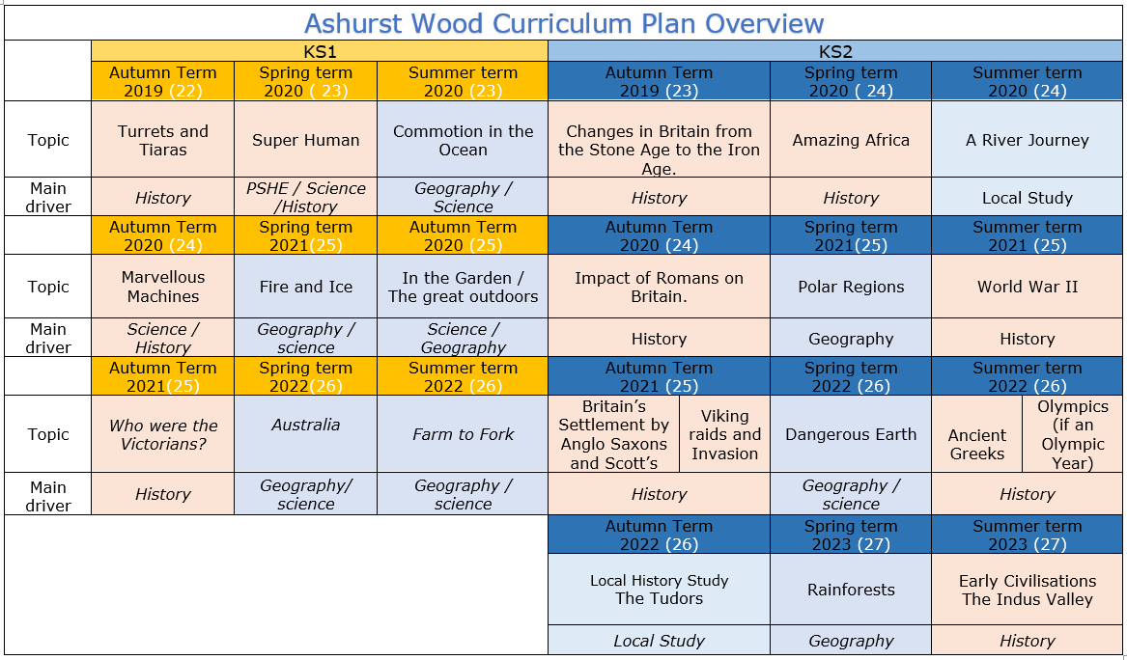

Slide 3
KS2
Amazing Africa - Benin
HISTORY TEACHING AND LEARNING AT ASHURST WOOD
Our topic planning is designed so that some topics are History led and the key knowledge and skills are captured in the planning and knowledge organisers. Other topics may contain historical knowledge in addition to the main driver. All children in KS1 will study the same topic and so expectations will be different for a YR Y1 and a Y2 child. For this reason and to ensure that there is no ceiling placed on a child’s learning we have identified outcomes for all children Must (End of Y4) Should (end of Y6) Could a rich and deep understanding.
History
At Ashurst Wood
What will children Know by the end of this topic ?
Must
Significance and interpretation
Ask and answer questions about how and why events and people being studied are significant.
Construct relevant questions about history and begin to suggest how these might be answered.
Can ask and answer questions about how and why events/people are significant.
Should
Chronological understanding
Develop a clear understanding of the order of the time periods that they have studied (covering all units from KS1 & KS2).
Place world history events on a timeline using the correct dates and labels.
Have a clear understanding of the order of the time periods that they have studied (covering all units from KS1 & KS2).
Comment on trends that happen over time.
Significance and interpretation
Recognise that some events and people are more significant than others and use evidence to back-up responses.
Understand that historical knowledge comes from a range of sources,
Chronological understanding
Place events of British history on a timeline, using dates.
Begin to understand the scale of history (eg. the Bronze Age lasted for ≈2000 years, but vast amounts of change in last century.)
Position a growing range of eras and events on a timeline (eg. Ancient Egypt, Anglo-Saxons, Romans, Iron Age, Guy Fawkes).
Separate out timeline of Britain from global events and recognise that some events are more globally important than others.
Skills
Understand that there can be many versions of the same events in history, giving reasons why these may exist.
Make links between historical events, changes and cultures across a range of periods studied
Skills
Express preferences and personal responses to topics being studied and back-them up with evidence / facts.
show empathy for people living in the past, recognising what their lives would have been like and how they would have felt.
Skills
Annotate a timeline with historical terms and facts, showing a sense of historical scale.
Change and development
Deepen understanding of trends/themes over time
Describe changes across an historical period (considering social, political, cultural and technological changes).
Plan and carry out an enquiry - Skills
Consider the validity of different sources and select reliable, appropriate resources to use to answer a specific question.
Reach conclusions on what happened based on the study of a range of sources.
Reflect on enquiries and identify ways in which they could be improved or extended
Change and development
Begin to have an understanding of broader trends / themes over time.
Plan and carry out an enquiry
Ask relevant questions about history and suggest sources of evidence that could be used to answer them, recognising the difference between primary and secondary sources.
Use historical terms correctly.
Skills
Discuss changes, similarities and differences.
Describe what life was like for people living at the same point (rich/ poor, military/civilians etc.)
Ask and answer questions about changes, similarities and differences and challenge responses.
Discuss and debate trends and themes over time.
Skills
Investigate everyday life for people in the past, including clothing, food, houses, beliefs and leisure activities and recognise how these were similar / different to the modern day.
Ask and answer questions about changes, similarities and differences.
Explore differences between different people living at the same time.
Use sources as evidence - Skills
Draw together and analyse a wide range of sources (both primary and secondary), sourcing these independently where appropriate.
Challenge the accuracy, validity and usefulness of artefacts, texts, photographs, online resources etc. when investigating historical sources.
Use sources as evidence
Understanding that historical knowledge comes from a range of sources.
Cause and effect
Ask and answer clear and accurate questions about what happened.
Ask ‘why’ questions to further historical understanding.
Independently ask and answer clear and accurate questions about the past.
Skills
Use a range of sources or artefacts (written, visual or oral) to learn more about the past.
Consider the range of sources available when we study different historical periods (eg. why do we know much more about the Romans than the Iron Age?)
Look at two versions of the same events identifying how they are similar/different.
Question the accuracy of modern depictions of historical events.
Skills
Debate and discuss different opinions about historical causes and effects.
Discuss and compare a range of plausible causes and effects.
Investigate and describe legacies for the modern world, investigating and discussing how ancient civilisations can still have an impact on our lives
Cause and effect
Independently question the reasons behind historical events and changes.
Give increasingly historically accurate answers to these questions.
Topic specific – Should
Understand that evidence about Benin may not be accurate and be able to say why.
Pupils are able to create plausible alternative explanations for meaning of objects, keeping consistent with the characteristic features of the time.
Identify how the Victorians impacted Benin
Make comparisons between Benin society and other societies of that time.
Skills
Question, investigate and give reasons for events in the past (eg. why did the first Roman invasions of Britain fail, but later ones were successful?)
Describe the impact of events in the more distant past on modern life (eg. the legacy of the Roman Empire for modern Europe).
Topic specific - Must
Be able to locate Benin region of Nigeria on a map.
Locate when Benin was at its height on a timeline.
Understand that Benin was a large empire that traded over long distances.
Could
Debate whether the bronzes should be returned to Benin.

Slide 4
Year / Class KS2 |  | Topic Title: Amazing Africa - Benin
Pre learning Links. In KS2 prior knowledge will depend on which year group the child is in and which cycle is being covered. KS1 – who were the Romans - Significant people - Norman Castles - Australia (Rain Forests) |  | Stunning Start: Greek Feast Fantastic Finish: Ancient Olympic Games
The Big Question: What is special about Ancient Benin? |  | Creative Arts and Forest School Links PE – Olympics (Para Olympics) Art Greek Pots
Small Question | Why do YOU think we should study Benin in KS2 history?
Small Question | What sort of place was Benin 500 to 1,000 years ago? | Literacy links Book Lists for World Civilizations (booksfortopics.com) | Vocabulary Archaeologist Artefacts Burial Remains Timeline Chronology Civilisation Historian Archaeologist archaeology sources importance significance impact effects Reason change continuity this suggests… may be perhaps could be first hand evidence | Tribe Agriculture Evolution Hillfort Hunter-gatherer Nomadic people Roundhouse Settlement Smelting Era Change Time Period Dates Legacy Timeline Chronology Archaeologist museum second hand evidence oral | Anachronism chronological order era/period B.C.E (Before the Common Era) C.E (The Common Era) B.C (Before Christ) A.D (Anno Domini) millennium thousands of years religion sacrifice Britons nomad/nomadic Dictatorship Slave Gods Alexander the Great Parthenon Acropalis | this source suggests that… this source doesn’t show that… reliable could have been… might have been… may be impact effects consequences significance impression change continuity cause/s infer suggest My conclusion is that…. archaeologist
Small Question | What can we tell about Benin society from the images and artefacts that have survived?
Small Question | Why did the Victorians get involved in Benin and what were the effects on the Benin people?
Small Question | What were the greatest achievements of the Benin Kingdom?
Small Question | How has the Benin civilisation has had an impact on modern society?
Small Question | What was happening n Britain at this time?
Small Question | Should the Benin Bronzes be returned?
Useful Link https://www.twinkl.co.uk/homework-help/history-homework-help/the-kingdom-of-benin/top-ten-kingdom-of-benin-facts-for-kids https://www.bbc.co.uk/bitesize/topics/zpvckqt/articles/z3n7mp3 http://www.charlesdickens.southwark.sch.uk/perch/resources/admin/ancient-benin-pupil-booklet.pdf https://www.kingdomofbenin.com/kids.html https://www.middletonprimary.net/wp-content/uploads/2020/03/benin-mini-quiz.pdf

Slide 5
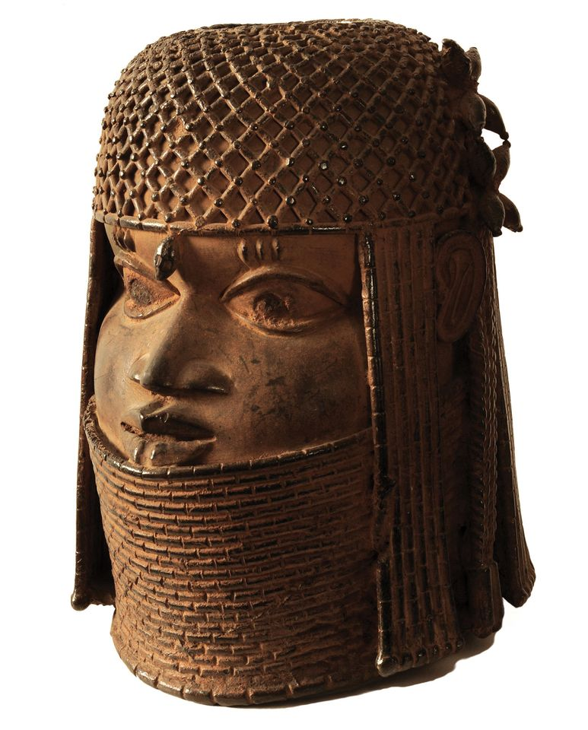
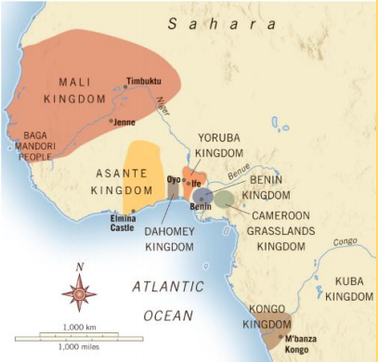
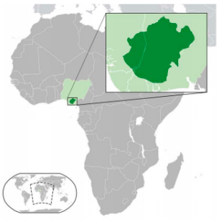
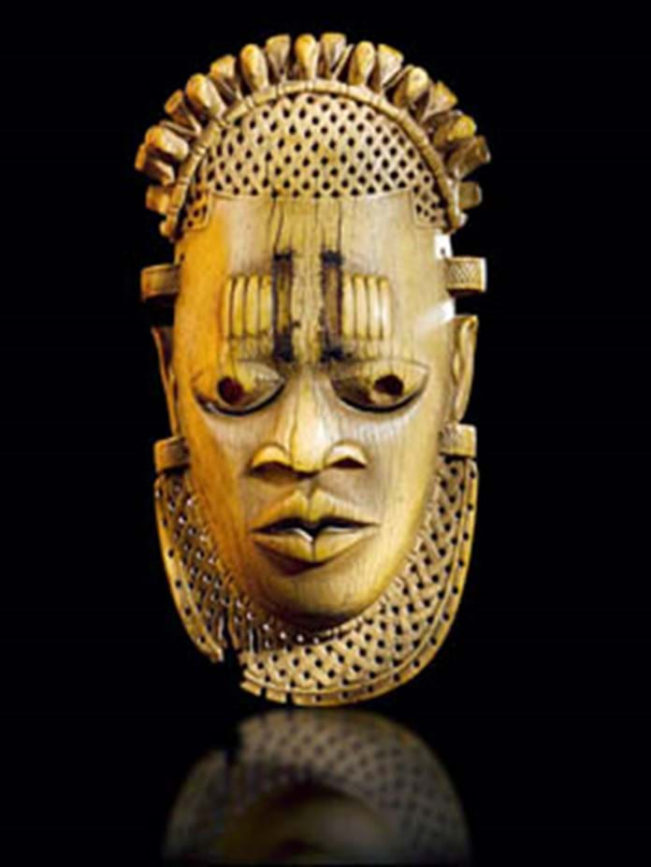
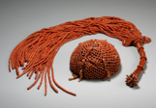
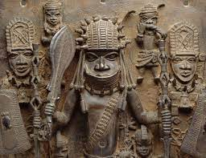
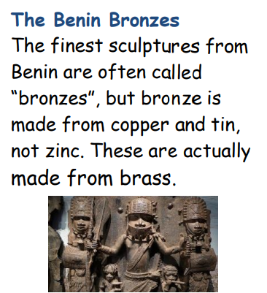
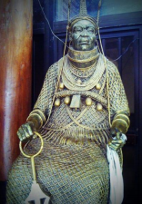
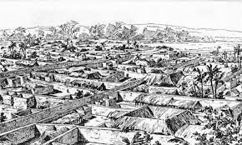
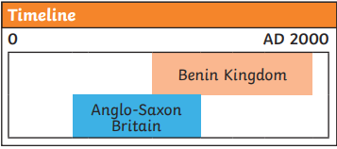
VOCABULARY
Ogiso | The title used by the early rulers of Igodomigodo. It means ‘kings of the sky’. It is thought that there were around 31 Ogiso rulers
Oba | The title used by Eweka and subsequent rulers. Eweka was from the Yoruba people and Oba is the Yoruba word for ‘king’.
Edo | The name given to the kingdom of Igodomigodo by Oba Eweka. The people also became known as the Edo people.
Yoruba | The name of the people from the holy city of Ife. The histories of the Edo and Yoruba people are closely linked.
ohen | A priest who performed religious ceremonies.
animists. | People who believe that humans, animals and objects all have souls or spirits
brass | A yellowy metal made of a mixture of copper and zinc.
abolition | Ending a system or practice (abolished)
British | Empire The lands and countries under the control of Britain
dynasty | A line of people from the same family who play an important role
Nigeria | A country located on the west coast of Africa
colonisation | Settling among and taking control over indigenous people of an area
indigenous | Natives to a place
primitive | The early stage in development
repatriation | returning back to the original country
Ife | The holy city near the Kingdom of Benin, ruled by the Yoruba people
Igodomigodo | The original land of the Kingdom of Benin
Colonisation | When invaders take over control of a country by force, and live among the people.
Voodoo (or Vodun) | The belief that non-human objects have spirits or souls.
Guild | A group of people who all do the same job, usually a craft.
Coral beads have a special significance in traditional Edo customs. The beads are made from coral stones from the seas, which are polished and shaped. Edo chiefs would wear necklaces of coral beads and the Oba would wear necklaces, collars and crowns made from them.
Amazing Africa
Benin
Ancient City of Benin

