Slide 1
Essential Characteristics
• An excellent knowledge and understanding of people, events, and contexts from a range of historical periods and of historical concepts and processes.
• The ability to think critically about history and communicate ideas very confidently in styles appropriate to a range of audiences.
• The ability to consistently support, evaluate and challenge their own and others’ views using detailed, appropriate and accurate historical evidence derived from a
range of sources.
• The ability to think, reflect, debate, discuss and evaluate the past, formulating and refining questions and lines of enquiry.
• A passion for history and an enthusiastic engagement in learning, which develops their sense of curiosity about the past and their understanding of how and why
people interpret the past in different ways.
• A respect for historical evidence and the ability to make robust and critical use of it to support their explanations and judgments.
• A desire to embrace challenging activities, including opportunities to undertake high-quality research across a range of history topics.

Slide 2
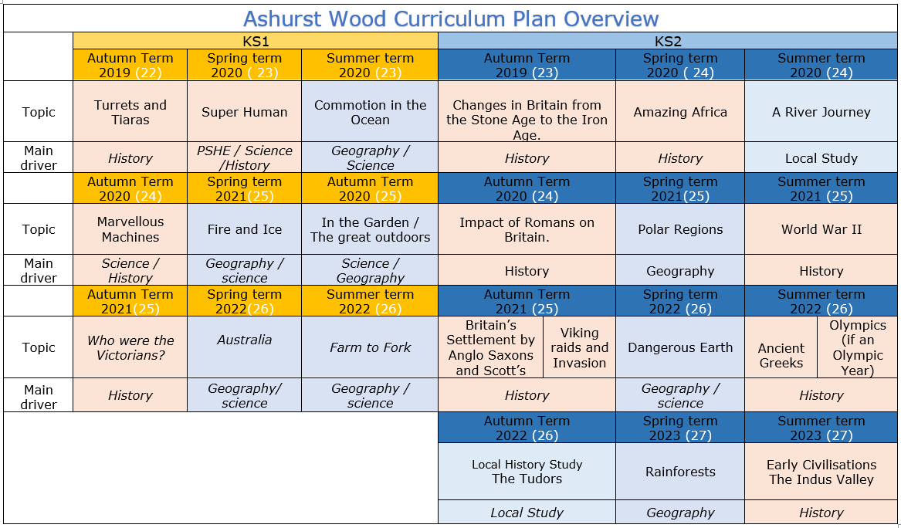

Slide 3
KS2
Ancient Greece.
HISTORY TEACHING AND LEARNING AT ASHURST WOOD
Our topic planning is designed so that some topics are History led and the key knowledge and skills are captured in the planning and knowledge organisers. Other topics may contain historical knowledge in addition to the main driver. All children in KS1 will study the same topic and so expectations will be different for a YR Y1 and a Y2 child. For this reason and to ensure that there is no ceiling placed on a child’s learning we have identified outcomes for all children Must (End of Y4) Should (end of Y6) Could a rich and deep understanding.
History
At Ashurst Wood
What will children Know by the end of this topic ?
Must
Significance and interpretation
Ask and answer questions about how and why events and people being studied are significant.
Construct relevant questions about history and begin to suggest how these might be answered.
Can ask and answer questions about how and why events/people are significant.
Should
Chronological understanding
Develop a clear understanding of the order of the time periods that they have studied (covering all units from KS1 & KS2).
Place world history events on a timeline using the correct dates and labels.
Have a clear understanding of the order of the time periods that they have studied (covering all units from KS1 & KS2).
Comment on trends that happen over time.
Significance and interpretation
Recognise that some events and people are more significant than others and use evidence to back-up responses.
Understand that historical knowledge comes from a range of sources,
Chronological understanding
Place events of British history on a timeline, using dates.
Begin to understand the scale of history (eg. the Bronze Age lasted for ≈2000 years, but vast amounts of change in last century.)
Position a growing range of eras and events on a timeline (eg. Ancient Egypt, Anglo-Saxons, Romans, Iron Age, Guy Fawkes).
Separate out timeline of Britain from global events and recognise that some events are more globally important than others.
Skills
Understand that there can be many versions of the same events in history, giving reasons why these may exist.
Make links between historical events, changes and cultures across a range of periods studied
Skills
Express preferences and personal responses to topics being studied and back-them up with evidence / facts.
show empathy for people living in the past, recognising what their lives would have been like and how they would have felt.
Skills
Annotate a timeline with historical terms and facts, showing a sense of historical scale.
Change and development
Deepen understanding of trends/themes over time
Describe changes across an historical period (considering social, political, cultural and technological changes).
Plan and carry out an enquiry - Skills
Consider the validity of different sources and select reliable, appropriate resources to use to answer a specific question.
Reach conclusions on what happened based on the study of a range of sources.
Reflect on enquiries and identify ways in which they could be improved or extended
Change and development
Begin to have an understanding of broader trends / themes over time.
Plan and carry out an enquiry
Ask relevant questions about history and suggest sources of evidence that could be used to answer them, recognising the difference between primary and secondary sources.
Use historical terms correctly.
Skills
Discuss changes, similarities and differences.
Describe what life was like for people living at the same point (rich/ poor, military/civilians etc.)
Ask and answer questions about changes, similarities and differences and challenge responses.
Discuss and debate trends and themes over time.
Skills
Investigate everyday life for people in the past, including clothing, food, houses, beliefs and leisure activities and recognise how these were similar / different to the modern day.
Ask and answer questions about changes, similarities and differences.
Explore differences between different people living at the same time.
Use sources as evidence - Skills
Draw together and analyse a wide range of sources (both primary and secondary), sourcing these independently where appropriate.
Challenge the accuracy, validity and usefulness of artefacts, texts, photographs, online resources etc. when investigating historical sources.
Use sources as evidence
Understanding that historical knowledge comes from a range of sources.
Cause and effect
Ask and answer clear and accurate questions about what happened.
Ask ‘why’ questions to further historical understanding.
Independently ask and answer clear and accurate questions about the past.
Skills
Use a range of sources or artefacts (written, visual or oral) to learn more about the past.
Consider the range of sources available when we study different historical periods (eg. why do we know much more about the Romans than the Iron Age?)
Look at two versions of the same events identifying how they are similar/different.
Question the accuracy of modern depictions of historical events.
Skills
Debate and discuss different opinions about historical causes and effects.
Discuss and compare a range of plausible causes and effects.
Investigate and describe legacies for the modern world, investigating and discussing how ancient civilisations can still have an impact on our lives
Cause and effect
Independently question the reasons behind historical events and changes.
Give increasingly historically accurate answers to these questions.
Topic specific – Should
Identify key figures in Ancient Greece and the impact they had.
Have an understanding of how people lived, and the roles men, women and children had.
Discuss the role of slaves – make links to other societies studied.
Make comparisons between Ancient Greek society and other societies of that time.
Skills
Question, investigate and give reasons for events in the past (eg. why did the first Roman invasions of Britain fail, but later ones were successful?)
Describe the impact of events in the more distant past on modern life (eg. the legacy of the Roman Empire for modern Europe).
Could
Debate whether the Parthenon (Elgin) Marbles should be returned to Greece
Would you rather live in Ancient Greece or Britain in 750BC – present your reasons.
Topic specific - Must
Be able to sequence on a timeline the key events in Ancient Greece.
Give reasons as to why the Ancient Greek were progressive.
Draw conclusions about life in Ancient Greece from using artifacts.

Slide 4
Year / Class KS2 |  | Topic Title: The Ancient Greeks (+ Olympics if an Olympic year)
Pre learning Links. In KS2 prior knowledge will depend on which year group the child is in and which cycle is being covered. KS1 – who were the Romans / - Significant people - Norman Castles |  | Stunning Start: Greek Feast Fantastic Finish: Ancient Olympic Games
The Big Question: Who were the Ancient Greeks? |  | Creative Arts and Forest School Links PE – Olympics (Para Olympics) Art Greek Pots
Small Question | How can we possibly know so much about the Ancient Greeks who lived over 2,500 years ago?
Small Question | What influence did the Ancient Greeks have on our society? (Role of democracy, Olympics competing for your country) Making Greek democracy come to life – a ‘smashing’ lesson | Literacy links https://www.booksfortopics.com/ancient-greece Greek Myths | Vocabulary Archaeologist Artefacts Burial Remains Timeline Chronology Civilisation Historian Archaeologist archaeology sources importance significance impact effects Reason change continuity this suggests… may be perhaps could be first hand evidence | Tribe Agriculture Evolution Hillfort Hunter-gatherer Nomadic people Roundhouse Settlement Smelting Era Change Time Period Dates Legacy Timeline Chronology Archaeologist museum second hand evidence oral | Anachronism chronological order era/period B.C.E (Before the Common Era) C.E (The Common Era) B.C (Before Christ) A.D (Anno Domini) millennium thousands of years religion sacrifice Britons nomad/nomadic Dictatorship Slave Gods Alexander the Great Parthenon Acropalis | this source suggests that… this source doesn’t show that… reliable could have been… might have been… may be impact effects consequences significance impression change continuity cause/s infer suggest My conclusion is that…. archaeologist
Small Question | Theseus and the Minotaur: Is there any evidence for the legend?
Small Question | What can we work out about everyday life in Ancient Athens?
Small Question | What can we learn from Greek pots? (Ancient Greek vases: the answer lies on the pot)
Small Question | What was life like for women in Ancient Greece?
Small Question | What can we tell about the Ancient Greeks from a study of their Olympics?
Small Question | How did life differ for Ancient Greeks living in different city states?
Small Question | How Great is your Greek?
Useful Link https://www.historyforkids.net/ancient-greece.html https://www.ks2history.com/ancient-greeks-lesson https://www.britishmuseum.org/learn/schools/ages-7-11/ancient-greece

Slide 5
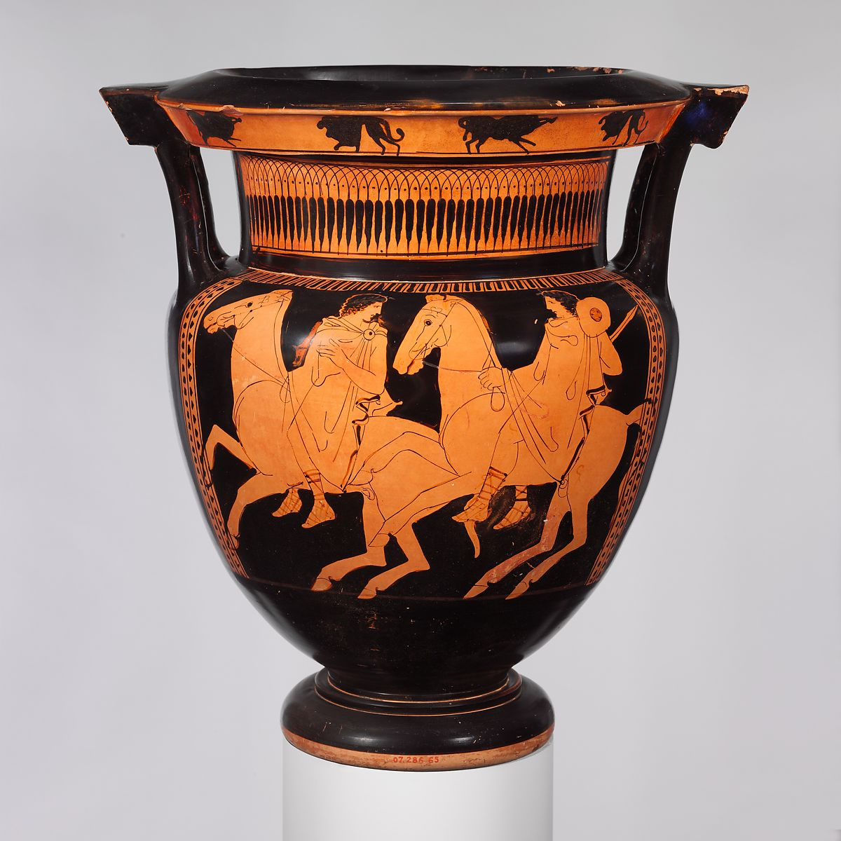
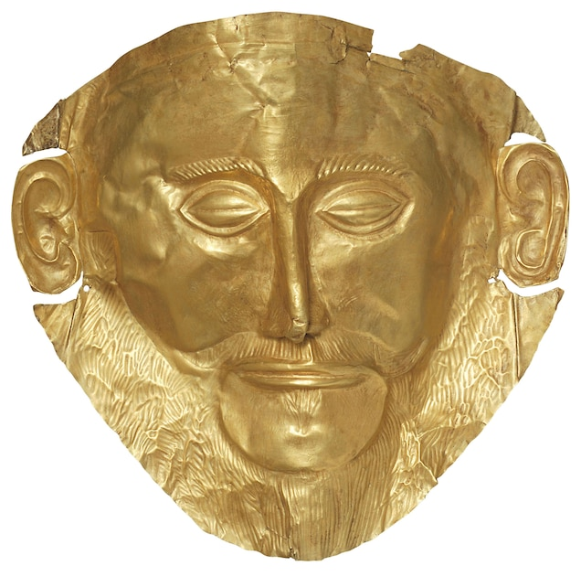
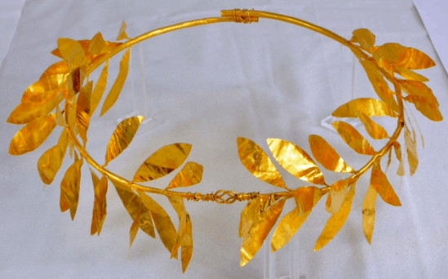
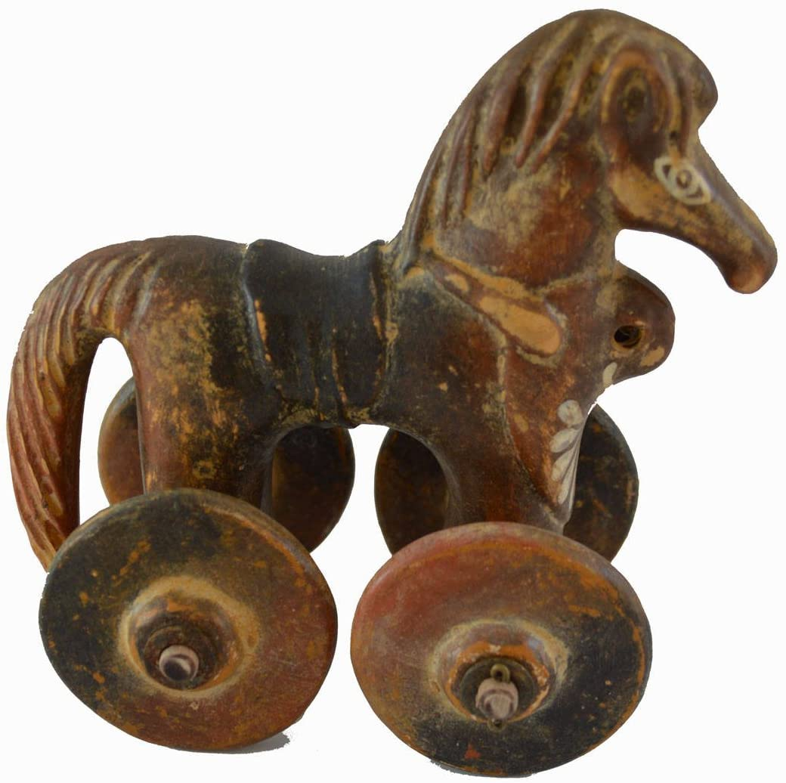
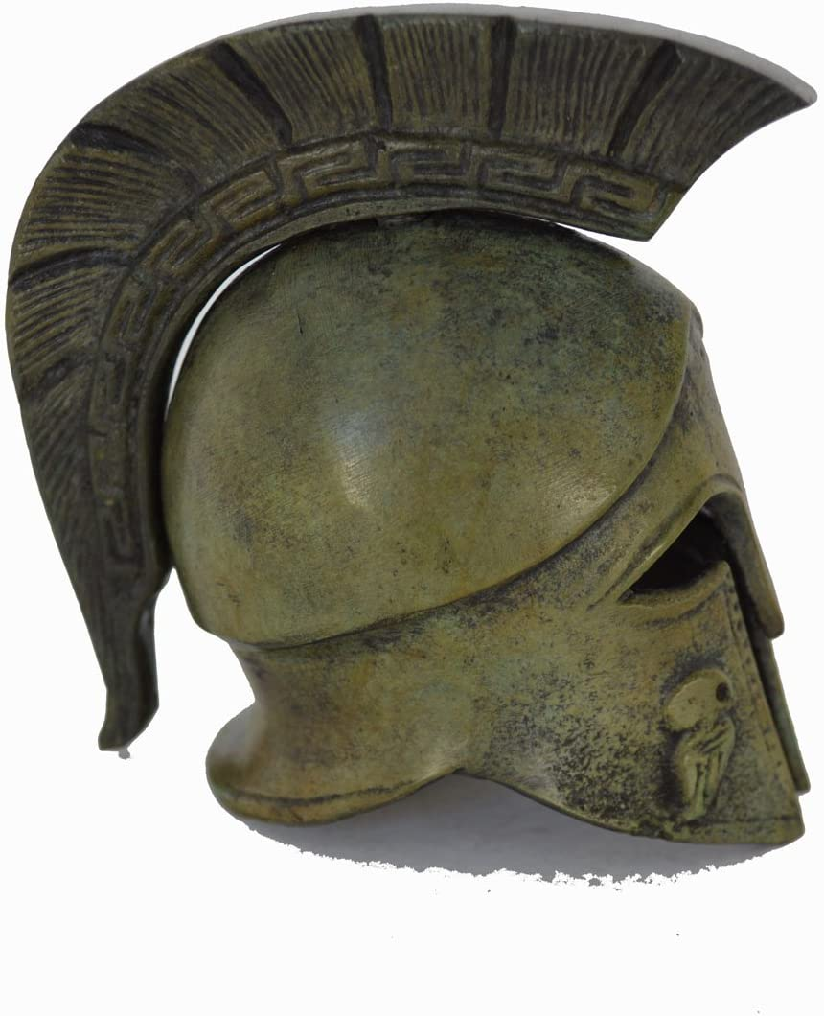
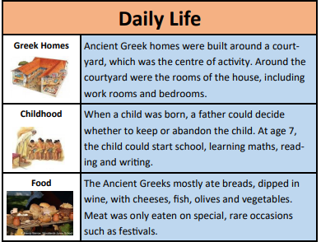
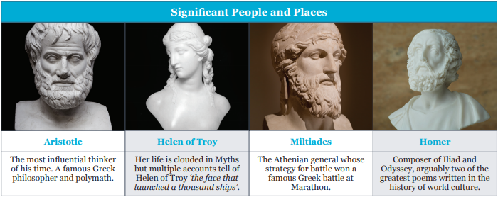
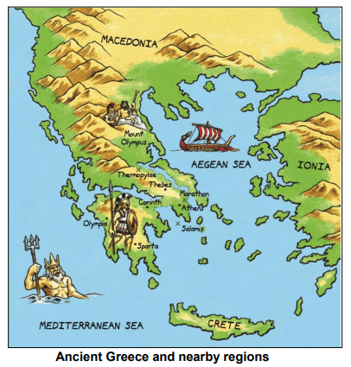
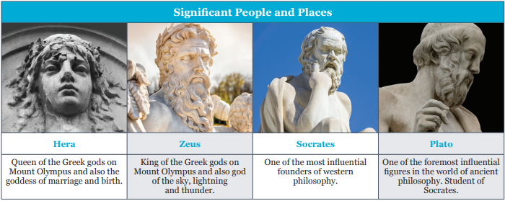
VOCABULARY
Acropolis | A large hill in the centre of Athens
Ancient | Something that is very old and existed many years ago.
Spartan | People who lived in ancient Sparta. They were known for being great warriors.
Hoplite | A solider in the Greek army who fought with a long spear and used large round shield for protection.
Democracy | A system of government where the people can vote to decide rules. Athens had democracy from 510 BC
Olympics | A religious festival held in honour of Zeus, attended by people from all over Greece.
Philosopher | A person who studies ideas about knowledge, right and wrong and the value of things.
Crete | A Greek island in the Mediterranean sea.
Architecture | The art of designing a building
Labyrinth | A type of maze
Minotaur | A monster from Greek mythology.
Myth | A traditional story usually involving supernatural beings or events
Civilization | A society that is advanced, lives in cities and has government and language.
Empire | Many countries that are ruled by one leader.
Government | The system used for being in charge of a country.
Culture | The beliefs, customs, arts etc of a particular society, time, place or group.
Slave | A person who is owned by another person.

Slide 6
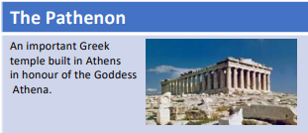
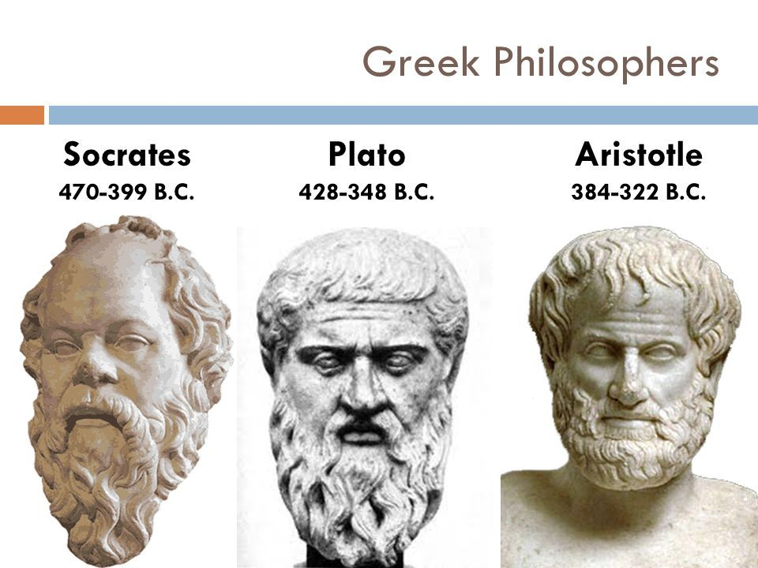
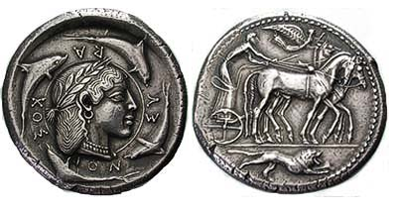
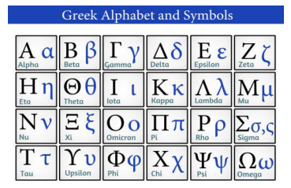
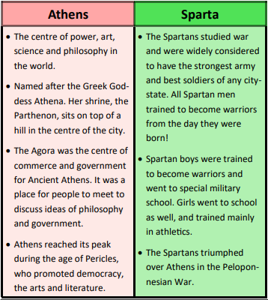
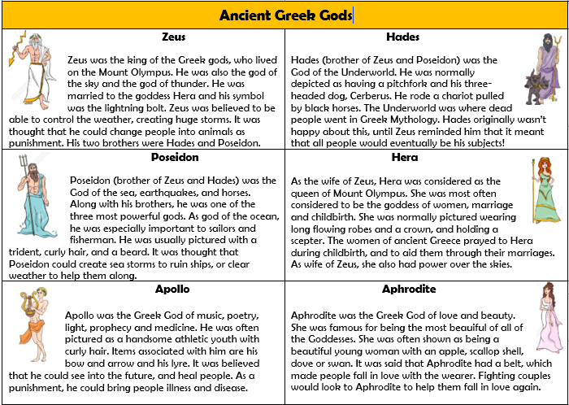
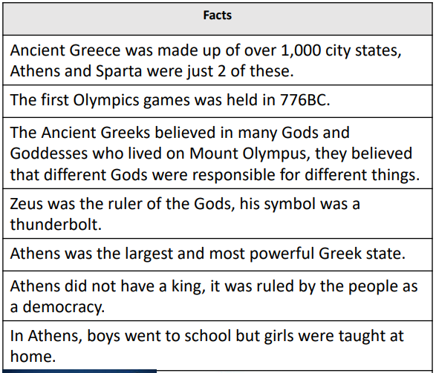
The Anglo Saxons and Viking struggle for the Kingdom of England.
Ancient Greece Timeline

