Slide 1
Essential Characteristics
• An excellent knowledge and understanding of people, events, and contexts from a range of historical periods and of historical concepts and processes.
• The ability to think critically about history and communicate ideas very confidently in styles appropriate to a range of audiences.
• The ability to consistently support, evaluate and challenge their own and others’ views using detailed, appropriate and accurate historical evidence derived from a
range of sources.
• The ability to think, reflect, debate, discuss and evaluate the past, formulating and refining questions and lines of enquiry.
• A passion for history and an enthusiastic engagement in learning, which develops their sense of curiosity about the past and their understanding of how and why
people interpret the past in different ways.
• A respect for historical evidence and the ability to make robust and critical use of it to support their explanations and judgments.
• A desire to embrace challenging activities, including opportunities to undertake high-quality research across a range of history topics.

Slide 2
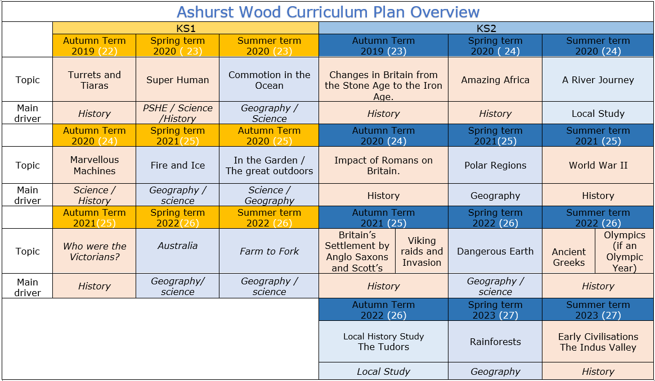

Slide 3
KS2
Local Study - Tudors
HISTORY TEACHING AND LEARNING AT ASHURST WOOD
Our topic planning is designed so that some topics are History led and the key knowledge and skills are captured in the planning and knowledge organisers. Other topics may contain historical knowledge in addition to the main driver. All children in KS1 will study the same topic and so expectations will be different for a YR Y1 and a Y2 child. For this reason and to ensure that there is no ceiling placed on a child’s learning we have identified outcomes for all children Must (End of Y4) Should (end of Y6) Could a rich and deep understanding.
History
At Ashurst Wood
What will children Know by the end of this topic ?
Must
Significance and interpretation
Ask and answer questions about how and why events and people being studied are significant.
Construct relevant questions about history and begin to suggest how these might be answered.
Can ask and answer questions about how and why events/people are significant.
Should
Chronological understanding
Develop a clear understanding of the order of the time periods that they have studied (covering all units from KS1 & KS2).
Place world history events on a timeline using the correct dates and labels.
Have a clear understanding of the order of the time periods that they have studied (covering all units from KS1 & KS2).
Comment on trends that happen over time.
Significance and interpretation
Recognise that some events and people are more significant than others and use evidence to back-up responses.
Understand that historical knowledge comes from a range of sources,
Chronological understanding
Place events of British history on a timeline, using dates.
Begin to understand the scale of history (eg. the Bronze Age lasted for ≈2000 years, but vast amounts of change in last century.)
Position a growing range of eras and events on a timeline (eg. Ancient Egypt, Anglo-Saxons, Romans, Iron Age, Guy Fawkes).
Separate out timeline of Britain from global events and recognise that some events are more globally important than others.
Skills
Understand that there can be many versions of the same events in history, giving reasons why these may exist.
Make links between historical events, changes and cultures across a range of periods studied
Skills
Express preferences and personal responses to topics being studied and back-them up with evidence / facts.
show empathy for people living in the past, recognising what their lives would have been like and how they would have felt.
Skills
Annotate a timeline with historical terms and facts, showing a sense of historical scale.
Change and development
Deepen understanding of trends/themes over time
Describe changes across an historical period (considering social, political, cultural and technological changes).
Plan and carry out an enquiry - Skills
Consider the validity of different sources and select reliable, appropriate resources to use to answer a specific question.
Reach conclusions on what happened based on the study of a range of sources.
Reflect on enquiries and identify ways in which they could be improved or extended
Change and development
Begin to have an understanding of broader trends / themes over time.
Plan and carry out an enquiry
Ask relevant questions about history and suggest sources of evidence that could be used to answer them, recognising the difference between primary and secondary sources.
Use historical terms correctly.
Skills
Discuss changes, similarities and differences.
Describe what life was like for people living at the same point (rich/ poor, military/civilians etc.)
Ask and answer questions about changes, similarities and differences and challenge responses.
Discuss and debate trends and themes over time.
Skills
Investigate everyday life for people in the past, including clothing, food, houses, beliefs and leisure activities and recognise how these were similar / different to the modern day.
Ask and answer questions about changes, similarities and differences.
Explore differences between different people living at the same time.
Use sources as evidence - Skills
Draw together and analyse a wide range of sources (both primary and secondary), sourcing these independently where appropriate.
Challenge the accuracy, validity and usefulness of artefacts, texts, photographs, online resources etc. when investigating historical sources.
Use sources as evidence
Understanding that historical knowledge comes from a range of sources.
Cause and effect
Ask and answer clear and accurate questions about what happened.
Ask ‘why’ questions to further historical understanding.
Independently ask and answer clear and accurate questions about the past.
Skills
Use a range of sources or artefacts (written, visual or oral) to learn more about the past.
Consider the range of sources available when we study different historical periods (eg. why do we know much more about the Romans than the Iron Age?)
Look at two versions of the same events identifying how they are similar/different.
Question the accuracy of modern depictions of historical events.
Skills
Debate and discuss different opinions about historical causes and effects.
Discuss and compare a range of plausible causes and effects.
Investigate and describe legacies for the modern world, investigating and discussing how ancient civilisations can still have an impact on our lives
Cause and effect
Independently question the reasons behind historical events and changes.
Give increasingly historically accurate answers to these questions.
Topic specific – Should
Identify how the Tudors impacted on the local area. (Changes in the local area over history)
Identify key figures in the Tudor period and the impact they had.
Describe the main changes in the Tudor period (using terms such as: social, religious, political, technological and cultural).
Could
Communicate information about an aspect of Tudor life that has had a lasting legacy on present life.
Use original ways to present information and ideas to the class / parents
Topic specific – Must
From the unit on Images of Henry VIII understand that context has an impact on the accuracy of resources.
Be able to suggest suitable sources of evidence to understand Tudor life.
Suggest causes and consequences of some of the main events in the Tudor period. ( Break with the Catholic Church / reasons why Henry had 6 wives!)
Describe the characteristic features of the Tudors, including ideas, beliefs, attitudes and experiences of men, women and children.
Skills
Question, investigate and give reasons for events in the past (eg. why did the first Roman invasions of Britain fail, but later ones were successful?)
Describe the impact of events in the more distant past on modern life (eg. the legacy of the Roman Empire for modern Europe).

Slide 4
Year / Class KS2 |  | Topic Title: Amazing Africa – Local study Tudors
Pre learning Links. In KS2 prior knowledge will depend on which year group the child is in and which cycle is being covered. KS1 – Great fire of London (Tudor houses) |  | Stunning Start: Visit to Heaver Castle or Hampton Court Fantastic Finish: Tudor assembly KS2 talk to children about the local area and the Tudors.
The Big Question: How do we know the Tudors lived round here? |  | Creative Arts and Forest School Links Art – Walk to sketch Tudor buildings DT – Build a Tudor house
Small Question | Could you spot Henry VIII in a police line-up?
Small Question | Why did Henry Break with Rome? Love or religion? | Literacy links Children's Books: Tudors Topic (booksfortopics.com) | Vocabulary Archaeologist Artefacts Burial Remains Timeline Chronology Historian archaeology sources importance significance impact effects Reason change continuity this suggests… may be perhaps could be first hand evidence | Era Change Time Period Dates Legacy Timeline Chronology museum second hand evidence Oral Primary evidence Different experiences I can infer that .. Eye witness Living memory impression change continuity cause/s infer suggest | chronological order era/period B.C.E (Before the Common Era) C.E (The Common Era) B.C (Before Christ) A.D (Anno Domini) religion Significance this source suggests that… this source doesn’t show that… reliable could have been… might have been… may be impact effects consequences significance | Heir Reign Succeed Knighted King Queen Monarch Peasants Protestant Catholic Wattle & daub Dissolution Monastery My conclusion is that….
Small Question | Who was Catherine of Aragon? the highs and lows of Catherine of Aragon
Small Question | How can you identify a Tudor building?
Small Question | Why is the Mary Rose so important? Why on earth did the Mary Rose, pride of the Tudor fleet, sink so quickly under the nose of Henry VIII himself? Home study option SMART TASK
Small Question | Would you have liked to live in Tudor times?
Small Question | Does a royal portrait show you what the person really looked like? Elizabeth I portraits – things aren’t what they seem
Small Question | If the Armada was so good, why did they end up defeated? How was the Spanish Armada defeated by the smaller English fleet? Using a technique called Waiting room
Useful Link Tudor and Stuarts - KS2 History - BBC Bitesize

Slide 5
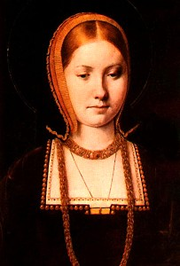
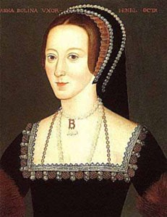
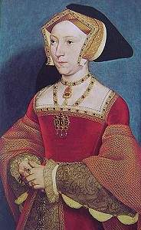
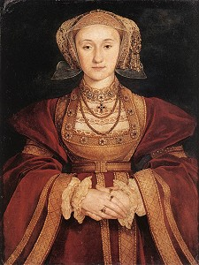
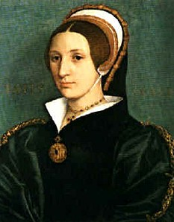
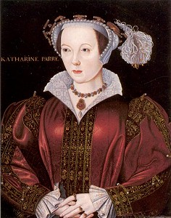
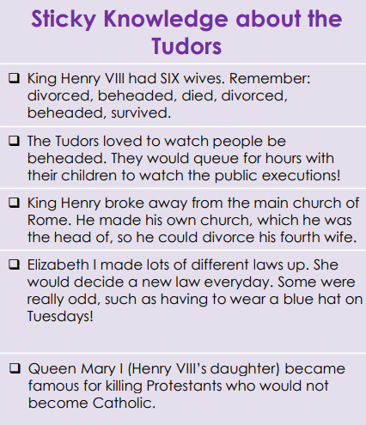
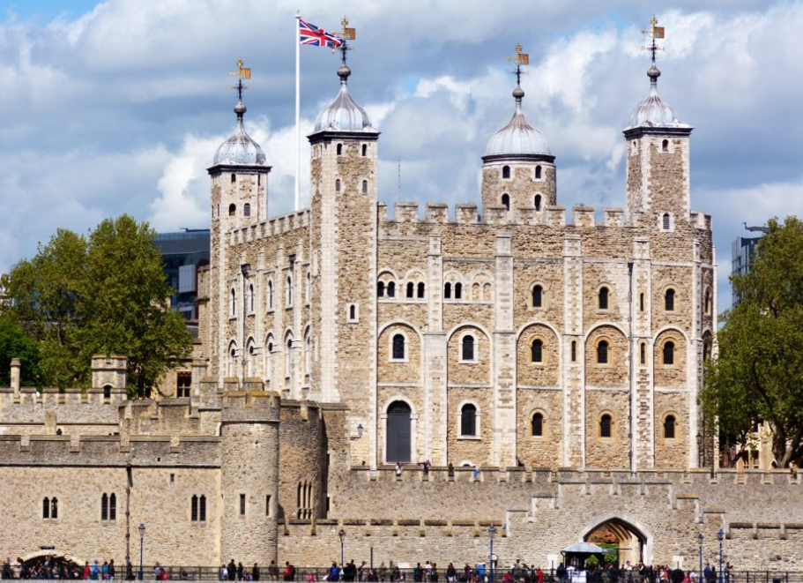
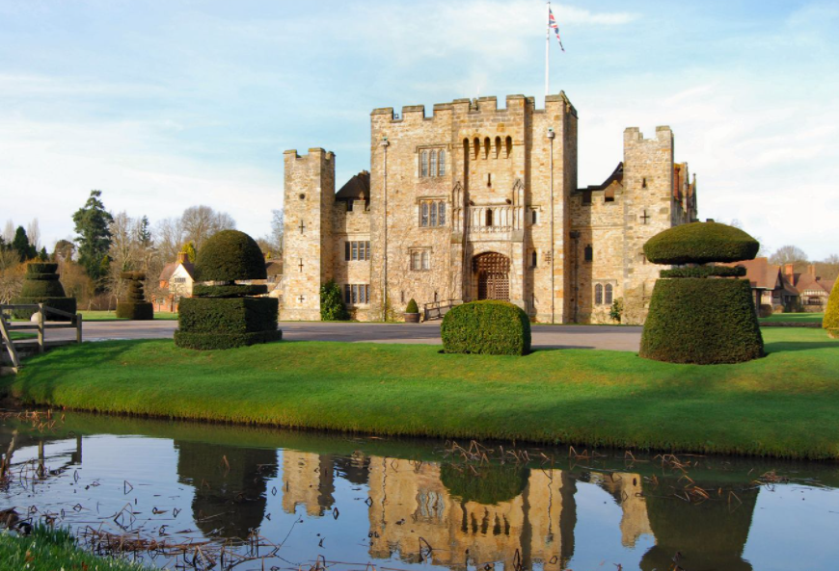
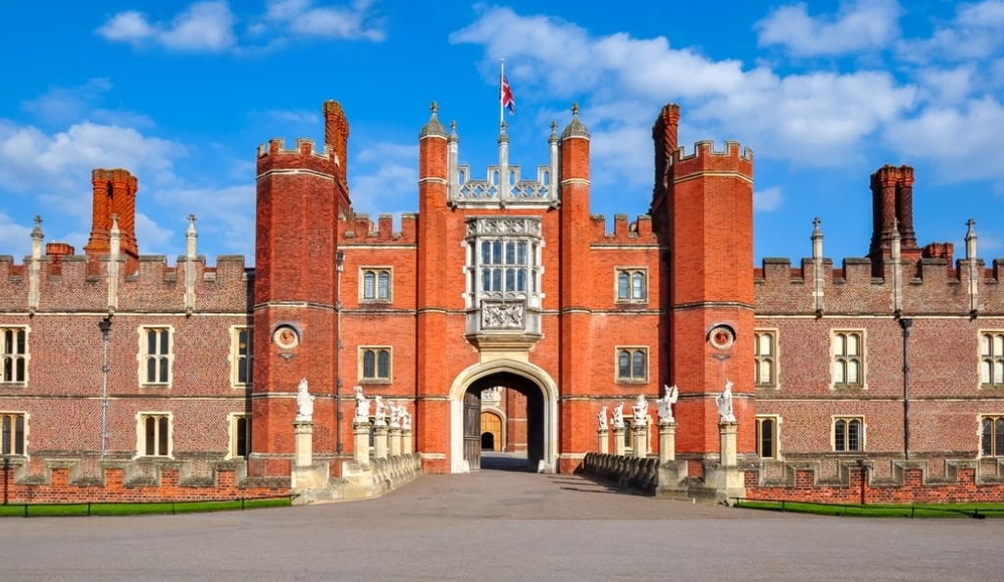
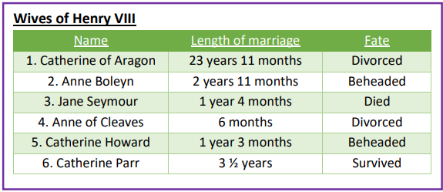
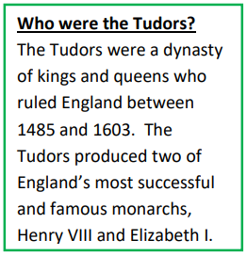
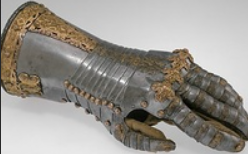
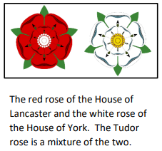
Catherine of Aragon
Anne Boleyn
Jane Seymour
Anne of Cleves
Catherine Howard
Catherine Parr
1509
Henry VIII becomes King.
1534
The Break with Rome as the Act of Supremacy is passed.
1536
Dissolution of the monasteries.
1538
All copies of the Bible had to be in English.
1547
Edward VI becomes King.
1553
Mary I becomes Queen.
1558
Elizabeth I becomes Queen.
1509
Mary Queen of Scots beheaded
1588
The Spanish Armada was sent..

Slide 6
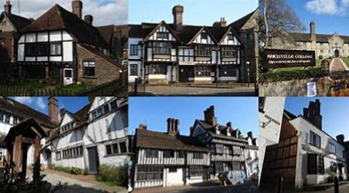
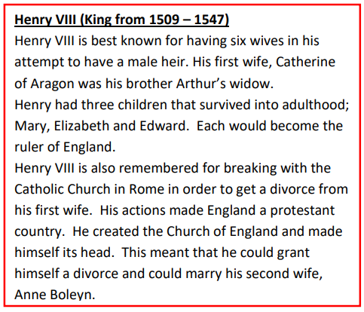
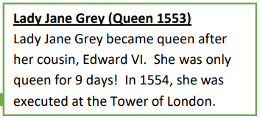
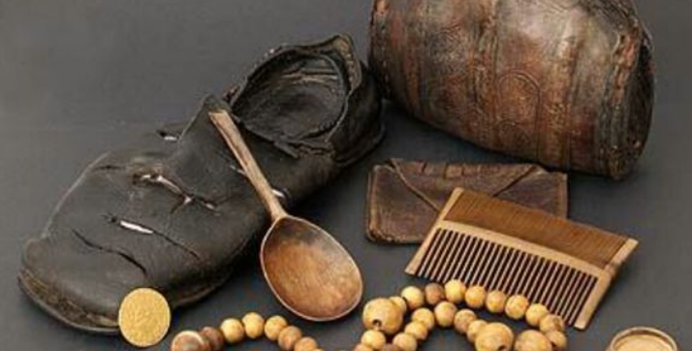
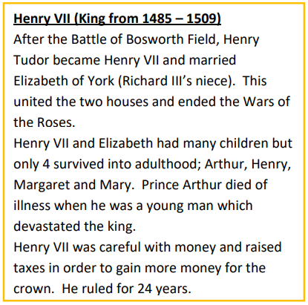
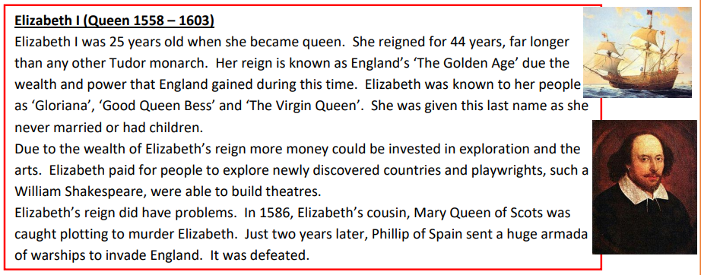
VOCABULARY
Monarch | A sovereign head of state (king or queen).
Armada | A Spanish word for a fleet of ships in the navy
Execution | To carry out a sentence of death (e.g. beheading)
Reign | The time period a king or queen is at the throne.
Vagrancy | Being homeless.
Treason | A crime of betraying your own country, e.g. trying to overthrow a king/queen.
Scold’s Bridle | A device placed on a woman’s head when she was accused of gossiping
War of the Roses | A battle which took place between two kingdoms, leading to the first Tudor king.
Inherit. | To receive something after somebody’s death
Heir | Someone who is inline to receive/inherit something after a death. E.g. the king’s children will inherit the throne.
Protestant | A member or follower of any of the Western Christian Churches that are separate from the Roman Catholic Church. They broke away from the Church during the Reformation.
Catholic | A form of Christianity, followers of the Roman Catholic Church
Reformation | Reformation, also called Protestant Reformation, the move of part of the church away from the authority of the Pope. Its greatest leaders undoubtedly were Martin Luther and John Calvin.
Renaissance | A revival of European Art and culture based upon the ideas of Greece and Rome. It included a new appreciation for learning.
Pope | The Spiritual leader of the Roman Catholic Church, he is based in Rome
Dissolution of the Monasteries | The closure of English Monasteries by Henry VIII in 1536-1540. Monasteries were run by the catholic church and were homes for Monks and Nuns. They also provided hospital care and charity to the local people.
The Spanish Armada. | A fleet of 130 Spanish ships that sailed from Spain in August 1558 which the purpose of escorting an army to invade England. Elizabeth had angered Phillip II of Spain as she had refused to marry him, executed Mary Queen of Scots and had stolen Spanish gold from his ships

