Slide 1
Essential Characteristics
• An excellent knowledge and understanding of people, events, and contexts from a range of historical periods and of historical concepts and processes.
• The ability to think critically about history and communicate ideas very confidently in styles appropriate to a range of audiences.
• The ability to consistently support, evaluate and challenge their own and others’ views using detailed, appropriate and accurate historical evidence derived from a
range of sources.
• The ability to think, reflect, debate, discuss and evaluate the past, formulating and refining questions and lines of enquiry.
• A passion for history and an enthusiastic engagement in learning, which develops their sense of curiosity about the past and their understanding of how and why
people interpret the past in different ways.
• A respect for historical evidence and the ability to make robust and critical use of it to support their explanations and judgments.
• A desire to embrace challenging activities, including opportunities to undertake high-quality research across a range of history topics.

Slide 2
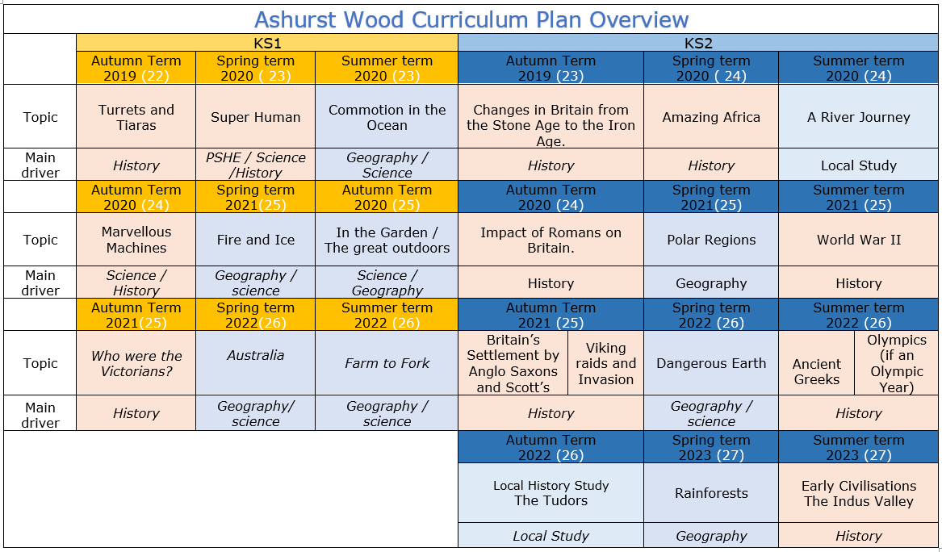

Slide 3
KS2
Changes in Britain from the stone age to the Iron age
HISTORY TEACHING AND LEARNING AT ASHURST WOOD
Our topic planning is designed so that some topics are History led and the key knowledge and skills are captured in the planning and knowledge organisers. Other topics may contain historical knowledge in addition to the main driver. All children in KS1 will study the same topic and so expectations will be different for a YR Y1 and a Y2 child. For this reason and to ensure that there is no ceiling placed on a child’s learning we have identified outcomes for all children Must (End of Y4) Should (end of Y6) Could a rich and deep understanding.
History
At Ashurst Wood
What will children Know by the end of this topic ?
Must
Significance and interpretation
Ask and answer questions about how and why events and people being studied are significant.
Construct relevant questions about history and begin to suggest how these might be answered.
Can ask and answer questions about how and why events/people are significant.
Should
Chronological understanding
Develop a clear understanding of the order of the time periods that they have studied (covering all units from KS1 & KS2).
Place world history events on a timeline using the correct dates and labels.
Have a clear understanding of the order of the time periods that they have studied (covering all units from KS1 & KS2).
Comment on trends that happen over time.
Significance and interpretation
Recognise that some events and people are more significant than others and use evidence to back-up responses.
Understand that historical knowledge comes from a range of sources,
Chronological understanding
Place events of British history on a timeline, using dates.
Begin to understand the scale of history (eg. the Bronze Age lasted for ≈2000 years, but vast amounts of change in last century.)
Position a growing range of eras and events on a timeline (eg. Ancient Egypt, Anglo-Saxons, Romans, Iron Age, Guy Fawkes).
Separate out timeline of Britain from global events and recognise that some events are more globally important than others.
Skills
Understand that there can be many versions of the same events in history, giving reasons why these may exist.
Make links between historical events, changes and cultures across a range of periods studied
Skills
Express preferences and personal responses to topics being studied and back-them up with evidence / facts.
show empathy for people living in the past, recognising what their lives would have been like and how they would have felt.
Skills
Annotate a timeline with historical terms and facts, showing a sense of historical scale.
Change and development
Deepen understanding of trends/themes over time
Describe changes across an historical period (considering social, political, cultural and technological changes).
Plan and carry out an enquiry - Skills
Consider the validity of different sources and select reliable, appropriate resources to use to answer a specific question.
Reach conclusions on what happened based on the study of a range of sources.
Reflect on enquiries and identify ways in which they could be improved or extended
Change and development
Begin to have an understanding of broader trends / themes over time.
Plan and carry out an enquiry
Ask relevant questions about history and suggest sources of evidence that could be used to answer them, recognising the difference between primary and secondary sources.
Use historical terms correctly.
Skills
Discuss changes, similarities and differences.
Describe what life was like for people living at the same point (rich/ poor, military/civilians etc.)
Ask and answer questions about changes, similarities and differences and challenge responses.
Discuss and debate trends and themes over time.
Skills
Investigate everyday life for people in the past, including clothing, food, houses, beliefs and leisure activities and recognise how these were similar / different to the modern day.
Ask and answer questions about changes, similarities and differences.
Explore differences between different people living at the same time.
Use sources as evidence - Skills
Draw together and analyse a wide range of sources (both primary and secondary), sourcing these independently where appropriate.
Challenge the accuracy, validity and usefulness of artefacts, texts, photographs, online resources etc. when investigating historical sources.
Use sources as evidence
Understanding that historical knowledge comes from a range of sources.
Cause and effect
Ask and answer clear and accurate questions about what happened.
Ask ‘why’ questions to further historical understanding.
Independently ask and answer clear and accurate questions about the past.
Skills
Use a range of sources or artefacts (written, visual or oral) to learn more about the past.
Consider the range of sources available when we study different historical periods (eg. why do we know much more about the Romans than the Iron Age?)
Look at two versions of the same events identifying how they are similar/different.
Question the accuracy of modern depictions of historical events.
Skills
Debate and discuss different opinions about historical causes and effects.
Discuss and compare a range of plausible causes and effects.
Investigate and describe legacies for the modern world, investigating and discussing how ancient civilisations can still have an impact on our lives
Cause and effect
Independently question the reasons behind historical events and changes.
Give increasingly historically accurate answers to these questions.
Topic specific – Should
Understand that no single source of evidence gives the full answer to questions about the past. – Druids
Have an understanding of how people lived across the three ages and the roles men, women and children had.
Compare the rate of change over the three ages to the speed of change in a later period of time. (Use timelines to demonstrate this)
Could
Dragon’s Den : which technological development should our Iron Age settlement get next? – justify reasons for their choices based on knowledge of the time period and impact of inventions on society.
Topic specific – Must
Understand the key differences between the three ages.
Give reasons as to why Skara Brae is so important
Use more that one source of evidence to ask questions about the three ages.
Describe why the discoveries such as how to get metals out of rocks changed society.
Describe some of the beliefs at the time and why information about druids may be unreliable.
Skills
Question, investigate and give reasons for events in the past (eg. why did the first Roman invasions of Britain fail, but later ones were successful?)
Describe the impact of events in the more distant past on modern life (eg. the legacy of the Roman Empire for modern Europe).

Slide 4
Year / Class KS 2 |  | Topic Title: Changes in Britain from the stone age to the Iron age
Pre learning Links. In KS1 prior knowledge will depend on which year group the child is in. |  | Stunning Start: Fantastic Finish: Hands on History workshop
The Big Question: What was the most significant change from the Stone age to the Iron Age? |  | Creative Arts and Forest School Links Art – Cave paintings Forest Schools – Pewter smelting
Small Question | Is it true to say that Stone Age man was just a simple hunter gatherer only interested in food and shelter?
Small Question | What can we learn about life in the Stone Age from a study of Skara Brae? | Literacy links Booklist: Stone Age to Iron Age (booksfortopics.com) | Vocabulary Neolithic Palaeolithic Mesolithic Stone Age Bronze Age Iron Age Archaeologist Artefacts Burial Remains Skara Brae Domestication Timeline Chronology Forage Prehistoric | Tribe Agriculture Evolution Hillfort Hunter-gatherer Nomadic people Roundhouse Settlement Smelting Era Change Time Period Dates Legacy Timeline Chronology Archaeologist museum | Anachronism chronological order era/period B.C.E (Before the Common Era) C.E (The Common Era) B.C (Before Christ) A.D (Anno Domini) millennium thousands of years religion sacrifice Britons nomad/nomadic civilisation resistance | Archaeologist archaeology sources importance significance impact effects Reason change continuity this suggests… may be perhaps could be first hand evidence second hand evidence oral Historian | this source suggests that… this source doesn’t show that… reliable could have been… might have been… may be impact effects consequences significance impression change continuity cause/s infer suggest My conclusion is that…. archaeologist
Small Question | What was life like in the Iron Age and how do we know?
Small Question | What was copper mining critical to people of this time?
Small Question | How were Hill Forts developed in the Iron Age?
Small Question | Why did they build Stonehenge?
Small Question | Why is some information about the Iron Age Druids unreliable?
Small Question | How much did life change when man learned how to farm?
Useful Link https://www.hamilton-trust.org.uk/topics/upper-key-stage-2-topics/stone-age-iron-age-britain/ Iron Age Facts | Iron Age For Children | DK Find Out www.bbc.com/bitesize/articles/z34djxs Information on the Stone Age The Iron Age | TheSchoolRun https://www.bbc.com/teach/class-clips-video/history-ks2-new-stone-age-animation/zjh2t39 Life in the Stone Age https://www.hornpark.greenwich.sch.uk/sites/default/files/docs/Year%203%20Stone%20Age%20to%20Iron%20Age%20Knowledge%20Organiser.pdf

Slide 5
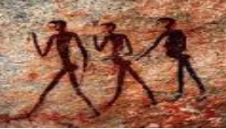
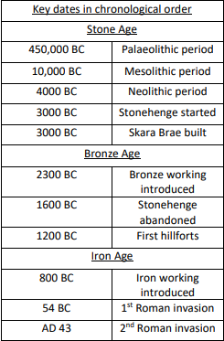
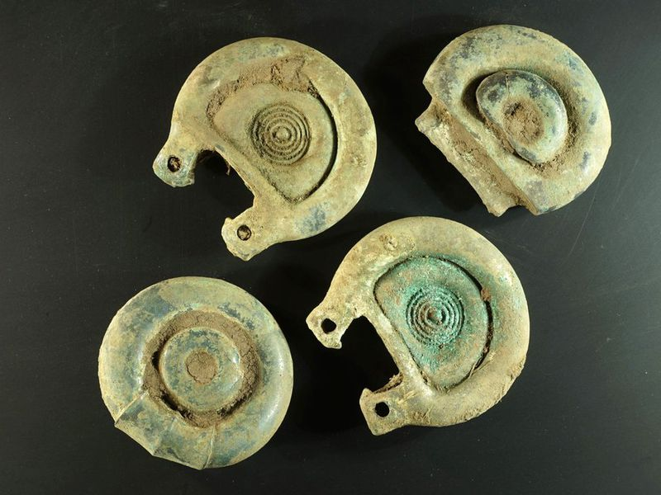

Slide 6
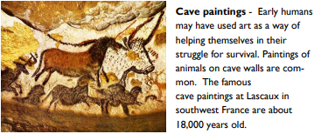
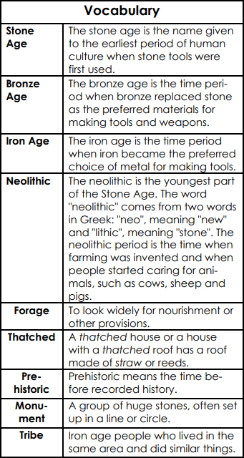
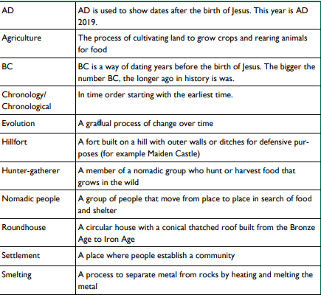
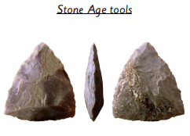
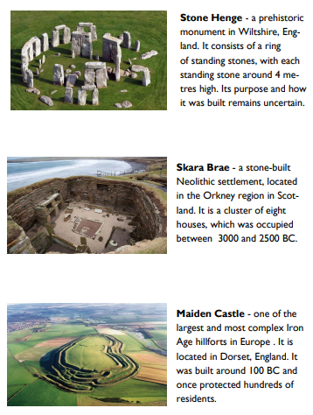
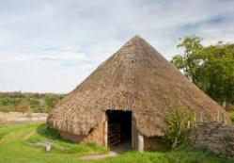
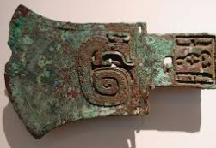
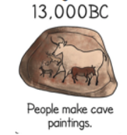
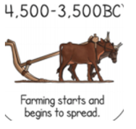
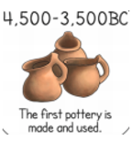
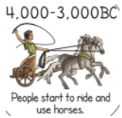
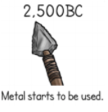
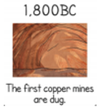
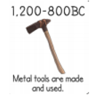
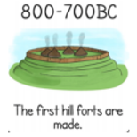
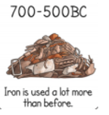
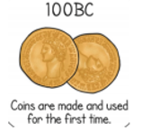
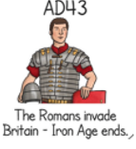
Changes in Britain from the stone age to the Iron age

