Slide 1
Essential Characteristics
• An excellent knowledge and understanding of people, events, and contexts from a range of historical periods and of historical concepts and processes.
• The ability to think critically about history and communicate ideas very confidently in styles appropriate to a range of audiences.
• The ability to consistently support, evaluate and challenge their own and others’ views using detailed, appropriate and accurate historical evidence derived from a
range of sources.
• The ability to think, reflect, debate, discuss and evaluate the past, formulating and refining questions and lines of enquiry.
• A passion for history and an enthusiastic engagement in learning, which develops their sense of curiosity about the past and their understanding of how and why
people interpret the past in different ways.
• A respect for historical evidence and the ability to make robust and critical use of it to support their explanations and judgments.
• A desire to embrace challenging activities, including opportunities to undertake high-quality research across a range of history topics.

Slide 2
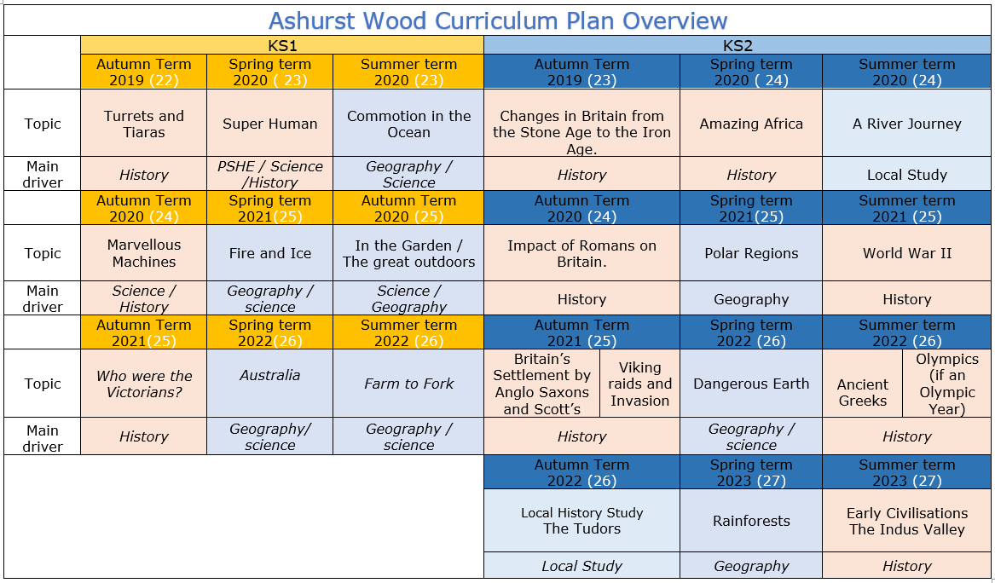

Slide 3
KS2
HISTORY TEACHING AND LEARNING AT ASHURST WOOD
Our topic planning is designed so that some topics are History led and the key knowledge and skills are captured in the planning and knowledge organisers. Other topics may contain historical knowledge in addition to the main driver. All children in KS1 will study the same topic and so expectations will be different for a YR Y1 and a Y2 child. For this reason and to ensure that there is no ceiling placed on a child’s learning we have identified outcomes for all children Must (End of Y4) Should (end of Y6) Enrich a rich and deep understanding.
What will children Know by the end of this topic ?
History
At Ashurst Wood
Pupils should continue to develop a chronologically secure knowledge and understanding of British, local and world history, establishing clear narratives within and across the periods they study. They should note connections, contrasts and trends over time and develop the appropriate use of historical terms. They should regularly address and sometimes devise historically valid questions about change, cause, similarity and difference, and significance. They should construct informed responses that involve thoughtful selection and organisation of relevant historical information. They should understand how our knowledge of the past is constructed from a range of sources.
Must
KS2
In planning to ensure the progression described above through teaching the British, local and world history outlined below, teachers should combine overview and depth studies to help pupils understand both the long arc of development and the complexity of specific aspects of the content.
Pupils should be taught about:
the Roman Empire and its impact on Britain
Should
ENRICHMENT
Blue bell railway trip
Aspire

Slide 4
KS2
World War II
HISTORY TEACHING AND LEARNING AT ASHURST WOOD
Our topic planning is designed so that some topics are History led and the key knowledge and skills are captured in the planning and knowledge organisers. Other topics may contain historical knowledge in addition to the main driver. All children in KS1 will study the same topic and so expectations will be different for a YR Y1 and a Y2 child. For this reason and to ensure that there is no ceiling placed on a child’s learning we have identified outcomes for all children Must (End of Y4) Should (end of Y6) Could a rich and deep understanding.
History
At Ashurst Wood
What will children Know by the end of this topic ?
Must
Significance and interpretation
Ask and answer questions about how and why events and people being studied are significant.
Construct relevant questions about history and begin to suggest how these might be answered.
Can ask and answer questions about how and why events/people are significant.
Should
Chronological understanding
Develop a clear understanding of the order of the time periods that they have studied (covering all units from KS1 & KS2).
Place world history events on a timeline using the correct dates and labels.
Have a clear understanding of the order of the time periods that they have studied (covering all units from KS1 & KS2).
Comment on trends that happen over time.
Significance and interpretation
Recognise that some events and people are more significant than others and use evidence to back-up responses.
Understand that historical knowledge comes from a range of sources,
Chronological understanding
Place events of British history on a timeline, using dates.
Begin to understand the scale of history (eg. the Bronze Age lasted for ≈2000 years, but vast amounts of change in last century.)
Position a growing range of eras and events on a timeline (eg. Ancient Egypt, Anglo-Saxons, Romans, Iron Age, Guy Fawkes).
Separate out timeline of Britain from global events and recognise that some events are more globally important than others.
Skills
Understand that there can be many versions of the same events in history, giving reasons why these may exist.
Make links between historical events, changes and cultures across a range of periods studied
Skills
Express preferences and personal responses to topics being studied and back-them up with evidence / facts.
show empathy for people living in the past, recognising what their lives would have been like and how they would have felt.
Skills
Annotate a timeline with historical terms and facts, showing a sense of historical scale.
Change and development
Deepen understanding of trends/themes over time
Describe changes across an historical period (considering social, political, cultural and technological changes).
Plan and carry out an enquiry - Skills
Consider the validity of different sources and select reliable, appropriate resources to use to answer a specific question.
Reach conclusions on what happened based on the study of a range of sources.
Reflect on enquiries and identify ways in which they could be improved or extended
Change and development
Begin to have an understanding of broader trends / themes over time.
Plan and carry out an enquiry
Ask relevant questions about history and suggest sources of evidence that could be used to answer them, recognising the difference between primary and secondary sources.
Use historical terms correctly.
Skills
Discuss changes, similarities and differences.
Describe what life was like for people living at the same point (rich/ poor, military/civilians etc.)
Ask and answer questions about changes, similarities and differences and challenge responses.
Discuss and debate trends and themes over time.
Skills
Investigate everyday life for people in the past, including clothing, food, houses, beliefs and leisure activities and recognise how these were similar / different to the modern day.
Ask and answer questions about changes, similarities and differences.
Explore differences between different people living at the same time.
Use sources as evidence - Skills
Draw together and analyse a wide range of sources (both primary and secondary), sourcing these independently where appropriate.
Challenge the accuracy, validity and usefulness of artefacts, texts, photographs, online resources etc. when investigating historical sources.
Use sources as evidence
Understanding that historical knowledge comes from a range of sources.
Cause and effect
Ask and answer clear and accurate questions about what happened.
Ask ‘why’ questions to further historical understanding.
Independently ask and answer clear and accurate questions about the past.
Skills
Use a range of sources or artefacts (written, visual or oral) to learn more about the past.
Consider the range of sources available when we study different historical periods (eg. why do we know much more about the Romans than the Iron Age?)
Look at two versions of the same events identifying how they are similar/different.
Question the accuracy of modern depictions of historical events.
Skills
Debate and discuss different opinions about historical causes and effects.
Discuss and compare a range of plausible causes and effects.
Investigate and describe legacies for the modern world, investigating and discussing how ancient civilisations can still have an impact on our lives
Cause and effect
Independently question the reasons behind historical events and changes.
Give increasingly historically accurate answers to these questions.
Topic specific – Should
Identify key figures in WWII and the impact they had.
Have an understanding of how people lived, and the roles men, women had.
Identify how WWII impacted children and families.
Show an awareness of the concept of propaganda and how historians must understand the social context of evidence studied.
Identify how the American forces changed the diversity in Britain.
Could
Debate whether the British or Americans were more tolerant of diversity.
Present to the class a report on how the war changed our society.
Make and present comparisons between WWII and events in the present.
Topic specific – Must
Be able to sequence on a timeline the key events leading up to and through the period of WWII.
Give reasons as to why the War started.
Understand and give reasons why accounts of the same event may differ.
Identify how the war impacted on the local area.
Skills
Question, investigate and give reasons for events in the past (eg. why did the first Roman invasions of Britain fail, but later ones were successful?)
Describe the impact of events in the more distant past on modern life (eg. the legacy of the Roman Empire for modern Europe).

Slide 5
Year / Class KS2 |  | Topic Title: Amazing Africa - Benin
Pre learning Links. In KS2 prior knowledge will depend on which year group the child is in and which cycle is being covered. KS1 – growing food, map knowledge Europe |  | Stunning Start: Now press play (2021 only) Fantastic Finish: Bluebell railway trip
The Big Question: what is the significance od WWII? |  | Creative Arts and Forest School Links DT – create a gas mask box / propaganda poster Y3 science – light and dark Maths rationing example using money + food shop
Small Question | Why did Britain have to go to war in 1939?
Small Question | Why was it necessary for children to be evacuated? Introductory task | Literacy links Book Lists for World War II (booksfortopics.com) | Vocabulary Archaeologist Artefacts Burial Remains Timeline Chronology Civilisation Historian Archaeologist archaeology sources importance significance impact effects Reason change continuity this suggests… may be perhaps could be first hand evidence | Agriculture Era Change Time Period Dates Legacy Timeline Chronology Archaeologist museum second hand evidence Oral Primary evidence Different experiences I can infer that .. Eye witness Living memory Evacuate Represent Vote Parliament Houses of Parliament | Anachronism chronological order era/period B.C.E (Before the Common Era) C.E (The Common Era) B.C (Before Christ) A.D (Anno Domini) millennium thousands of years religion sacrifice Dictatorship Significance Reliability British Empire Allotment Automic bomb Censorship Host family | this source suggests that… this source doesn’t show that… reliable could have been… might have been… may be impact effects consequences significance impression change continuity cause/s infer suggest My conclusion is that…. archaeologist
Small Question | How was Britain able to stand firm against the German threat?
Small Question | Which 8 objects should we show to explain how Britain coped with the effect of war on the Home Front? + Britain during World War Two – Call My Bluff
Small Question | Why is it so difficult to be sure what life was really like on the Home Front?
Small Question | What is propaganda and what role did it play in WWII? Y6 pupils play film detectives to learn about government propaganda SMART TASK
Small Question | What were the key events in WWII? Why did Germany lose the Battle of Britain?
Small Question | What has changed as a result of WWII? ( segregation GI’s, Military service becoming more diverse, awareness of how dangerous racism was)
Useful Link https://www.ducksters.com/history/world_war_ii/ https://www.natgeokids.com/uk/discover/history/general-history/world-war-two/ https://www.historyforkids.net/world-war-two.html

Slide 6
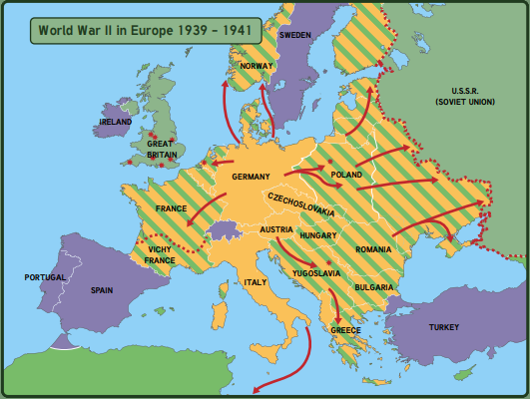
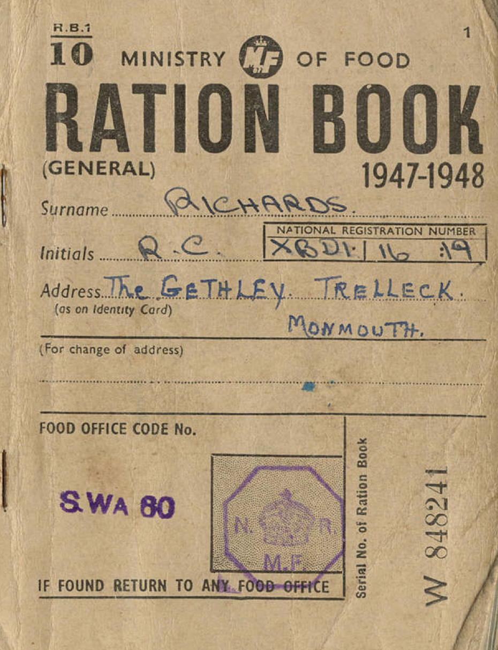
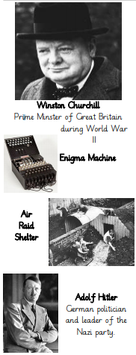
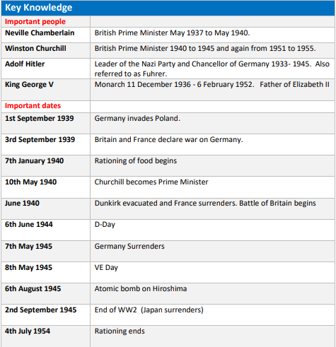
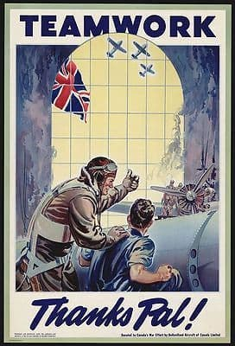
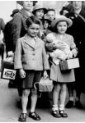
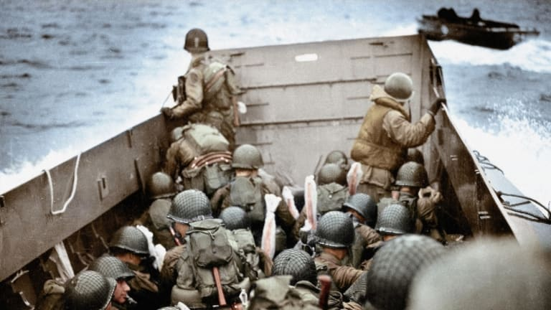
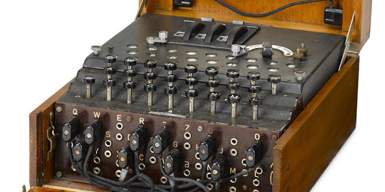
1918
The treaty of Versailles - ending WWI
1933
The Nazi Party (led by Adolf Hitler) came to power in Germany
1936
Hitler moved troops into the Rhineland, violating the terms of the Treaty of Versailles
1938
German troops invaded Austria
1939
German troops invaded Czechoslovakia
1st September 1939
German troops invaded Poland
3rd September 1939
Britain declared war on Germany because they had invaded Poland. Second WW started
July-October 1940
The battle of Britain - attacks on British towns, cities and ports from the German air force.
September 1940 - May 1941
The Blitz attacks. German bomber planes attacked Britain at night.
8th May 1945
Victory Day in Europe (VE DAY) - the day the war officially ended.

Slide 7
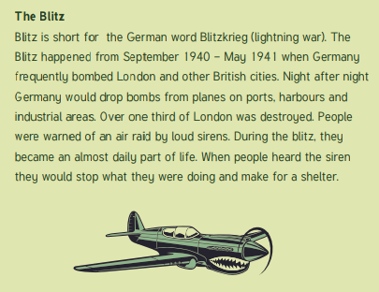
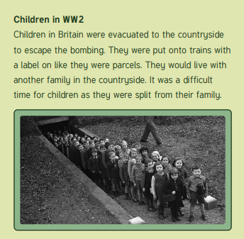
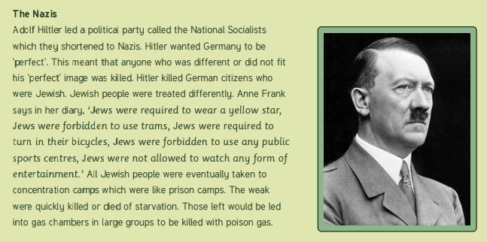
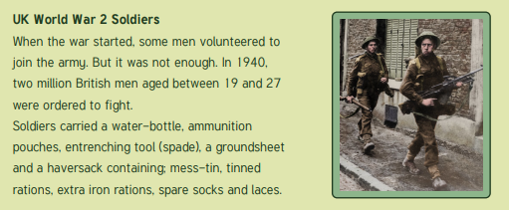
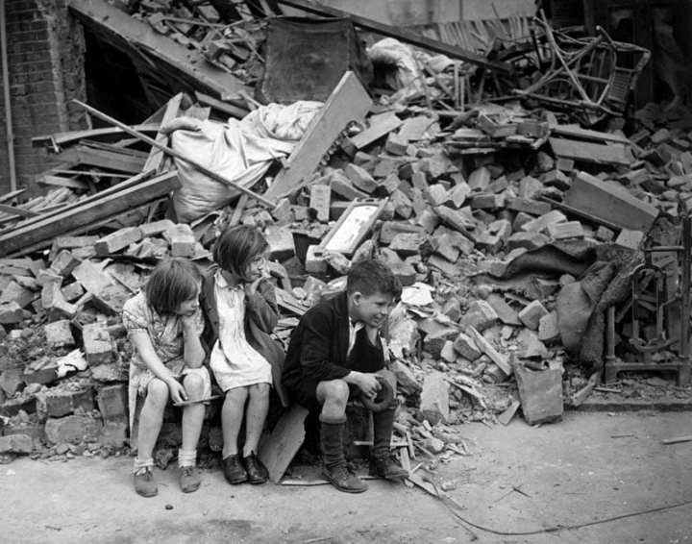
VOCABULARY
allies | countries which fought on the British side (including: USA, Great Britain, France, Russia (1941-1945))
propaganda | information, especially of a biased or misleading nature, used to promote a political cause or point of view.
evacuee | someone who was evacuated, moved from a danger area to a safer place (normally from the cities to rural areas)
black out | system of ensuring no lights were visible after dark so that buildings could not be spotted by enemy planes
rationing | the controlled distribution of scarce resources (mainly food & clothing)
air raid shelter | a building to protect people from bombs dropped by planes
axis | countries which fought on the German side (including: Italy, Germany, Japan, Russia (1939-1941))
trenches | a long, narrow ditch used for troops to shelter from enemy fire or attack
Nazi | member of the fascist German political party which came to power in 1933
blitz | series of aerial bombing raids on the UK, mainly cities including London, Bristol and Nottingham
holocaust | Mass murder of Jews and other groups of people by the Nazis
Blitzkrieg | Translated as ‘lightning war’. German quick strike invasion of Western Europe
Luftwaffe | The German Air Force (responsible for the Blitz)
Enigma | A machine used by the Nazis to send coded messages
Home Front | Britain and the people of Britain who helped in the war effort
Home Guard | The people who protected the coast from a German invasion
Invade | Using power in order to attack other countries

