Slide 1
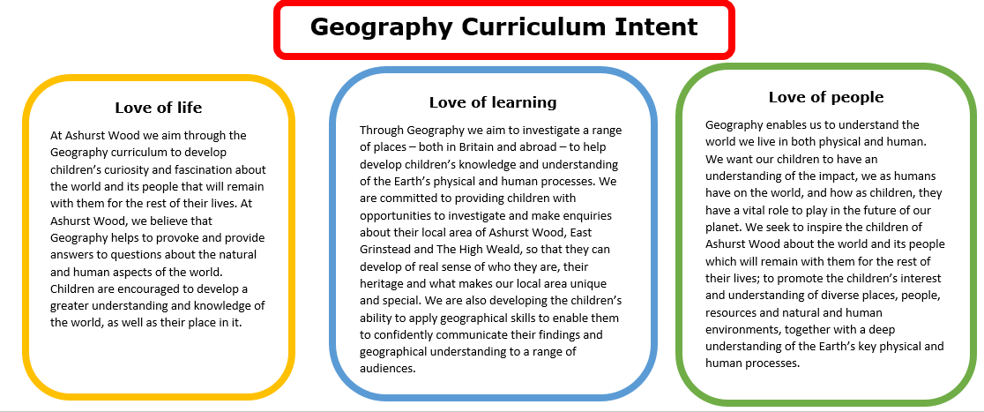
Essential Characteristics
An excellent knowledge of where places are and what they are like.
An excellent understanding of the ways in which places are interdependent and interconnected and how much human and physical environments are interrelated.
An extensive base of geographical knowledge and vocabulary.
Fluency in complex, geographical enquiry and the ability to apply questioning skills and use effective analytical and presentational techniques.
The ability to reach clear conclusions and develop a reasoned argument to explain findings.
Significant levels of originality, imagination or creativity as shown in interpretations and representations of the subject matter.
Highly developed and frequently utilised fieldwork and other geographical skills and techniques.
A passion for and commitment to the subject, and a real sense of curiosity to find out about the world and the people who live there.
The ability to express well-balanced opinions, rooted in very good knowledge and understanding about current and contemporary issues in society and the environment.

Slide 2
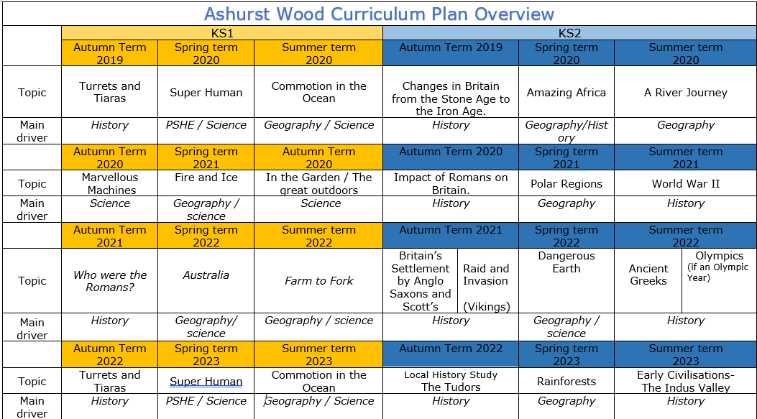
Commotion in the Ocean
Geography / Science
Amazing Africa
Geography / History
A river journey
Geography
Fire & Ice
Geography / Science
Polar Regions
Geography
Australia
Geography / Science
Farm to Fork
Geography / Science
Dangerous Earth
Geography / science
Commotion in the Ocean
Geography / Science
Rainforests
Geography

Slide 3
KS 2
GEOGRAPHY TEACHING AND LEARNING AT ASHURST WOOD
Our topic planning is designed so that some topics are Geography led and the key knowledge and skills are captured in the planning and knowledge organisers. Other topics may contain geographical knowledge in addition to the main driver. All children in KS1 will study the same topic and so expectations will be different for a YR Y1 and a Y2 child. For this reason and to ensure that there is no ceiling placed on a child’s learning we have identified outcomes for all children Must (End of Y4) Should (end of Y6) Could a rich and deep understanding.
GEOGRAPHY
At Ashurst Wood
A River Journey
What will children Know by the end of this topic ?
SHOULD
Identify and describe how rivers affect the human activity within a location.
Use a range of geographical resources to give detailed descriptions and opinions of the characteristic features of a location.
Analyse and give views on the effectiveness of different geographical representations of a location (such as aerial images compared with maps and topological maps - as in London’s Tube map).
Name and locate some of the countries and cities of the world and their major rivers. Explain how these rivers have affected human and physical characteristics.
Describe how countries and geographical regions are interconnected and interdependent.
Describe and understand key aspects of: the water cycle.
Explain and give examples of how rivers have influenced : settlements, land use, economic activity including trade links, and the distribution of natural resources including energy, food, minerals, and water supplies.
understand geographical similarities and differences through the study of human and physical geography of a region of the United Kingdom, a region in a European country,
MUST
Understand and describe how the water cycles works.
Names the main rivers in the UK
Be able to identify similarities and differences between the Kingdoms of the UK
Locate and name topical features on a map
Use aerial photographs to describe features of a river.
Use field work to observe and record physical features of a river location.
Name and locate counties and cities of the United Kingdom, geographical regions and their identifying human and physical characteristics, including hills, mountains, cities, rivers, key topographical features and land-use patterns; and understand how some of these aspects have changed over time. (Thames barrier)
Identify and name key physical features rivers, coasts, and describe how they influence human use.
Use the eight points of a compass, four-figure grid references, symbols and key to communicate knowledge of the United Kingdom and the wider world.
Enrichment
Forest Schools
Visit to Cuckmere Haven
SKILLS
Collect and analyse statistics and other information in order to draw clear conclusions about rivers.
Use different types of fieldwork sampling (random and systematic) to observe, measure and record the human and physical features in the local area. Record the results in a range of ways.
Create maps of locations identifying patterns (such as: land use, climate zones, population densities, height of land).
Use the eight points of a compass, four-figure grid references, symbols and a key (that uses standard Ordnance Survey symbols) to communicate knowledge of the United Kingdom and the world.
SKILLS
Give and explain views about a location
Ask geographical questions about rivers and the places they are found.
COULD
Describe how physical features are formed; rivers, lakes, waterfalls
Represent a key geographical feature such as a riverbed in a 3D representation.
Explain how climate change is resulting in rising sea levels and the affect this will have around the world.

Slide 4
Year / Class 2023- 2024 KS2 |  | Topic Title: A river journey
Pre learning Links. In KS1 prior knowledge will depend on which year group the child is in. Commotion in the ocean – location of seas and oceans Australia – geographical landmarks |  | Stunning Start: Cuckmere haven trip Fantastic Finish:
The Big Question: Are all rivers the same? |  | Creative Arts and Forest School Links Dance Science the water cycle Art – Landscape water colours FS – River habitats
Small Question | Which kingdom has the most rivers? What are the key physical similarities and differences between the regions of the UK
 |  | Literacy links Pompei Topic books Book Lists for Rocks & Soils, Volcanoes, Mountains... (booksfortopics.com) | Vocabulary settlement community landscape relief map political map cliff ocean fieldwork sketch North East South West valley vegetation soil transport [carry] diagram South East weather flood plain meander surface sea level | population precipitation condensation industry continent sub-continent development irrigation ground water tourist pollution Greenwich/Prime Meridian Time zone scale [maps] grid reference terrain features contour lines natural products industrial land use congestion | mountain weathering erosion [within weathering] port harbour factory office industry compass North West Environment grid reference satellite settlement patterns inland urban/ rural valley contour height deposition transportation confluence mouth source | sustainable weathering/erosion natural disaster ox-bow lake spring [water] natural resources man-made materials Trade Leisure climate/ weather climate zones tributary river delta ox-bow lake grid reference water cycle arid evaporation settlement Excursion natural disaster Ordnance Survey distance scale
Small Question | Where are the UK rivers? Locate UK rivers and seas.
Small Question | What is erosion?
Small Question | What are rivers used for? | Literacy links Pompei Topic books Book Lists for Rocks & Soils, Volcanoes, Mountains... (booksfortopics.com) | Vocabulary Magma Natural disaster Tectonic plate Volcano Earthquake Ocean Contour Lines Landscape Mountain
Small Question | Can you tame a river?
Small Question | Where do rivers start and finish?
Small Question | Are all floods bad? How can the sea heat our homes? (renewable energy)
Small Question | Why are there 50 cities on the UK rivers?
Useful Links River facts - all about rivers. What is the longest river? (3dgeography.co.uk) https://www.bbc.co.uk/teach/class-clips-video/geography-ks1--ks2-the-water-cycle/zbcmxyc https://www.bbc.co.uk/news/magazine-26133660 Thames barrier

Slide 5
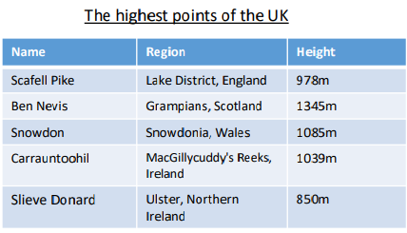
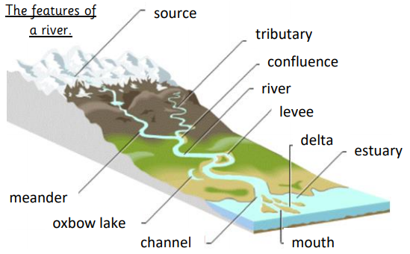
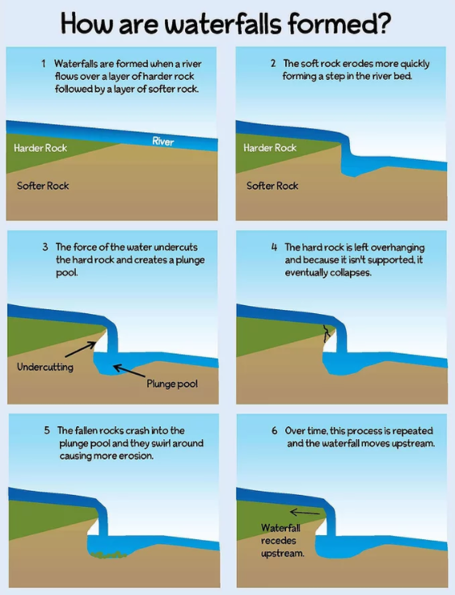
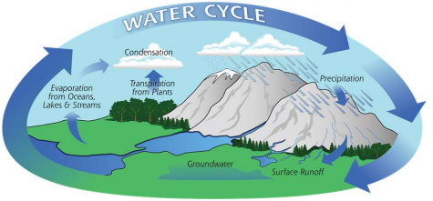
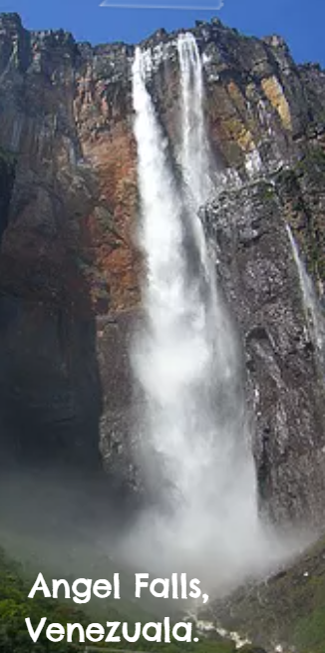
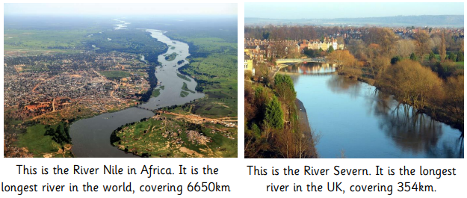

Slide 6
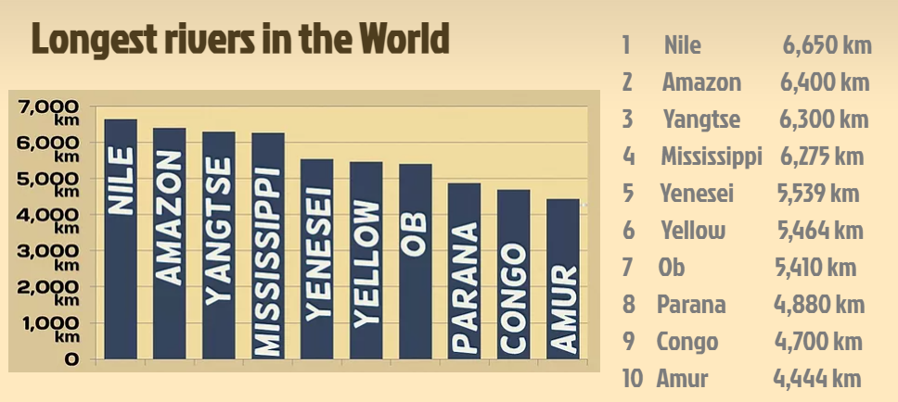
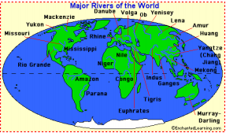
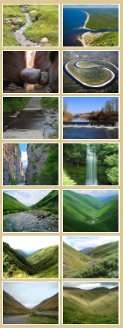
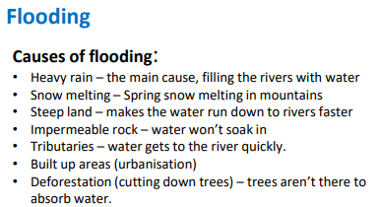
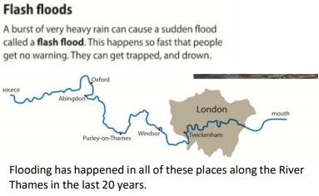
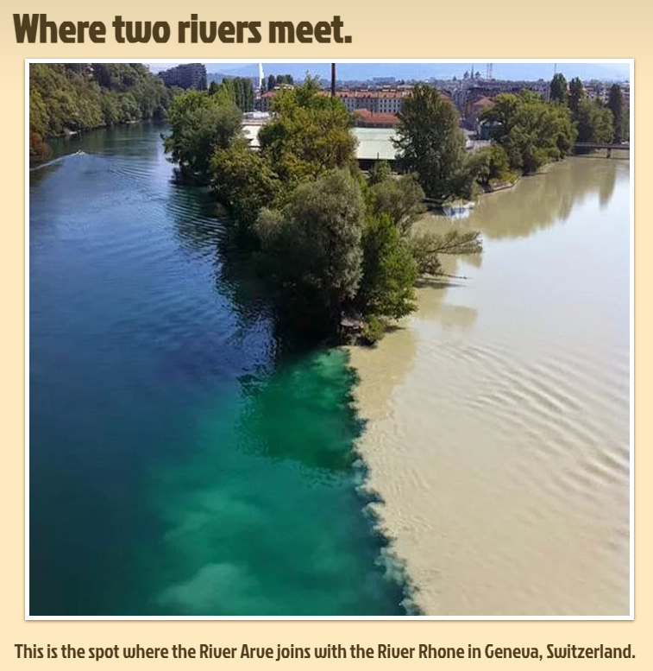
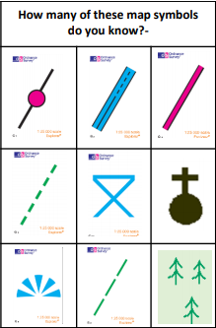
VOCABULARY
Water Cycle. | The continuous recycling process of water
Tributary | Where one river meets another and merge together.
Stream | A small body of flowing water.
Source | The beginning of a stream of water.
Meander | A winding curve or bend in a river.
River | A large amount of fresh water flowing continuously in a long line across land.
Lake | A large area of water surrounded by land
Erosion | The process that wears away the riverbed and banks.
Deposition | The process where material being transported by a river is put down.
Course | the route or direction followed by a river source the original point from which a river flows
Precipitation | rain, snow, sleet, or hail that falls to or condenses on the ground
Erosion | the gradual destruction of something
Transportation | The action of transporting someone or something
Deposition | the process where material being transported by a river is deposited
Sediments | matter that settles to the bottom of a liquid
Tide | the alternate rising and falling of the sea
Tributary | a river or stream flowing into a larger river or lake
Channel | a length of water wider than a strait, joining two larger areas of water, especially two seas
Turbulent | moving unsteadily or violently
Evaporate | turn from liquid into vapour
Infiltrate | the process by which water on the ground surface enters the soil
Saturate | to become thoroughly soaked with water or other liquid so that no more can be absorbed
A River Journey

