Slide 1
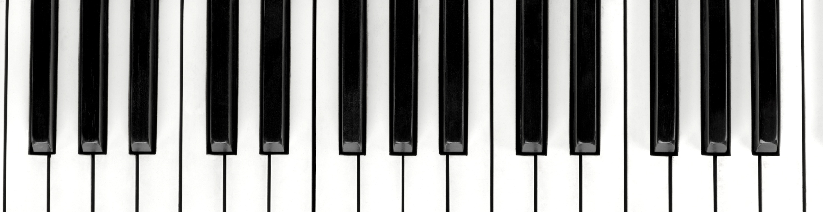
Music at Ashurst Wood

Slide 2
The Music Curriculum
The primary music national curriculum for Key Stages One and Two covers the following:
• Singing
• Playing tuned and untuned instruments
• Listening to recorded and live music
• Composing and improvising
• Understanding music history
• Understanding notation
Teaching music in primary school requires facilitating children to;
“perform, listen to, review and evaluate music across a range of historical periods, musical genres, styles and traditions, including the works of the great composers and musicians.”

Slide 3

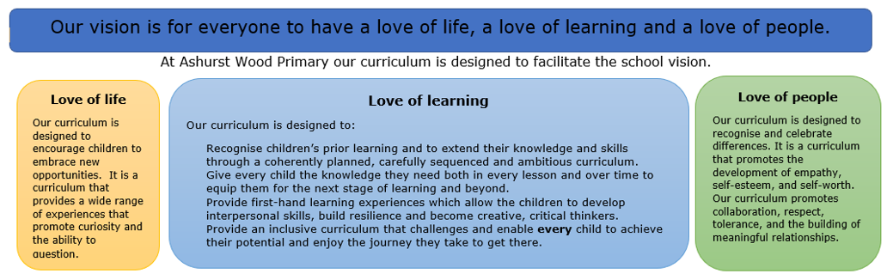
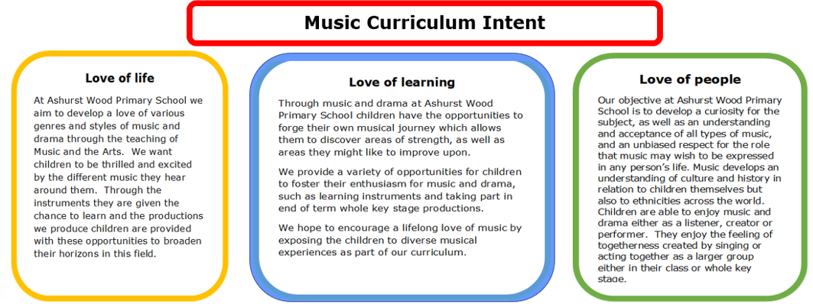

Slide 4
Appreciation
Pop
Opera
Children listen to a range of high-quality music to promote an appreciation of music across different genres, styles and traditions, including by great composers and musicians.
We have developed a plan of core music appreciation in each class in addition to the music appreciation within music lessons.
Children learn to review their work and the work of others. In doing this, they broaden their experience of music from different cultures and historical periods, develop skills in understanding musical composition and extend their musical vocabulary.
Blues
Rock
Folk
Soul
Rock and Roll
Country
Reggae
Hip Hop
Calypso
Classical
Jazz

Slide 5
Performance
Children are given opportunities to play and perform in solo and ensemble contexts.
All children are able to express their thoughts and feelings through music to develop self-confidence and a love of music and singing.
Examples include:
• Key Stage Two Christmas carol service
• Harvest festival
• Key Stage One nativity
• Key Stage Two production
• Assemblies

Slide 6
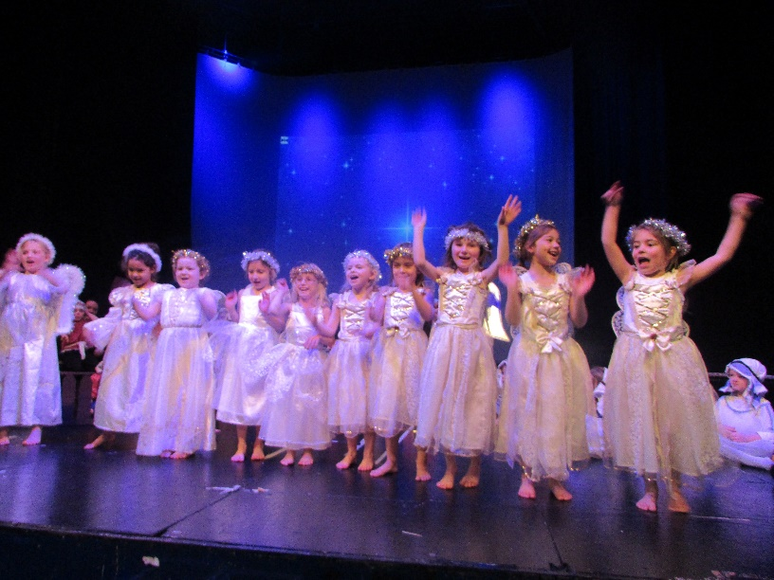
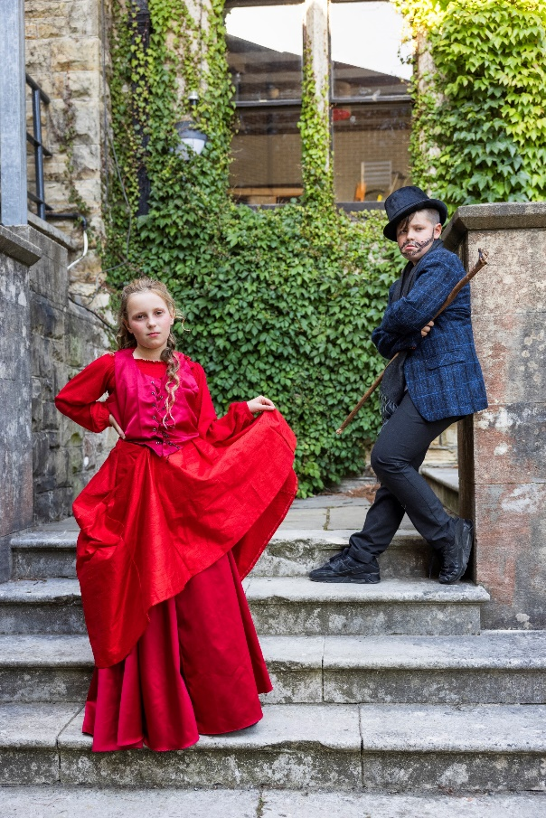
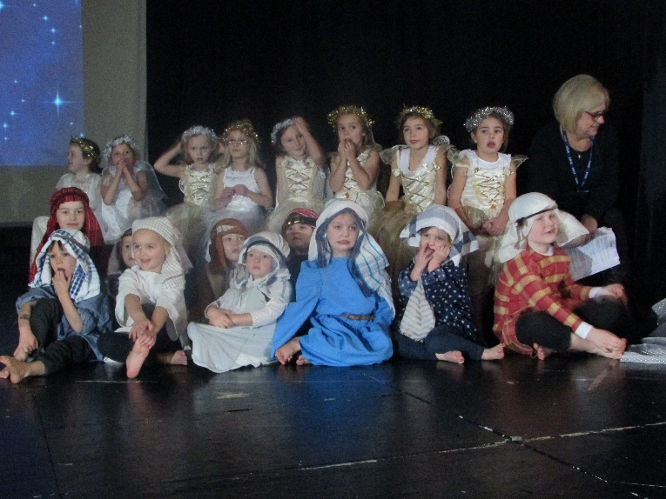
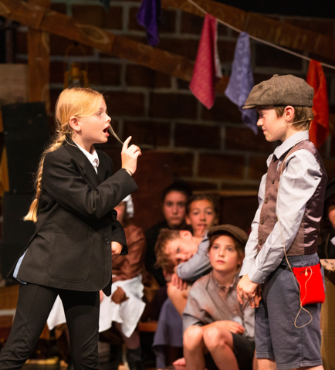
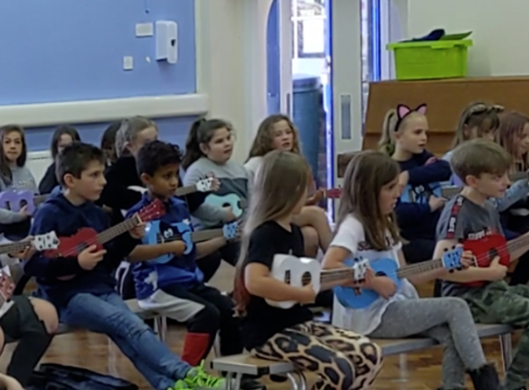
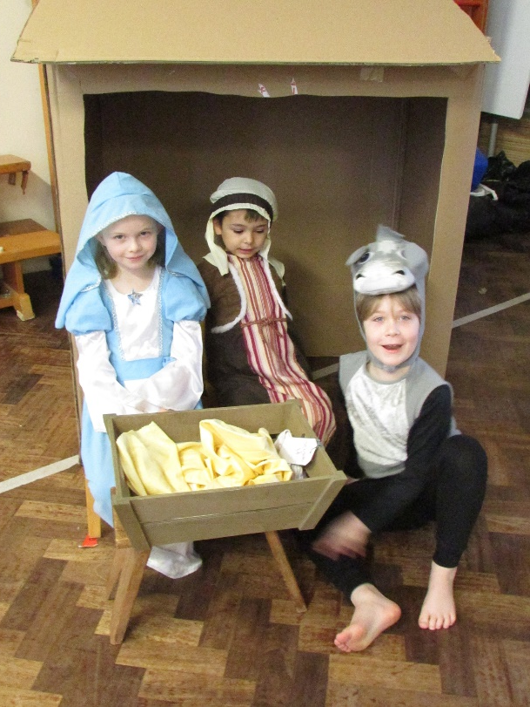
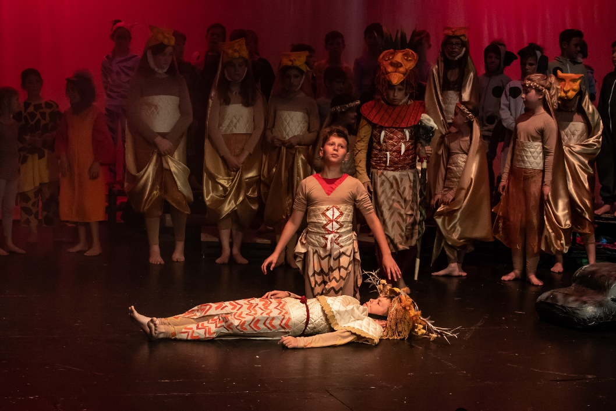
Performance
Key Stage Two Production
Assemblies
Key Stage One Nativity

Slide 7




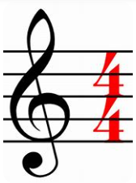


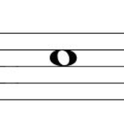




Technical Knowledge
Children explore how music is created using their voices and tuned and untuned percussion instruments.
Teachers ensure that all children develop their depth of understanding and progression of skills through the teaching of technical elements including pitch, duration, dynamics, tempo, timbre, texture, structure and musical notation.
At our school, the teaching and learning of music is planned using the ‘Kapow’ scheme of work.

Slide 8
What our children say
I like performing together.
It is fun and it makes people happy.
You learn about bars, minims and time signatures.
We get to make our own music. (composing)
I am enjoying learning the songs.
It makes me joyful.
You get to play different instruments.
You learn about different countries and the way they make different types of music.
It brings people together.
It is fun playing the glockenspiels.
It’s cool!

