Slide 1
Physical Education at Ashurst Wood

Slide 2
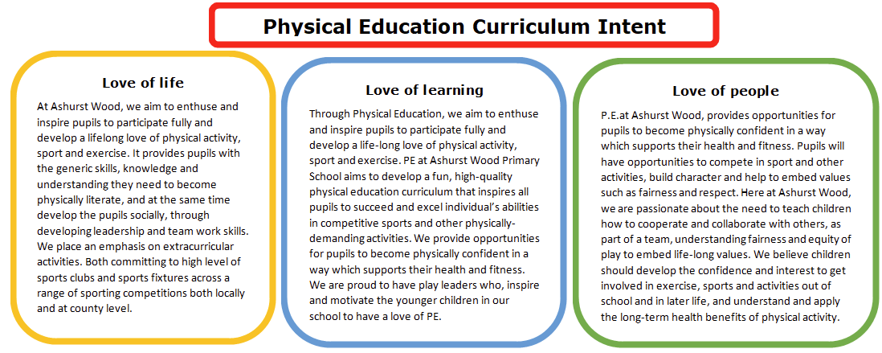
Physical Education Curriculum Intent

Slide 3
Ashurst Wood Physical Education Curriculum
Physical Education is an important subject in school because it increases physical competence, health-related fitness and self-responsibility. We want to promote an enjoyment of physical activity for all our children so that they can be physically active for a lifetime.
Our children love trying new sports.
They enjoy a range of after school sports clubs including netball, football and tennis.
By the time our children leave the school they will have participated in sports festivals, and most will have represented the school competitions and tournaments.
At Ashurst Wood we use the Twinkle PE materials which are organised in a two year rolling programme.
Lessons cover;
Multi Skills
Outdoor Adventurous Activities
Dance
Athletics
Games
In addition to class PE lessons, the children also get a session taught by our Sports Coach and Forest School sessions.

Slide 4
School Games Award
We are delighted to have maintained our Gold School Games Award for Key Stage Two and our Quality Start Award for Key Stage One.
This recognises the hard work that has been undertaken to ensure all our pupils have access to a wide variety of sports opportunities within the school.

Slide 5
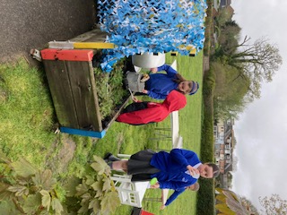
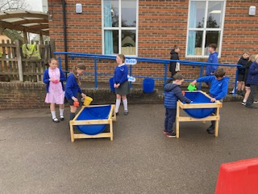
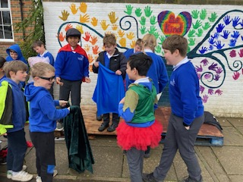
Active Lunch Times
At Ashurst Wood, children are able to take part in sporting activities at lunch times organised by our Play Leaders (Year 5 children).
Children are also able to take part in a wide variety of play activities at play time as part of the OPAL network.

Slide 6
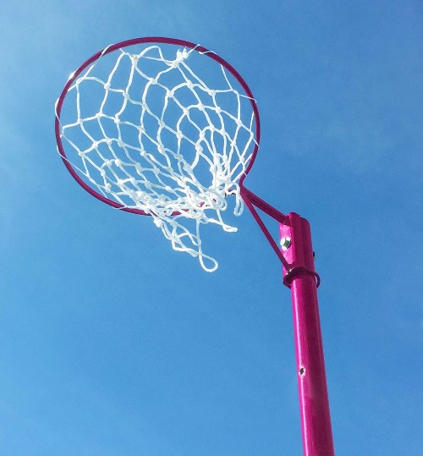
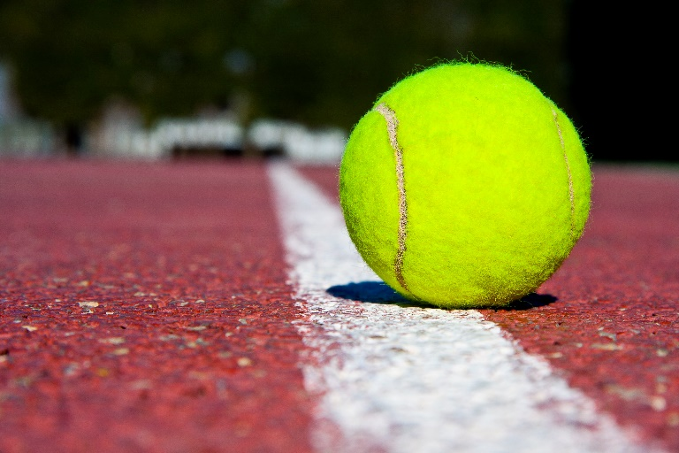
Clubs at Ashurst Wood
We offer a range of clubs for the children to engage in extra-curricular sporting opportunities. The clubs change throughout the year, depending on the season and weather.
Football
Netball
Kicks Dance
Karate
Kick Boxing
Rounders

Slide 7
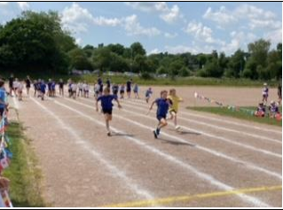
Sporting Events
Ashurst Wood takes part in a vast array of different sports with other local schools during the year.
Mid Sussex Active Primary School Sports Competitions include;
Primaryship Netball Tennis- Road to Eastbourne
Primaryship Football MSA Multi Skills Festival
Boys & Girls Football Competitions Basketball Tournament
Cross Country MSA Tri Golf
Sport Hall Athletics Area Sports
QuickSticks Hockey Stoolball
Netball Festival Kwik Cricket
Tag Rugby

Slide 8
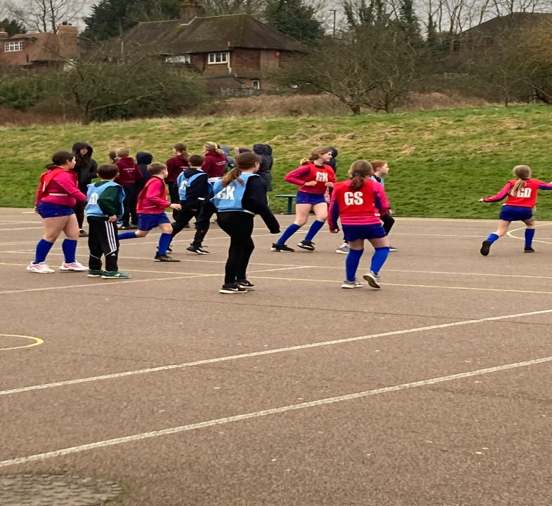
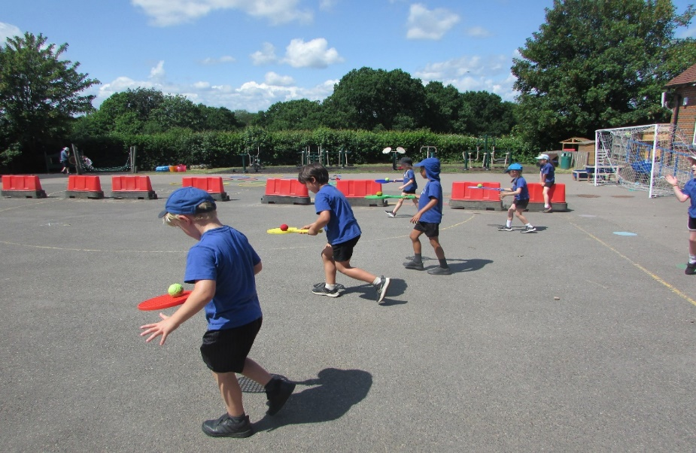
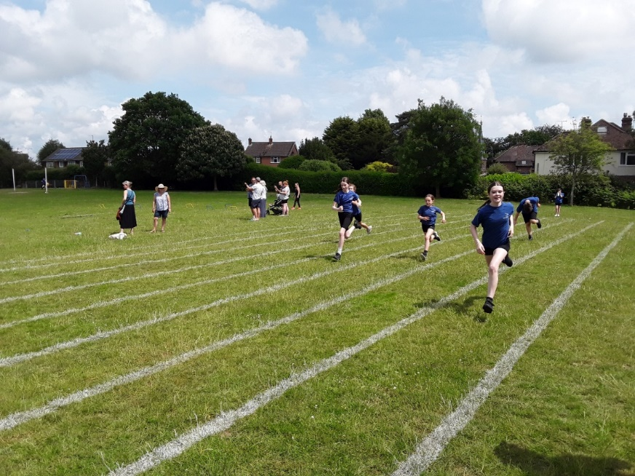
East Grinstead Group of Schools Sporting League.
At Ashurst Wood, we take part in the netball and football league playing matches against other local primary schools.

Slide 9
Pupil Voice for matches,
tournaments and festivals.
I am a really sporty person and I enjoy taking part in athletics like the Area Sports at Sackville.
It is fun and challenging and it is important to take part.
I really enjoy playing team sports like bench ball and hockey and taking part in tournaments.
It is good when you get to play in the East Grinstead Sports Centre. Playing sport is fun.
I play in the football tournaments and it is good experience playing against other schools.
It is fun and sometimes challenging but it makes me happy as I like a challenge.
I love it when we score and play well as a team.
It is fun and it keeps you fit.

