Slide 1
Religious Education at Ashurst Wood
The teaching of R.E. (religious education) is statutory in English primary schools.
That means that Government legislation stipulates that schools are legally obliged to teach it.
It also stipulates that the teaching of Religious Education MUST be non-denominational.

Slide 2
Religious Education at Ashurst Wood

Slide 3
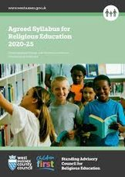
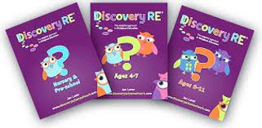
Religious Education at Ashurst Wood
At Ashurst Wood Primary School we have developed a 2-year rolling long term Term Plan using a combination of the following publications:-
Discovery R.E is a comprehensive and detailed set of medium term planning set out in single year groups.​
​
Each main religion is covered (Christianity, Buddhism, Hinduism, Islam, Judaism and Sikhism) which are all taught through enquiry modules and involves critical thinking.​
​
Christianity is taught in every year group, with Christmas and Easter given fresh treatment each year.
The Local Agreed Syllabus is a document which outlines the statutory requirements for Religious Education (RE) in the Local Authority.

Slide 4
Religious Education at Ashurst Wood
The table below shows what the Agreed Syllabus has outlined as being relevant to what is taught in R.E in schools.​
​We can see from this criteria that R.E is not just learning about different religions but also about how people express their faith, how they feel they belong, how they put their beliefs into practice and asking bigger questions e.g. about right and wrong and their own opinions about God.
Core Beliefs, Ideas and Symbols ​ | Expression of Faith ​ | Identity-daily life ​ | Social Action - putting beliefs into action ​ | Ask big questions and make connections ​
Pupils should have the opportunity to learn about and understand the main beliefs/concepts and teachings of the religions studied. For example: ​ core concepts and ideas such as beliefs about God, Allah, creation, mitzvot; ​ principal sources of authority such as the Bible, Torah, Qur’an; ​ important stories - Old Testament stories, New Testament stories, The Night of Power, Rama and Sita; ​ significant religious leaders such as Moses, David, Muhammad, Esther, Ibrahim; ​ important symbols and artefacts such as Ner Tamid, prayer beads, cross. ​ ​ | Pupils should have the opportunity to learn about how people express their belief and faith as individuals, groups, and communities. For example: ​ through worship at home; ​ worship and attendance at a place of worship- synagogue, man dir, mosque, church; ​ major celebrations and festivals such as Easter, Christmas, Eid ul Fitr, Sukkot, Hanukkah, Diwali. ​ | Pupils should have the opportunity to learn about the daily lives of people in the religions studied and how they reflect their religion and sense of belonging. For example: ​ the daily life of a Christian, Muslim, or Jewish child; ​ special clothes, food, personal devotion; ​ rituals and traditions that mark important events – birth customs. ​ ​ | Pupils should have the opportunity to learn about how people of faith put their beliefs into practice and actions individually, as communities and organisations and their link with cultural heritage and British values. For example: ​ Tikkun Olam; ​ Christian Aid; ​ Idabah (worship and belief in action) in the Muslim community; ​ how different communities and organisations work together to make the world a better place - interfaith projects locally, nationally, and globally; ​ the impact of religions on culture and society – such as the impact of Christianity as basis of UK jurisprudence. ​ | Pupils should have the opportunity to think about “big questions” about meaning, purpose and truth, identity, similarities, and differences between the religions studied, their own lives and the world around them. For example: ​ consider issues of right and wrong; ​ talk about how people should live their lives; ​ share their own ideas about God and the world.​ ​

Slide 5
Religious Education at Ashurst Wood
What does the R.E Curriculum at Ashurst Wood look like?
​
Our Medium-Term Plan is mapped out with a Theme, Religion to focus on, Key Question/s and links to British Values and also to the Agreed Syllabus.​
​
An example of progression of knowledge in this area would be as follows:-​
​
KS 1 question- ‘What is Christmas?’ (although this question is on the planning every other year, we focus on the Christmas story every year in KS 1 as part of our Nativity production and general learning)​
​
Year 3 and 4 question- ‘What is the most significant part of the nativity story for Christians today?’​
​
Year 6 question- ‘Do Christmas celebrations and traditions help Christians understand who Jesus was and why he was born?’​
​
We would hope that the children have retained the knowledge from each time they learn about the Christmas story to use and apply it to their thinking as they go higher up the school.

Slide 6
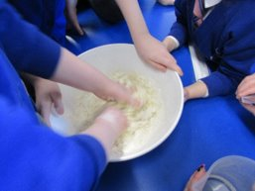
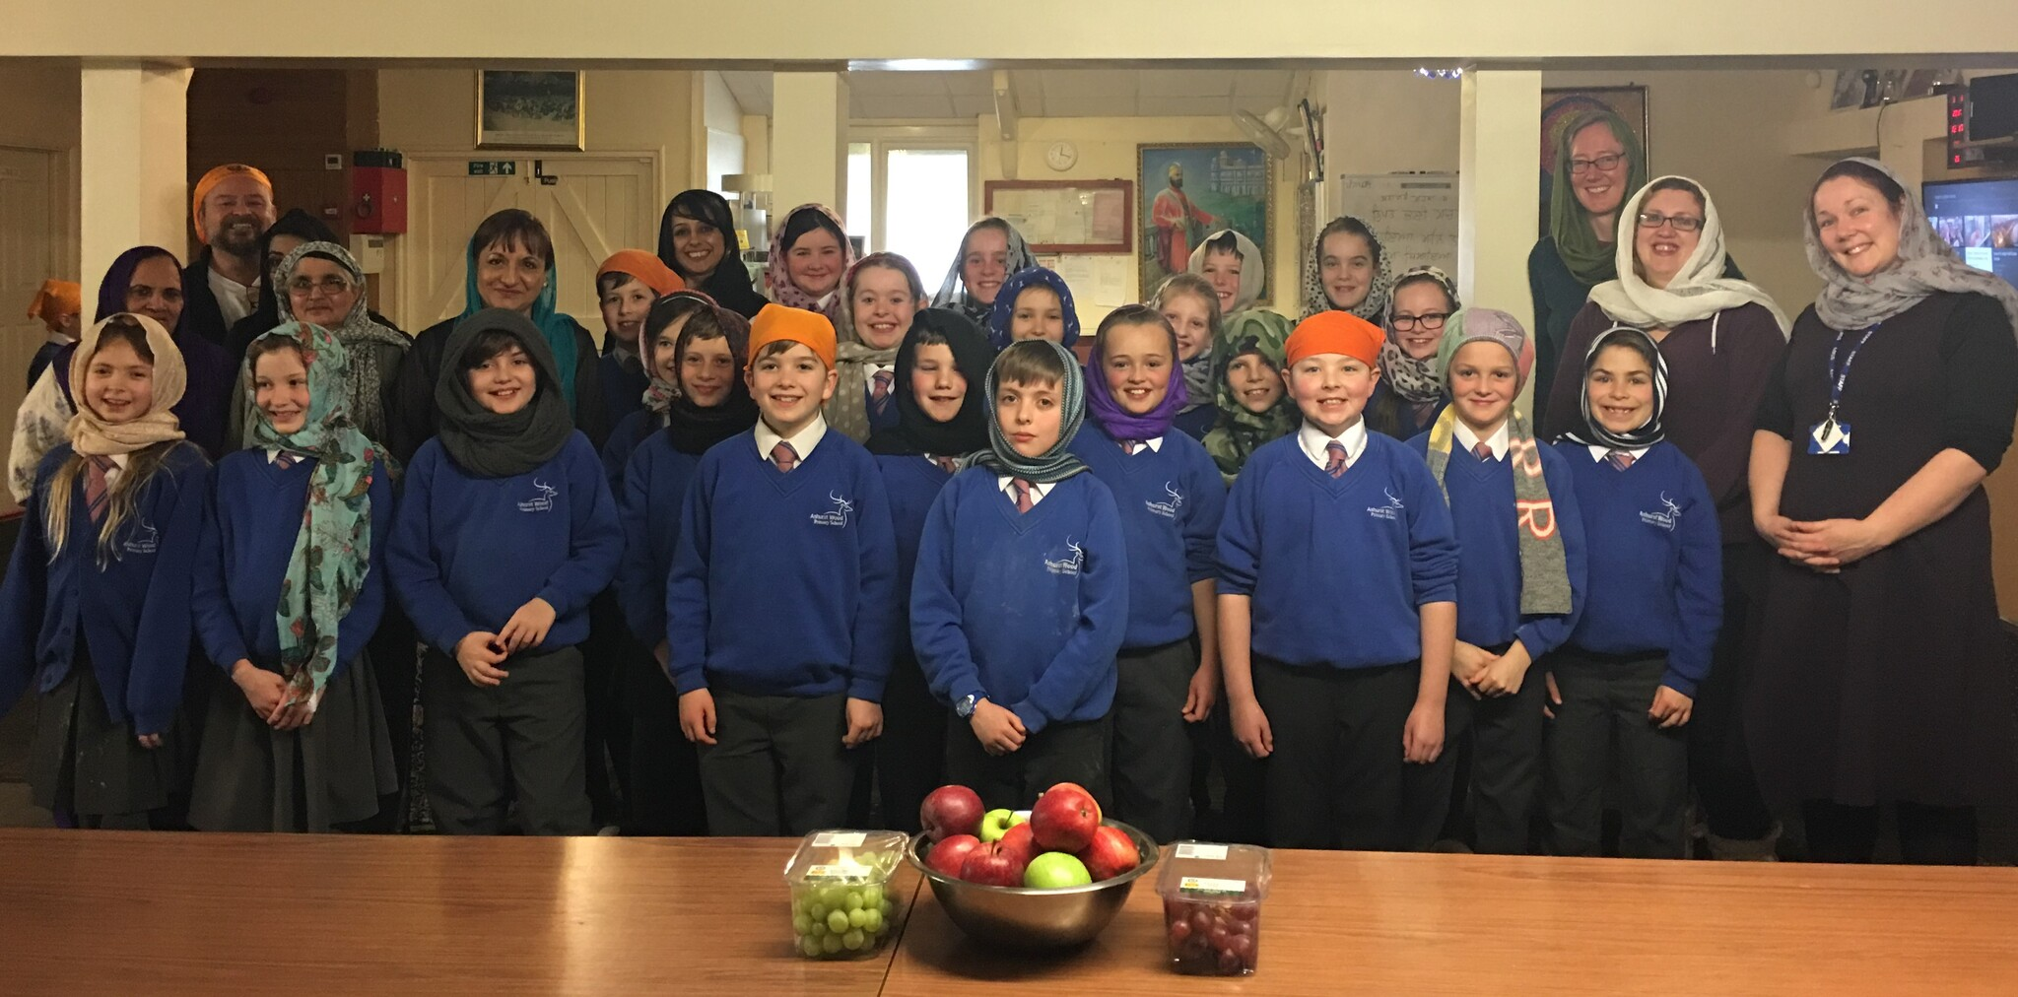
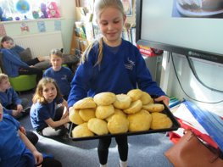
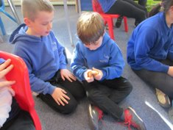
Religious Education at Ashurst Wood
Where possible we provide ‘hands on’ experiences in R.E.
Breaking of the bread.
Visiting the Gurdwara

Slide 7
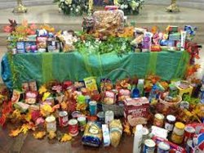
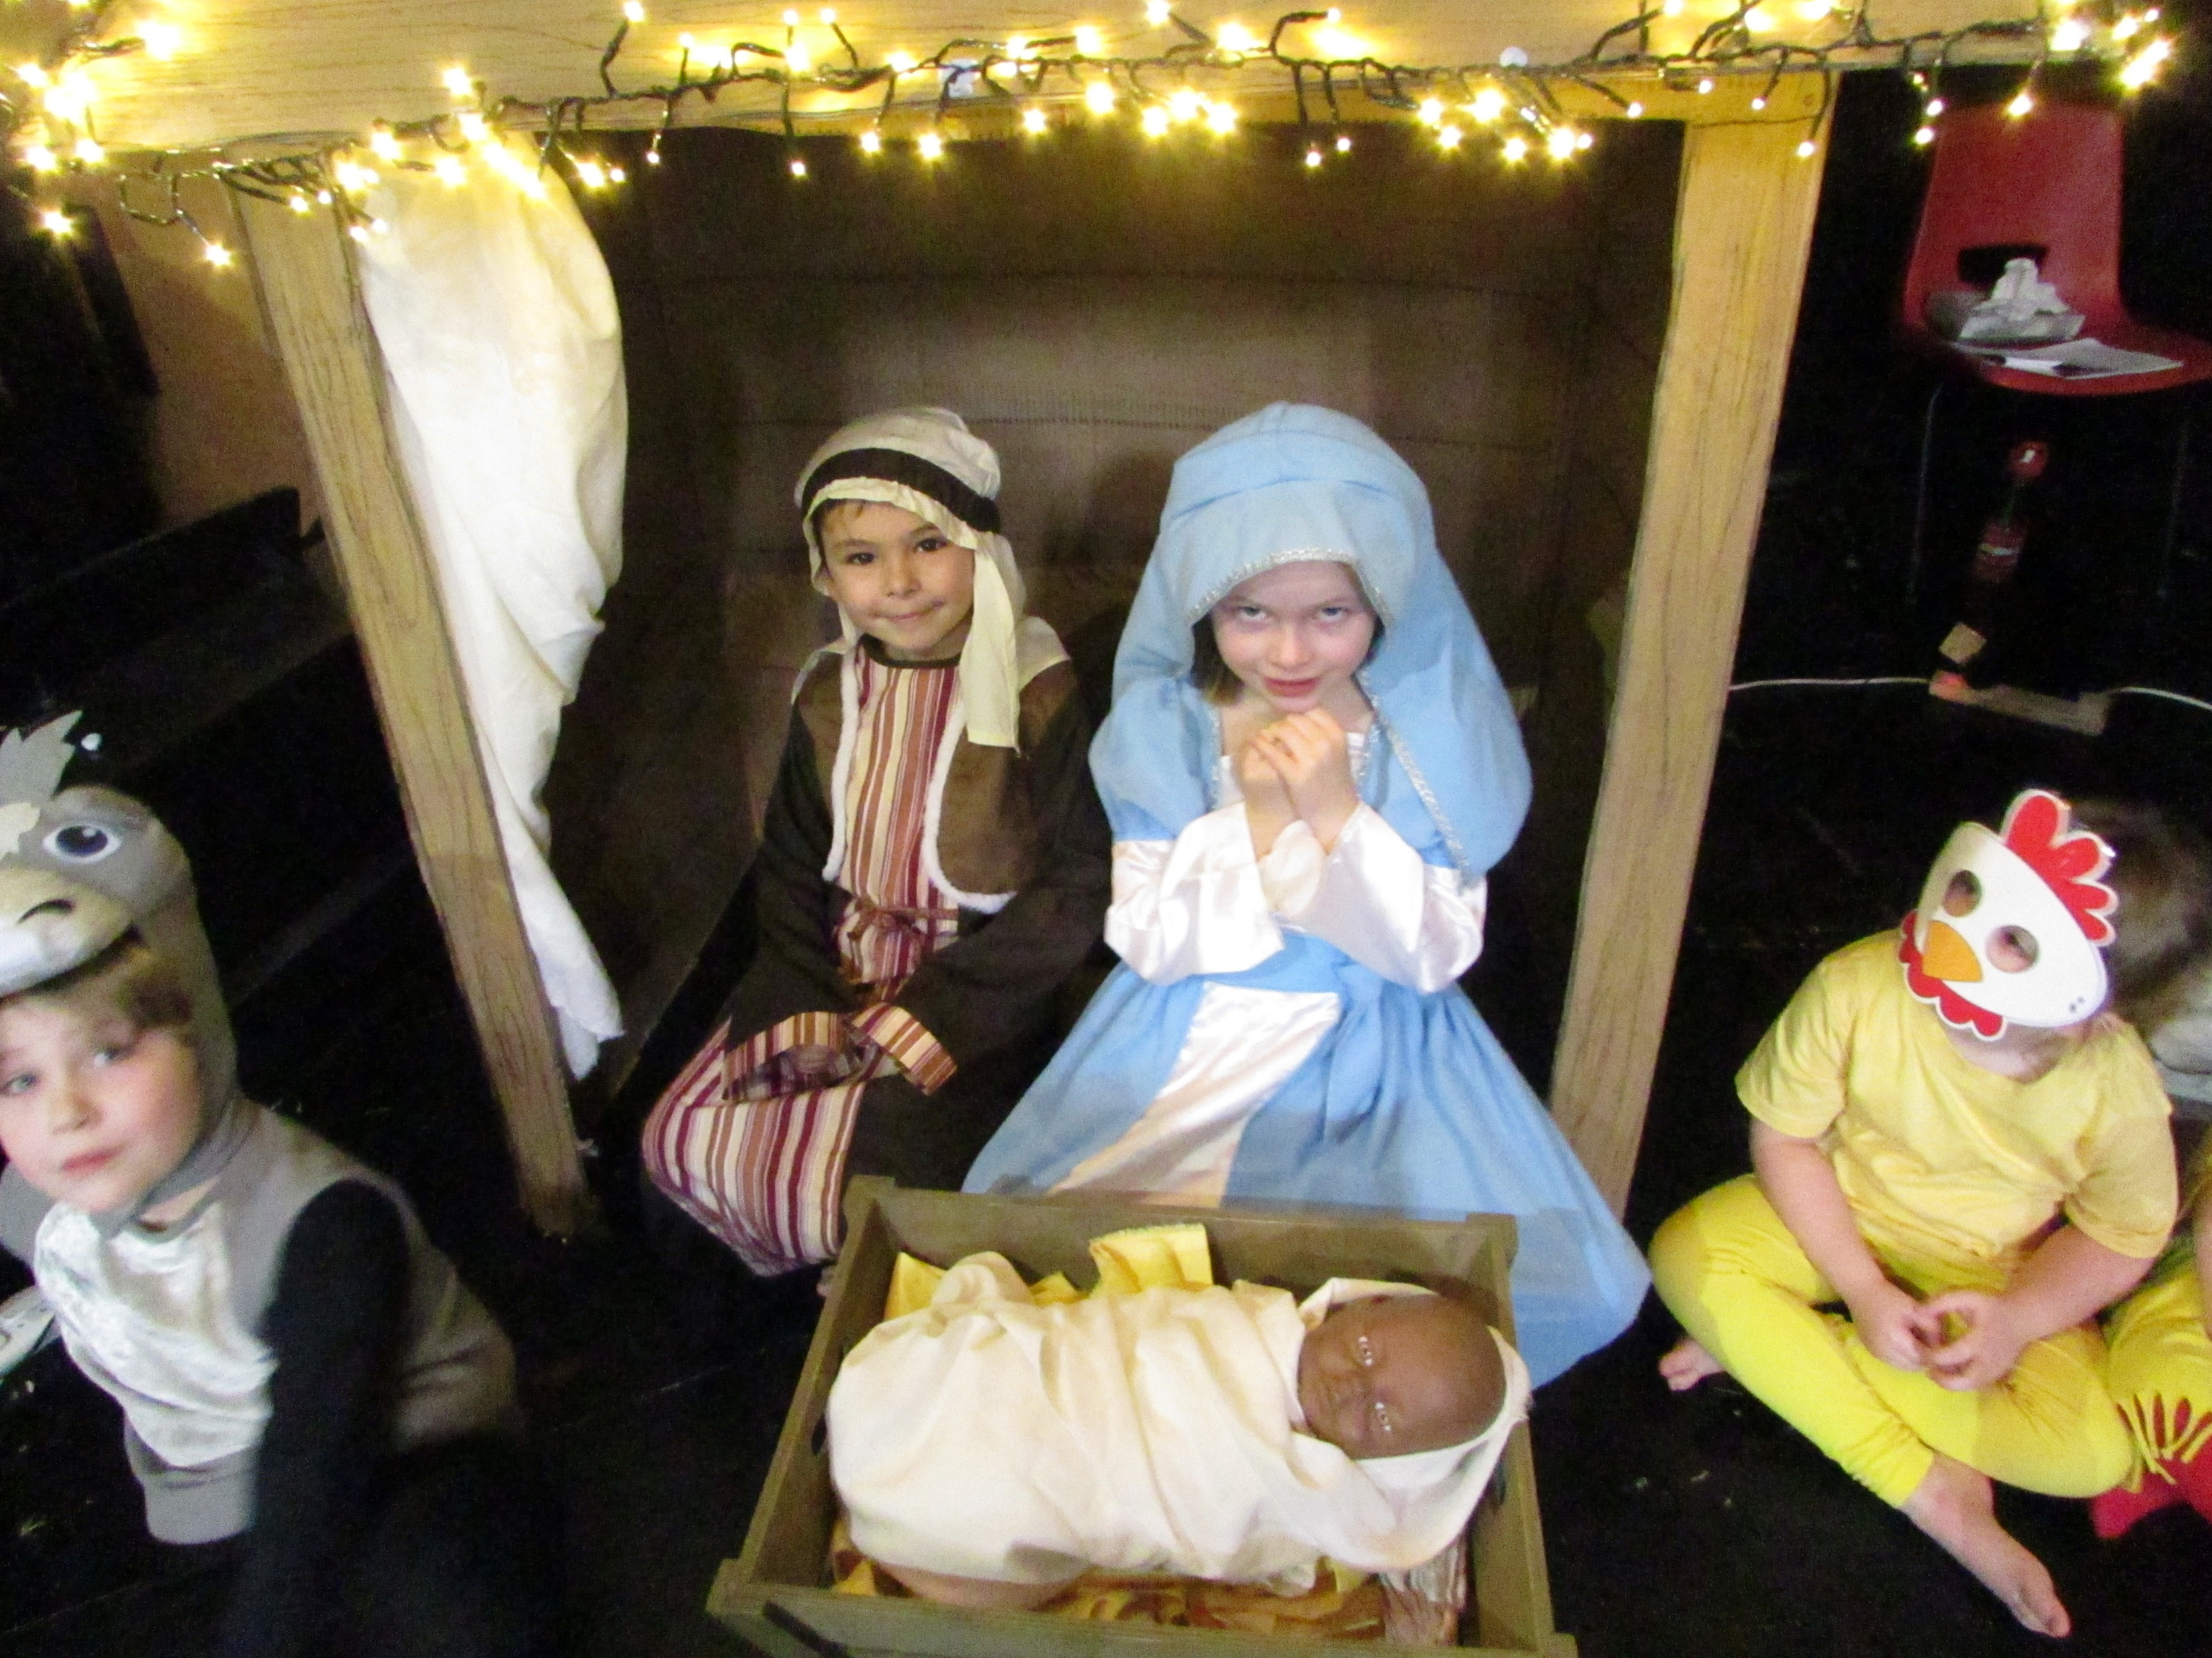
Religious Education at Ashurst Wood
R.E. in the wider Curriculum
Open the Book Assemblies​
​Harvest Assembly from local vicar/Harvest collection​
​Visit to St Dunstan’s Church at important points of the year- e.g. Harvest, Christmas. Children to recite a poem or sing a song whilst there.​
​KS1 Nativity performance​
KS2 Carol Concert at the local village hall​
​Yr 3/4 visit to St Swithuns Church during our local study topic​
Yr 6 singing carols at the local community cafe

Slide 8
Religious Education at Ashurst Wood
What our pupils say
I like answering the questions.
I remember in Reception we learnt about when Jesus was born but now in Yr 5 we are learning more about his life
R.E challenges my thinking because every time there is something new.
My Favorite part of R.E is learning about different religions
I remember learning about Diwali.

