Slide 1
Essential Characteristics
• An excellent knowledge and understanding of people, events, and contexts from a range of historical periods and of historical concepts and processes.
• The ability to think critically about history and communicate ideas very confidently in styles appropriate to a range of audiences.
• The ability to consistently support, evaluate and challenge their own and others’ views using detailed, appropriate and accurate historical evidence derived from a
range of sources.
• The ability to think, reflect, debate, discuss and evaluate the past, formulating and refining questions and lines of enquiry.
• A passion for history and an enthusiastic engagement in learning, which develops their sense of curiosity about the past and their understanding of how and why
people interpret the past in different ways.
• A respect for historical evidence and the ability to make robust and critical use of it to support their explanations and judgments.
• A desire to embrace challenging activities, including opportunities to undertake high-quality research across a range of history topics.

Slide 2
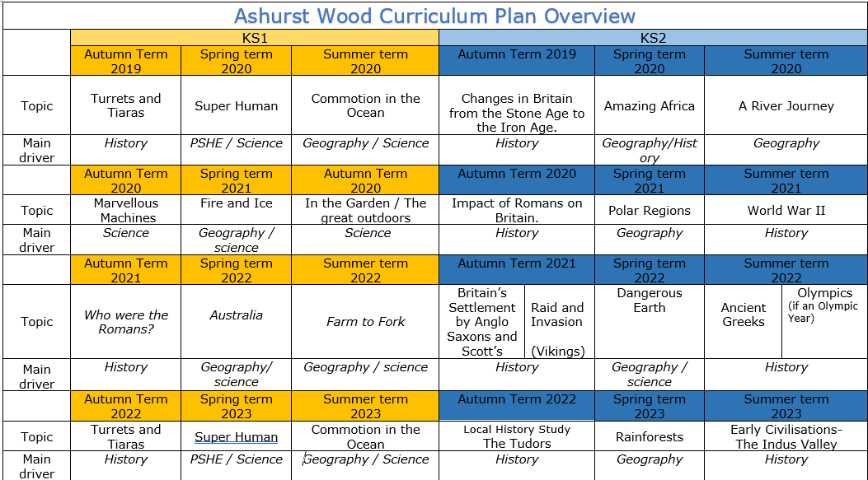
Turrets and Tiaras
History
Changes in Britain from the stone age to the Iron age
History
Nurturing Nurses
Impact of the romans on Britain
History
Great Fire of London
Who were the Romans?
History
The Anglo Saxons and Viking struggle for the Kingdom of England.
History
Turrets and Tiaras
History
Nurturing Nurses

Slide 3
KS1
HISTORY TEACHING AND LEARNING AT ASHURST WOOD
Our topic planning is designed so that some topics are History led and the key knowledge and skills are captured in the planning and knowledge organisers. Other topics may contain historical knowledge in addition to the main driver. All children in KS1 will study the same topic and so expectations will be different for a YR Y1 and a Y2 child. For this reason and to ensure that there is no ceiling placed on a child’s learning we have identified outcomes for all children Must (End of Y1) Should (end of Y2) Could a rich and deep understanding.
History
At Ashurst Wood
Superhuman – Nurturing nurses
Should
Know where some key people fit on a timeline.
Remember a few significant names and dates.
Use common words and phrases related to the passing of time (now, then, before).
Understand why people and events being studied are important.
Use historical vocabulary (eg. past, present, recently, years, decades, centuries).
Should
• Know that Florence Nightingale & Mary Seacole were both nurses during the 19th century and both were present during the Crimean war.
• To know where some key events fit onto a timeline - understanding of when 1820 was and a wider overview of the period.
• Understanding of what it was like to grow up in the 1820’s as a girl.
• Early childhood experience of Florence and Mary - Know that Florence came from a well-off Victorian family and was asked to lead a party of nurses to help heal the soldiers during the Crimean war. Mary leant most of her nursing from her mother back in Jamaica. She came over to England in the 1850s wanting to help in the Crimean war.
• Know that the British Government would not take Mary to the Crimea, so Mary decided to go by herself and set up the British Hotel to help wounded soldiers.
• Know that Florence had a nursing career prior to travelling to the Crimean War.
• Know about the conditions in the Crimea- conditions of the hospitals.
• Know about the changes Florence made to the hospitals. Impact of the changes she made home and abroad.
EYFS
Must
Recognise the difference between ‘old’ and ‘new’
Know where some basic events fit on a timeline, relating to their topic Begin to understand why events being studied are important.
Use phrases such as now, after, before, modern, new, old, a long time ago, in my lifetime, before I was born, when I was younger.
Begin to recognise different ways we can learn about the past (eg. from images, objects, stories, first-hand witnesses).
Children at the expected level of development will:
Talk about the lives of the people around them and their roles in society;
- Know some similarities and differences between things in the past and now, drawing on their experiences and what has been read in class;
- Understand the past through settings, characters and events encountered in books read in class and storytelling.
Skills
Record some events onto a timeline.
Say how lifestyles (work, school, play etc.) were the same or different in the past.
Describe differences between ‘then’ and ‘now’.
Discuss the speed of change - sometimes in slow increments, sometimes in leaps
Recount key events from the past in their own words and begin to explain why these events happened.
Begin to think about the impact that historical events have had on modern life.
Begin to express preferences and justify them with evidence / facts (eg. Who was the greatest explorer?
Ask and answer historically relevant questions.
Compare events from different periods in history (eg. different discoveries/voyages).
Use a range of sources (eg. pictures, photos, artefacts, stories, text books, field trips etc.) to extract some information about the past.
Begin to piece together clues from a variety of different sources.
Skills
• Place some basic events onto a timeline and use this to support the retelling of past events.
• Say how something is the same or different in the past.
• Develop a sense of time and how fast things change (eg. differences between changes in their / their parents / their grandparents lifetimes).
• Show an understanding of some key events.
• Start to think about the reasons why things might change (eg. improvements in technology / making life easier / more fun).
Ask and answer some historical questions.
• Sort pictures / objects / events into ‘old’ and ‘new’.
• Use pictures and photographs to extract some information about the past.
ENRICHMENT
School nurse / parent visit to talk to children
First aid training
Skills
• Compare hospitals past and present.
• Compare Florence and Mary’s lives.
• Discuss Florence Nightingale’s legacy. Hospitals today.
• Use a range of sources to find out about the past, including photographs and artefacts. Historical Vocabulary before, after, past, present, then, now, chronological, event, compare, change, artefact Key Concepts before/after similar, different Topic Specific Vocabulary.
• To imagine how people in the past thought or felt.
• To begin to discuss which sources of information are the most useful.
• To ask and answer questions about the past to find out answers.
Enrich
Use knowledge of Florence Nightingale and Mary Seacole to research another aspect of Victorian life.

Slide 4
Year / Class KS1 |  | Topic Title: Superhuman – Nurturing nurses
Pre learning Links. In KS1 prior knowledge will depend on which year group the child is in. |  | Stunning Start: look at photographs and try to sequence in chronological order. Fantastic Finish: First aid skills
The Big Question: What makes Florence Nightingale and Mary Seacole superheros? |  | Creative Arts and Forest School Links
Small Question | What was it like in hospitals at this time?
Small Question | How have hospitals changed? | Literacy links | Vocabulary Castle Queen / King Princess Prince Turret Chivalry St Georges Day Royalty Past / Present Armour Lance Month Long ago Recent Parent Grand parent Clue | Politeness Helpful Servant Poor / Rich Drawbridge Moat Count Earl Countess Duchess Remember Today Yesterday Tomorrow The present The past The future What? When? Where? Why? | Timeline Date order Similar Different Important Living memory Inventions Homes The older generation Photograph Camera Painting Portrait Artifact Detective Opinion Artefact Week Year | Ancient Long ago Wea / period Royal Trason Diary Websites Investigate Research Historians Experts Significant Survive Camera Chronological order Memory Lifetime Calendar Decade Century Day
Small Question | Why is Florence Nightingale known as the lady with the lamp?
Small Question | What was Florence Nightingales greatest achievement?
Small Question | How was Florence Nightingale different to other women of her time?
Small Question | How did Mary Seacole help the British soldiers?
Useful Link https://www.linakerschool.co.uk/florence-nightingale-1/ https://www.florence-nightingale.co.uk/mary-seacole/ https://www.bbc.co.uk/bitesize/topics/zns9nrd/articles/znsct39

Slide 5
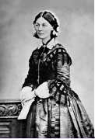
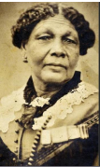
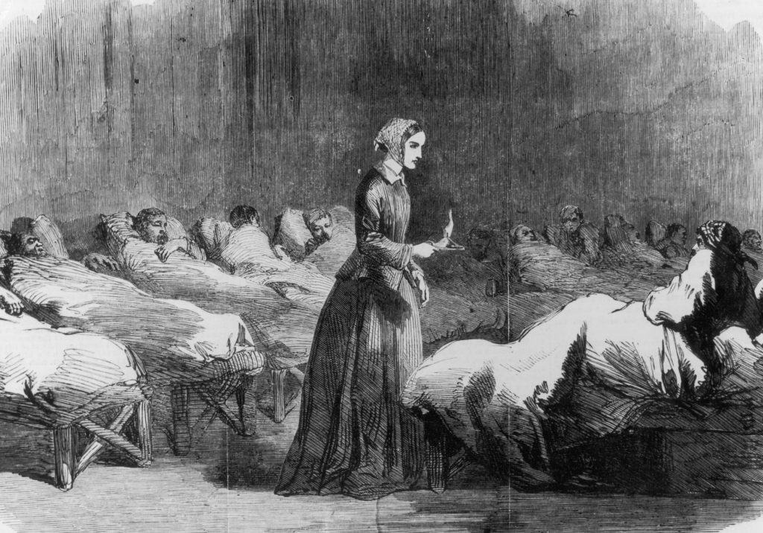
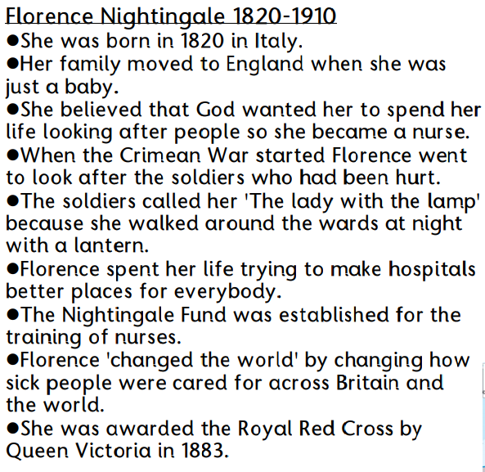
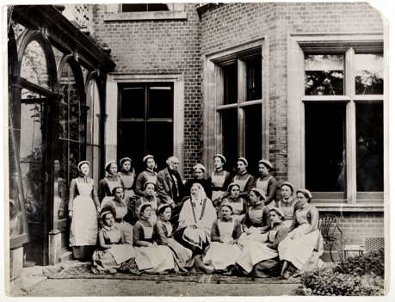
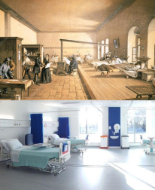
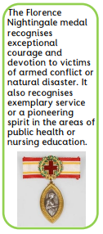
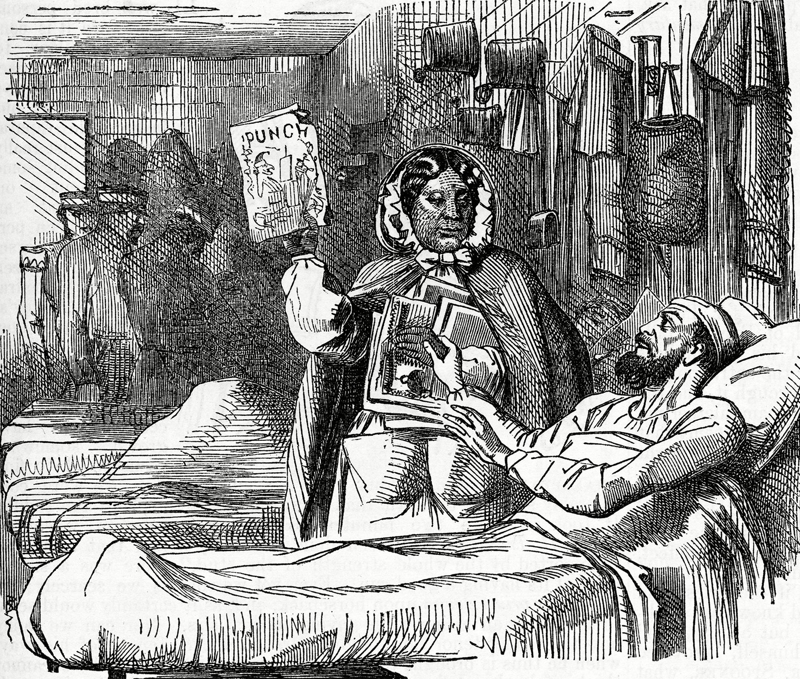
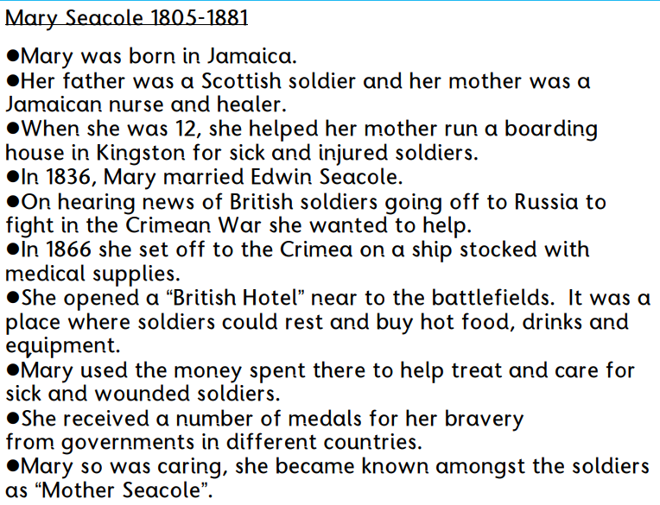
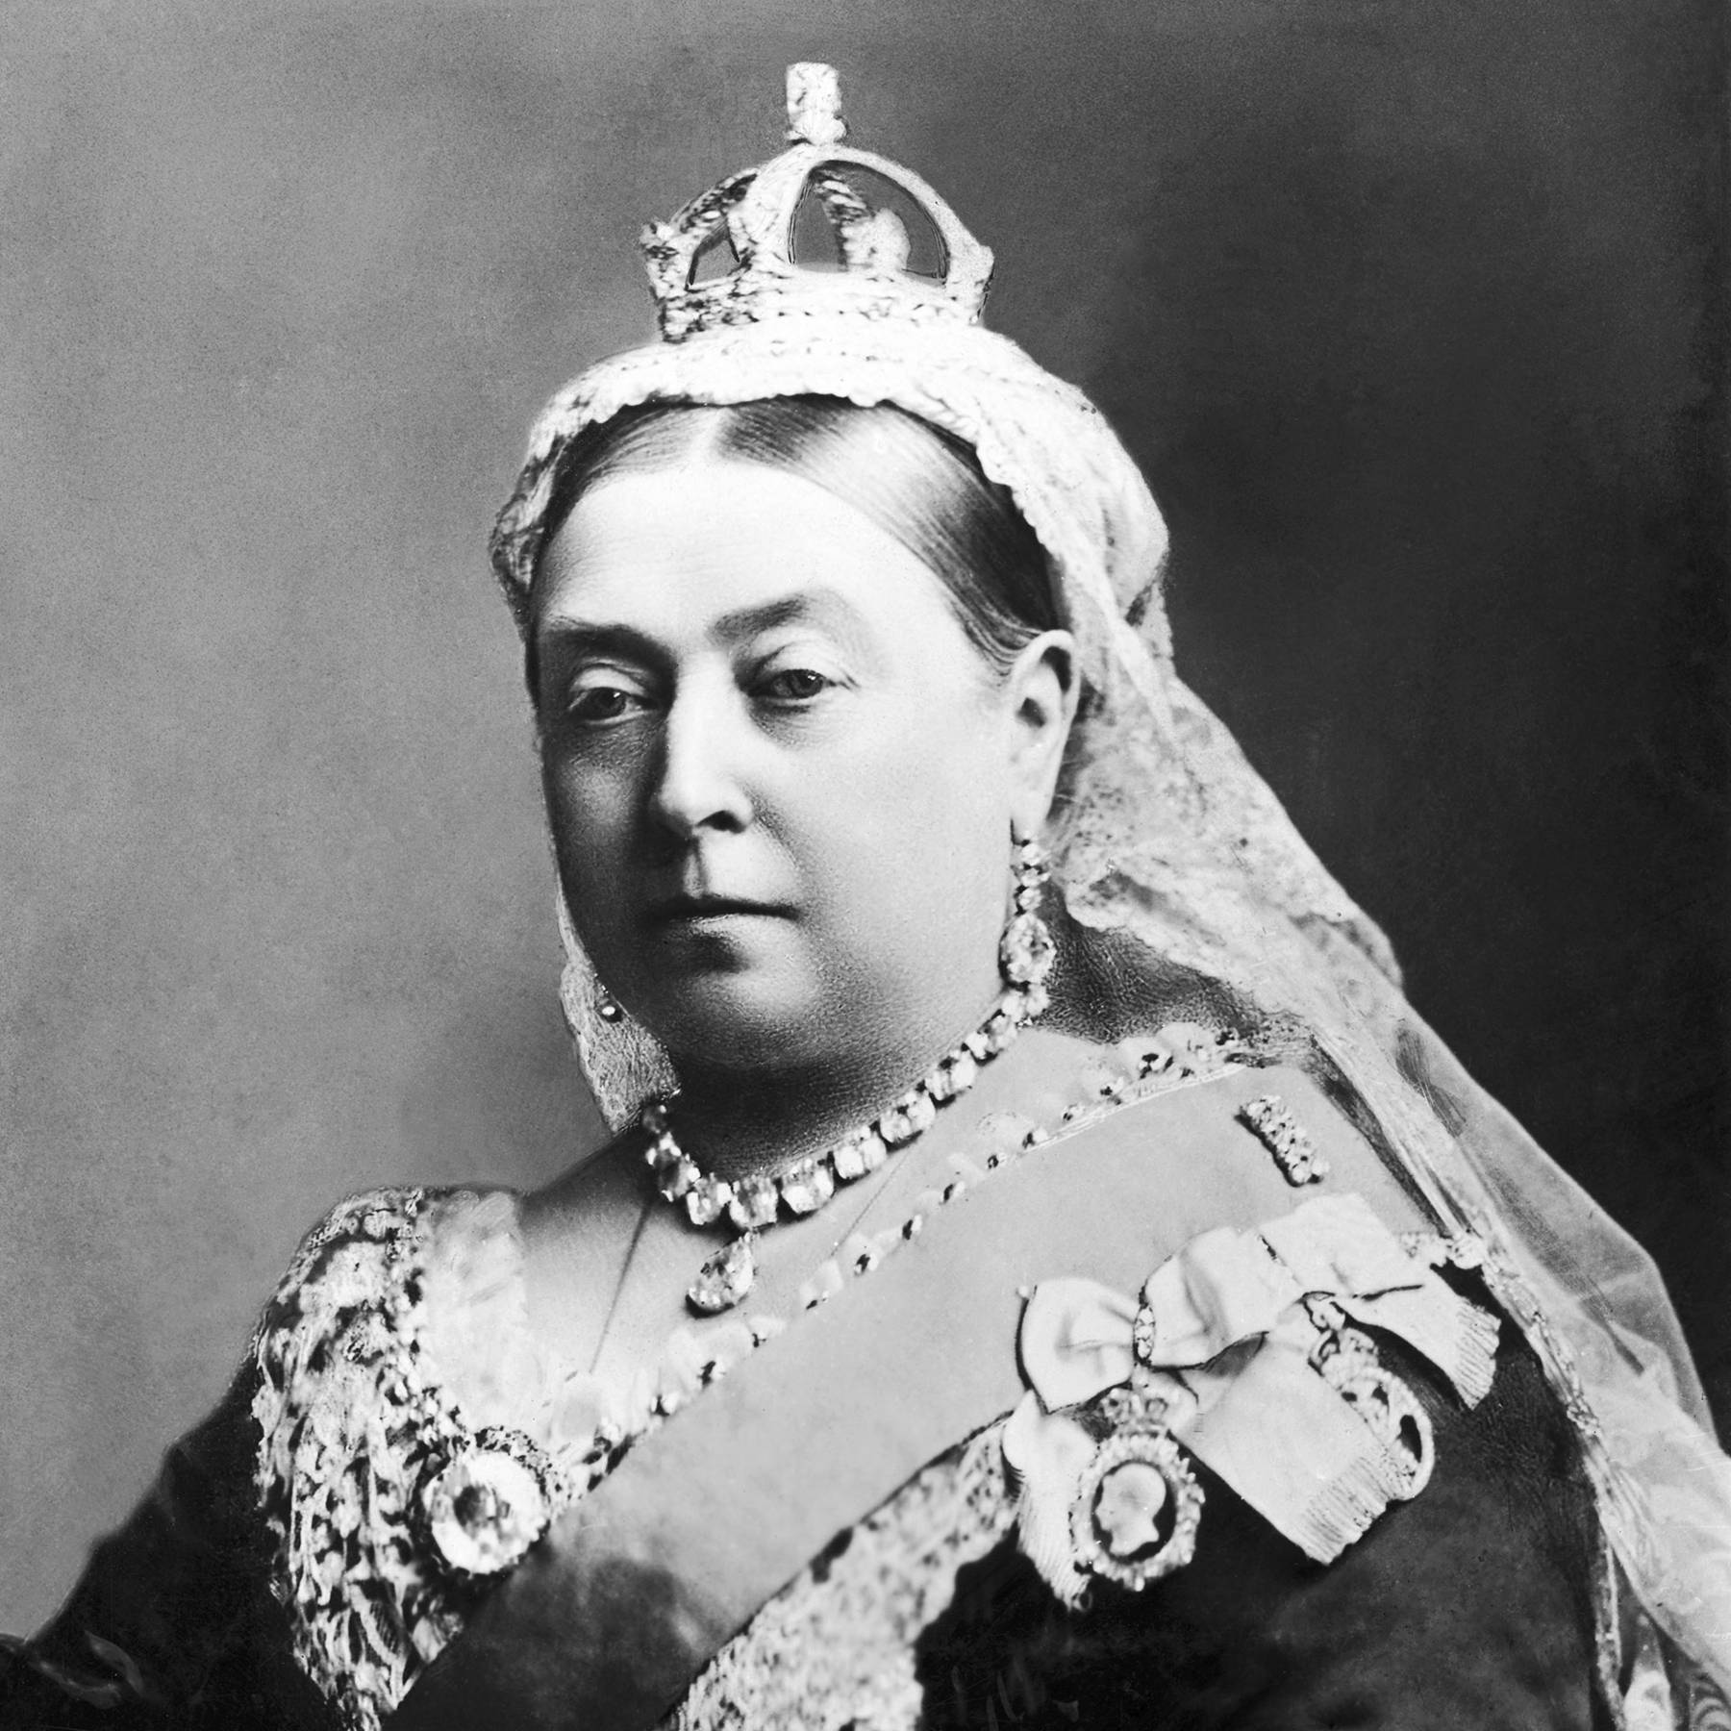
VOCABULARY
Crimean War | a war a long time ago in Crimea. On one side was Britain, France and Turkey and on the other side was Russia.
Dedication | give a lot of time and energy to something because it is important
Founder | a person who is the first to come up with an idea
Injured | an accident which causes damage or hurt
Lady of the Lamp | Florence Nightingale was given this name because she visited soldiers at night with a small lantern in her hand
Nurse | someone who works in a hospital and is trained to give care to people who are sick or injured
Royal Red Cross | a medal given to army nurses for always carrying out nursing jobs over a long amount of time and showing bravery and dedication to nursing
St. Thomas’ Hospital | the place where Florence set up her training school
Unhygienic | not clean
Wound | A serious infection that can lead to death
Heroine | Woman with heroic qualities such as great bravery
Influenza | Highly infectious disease
Amputated | Body part cut off by a surgeon
Slave | Servant or worker owned by another person

