Slide 1







SEND Information Report
Our Vision
Meet the team
Our Objectives
Additional
Support?
Identification
Education
Further Help
Complaints
Our Aims
What is SEND?
Staying Informed
Our Mission
SEND Support

Slide 2
The Mission
Our mission at ONE Multi Academies Trust is to celebrate and support diversity, providing tailored educational experiences through Quality First Teaching and inclusive provisions, embodying our belief in
‘Together As One’.

Slide 3
Our Vision
ONE Multi Academies Trust don’t just accept difference—we celebrate, we support, and we thrive on it for the benefit of our learners and our communities. The Trust is inclusive and understands that every child is different, meaning every child’s educational needs are different. Our academies provide Quality First Teaching, together with scaffolding and modelling for our learners alongside a range of provisions to help our learners to achieve.
We believe in ‘Together As One’.

Slide 4

Our Aims
We aim to:
Have happy learners who feel secure
Ensure every leaner is included
Raise the aspirations of, and expectations for all pupils with SEND.
Support learners to make progress in line with, or exceeding their expectations
Encourage learners to become more independent in their learning in order to prepare them for life after school.
Support learners to make a successful transition from school to further and/or higher education and employment.

Slide 5

Our Objectives
To identify and provide effective support for learners who have special educational needs.
To work within the guidance provided in the SEND Code of Practice, 2014.
To operate a “whole learner, whole school” approach to management the provision of support for special educational needs.
To provide support and advice for all staff working with learners with special educational needs.

Slide 6
What is SEND?
A child or young person has special educational needs if he or she has a learning difficulty or disability which calls for special educational provision to be made for him or her.
A child of compulsory school age or a young person has a learning difficulty or disability if he or she—
has a significantly greater difficulty in learning than the majority of others of the same age, or
has a disability which prevents or hinders him or her from making use of facilities of a kind generally provided for others of the same age in mainstream schools or mainstream post-16 institutions.

Slide 7
Additional Support?
SEND is not a fixed or permanent characteristic; it is a recognition that at a specific time a child has additional learning needs. At times, many pupils will require tailored or additional support to fully participate in everything the school has to offer.
(EEF SEN in mainstream guidance report 2020)

Slide 8
How do we decide whether a child has a special educational need?
All learners are assessed throughout the school year by their teachers. Teachers are always checking how well the learners are doing as they mark books, complete assessments and work with the class.
Some learners will be making less progress than we would expect. With some extra help, most of these will begin to catch up. This extra help might be equipment in class time, strategies for staff or targeted intervention.
A few learners will still struggle, even when this extra help has been put in place. When this happens, we would usually say that the child has a Special Educational Need (SEN).
The SENDCO will now carry out more detailed assessments/observations to find out what type of SEN the learner has. If we need more information about a learner’s needs or the type of support that they need, we may ask for help from other professionals such as The Learning Support Team or Educational Psychologists.
Once we have decided that a learner has SEND they will be added to the SEND register. This is a list of names that the SENCO uses to check how well learners with SEND are doing at the academy. The SENCO will now be watching the learner’s progress and helping teachers decide what different help the learner needs.

Slide 9
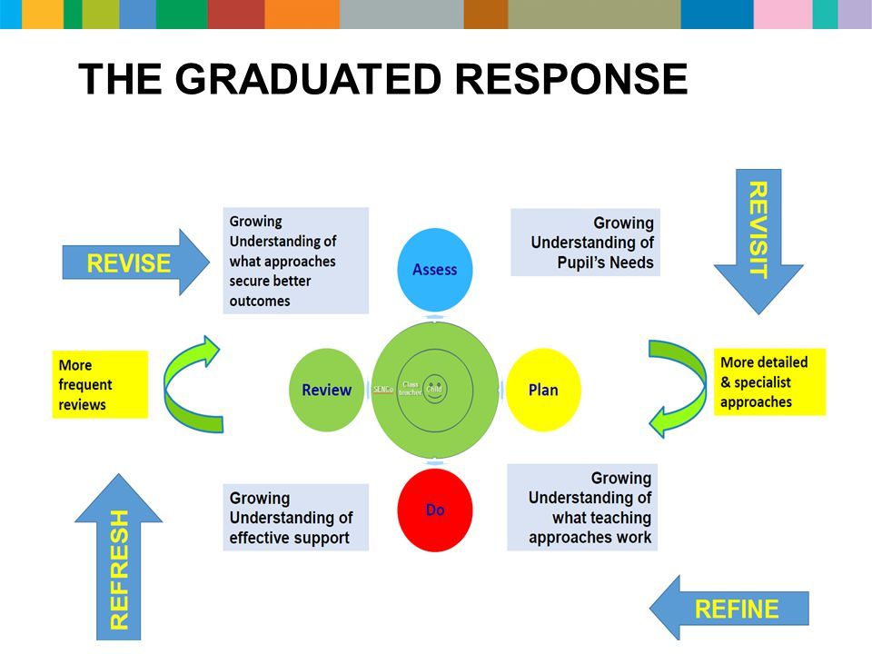
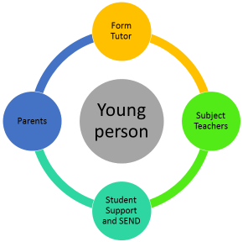
SEND Support
ONE Multi Academies Trust has an ethos of inclusion. We are committed to ensuring that every learner has the opportunity to achieve their best, become confident individuals with fulfilling lives and make a successful transition into adulthood, whether into employment, further or higher education or training.
School based support
All students with SEND
Pupil passports
Effectively planned lessons
Quality First Teaching
Reasonable adjustments in lessons to reduce barriers to learning
Specialist
Individualised Programme
1- 1 support
External Agency Support
Some students with SEND
Specialist equipment or additional adult support
Targeted Interventions
Work with outside agencies
Targeted
A programme of study away from the mainstream classroom
Small groups or 1-1
Teaching assistants/ Pastoral can provide intense support
External support
Educational Psychology
Learning Support Team
Hearing Impaired Team
Visually Impaired Team
CAMHS Child and Adolescent Mental Health Services
Alternative provision (WVTC, SPARKS)
School Nurses
Universal
TRUE Classrooms
QFT- modelling, scaffolding and teaching to the top
Teachers have strategies to support students with SEND
Additional resources in the classroom
May include a Teaching Assistant

Slide 10
Staying Informed
We are proud of the strong partnerships we have created with parents, students and the community and place a high value on the comments and feedback that they provide, in helping us to improve the school even further.
Learners are assessed in lessons regularly. Assessment data is formally recorded and tracked, so that learners progress can be closely monitored. Reports on learners progress are published each term to parents and each year there is a parents evening where progress can be discussed. The SENDCO is available to speak to at parents evening.
An Annual Review meeting is offered to the parents of learners who are supported through an Education Health and Care Plan (EHCP). This meeting, which will include the pupil, will be to discuss and agree support programmes, or review the support offer.
We can arrange meetings on request, or through parents evenings.
There are a number of ways that parents can be involved in the school:
Meetings with the SEND and Pastoral Teams run throughout the year and can be requested by parents
Parents evenings with subject teachers take place annually
Key information published by the school
School newsletters
Text, email and phone calls
Parents can apply to become Governors when vacancies arise
The school regularly texts, emails or contacts parents by phone to discuss any concerns, discuss progress or give praise. Praise, rewards and behavioural concerns are logged and can be viewed by parents on Classcharts.

Slide 11



Inclusive Education
We welcome learners of all abilities and backgrounds into our caring and challenging learning environment and through our highly skilled and compassionate team of staff, seek to create an exceptional learning community where everyone can excel.
The Curriculum
The Building
Spacious site
Lift access to upper floors
Disabled toilet facilities
Hearing Induction Loop
Able to support radio and hearing aid use
Assistive technology (laptop computers)
Managed transitions for pupils if needed
A copy of the accessibility plan is available on the main school website
Strategies for subject teachers are detailed in the Pupil Passports.
Quality First Teaching using scaffolding and modelling alongside resources to suit the individual needs of learners.
Alternative curriculum packages for individual learners with specific needs.
Learners with SEND have the same curriculum choices as all learners
Knowledge organisers present a clear overview of key ideas.
Teachers use accessibility tools to make lessons inclusive.
Quiet working spaces available for learners with specific needs.
Support from teaching assistants assigned to year groups
Trips and Visits
Activities are open to all pupils. Discussions with parents and providers take place as needed, and full risk assessments are carried out. Reasonable adjustments and additional staffing
are utilised in line with specific pupil needs.

Slide 12
Further help
ONE Multi Academies Trust Website- https://onemat.org.uk
The Khalsa Academy Wolverhampton website – https://tkaw.org/
Local Offer
Wolverhampton’s Local Authority https://www.localofferwolves.co.uk/
Atam Academy Webiste- https://atamacademy.com/
Local Offer- https://find.redbridge.gov.uk/kb5/redbridge/fsd/localoffer.page?localofferchannel=0
SEND Code of Practice: 0-25 years this is the formal document that provides all educational providers with guidance on statutory provision.
https://www.gov.uk/government/publications/send-code-of-practice-0-to-25

Slide 13
Complaints
What can you do if you are not satisfied with a decision or what is happening?
Your views are important and it is important that people listen to them and that you are satisfied with what happens.
If you have a concern then the first point of contact would be:
The Khalsa Academy Wolverhampton- The Assistant Principal for Inclusion, Miss Amy Evans. You can contact her on a.evans@tkaw.org or 01902 925390 If you are not satisfied that your concern has been addressed please speak to the Head of School Mr Sukhdev Shoker.
Atam Academy- SENDCO, Samantha Williams on senco@atamacademy.com - or 0208 252 9831. If you are not satisfied that your concern has been addressed please speak to the Principal Chris Steed.

