Slide 1
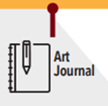
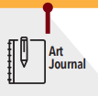
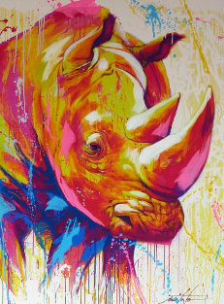
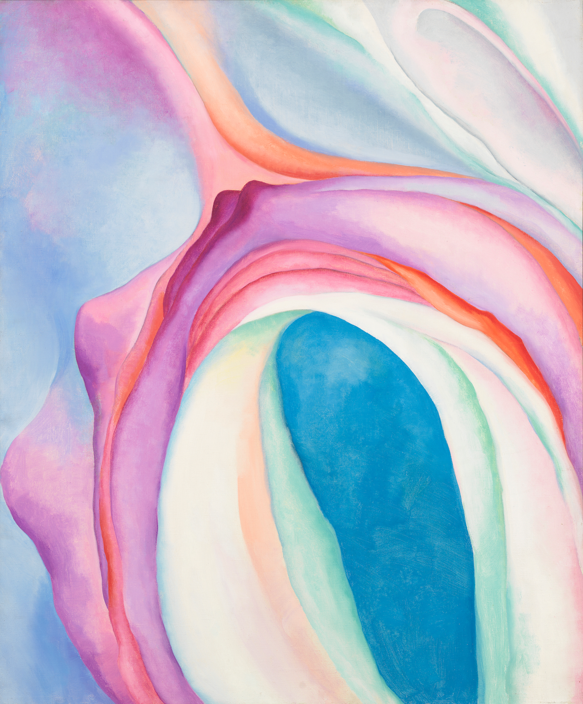
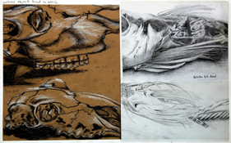
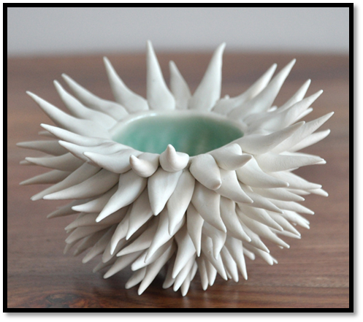
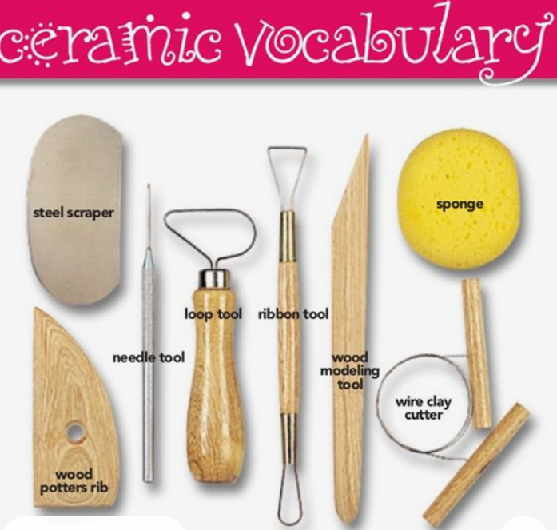
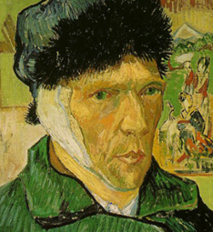
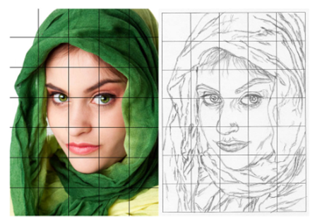
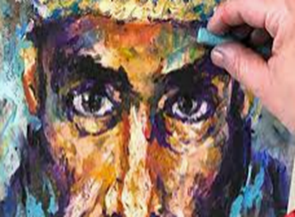
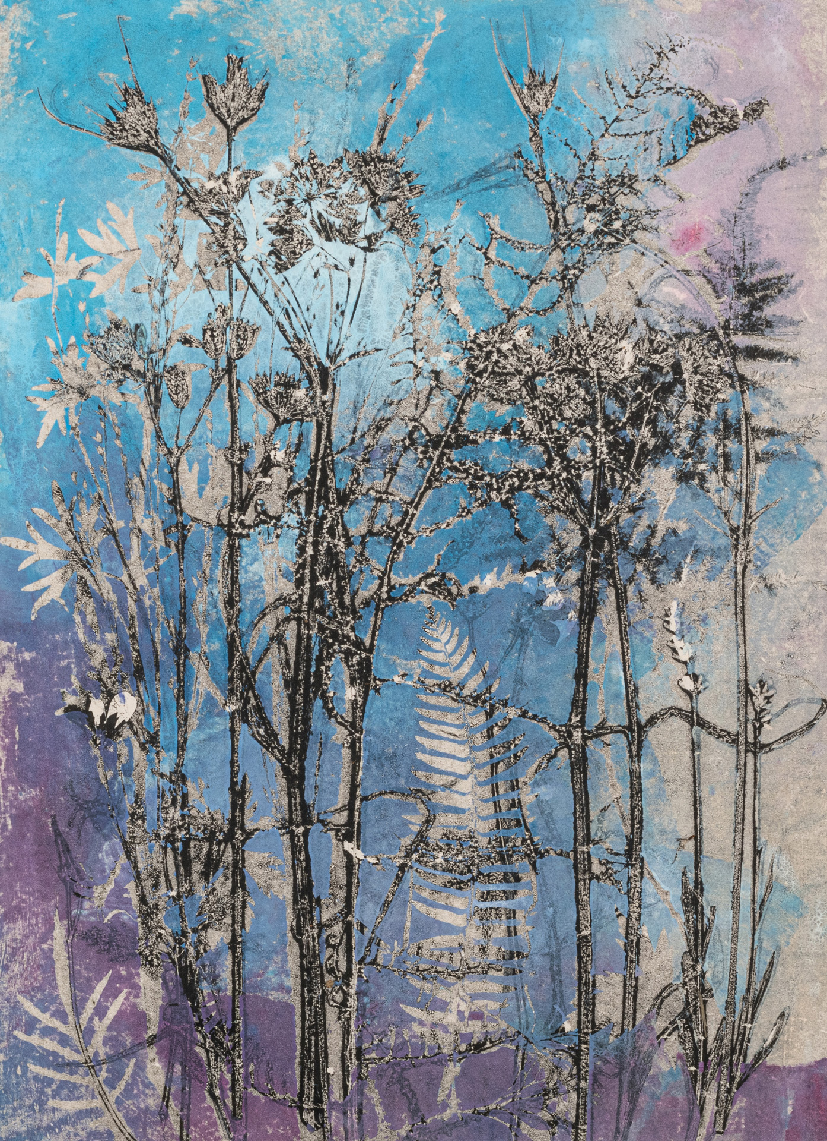
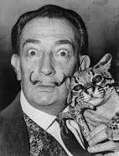
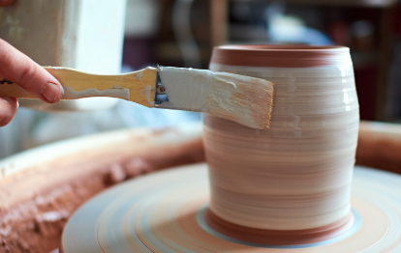
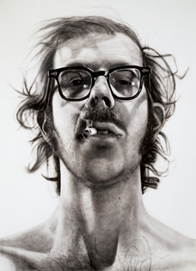
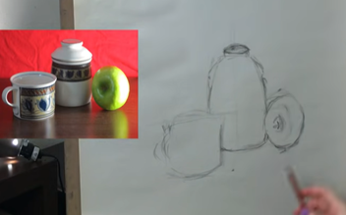
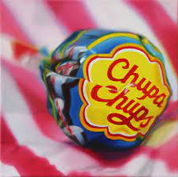
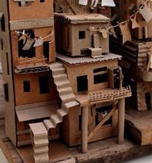
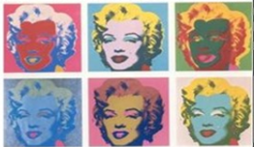
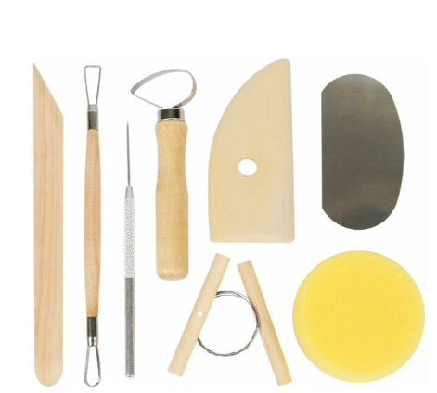
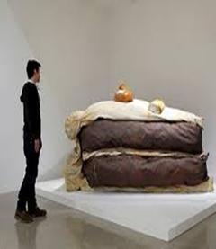
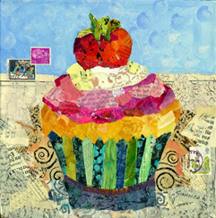
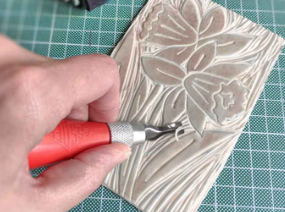
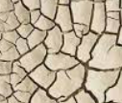
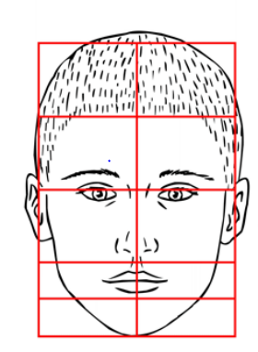
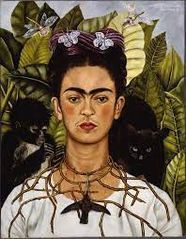
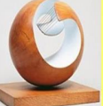
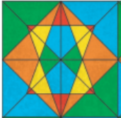
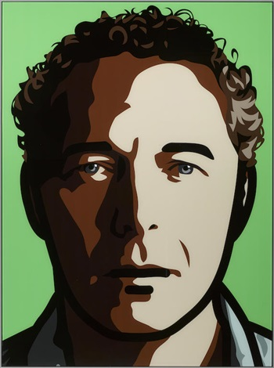
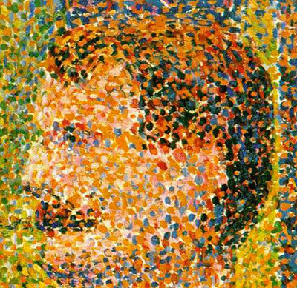
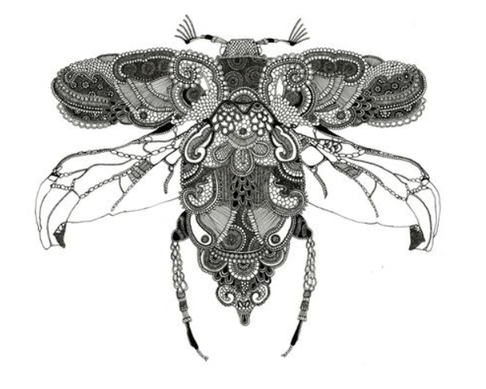
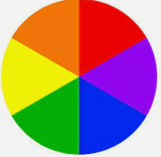
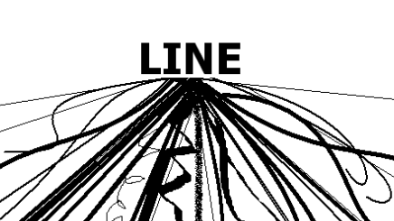
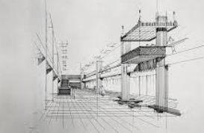
ATAM Academy – Art and Design
Look at all the different options you have in your further education, Architecture , illustration, Graphic design, Game designer, Fine Artist
Go to university to enhance your Art and Design knowledge and get a degree
Apply for University through UCAS or alternative post 18 courses
YEAR
Check out some amazing places
YEAR
12
Consider summer work experience and voluntary work to enhance your learning
13
Consider the format of GCSE examinations and refine revision techniques
Reflect on your journey in Art and Design so far
GCSE PROJECT
EXTERNALLY SET
Select and exhibit work for summer exhibition
Attend intervention sessions
Sit your GCSEs feeling confident
11
YEAR
Year 11 mock exams
Firm up your post 16 pathway
Year 10 mock exams
DEVELOPMENT PHASE
Complete Y10 mock exams to get GCSE ready
FOUNDATION STUDIES
DIRECTED project – past exam question
YEAR
10
Topic 1
NATURAL FORMS
Oil Pastel
experimentation
Observational drawing
Artist study
Noe Two, fauvism
Artist study
Georgia O’Keeffe,
Artist Study
Heather night
Ceramic tools and techniques
Artist study
Vincent Van Gogh
YEAR
Grid method
Drawing to scale
9
Monoprint
Chuck Close
Artist study
Sarah Graham
Topic 2
VESSELS
Glaze and firing
Topic 3
IDENTITY
Topic 3
SUPER MARKETS
SURREALISM
Artist study
Salvador Dali
Topic 1
POP ART
Photo realism
Artist study
Roy Lichtenstein
YEAR
Introduction to ceramics
8
Artist Study
Claes Oldenburg
Exploring mix media
3d cardboard sculpture and modelling
Topic 2
DREAM ROOM
Lino print
Artist study
Nancy Standlee
Artist study
Frida Kahlo
Indian culture Rangoli Art?
Aboriginal Art speaking with dots
Exploring how to describe a texture with a pencil
Topic 2
Portraits – how to draw them.
Introduction to Acrylic paint
Drawing shape and forms
Arabic Geometric Pattern - print
Zentangle what patterns can you create?
Artist study Julian Opie .
Final piece – self portrait in Julian Opie style
Artist study George Seurat
Introduction to oil pastel
Topic 3 Culture
Artist Study
Rosalind Monks.
Topic 1
FORMAL ELEMENTS – What are they ?
Meet the Art and Design teaching team.
Transitioning to secondary Art
YEAR
7
Welcome to Art
Creating the illusion of 3D objects using tone
Build a solid foundation in Art and Design
Take a tour through your Art Learning journey
The beginning of an understanding of the art world and culture within.

