Slide 1
Year 11
Raising Achievement

Slide 2
Plans for Year 11 - Mr Williams
Online tuition - Mr Jaspal Singh
Interventions - Mr Choudhury
Attendance & punctuality - Mrs Virk
Maths - Mr Ahmed
MFL - Mrs Ghuman
Science - Mr Choudhury
English- Mrs Virk
Revision - Mrs Virk
Sixth Form - Mr Williams

Slide 3
Senior Vice
Principal Mr Williams

Slide 4
GCSE Results 2024
Progress Scores
DfE - Well Above average
Estimated to be - top 500 schools nationally - top 10%
English P8 is 0.62 versus -0.04
Maths P8 is 0.61 versus -0.02

Slide 5
GCSE Results 2024
Attainment Scores
English and Maths
Grade 5+ in English and Maths - 57% vs national average of 45% last year +12%
Grade 4+ in English and Maths - 74% versus national average of 65% + 9%
Science
Grade 4+ in Science 81% versus national average of 66% +16 %
Grade 5+ in Science 61% versus national average of 47% + 14%
Ebacc
74% were entered for EBacc versus 39% national average - + 35%

Slide 6
GCSE Results 2024
Grades
Just under a quarter of all grades achieved were 7 - 9
60% of grades were at grade 5+

Slide 7
163

Slide 8
GCSE Exams are 5 months away

Slide 9
WHAT IS COMING UP?
Mock exams
Mock 2: 10th-28th February
Leave half-term free
Parents Evenings
12th December
27th March

Slide 10
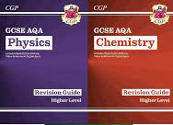
WHAT IS COMING UP?
Discounted revision resources and guides
Elevate revision and study skills workshops
February half-term interventions
Easter School
Mentoring

Slide 11
Mentors
Students assigned a mentor
Fortnightly meetings
Pastoral wellbeing
Dealing with stress
Timetable revision
Attendance / Punctuality
Revision techniques

Slide 12
Resources
GCSE POD
SENECA
Sparx Maths
Revision guides - sold to parents at a discount
Revision lists prior to every exam
Online tuition

Slide 13
Online Tuition Mr Jaspal Singh

Slide 14
Senior Assistant Principal Mr Choudhury

Slide 15
“Those who perform just one GCSE grade better than their counterparts across nine subjects have been shown to earn on average over £200,000 more throughout their lives.” (DfE, 2021)

Slide 16
Intervention
Compulsory
Core subjects come first
Punctuality and preparation are critical
Communicate 24 hours in advance of any planned absence (2 strikes)

Slide 17
Associate Assistant Principal Mrs Virk
Assistant Principal Mr Virk

Slide 18
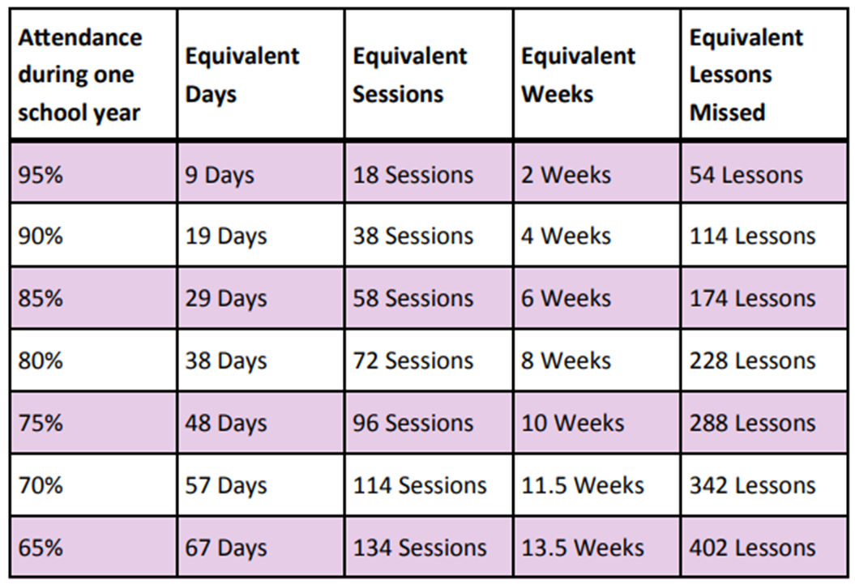
Attendance & Punctuality: 100% is the Goal!
Missing school = Missing learning.
Every lesson counts towards your success.
Attendance is critical to improving academic performance.
Aim for 100% attendance to ensure you're in every lesson, every day.
Be on time to school and lesson.

Slide 19
General expectations
Be fully engaged in lessons—participate, ask questions, and contribute.
Being at lessons on time, with all your equipment, ready to learn.
Teachers have interventions and clubs available to attend at lunch time and afterschool.
Library area is now open every lunchtime for you to complete independent study. This is the only place you will be allowed at lunchtimes should you wish to revise/ complete homework.
Be in correct uniform all the time - be ready to learn!
If you need help, reach out to Mrs. Virk or Mrs. Dhanjal for pastoral support.

Slide 20
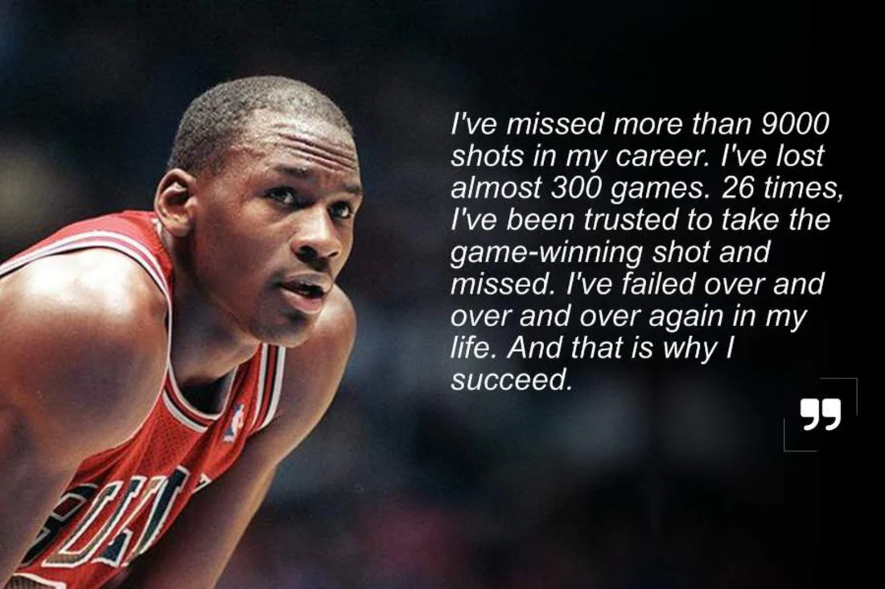

Slide 21
Director of Maths Mr Ahmed
"Pure mathematics is, in its way, the poetry of logical ideas." – Albert Einstein
Mathematics is not just a subject—it’s a foundation for logical thinking, problem-solving, and many careers. The skills your children develop in Maths are essential for life and future opportunities.

Slide 23
RAISING ACHIEVEMENT
IN MATHEMATICS
The value of consistent practice in mathematics
Key strategies:
Targeted Intervention - In class and independent tasks
Sparx Maths
Half past papers - weekly
Corbettmaths
Maths Genie
1st class maths

Slide 24
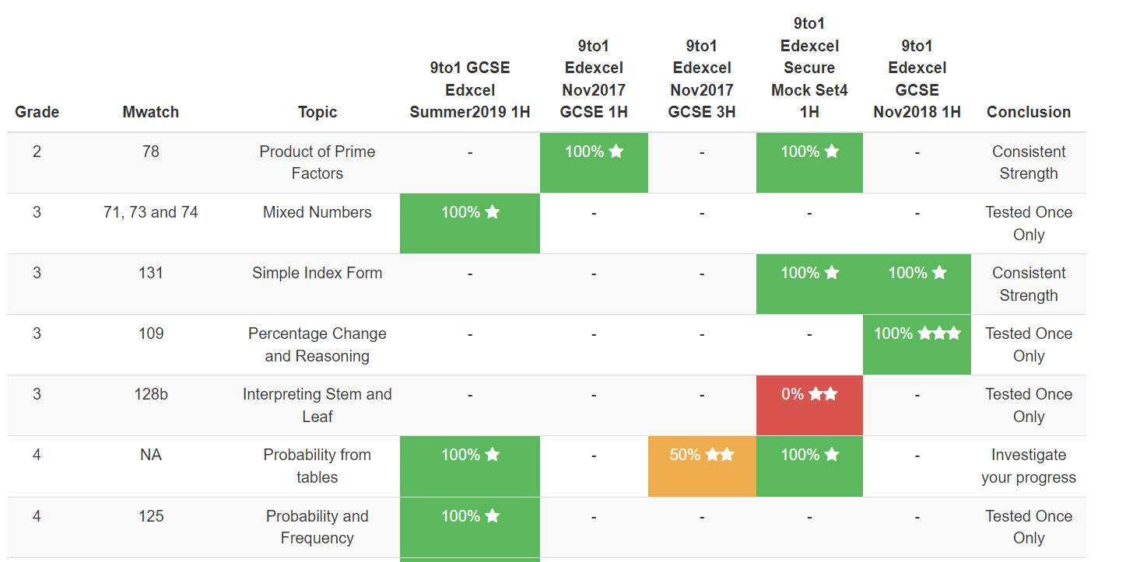
QUESTION LEVEL ANALYSIS (QLA)
DATA DRIVEN
We use QLAs to show class progress in each topic across all tests, categorised by AO1/2/3 strands. The students also have their own individual maths matrix!

Slide 25
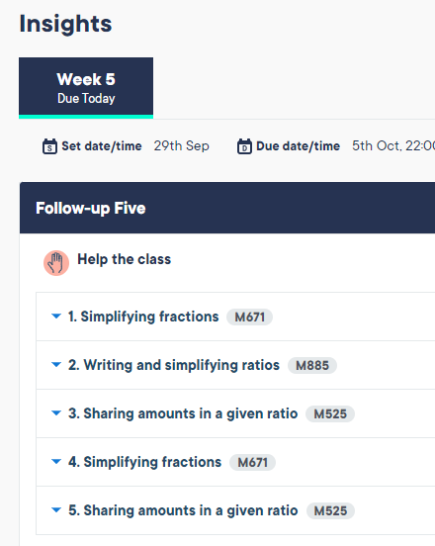
SPARX MATHS
Sparx Maths as a valuable resource a tool for personalised learning.
The AI learns about the students strengths and weaknesses and creates personalised ‘Target’ questions as well as provide ‘Insights’ for teachers.
Evidence shows that the more students engage with the platform - the better their outcomes.

Slide 26
PARENTAL/CARER SUPPORT
The importance of parental involvement in homework and study.
Tips for parents/carers to support their children effectively.
Regular practice - little but often.
Seeking help when needed - teachers, online platforms, peers, parents…
Effective time management

Slide 27
PARENTAL/CARER SUPPORT
Create a Study Schedule:
Help your child create a revision timetable. Break down topics into manageable chunks and ensure they revise regularly. Consistency is key.
Provide a Calm Study Environment:
Ensure your child has a quiet, well-lit place to study, free from distractions. Having the right environment can improve focus and productivity.
Seeking help when needed - teachers, online platforms, peers, parents…
Effective time management

Slide 28
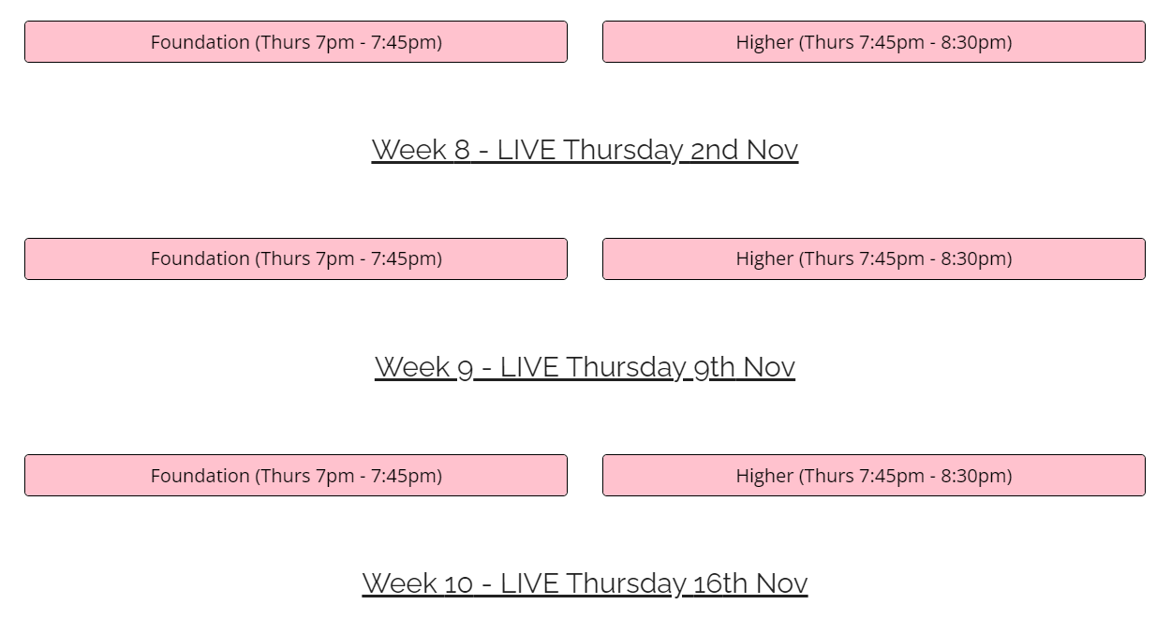
PARENTAL/CARER SUPPORT
Encourage Practice with Past Papers:
Practicing past exam papers under timed conditions is one of the most effective ways to prepare. It helps students understand the format and timing, and highlights areas for improvement.
Half past papers

Slide 29
KEY INFORMATION
Exam Board: Edexcel
Exam Structure:
Three papers:
Paper 1: Non-calculator
Paper 2 and 3: Calculator allowed
Levels:
Foundation Tier (Grades 1–5)
Higher Tier (Grades 4–9)
We expect students to buy and use their own calculators.
They will be familiar with them and be able to use them efficiently in their exams

Slide 30
KEY DATES AND EXAMS
Edexcel 8300
3 Papers
Paper 1
Non-Calculator
1 hour 30 minutes
Date: 15th May 2025
Paper 2
Calculator
1 hour 30 minutes
Date: 4th June 2025
Paper 3
Calculator
1 hour 30 minutes
Date: 11th June 2025
Each paper has a 33% weighting.
The overall grade is based on the sum of all 3 papers.

Slide 31
KEY DATES AND EXAMS
Edexcel 8300
3 Papers

Slide 32
SUMMARY
We need students to engage with their learning in class as well as independently
They will need to work on their independent targeted learning in order for us to be able to strengthen their weaknesses
We need you as parents and carers to support their children's journey
We will be sending information about target intervention lessons for students to attend.

Slide 33
FINAL THOUGHTS
The next few months are critical in your child's GCSE Maths journey. With the right preparation, consistent effort, and support, they can achieve their best.
We are here to support students in every step of the way—whether it’s through in-class learning, extra sessions, or personalised feedback.
Parents and carers play an important role in this journey, and your involvement can make all the difference.

Slide 34
Director of MFL and Sikh Studies Mrs Ghuman

Slide 35
Subject Information : MFL
All students for MFL will be tiered:
Higher (grades 9-3)
Foundation (grades (1-5)
There are 4 examinations each worth 25%:
Speaking, Listening, Reading & Writing

Slide 36
Subject Information : Panjabi
Course Completion by: February 2025 | Interventions: Thursday morning intervention (pre-reading and preparation must be done at home) Groups will be adjusted after analysis of mock results
Work that should be completed at home: Learning and revision of vocabulary and key sentence structures Reading of text from lessons but also unfamiliar texts Practise speaking questions Creating topic mats and revision maps of topics completed | Exam board: AQA

Slide 37
Subject Information : French
Course Completion by: February 2025 | Interventions: Wednesday after school intervention with Mrs Bove and Mrs Parsons
Work that should be completed at home: Learning and revision of vocabulary and key sentence structures Learning of key verbs Practise speaking questions Completing listening and reading exercises Using Pearson active learn for listening, reading and grammar | Exam board: AQA

Slide 38
What should already be happening at home in preparation for exams:
Students must be: | What parents can do to help:
Getting familiar with key skills being tested in each paper | Ask: What will you need to do in this paper?
Getting familiar with key vocabulary being tested in each topic | Ask: What topic is difficult?
Know key stem questions that will be used in different papers | Ask: What questions do you find easy or difficult?
Getting familiar with mark schemes and criteria to answer different types of questions | Support: look over exam papers with them and check if they know what is required for 32 marks, 16 marks questions in writing paper
Students should be reflecting after every assessment and everytime a PLC is completed | Ask: Did you do enough revision? What questions or topics were difficult?
Reviewing and be familiar with specification which can be found from Exam board website | Support: Look over the specification with them and ask do they understand which key skills will be tested and how?
Revising Daily - little but often, be consistent | Support: Have a copy of their revision timetable Ask: What are you revising today?

Slide 40
Science Mr Choudhury

Slide 41
Results
Last Year 11 cohort
Combined Science - 67% achieved Grades 9-5
Triple Science - 100% achieved Grades 9-5
On average achieved almost one grade above target grades
Our Current Year 11s
Have the ability to do better
Have the drive to do better
But need to enhance their revision and independent practice needed to secure higher grades

Slide 42
Know what you need to do
YES
Do you know your recall off by heart?
Exam Questions
NO
Memorising
Application to new context
‘Describe’
Or 1 or 2 mark EQ
Explain Qs
Data Analysis Qs
Notes:
Do you know your recall off by heart – how do you know – do the recall questions given you should get all of them right

Slide 43
Reflect – Keep a log of what you did well and what you need more help with
Unit 1: Cell Biology Eukaryotes and Prokaryotes Animal and Plant Cells Cell Specialisation Cell Differentiation Microscopes and Magnification RQP: Observing cells under a microscope Chromosomes Cell Division – Mitosis and the Cell Cycle Stem Cells – Embryonic and Meristem Diffusion Osmosis RQP – Osmosis in potatoes
Notes:
Next time you would start with the red and then move to amber.
With green you might just do a quick exam q on as a starter

Slide 44
What we have provided
Topic Lists and Knowledge Organisers
Powerpoints and Worksheets
Exam Questions by Paper and Topic
Recall Questions to memorise
Seneca
Weekly Tests with feedback (can be End of topic Tests)
Pre-learn HWs
Intervention

Slide 45
What is expected
Each student should have RAG’d the topic sheets
Each student should know what stage of learning they are at
2 hours of revision on top of their homework
70% pass mark on their recall tests
Seneca/Recall Daily as practice

Slide 46
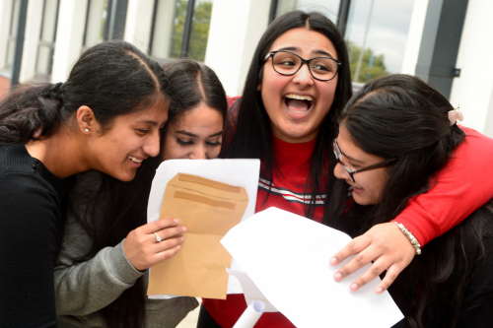
What will Results Day look like for you?

Slide 47
Associate Assistant Principal
Director of English Mrs Virk

Slide 48
GCSE ENGLISH LANGUAGE/ LITERATURE
All students are following a course which will give them two outcomes in English:
English Language
English Literature
Grades 1-9
Two Outcomes = Four Exams
There is no tiering of higher/ foundation in English. ALL students sit the SAME exam.

Slide 49
TOPICS AND TEXTS: ENGLISH LITERATURE
Macbeth
A Christmas Carol
An Inspector Calls
Unseen Poetry
15 poems from the AQA anthology
All exams are ‘closed book’. Although for some of your texts, you will be given extracts to use as a springboard BUT you are expected to know all your texts really well.

Slide 50
TOPICS AND TEXTS: ENGLISH LANGUAGE
In both English Language papers, you have to hone your skills to be able to understand and explore ‘unseen’ texts.
The texts will be taken from the 19th, 20th and 21st Centuries. This means that pupils will be challenged by:
Unusual vocabulary
A variety of sentence structures
Unfamiliar topics
Pupils must be reading!

Slide 51
KEY AREAS FOR SUCCESS
Reading and Interpretation Skills:
Regular practice with unseen texts
Focus on analysis of language, structure, and form
Writing Skills:
Improving clarity, coherence, and vocabulary in written responses
Regular timed practice for creative writing and essays
Literature Knowledge:
Deep understanding of key themes, characters, and quotes
Practice with essay structure and critical interpretation

Slide 52
SUPPORT IN THE CLASSROOM
Structured Lessons:
Focus on exam-style questions and practice papers
Teaching of key exam strategies (e.g., timing, planning answers)
Mock Exams:
Regular mock exams to track progress
Detailed feedback to guide improvements
Targeted Support for Individual Needs:
Differentiated resources and small group work for specific challenges

Slide 53
INTERVENTION AND EXTRA SUPPORT
Before and After-School Intervention Sessions:
Weekly sessions focused on exam preparation and key areas of difficulty
Targeted invites for students needing additional support
These interventions are targeted to support students
Aspire 9: For high-achieving students aiming for top grades (7-9) to ensure they are stretched and challenged to achieve their highest potential.
Mid-Grade Boosters: For students on the cusp of achieving grades 4-6, focusing on pushing them to secure and exceed their target grades.
Additional Support Group: For students requiring extra help to reach key milestones, offering focused, small-group sessions to strengthen their understanding and confidence.
These targeted interventions are designed to provide the right level of support for every student, ensuring they are fully prepared for success in their exams.

Slide 54
REVISION STRATEGIES
Active Revision:
Regular re-reading of key texts (e.g., Macbeth, A Christmas Carol)
Creating quote banks and mind maps for themes and characters
Practice, Practice, Practice:
Use past papers and timed exam questions to improve speed and confidence
Practice writing analytical paragraphs and creative pieces
Memorisation Techniques:
Flashcards for key quotes, themes, and terms
Frequent low-stakes quizzes

Slide 55
Associate Assistant Principal
Director of Learning: Year 11 Mrs Virk

Slide 56
Applications for Sixth Form/ College/ Apprenticeships/ Post-16 Avenues
Open evenings are currently taking place across each borough. Please search for these online to ensure you are able to to be able to attend these.
Khalsa VI Redbridge Open Evening
Tuesday 17th December 2024- 5-7pm
All sixth form applications for schools are completed online.
Reference: Mrs. M. Virk
m.virk@atamacademy.com

Slide 57
How are we supporting year 11 students?
Subject specific interventions
Library space to study at lunchtime
Pastoral Care
Resources
Tailored assemblies

Slide 58
Homework Expectations
All homework needs to be written in planners
Homework is set twice a week from each subject
Each task should take 45 mins-1 hour to complete
Homework tasks may include:
Reconsolidation of key skills and knowledge
Practice Exam Papers
Pre- Reading tasks
SENECA
GCSE Pod

Slide 59
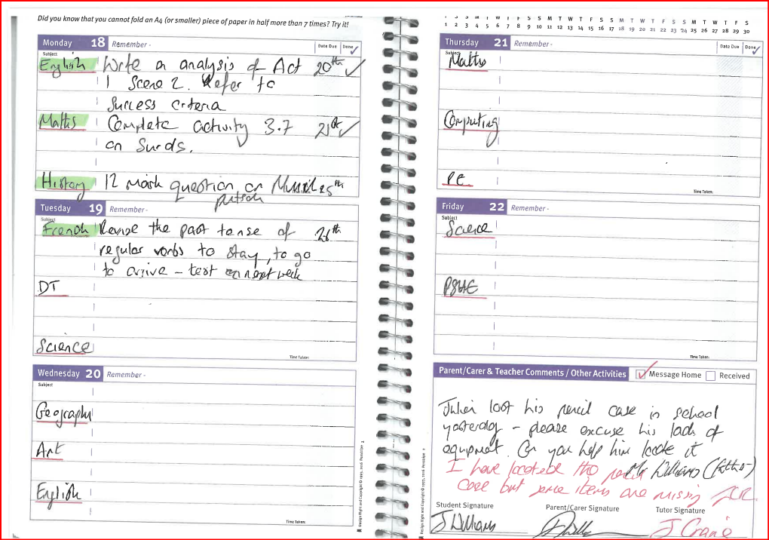
Planners - Example

Slide 60
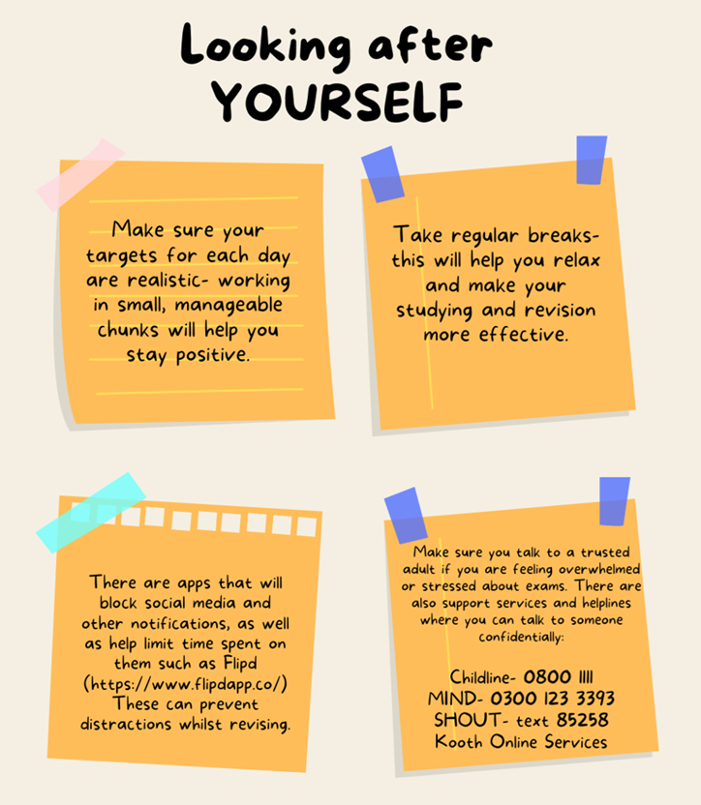
Supporting Student Wellbeing

Slide 61
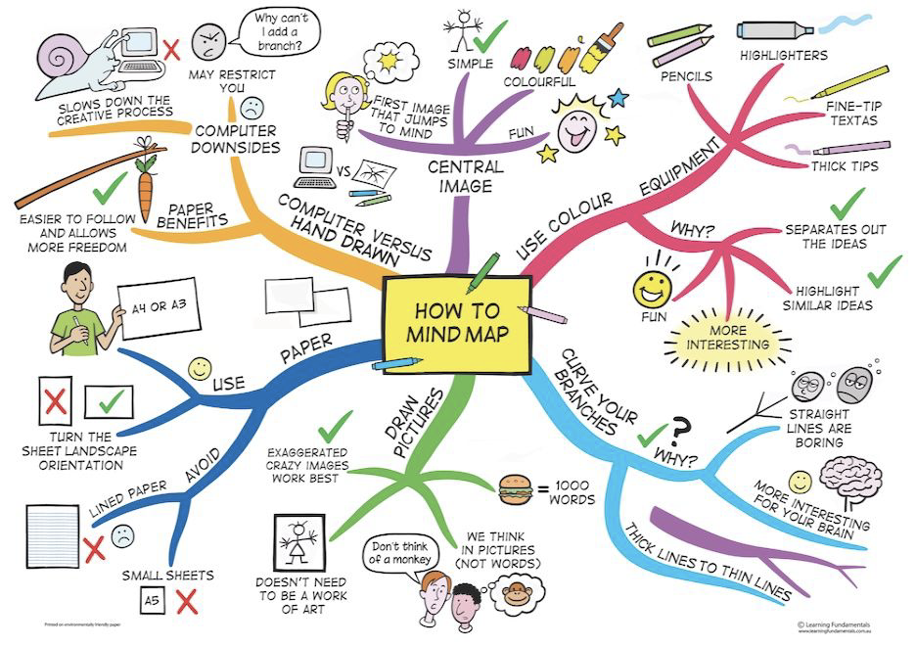
Revision Strategies
Create a revision timetable
Break down the syllabus
Use Active Learning Techniques
Practice past papers
Set specific goals
Revision Cards - Recap Quizzes - Subject Checklists - Post- It Notes - Mind Maps

Slide 63
Senior Vice Principal Mr Williams

Slide 64
Khalsa Sixth Redbridge

Slide 65
KHALSA VI Open Day - 17th December 2024
Sixth Form Taster Day - December 2024
Applications open - 28th November 2024
Applications close - 28th March 2024
Interviews - March /April 2024

Slide 66
What sets us apart:
Academic rigour - Challenge
Staff who know you - Personalised Learning
Small class sizes - 1-2-1 support
Bespoke Personal Development - Careers Placements

Slide 67
So far this year :
Induction day and team building
Personal development lessons - unifrog and CV writing
Head Boy and Head Girl appointments
Careers Compass trip to Nat West Investment Banking
AFAB - Sikh Faith Ambassadors to Redbridge primary schools
Careers speakers on Law and Finance
Online Medical work experience and seminars

Slide 68
2024 Subjects | 2025 Subjects
Maths Further Maths Biology Physics Chemistry Psychology English Literature Sociology History Business | Economics Geography Computer Science Art Sports & Exercise Science BTEC Business BTEC

Slide 69
Thank You

