Slide 1
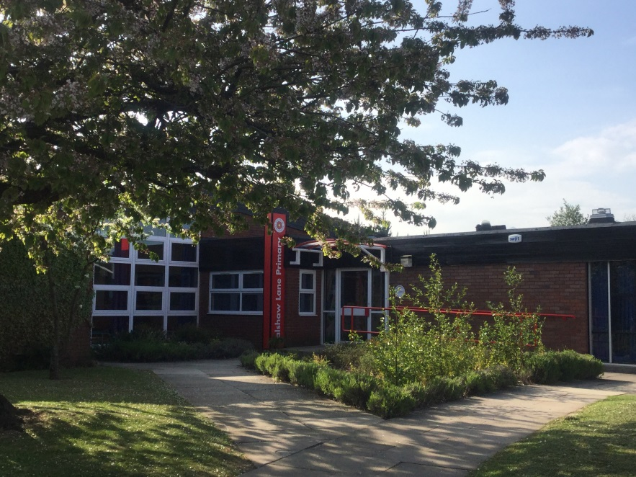
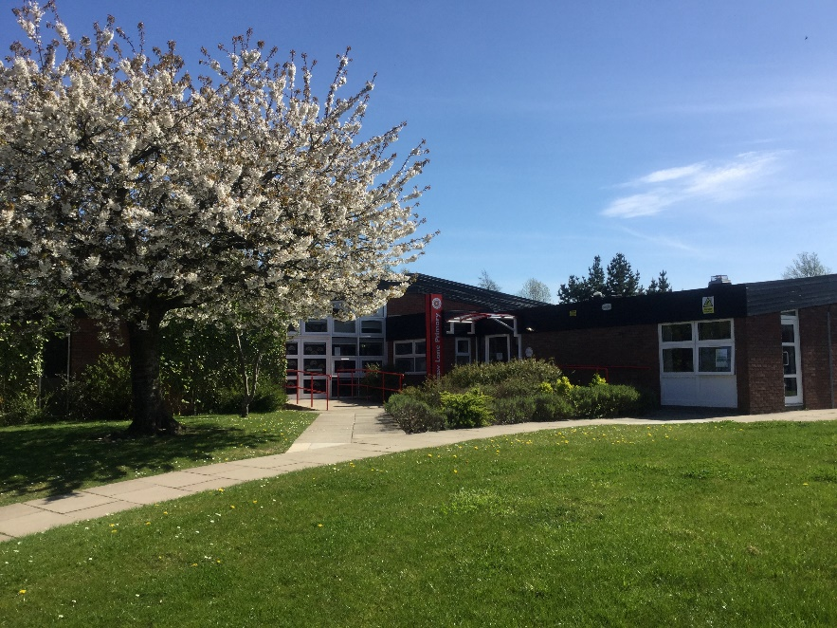

Welcome to Balshaw Lane Primary

Slide 2
Agenda
the Early Years staff team
how we will organise the classes
arrangements for the induction sessions
arrangements for September
how you can help your child get ready for school.

Slide 3
Two classes: RH and RA
The two classes will be split by sharing siblings; girls and boys; chronological age order.
All the children have the chance to mix between the two classes in Reception.
Phonics groups are mixed later between the classes.

Slide 4
Induction
Playgroup session: Tues 11th June
A-L 9.30 -10.45am
M-Z 1.30-2.45pm
Induction sessions
Tues 2nd July: RH 9.15 -11.15am or 12.45 – 2.45pm
Thurs 4th July: RA 9.15 -11.15am or 12.45 – 2.45pm

Slide 5
Staggered start in September
Over 3 days
Tues 3rd, Wed 4th and Thurs 5th Sept
(Monday 2nd Sept: INSET day)
mornings: 9.15 - 11.30am
afternoons: 12.30 – 2.45pm
Your child will attend for the mornings or afternoons.

Slide 6
Autumn term
Baseline assessment
Curriculum Meeting
Parents’ Evening in October

Slide 7
How to prepare your child
Toilet training & hand washing
Turn taking: listening to others, sharing
Coat: taking on/off, zip up/down, sleeves
Using own lunchbox
Emptying school bag
Getting dressed inc shoes, socks, wellies
Reading lots of stories, nursery rhymes
Early writing; own name
Early counting

Slide 8
Always here for support…
Information on the website
School prospectus
By phone
Note in the planner
A message in the morning
At the end of the day
Seesaw app
School Twitter:@BalshawLaneCPS

Slide 9
Does your child have SEND or medical needs? If so, please have a chat with us afterwards.
Is your child eligible for Pupil Premium funding?

Slide 10
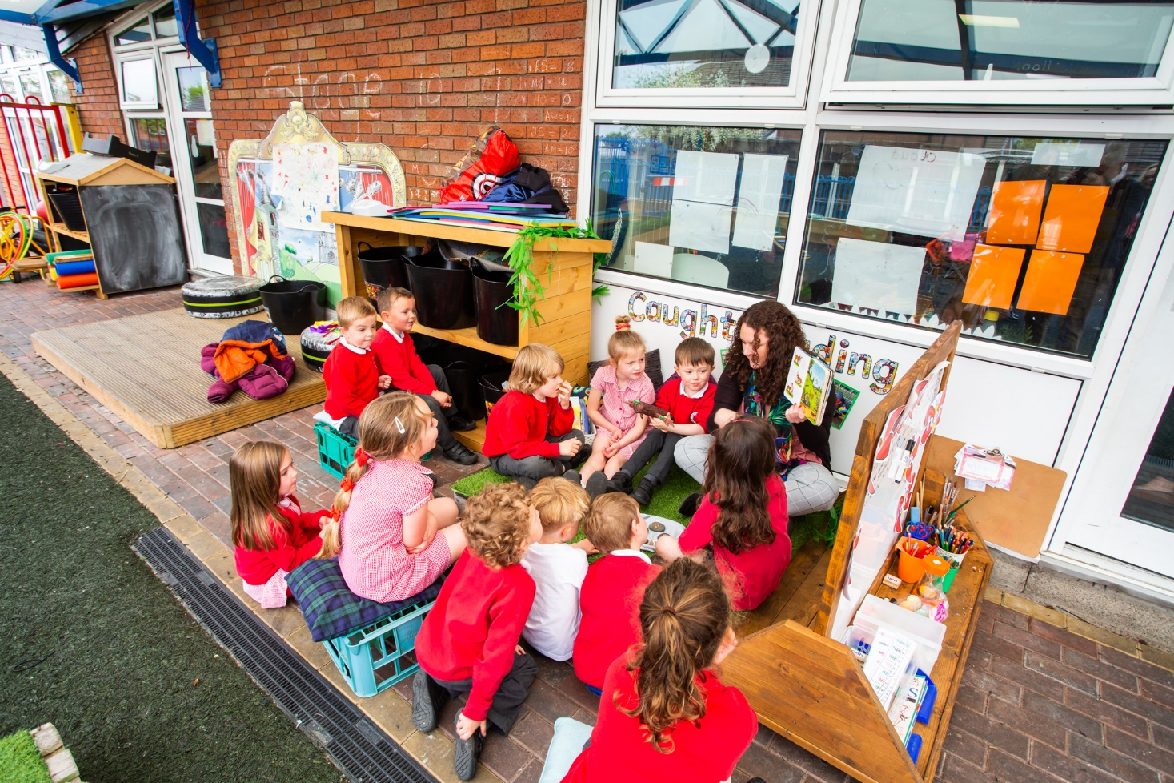
It’s a big step

Slide 11
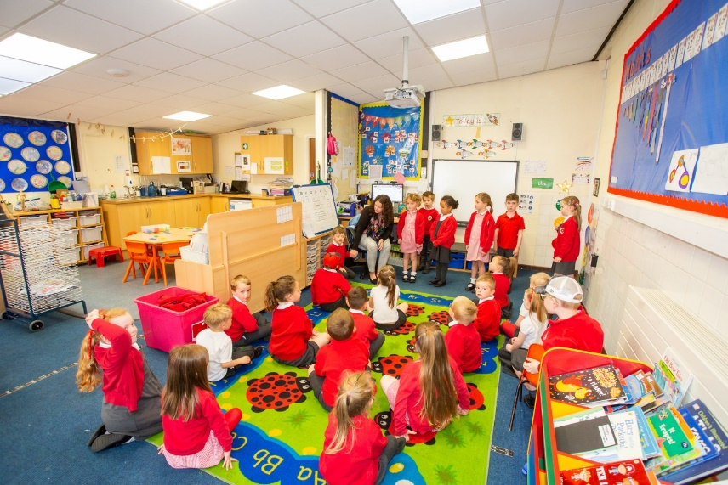
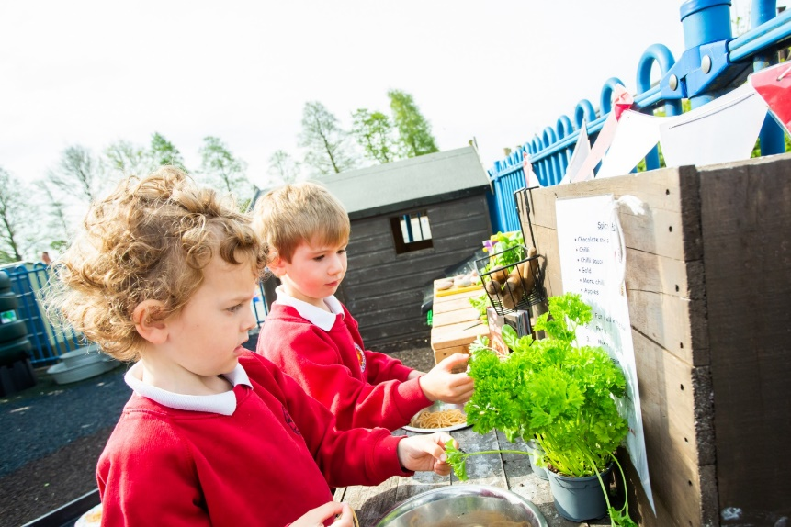
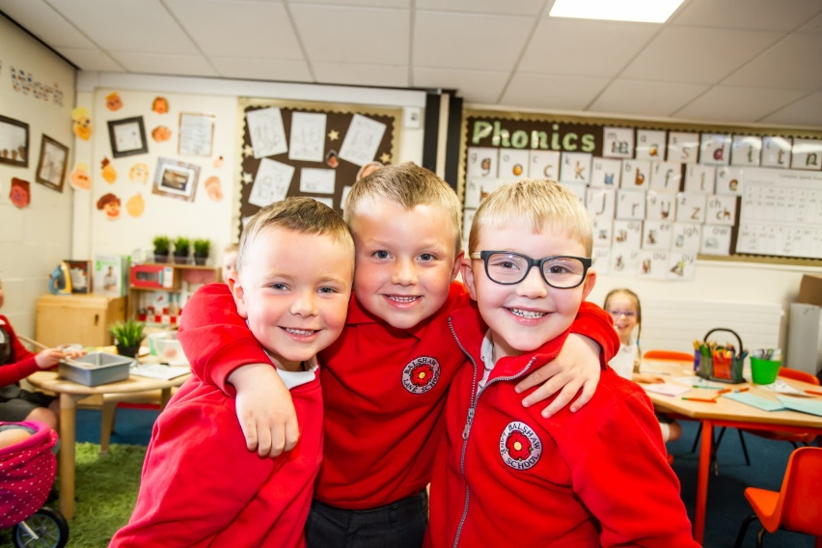
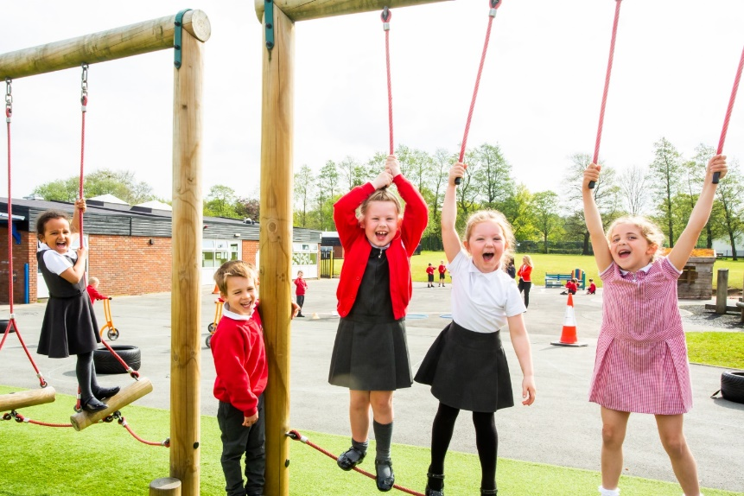
Early Years

Slide 12
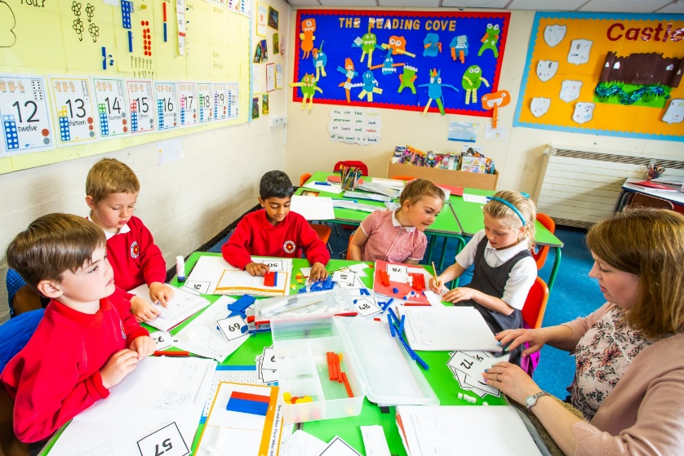
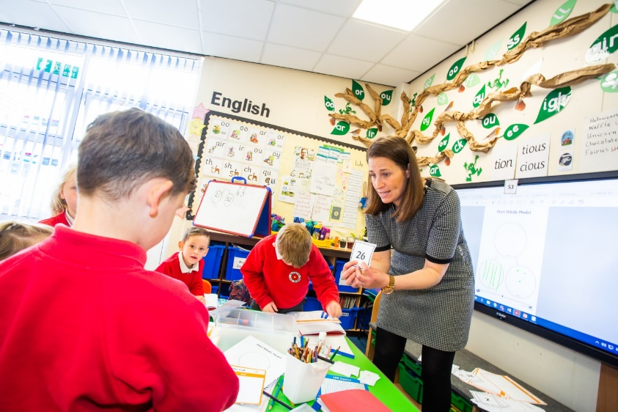
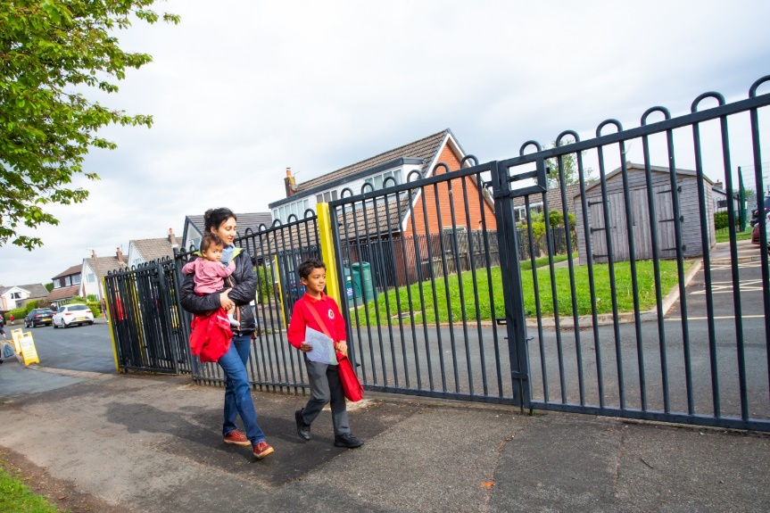
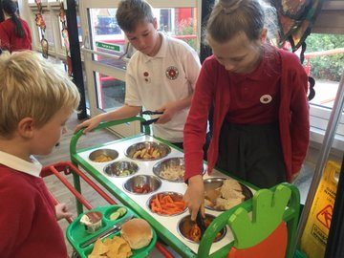
The start of your child’s school life

Slide 13
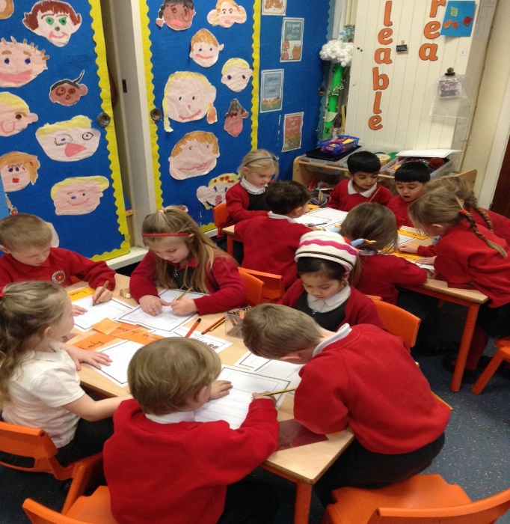
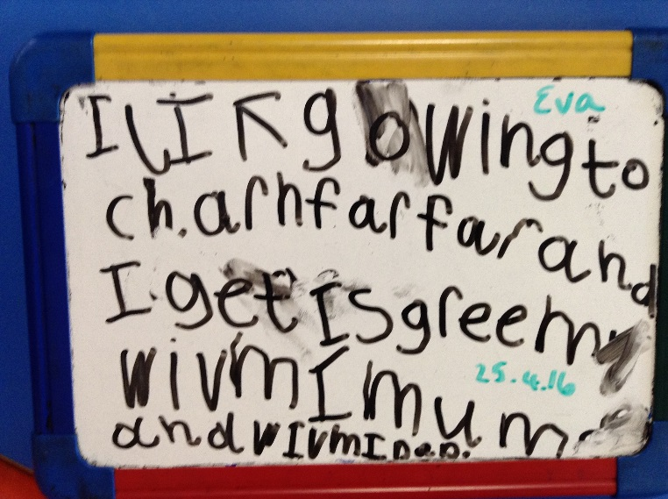
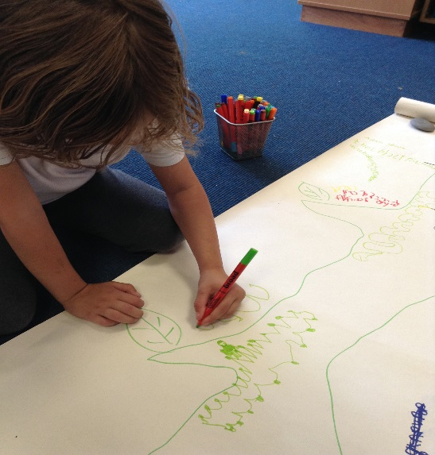
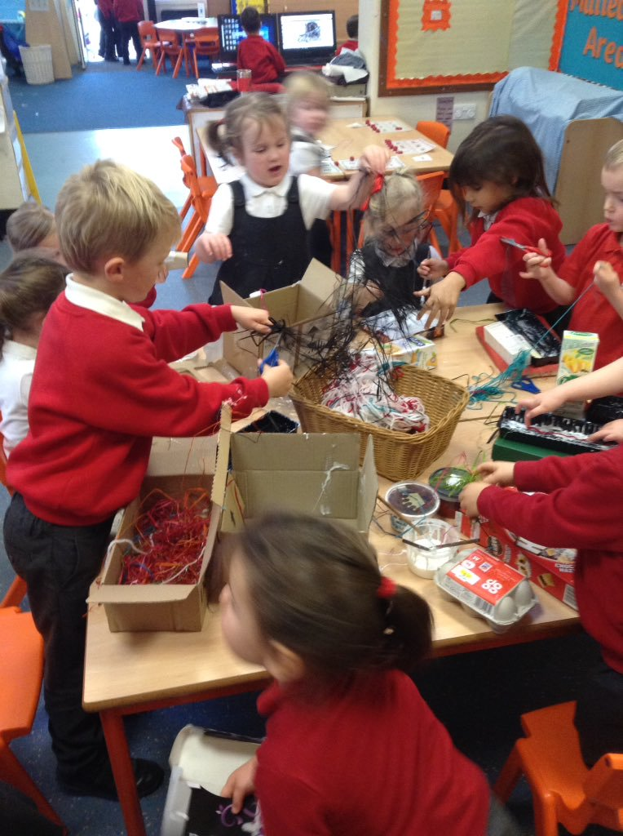
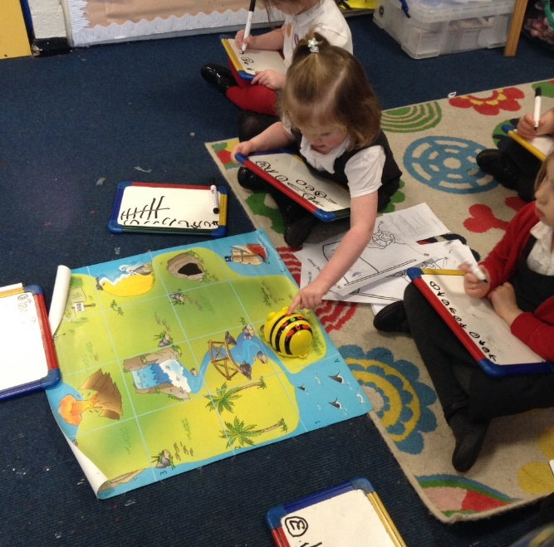
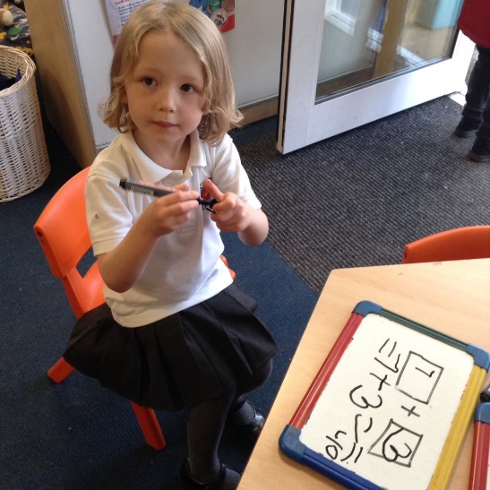
Progress in learning

Slide 14
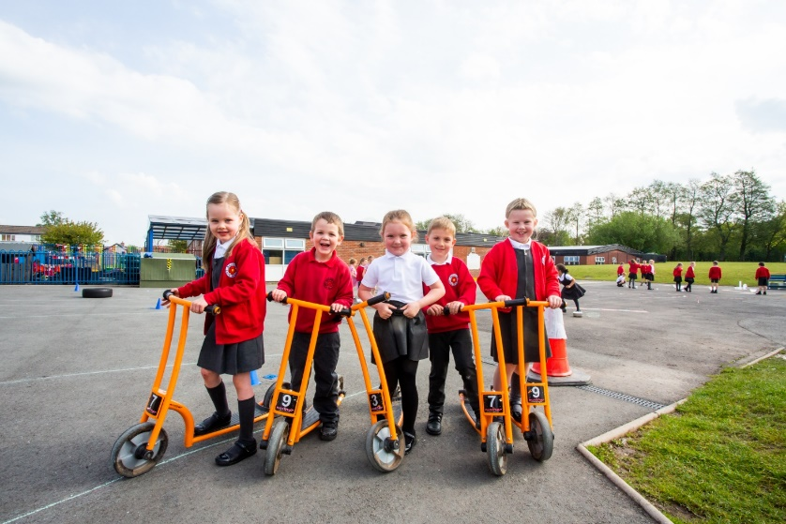
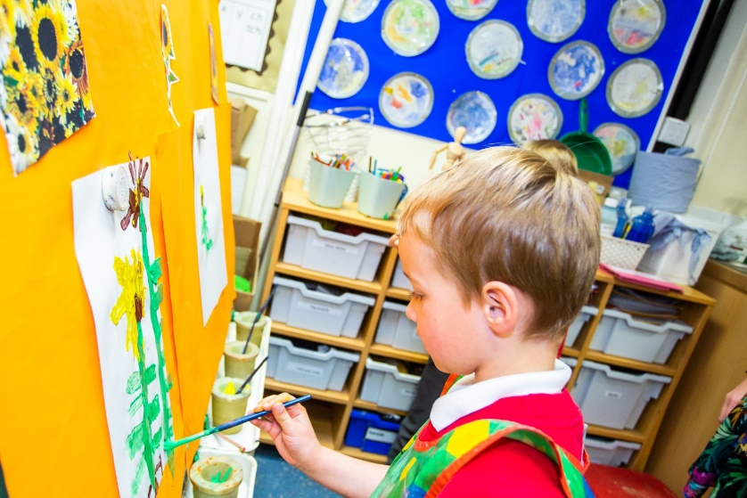
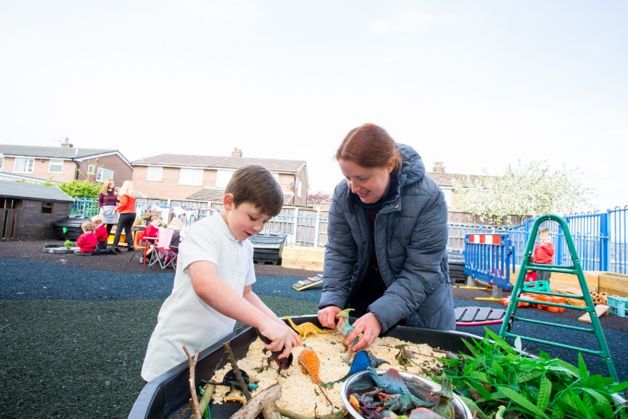
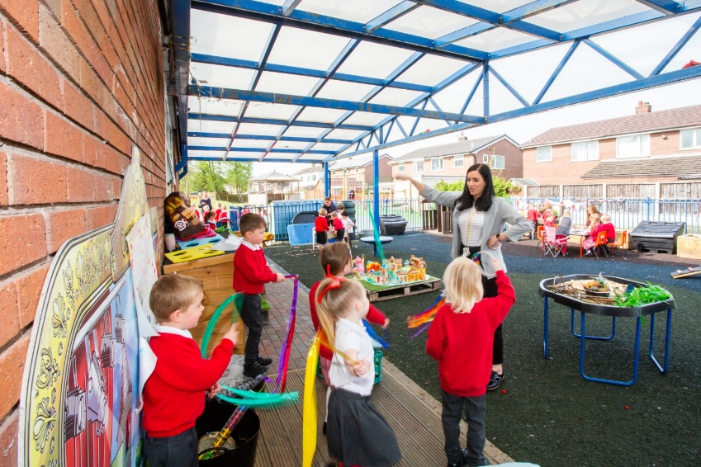
Learning through play

Slide 15
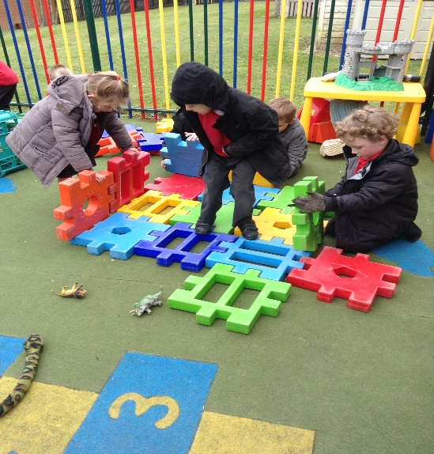
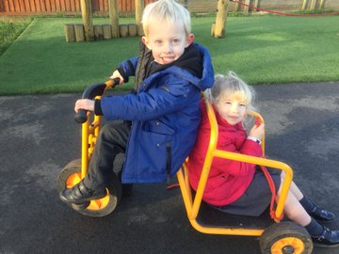
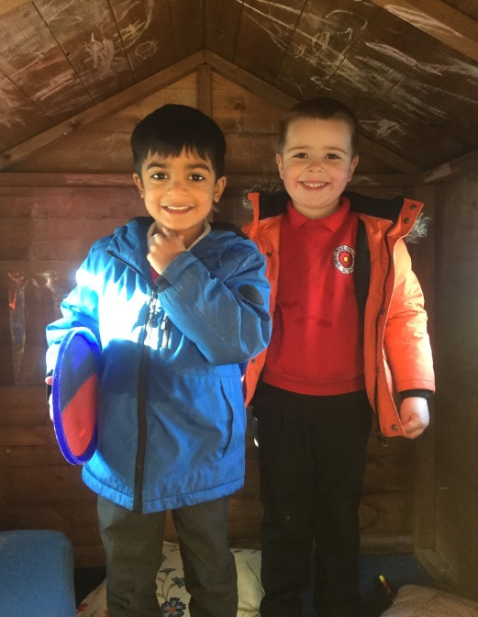
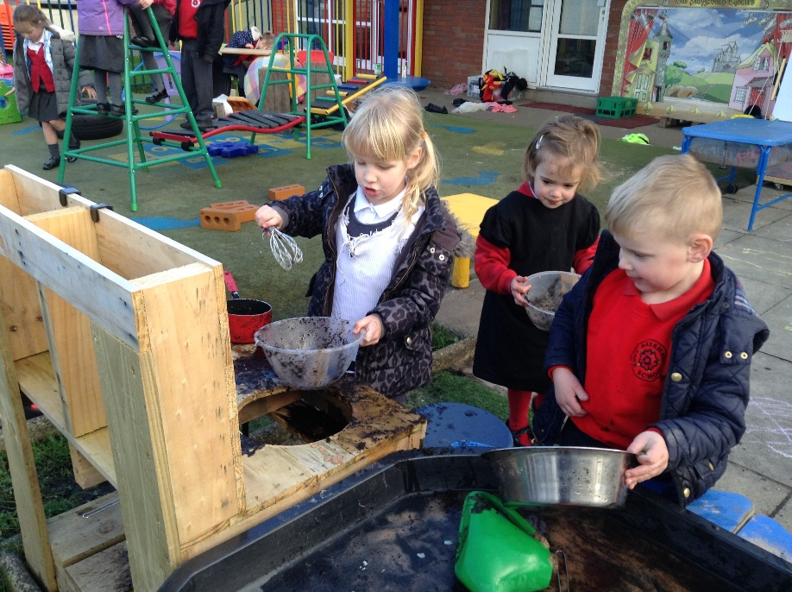
Outdoor learning

Slide 16
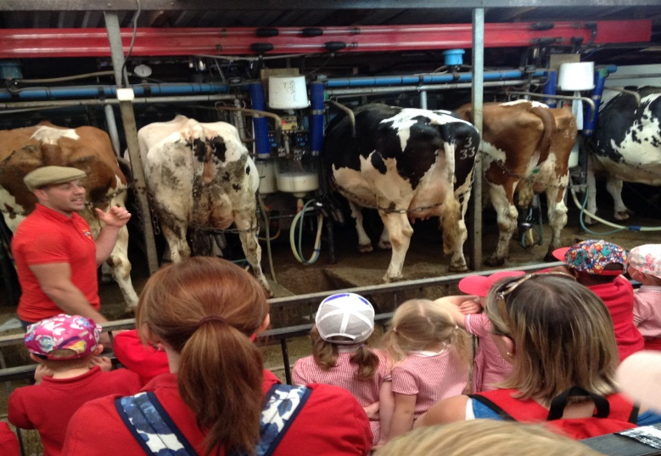
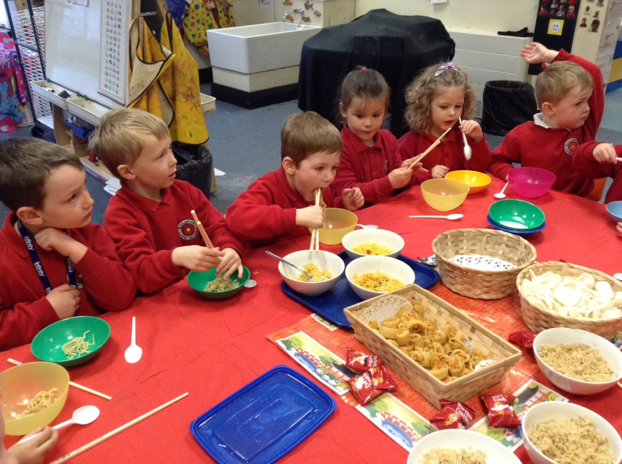
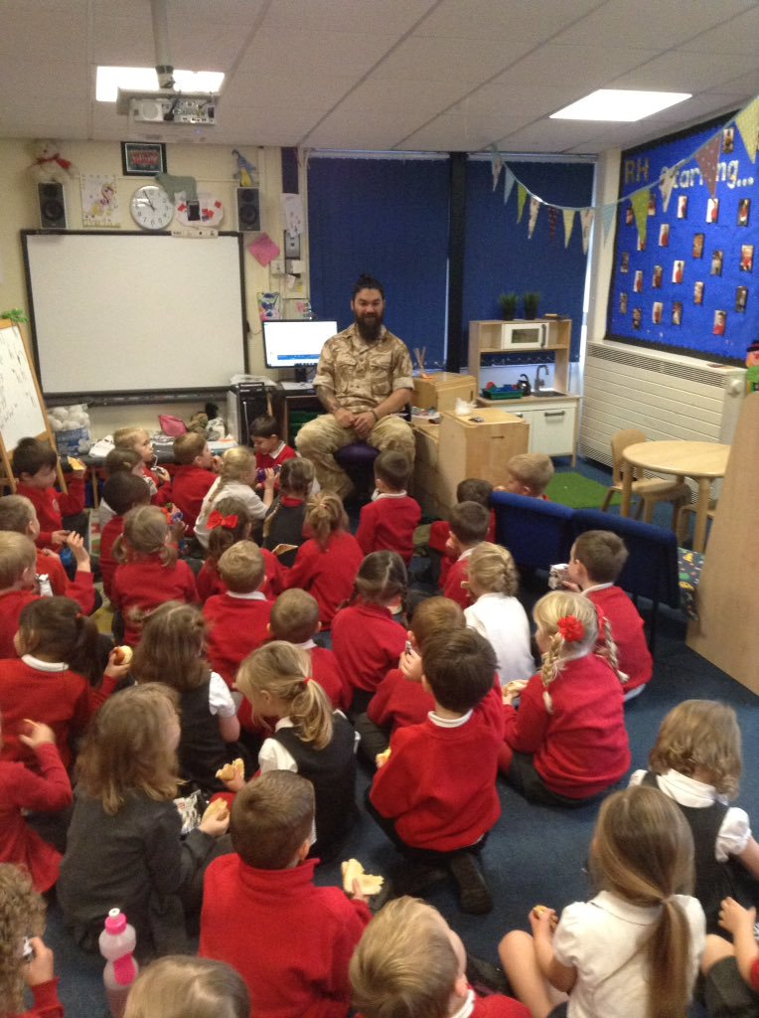
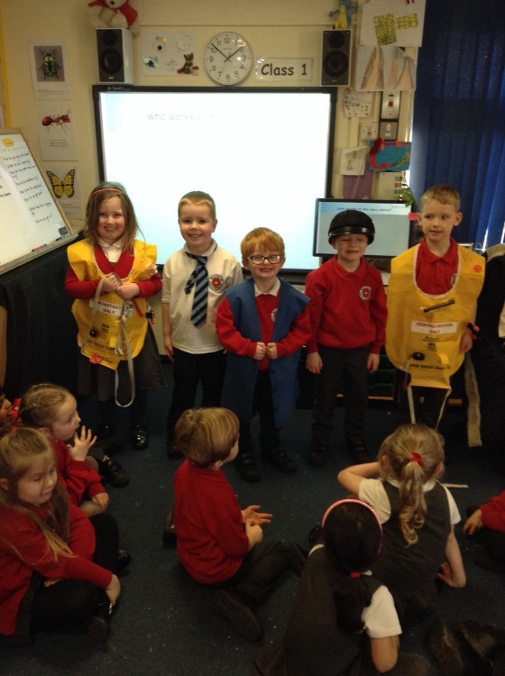
Learning about life

Slide 17
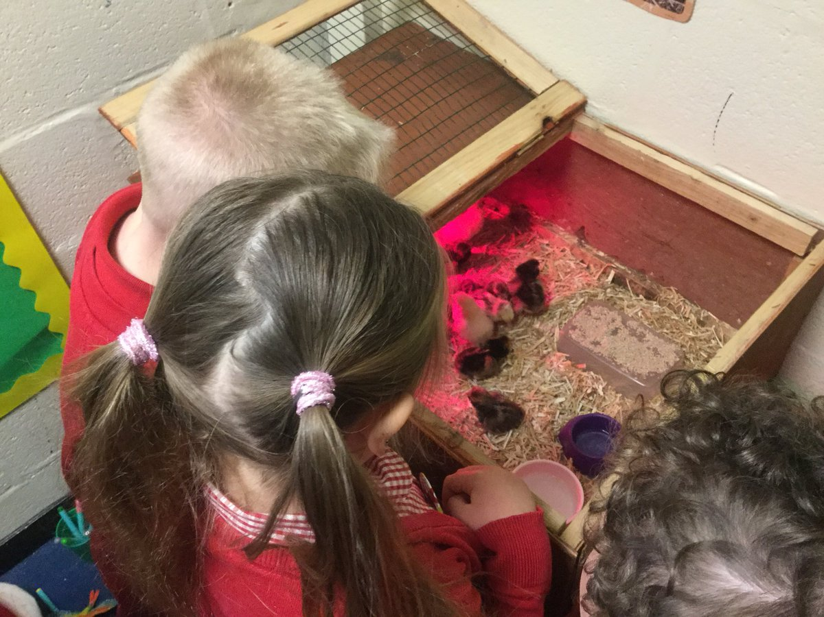
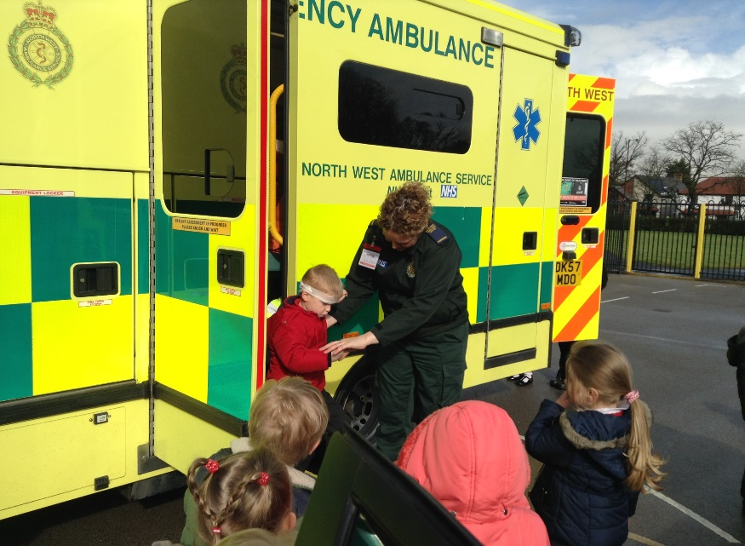
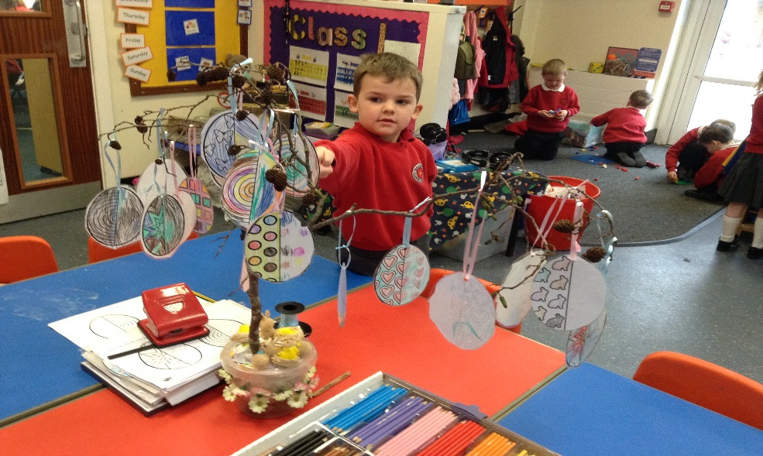
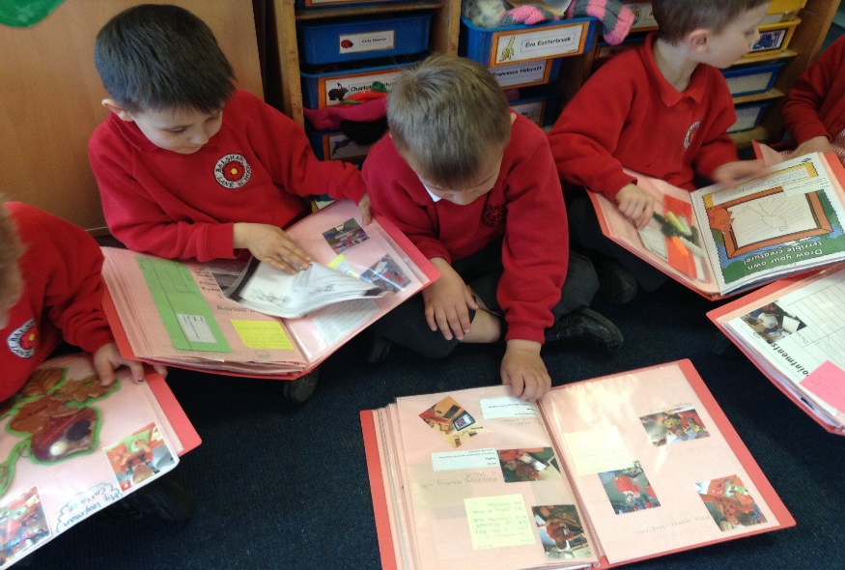
Becoming rounded individuals

