Slide 1
LEGO 1 Workshop:
Diverse Families
Age: Y3&4
Length of session: 1 Hour
Version updated on: 14/10/2022
To check for the latest version email info@diversityrolemodels.org

Slide 3



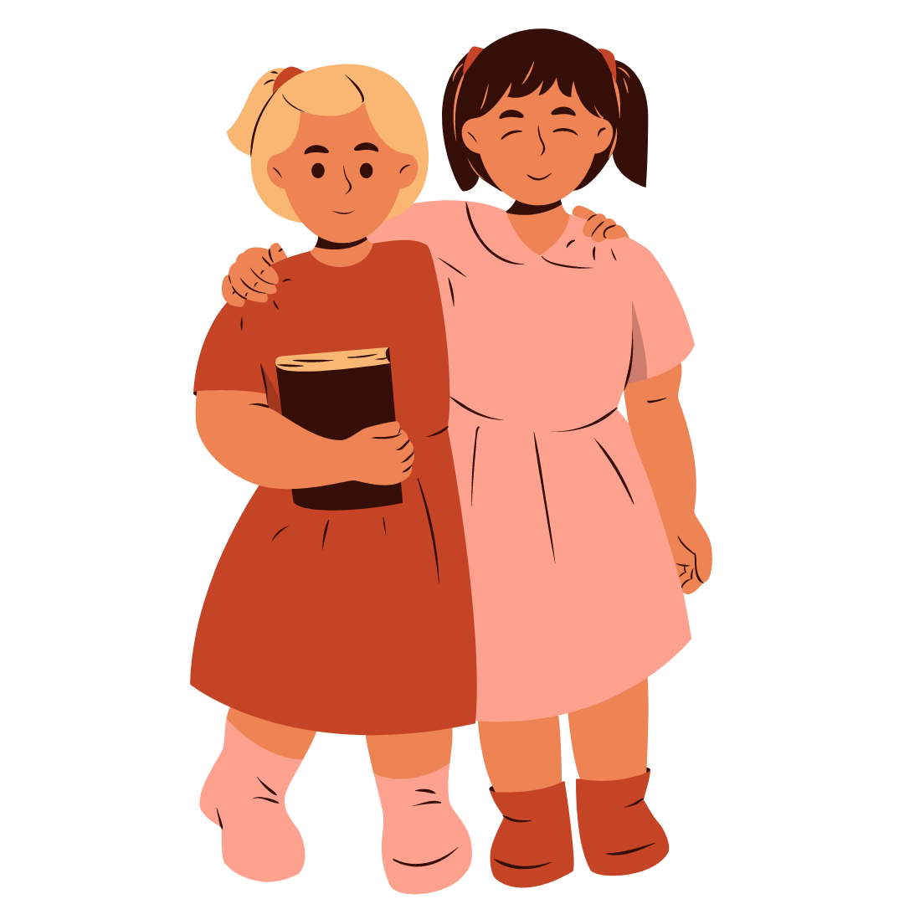
Workshop Rules
Hands up before speaking
Listen to each other
Respect each other's opinions / ideas
No naming people

Slide 4

Lego Agreement
Hands off the Lego when we’re not using it
Give your Lego back the way you found it
Remember – we're using this LEGO for all 3 workshops!

Slide 5
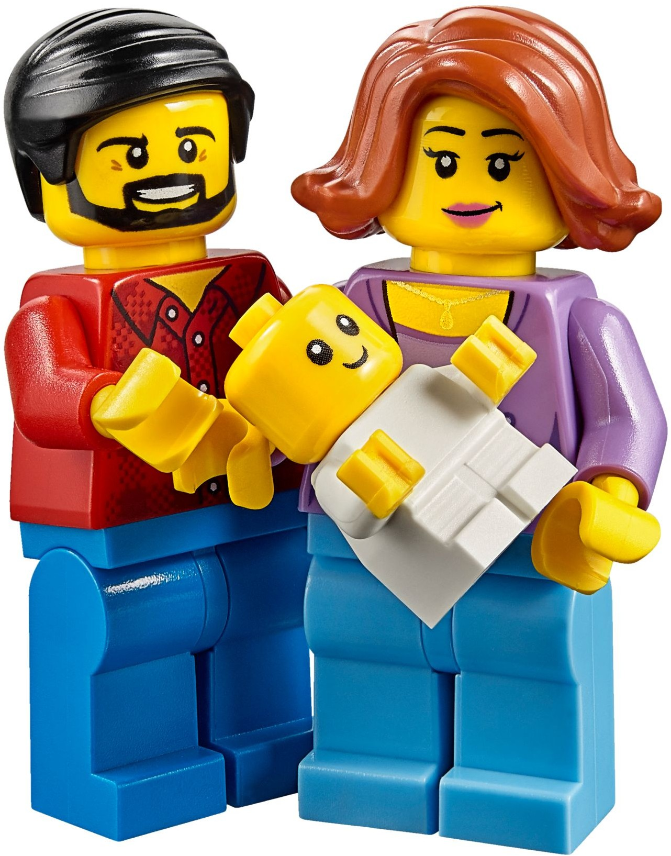
What makes a family a family?
On your worksheet can you come up with 6 things (words) that are important to have in a family?
Notes:
Starter 5 mins

Slide 6
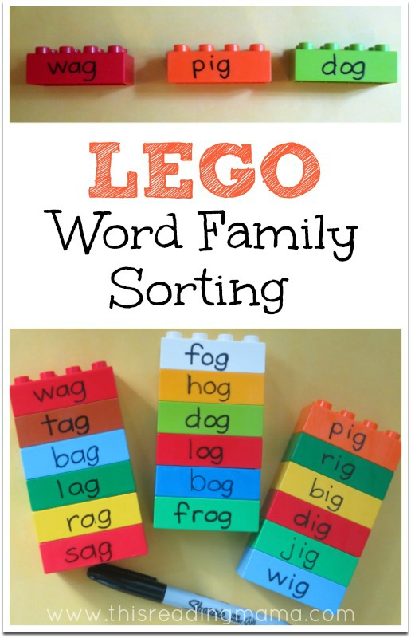
What makes a family a family?
In your groups, discuss your ideas and come up with a list of 6 words AS A GROUP (you all need to agree).
Write these onto the 6 ideas on Lego bricks you have been given using the pen you have been given.
One word per Lego brick.
Notes:
Lego activity 1
Use Dry wipe pen
5 mins

Slide 7
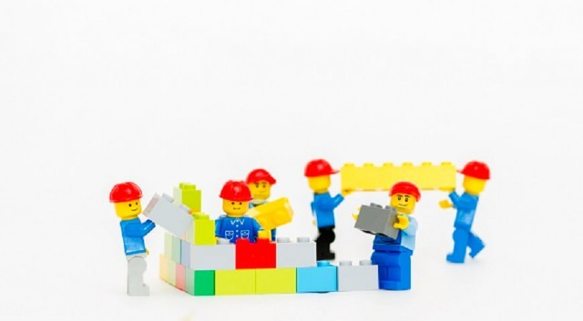
What makes a family a family?
As a group, make a TOWER out of your 6 bricks, putting the word that you think is the MOST IMPORTANT at the BOTTOM of your tower.
Your tower can be any shape you like, feel free to be creative.
Notes:
Lego Activity 1
7.5 mins

Slide 8
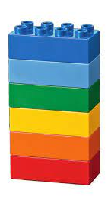
Why do you think the most important brick goes at the bottom?
Keep this tower safe – you will need it later!
Notes:
Lego Activity 1 – 5 mins
Why do you think the most important brick goes at the bottom?
It makes a family a family – it keeps the family together and strong – just like that bottom brick

Slide 9
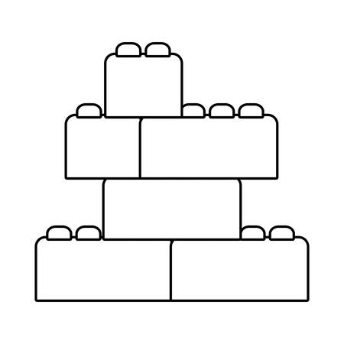
What makes a family a family?
LOVE
CARE
KINDNESS
HAPPINESS
RESPECT
SUPPORT
Notes:
Lego Activity 1
Take feedback then reveal some ideas

Slide 10
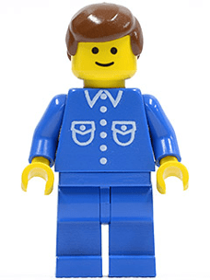
What makes a family a family?
Look at the Lego Minifigure your group has been given.
As a group decide their name, age, hobbies, and what job they do.
Write on your sheet and feedback to the class.
Notes:
Lego Activity 2 – 5 mins
F anf RM can model to show different ideas
Take feedback to the class.

Slide 11
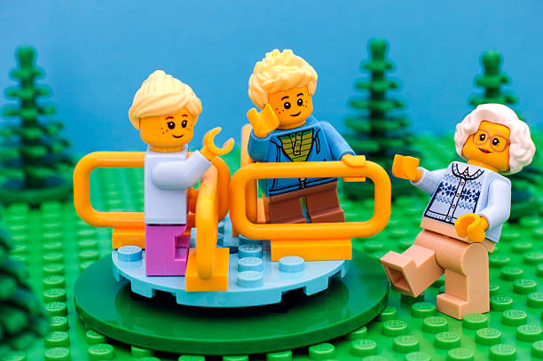
What makes a family a family?
Now working ON YOUR OWN create a family for your Lego Minifigure.
Draw or write (or both) whotheir family members are, their names, ages, how they are related, if they live together, and any other information you want to include.
Share you Lego families with your group.
Notes:
10 mins
Activity 2 – take some ideas from the class if time

Slide 12
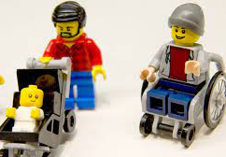
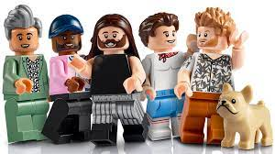
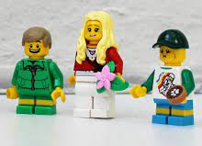
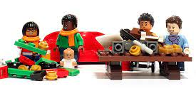
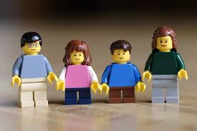
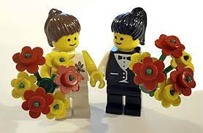
What makes a family a family?
Did you all create the exact same family?
Notes:
5 mins
Why not? - drawing out that all families are different – it does not matter WHO is part of that family – so what does matter? That they have all the things that make a family a family – love,kindness, etc…

Slide 13
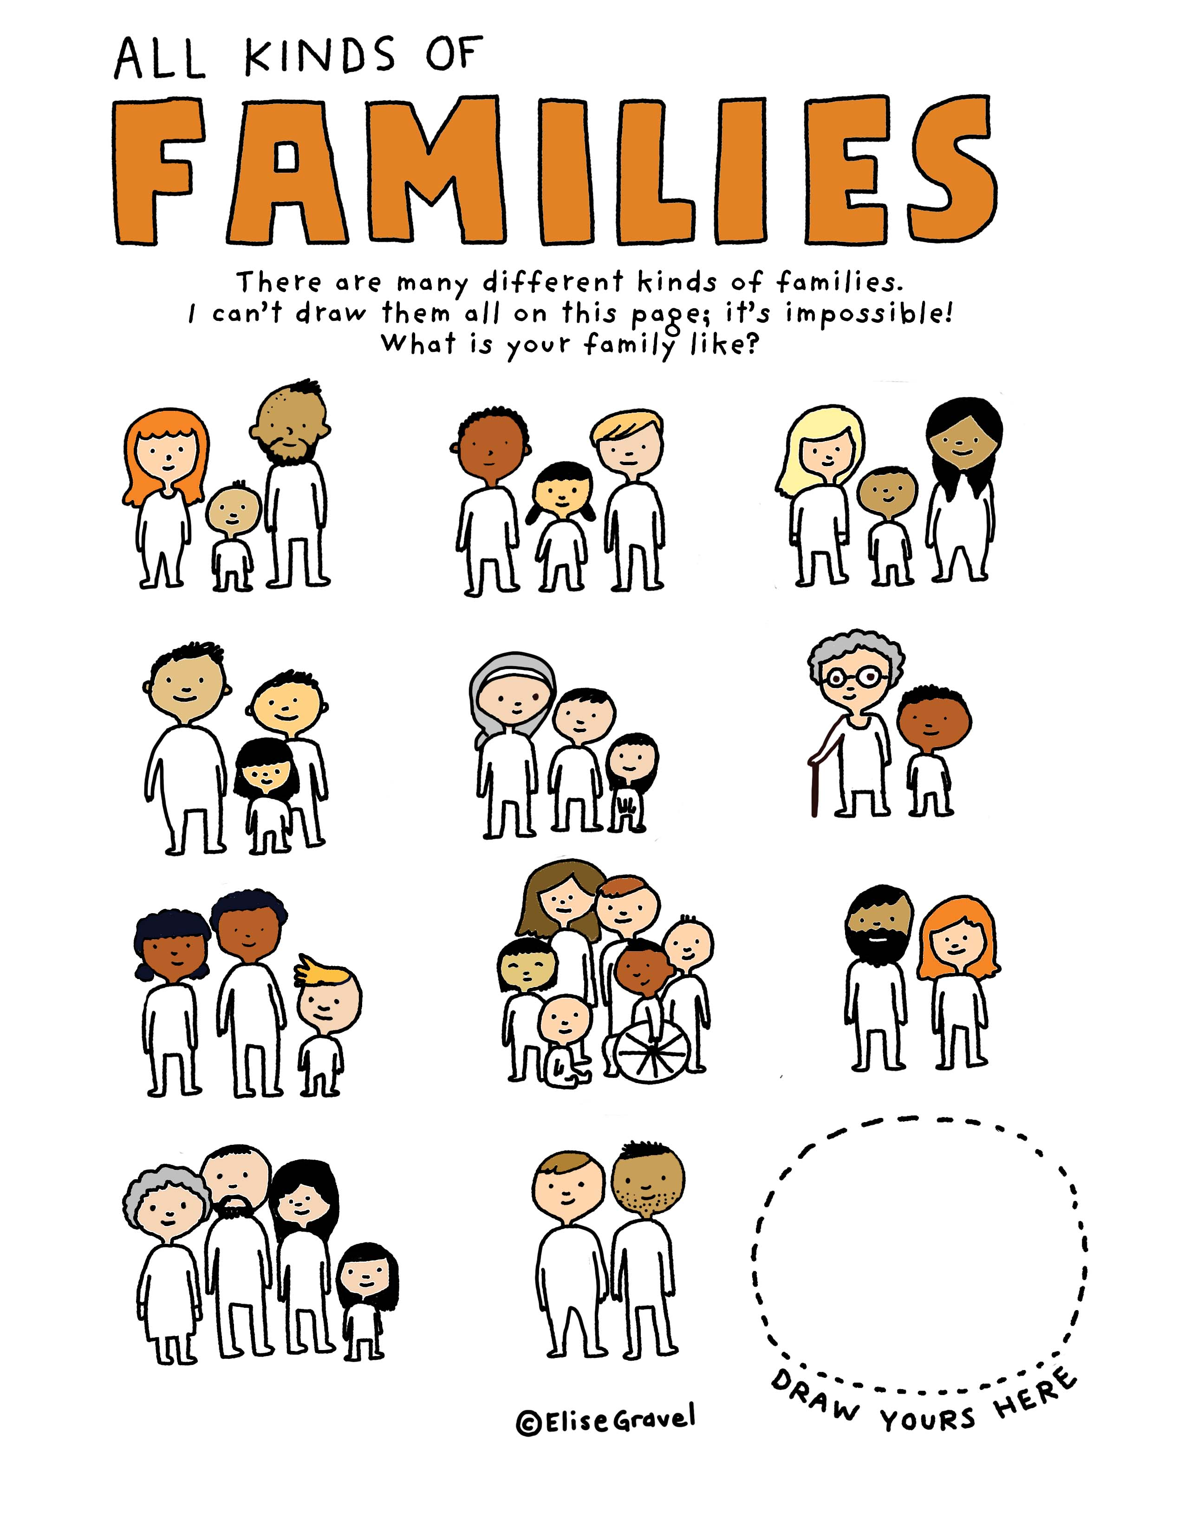
Notes:
Discuss this further using this image and getting them to think about their own family

Slide 14
Our special guest!
RM talks about their family
Notes:
5 mins

Slide 15
Question Time
Questions
Family
Work
Religion
Friends
Growing up
Love & Relationships
Notes:
5 mins
Ask class what the names of the role model’s family are. Use this as a starter to get them to ask questions about the family. Model a higher level question e.g. Do your parents gets on with your partner?

Slide 16

Respecting Differences
Hands Up: Have you ever seen someone tease someone because their family is different?
What could you do if you see someone being teased or bullied because their family is different?
Notes:
IS THIS NEEDED? 5 mins
Hands up - Have you ever seen someone tease someone because of their difference at this school?
Possible follow up: Why is that hurtful?
Possible follow up: What should we do instead of tease?

Slide 17
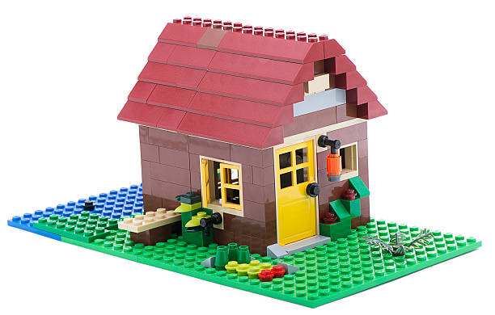
Making a home…
In your groups, you have 5 minutes to build a home for one of your lego families.
Include the bricks from your family TOWER, so your words can be seen.
Notes:
Activity 3

Slide 18


Family house rules…
As a group, create a list of 5 house rules for your family for everyone to feel happy, safe and included.

Slide 19
Is your class like a family?
On your post-it note write ONE rule you think everyone in the class should follow to make everyone happy, safe and included.
As a class make a post-it tower on the board.
Notes:
Is your class like a family? – go back to the tower ideas and what makes a family – draw out that it is

