Slide 1

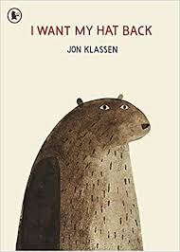
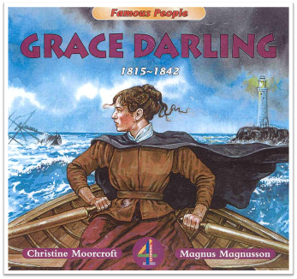


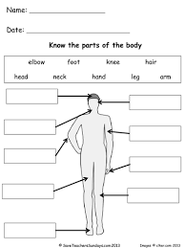
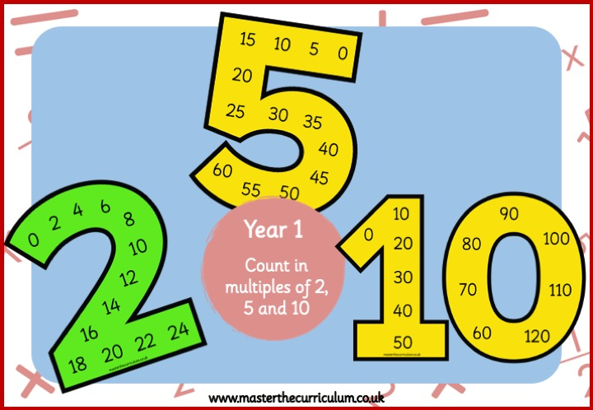
Writing
RE
History
This half term, we will start focusing on the story ‘I Want My Hat Back’ and examine how the character’s feelings develop and change throughout the story. We will focus on the use of question marks and this will lead us to writing our own version of the story which we will send to the author. Within all of our writing, we will have a big focus on continuing writing al of our sentences with the Brilliant Basics – capital letters, full stops and finger spaces.
In RE this half term, we will be learning about Salvation within Christianity focusing on the Easter Story.
In History this half term, the children will be learning about the significant individual Grace Darling and her connection and influence on the RNLI.
Curriuculum newsletter: Spring 2
Holly 1
Reading
Science
PE
Children who enjoy reading regularly thrive in their learning and therefore children are asked to read with an adult for 5- 10 minutes every day to rehearse this skill and develop a love of reading. This could be school books, library books as well as own reading books.
Reading books will be changed once a week to allow children to develop fluency and a good understanding of the vocabulary within the book. They will read this book three times in school before it is sent home.
This half term, children will learn about animals, including humans. They will identify common animal groups, learn about carnivores, herbivores and omnivores, describe animal body parts, and explore the human body and five senses.
We have PE lessons every Monday and Wednesdays so please ensure that your child wears their full PE kit on these days. Please also ensure that their PE kit is fully named. This half term in PE we will be focusing on target and net and wall games.
Maths
DT
Computing
We will begin to look at numbers up to 50. We will learn how to partition numbers into tens and ones, compare numbers using place value and learn to count in 2’s, 5’s and 10’s. Following that, we will explore calculation strategies within 20 and number bonds and doubles.
In Computing, we will be focusing on data and information and learning how to group data.
A message from Mr Thomas
Welcome back to Holly 1! We are very excited for the half term ahead and all of the exiting things we have going on. Any questions, just ask!.
In DT this half term, children will learn about stable structures, focusing on toy garages. They will explore what makes structures strong and stable, investigate materials, and then design, make and evaluate their own toy garage.

