Slide 1

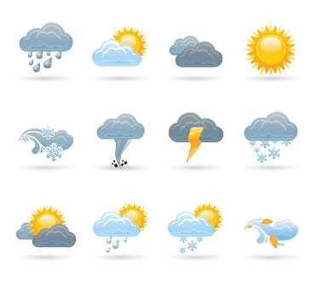


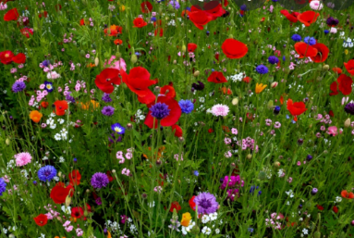
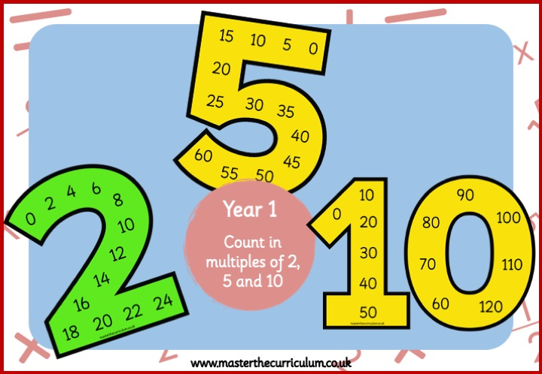
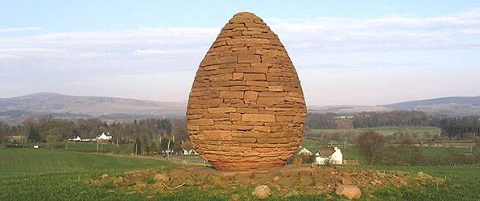
Writing
RE
History
This half term, we will be exploring the book The Odd Egg and learning how the characters develop throughout the story. We will focus on using adjectives to add detail to our descriptive writing and begin using exclamation marks to show excitement or surprise. Later in the unit, we will write our own versions of the story to share with others. Throughout all of our writing, we will continue to have a strong focus on the Brilliant Basics – capital letters, full stops and finger spaces.
In RE this half term, our enquiry question will be ’Is Shabbat important to Jewish children?’
This half term, we will look at seasonal changes in the UK and what weather is. We will focus on different weathers associated with each season and look at how we can measure various elements of weather and what equipment we will use. What dangers are associated with each type of weather and how we can stay safe.
Curriuculum newsletter: Summer 1
Holly 1
Reading
Science
PE
Children who enjoy reading regularly thrive in their learning and therefore children are asked to read with an adult for 5- 10 minutes every day to rehearse this skill and develop a love of reading. This could be school books, library books as well as own reading books.
Reading books will be changed once a week to allow children to develop fluency and a good understanding of the vocabulary within the book. They will read this book three times in school before it is sent home.
This half term in Science, we will learn about plants. We will identify common wild and garden plants, including deciduous and evergreen trees, and describe the basic structure of flowering plants. The children will also plant and grow their own marigolds.
We have PE lessons every Monday and Wednesdays so please ensure that your child wears their full PE kit on these days. Please also ensure that their PE kit is fully named. This half term in PE we will be focusing on striking and fielding games.
Maths
Art
Computing
This half term, we will be developing our confidence with counting in 2s, 5s and 10s. We will also continue to practise our number bonds to 10 and build our understanding of numbers up to 20. The children will learn more about place value by recognising tens and ones, and they will begin comparing numbers using the greater than ( > ) and less than ( < ) symbols.
In Computing, we will be creating media using digital writing. We will become familiar with using a keyboard and mouse entering and removing text, along with changing the look of text.
A message from Mr Thomas
Welcome back to Holly 1! We are very excited for the half term ahead and all of the exiting things we have going on. Any questions, just ask!.
In Art, we will be learning about sculptures and understand that art can be created from a variety of materials including natural materials. We will learn about the sculptor Andy Goldsworthy and create a natural sculpture inspired by him.

