Slide 1

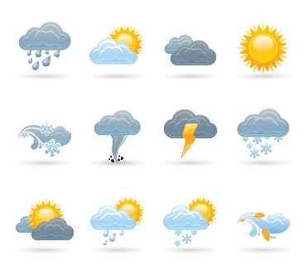


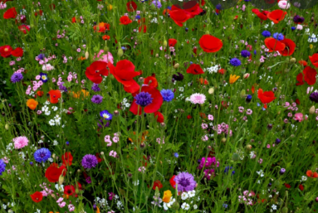
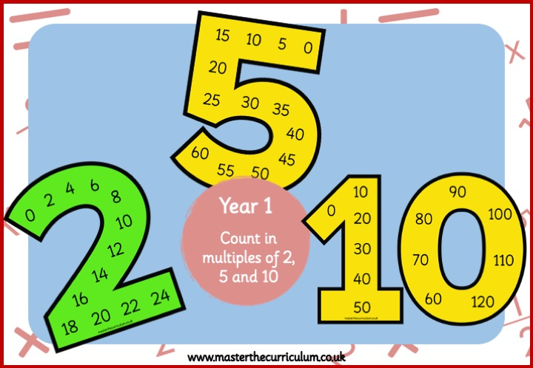
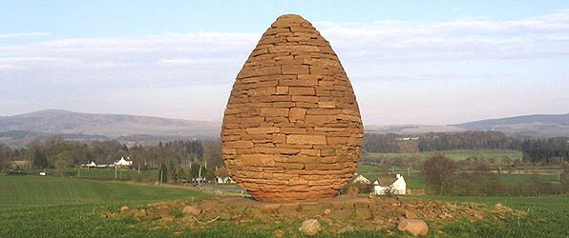
Writing
Wider Curriculum
Geography
This half term, we will be exploring the book There’s a Rang-Tan in my bedroom looking at conservation and the human impact on the world around us.
We will then move on to writing a variety of narratives to really extend our descriptive writing.
Throughout all of our writing, we will continue to have a strong focus on the Brilliant Basics – capital letters, full stops and finger spaces.
RE: Islam
Music: Boomwhackers
PSHE: Healthy Relationships
Computing: Making music
This half term we are learning about the wider world. We will be able to name and locate the continents and oceans of the world.
Curriuculum newsletter: Summer 1
Holly 1
Reading
Science
PE
Children who enjoy reading regularly thrive in their learning and therefore children are asked to read with an adult for 5- 10 minutes every day to rehearse this skill and develop a love of reading. This could be school books, library books as well as own reading books.
Reading books will be changed once a week to allow children to develop fluency and a good understanding of the vocabulary within the book. They will read this book three times in school before it is sent home.
This half term in Science, we will learn about plants. We will learn the structure of plants and will have a chance to grow a few different varieties.
We have PE lessons every Monday and Tuesday so please ensure that your child wears their full PE kit on these days. Please also ensure that their PE kit is fully named. This half term in PE we will be focusing on striking and fielding games.
Maths
Art
Home learning
This half term, we will start our learning on multiplication and division. If you can practise counting in 2s, 5s and 10s this will really help to consolidate the learning we are completing in class.
Towards the end of the half term, we will begin our learning on fractions where will learn the fractions ½, ¼, 2/4, ¾ and 1/3
Home learning: Home learning will be sent home each week and will this will need to be returned the following week.
A message from Miss Warner
Welcome back to Holly 2! Hopefully the children are rested and ready for a lovely term of summer learning!
In Art, we will be learning about the artist Picasso. We will learn about cubism and will then create our own paintings.

