Slide 1

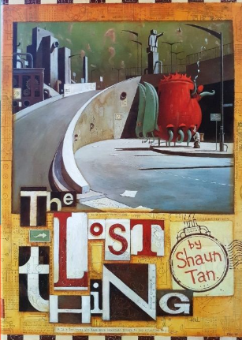

Writing
Science
History
In Spring 2, we will be using a video called
‘The Lost Thing’ to inspire us to write our own
narratives based on their own utopian settings!
We will focus on using cohesion to make our
writing flow, as well as embedding our
understanding of subordination, including
relative clauses.
In science, we will be looking at materials and states of matter. We will learn how to define materials based on their properties and will learn about solubility, transparency and conductivity.
This half term in History Maple 1 will learn all about the Ancient Greeks.
We will study historical sources and understand that the ancient Greeks developed democracy. We will also debate the most important legacy created by them.
Curriuculum newsletter: Spring 2
Maple 1
Reading
PSHE
PE
Throughout Spring 2 Maple 1 will continue with ‘reading theatre’ sessions three times per week, where they will develop their expression, smoothness, pace and prosody when reading.
We will also continue to develop our ability to comprehend a range of texts by retrieving, making inferences and making predictions based on details stated or implied.
In our PSHE ‘healthy me’ unit, Maple 1 will be learning about the health risks associated with smoking and drinking alcohol. We will also be thinking more generally about healthy and unhealthy lifestyles choices and how these might affect body image.
This half term in PE, pupils will develop skills in football and golf.
Golf will be on Mondays and football will be on Fridays. Please send your child to school in appropriate PE kit on these days.
Maths
DT
PSHE
This half term, we will continue to develop our understanding of fractions and decimals before being introduced to percentages and how these link to fractions and decimals.
We will also learn about angles – including how to use a protractor to measure and draw angles.
Music – Musical architects
Computing – Flat File Databases
RE - Christianity
A message from Miss Hawkins…
I hope you have had a lovely half term break! If you would like to come in and talk about any of our learning this term, then please do not hesitate to have a chat with me.
In DT this half term, our concept is mechanism which we will study by learning about Chinese inventions. Specifically we learn about paper, gunpowder and the compass before designing, making and evaluating our own kite.

