Slide 1

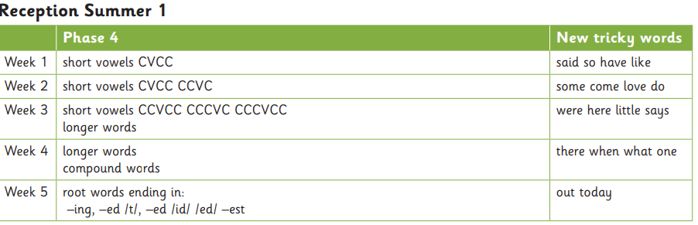

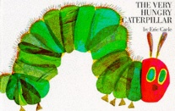



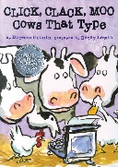

Communication and Language
Phonics
Books we will be reading
We will be learning to:
listen to and talk about stories to build familiarity and understanding. Engage in non-fiction books. Listen to and talk about selected nonfiction to develop a deep familiarity with new knowledge and vocabulary.
Use new vocabulary in different contexts. Explain why things might happen. Retell the story once they have developed a deep familiarity with the text; some as exact repetition and some in their own words
Work and play cooperatively and take turns with others;
Form positive attachments to adults and friendships with peers;
Show sensitivity to their own and to others’ needs
Curriuculum newsletter: Summer 1
Oak 2
Personal, Social and Emotional Development
Maths
Literacy
This half term we will be focusing on:
understanding our feelings and those of others, and begin to regulate their behaviour accordingly;
Set and work towards simple goals, being able to wait for what they want and control their immediate impulses when appropriate;
Giving focused attention to what the teacher says, responding appropriately even when engaged in activity, and show an ability to follow instructions involving several ideas or actions.
be confident to try new activities and show independence, resilience and perseverance in the face of challenge;
Explaining the reasons for rules, know right from wrong and try to behave; accordingly,
• Manage their own basic hygiene and personal needs, including dressing, going to the toilet, and understanding the importance of healthy food choices.
We will be learning to:
Explore shapes and pattern
Subtraction and addition facts
Number patterns within 20
We will be learning to:
spell some key words correctly.
Write sentences that are dictated using phonetic knowledge
write simple sentences that can be read by others
Use some finger spaces, full stops, capital letter
Write so it can be read by themselves and others.
Rereads sentence to check it makes sense.
A message from Mrs Prosser
Physical Development
Expressive art and design
Understanding of the world
I hope you had a lovely Easter holidays. I am looking forward to hearing about it! This half term we are focusing on using cutlery, knowing what makes us healthy and learning about farms and life in the past.
Our P.E day will be on Friday.
Gross motor skills: Confidently and safely uses a range of large and small apparatus Develop the foundations for handwriting which is increasingly accurate information.
Fine motor skills : Develop their small motor skills so that they can use a range of tools competently, safely and confidently. tools: pencils for drawing and writing, paintbrushes, scissors, knives, forks and spoons.
We will be learning to:
know that music can touch your feelings
Explore materials, textures and tools.
Explore colour mixing with the prime colours
use different size tools to add detail or change effect
We will be learning to:
Observe shape, size through drawing
Understand life cycles and changes over time Notice changes to state of matter using some technical vocabulary
understand changes to body during exercise

