Slide 1

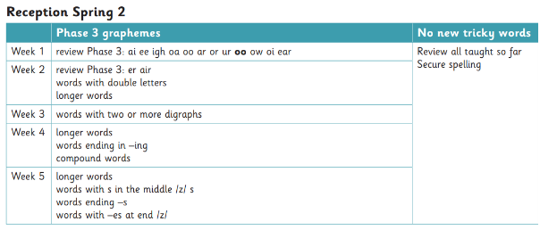






Communication and Language
Phonics
Books we will be reading
We will be learning to:
Use talk to help work out problems and organise thinking and activities explain how things work and why they might happen
Describe events in some detail
Participate in class discussions
Extend sentences with conjunctions (and because).
Think about the perspectives of others.
Build positive friendships with peers and adults.
Know how to be a good friend.
Curriuculum newsletter: Spring 2
Oak 2
Personal, Social and Emotional Development
Maths
Literacy
We will be learning to:
Investigate and learn about number patterns within 15
Double and halve number
Learn more about shapes and patterns
We will be learning to:
Use and apply some phase 3 digraphs in words.
Spelling phonetically with increased accuracy using phonic knowledge
Write simple sentences in a logical sequence – may omit some words in the sentence and finger spaces.
Read sentence back that they have written.
Sentence may be difficult to read by others
This half term we will be focusing on:
Identify and moderate their own feelings socially and emotionally.
Understand behaviours change when mood/ feelings change. Understand that they control their own body.
Respond appropriately when engaging with activity.
Show resilience and perseverance in the face of challenge. Manage their own needs
Develop independence and ask for help when needed Understand the importance of healthy eating
A message from Mrs Prosser
Physical Development
Expressive art and design
Understanding of the world
Welcome back Oak 2!
I hope you had a lovely half term.
This term we will be looking at traditional stories and learn what a story is. We will be busy building our independence skills.
Our P.E day will be on Tuesday children come to school wearing their P.E kit. Friday’s Oak 2 will have Forest school.
Gross: Combine different movements with ease and fluency. Further refining a range of ball skills including throwing, catching, kicking, passing, batting and aiming. Develop confidence, competence, precision and accuracy when engaging in activities that involve a ball.
Fine: Hold scissors correctly and cut carefully along a more complex shape, rotating the paper for accuracy.
Can cut food up using knife and fork.
Add increasing details to drawings
We will be learning to:
Make our drawings look like what they are intended to look like
Make sculptures and use digital media
Make our own props for role play
Create our own dances to perform to others
We will be learning to:
Understand past through stories, settings, characters Identify different food and what are healthy for our bodies
Understand seasonal changes-spring
Understand how and why we celebrate Easter.
Talk about own beliefs

