Slide 1






Welcome to our
Phonic/Reading
Workshop for
Parents
Watch this video clip for an introduction on how
to support phonics learning and reading at home…
https://www.youtube.com/watch?v=l8Oj6_6oJq8

Slide 2
Reading Scheme
Government guidance states that children learn to read and write best when using a phonics (pure sounds) approach.
We follow the ‘Letters and Sounds’ DfE programme for preparing children to read through a phonic based approach.

Slide 3
Laying the foundations = Phase 1 of ‘Letters and Sounds’
This is taught in Early Years throughout Nursery and Foundation. However, for some children there can be gaps in their learning which mean they will struggle to move onto phase 2 (learning phonemes) if they do not have the foundations of Phase 1.

Slide 4
Laying the foundations = Phase 1 of ‘Letters and Sounds’
Phase One activities are arranged under the following seven aspects.
■ Aspect 1: General sound discrimination – environmental sounds
■ Aspect 2: General sound discrimination – instrumental sounds
■ Aspect 3: General sound discrimination – body percussion
■ Aspect 4: Rhythm and rhyme
■ Aspect 5: Alliteration
■ Aspect 6: Voice sounds
■ Aspect 7: Oral blending and segmenting
Each aspect is divided into three strands.
■ Tuning into sounds (auditory discrimination)
■ Listening and remembering sounds (auditory memory and sequencing)
■ Talking about sounds (developing vocabulary and language comprehension).
Activities within the seven aspects are designed to help children:
1. listen attentively;
2. enlarge their vocabulary;
3. speak confidently to adults and other children;
4. discriminate phonemes;
5. reproduce audibly the phonemes they hear, in order, all through the word;
6. use sound-talk to segment words into phonemes.
(Please consider if your child has any gaps in this phase and use the suggested ideas for practise with supporting these gaps provided on the next slide)

Slide 5
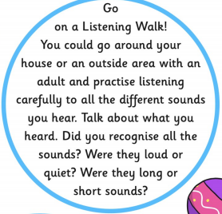
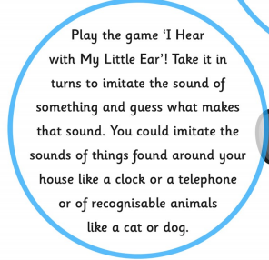
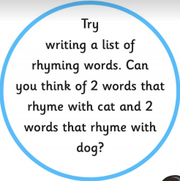
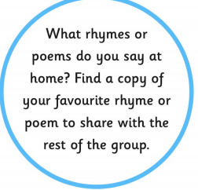
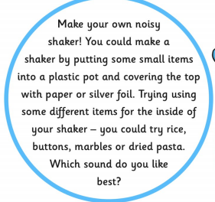
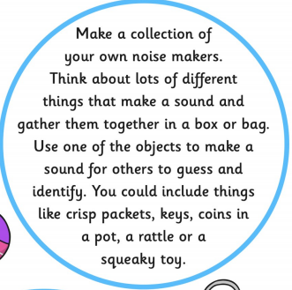
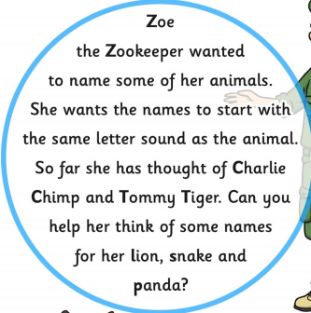
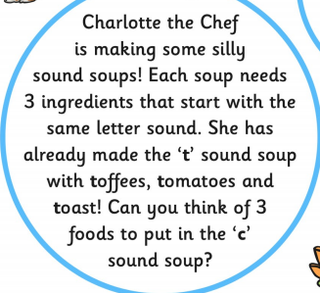
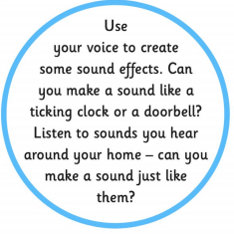
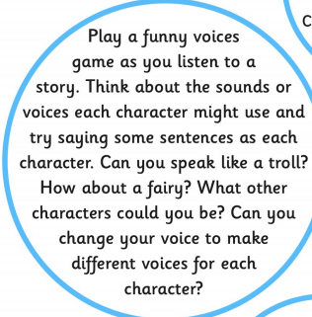
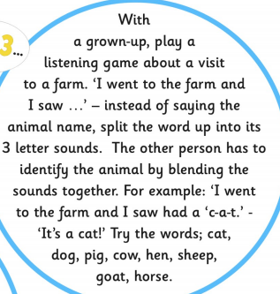
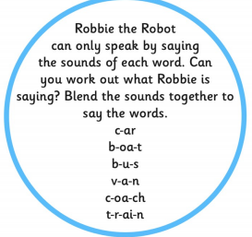
Laying the foundations = Phase 1 of ‘Letters and Sounds’
■ Aspect 1: ■ Aspect 4:
■ Aspect 2: ■ Aspect 5:
■ Aspect 3:and ■ Aspect 6: ■ Aspect 7:

Slide 6
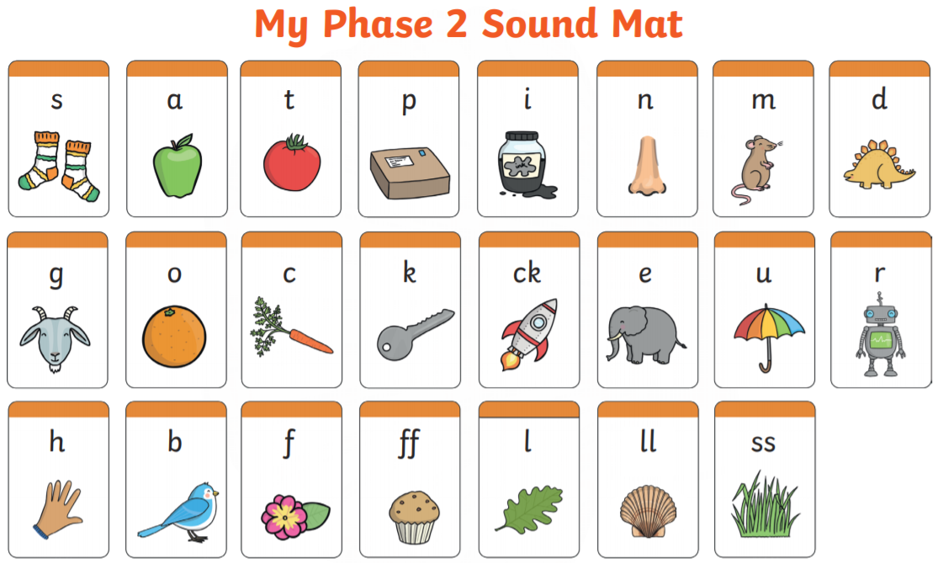
Phase 2 = learning the Phonemes
Definitions
Phonemes - A phoneme is the
smallest unit of sound
e.g. b, c, a, ch, sh, ee
44 phonemes in the English language
Graphemes – A grapheme is the letter(s)
representing a phoneme (visual)
e.g. t, ai, igh
Initially it is all about the sounds letters make in words – letter sounds NOT letter names
Correct pronunciation is imperative 26 letters in our alphabet BUT 44 sounds in our language
Many of the sounds are spelt in a variety of ways
For example: ai ay a-e a

Slide 7
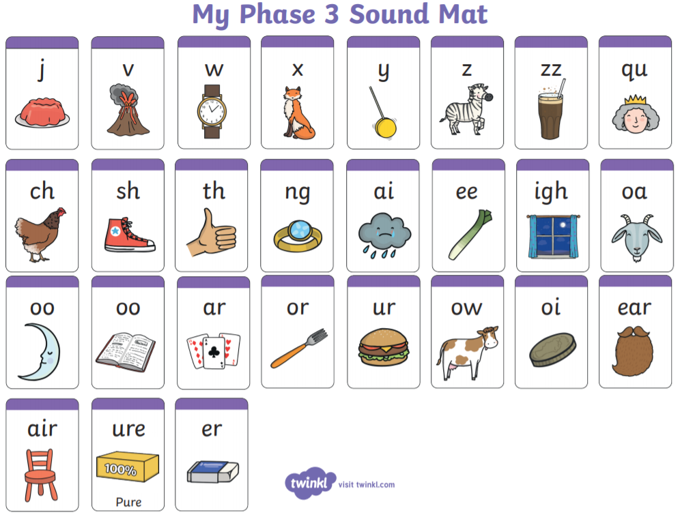
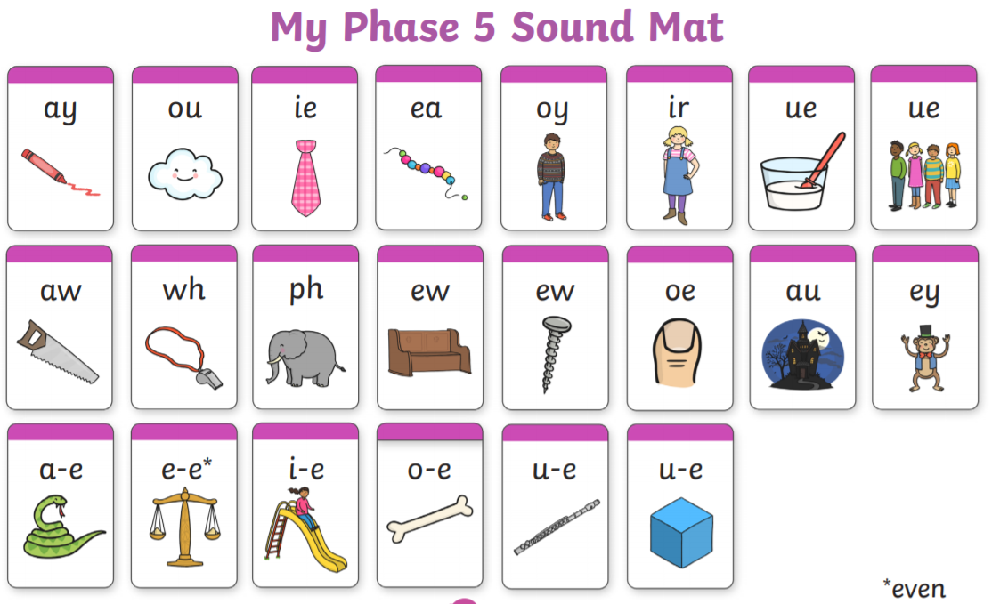
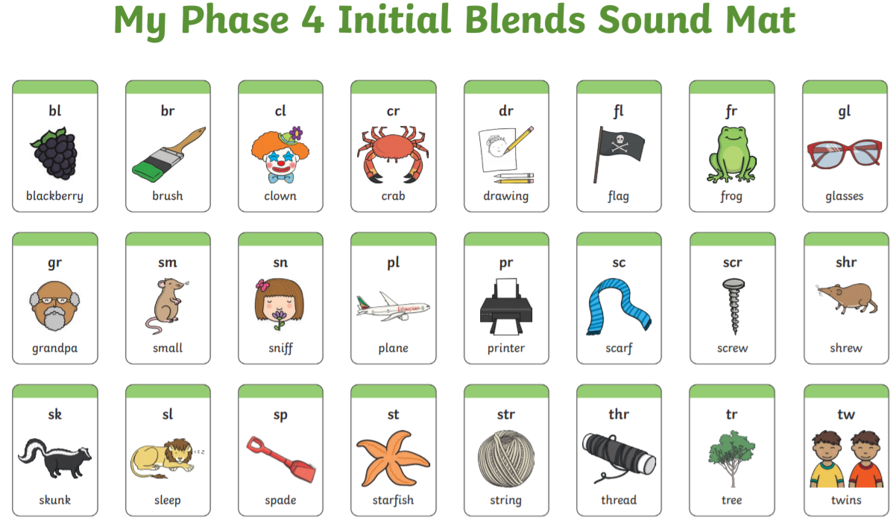
Phase 3, 4, and 5 phonemes
Digraph - Two letters which make one phoneme (sound) ai ee ar oy
Trigraph - Three letters which make one phoneme (sound)
igh ure
Split digraph – These phonemes have a letter in the middle where the – (dash or hyphen) is. E.g. make cute like
a-e e-e i-e o-e u-e
Phase 4 – letters can be sounded out individually in words or as a consonant cluster blend like below…

Slide 8
The importance of the Pure Sound
Pronunciation
This video clip explains the importance of the pure sound and demonstrates how to pronounce all the phonemes.
https://www.youtube.com/watch?v=UCI2mu7URBc
Use this video clip to practise flashcard sounds with your child quickly every school day, if possible. When they are secure at recognising most of them, turn the sound off and see if they can tell you the phonemes correctly. Or why not let them test you and they can be the teachers seeing if you are right!

Slide 9




Understanding the Sounds
You can help by making sure your child
really knows the sounds………
They should be able to:
Hear the sounds Say the sounds
Recognise the letters Write the sounds
that make the sounds

Slide 10
Blending words
We learn to read by blending the letters together to make a word.
e.g. C – a – t = cat
f – ee – t = feet
Watch this video for support on how to blend words with your child…
https://www.youtube.com/watch?v=vqvqMtSNswo

Slide 11
Segmenting words
We learn to segment words by recognising or hearing the phonemes in words
and saying them out loud…
e.g. Cat = C – a – t
feet = f – ee – t
This helps the children understand that words are made up of different
sounds. This will help them with their spelling, when they begin to write.
Recognising that there are several letters in words and beginning to place them
together in the right order to make a word is a key skill.

Slide 12

Using Sound buttons to support learning
phonemes and reading words
As part of our phonic teaching we get the children to use sound buttons. This is segmenting a word to find each phoneme sound in the word.
e.g. The is in red to highlight that it is a tricky word that can’t be sounded out but needs to be learnt by sight and memory.
The dots … represent each phoneme that has only a single letter (grapheme) representing it.
The lines ____ represent each phoneme that has two or more letters representing it. Mainly the digraphs and trigraph sounds. E.g. ay igh ee oa

Slide 13


Using Sound buttons to support learning
phonemes and reading words
Using sound buttons, when children are learning to read and remember their phonic sounds, is a great visual and fun way to learn to read.
Please encourage your child to continue to practise this skill at home by…
Using the phonic homework sheets for word ideas and getting the children to rewrite these words on post-it notes or strips of paper .
Stick them or hide them around the house or garden and ask children to go on a word hunt. When they find a word, if they can read they keep it.
Play snap, pairs or memory games with words and get the children to add sound buttons when they find matching pairs.
Wear silly glasses, sunglasses or use a magnifying glass or binoculars to hunt for sounds in words – when they spot a digraph or trigraph in a word underline it!

Slide 14
Sounds are like muscles, use them or lose them!
Things to practise at home…P.T.O

Slide 15
Fun ways to learn at home…
*Play sound snap
*Play sound pairs
*Treasure hunt/letter detectives - sounds and words in the home or anywhere!
*Play i-spy – initial sounds as well as digraphs and trigraphs when reading words.

Slide 16
Fun ways to learn at home…
*Play teachers – flashcard sounds
*Matching sounds to letters – you say a sound, child finds the right card.
*Write sounds with sticks in the soil, chalk, paint, shaving foam.
*Great website with more ideas, information and online phonic games https://www.dogsthorpeinfants.co.uk/sonic-phonics

Slide 17
Top Tips for learning to read at home…
Julia Donaldson (famous author) shares her top tips on how to gain a love of reading in this video clip…
https://www.youtube.com/watch?v=1-wud5ndvuE
This video demonstrates fun ways to learn new vocabulary when reading with your child…
https://www.youtube.com/watch?v=cCdowxgklgI
This video demonstrates fun ways to learn about comprehension when reading…
https://www.youtube.com/watch?v=xm7eZctoGag
This video demonstrates the importance of retelling or making up stories…
https://www.youtube.com/watch?v=F8k93ylkBPA

