Slide 1
Personal Statements - let’s get started!
26th May 2021
Notes:
Significance
Don’t forget ot snot all about results

Slide 2
Quick re-cap
https://www.youtube.com/watch?v=_8hFkMAjW-I&feature=youtu.be
Notes:
Teachers’ notes:

Slide 3
Outcomes:
By now you should have your own copy of the Personal Statement booklet.
By the end of today’s session, you should have:
Some detailed notes in each of the sections in your booklet
Identified any gaps on page 8 and have a plan of how you will fill
those gaps.
Notes:
Teachers’ notes:
The Notes for reference and recommendation writers tool is a place for students to include any overspill of their Personal Statement, so their reference writers can include it in their assessment.
Teachers see the notes from their students on the same page they write references from, so they’re really handy. This is a great way for teachers to get to know their students and their interests!

Slide 4
Ready, set… Write!
1. Read through the top tips section
2. Read the guidance for paragraph 1 and start making some detailed notes about what you could include in that section.
3. Repeat this process for sections 2 and 3.
4. Go onto Unifrog and see an example personal statement for the s same subject you are applying for. Now check your notes, is there anything you could add?
5. If you are now aware of any gaps in your notes (i.e. you haven’t written much for certain sections), complete the table on page 8 of your booklet and identify ways in which you can fill these gaps over the next few months.

Slide 5
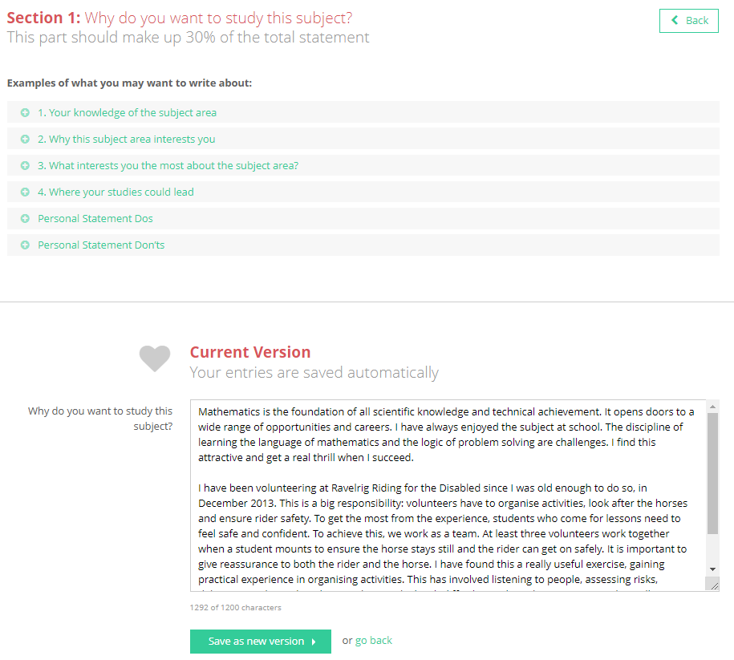
Next steps:
Go on to Unifrog and find the “Using the Personal statement” tool
Type up and expand on the notes you have made today in your booklet and create your first draft!
When you’ve finished a draft, send it to Miss McGowan, Miss Darby or your form tutor for feedback!
Save unlimited versions in each of the 3 sections, and click the green links for hints and tips!
Notes:
Teachers’ notes:

Slide 6
Remember:
Week beginning 12th July is your chance to significantly add to section 2. This could be through a virtual work experience placement, one (or more) MOOCs, insight days, reading around your subject etc.
Monday 19th July you will be updating your Personal statement on Unifrog to reflect the experiences you had the week before.
So if you haven’t sorted anything out yet… get on it!
Speak to your Form Tutor or the Sixth Form team if you need help with this.

