Slide 1
Section 2: The Causes of the Japanese Tsunami
Objectives/End Points
Pupils will learn that:
• The earth is broken into different sections
• The earth’s crust is broken up into pieces like a jigsaw
• There are differences between types of crust (oceanic and continental)
• Japan is located on a destructive plate boundary with three plates moving towards each other
• Tsunamis are created from mega thrust earthquakes under the ocean
• Tsunami waves can lead to complete devastation where they hit

Slide 3
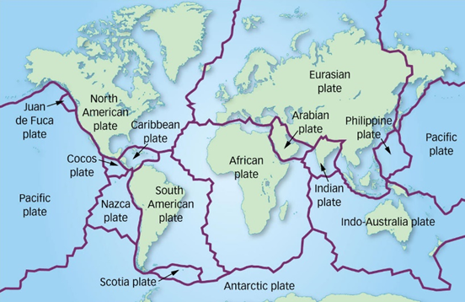
Click here to watch video about the structure of the earth

Slide 5
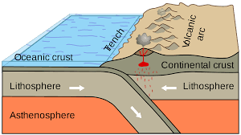
Destructive plate boundary:
Oceanic plate moves towards continental plate
Oceanic plate sinks (subducted) under the continental plate. This is because the oceanic plate is heavier and dense.
Both volcanoes and earthquakes occur here due to the pressure building up .

Slide 6
What is a Tsunami?
“A tsunami is a large ocean wave that is caused by an earthquake lifting the ocean floor.”

Slide 7
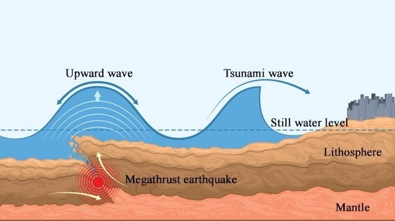
“Asian Tsunami: causes of a Tsunami”.
At a destructive plate boundary, a megathrust earthquake occurs, which lifts the seabed.
The sea above the earthquake is displaced.
This creates ripples in the deep ocean which can travel up to 500 miles per hours towards the coastline.
As the wave approaches the shore, friction with the seabed slows the front of the wave
The back of the wave catches up to the front and crashes into the coastline causing massive devastation.
https://www.bbc.co.uk/bitesize/clips/zmtc87h

Slide 8
The Japanese Tsunami
The Japanese Tsunami occurred on the 11th March 2011, when an Earthquake measuring 8.9 on the Richter Scale occurred off the East coast of Japan
The Mega Trust Earthquake lasted approximately 6 minutes and caused a 10metre high Tsunami wave, which took less than an hour to hit the shore

Slide 9
Your Task
1) Draw a labelled diagram of a Destructive Plate Boundary with the labels of:
Oceanic Crust
Continental Crust
Subduction
Volcano
Earthquake
2) Rearrange the sentences below in the order of how a Tsunami forms. Draw an image next to each of them to help you remember what is happening
The sea above the earthquake is displaced.
This creates ripples in the deep ocean which can travel up to 500 miles per hours towards the coastline.
At a destructive plate boundary, a megathrust earthquake occurs, which lifts the seabed.
The back of the wave catches up to the front and crashes into the coastline causing massive devastation.
As the wave approaches the shore, friction with the seabed slows the front of the wave

Slide 10
The Causes of the Japanese Tsunami
Objectives/End Points
Pupils will learn that:
• The earth is broken into different sections
• The earth’s crust is broken up into pieces like a jigsaw
• There are differences between types of crust (oceanic and continental)
• Japan is located on a destructive plate boundary with three plates moving towards each other
• Tsunamis are created from mega thrust earthquakes under the ocean
• Tsunami waves can lead to complete devastation where they hit

