Slide 1
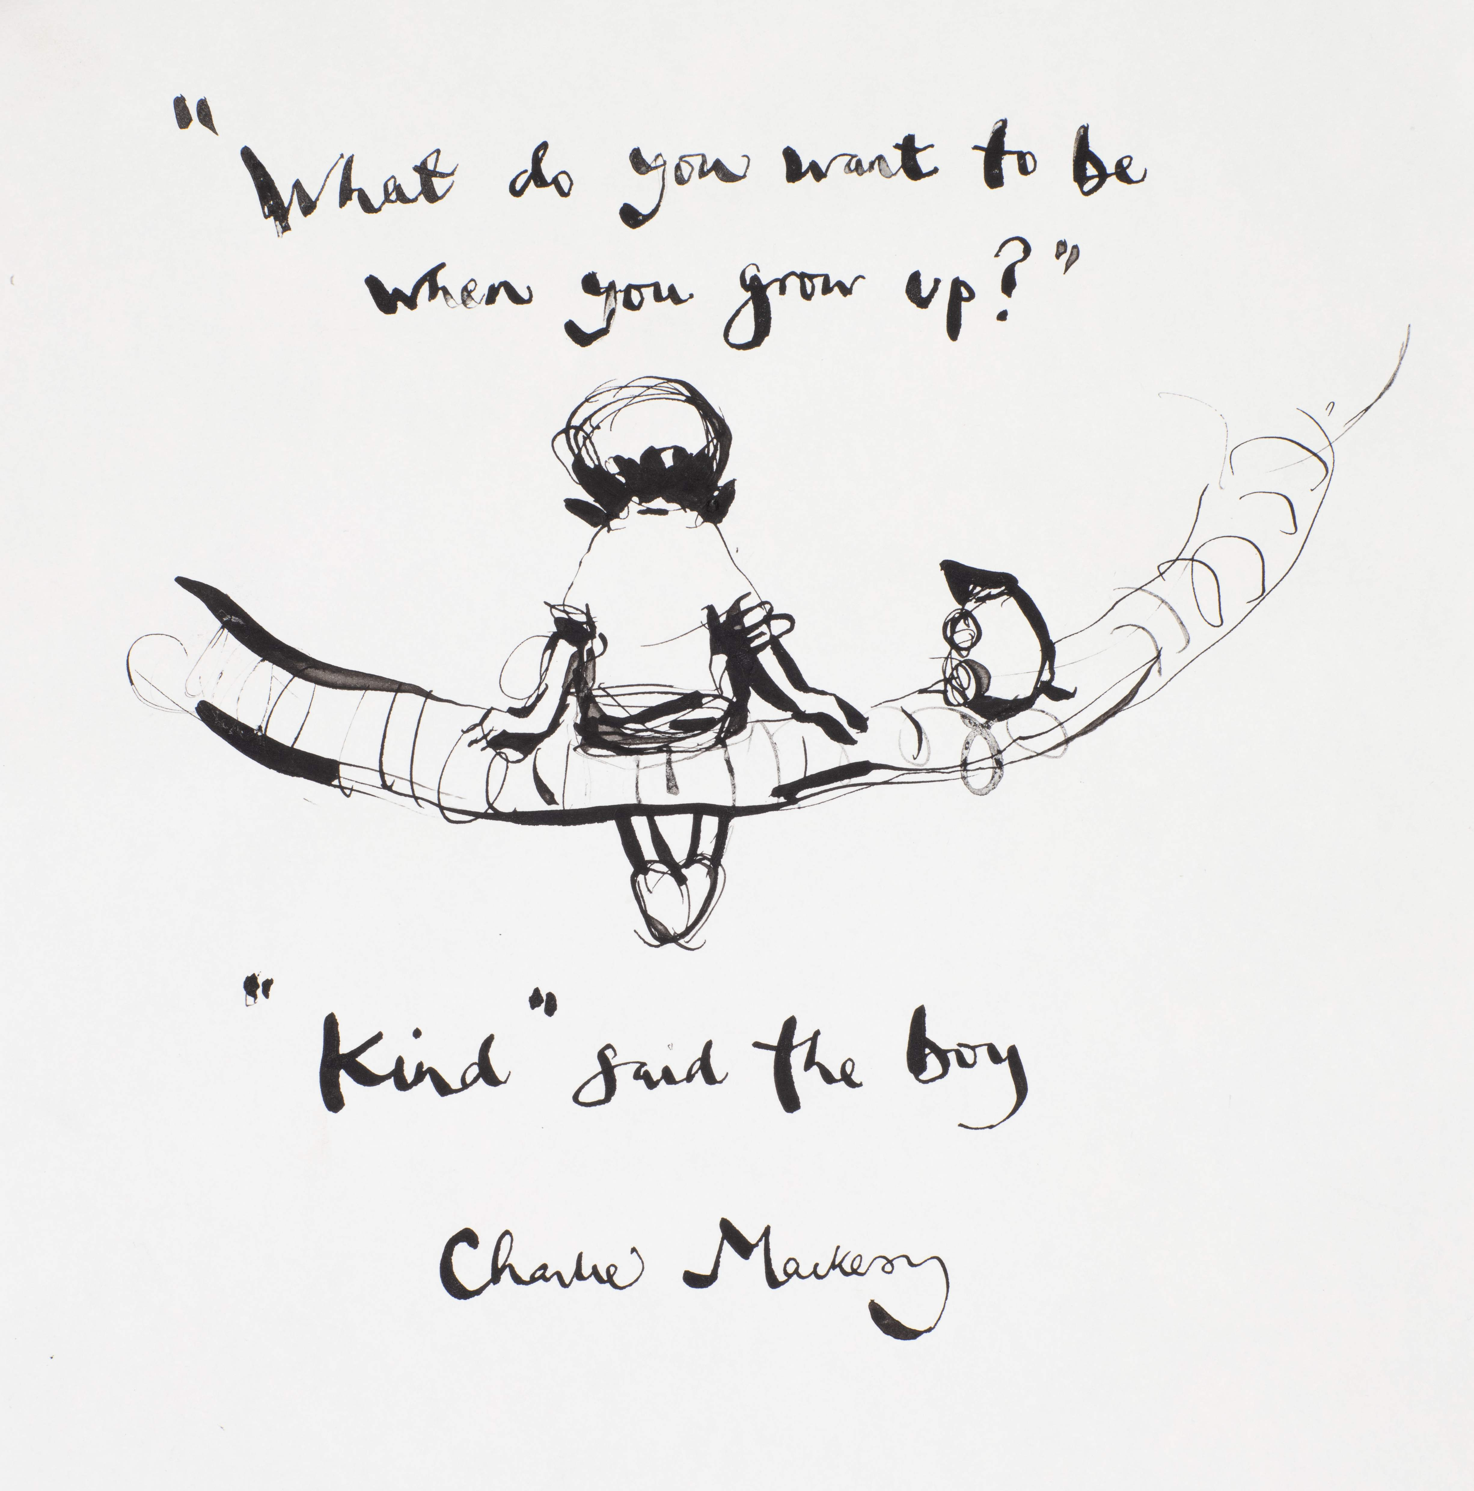
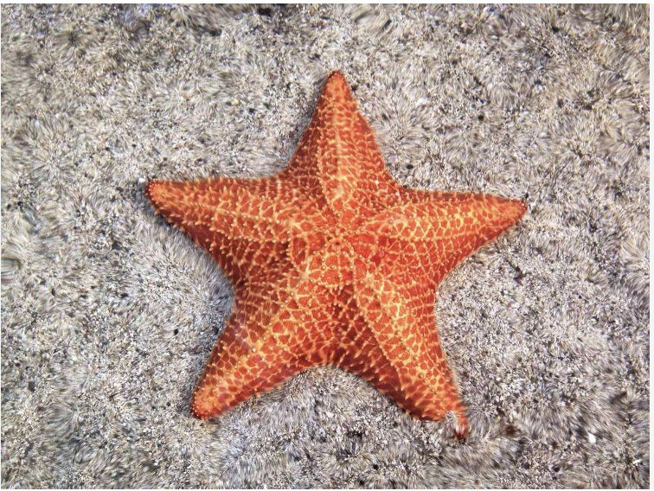

Welcome to Starfish Class
BELONG - INSPIRE - GROW

Slide 2
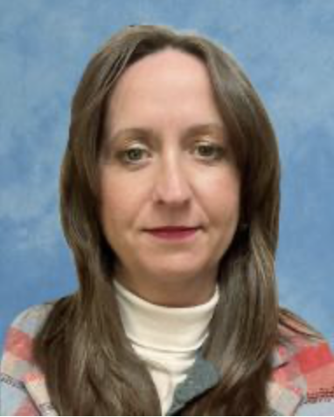
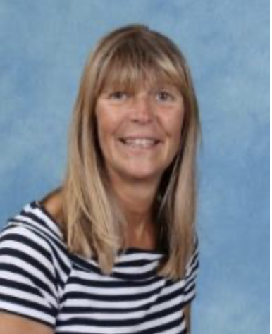
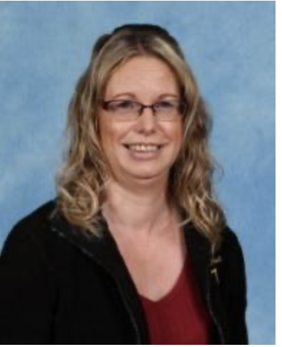
Meet the Team
Teachers– Miss Assinder
Support Staff – Mrs Balster and Mrs Broad
BELONG - INSPIRE - GROW

Slide 3
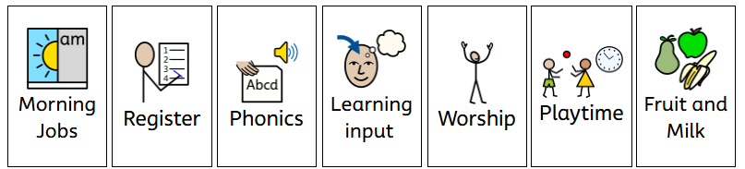
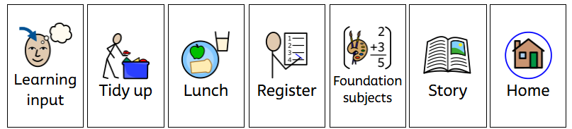

A Typical Day In Starfish Class
BELONG - INSPIRE - GROW

Slide 4
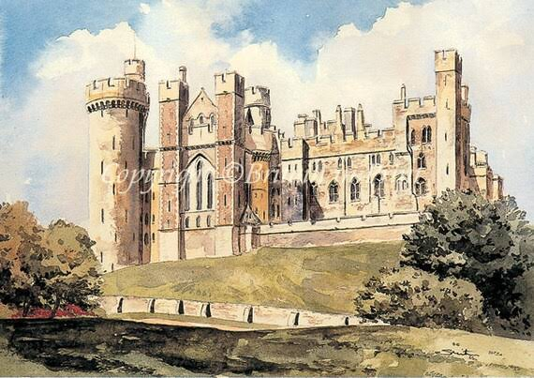

Year Group Events
Harvest Festival 6th October
Arundel Castle
TBC
Forest School
Wednesday 30th September and 17th March.
BELONG - INSPIRE - GROW

Slide 5
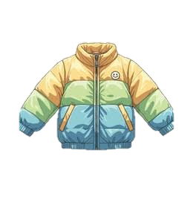
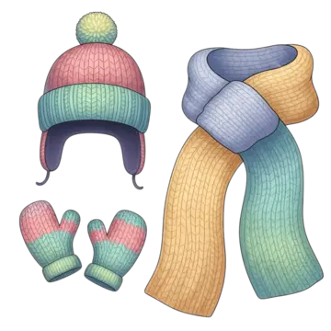

BELONG - INSPIRE - GROW

Slide 6
Home learning
Please remember to read with your child at least 5 times a week. Regular reading helps to build confidence, improve vocabulary and develop a love for reading. After each night, please record it in your child’s reading diary so that they can earn their reading certificates!
Please practise counting daily (beyond 20), and help your child form these numbers correctly. Times Tables could focus on 2, 5 and 10 times tables.
BELONG - INSPIRE - GROW

Slide 7


Going for Gold Our School Rules
BELONG - INSPIRE - GROW

Slide 8
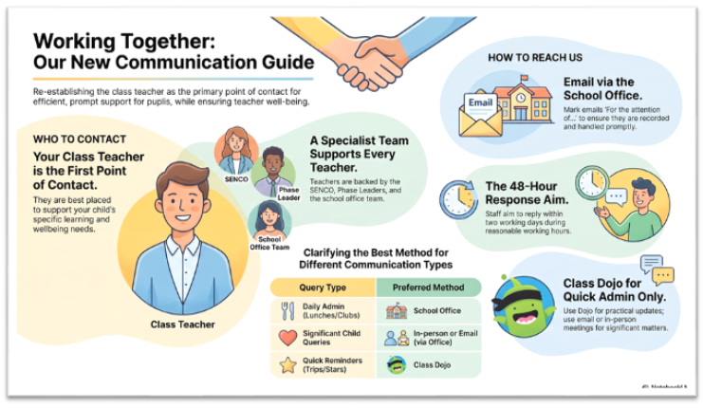
Communication
Please send emails through the office – office@tufnell.org
Class DoJo is there for quick messages and for us to share class information with you.
Year group newsletter is always great to refer back to.
BELONG - INSPIRE - GROW

Slide 9
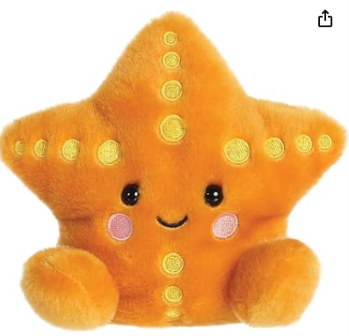
Stephanie starfish
Each week, one child will be chosen to take Stephanie the Starfish home
for the weekend.
This is a fun activity designed to encourage children to talk about and
Share their weekend experiences.
We would love for your child to take ownership of the activity by writing one simple sentence about what they did with Stephanie did over the weekend.
For example: Stephanie watched me play football and we won!' Or 'Stephanie came to the park
with me and it was fun.' Or 'Stephanie watched TV with me.
Stephanie''s weekend can be as exciting or as simple as you like! E.g. Joining a family visit,
playing at home, a day out, or just time together.
You do not need to take any photos, but you can if you would like to.
Your child can also draw a picture to go alongside their sentence instead if you wish.
This is just a fun way for your child to share about their weekend and practise writing at home with you!

Slide 10
Any Questions
BELONG - INSPIRE - GROW

Slide 11
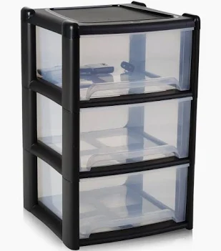
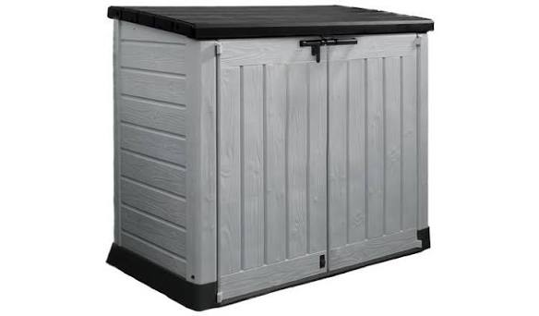
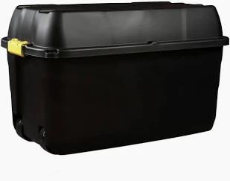
Any Donations Welcome
Since moving into our new KS1 space, we’re looking for donations that could help us spruce up and develop our outdoor area and create an even more exciting environment for the children.
We would be incredibly grateful for any outdoor (or indoor games), toys or resources that your child may have outgrown or no longer plays with. They certainly don’t need to be in perfect condition, but safe and suitable for a new lease of live would be greatly appreciated!
We’re also looking for:
Strong storage boxes, outdoor storage or sheds,
Children’s furniture – benches, deck chairs etc
Cushions and soft furnishings
Outdoor equipment and resources – games / toys
Toy cars, diggers, planks of wood, guttering, large logs
Watering cans, containers, water and sand play toys
Play sand, soil, stones, or bark for defining areas
Any other useful material or bits and pieces
BELONG - INSPIRE - GROW

Slide 12
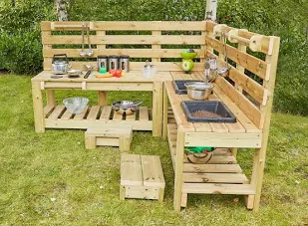
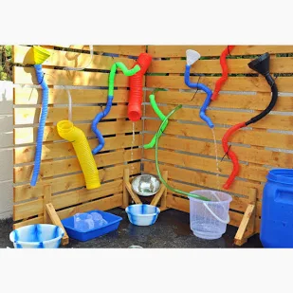
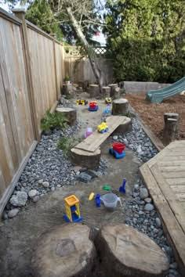
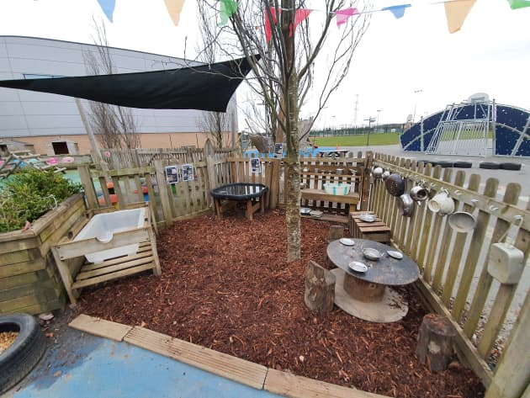
Any Donations Welcome
We currently have a mud kitchen being built, so any old pots,
pans, utensils, baking trays or similar kitchen items would be welcome.
We’re also very grateful for anyone who may be able to offer trades, or practical skills or materials to help us develop the space! If that’s you or someone you know, let us know!
We will also be looking to develop a space for sand and water. Please if you had any play sand, soil, sand toys or buckets and spades, water containers, funnels for water or sand play!
If there’s anything that you think could be useful,
please ask or get in touch – you never know it might be a
great resource or material!
BELONG - INSPIRE - GROW

