Slide 1
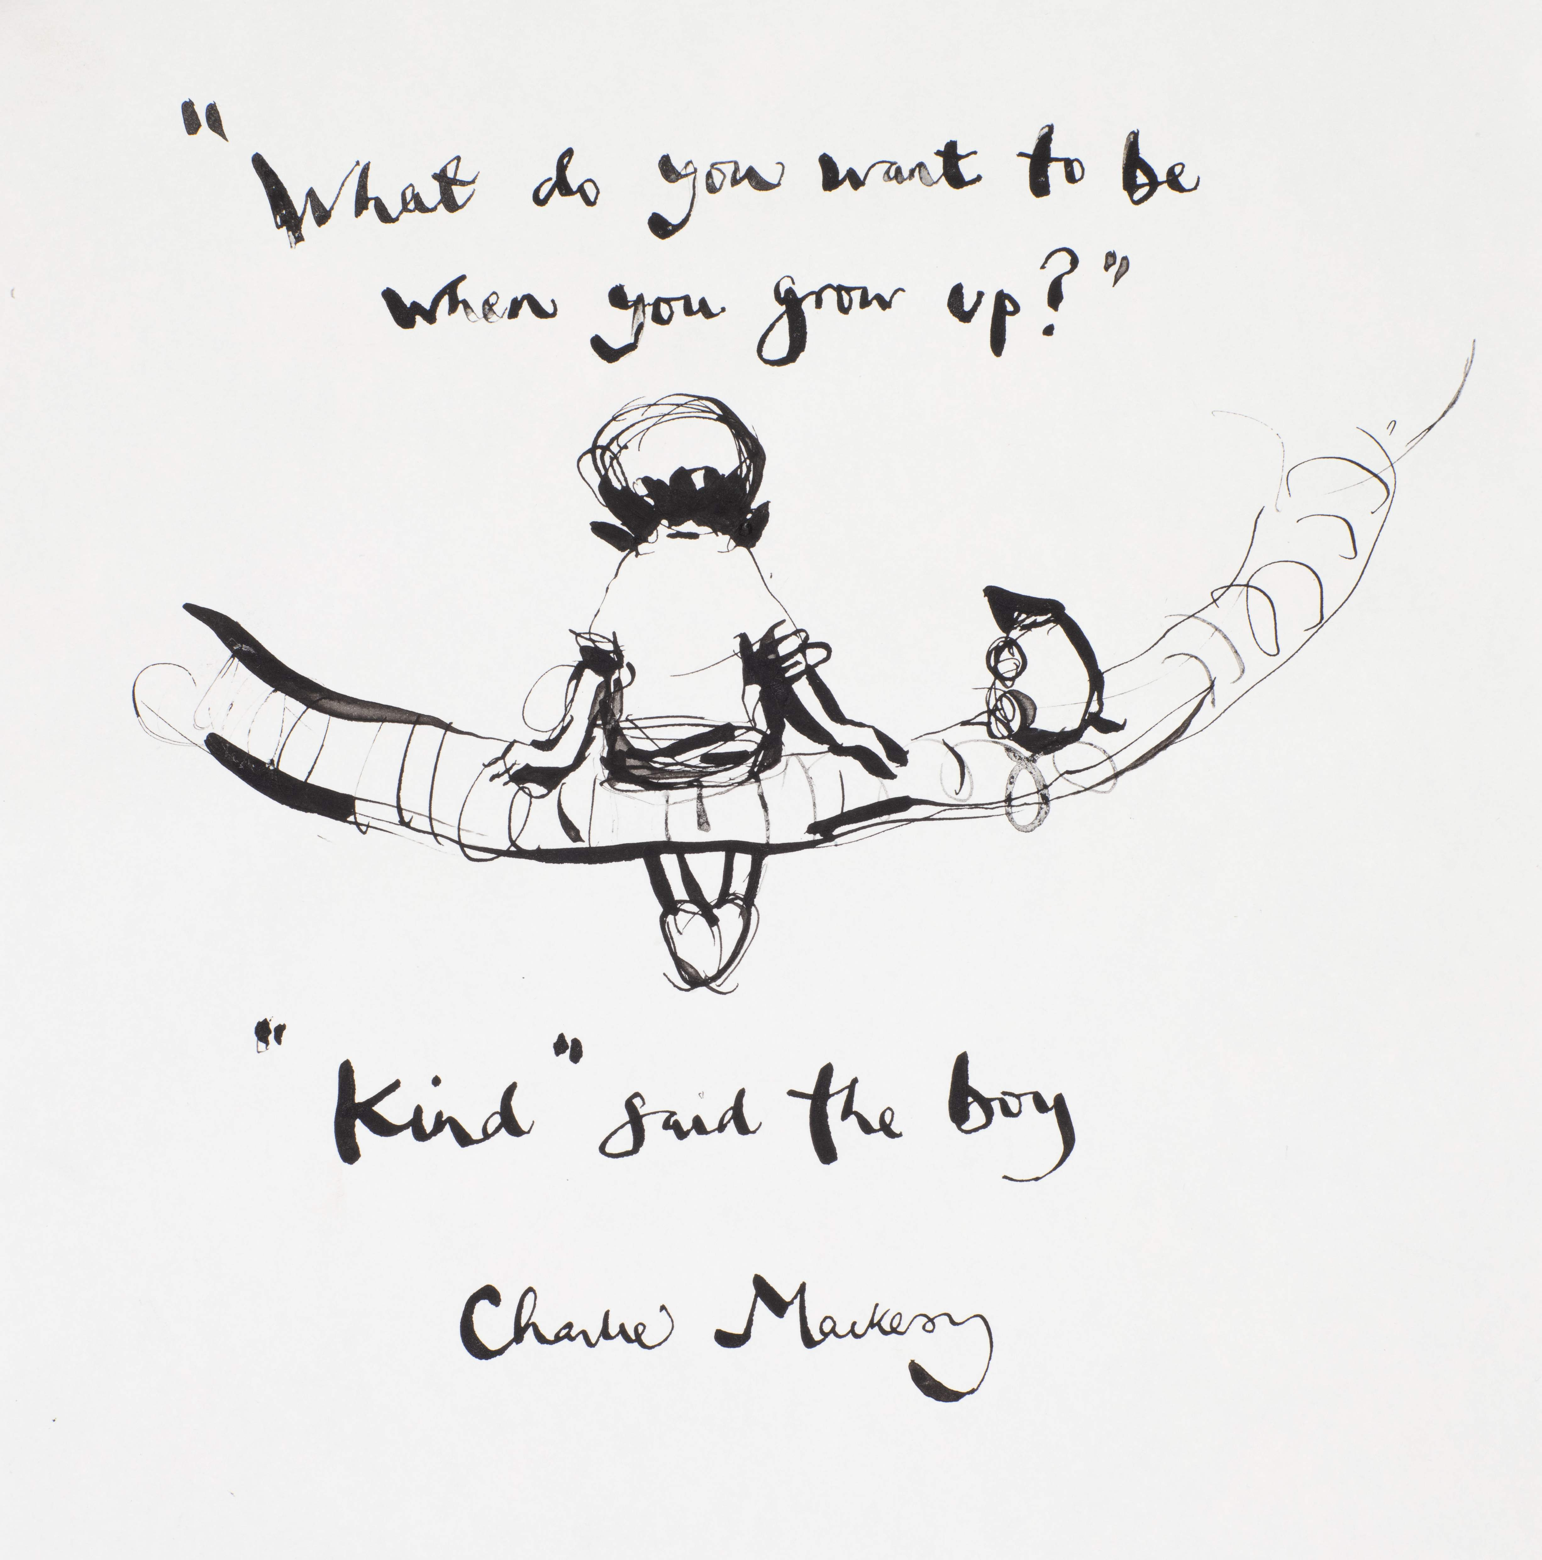

Welcome to Year 4
BELONG - INSPIRE - GROW

Slide 2
Meet the Team
Mrs Hutchins/ Miss McWilliam, Mrs Stevens and Mx Tiller
Jellyfish Class
Miss Wilkinson and Mrs Stevens
Cuttlefish Class
Mrs Harvey, Mrs Lunn and Mrs Pierce
Oyster Class
BELONG - INSPIRE - GROW

Slide 3
A Typical Day In Year 4
8.30 Doors Open.
8.45: Register/visual timetable/SODA activity.
9.00-10.00 :Lesson time.
10:00: Worship.
10.20-10.35: Break time. (Snack)
10.35-12.00 Lesson time.
12.00-1.00: Lunch. ​
1:00–3.15: Lesson time.
3.20: Home time
BELONG - INSPIRE - GROW

Slide 4
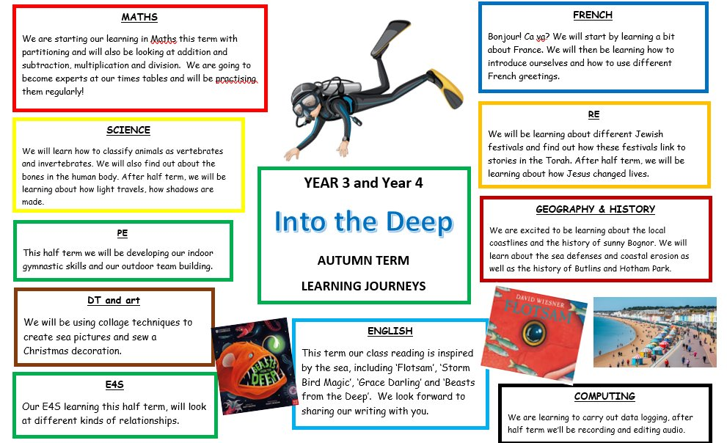
Autumn Learning Journey
BELONG - INSPIRE - GROW

Slide 5
Year Group Events
Autumn Term
Harvest service at St Mary’s, Wednesday 7th October, 10am.
Tuesday 13th October – Chichester harbour visit
History trip to Hotham Park after half term.
Christmas church service in last week of school.
Spring Term
27^{/ 1} - Cuttlefish class Cathedral church visit.
28/1 - Jellyfish class Cathedral church visit.
29^{/ 1}- Oyster class Cathedral church visit.
School Play shortly before Easter holidays
Easter church service in last week of term
Summer Term
Roman history day dressing up
Possible swimming lessons!
Trip to Novium museum in Chichester
BELONG - INSPIRE - GROW

Slide 6
General Information
Forest school Year 3 and 4 dates – October and March/ April
Year 4 multiplication check in June 2027
Parents evening – week beginning 12th October Tuesday and Thursday
PE days – Mondays and Wednesdays
BELONG - INSPIRE - GROW

Slide 7


Going for Gold Our School Rules
BELONG - INSPIRE - GROW

Slide 8
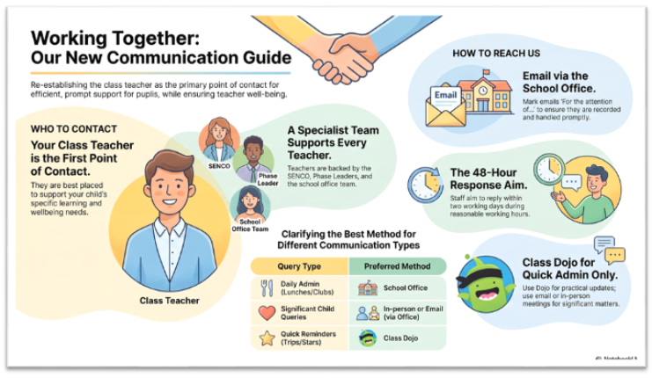
Communication
Please send emails through the office – office@tufnell.org
Class DoJo is there for quick messages and for us to share class information with you.
Year group newsletter is always great to refer back to.
BELONG - INSPIRE - GROW

Slide 9
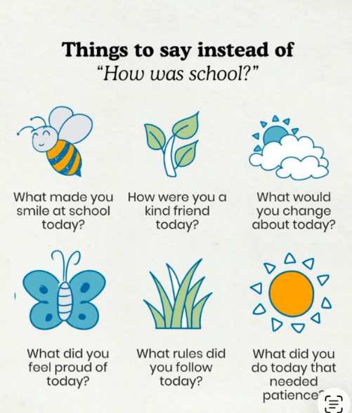
Ways Parents Can Support
BELONG - INSPIRE - GROW

Slide 10
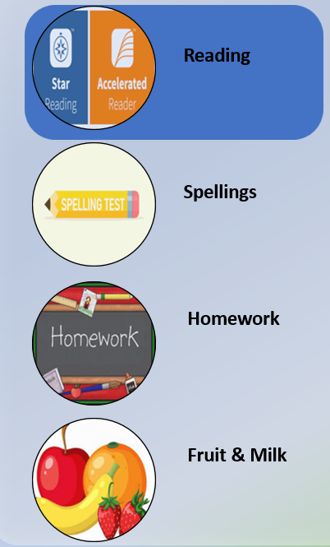
Ways Parents Can Support
BELONG - INSPIRE - GROW

