Slide 1
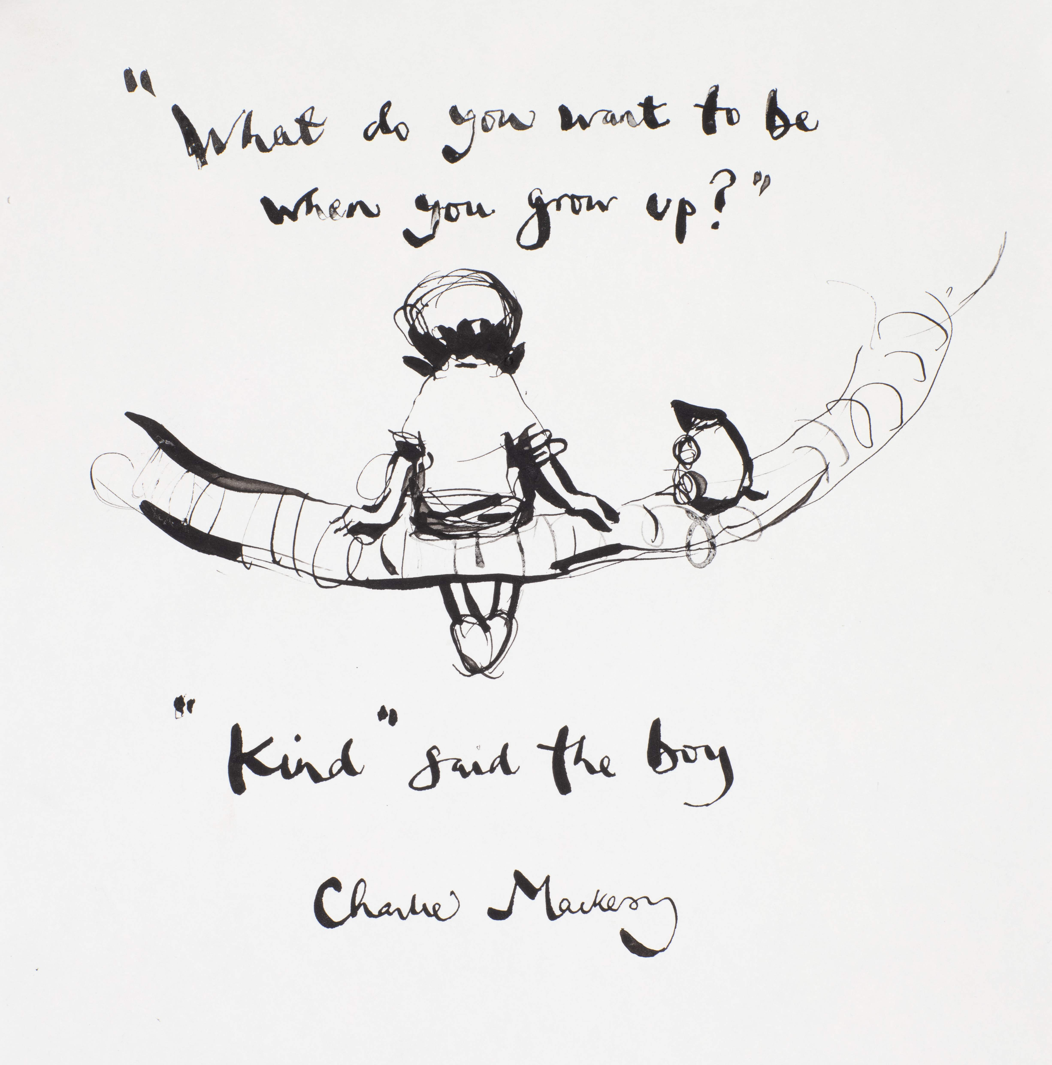

Welcome to Year 5
BELONG - INSPIRE - GROW

Slide 2
Meet the Team
Kittiwake
Mrs Benbow (Mon-Thurs)
Mrs Cremor (Thurs-Fri)
Year Group Support Staff
Mrs Littleproud
Sanderling
Mrs Tallis (Mon-Wed)
Mrs Richardson (Wed-Fri)
BELONG - INSPIRE - GROW

Slide 3
A Typical Day In Year 5
8.30: Doors open- Starter of the Day task (SODA)
8.45: Register/go through the day using our visual timetable
8:50–9:00: Continue SODA- could be arithmetic, SPaG, spelling practice, quiet reading
9:00–10:00: Mathematics
10:00: Worship (excluding a Friday celebration worship at 9am)
10.20-10.35: Break and snack time
10.40-11.00: Continue learning
11.00-11.55: English
12:00-1.00: Lunch ​
1:00–1:05: Register
1:10-2.00: Wider curriculum subject (RE, Science, History, Geography, PE, ICT, E4S, Guided reading, Music, MFL, DT/Art
2.00-3.05 Wider curriculum subject (RE, Science, History, Geography, PE, ICT, E4S, Guided reading, Music, MFL, DT/Art
3.05: Pack away – end of day tasks and discussions
3.20: Home time
BELONG - INSPIRE - GROW

Slide 4
WRITING JOURNEYS
Writing will be linked to our ‘Anglo-Saxons and Vikings’ topic through the non-fiction text ‘The History Detectives Investigate: Anglo-Saxons’, and the fiction text ‘Viking Boy’. Children will be writing: digital news articles; non-chronological reports; persuasive adverts; character profiles; explanation texts and adventure stories. Regular guided reading sessions will be linked to both of our texts.
MATHS
Our topics in the first half of term will be: place value and methods for addition and subtraction. In the second half of term, we will study multiplication and the calculation of area and perimeter. Reasoning, problem-solving and mental calculation methods will be weaved into all units, and the consolidation of times tables facts will be an important focus.
HISTORY AND GEOGRAPHY
We will become active historians and discover for ourselves the huge impact the Anglo-Saxons and Vikings had, on Britain today. We will also draw comparisons with other parts of the world, within the same time-period. In Geography, we will study Europe and the UK, looking at geographical regions, land use and human/physical features. Children will use maps, atlases and computer mapping to support their work.
PE
Before half-term, we will cover basketball and dance skills. After half-term, the children will improve their gymnastics and netball skills.
FRENCH
The children will learn the vocabulary for places in town and places near to where they live. They will also learn to ask for, and to give, directions.
SCIENCE
In the first half-term, the children will learn how to work scientifically - planning, carrying out and evaluating their own experiments. After half-term, they will look at ‘forces’. The children will identify different types of force in action, learn how to measure ‘force’ and design their own investigations.
MUSIC
In the second half of term, we will focus on learning to sing popular songs. Children will have the opportunity to appraise and perform different styles of music.
DT
In the first half of term, the children will plan and cook Saxon pottage and flat bread.
After half-term, they will be using natural resources from the forest to build and test their own Viking catapults.
RE
To begin our RE curriculum, we will be asking: what helps Muslims to lead a good life? In the second part of the term, we will ask ‘how did the Christian Church begin?
COMPUTING
In Autumn 1, we will be building our skills in ‘stop-animation’. In Autumn 2, we will look at information sharing and developing our research skills.
E4S
We will be looking, over the first half-term, at keeping ourselves and others safe and at ways to respond in an emergency. After half-term, we will learn about increasing our emotional resilience.
BELONG - INSPIRE - GROW

Slide 5
Being Independent Pupils​
Arrive and come upstairs to the classroom independently​.
Be in charge of own equipment (water bottles, pencil cases etc)​.
Remember reading book and diary every day​.
Homework to be completed on time​.
Green cards needed if leaving school independently.​
BELONG - INSPIRE - GROW

Slide 6
When do we teach PE?
We have 2 PE sessions- Tuesdays and Thursdays
Children to continue to come in wearing their kit on these days.
Our updated uniform policy is that children wear plain black trainers on PE days (Please move to black trainers when a new pair is bought).
BELONG - INSPIRE - GROW

Slide 7
Year Group trips and events
​​
​​
Harvest Festival​- Wed 7th October
Forest School – Wed 18th Nov​​
Bikeability​- Friday 9th January
Swimming- Spring Term​​
River Trip- Summer Term ​​
BELONG - INSPIRE - GROW

Slide 8
Home learning ​
​
Children are expected to read 5 times a week at home.
Please record ‘Home reads’ in the reading diary. Please sign their reading diary.​
Homework tasks due in on Wednesdays. New tasks set on Wednesdays.
Spelling tests on Wednesdays​
BELONG - INSPIRE - GROW

Slide 9


Going for Gold Our School Rules
BELONG - INSPIRE - GROW

Slide 10
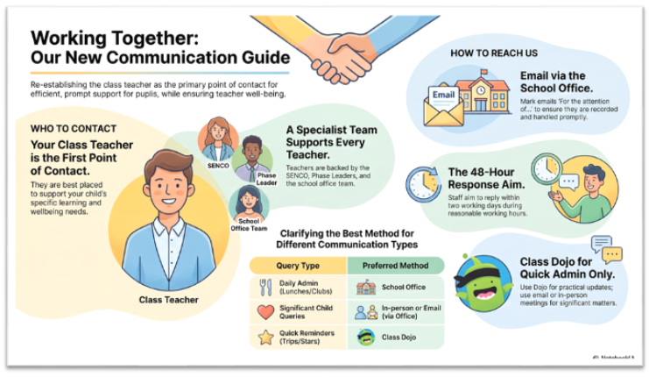
Communication
Please send emails through the office – office@tufnell.org
Class DoJo is there for quick messages and for us to share class information with you.
Year group newsletter is always great to refer back to.
BELONG - INSPIRE - GROW

Slide 11
Ways Parents Can Support
SLEEP: Encourage a good sleep routine – well rested
BUILD independence
HOMEWORK: Check homework is completed on time
READING: Read daily (up to 5 times a week) with your child – out loud is best!
ATTENDANCE: it is really important that your child is here everyday, so they do not miss any learning, some lessons are only taught once.
BELONG - INSPIRE - GROW

