Slide 1
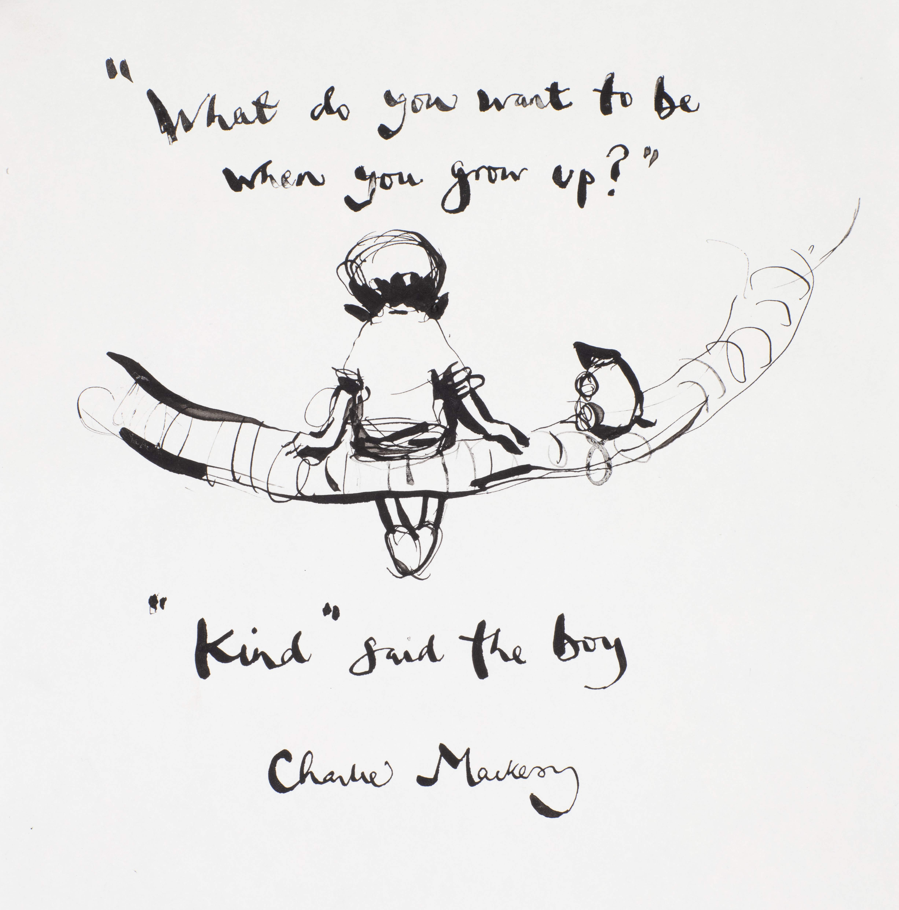

Welcome to Year ……..
BELONG - INSPIRE - GROW

Slide 2
Meet the Team
Teachers – Mrs Cook and Mr Rondeau
Support Staff – Mrs Morling, Mrs Wingfield and Mrs Johnston
BELONG - INSPIRE - GROW

Slide 3
A Typical Day In Year 6
8.30: Doors Open (start SODA) / from Autumn 2 targeted support intervention groups)
8.45: Register/visual timetable
8:50–9:00: SODA (Start of day activity)
9:00–10:00: Mathematics
10:00: Worship (excluding a Friday celebration worship at 9am)
10.20-10.35: Break and snack time
10.40-11.00: Continue learning
11.00-11.55: English
12:00-1.00: Lunch ​
1:00–1:05: Register
1:10-2.00: wider curriculum subject (RE, science, history, geography, PE, ICT, E4S, book talk, music, MFL, DT or art)
2.05-3:00: wider curriculum subject (RE, science, history, geography, PE, ICT, E4S, book talk, music, MFL, DT or art)
3.05: Pack away – end of day tasks and discussions
3.20: Home time
BELONG - INSPIRE - GROW

Slide 4
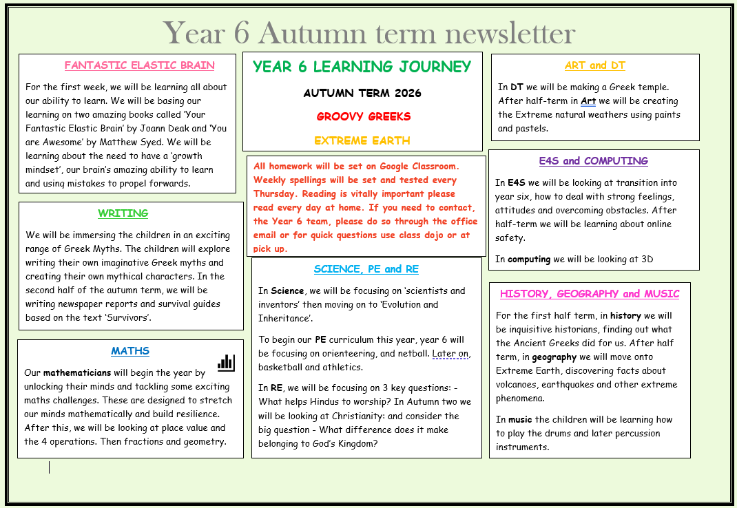
Autumn Learning Journey
BELONG - INSPIRE - GROW

Slide 5
Year Group trips and events
This year to enrich your child’s time in year 6 and to provide an experience that links their learning in class with the outside world we are planning some fun and exciting trips.
Their will be a letter coming out shortly with details of the years events and how you can best support the school to do so.
We may need adult support on some occasions to ensure safety in numbers and will be in contact with you if this is case.
Our first trip in Autumn term will be to London and the natural history museum – bringing our science topic on evolution to life!
BELONG - INSPIRE - GROW

Slide 6
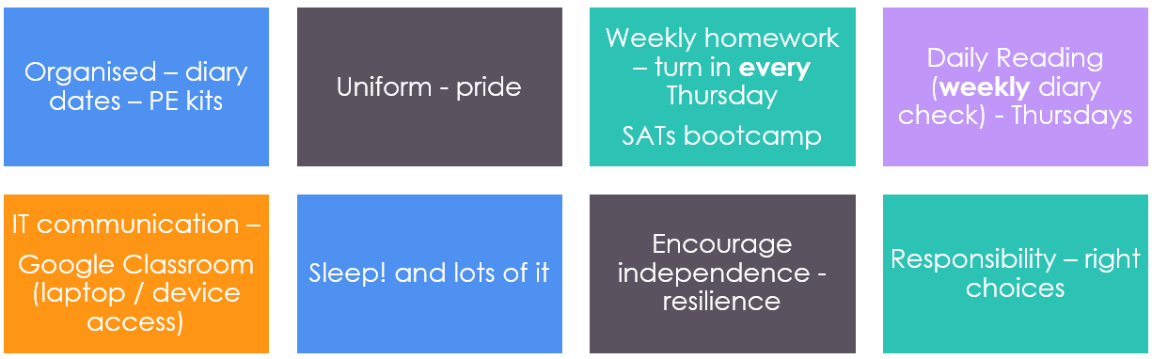
General Information
BELONG - INSPIRE - GROW

Slide 7


Going for Gold Our School Rules
BELONG - INSPIRE - GROW

Slide 8
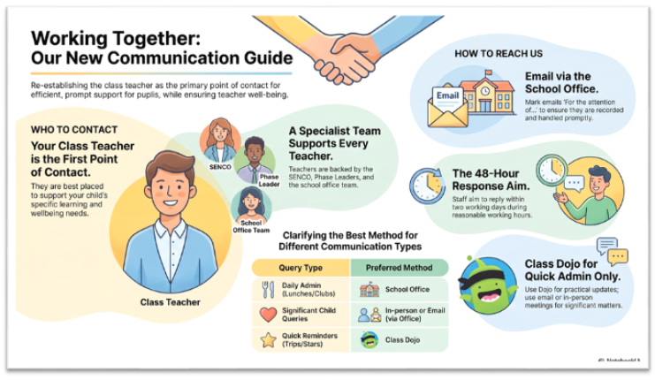
Communication
Please send emails through the office – office@tufnell.org
Class DoJo is there for quick messages and for us to share class information with you.
Year group newsletter is always great to refer back to.
BELONG - INSPIRE - GROW

Slide 9
Ways Parents Can Support
SLEEP: Encourage a good sleep routine – well rested
BUILD independence
HOMEWORK: Check homework is completed on time
READING: Read daily (up to 5 times a week) with your child – out loud is best!
ATTENDENCE: it is really important that your child is here everyday, so they do not miss any learning, some lessons are only taught once.
BELONG - INSPIRE - GROW

