Slide 1


SCHOOL YEAR 2025-2026
NEW TO RECEPTION
INTAKE MEETING

Slide 2
WELCOME
•We’re delighted to welcome your child to Reception at Bishop Martin. This is an exciting year filled with growth, discovery, and learning.

Slide 3

Class Teacher
Miss Rowat
This academic year, Miss Rowat has the pleasure of being your child's teacher.

Slide 4

WHAT TO EXPECT IN RECEPTION
  Final year of EYFS
  More structured learning than Nursery
  Mix of adult-led activities and child-initiated play
  Learning indoors and outdoors
Notes:
Follow-on from learning in Nursery, regardless of them attending our nursey or another provision.

Slide 5
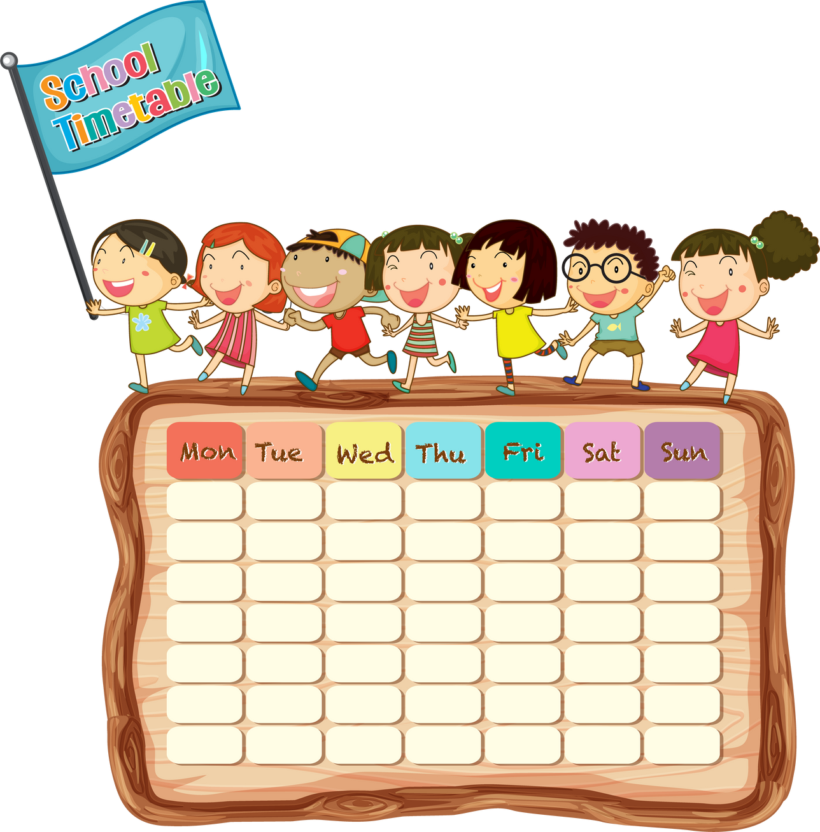
A DAY IN THE LIFE
• Morning Register & Welcome
• Maths Session (Maths – No Problem!)
• Snack Time – fruit, toast & milk
• Phonics (Read Write Inc.)
• English / Literacy
• Child-Initiated Play throughout
• Lunch in Dinner Hall - Play with KS1 peers
• Foundation Subjects
• Story time & End of the Day

Slide 6

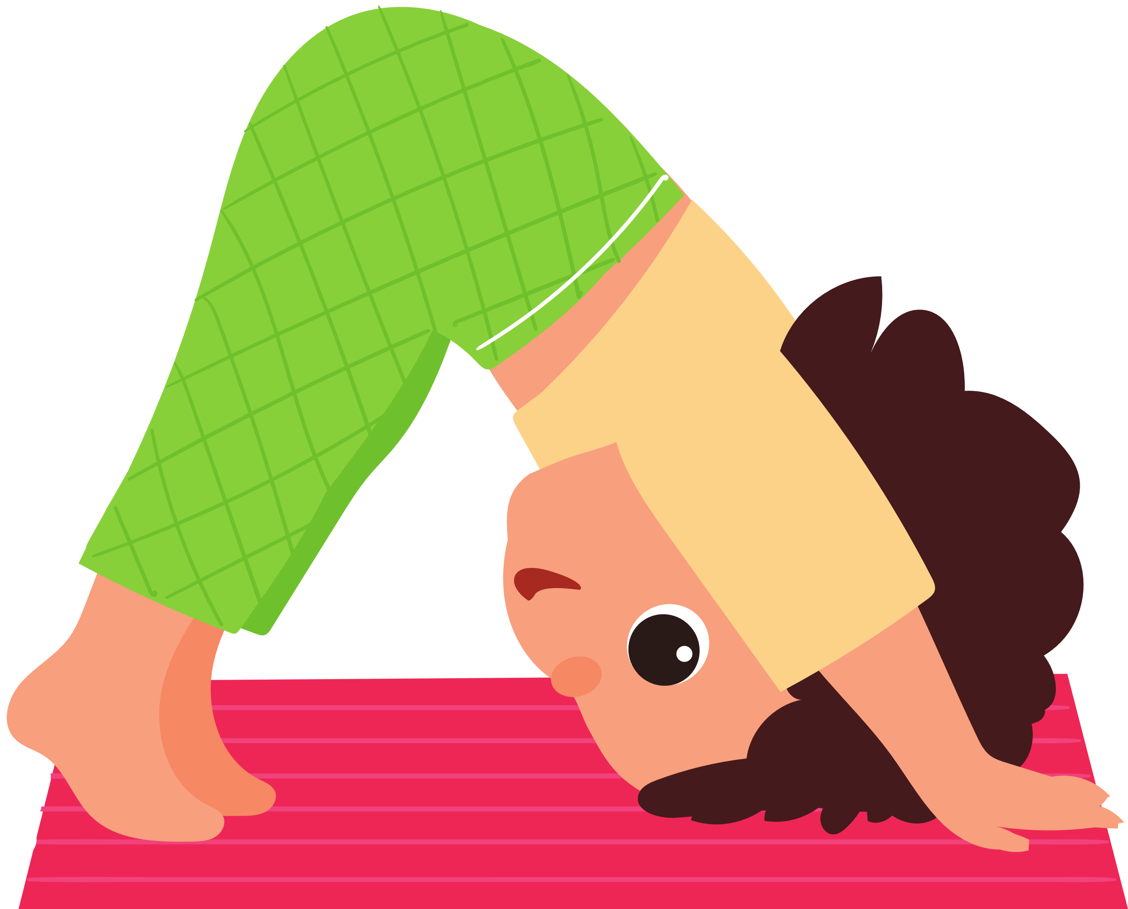
THE EYFS CURRICULUM
Prime areas
•Prime Areas:
• Communication and Language
• Physical Development
• Personal, Social & Emotional Development

Slide 7



THE EYFS CURRICULUM
Specific areas
• Literacy
• Mathematics
• Understanding the World
• Expressive Arts and Design

Slide 8


PHYSICAL DEVELOPMENT
  Weekly PE sessions for coordination and balance
  Children wear PE kit on PE days (check school policy)

Slide 9

ASSESSMENT
• Continuous observation and assessment and use of the Seesaw app
• End-of-year assessment against Early Learning Goals (ELGs)
• Parents receive a report on progress

Slide 10

PHONICS – READ WRITE INC.
  Daily sessions to teach sounds and blending
  Support early reading and writing
  Books matched to phonics stage

Slide 11


MATHS – NO PROBLEM!
  Practical, hands-on approach
  Focus on number, shape, space, patterns, and basic calculations
  Encourages deep understanding

Slide 12


FOUNDATION SUBJECTS
• RE, Music, PE, Art and Design, and Understanding the World
• Encourage exploration, creativity, and knowledge of the world

Slide 13


UNIFORM EXPECTATIONS
  •Promotes belonging, equality, and pride.
  PE kit on PE days
  Please label all clothing (see school policy)

Slide 14



ADDITIONAL INFORMATION
• Children have daily access to outdoor areas, which supports physical development and creativity and encourages independence and teamwork
• Daily snack: fruit, toast, milk
• Lunch is eaten in dinner hall
• They play with KS1 peers at lunch time

Slide 15



HOW YOU CAN HELP AT HOME
  Reading - Read daily, practise letter sounds, discuss books
  Maths - Count, spot numbers, talk about time and shapes
  Independence - Dressing, toileting, responsibility
  Talking - Conversations build vocabulary and confidence

Slide 16


WE’RE HERE TO SUPPORT YOU
We value communication and working together. Please ask questions and share successes. Let's make it a great year!

Slide 17
THANK YOU!
Your involvement in our child's education is greatly appreciated.

