Slide 1


GCSE Changing Cities
It is your responsibility to make sure that you are able to answer each of the questions set in the tasks below. This will be based on what you are taught in lessons and the information included the knowledge organisers.
Task 1 ? | Task 2 | Task 3
Task 4 | Task 5 | Task 6
What is urbanisation?
What are the main factors that contribute to urbanisation in developing countries?
How does urbanization affect the distribution of population within a country?
Why is urbanization happening at a slower rate in developing countries compared to developed countries?
What are conurbations?
Which regions in the UK have the highest urban population?
Where are the major urban centres located in the UK?
How does the distribution of the urban population in the UK differ between the north and south?
What factors influence the location of major cities in the UK?
How does the land use in the inner city differ from that in the suburbs?
What is the urban-rural fringe?
What types of buildings and activities are typically found in the inner city, and why?
How do transport links influence land use in the suburbs and urban-rural fringe?
Knowledge Expert
What is re-urbanisation?
What is the difference between suburbanisation and counter-urbanisation?
How has Manchester’s population changed in recent years?
What impact has regeneration had on the city centre of Manchester?
How has the transport system in Manchester changed to accommodate the growing population?
What does the census data reveal about the population growth in Manchester?
How has the ethnic diversity of Manchester changed according to the census data?
What trends can be seen in the age structure of Manchester’s population from the census data?
What does situation mean?
How does Manchester's location near other major cities affect its growth?
Why is Manchester’s position in the UK important for trade and business?
What enhances Manchester’s connectivity?

Slide 2
GCSE Changing Cities
It is your responsibility to make sure that you are able to answer each of the questions set in the tasks below. This will be based on what you are taught in lessons and the information included the knowledge organisers.
Task 7 | Task 8 | Task 9
Task 10 | Task 11 Describe the site and situation on Mexico City Describe and explain the structure of Mexico City Why has the population of Mexico City changed over time? Whay impact has this had on the city? | Task 12 What are the reasons for inequality in Mexico City? What are the impacts of rapid urbanization on the environment and people? What are the top down approaches to solving Mexico's problems? What are the bottom up approaches to solving Mexico's problems?
Define the term globalization.
How did globalisation influence deindustrialisation?
What is a drawback to deindustrialsation?
What is the process of de-centralisation?
What is gentrification?
How did deindustrialization contribute to rising inequality in Manchester?
How can economic change influence inequality?
What social issues did Manchester face as a result of deindustrialisation?
How has the shift in shopping habits affected the Central Business District in Manchester?
What factors have contributed to the growth of shopping centres like the Trafford Centre?
How has the increasing popularity of online shopping impacted retail businesses in Manchester’s CBD?
What are some consequences of vacant storefronts in Manchester’s CBD due to the decline in traditional retailing?
Knowledge Expert
How has the introduction of smaller waste bins in Manchester contributed to the city’s recycling efforts?
What measures have been taken to improve sustainable transport and reduce pollution in Manchester?
What initiatives are in place to improve the quality of education in Greater Manchester schools?
How are health and wellbeing initiatives helping to improve the overall health of Manchester’s population?

Slide 3



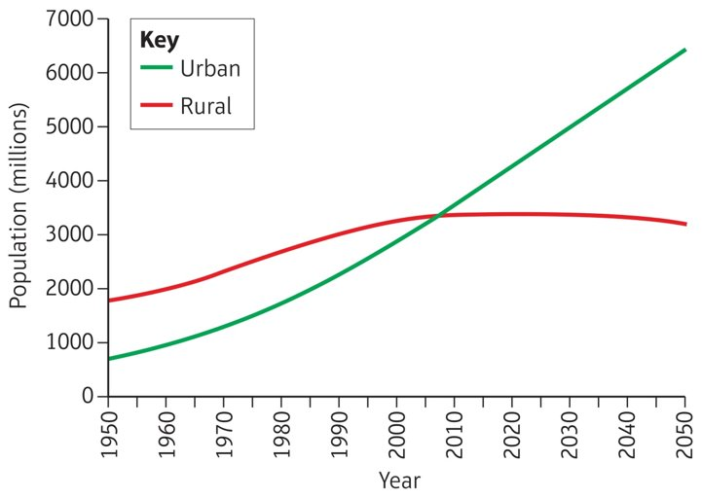


GCSE Changing Cities
knowledge checkers
Lesson 1
Urbanisation is a global process
Core knowledge
Key words
Reasons for urbanisation – Natural Increase and Migration
Urban – Urban refers to towns or cities with lots of people, buildings, and activities
Rural -Rural refers to areas in the countryside with fewer people, more open spaces, and less development compared to urban areas
Urbanisation- means an increase in the proportion of people living in urban areas compared to rural areas.
Developed Countries: Urbanisation in developed countries, like the UK and the USA, happened mostly during the Industrial Revolution and early 20th century. Over the last 50 years, urban growth has slowed as most people already live in cities.
Why? : Better jobs, transport, and services in cities attracted people
Effects: Economic growth and modern cities. Environmental problems, like pollution and loss of green space, have also increased.
Emerging Countries: In emerging economies, like Brazil and China, urbanisation has been rapid in the last 50 years due to industrialisation and economic growth.
Why? : Economic growth, new job opportunities, and improved infrastructure made cities attractive.
Effects: Big cities grew quickly, but overcrowding, poor living conditions, and pollution have also become problems.
Developing Countries: Developing nations, such as Nigeria and Ethiopia, are experiencing the fastest rates of urbanisation today. High population growth and rural-to-urban migration are driving this trend.
Knowledge Organiser
Megacity-A population over 10 million
Why? : Rural areas often have limited jobs and services, so people move to cities in search of better living conditions.
Effects: Rapid urbanisation has caused overcrowded slums, lack of basic services, and social problems like unemployment.
Take it further...

Slide 4
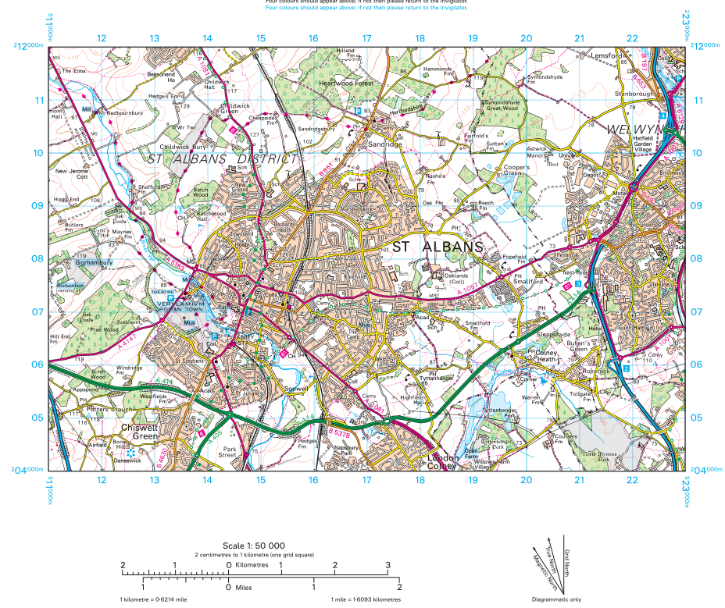
Exam Practice 1
Study the Ordnance survey (OS) map extract
Which one of the following grid squares does the A1081 mina road pass through
1707
1506
1409
1206
Name the two suburbs of St Albans located in the following grid squares
1508
1405
Suggest one reason why the area in grid squares 1407 became the original site of St Albans
_______________________________________________________________________________________________________________________________________________________________________________________________________________________________________________________________________________________________

Slide 5
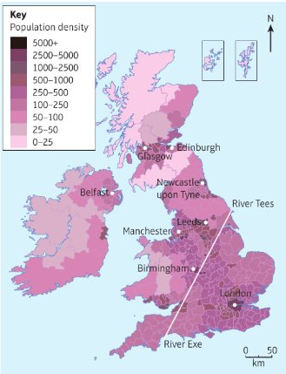





GCSE Changing Cities
knowledge checkers
Lesson 2
How does urbanisation vary across the UK?
Core knowledge
Key words
Population distribution across the UK is uneven. There are places with a lot of people in a small area, like cities, with a high population density. And places where there are very few people, like rural areas, with a low population density.
High Population density- A place with a lot of people in a small area
Low Population density- A place with very few people like rural areas.
Conurbations- large urban areas where several towns have merged with the suburbs of a central city.
Physical factors:
(North and West)
The land in these areas is higher, with mountains and steep slopes in Wales, Scotland and the Pennines.
This land is difficult to farm.
Fewer people live here.
(South and East)
The land in these areas is lower and flatter.
Rich soils in Herefordshire and East Anglia – lots of farming communities
Important Urban areas in the UK:
London Manchester
Birmingham. Leeds
Glasgow Edinburgh
Liverpool. Leicester
Bristol
Sheffield
Knowledge Organiser
Historical factors:
Large factory towns grew rapidly near coals fields or in manufacturing hubs.
Industrial cities such as Birmingham, Manchester, Glasgow, Bradford, Swansea and Newcastle grew rapidly as more people moved to these areas in search of employment.
Economic factors:
Since the 1950’s, UK economic growth has been based on tertiary and quaternary industries.
These needs space, good communications and good transport links.
London in particular as a centre for UK road, rail and air communications, has a large market and a large labour force.
Political factors:
London is the centre of UK government. This has been an important factor in encouraging bug companies to set up in the capital.
It has close links to the European markets.
London is also a financial hub which is important for its continued growth.
Take it further

Slide 6
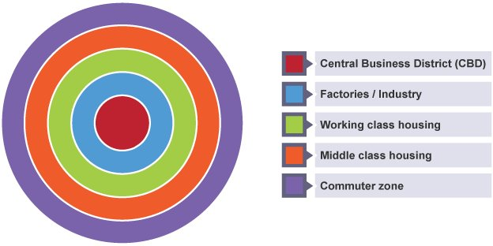
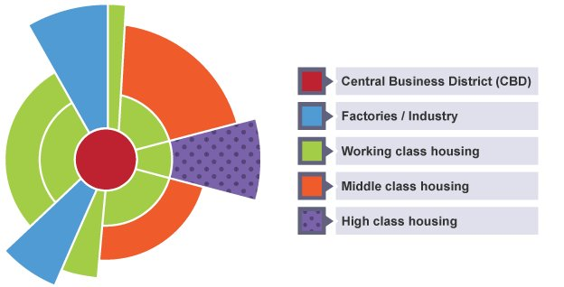

GCSE Changing Cities
knowledge checkers
Lesson 3
Urban land use modelling
Core knowledge
Key words
Burgess or concentric zone model.​
This model is based on the idea that land values are highest in the centre of a town or city. This is because competition is high in the central parts of the settlement.
Although, new working and housing trends have emerged since the model was developed. Many people now choose to live and work outside the city on the urban fringe - a phenomenon that is not reflected in the Burgess model.
Central business district (CBD)- where most business and commerce is located in the city centre.
Inner City: The area close to the centre of a city, often characterized by older housing, industrial buildings, and higher population density.
Suburb: A residential area located on the outskirts of a city or town. Suburbs typically have lower population density than inner-city areas and are often characterized by family homes, green spaces, and commuter links to urban centers.
Urban-Rural Fringe: The area where the city meets the countryside. It is a zone of transition with a mix of urban and rural land uses,
This is based on the circles on the Burgess model, but adds sectors of similar land uses concentrated in parts of the city. Notice how some zones, eg the factories/industry zone, radiate out from the CBD. This is probably following the line of a main road or a railway.
The Suburbs​
Suburban houses are usually larger than inner city terraces and most have a garden.
Typically, they are detached or semi-detached and the roads around them are arranged in cul-de-sacs and wide avenues.
Land prices are generally cheaper than in the CBD and inner city, although the desirability of housing can make some areas expensive.​
Many suburbs were built in the UK in the 1930s.
More modern housing estates were built in the late 20th century.
Facilities such as schools, places of worship, supermarkets and parks are often present.
The inner city​
Typically found next to the CBD and has mainly terraced houses in a grid like pattern.
Originally built to house factory workers Many of these factories have now closed down.​
Unemployment and other socioeconomic problems have caused unrest in inner city areas (Riots) e.g. Toxteth in Liverpool
Many inner city areas that declined in the late 20th century have undergone a period of regeneration in recent years.
Run down terraced housing is often bought by investors and improved to appeal to young professionals who need access to the CBD. This is called gentrification.
Knowledge Organiser
Urban Rural Fringe​
This is found at the edge of a town or city.
It is common for this area to have a mixture of land uses such as some housing, golf courses, allotments and airports.
The mixture of land use often causes conflict as different groups have different needs and interests.
E.g. Terminal 5 at Heathrow on the outskirts of London was a source of controversy.
Take it further...

Slide 7
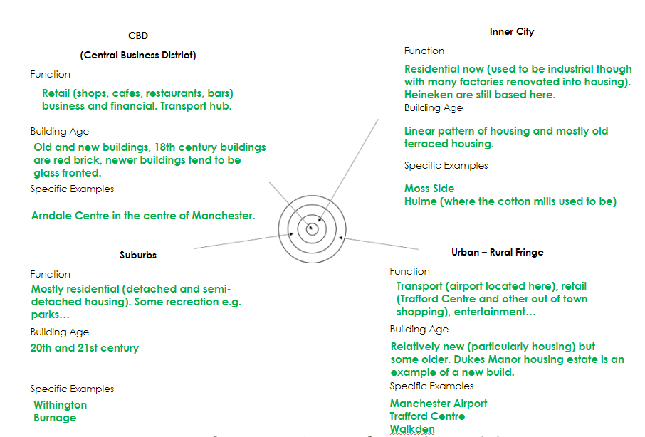





GCSE Changing Cities
knowledge checkers
Lesson 4
Site, Situation and Structure
Core knowledge
Site
Physical location: Manchester is located on relatively flat land near the River Irwell in the northwest of England.
Geographical advantages: It developed as a key industrial city due to its proximity to coalfields and waterways, enabling transport of raw materials like cotton.
Situation
Regional: Manchester lies about 60 km east of Liverpool and 160 km northwest of Birmingham, acting as a hub for the Northwest region.
National: It's centrally located in the UK, making it accessible to major cities like London (320 km to the southeast).
Global: Historically, Manchester was a major player in the global cotton trade during the Industrial Revolution, connecting with international markets through Liverpool’s port.Mamucium was a frontier fort and settlement of the Roman Empire.
Connectivity
Regional: Linked by a network of motorways (M60, M6, M62) and railways, connecting to cities like Leeds, Sheffield, and Liverpool.
National: Direct rail links (e.g., Manchester Piccadilly to London Euston in ~2 hours) and major motorways.
Global: Manchester Airport is the third busiest in the UK, offering direct flights to over 200 destinations worldwide.
Cultural: Manchester is globally recognized for its music, football (Manchester United and Manchester City), and vibrant cultural scene, enhancing its status as an international city.
Environmental: Investment in green spaces, such as Heaton Park and urban green initiatives, aims to balance its urban growth.
Knowledge Organiser
Key words
Site-this the place where the settlement is located
Situation- relates to its surrounding features, both human-made and natural.
Connectivity- how easy or difficult it is for people or things to reach/leave is a place.
Function- The function of an area is it’s reason for being or it’s purpose.
Take it further...

Slide 8
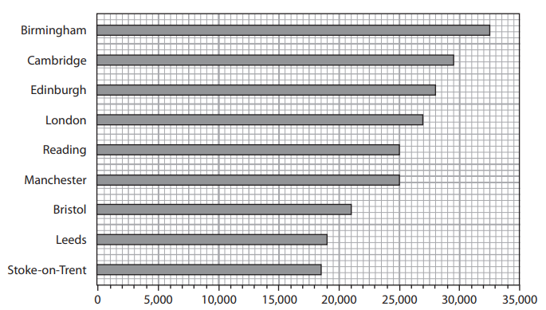
Exam Practice 2
Study figure 1. Identify the range of mean annual earnings shown in figure 1B.
A – 14,000
B – 18,500
C – 25,000
D – 32.500
Suggest one reason for the differences shown in Figure 1B (3)
________________________________________________________________________________________________________________________________________________________________________________________________________________________________________________________________________________________________________________________________________________________________________________________________________________________________________________________________________________________________________________________________________________________________________________________________________________________________________
Explain one reason why suburbanisation has taken place in the UK. (2)
______________________________________________________________________________________________________________________________________________________________________________________________________________________________________________________________________________________________________
Feedback

Slide 9





GCSE Changing Cities
knowledge checkers
Lesson 5
The changing city and migration
Core knowledge
Key words
Urbanisation: Manchester experienced rapid urbanisation during the Industrial Revolution, becoming a global hub for textile production. This led to a population boom and the development of dense inner-city areas with terraced housing and factories to accommodate workers.
Suburbanisation: In the 20th century, improved transport links, such as trams and trains, enabled people to move out of the crowded inner city to suburban areas like Didsbury and Sale, which offered larger homes and greener environments.
Counterurbanisation: In the late 20th century, some residents and businesses relocated further away from the city to rural areas or smaller towns around Greater Manchester, driven by a desire for a quieter lifestyle and more space.
Re-urbanisation: From the 1990s onwards, significant investment in regeneration projects, such as the redevelopment of the Northern Quarter and Salford Quays, brought people back to the city center. This process transformed Manchester into a vibrant cultural and economic hub, attracting young professionals and students.
National migration often involves young professionals and students moving to the city for education or job opportunities, leading to a younger age structure in areas like the city center.
International migration, particularly from South Asia, the Caribbean, and Eastern Europe, has increased Manchester's ethnic diversity, creating vibrant communities in areas like Rusholme and Cheetham Hill.
This diversity has influenced housing demand, with inner-city areas offering affordable housing for new migrants, while suburban regions accommodate families seeking larger homes. Services such as schools, healthcare, and transport have had to expand and adapt to meet the needs of a growing and diverse population, while cultural influences have enriched the city's identity, as seen in its restaurants, festivals, and markets.
Urbanisation- The process by which an increasing proportion of a population lives in urban areas, often driven by rural-to-urban migration and natural population growth.
Suburbanisation- The outward growth of urban areas as people move from city centers to suburbs, often facilitated by improved transport links and a desire for larger homes and greener spaces.
Counterurbanisation- The movement of people and businesses from urban areas to rural or semi-rural locations, often driven by a desire for more space and a better quality of life
Reurbanisation- The process of revitalizing and redeveloping urban areas that had previously experienced decline, often through investment, infrastructure improvements, and an influx of new residents or businesses.
National Migration- The movement of people within the same country, often driven by factors like job opportunities, education, or lifestyle preferences
International Migration- The movement of people across country borders to live, work, or study, often driven by factors such as economic opportunities, conflict, or family reunification.
Knowledge Organiser
Take it further...

Slide 10


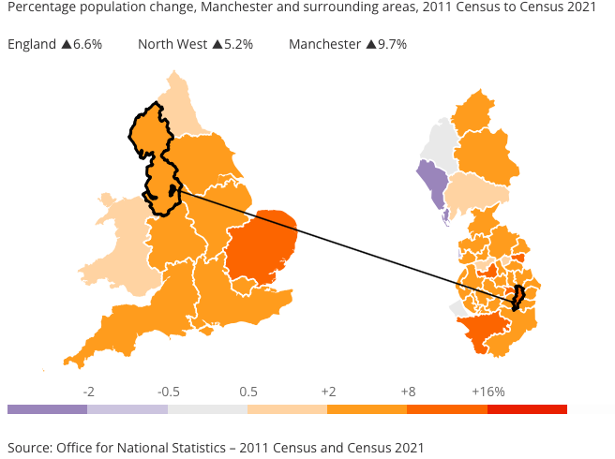


Exam Practice 2
GCSE Changing Cities
knowledge checkers
Lesson 6
Census data
Core knowledge
Key words
Manchester, according to the most recent Census data, has a diverse and dynamic population with key characteristics including a significant proportion of young adults, especially students, due to its renowned universities.
The city has a relatively high proportion of ethnic minorities, with the largest groups being of South Asian and Black Caribbean descent. The population has seen steady growth due to factors such as migration, both international and from other parts of the UK.
People are drawn to Manchester for its economic opportunities, including the thriving tech, media, and creative industries, as well as its cultural attractions and transport links. However, some areas of the city have experienced population decline due to the high cost of housing, particularly in certain inner-city areas, leading to displacement of lower-income families. Additionally, some people may move out of the city to suburban areas in search of more affordable living or better quality of life.
Census data- information collected every few years about the population, including details like age, gender, and where people live, to help the government make decisions.
Wards- to make it easier to understand the data, a city is split up into different areas. These are called wards. There are 32 in Manchester.
Knowledge Organiser
Overall, Manchester’s population growth can be attributed to its appeal as a vibrant, economically strong city, although challenges such as housing affordability and migration trends contribute to the complex dynamics of population change.
Take it further...

Slide 11






GCSE Changing Cities
knowledge checkers
Lesson 7
Population characteristics and deindustrialisation
Core knowledge
Key words
Deindustrialisation in Manchester, like in many other cities, was caused by several factors.
Globalisation led to industries moving abroad to take advantage of cheaper labor and resources, reducing the number of manufacturing jobs in the city.
De-centralisation occurred as businesses and industries relocated from city centers to suburban or rural areas, often in search of lower operating costs and better transport links.
Technological advances also played a role, as new machinery and automated processes meant fewer workers were needed in factories. Additionally, developments in transport allowed goods to be imported more easily from other countries, reducing the need for local production.
The impacts on Manchester included job losses, economic decline in former industrial areas, and population changes, with many people moving away in search of work. However, the city has since shifted towards a more service-based economy, focusing on sectors like media, technology, and education, helping to regenerate some areas.
Deindustrialisation- Deindustrialisation is the process where industries and factories close down or move away from an area, leading to a decline in manufacturing jobs and a shift towards other types of work.
Globalisation- This is the process where cities become part of a world market.
De-centralisation- This is the movement away from the centre, the conditions here were not great, lots of areas were cleared and redeveloped so factories either closed or were demolished or they moved out of the city.
Knowledge Organiser
Misconceptions
Take it further...
Population Growth: It's often assumed that a growing population always means more people are being born, but migration (both in and out) can also significantly impact population size.
Declining Populations: People often assume that a population is declining due to fewer births, but factors like migration and changes in living standards can also influence population growth or decline.

Slide 12
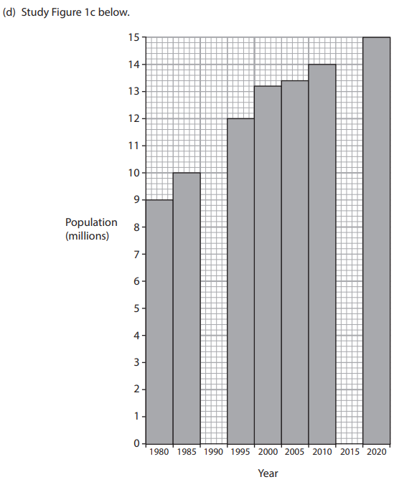
Exam Practice 3
Explain one reason why decentralisation has taken place in the UK (2)
____________________________________________________________________________________________________________________________________________________________________________________________________________________________________________________________________________________________________________________
Complete the graph by plotting the data from the table below (2)
Year | Population (millions)
1990 | 11.0
2015 | 14.4
Feedback
Identify the period when Kolkata's population increased by 1.2 million
A 1980 to 1985
B 1995 to 2000
C 2000 to 2005
D 2005 to 2010

Slide 13





GCSE Changing Cities
knowledge checkers
Lesson 8
Deindustrialisation and inequality
Core knowledge
Key words
Economic change can increase inequality through:
Shift from manufacturing to service-based economy: High-skilled workers benefit from the rise of tech, finance, and media sectors, while low-skilled workers face fewer job opportunities.
Widening wage gap: Those with access to high-paying jobs see increased wealth, while those in low-skilled roles experience stagnation or decline.
Gentrification: Rising property prices in regenerated areas push lower-income families out, creating socio-economic divisions.
Disparities in quality of life: Wealthier residents experience improved housing and services, while poorer areas face unemployment, poverty, and poor housing conditions.
Economic growth benefits some, not all: Some individuals and areas see improved living standards, while others are left behind, increasing inequality in the city.
The links between deprivation and deindustrialisation are closely tied to the economic and social impacts of industries closing down or relocating. Here are the key points:
Job Losses: Deindustrialisation leads to the closure of factories and manufacturing plants, which were once major employers in many areas.
Economic Decline: As industries close, the local economy often suffers because other businesses and services that relied on the manufacturing sector may also shrink or disappear. This reduces local income and opportunities.
Skills Mismatch: Many of the jobs lost during deindustrialisation were low-skilled and paid well. However, workers may struggle to find new work if they lack the skills needed for the emerging service-based economy.
Social Issues: The economic decline caused by deindustrialisation often leads to social issues such as increased crime, poor housing, and poor health, which further exacerbate deprivation in affected communities.
Migration: As a result of deindustrialisation, people may move away from areas where jobs are scarce, leading to population decline and further economic challenges for the remaining residents.
Gentrification is the process where wealthier people move into a previously lower-income area, often leading to increased property prices and the displacement of original residents.
Deprivation refers to the lack of basic necessities or services, such as housing, healthcare, and education, which results in poor living conditions and limited opportunities.
Inequality is the unequal distribution of resources, opportunities, or wealth among different groups in society, often leading to disparities in living standards and quality of life.
Knowledge Organiser
Take it further...

Slide 14
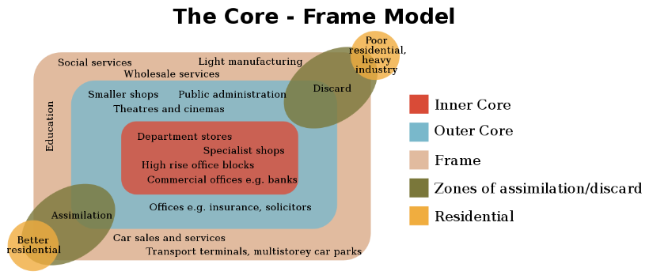






GCSE Changing Cities
knowledge checkers
Lesson 9
Changes in retailing
Core knowledge
Key words
Recent changes in retailing have significantly impacted Manchester in several ways:
Decline in the CBD: As shopping habits have shifted the CBD, once a vibrant hub for retail, has seen a decline in foot traffic. Many traditional shops have closed or relocated leaving vacant
Edge-of-Town Shopping: Retail areas located on the outskirts of cities, often offering larger stores, more parking, and easier access compared to city centre shopping.
Out-of-Town Shopping: Shopping centre and retail parks located outside urban areas, typically with larger stores and more parking spaces, attracting shoppers away from the city centre.
Internet Shopping (E-commerce): The purchasing of goods and services online, which has increased in popularity, affecting traditional brick-and-mortar retail stores.
Footfall: The number of people visiting a particular area or store, often used to measure the success of retail locations.
Retail Decline: The reduction in the number of retail businesses or stores in a specific area, often linked to factors such as increased online shopping or the development of out-of-town centre
store fronts, as people increasingly shop at larger shopping centers or online.
Growth of Edge and out of Town shopping: Shopping centres on the outskirts of Manchester, such as the Trafford Centre, have grown in popularity due to their larger stores, ample parking, and ease of access.
Increasing Popularity of Internet shopping: Online shopping has seen tremendous growth, further reducing foot traffic to the CBD. Consumers now have access to a wider range of products from the comfort of their homes, which has led to a shift in retail patterns and impacted local businesses
Knowledge Organiser
Misconceptions
The Decline of Physical Retail is Total: While the rise of online shopping has indeed shifted retail trends, many physical stores in Manchester are evolving rather than disappearing. There has been a rise in experiential retail, where stores offer unique experiences to entice customers, blending digital and physical spaces (e.g., pop-up stores, interactive displays, and in-store events).
Only Big Chains are Thriving: While large brands have a significant presence, independent stores and local businesses are also thriving, particularly in areas like the Northern Quarter. Many shoppers are increasingly looking for unique or local products, with a growing demand for sustainability and ethical retail.
Take it further...

Slide 15




GCSE Changing Cities
knowledge checkers
Lesson 10
Making Manchester more sustainable.
Core knowledge
Key words
Recycling: Recycling can lead to a reduction in greenhouse gas emissions. What’s being done? Smaller bins have been introduced. This means the capacity of general waste bins reduced from 240 to 140 litres. Prior to this scheme, Manchester city centre had a 19% rate for recycling (the lowest in the country) which has now increased to 39% and 50% for properties with their own bins.
Sustainable Transport Networks: Sustainable transport prevents pollution and congestion in the city. What’s being done? More sustainable transport has been introduced to the city. Cycling has been promoted by the improvement of cycle lanes and car sharing schemes are also been advertised across the city.
Affordable and Energy-Efficient Housing: Better quality of life comes with having a sustainable home. What’s being done? The help to buy scheme that was introduced by the government reduces the deposit needed to be paid making getting a mortgage more realistic. More retirement homes are being built to support the elderly.
Improved Access to Education : Having an education provides greater life chances and opportunities which results in a better quality of life. What’s being done? 1150 schools taking part in ‘Greater Manchester Challenge’ which attempts to improve standards in schools. The schools are rewarded for work on the following: promoting healthy lifestyles, education on drug and alcohol abuse, emotional and mental wellbeing and sex and relationship education.
Increasing access to employment: Skills gained for employment should reduce unemployment rates and the money earned can improve quality of life. What’s being done? The Big Lottery Fund and European Social Fund is giving Greater Manchester £9.7 million over the next 3 years.
Health and Wellbeing Initiatives: People who are more physically active are healthier and should have less of a demand on the health services. What’s being done? Schemes to encourage people to join gyms and take part in activities to help them get healthier. The government are also investing in healthcare centres and providing education to promote healthy lifestyles.
Sustainability: The ability to meet present needs without compromising the ability of future generations to meet their own needs, often focusing on environmental, economic, and social dimensions.
Recycling: The process of converting waste materials into reusable materials, helping to reduce landfill waste and conserve natural resources
Knowledge Organiser
Take it further...

Slide 16
Exam Practice 4
First let's plan this answer.
You have studied a major UK city
Assess the impacts of recent changes in retailing on this city (8)
 | 2
Now answer it.
_________________________________________________________________________________________________________________________________________________________________________________________________________________________________________________________________________________________________________________________________________________________________________________________________________________________________________________________________________________________________________________________________________________________________________________________________________________________________________________________________________________________________________________________________________________________________________________________________________________________________________________________________________________________________________________________________________________________________________________________________________________________________________________________________________________________________________________________________________________________
Impacts
Significance
Feedback

Slide 17




GCSE Changing Cities
knowledge checkers
Lesson 11
Mexico City intro
Core knowledge
Key words
Site
Location: Southern North America, bordered by the U.S., Guatemala, Belize, Pacific Ocean, Gulf of Mexico, and Caribbean Sea.
Geography: Mountains, deserts, tropical rainforests, and coastlines.
Cultural Features: Ancient Aztec and Mayan civilizations; UNESCO sites like Chichen Itza.
Situation
National: Blend of indigenous and Spanish culture (e.g., Day of the Dead); faces deforestation and water scarcity.
Regional: Acts as a bridge between North and Central America; member of USMCA and Pacific Alliance.
Global: Major exporter (oil, cars); known for tourism and cultural exports (e.g., cuisine, music).
Connectivity
National: Well-connected cities but rural areas lag in infrastructure.
Regional: U.S. border facilitates trade and migration; sea and land links with Central America.
Global: Seaports and international airports link to global trade and travel.
Central Business District (CBD): The commercial and administrative core of a city, typically with offices, government buildings, and high-end retail.
Inner City: A densely populated area near the CBD, often containing older housing and small-scale businesses.
Suburbs: Residential areas on the outskirts of a city, often with modern housing and local amenities like schools and shopping centre.
Urban-Rural Fringe: The transitional zone between the city and countryside, with mixed land use such as industrial parks, new housing, and informal settlements
Knowledge Organiser
Mexico's Urban Structure
Central Business District (CBD):
  Functions: Commercial and administrative hub with offices, government buildings, and high-end retail.
  Building Age: Predominantly older, historic buildings, often colonial-style, mixed with modern skyscrapers in some areas.
Inner City:
  Functions: Mix of residential and small-scale commercial activities. Often areas of gentrification and redevelopment.
  Building Age: Primarily older, densely packed housing, often from the 19th and early 20th centuries.
Suburbs:
  Functions: Predominantly residential with shopping malls, schools, and local businesses. Wealthier areas may have gated communities.
  Building Age: Mid-to-late 20th century with ongoing modern developments.
Urban-Rural Fringe:
  Functions: Transitional zone with a mix of industrial estates, large retail parks, and new housing developments. May also include informal settlements.
  Building Age: Newer buildings, alongside unplanned or informal housing.
Take it further...

Slide 18





GCSE Changing Cities
knowledge checkers
Population change and Migration in Mexico City
Core knowledge
Key words
Reasons for Population Growth in Mexico:
Rates of Natural Increase: High birth rates and declining death rates due to improved healthcare and living standards in the past.
National Migration: Rural-to-urban migration driven by better job opportunities and access to services in cities.
International Migration: Remittances from Mexican emigrants support families, improving living conditions and encouraging population growth.
Economic Investment and Growth: Industrialization and foreign investment have created jobs, attracting people to urban areas and supporting population growth.
Causes of Migration and Impacts on Mexico City:
National Migration Causes:
Rural poverty and lack of opportunities push people to urban areas for jobs and education.
International Migration Causes:
Return migration from abroad (e.g., the U.S.) brings people back with skills and remittances.
Impacts on Age Structure:
Younger, working-age populations dominate urban areas, leaving older populations in rural regions.
Impacts on Ethnicity:
Increased ethnic diversity as indigenous and rural groups move to the city.
Impacts on Housing:
Overcrowding and the growth of informal settlements due to rapid population influx.
Impacts on Services:
Strain on schools, healthcare, and infrastructure in urban areas, leading to unequal access and service shortages.
National Migration: Movement of people within a country, often from rural to urban areas in search of better opportunities.
International Migration: Movement of people across national borders, such as Mexicans migrating to and returning from the U.S.
Age Structure: The distribution of a population by age groups, influenced by migration patterns and birth rates.
Ethnicity: Shared cultural, linguistic, or ancestral traits, often highlighted in urban areas with diverse migrant populations.
Housing: Residential structures, including formal developments and informal settlements, affected by population pressures.
Services: Public amenities like healthcare, education, and transport, which can become strained due to rapid population growth
Knowledge Organiser

Slide 19




GCSE Changing Cities
knowledge checkers
Lesson 12
Inequality in Mexico City
Core knowledge
Key words
Extreme Wealth vs. Poverty
Wealthy areas like Polanco and Santa Fe have luxury housing, high-end services, and infrastructure, while poorer areas like informal settlements on the urban fringe lack basic services and proper housing.
Reasons for Inequality - Informal, low-paying work
Lack of Job Security:​
Informal workers often lack job stability. There are no formal contracts or protections, making it uncertain whether they’ll have work tomorrow.​
Unprotected by Labour Laws:​
Informal jobs fall outside legal frameworks. Workers don’t benefit from labour laws that ensure fair wages, working hours, or safety conditions.​
Odd Working Hours:​
Informal work often involves irregular hours. Workers may need to be available at any time, affecting their work-life balance.​
No Social Benefits:​
Informal workers miss out on pension plans, health insurance, and other social benefits provided by formal employment.​
Summary:​
Employers can terminate informal workers without notice or due process.​
​Low Wages and Savings:​
Informal jobs typically pay less. Saving money becomes challenging due to low incomes.
Urbanization: Rapid migration has led to overcrowding and uneven development, with wealthy areas receiving better investment.
Access to Services: Disparities in education, healthcare, and infrastructure deepen inequality as poorer communities struggle with limited resources.
Historical Factors: Land ownership and systemic barriers have perpetuated inequality over generations.
Spatial Inequality - the unequal distribution of income and resources across geographical regions.
Informal Economy – The part of an economy that is neither taxed nor monitored by any form of government. ​
​
Informal Sector – The part of an economy operating outside of official recognition.
Knowledge Organiser
Take it further...

Slide 20
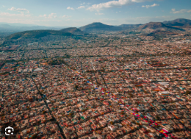




GCSE Changing Cities
knowledge checkers
Lesson 13
Issues in Mexico City
Core knowledge
Key words
Effects of Rapid Urbanization in Mexico City:
Housing Shortages: Insufficient formal housing leads to
overcrowded living conditions.
Squatter Settlements: Growth of informal settlements with
poorly constructed homes lacking basic utilities.
Under-Employment: Many residents work in low-paying or
informal jobs due to a lack of formal opportunities.
Unemployment: Rapid population growth outpaces job creation, increasing unemployment rates.
Pollution: Air and water pollution rise due to increased traffic, industry, and inadequate waste management.
Inadequate Services: Strain on schools, hospitals, and transport systems, causing inequality in access.
Traffic Congestion: Overcrowded roads lead to longer commute times and worsened air quality
Urbanization: The growth and expansion of urban areas as populations increase and migrate from rural regions.
Inequality: Unequal distribution of resources, wealth, and opportunities within a population.
Informal Settlements: Unplanned residential areas lacking proper infrastructure and services, often emerging on illegally occupied land.
Under-Employment: A situation where workers are employed in jobs that do not match their skills or provide sufficient income.
Knowledge Organiser
Misconceptions
"Urbanization solves poverty": While urbanization creates opportunities, it often exacerbates inequality, leaving many in informal settlements without access to basic services.”
“Only the poor face challenges": Rapid urbanization also strains services and infrastructure in wealthier areas, leading to traffic congestion and pollution that affect all residents.”
“Squatter settlements are temporary": Informal settlements often become long-term, with generations living in inadequate conditions
Take it further...

Slide 21



GCSE Changing Cities
knowledge checkers
Lesson 14
Solving Mexico’s problems
Core knowledge
Key words
Top-Down Approach
A centralized strategy where decisions, policies, and solutions are made by higher authorities (e.g., governments or organizations) and then implemented at lower levels.
Example: The government builds a city-wide metro system to reduce traffic congestion.
Advantages: Community engagement, sustainability, innovative solutions, cost effectiveness (cheaper). Disadvantages: Dependency on external funding, inconsistent quality as it depends on capacity and resources of local groups.
Bottom-Up Approach
A decentralized strategy where solutions are developed and implemented by local communities or grassroots organizations, addressing issues from the ground level.
Example: Neighborhood groups create urban gardens to combat food insecurity locally.
Advantages: engages local residents, ensuring it meets needs, cost effective solutions, flexibility, sustainability, improved trust and empowerment. Disadvantages: limited resources, benefits may only be local, lack of institutional support and dependency on community participation.
The Role of Government Policies in Mexico City:
Social Policies:
Housing Initiatives: Programs to improve informal settlements, provide affordable housing, and upgrade infrastructure.
Healthcare Access: Expanding healthcare facilities and services to underserved areas.
Education Investment: Building schools and offering programs to reduce educational inequality.
Economic Policies:
Job Creation: Supporting small businesses, promoting entrepreneurship, and attracting foreign investment.
Public Transport Expansion: Projects like the Metro system and BRT (Bus Rapid Transit) lines to improve mobility and reduce costs for workers.
Environmental Policies:
Air Quality Management: Restrictions on vehicle use (e.g., "Hoy No Circula" program) and promotion of cleaner energy sources.
Green Spaces: Development of urban parks and reforestation initiatives to reduce pollution and improve public health.
Waste Management: Policies to improve recycling and reduce landfill use.
Bottom-Up Approach:
A strategy where decisions and actions are initiated by local communities or individuals, rather than imposed by higher authorities.
Top-Down Approach:
A strategy where decisions and actions are made by higher authorities (e.g., government, organizations) and implemented down to lower levels.
Government Policy:
A set of guidelines or principles developed by a government to direct and influence actions within various sectors, such as social, economic, or environmental areas.
Knowledge Organiser
Take it further...

Slide 22
Exam Practice 5
First let's plan this answer.
You have studied a major city in either a developing or an emerging country.
Evaluate how successful bottom-up and top down approaches have been in solving the problems caused by rapid growth
1 | 2
Now answer it.
_________________________________________________________________________________________________________________________________________________________________________________________________________________________________________________________________________________________________________________________________________________________________________________________________________________________________________________________________________________________________________________________________________________________________________________________________________________________________________________________________________________________________________________________________________________________________________________________________________________________________________________________________________________________________________________________________________________________________________________________________________________________________________________________________________________________________________________________________________________________
Bottom - up
Top down
Feedback

