Slide 1


GCSE Global Development
It is your responsibility to make sure that you are able to answer each of the questions set in the tasks below. This will be based on what you are taught in lessons and the information included the knowledge organisers.
Task 1 What is a developing country? What is a developed country? What is an emerging country? What are some factors that will affect development? | Task 2 What is the Demographic Transition Model (DMT) ? Describe the pattern of the DMT. What is a population pyramid? Describe the pattern of a population pyramid for a developing country. Describe the pattern of a population pyramid for a developed country. | Task 3 Name 4 factors affecting development. What is quality of life? What is food security? What is water security?
Task 4 What is GDP & GDP Per Capita? What is the Human Development Index (HDI)? What is corruption and how can it influence a country's wealth and development? Describe global HDI levels. Where would we find the highest/lowest? | Task 5 What is the development gap? How do we measure/ compare inequality? Explain the Gini Coefficient. What would the graph look like in a country with equal income compared to a country with a lot of inequality? Describe the wealth distribution in the UK. | Task 6 Name the 5 causes of global inequality, then go through and give a brief explanation of each one? What does an open/closed economy refer to and how can it affect development? What are the impacts of even development? Briefly describe the poverty cycle.
Knowledge Expert

Slide 2
GCSE Global Development
It is your responsibility to make sure that you are able to answer each of the questions set in the tasks below. This will be based on what you are taught in lessons and the information included the knowledge organisers.
Task 7 What are international strategies? Name 2 examples. What is fairtrade? What are the benefits and outcomes of fairtrade in a local area? | Task 8 Describe top-down development and name an example. What are the advantages of the top-down approach? What are the disadvantages of the top-down approach? Describe bottom-up development and name an example. What are the advantages of the bottom-up approach? What are the disadvantages of the bottom-up approach? | Task 9 Describe the location of India. What type of country is India? Developing? Emerging? Or Developed? How has India's physical geography impacted their development?
Task 10 Describe uneven development in India. Which areas are most/ least developed? Name the 3 main reasons for India's uneven development. What is the positive multiplier effect? | Task 11 Is India's economy growing or declining. What factors have contributed to India's changing economy? What are the 4 different job categories? Describe them and explain how the changes in jobs in India have impacted the economy. | Task 12 What does the term geopolitics mean? Describe India's relationship with the UK. How has colonialism affected India? What is the partition of India? How has it impacted them/their international relationships? Describe India's relationship with the Pakistan. Describe India's relationship with the China.
Knowledge Expert

Slide 3









GCSE Global Development
Knowledge Checkers
Lesson 1
Introduction to Development
Core knowledge
Key words
Developing Country- A country that has a high GDP and an overall higher quality of life.
Developed Country- A country that has a low GDP and an overall lower quality of life.
Emerging Country- A country that is not yet fully developed but is has a steady/ or quick rate of economic growth.
Water Security- The ability of a population to ensure sustainable access to adequate quantities of acceptable quality water.
Food Security- When all people at all times have access to sufficient, safe, nutritious food to maintain a healthy and active lifestyle.
Geopolitical Relationships- How geography affects politics and international relationships.​
Landlocked- This is when a country is not connected to the sea/ocean. This makes international trade more difficult and impedes development.
All countries move this way
Developing
Developed
Emerging
A country’s level of development will be impacted by lots of different factors, such as food and water security. Countries that have less access to food and water (a low level of food/water security) have a lower level of development… How can a country develop when they can’t even access basic necessities? This means people have a lower quality of life.
A lack of access to food and water might be as a result of a lack of resources the natural landscape in that county offers, e.g. countries in a desert biome lack the ability to grow crops and get water from natural sources. The natural landscape can also limit a country’s ability to trade, because landlocked countries are more difficult to access. Low accessibility combined with a low level of development will also reduce the amount of international relationships, affecting trade, economic growth and job availability.
Knowledge Organiser
Take it further...
This video shows: An introduction to development

Slide 4

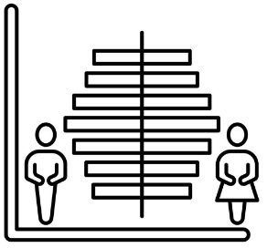


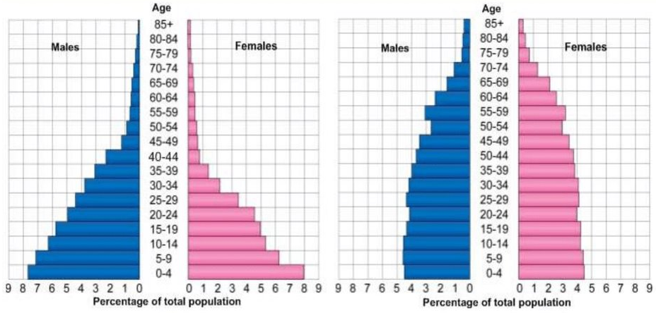
GCSE Global Development
Knowledge Checkers
Lesson 2
Prisoners and DTM
Core knowledge
Key words
A demographic transition model changes as a place develops. The DTM helps to understand the demographic changes that accompany economic development and modernization. This theoretical model consists of 4-5 stages:
Demographic Transition Model- This is a model that shows how a place and the population change over time.
Population Pyramid- This is a type of graph that shows us age and gender distribution of a particular population.
​
At the beginning of its development a country will start with high birth rates and high death rates. This will produce a stable population.
Death rates decline due to improvements in healthcare and sanitation, while birth rates remain high, resulting in population growth.
Birth rates begin to decline as societies become more industrialized and urbanized, leading to slower population growth.
Take it further...
Knowledge Organiser
Only watch to 4 minutes 20 seconds
Both birth and death rates are low, stabilizing the population.
These videos show: an explanation for both the Demographic Transition Model and population pyramids.
Optional: Some theorists suggest a fifth stage where birth rates may fall below death rates, leading to population decline.
DTM
Population
A countries demographic and population will vary based on its level of development. For example, a developing country will be in stage 1, with high birth/death rates, as they only have basic resources and no access to healthcare or family planning. Whereas a developed country will be around stage 4, as people have access to good healthcare and services and prioritise jobs. Emerging countries will be somewhere in the middle, around stages 2-3 as resources improve and urbanisation and development increases.
Developing Country
Developed Country

Slide 5










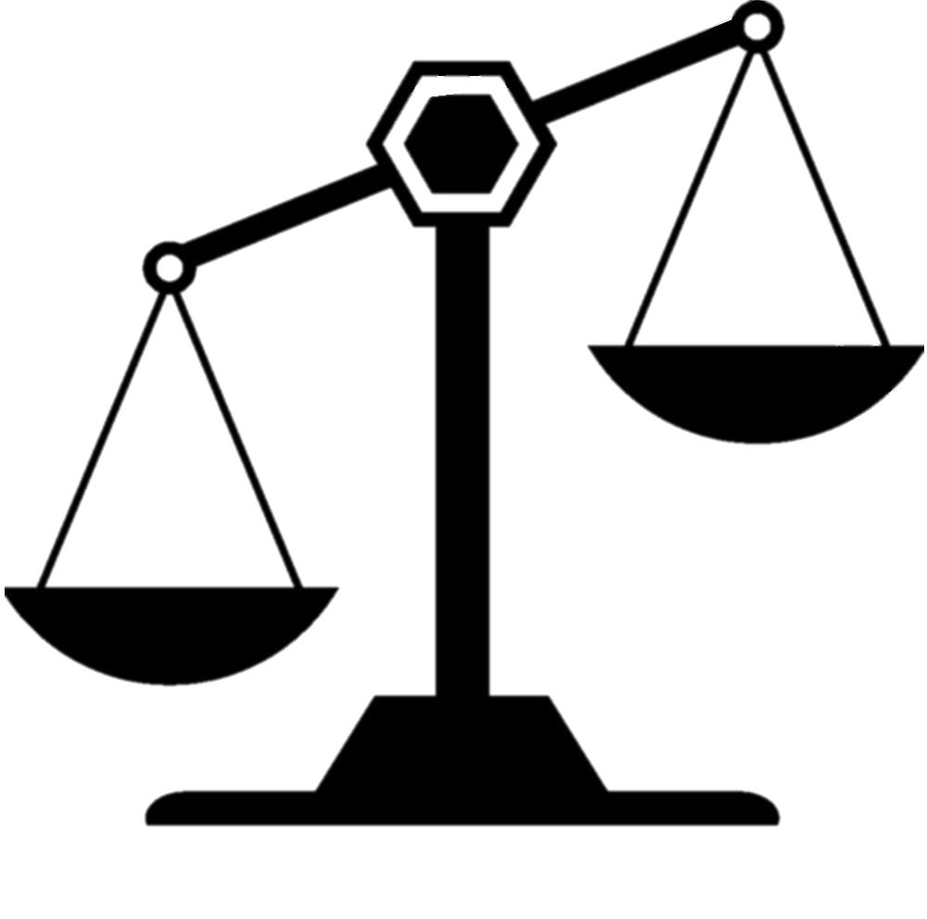


GCSE Global Development
Knowledge Checkers
Lesson 3
Development
Core knowledge
Key words
Social. E.g Housing, Education, Health
Economic. E.g Income, unemployment, trade
Development- The process where people, a place or a country change, or make economic or social progress.
Quality of life- The degree of well-being (physical and psychological) felt by an individual or group of people in a particular area. This can be affected by economic, physical, social or psychological influences.
Three strands of food security:
Availability- Sufficient amounts of food being available on a consistent basis.​
Access- Having sufficient resources to obtain appropriate foods for a nutritious diet.
Consumption- Making appropriate use based on knowledge of basic nutrition and care, as well as adequate water and sanitation.
Factors affecting development
Cultural. E.g Work-life balance, democratisation, balancing cultures.
Technology. E.g Internet access, Electrification
Development occurs in a low income country when there are economic improvements which will lead to higher levels of investment. This will improve local food supply due to investment into machinery and fertilisers. Investing money into technological advancement will also increase development by extending the electricity grid outwards from the main urban areas to rural areas. Investments in the roads or introducing new railways will improve accessibility within remote regions.
Knowledge Organiser
Food Security
There is a geographical imbalance between food production and food consumption. This means that there is a lack of food security in many countries. This will limit development. There are 3 main strands: availability, access and consumption
Water Security
There is also a geographical imbalance between water availability and water consumption. For about 80 countries, home to 40% of the world’s population, lack of water is a constant threat. 840,000 people die each year from water-related diseases (such as cholera). In developing countries, most deaths still result from water borne
diseases. These are just
some facts relating to
water security.​
Take it further...
These videos show:
Development explained
Why countries develop at different rates.
Some countries are producing too much or not enough food.
Some countries are consuming too much whilst others not enough.
Food Production
Food Consumption

Slide 6
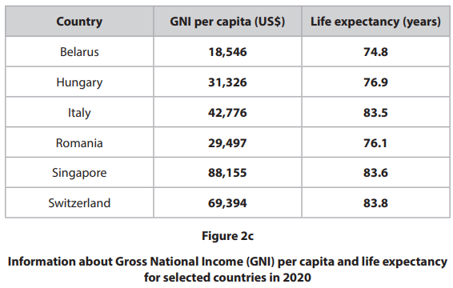
Exam Practice 1
Define the term development. (1) | 2. Calculate the mean life expectancy for the countries shown on Figure 2c. Write your answer to one decimal place. You must show your working in the space below. (2) ________________________ years
3. Explain two reasons why life expectancy has increased in some emerging and developing countries. (4)
Feedback
___________________________________________________________________________________________________________________________
_________________________________________________________________________________________________________________________________________________________________________________________________________________________________________________________________________________________________________________________________________________________________________________
Describe the relationship between GNI per capita and life expectancy shown in Figure 2c. (3)
_______________________________________________________________________________________________________________________________________________________________________________________________________________________________________________________________________________________________

Slide 7



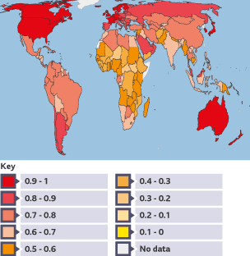





GCSE Global Development
Knowledge Checkers
Lesson 4
How is development measured?
Core knowledge
Key words
A country’s level of development is not just about how much money they have. We can do this by using the HDI, which is the human development index. This is a way of measuring development using GNI per capita, years of education and life expectancy. Looking at multiple factors can give a better overall idea of how a country is doing. HDI values can range from 0 (less developed) to 1 (more developed).
However, there are other factors that can also impact or limit development that aren’t considered in the HDI, such as inequality or environmental issues. For example, HDI does not show whether there is a gender pay gap - a difference between the average earnings of men and women. Another potential unconsidered impact is corruption. The quality of the government is a big factor in development​. Places where the quality of the government is poor often have high levels of corruption. This is measured through the Corruption Perceptions Index.
GDP (Gross Domestic Product)- The total value of goods and services produced within a country in a year.​
GDP Per Capita- A country’s GDP divided by it’s total population
GNI (Gross National Income)- The total value of goods and services produced within a country in a year plus overseas earnings.
HDI (human Development Index)- A composite measure of development within a country using GNI per capita, years of education and life expectancy.
Corruption- This is the abuse of power or authority for personal gain or benefit. It can take different forms, such as bribery, embezzlement, or hiding things.
Knowledge Organiser
The map to the right shows the global HDI levels. As a pattern we can see more developed countries in the Northern hemisphere, other than some anomalies like Australia and Argentina.
Take it further...
The links below have some great interactive maps and facts on there!
These videos explain GDP, GNI and HDI.
Human Development Index | Human Development Reports (undp.org)
Human Development Index (HDI) by Country 2025 (worldpopulationreview.com)

Slide 8



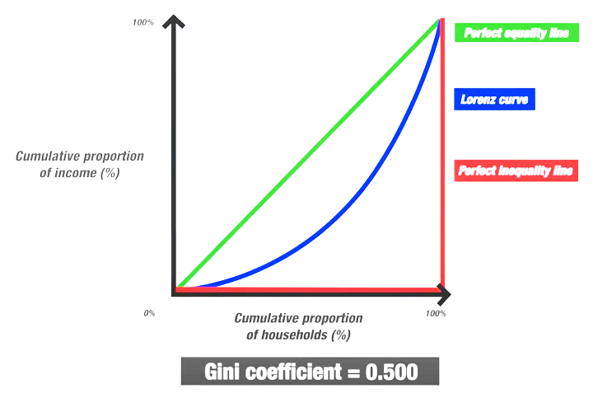

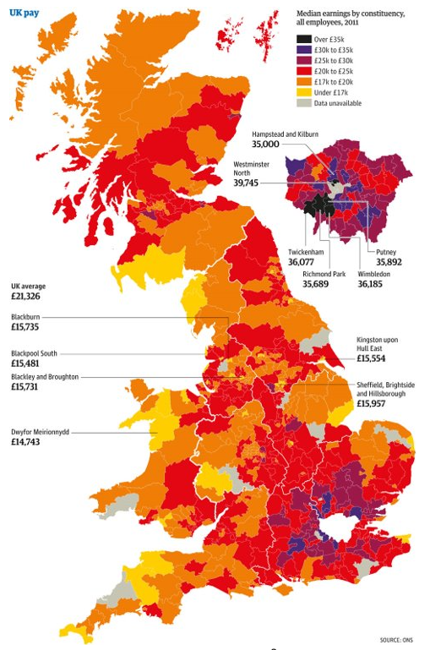


GCSE Global Development
Knowledge Checkers
Lesson 5
Uneven Development
Core knowledge
Key words
There are differences in development across different countries. Rich countries tend to have a smaller income gap than poorer countries. The Gini Coefficient can be used to show the extent of income inequality. To calculate the Gini Coefficient we use the Lorenz Curve. This is a line on a graph that shows us the distribution of income in a population. The Gini Coefficient value goes between 0 and 1. The value 0 reflects perfect equality as it the Lorenz curve matches the perfect equality line. As the Lorenz curves moves further away from the perfect equality line, inequality increases. The value 1 reflects perfect inequality. Shown in graph below:
The Development Gap- The difference in income and the quality of life in general between the richest and poorest countries in the world.
The Gini Coefficient- A measure used to assess the level of income inequality in a place.
A high value= more unequal share of income.
A low value= more equal share of income.
GDHI (Gross Disposable Household Income)- The amount of money that households (individuals or families) have available for spending or saving.​
However comparing these incomes from different countries can be tricky because they all use different equivalence scales, household income definitions and household coverage.
Knowledge Organiser
Take it further...
Uneven development not only occurs between countries but also within countries like the UK and Mexico and even within cities like in Nairobi in Kenya. The map to the left shows wealth distribution across the UK, and it is clear to see the uneven development between the North and South of the UK.
These videos show:
The development gap.
The Gini Coefficient explained

Slide 9



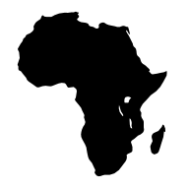
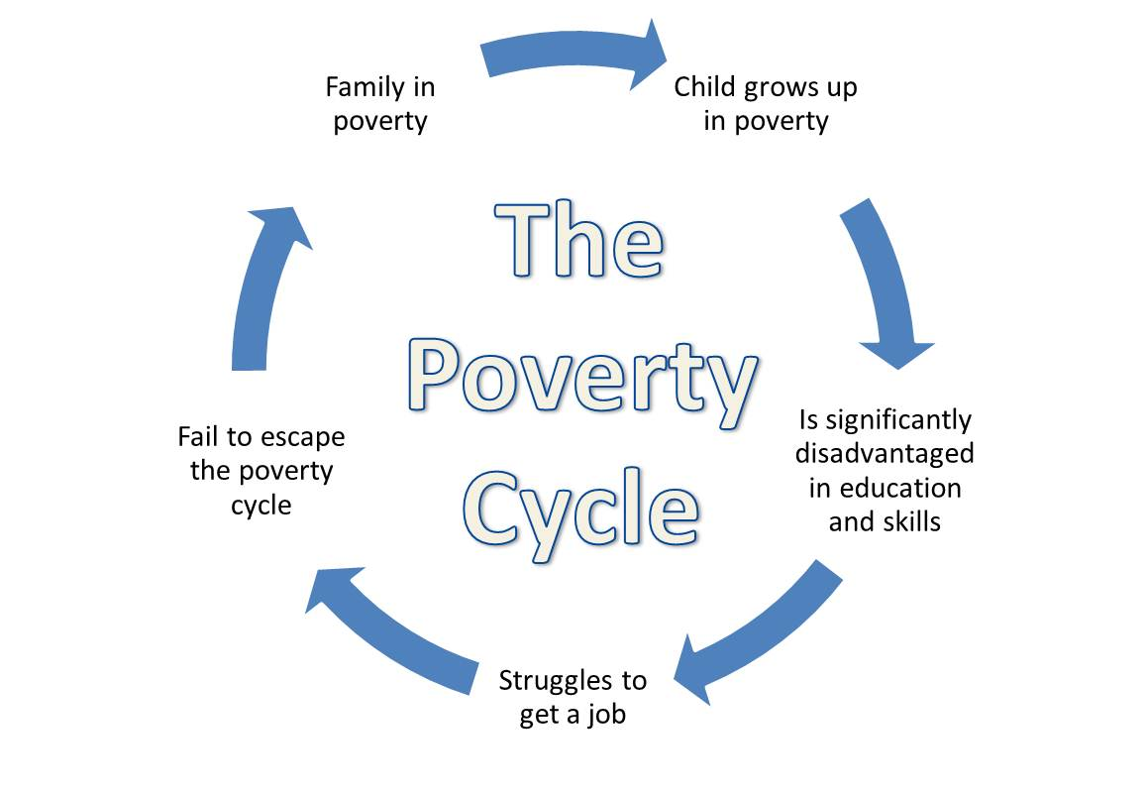
GCSE Global Development
Knowledge Checkers
Lesson 6
Factors Affecting Development
Core knowledge
Key words
Social investment
Countries that have prioritised investment in education and health have generally developed at a faster rate than nations which have invested less. As countries develop, fertility declines. Education, especially female literacy, is the key to lower fertility. Female education increases knowledge of birth control, creates greater social awareness and opportunities for employment.
The physical environment
Accessibility: Many landlocked countries have developed more slowly than coastal nations
Climate: Tropical countries have grown more slowly than those in temperate latitudes.
Size: Small island countries face considerable disadvantages
Location: Countries affected by natural hazards face particular difficulties.
Demographics- The study of statistics such as births, deaths, income, or the incidence of disease which show the changing structure of population
Colonialism- Acquiring control over another country, occupying it with settlers, and exploiting it economically.
Neo Colonialism- The dominance of poor countries by rich countries, not by direct political control (as in colonialism), but by economic power and cultural influence.
Causes of Global Inequality
Demography
Demographic transition is a significant factor; the highest rates of economic growth are experienced by nations where the birth rate has declined the most.
Knowledge Organiser
History
Through colonialism European powers, such as the UK and France, expanded their territories around the world and imposed unequal trading relationships on the colonies, which were exploited for their raw materials. The term 'neo-colonialism' is used to describe how rich countries can still dominate poorer countries economically and politically.
​Political and Economic Policies
Open economies (eg, the UK) that encourage foreign investment have developed faster than closed economies (eg Russia) Institutional quality in terms of good government, law and order and lack of corruption results in higher rates of growth.
Inequality in the UK
There are some major inequalities in the UK, and we can see that on the wealth map from lesson 5. There is a clear North-South divide; the lowest living standards in the UK tend to be in remote areas where the physical geography is challenging. This can make accessibility difficult and limit job opportunities. Areas once used for traditional heavy industries also have lower living standards as deindustrialisation left them with no investment and no jobs, as products could be produced cheaper abroad (e.g. China).
Impacts of Global Inequality
Global inequality will result in uneven development, which will impact people on a variety of scales. For example, people on low incomes have very limited access to adequate housing. Low investment in health will keep death rates high. The World Health Organisation says most people could be saved if they had access to inexpensive vaccines, clean water and sanitation. Low economic funds will limit technology which will limit development. Reaching a certain level of technology in a country requires investment in the technology itself and people with the necessary skills to operate it efficiently. This can be overcome with appropriate technology. Global inequality will also impact food and water security.

Slide 10
Exam Practice 2
Describe one index used to measure political corruption (2) | 2. Explain two physical factors that have led to some countries having a high level of development. (4)
3. Explain two historical factors that have led to global variations in the level of development. (4) | 4. State two components that form part of the Human Development Index (HDI). (2) _______________________________________ _______________________________________
 | Feedback
____________________________________________________________________________________________________________________________________________________________________
_________________________________________________________________________________________________________________________________________________________________________________________________________________________________________________________________________________________________________________________________________________________________________________
_________________________________________________________________________________________________________________________________________________________________________________________________________________________________________________________________________________________________________________________________________________________________________________

Slide 11
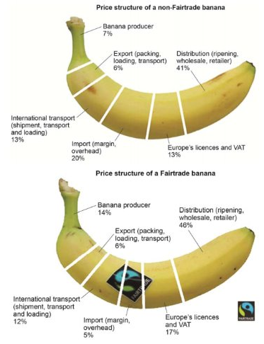






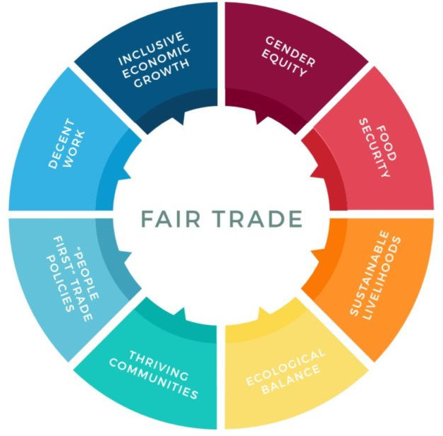



GCSE Global Development
Knowledge Checkers
Lesson 7
International Strategies
Core knowledge
Key words
Even though the farmers put in so much work to grow their bananas they only get 7% of the shares from each banana, with supermarkets taking almost half! By using international strategies like Fairtrade, farmers get a fair price for their product, and with this extra income they can invest. Fairtrade farmers don’t work alone, they’re part of cooperatives (like working in a team with other farmers). This means a minimum price can be set for their shared products , and they will also receive a ‘fairtrade premium’, which they can choose what to spend on. They might invest it in building wells to improve water access, or in hospitals to improve health, or in farming equipment to improve efficiency and productivity. Having a stable income like this improves quality of life people, giving them more opportunities! Other examples of international strategies include aid, debt relief and foreign direct investment.
International Strategies- These are plans that have been made to combat uneven development.
Foreign Direct Investment (FDI)- overseas investment in physical capital by transnational corporations (TNCs).​
Fair Trade- a movement that aims to create direct long-term trading links with producers in developing countries to ensure they receive a fair and guaranteed price for their products.​
Aid- assistance in the form of grants or loans at below market rates.​
Debt relief- establishing ways of reducing or cancelling debts for the world’s poorer nations.
Knowledge Organiser
Take it further...
These videos show: The different types of international strategies explained.
1- All strategies
2- Fairtrade
3- Debt Relief

Slide 12






GCSE Global Development
Knowledge Checkers
Lesson 8
Top vs Bottom
Core knowledge
Key words
Bottom-up development is organised by communities with the aim of benefitting the local area. This is often led by NGO’s.
Planned and controlled by local communities.
Target some of the poorest communities of an area.
Schemes are much less expensive.
More appropriate technology is used.
Many NGOs rely on voluntary donations, which can limit spending capacity
The projects only help a small number of people.
Governments and communities in developing countries often rely on NGOs too much without developing their own strategies.
Example: WaterAid, a UK NGO, install wells and hand pumps in Africa, an example of a bottom-up development scheme. They only cost £292 each, and use technology that the local people can use, maintain and repair if necessary. They provide clean water for a village, eliminating the need for women and children to go and travel long distances to collect water. Children are now able to spend more time studying instead of having to collect water.​
Top-down development is on a much larger scale and is organised by governments and other large institutions. Top-down development identifies a country’s needs/opportunities, with experts brought in to create the plans.
Benefit large communities
Provide many jobs for the local communities
Other industries and services can often benefit, boosting local business (multiplier effect)
Locals have little say on projects, as decisions made by governments
Schemes can be very expensive, which might require further money borrowing
Machinery and high-tech solutions are usually used, reducing the jobs available
Sometimes projects are left unfinished as the government runs out of money
Example: The Three Gorges Dam on the Yangtze River, built to produce hydroelectric power and control flooding, displaced 1.4 million people due to development and land flooding, illustrating how top-down approaches can have unintended consequences on local communities. However, it successfully decreases CO2 emissions by 100 million tonnes, and provides energy to millions, reducing China’s dependence on oil.
Transnational Corporation (TNC)- This is a company that has production of goods or services, foreign investments, or income in more than one country. They set up factories in developing countries as land and labour are cheaper there.
Top-Down Development- This occurs when decisions about development are made by governments or large companies.​
Bottom-Up Development- This occurs through the actions of Non-Governmental Organisations (NGOs) working on small-scale projects with local communities.
Non-government Organisations (NGO’s)- A company/ group that operates separately from the government, e.g. a charity)
Knowledge Organiser
Take it further...
These videos show:
TNC’s explained
Bottom up/ Top down development

Slide 13
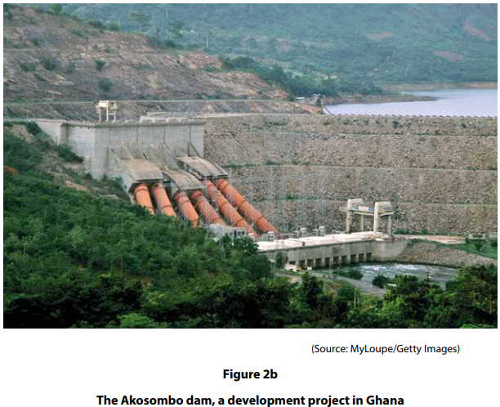
Exam Practice 3
Top down projects are often controversial. Explain one advantage and one disadvantage of top-down development projects in the promotion of development. (4) | 2. Study Figure 2b The following statements describe different types of development project. Identify the two statements which describe the type of project shown in Figure 2b. The project relies on intermediate technology Local people are responsible for designing the project Large amounts of money are borrowed to pay for the project The project has limited environmental impact The project brings national prestige to the country
 | 3. Explain two advantages of using community-led projects to address uneven development. (4)
Advantages
___________________________________________________________________________________________________________________________________________________________________________________________________________________________________________________________________________________________________________________________
Disadvantages
___________________________________________________________________________________________________________________________________________________________________________________________________________________________________________________________________________________________________________________________
________________________________________________________________________________________________________________________________________________________________________________________________________________________________________________________________________________________________________________________________________________________________________________________________________

Slide 14
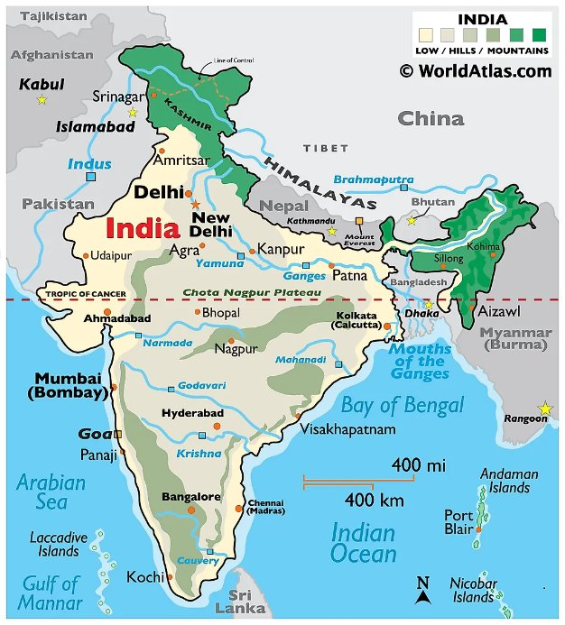
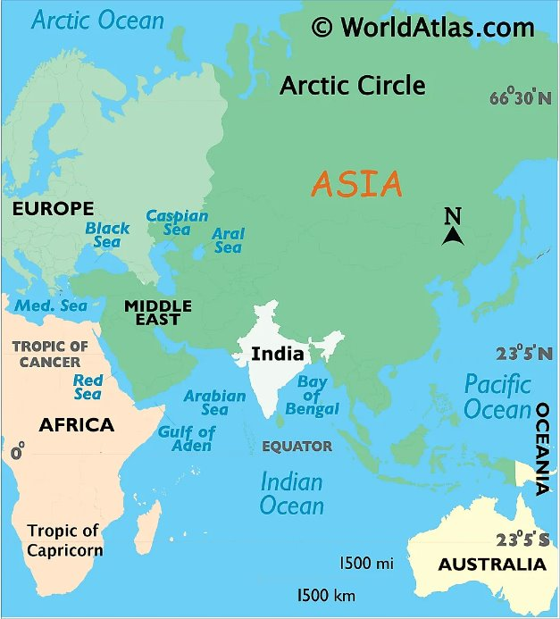






GCSE Global Development
Knowledge Checkers
Lesson 9
India’s Location and Context
Core knowledge
Key words
Social- Things that affect people (education, healthcare, food, water).
Political- Things that are to do with the government or laws of a country.
Cultural- Things that relate to the ideas, customs and social behaviour of a country.
Economic- Things that relate to the money in a country e.g. the GDP.
Environmental- Things to do with the natural land e.g. trees, rivers, ecosystems.
Knowledge Organiser
Take it further
This video shows: India as an up-and-coming economic superpower.
India is known as an emerging country.
They are also a huge market for goods and services.
The region also contains a lot of people meaning there is a constant supply of workers.
India is predicted to be the world’s second largest economy by (2050), behind only China.
Their growth rate has been sustained for a long time and their economy has quadrupled (x4) since 1997.
India’s relationships with powerful neighbours such as China, the UAE and the ‘Asian Tiger’ economies encourages trade.
​India's geography has massively shaped their development, including its diverse physical features, climate, and resources. ​
The monsoon climate and the fertile plain have supported intensive agriculture across some parts of the country. ​
India is rich in natural resources, such as minerals, coal, and iron ore.​
India’s central location between Europe, the Middle East, Africa, and East Asia provides it with a strategic advantage for international trade. Its coastline allows for maritime trade with these different regions.
The extensive coastline is advantageous to India, it facilitates port development and maritime trade, impacting economic activities such as fishing, shipbuilding, and maritime transport.

Slide 15

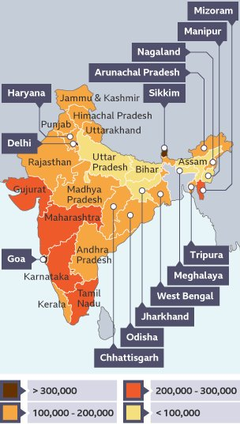


GCSE Global Development
Knowledge Checkers
Lesson 10
Uneven Development in India
Core knowledge
Key words
Although India has undergone rapid economic development in the last 20 years, it has great variations in wealth within the country. The Human Development Index (HDI) places India 132nd out of 191 countries, with around 10% of the nation's population still living on $2.15 (US dollar) a day. Generally, the states in the south and west (with the exception of Rajasthan and Kerala) have a far higher level of development than the states in the north and east.
Core- The most developed places (countries or within a country). E.g. Tamil Nadu.
Periphery- Periphery areas are those less developed than core or semi-periphery places. E.g. Bihar
Reasons for India’s Uneven Development
Take it further...
Population
These videos show:
-The Green Revolution
- Reasons for uneven development
Climate
Knowledge Organiser
Location
The south and the west also had the lowest rates of natural increase compared to the high rates of natural increase in the north and the east. In Kerala, in the south, fertility rates are now 1.8 - only slightly higher than the UK.
The Green Revolution (and also the increase in food exports) was greatest in the south and the west compared to the north. Northern states like Rajasthan, is often affected by drought and crop failure due to the failure of the monsoon.​
Coastal locations such as Mumbai (in Maharashtra) historically benefitted from being linked to trade routes with the rest of the world, in contrast to landlocked states such as Bihar. This gap increased further when coastal locations allowed the south and the west to develop large container ports, which linked these states to an increasingly globalised world.​
These reasons led to the positive multiplier effect in the south and the west where a high level of development created a well-educated work force. This then attracted foreign investment from transnational corporations, further increasing the wealth of the south and the west. In contrast, the north and east of India are landlocked, therefore cannot directly trade internationally. This deters foreign investors from these regions. This can result in a lack of schools, transport networks and employment opportunities causing young people to move out of the region towards successful cities. This is known as brain drain.​

Slide 16





GCSE Global Development
Knowledge Checkers
Lesson 11
India’s Changing Economy
Core knowledge
Key words
India's economy is on the rise. The factors below have all contributed to its changing economy.
There are 4 different types of jobs: primary, secondary, tertiary and quaternary. All jobs in the world will fall into one of these categories. Developed countries have a higher amount of tertiary and quaternary jobs, whereas less developed countries have more primary and secondary jobs.
Jobs | Primary jobs in the agriculture sector have more than halved because it is a low paying and strenuous job. As the country has developed more job opportunities with higher wages are available. Whereas tertiary and quaternary jobs have risen. The number of jobs in services have grown because it is an English-speaking country and through this India has become the global leader in outsourcing. Low-cost labor has led to many jobs in call centers and back offices.
Trade | Until the early 1990's India was a relatively closed economy. There were very high tariffs on imports. Reducing the barriers to trade was an important part of the economic reforms India made at the time. As India has become more connected into the global economy, the volumes of both its exports and its imports have risen sharply.
Aid | Historically, India is the biggest recipient of foreign aid. However, such aid has declined rapidly in recent years as the country has developed. India itself now sends aid to other countries, such as Nepal.
Foreign Direct Investment (FDI) | Recent economic development owes much to an increasing level of FDI, which rose from US$17,800 million in 2005/2007 to US$34,400 million in 2014. The Indian government is keen to encourage FDI into developing the country’s infrastructure in 2014/2015, investors based in Mauritius and Singapore were the two major sources of India's FDI. FDI is dominated by large investments from TNC's, but some smaller Businesses are involved, especially in smaller start-ups, for example in India’s technology sector.
Public Investment | Public investment in education, health, transport and housing is essential to social and economic development. For example, India's well-educated workforce is vital to its ICT sector. Since the 1990s, India has gradually been selling off its public companies through privatisation, which has attracted more FDI. However, the public sector remains much larger than the UK or the USA, and it employs many people.
Demographics | India's demographics have undergone significant changes, such as the exponential growth of a young population, rapid urbanisation, increased literacy and education. All these factors combined make for a great workforce to grow India's economy.
Primary Jobs- This involves collecting raw resources/materials, e.g. a farmer or a miner.
Secondary Jobs- This is creating something from the raw materials, e.g. manufacturer/factory worker.
Tertiary Jobs- Providing a service, e.g. teacher, nurse, hospitality (restaurants/hotels).
Quaternary Jobs- Jobs in research and development, e.g. a scientist.
Knowledge Organiser
Take it further...
This videos shows:
-Reasons why India's economy has grown.

Slide 17
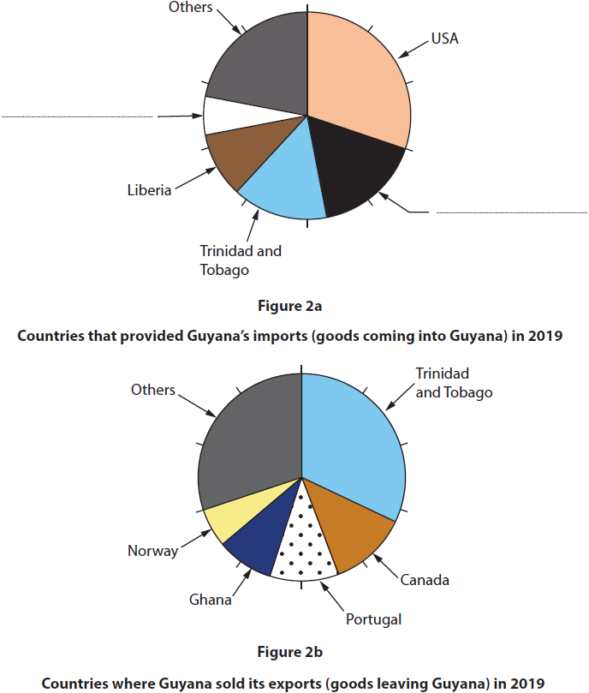
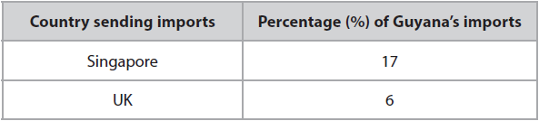
Exam Practice 4
Define the term periphery. (1) ________________________________________________________________________________________________________________________________________________________________
For either a named developing or emerging country, explain two negative impacts of growth in the secondary sector. (4)
Feedback
International trade has influenced the development of many developing and emerging countries, such as Guyana.
(i) Label Figure 2a, by using the information in the table below, to complete the pie chart. (1)
(ii) Calculate the total percentage of Guyana's imports that came from Liberia and the USA. (1)
10%
20%
30%
40%
______________________________________________________________________________________________________________________________________________________________________________________________________________________________________________________________________________________________________________________________________________________________________________________________________________________________________________
(iii) State two ways that international trade may help a country to develop. (2)
_______________________________________________________________________________________________________________________________________________________________________________________________________________________

Slide 18
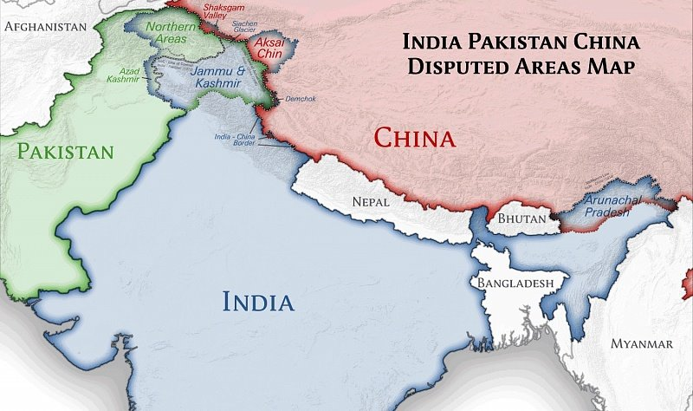





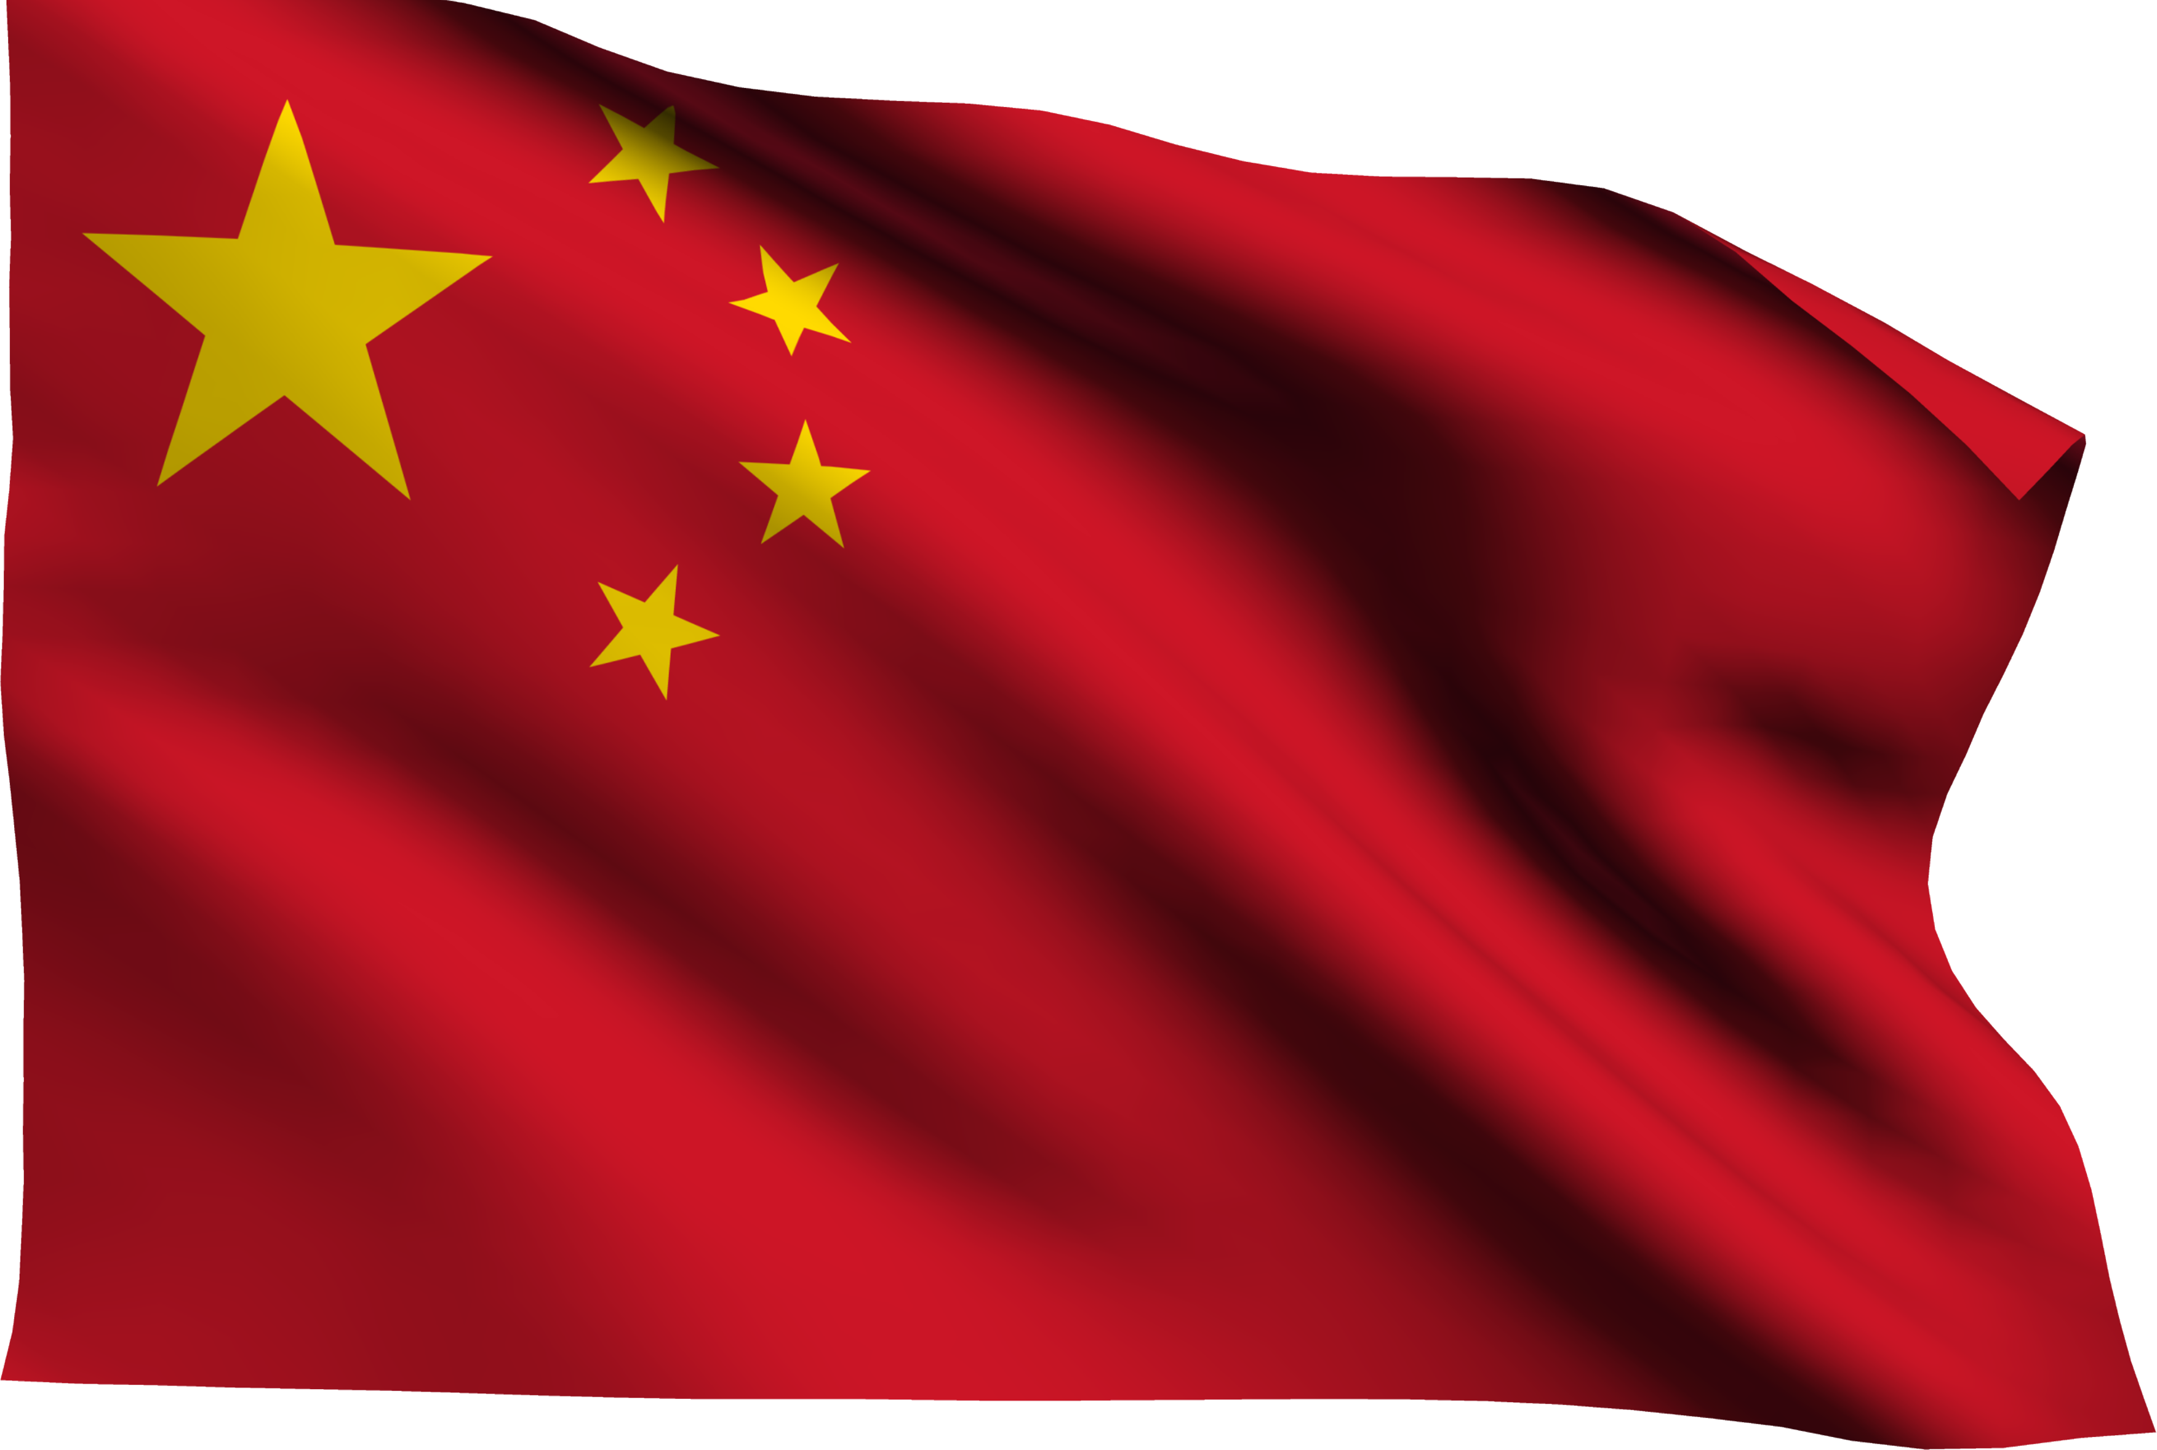


GCSE Global Development
Knowledge Checkers
Lesson 12
Geopolitics
Core knowledge
India has geopolitical relationships with countries all over the world, and they all have effects on India’s development. A lot of these relationships have developed from India's history, for example colonisation and the partition of India.
The UK- Overall India has a good relationship with the UK. These two countries have a long history together, as India was colonised a part of the British Empire. Whilst they got independence in 1947, colonisation helped shape India, with more English speakers in India than in the UK! Whilst feelings about colonisation can be mixed, it helped the country develop and become global leaders in outsourcing.
The partition of India (in 1947) refers to the division of British India (after they got independence) into two independent dominions: India and Pakistan. They were divided by majority and minority religions; the dominant religion was Hindu which was claimed as India, whereas the minority religion was Muslim which was deemed as Pakistan. The partition led to a mass migration of approximately 15 million people, accompanied by widespread communal violence, resulting in significant loss of life and displacement.
Key words
Knowledge Organiser
Geopolitics- The study of how Earth's geography (human and physical) affects politics and international relations.
Colonisation- When one country takes control over another country/group of people.
Pakistan- Overall India has a tense relationship with Pakistan, as there has been a lot of dispute over borders. After the partition of India, there has been a lot of turmoil and 3 wars (1947, 1965 and 1999) over the ownership of Kashmir. Both countries have nuclear weapons, and each conducted several threatening tests over the years.
Take it further...
China- Overall India has a tense relationship with China, as there has been a lot of dispute over borders. In 1962 the countries fought a brief war. There are numerous reasons for the desire of control over particular places between China and India, for example the Himalayas. Both countries have huge populations, and the Himalayas are a huge source of water for whoever controls them. Another example is the Indian Ocean, both countries want control over this for trade.
These videos show:
impacts of British colonisation on India
Partition of India explained

Slide 19


GCSE Global Development
Knowledge Checkers
Lesson 13
Impacts of Rapid Development
Core knowledge
Rapid development refers to a significant improvement in a country’s economy over a short time period, and this can be in infrastructure, services, economy, and overall quality of life. It is often characterised by a rapid increase in industrialisation and urbanisation. Rapid development can have a lot of implications, both positive and negative.
Negatives Impacts:
Deforestation has become a major problem. Causes include commercial logging, the conversion of forests to agriculture, urban and industrial expansion. Deforestation causes a range of serious problems, which include flooding, loss of biodiversity, soil erosion and climate change. This is affecting the livelihood and food security of millions across the country.
Climate Change- In 2015, the government said that climate change was the biggest threat to India's economy. More than 60% of Indian farming relies on the monsoon. Increasing erratic monsoon seasons threaten the $370 billion industry and millions of jobs. About 69% of India is prone to drought. India wants to reduce its CO2 emissions to play its part in climate change control, however there are still 400 million people without electricity. India still has a huge dependence on coal as an energy source.
Water Supply- There is enormous pressure on India's water supply, in terms of quantity and quality (polluted water sources). Less than 1/3 of sewage generated in urban areas is treated, the rest flows directly into water bodies. The Ganges and Yamuna are ranked among the world's worst polluted rivers.
Air pollution affects labor productivity through illness. It also damages agriculture as crop yields are low as plants struggle to grow. Air pollution also reduces life expectancy by 3.2 years for the 660 million Indians who live in cities. 13 of the world's top 20 polluted cities are in India, Delhi is the most polluted in the world.
Knowledge Organiser
Positive Impacts:
Their economy is growing rapidly.
The smart cities mission is a new initiative by the government to improve equality and the quality of life. The project will run between 2015-2020 and cover 100 cities across the country. Its core infrastructure elements include:
  adequate water and electricity supply
  improved sanitation
  affordable housing
  health and education
  efficient public transport.
India is aware of its growing economic strength and wants to play a more important role on the worlds stage. This is one reason why its relationship with western countries, like the USA and the EU in particular, have improved. India is a member of the influential G20 and one of the BRICS nations.
Take it further...
These videos show:
The cost of rapid urbanisation
Example exam question explained

Slide 20
Exam Practice 5
Describe how one geopolitical relationship has affected the development of a named developing country or emerging country. (3) | 2. Explain one negative social impact and one negative economic impact of rapid development. (4)
3. You have studied development in a named developing country or emerging country. State two features of this country's location in the world (2) | 4. Explain two ways in which private investment by transnational corporations (TNCs) and smaller businesses has improved the development in a named developing country or emerging country. (4)
Feedback
___________________________________________________________________________________________________________________________________________________________________________________________________________________________________________________________________________________________________________________________________________________________________________________________________
___________________________________________________________________________________________________________________________________________________________________________________________________________________________________________________________________________________________________________________________________________________________________________________________________
____________________________________________________________________________________________________________________________________________________________________________
___________________________________________________________________________________________________________________________________________________________________________________________________________________________________________________________________________________________________________________________________________________________________________________________________

