Slide 1


GCSE Ecosystems, Biodiversity and Management
It is your responsibility to make sure that you are able to answer each of the questions set in the tasks below. This will be based on what you are taught in lessons and the information included the knowledge organisers.
Task 1 What is an ecosystem? What are the key things that make up an ecosystem? How does a biome differ? What are the characteristics of a tropical rainforest? What are the characteristics of a desert? | Task 2 What are the three main stores in the nutrient cycle? How do nutrients enter and leave the nutrient cycle? Why do all nutrient cycles look the same? | Task 3 What does a terrestrial habitat mean? Describe each of the 4 UK terrestrial habitats.
Task 4 What is a marine ecosystem? How do we use marine ecosystems in the UK? How do we damage them? Be able to explain at least 3 ways. | Task 5 Describe the structure of a tropical rainforest. What type of plants and animals might be found on the forest floor? Why? What type of plants and animals might be found in the emergent layer? Why? | Task 6 How have plants adapted to the TRF? How have animals adapted to the TRF? Why is the TRF so biodiverse?
Knowledge Expert

Slide 2
GCSE Ecosystems, Biodiversity and Management
It is your responsibility to make sure that you are able to answer each of the questions set in the tasks below. This will be based on what you are taught in lessons and the information included the knowledge organisers.
Task 7 What goods are provided by the TRF? What services are provided by the TRF? How does climate change threaten TRF? | Task 8 What are the social causes of deforestation in TRF? What are the economic causes of deforestation in TRF? What caused deforestation in Madagascar? How has Madagascar been managed sustainably? | Task 9 Describe the structure of a deciduous woodland. Why does a deciduous woodland have a lower biodiversity compared to a TRF?
Task 10 How have plants adapted to the deciduous woodland? How have animals adapted to the deciduous woodland? What goods are provided by the deciduous woodland? What services are provided by the deciduous woodland? How does climate change threaten deciduous woodland? | Task 11 What are the social causes of deforestation in deciduous woodlands? What are the economic causes of deforestation in deciduous woodlands? | Task 12 How is the New Forest National Park used? How has the New Forest National Park been managed sustainably?
Knowledge Expert

Slide 3


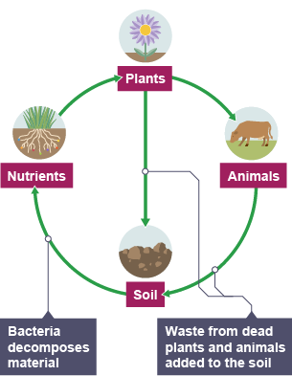







GCSE Ecosystems, Biodiversity and Management
knowledge checkers
What are ecosystems?
Core knowledge
Key words
An ecosystem is a natural environment and includes the flora (plants) and fauna (animals) that live and interact within that environment. Flora, fauna and bacteria are the biotic or living components of the ecosystem. Ecosystems are dependent on the following abiotic or non-living components:
Flora - All types of plant species that live in a specific area.
Fauna– All the different types of animals that live in a specific area.
Bacteria - Single-celled microorganisms, some of which are pathogenic in humans, animals and plants. Singular is bacterium.
Biotic- Living elements of an ecosystem, such as plants and animals.
Abiotic - Non-living elements of an ecosystem, such as climate, temperature, water, and soil type.
Climate - Average weather conditions over longer periods and over large areas.
Species - A type of organism that is the basic unit of classification. Individuals of different species are not able to interbreed successfully.
climate - the temperature and amount of rainfall are very important for determining what species can survive in the ecosystem
soil - the soil type is important as this provides nutrients that will support different plants
water - the amount of water available in an ecosystem will determine what plants and animals can be supported
The biotic parts of the ecosystem, which include bacteria, flora and fauna, have a complex relationship with the abiotic components - changing one will lead
to a change in the other.
Knowledge Organiser
Take it further...
Biome Tours
Video

Slide 4

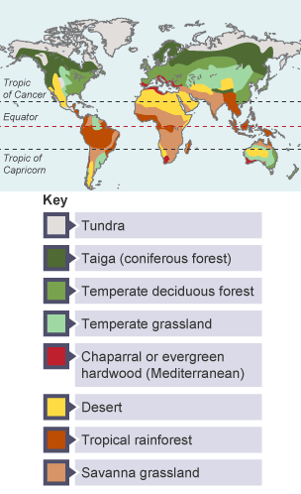





GCSE Ecosystems, Biodiversity and Management
knowledge checkers
Distribution of biomes
Core knowledge
Key words
The distribution of large-scale ecosystems (biomes) is determined by climate. Latitude, air pressure and winds are important factors that determine the climate of a place.
Biomes - A large-scale ecosystem.
Ecosystem– The living organisms in a particular area, together with the non-living components of the environment.
Temperate – mild
Coniferous tree – evergreen trees that do not drop their needles
Deciduous trees – trees that lose their leaves when temperatures drop
Knowledge Organiser
Characteristics of biomes
Tundra - found near the North and South poles. Very few plants and animals can survive here.
Taiga (coniferous forest) - found in Scandinavia, Russia and Canada. Evergreen trees thrive in this cool temperate climate.
Temperate deciduous forest - found across Europe and in the USA. These trees lose their leaves every year and thrive in mild and wet conditions known as a temperate maritime climate.
Temperate grassland - found in Hungary, South Africa, Argentina and the USA. Consists of grass and trees that thrive in a temperate continental climate of moderate rainfall and mild conditions.
Desert - found near the Tropics of Cancer and Capricorn. Conditions here are very hot and dry. Plants and animals are specially adapted to survive in the harsh conditions.
Tropical rainforest - found near the Equator. The climate is hot and humid and many different species can be found here.
Savanna grassland - found mainly in central Africa, southern India, northern Australia and central South America. Long grasses and a few scattered trees are found in these hot and dry conditions.
Take it further...
Biome Map
Video

Slide 5
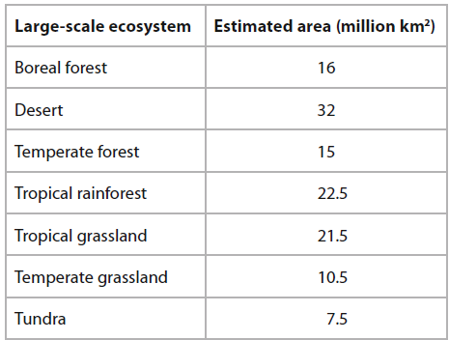
Exam Practice 1
Explain one way climate can influence the distribution of large-scale ecosystems. (3)
1 | 2
3 | 4
 | Feedback
Define the term biosphere.
________________________________________________________________________________________________________________________________________________________________________
________________________________________________________________________________________________________________________________________________________________________
Calculate the percentage (%) of the total land area shown in the table which is covered by temperate forest.
You must show your working in the space below. (2)
State two characteristics of a tundra ecosystem.
_____________________________________________
_____________________________________________
Identify two countries where a tundra ecosystem is located.
Australia
Canada
Libya
Spain
Norway
______%

Slide 6
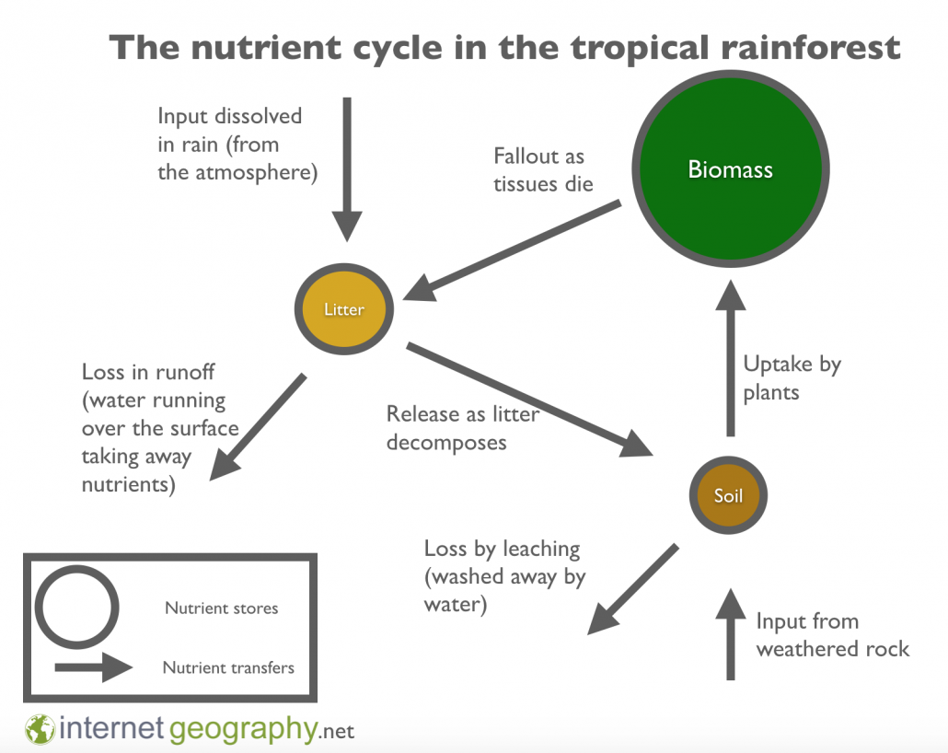



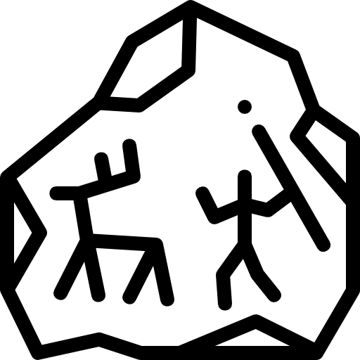



GCSE Ecosystems, Biodiversity and Management
knowledge checkers
Nutrient Cycle
Core knowledge
Key words
The nutrient cycle is a system where energy and matter are transferred between living organisms and non-living parts of the environment. This occurs as animals and plants consume nutrients found in the soil, and these nutrients are then released back into the environment via death and decomposition.
Nutrient - A nutrient is a substance used by an organism to survive, grow and reproduce.
Biomass – living parts e.g. plants and animals.
Leaching– When nutrients are washed out of the soil by heavy rainfall.
Weathered rock – small pieces of rock broken down by weathering, e.g. mechanical or biological weathering.
Knowledge Organiser
Misconceptions
Take it further...
Not all biomes will have the same nutrient cycle. The stores and transfers are proportional – they will change size to represent the amount stored or transferred.
Cool Geography
Video

Slide 7



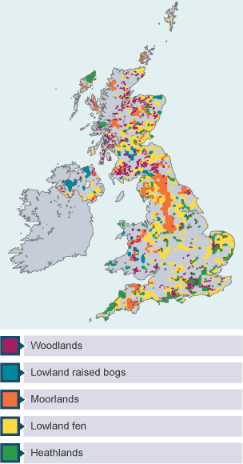





GCSE Ecosystems, Biodiversity and Management
knowledge checkers
UK Ecosystems
Core knowledge
Key words
The UK can be divided into seven main terrestrial habitats. Farmland makes up 52% of UK land cover and urban areas cover just 7%. Of the more ‘natural’ ecosystems, mountain, moorland and heath cover 11% of UK land and freshwater, wetlands and floodplains just 5%. The remainder of the UK consists of woods, grasslands and coastline.
Terrestrial - belonging to the land
Fragmented – split up and spread out
Hectare - unit of area in the metric system equal to 10,000 square metres
Moorland - upland landscapes dominated by heather
Heathland – wild, open landscape that's made up of low-growing plants, such as heather, gorse, broom, and grasses
Lowland raised bogs - peatland ecosystems, which develop primarily in lowland areas below 150m. They are a particular feature of cool, humid regions.
Moorlands are found in upland areas, mainly in Scotland, where estimates suggest they make up between 38% and 50% of the total land area. The Cairngorms and the Southern Uplands are an example of this kind of area.
Heathlands have been highly fragmented and only small, isolated areas exist in Breckland, Surrey, Hampshire and Dorset and the Lizard Peninsula in Cornwall.
Woodland Only 13% of the land area of the UK is made up of woodland. A large proportion of these are less than 100 years old and very few could be considered ‘ancient’ woodlands. The largest forests are Galloway Forest Park in Scotland, Kielder Forest Park in north-east England and the New Forest in southern England.
Lowland raised bogs There are thought to be around 53,000 hectares of lowland raised bogs in the UK. They therefore account for a very small area but have a very high biodiversity and so are very important. Key areas include the Flow Country in Scotland, Wicken Fen in East Anglia and the Inter-drumlin Fens of County Down and Armagh in Northern Ireland.
Knowledge Organiser
Take it further...
Internet Geography
Save my exams

Slide 8



GCSE Ecosystems, Biodiversity and Management
knowledge checkers
UK Marine Ecosystems
Core knowledge
Key words
Marine ecosystems around the UK are 3.5 times larger than the UK’s terrestrial ecosystems. They are separated into:​
Inshore habitats - Close to the shore and are important for recreation and tourism. ​
Offshore ecosystems - Away from the shoreline and are important for commercial fishing and energy production.
Marine - relating to the sea
Foraging – searching for food
Eutrophication - a type of water pollution caused by the addition of sewage or fertiliser. Reducing oxygen in the water.
Resource | Importance
Energy | North Sea oil and gas reserves lie beneath the sea floor. Offshore wind energy reduces the reliance on fossil fuels. The London Array is one of the largest offshore wind farms, with 175 wind turbines.
Food | Sea fishing contributes over £1.5 billion a year to the UK economy. Wild foraging of shoreline plants such as samphire are used in high end restaurants. UK fisheries and aquaculture provide thousands of jobs.
Tourism | Around 250 million people visit the coast each year, generating income and employment for local people.
Protection | Saltmarsh and sea grass provide coastal defence against flooding and coastal erosion. Coastal waters help to regulate the climate by absorbing greenhouse gases and releasing oxygen.
Knowledge Organiser
Overfishing​ 50% of the UKs catch each year is collected by just 4% of the fleet. These are made up of very large vessels. In 2011 there was a collapse in cod stocks. ​ | Eutrophication​ Is caused by fertilisers used on farmland being washed into the sea. It may also be caused when the sea is used to break down and detoxify sewage. ​ | Navigation​ The construction of deep-water ports and navigation channels, essential for global trade. ​
Windfarms​ The construction of large scale windfarms interferes with bird migration routes and the noise they make may disturb animals that rely on sound for example dolphins. ​ | Economic Development ​ Economic development of the coastline can often lead to costal ecosystems being removed. An example would be the removal of salt marsh.​ | Climate Change​ Climate change will cause lots of changes in the oceans, including:​: more storms​, sea level rise​ and loss of biodiversity​
Litter​ Ruin our beaches and affect the money made from leisure and tourism​ Kill fish and other marine life who swallow or get caught up in rubbish​ Dissolve into the water and enter the food chain, including ours​ | Oil Spills ​ UK’s biggest ever oil spill in 1967​ Spilling more than 100,000 tonnes of crude oil into the English Channel​ Beaches were left knee-deep in sludge​ More than 15,000 sea birds were killed.​ It took 13-15 years for the area to recover​ | Trawling​ Trawling is the use of very large nets to fish which scrape along the bottom of the sea bed picking up almost everything as they go. ​ This can destroy the plant life e.g. coral reef and seaweeds as well as killing marine life that is not being fished. ​

Slide 9
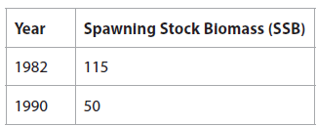
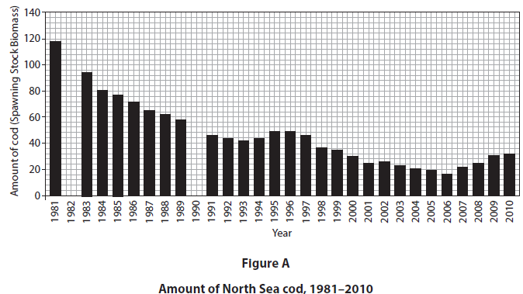
Exam Practice 2
Explain one reason why UK marine ecosystems are an important resource. (2)
1 | 2
3
State one terrestrial ecosystem in the UK. (1)
________________________________________
________________________________________________________________________________________________________________________________________________________________________
Complete the bar chart in Figure A using data from the table below. (2)
With reference to the bar chart in Figure A, explain why human activities can affect the amount of North Sea cod. (4)
___________________________________________________________________________________________________________________________________________________________________________________________________________________________________________________________________________________________________________________________________________________________________________________________________________________________________________________

Slide 10

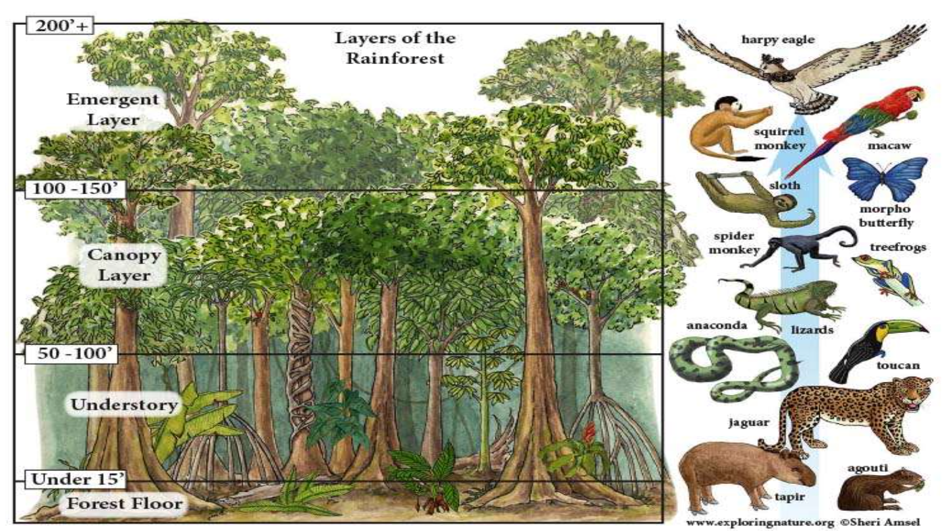



GCSE Ecosystems, Biodiversity and Management
knowledge checkers
Tropical Rainforests
Core knowledge
Key words
The tropical rainforests consist of a number of layers. If you were to walk around the tropical rainforest it would be dark and noisy. The vegetation above you would be very dense which would not allow much sunlight through. The tallest trees are in the emergent layer. They stick out from the canopy, and they get the most sunlight. Some plants grow on other plants, these are called epiphytes, examples of these include moss, ferns and orchids.
dense - thick
epiphytes – plants that grow on top of other plants (typically trees) co-existing in a harmless way. They get their nutrients from the air, water, dust, and debris around them.
Knowledge Organiser
Biodiversity: Tropical rainforests contain the highest biodiversity of plants and animals on Earth. Estimates range from over 50% to 80% of the world's plant and animal species. One 10km2 area can contain up to 1,500 flowering plants, 750 species of trees, 400 species of birds and 150 species of butterflies.
Why? High constant temperatures of 26°C to 30°C, Around 2000mm of rainfall a year, good levels of sunlight all year, constant growing season and high levels nutrients.
Take it further...
Video
Internet Geography

Slide 11






GCSE Ecosystems, Biodiversity and Management
knowledge checkers
TRF Adaptations
Core knowledge
Key words
Plants | Animals
Waxy leaves with drip tips: these ensure that rainwater runs off, preventing rotting | Many animals have adapted to living in the canopy, where there is plenty of food.
Buttress roots: these large roots provide stability for trees that can grow up to 40m in height. | Parrots, macaws and toucans have powerful beaks to break open nuts.
Tree leaves are large to absorb as much sunlight as possible. | Monkeys have evolved with strong grips and long tails for balancing to collect fruit and nuts from the tall main canopy.
Straight, smooth trunks: to allow water to reach its roots. | Sloths: algae grow in the fur to help it camouflage.
Evergreen appearance because of constant growing season, even though many trees are deciduous and lose their leaves. | Animals learn to swim or have webbed feet because there are many rivers in TRF
Tree roots are shallow and spread horizontally to gain nutrients from the top layer of soil. | Some animals have a good sense of smell or hearing because of low light levels on the forest floor.
Buttress roots - large roots, often above the ground.
Absorb – take in
Horizontally – side ways
Camouflage – blending into the background
Knowledge Organiser
Misconceptions
Take it further...
Although many of the adaptations are to deal with the climate, they also help them to survive due to the high levels of competition in the tropical rainforest.
Video
Bitesize

Slide 12


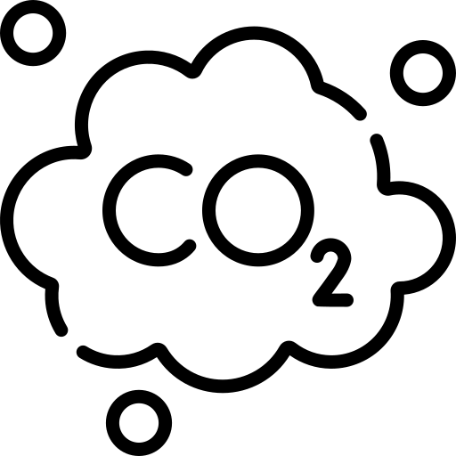


GCSE Ecosystems, Biodiversity and Management
knowledge checkers
Goods and Service
Core knowledge
Key words
The tropical rainforest provides a range of goods and service to support life.
Goods - the physical products and items that can be used by people
Services – benefits that the rainforest provides for people and the environment
Carbon sinks - areas that hold a lot of CO₂
Purification – cleaning something
Revenue – money, income
Goods | Services
Foods such as fruits, nuts, and spices Animal products such as meat and fur | Climate control and carbon sinks. Trees are important natural stores of carbon, and tropical rainforests are huge carbon sinks
Products such as rubber and resins for chewing gum, perfume and soaps Palm oil is used in cosmetics, confectionary, detergents and other products | Air and water purification. Rainforests absorb carbon dioxide and produce oxygen, which is vital in the fight against climate change. Trees act as a water store by intercepting rainfall
Water for domestic, industrial, and agricultural purposes and generate electricity | Habitats for plants, animals, and humans. Rainforests have spiritual and cultural benefits
Medicines to treat and cure diseases and pain relief The Madagascan rosy periwinkle, which can be poisonous, can help treat childhood leukaemia | TRFs provide a source of revenue from employment, recreation and tourism
Timber for construction, garden furniture, and fuel for heat and cooking | Protection against soil erosion. Tree roots bind the soil together, which not only supports the tree but also prevents soil being washed away
Knowledge Organiser
Threats from Climate Change
Structure
Biomass store will be reduced as longer periods of dry conditions slow down decomposition.
The soil structure will change as it is no longer able to support plant life because it is not fertile. The roots of plants and trees no longer hold the soil together so it is easily eroded.
Function
Cloud functioning will be disturbed, reducing the amount of water available for ecosystem function.
Less rainfall increases risk of drought and a greater chance of wild fires.
The nutrient cycling function will stop or slow down.
Biodiversity
A drier climate threatens plant and animal adaptations, leading to migration, extinction or invasion of new species as biodiversity cannot adapt to the changing climate fast enough.
Fewer trees would change biodiversity and habitats.

Slide 13
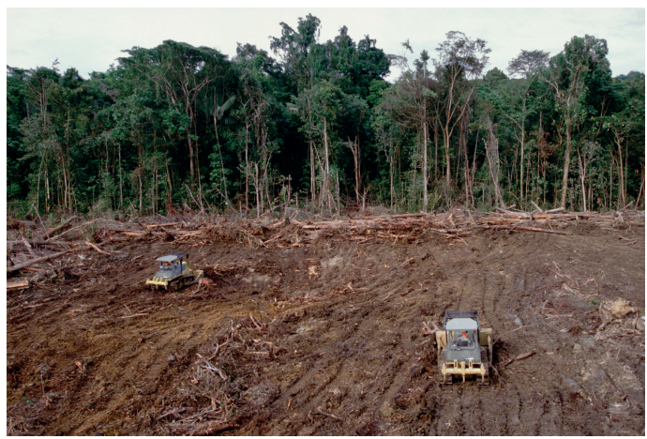
Exam Practice 3
Explain one cause of deforestation in tropical rainforests (2)
1 | 2
3 | 4
Feedback
Explain one reason why the tropical rainforest nutrient cycle is so rapid (3)
________________________________________________________________________________________________________________________________________________________________________
________________________________________________________________________________________________________________________________________________________________________
Explain two ways in which plants have adapted to living in deciduous woodlands. (4)
Suggest one economic cause for the changes to the tropical rainforest shown in the image. (3)
____________________________________________________________________________________________________________________________________________________________________________________________________________________________________________________________
________________________________________________________________________________________________________________
______________________________________________________________________________________________________________________________________________________________________________________________________________________________________________________________________________________________________

Slide 14

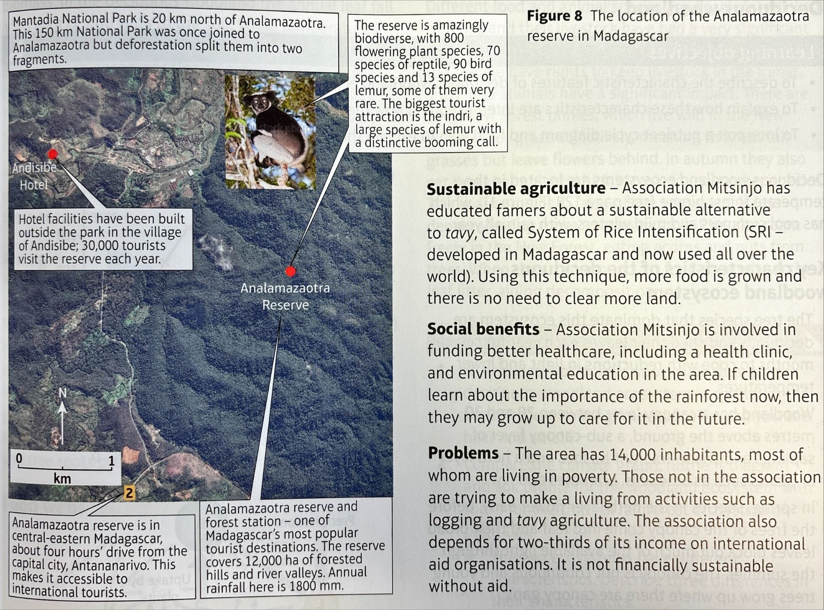
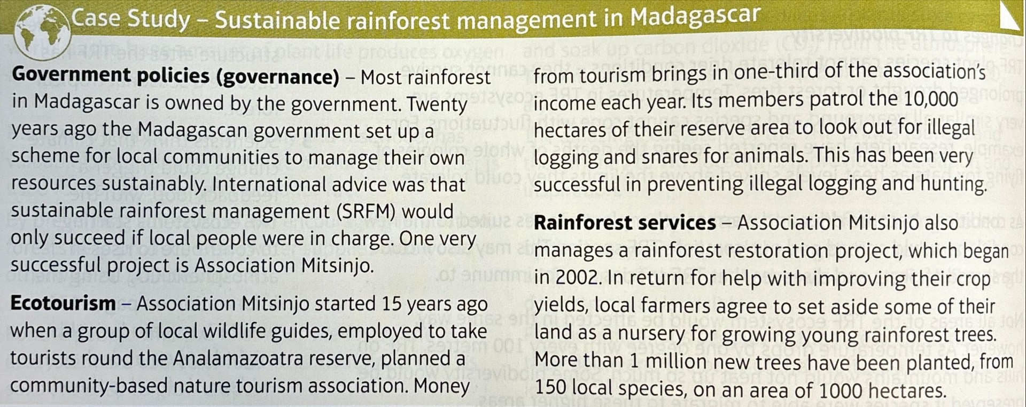
GCSE Ecosystems, Biodiversity and Management
knowledge checkers
Deforestation and Madagascar
Core knowledge
Key words
Social and economic causes of deforestation
Social | Economic
Population pressure: as populations grow, more space for housing is needed. | Logging and timber export
The opportunity for landless people to own a plot of land to grow food and use the wood for fuel | Palm oil plantations: large areas are cleared for palm oil as the demand for foods and cosmetics grows due to an increasing population
Improve infrastructure and provide energy for workers | Mining: valuable minerals are found in TRF such as iron ore
The expansion of urbanisation and agriculture means that land is cleared | Large areas of land are needed for cattle ranching or tavy – slash and burn
 | Tourism: camps and lodges are being built to satisfy the demands or increased 'eco-tourism' visitors.
Economic cause - related to the country using its natural resource to generate income
Social cause – relates to pressure from the growing population and has resulted in pressure for timber for heating and cooking and building space for new homes and roads
Knowledge Organiser

Slide 15
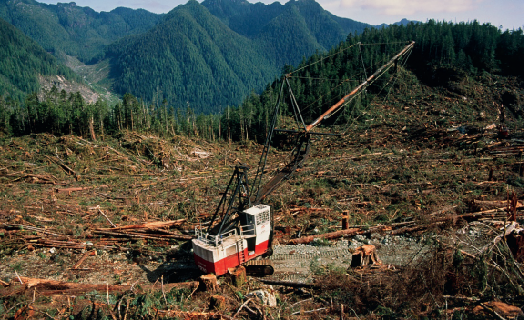
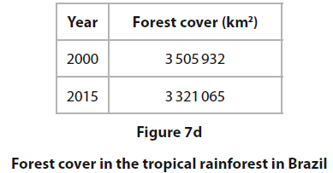
Exam Practice 4
1 | 2
 | 3
Feedback
Suggest one reason why this area of tropical rainforest is under threat. Use evidence from the image in your answer. (3)
Calculate the percentage (%) decrease in forest cover in the tropical rainforest in Brazil between 2000 and 2015.
Answer to one decimal place.
You must show your working in the space below. (2)
______%
____________________________________________________________________________________________________________________________________________________________________________________________________________________________________________________________
Suggest two ways that ecotourism may help the sustainable management of this area of tropical rainforest. (4)
__________________________________________________________________________________________________________________________________________________________________________________________________________________________________________________________________________________________________________________________________________________________________________________________
Notes:
3 505 932 – 3 321 065 = 184 867
184 867 / 3 505 932 * 100
5.3%

Slide 16
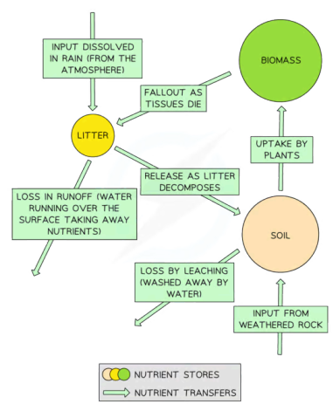
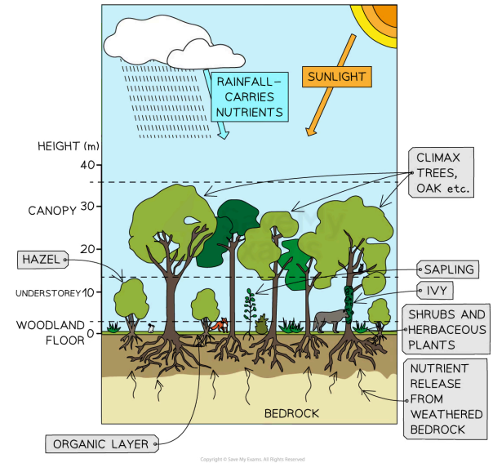



GCSE Ecosystems, Biodiversity and Management
knowledge checkers
Temperate deciduous woodland
Core knowledge
Key words
Deciduous woodlands are found in the temperate climates of the northern and southern hemispheres. Deciduous trees shed their leaves in the cooler winters
temperate - mild
biodiversity – amount and type of plants and animals in an area
latitude – how far north and south you are from the Equator
Knowledge Organiser
Deciduous woodlands have lower biodiversity because:
Summer has good levels of sunlight, but shorter days in the winter reduce nutrient cycling
The ecosystem is smaller than the tropical rainforest
Lower temperatures and fewer sunlight hours in higher latitudes mean less photosynthesis
Growing season for 7 months of the year
Good nutrient levels in the autumn when leaves fall to supply the soil
No extreme temperatures (range: 4°C–17°C)
Rainfall is around 1000mm per year
Take it further...
Video
Internet Geography

Slide 17
GCSE Ecosystems, Biodiversity and Management
knowledge checkers
Adaptations, good and services, threats and impacts of climate change
Core knowledge
Impacts of climate change
Animal adaptations | Plant adaptations
Some animals hibernate in the winter, such as hedgehogs | Trees such as oak have large, deep roots which reach nutrients and groundwater
Some birds migrate in the winter to warmer climates | Bluebells will flow early before trees block their sunlight
Squirrels store food by burying it in the summer to use in winter | Trees have broad, thin leaves, which absorb maximum sunlight and intercept rainfall
Some animals adapt to the changing seasons, such as growing thicker fur in winter | Trees shed their leaves in winter due to lower light and heat levels
Structure | Rising temperatures and drier conditions increase the risk of forest fires destroying wildlife habitats Trees may be destroyed by increased extreme weather events (storms)
Function | Periods of drought could threaten the survival of deciduous trees and make them vulnerable to disease Milder winters could cause fruiting and flowering to happen earlier in the season
Biodiversity | Pests and diseases may not be killed off during milder winter periods, threatening species An increase in temperature could lead to invasive species entering the deciduous woodland ecosystem Breeding, migrating and hibernating patterns for animals and birds may also alter with a changing climate
Knowledge Organiser
Deciduous woodland goods include:
Wood used for fires and stoves in the winter
Wood pellets used in power stations (biofuel)
Timber used in the construction industry (roofing)
Wood to make charcoal
Deciduous woodland services include:
Carbon storage: trees remove CO2 from the atmosphere
Protection of plants and animal species
Leisure and tourism, such as cycling, walking, and picnics
Threat of Climate Change to Deciduous Woodland:
Being located in a temperate climate, deciduous woodlands are less vulnerable to climate change
Any changes in climate will be less extreme
Species that live in deciduous forests are generalists, and are able to adapt to change
Deciduous trees can be used to monitor changes in climate through dendrochronology as they usually live a long time
Recent climate change has not had any major impacts on the structure or functioning of deciduous woodlands

Slide 18
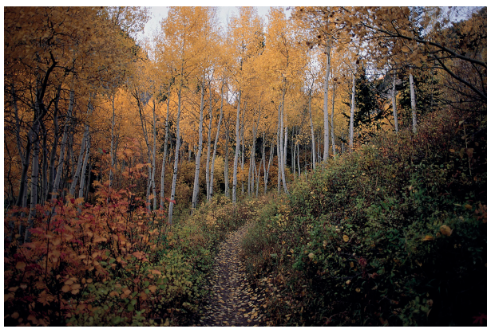
Exam Practice 5
Explain one reason why deciduous woodlands have a lower biodiversity than tropical rainforests. (3)
1 | 2
3 | 4
 | Feedback
Explain one way in which animals adapt to the environment in deciduous woodlands. (2)
________________________________________________________________________________________________________________________________________________________________________
________________________________________________________________________________________________________________________________________________________________________
Suggest two ways in which this deciduous woodland has adapted to the environment. Use evidence from the image.(4)
Explain one way in which climate change may be a threat to deciduous woodlands ecosystems. (3)
____________________________________________________________________________________________________________________________________________________________________________________________________________________________________________________________
____________________________________________________________________________________________________________________________________________________________________________________________________________________________________________________________

Slide 19






GCSE Ecosystems, Biodiversity and Management
knowledge checkers
Causes of deforestation
Core knowledge
Key words
Social and economic causes of deforestation
Social | Economic
Population growth and urbanisation place pressure on the countryside | Timber extraction: trees are slow-growing and are often felled faster than can be replaced
The UK’s population has grown significantly over the last 60 years. Deciduous woodland is cleared for housing | Slow-growing trees are felled and replaced by faster-growing and more profitable trees, reducing biodiversity
The number of vehicles on the UK’s roads has increased significantly as the population has grown - More roads are required, so woodland is cleared | Agricultural change: increased demand puts pressure on ancient woodlands
Wood is used in construction | Most of the land in the UK that is suitable for farming was cleared of deciduous woodland centuries ago
 | Deciduous woodland can be affected by pesticides and herbicides that are sprayed onto crops
urbanisation - growth of towns and cities, more urban areas
cleared – all trees removed
construction- building
extraction - removing
felled – cut down
pesticides – chemicals used to kill insects that may eat crops
Knowledge Organiser
Misconceptions
Take it further...
We often think about deforestation only being a problem in tropical rainforest but they can cause many issues in the UK as well.
Revision Video

Slide 20

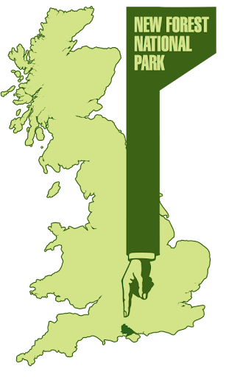



GCSE Ecosystems, Biodiversity and Management
knowledge checkers
New Forest
Core knowledge
Key words
New Forest National Park
New Forest is located on the south coast of England
Covers 480km2
Approximately 175,000 people live in the area
Popular with tourists (brings £500 million)
Annually, there are 15 million visitors
Visitors trample on plants, cause erosion by walking, drop litter, and start fires with BBQs
Animals are sometimes hit by cars
Commercial logging occurs so access is restricted
Approximately 40% of woodland is privately owned and not managed
National Park - a large area of land that is protected by law and designated for conservation purposes because of its national significance
grant – given money that does not need to be paid back
Management in the New Forest
New trees are planted to replace those cut down
Pesticide use is limited to prevent damage to the ecosystem
Work is restricted between April and August, which minimises the disturbance to nesting birds
Sustainable transport schemes for tourists (bike and electric car hire)
This helps to reduce congestion and air pollution
Landowners funded to plant native tree species by NPA (National Park Authority) Awareness-raising by NPA on the importance of sustainability in New Forest
Green Leaf Tourism Scheme: businesses use local products where possible, encourage walking and cycling, and set aside 10% of land for local wildlife
Local landowners get grants from the NPA to help improve biodiversity in their woodlands
Knowledge Organiser
Take it further...
New Forest Tourism
Mind map

Slide 21
Exam Practice 6
1
2
First let's plan this answer.
Evaluate the different approaches used to manage the threats facing deciduous woodlands in a named region (8)
What are the threats facing deciduous woodlands?
What can be done about these threats?
Rank these three solutions, which is the most/least effective. Why?
Now try to answer it
______________________________________________________________________________________________________________________________________________________________________________________________________________________________________________________________________________________________________________________________________________________________________________________________________________________________________________________________________________________________________________________________________________________________________________________________________________________________________________________________________________________________________________________________________________________________________________________________________________________________________________________________________________________________________

