Slide 1
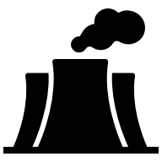

GCSE Resource Management
It is your responsibility to make sure that you are able to answer each of the questions set in the tasks below. This will be based on what you are taught in lessons and the information included the knowledge organisers.
Task 1 What is a biotic resource? What is an abiotic resource? What do we use resources for? Name the three environmentally damaging impacts of processes humans use to get resources. Extension: Can you name examples of bbwhere each of the processes occur? | Task 2 What is resource management? What does distribution mean? Briefly describe the global distribution of resources. Briefly describe the UK's distribution of resources. | Task 3 What does resource consumption mean? What does resource security mean? (e.g. water security) What does resource deficit mean? (e.g. energy deficit) How does a countries level of development impact their resource consumption?
Task 4 What is non-renewable energy? Name 1 example. What is renewable energy? Name 1 example. What is renewable sustainable energy? Name 1 example. Name 1 advantage and 1 disadvantage of renewable energy. Name 1 advantage and 1 disadvantage of non-renewable energy. | Task 5 What is the energy mix? Has global energy consumption increased or decreased? How does a countries level of development impact their energy mix? Can you describe an example of a developed countries energy mix? Can you describe an example of a developing countries energy mix? | Task 6 How and why has demand for and supply of energy changed? Give 3 answers. What is Wind energy? Name 1 advantage and 1 disadvantage. What is Solar energy? Name 1 advantage and 1 disadvantage. What is Hydroelectric Power (HEP)? Name 1 advantage and 1 disadvantage.
Knowledge Expert

Slide 2
GCSE Resource Management
It is your responsibility to make sure that you are able to answer each of the questions set in the tasks below. This will be based on what you are taught in lessons and the information included the knowledge organisers.
Task 7 Why is the use of non- renewable energy declining? Name 3 reasons. What is oil extraction? Name 1 advantage and 1 disadvantage. What is nuclear power? Name 1 advantage and 1 disadvantage. | Task 8 What is fracking? Can you describe the process of fracking? (Try and break it down into 5 steps) Name 3 advantages of fracking. Name 3 disadvantages of fracking. | Task 9 What is a carbon footprint? What is an ecological footprint? Who are stakeholders and why dop they matter? What is the UK government doing to try and increase sustainability in the UK? What can individuals do to save energy?
Task 10 What is a dam and how can it provide us with resources? Name an example of a dam in a developing country. What are some advantages of this dam? What are some disadvantages of this dam? What are the different opinions amongst stakeholders? Who has positive views and who has negative views? | Task 11 Which developing country is increasing investment and use of solar and wind energy? Name some facts about solar energy in this country. Name some facts about wind energy in this country. How many nuclear plants have been closed in this country?
Knowledge Expert

Slide 3


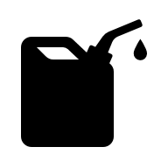
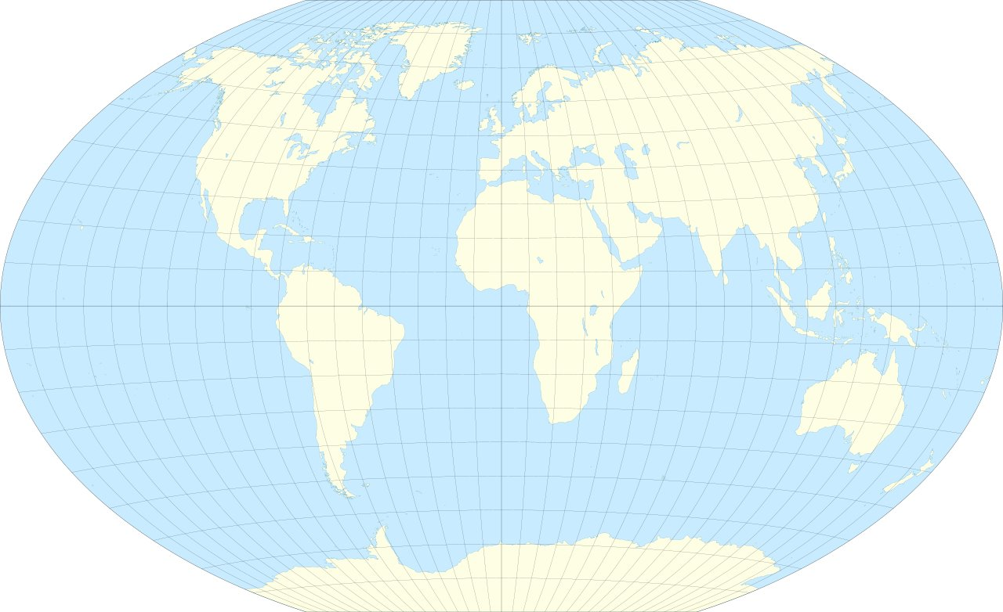
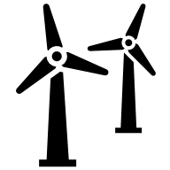




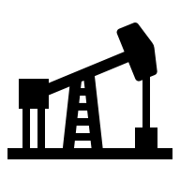
GCSE Resource Management
knowledge checkers
Lesson 1
How do we classify and use resources?
Core knowledge
Key words
 | Abiotic | Biotic
Renewable | Solar, Wind, HEP, Wave | Dung, Biogas
Non-renewable | Uranium | Coal, Oil, Natural gas (all come from decay of organic materials over millions of years)
Abiotic Resources- obtained from the lithosphere, atmosphere and hydrosphere, E.g., minerals, soil, sunlight, precipitation and fresh water.
Biotic Resources- obtained from the biosphere. These are living things that can reproduce: plants, animals, fungi, etc.
What do we use natural resources for?
Fuel for transportation, Energy/power, Water for agriculture, Materials for production and technology
Non-renewable Resources- those that cannot be ‘remade’, because it takes millions of years for them to form. They are finite and will run out, e.g. coal, oil, natural gas.
Overfishing- Millions of people rely on fish for a source of food or form of employment, but in the last 50 years unsustainable fishing practices have resulted in critical fish population levels. Decades of overfishing in the North Sea have led to a severe decline in cod numbers. Catches of 300,000 tonnes in the 1970s fell to 20,000 tonnes in 2006, recovering to 70,000 tonnes in 2015.
Deforestation (Cameroon)- Palm oil, a versatile vegetable oil, is a key ingredient in many foods and non-food products. Cameroon's rainforests, a biodiversity hotspot, are being rapidly deforested for palm oil plantations, threatening thousands of species. Deforestation causes soil erosion, which costs developing countries billions a year in damages.
Oil Extraction (Ecuador)- Indigenous people and wildlife depend on the Amazon rainforest in Ecuador. However, oil extraction in the region threatens both the environment and the communities that rely on it for survival. Oil spills and pollution, that happen as a result of oil extraction, can contaminate water sources and harm wildlife, endangering the delicate balance of this vital ecosystem.
The North Sea
Knowledge Organiser
Renewable Resources- those that are infinite and will not run out, e.g. renewable energy sources such as wind, solar and hydro-electric power (HEP).
Overfishing- Overfishing is the removal of fish from a body of water at a rate greater than the species can replenish its population naturally. It results in the species becoming increasingly underpopulated in that area.
Ecuador
Cameroon
Take it further...
Deforestation- Deforestation, clearing or thinning of forests by humans to make the land available for other uses.
Oil Extraction- Refers to the process of removing crude oil from the Earth.
Deforestation (Cameroon)
Oil extraction
(Ecuador)

Slide 4
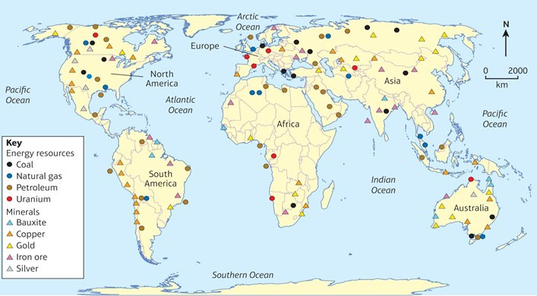


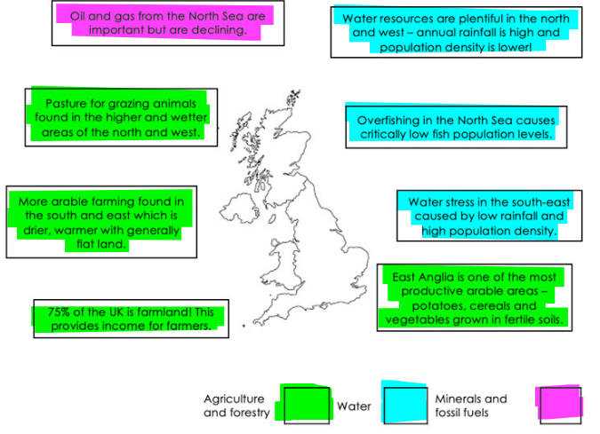


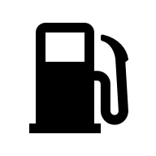



GCSE Resource Management
knowledge checkers
Lesson 2
Resource Management
Core knowledge
Global Distribution:
Highs- North America has a very large and wide range of resources.
Lows- Central and Eastern Africa have low resource distribution.
Trends- Majority of resources are in the Northern hemisphere.
Anomalies-West coast of South America and Australian coasts have a lot of resources, both in the southern hemisphere.
Key words
Agriculture- The practice of farming, including growing crops, and raising livestock, which will produce food and other products using plants and animals.
Water Resources- Water resources are essential for human life and are used for a variety of purposes, including drinking water, irrigation, industry, hydropower and recreation.
Minerals Resources- Mineral resources are naturally occurring substances found in the Earth's crust that can be extracted and used for various purposes, e.g. used to produce a wide range of products, from building materials and electronics to jewellery and medicine.
Knowledge Organiser
UK Distribution:
The North of the UK has water surplus (supply is higher than their demand).
South of the Uk has water deficit (demand higher than their supply).
Oil and gas supply from the North Sea is decreasing.
Global Distribution- Global distribution is how spread out something is across the world. It can refer to the spread of people, ideas, goods, or services.
Take it further...
Fossil Fuels- Fossil fuels are non-renewable energy sources formed from the remains of prehistoric plants and animals.
This video shows:
Distribution of Natural Resources
This video shows:
Resource Distribution/ Management (energy)
Resource Management- Resource management is the process of planning, scheduling, and allocating resources to reach demands.

Slide 5
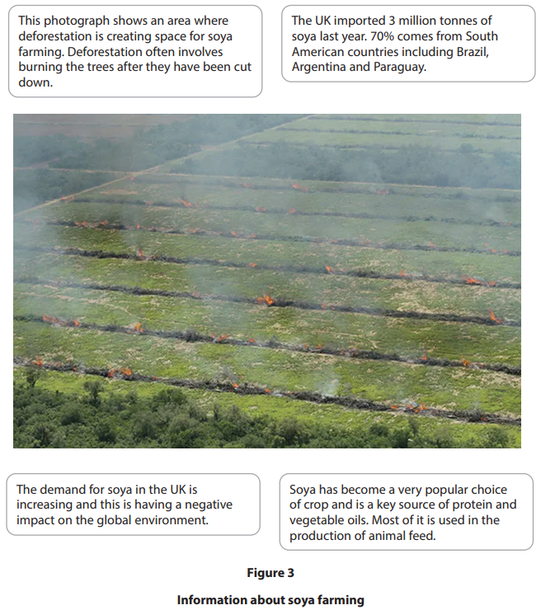
Exam Practice 1
1 | 3
2
Feedback | 4
Define the term abiotic. (1)
Calculate the number of tonnes of soya imported by the UK from South America last year, using the data in Figure 3.
You must show your working in the space below. (2)
__________________________________________________________________________________________
Identify one abiotic resource. (1)
Animals
Birds
Plants
Oxygen
Explain one reason why fossil fuels are non-renewable.(2)
______________________________________________________________________________________________________________________________________________________________________________
______ tonnes
Identify the two correct statements about soya farming. (2)
The UK imports soya from Argentina
Soya is low in protein and vegetable oils
The demand for soya in the UK is falling
Soya is only used in the production of food for people
Large areas of flat land are needed for soya farming

Slide 6








GCSE Resource Management
knowledge checkers
Lesson 3
Consumption of Resources
Core knowledge
Key words
People in developed countries use more natural resources than people in developing countries. This is due to a combination of factors, including economic development and population growth. As countries like China, India, and Brazil become more developed, their resource consumption is increasing. This is putting a strain on the planet's resources and causing problems for everyone.
Distribution- The location of a resource.
Consumption- The use of a resource.
Energy Security- Energy security refers to the ability of a country to ensure an adequate, affordable, and consistent supply of energy.
Water Security- Water security refers to the ability of a country to ensure an adequate, affordable, and consistent supply of water.
Water Surplus- Water supply is higher than the demand. (have too much)
Water Deficit- Water demand is higher than the supply. (don’t have enough)
Food Security- Food security refers to the ability of a country to ensure an adequate, affordable, and consistent supply of food.
Energy Consumption
The global distribution of energy is influenced by the location of fossil fuel reserves and the ability to harness renewable energy resources. Coal and oil reserves are located in places like the Middle East, where government instability can affect supply. Renewable energy availability depends on sunlight and wind patterns. Global energy consumption is expected to increase by 35% in the next 35 years, driven by economic development in Asia, particularly China and India.
Water Consumption
3% of Earth's water is freshwater, and it is unevenly distributed due to differences in meteorological processes and hydrological stores. This can cause different locations to experience either water surplus or water deficit. For example, North America and a large portion of South America have water surplus, and these areas have a lot of mountains and rainforests, which are areas with high levels of precipitation. Whereas a lot of countries in Africa, such as Ethiopia, are facing water deficit, largely due to the desert environments.
Food Consumption
The world has enough food to feed all its inhabitants, however food is unevenly distributed across the globe. Average food consumption is less than 2000 calories per day, and some countries have access to over double this, such as North America, which can be linked to higher obesity levels in westernised countries. Obesity is when calories are stored in the body as fat in excessive amounts, causing a person to become overweight. Whereas countries in Africa, such as Ethiopia, have less than half the needed calories (or less!!), leading to people becoming malnourished, where the bodies don’t have the nutrients they need.
Knowledge Organiser
These videos show:
How we consume resources.
The connection between energy, water and food.
Energy supply and demand.
Take it further...

Slide 7

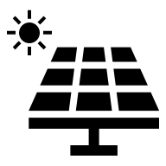


GCSE Resource Management
knowledge checkers
Lesson 4
Classifying Energy
Core knowledge
Key words
Energy can be classified in a few different ways, depending on whether it can be remade, used multiple times/ continually, how long it can last and whether it needs managing. Based on these factors we can categorise energy as renewable, non-renewable, or renewable sustainable energy sources. There are both advantages and disadvantages of each of these types of energy, with 2 examples given below.
Non-Renewable energy- Can’t be remade, being used up, once gone they are gone, e.g. diamonds.
Renewable sustainable energy- Can be renewed by humans and therefore might last, e.g. wood.
Renewable energy- These will renew themselves and don’t need managing, e.g. solar energy.
 | Advantages | Disadvantages
Burning Coal (Non- Renewable) | Still large quantities of coal available in 70 countries worldwide. Global coal supplies should last for another 200+ years. Coal is used in power stations. It's an efficient resource for generating large amounts of electricity. Mining coal is technically relatively easy and cheap. | Mining of coal is dangerous and can cause death. Open-cast mining of coal significantly impact the environment and habitats. Burning coal releases harmful greenhouse gases into the atmosphere, causing air pollution.
Wind Energy (Renewable) | Wind farms can be built on agricultural land, providing a source of income for the people who own the land. It's a clean fuel and doesn't pollute or emit greenhouse gases. It's one of the lowest priced renewable energy sources for the consumer. New technology means turbines are more efficient and make less noise. | Power can't be stored for calmer days Visual Pollution. Offshore wind farms are far from where the resource is needed, requiring expensive transmission lines. Energy is only produced when it's sufficiently windy.
Knowledge Organiser
Take it further...
These videos show:
How we classify renewable and non-renewable resources and shows the pros/cons of non-renewable energy. (Lesson 6 has a video for pros/cons of renewable energy).

Slide 8
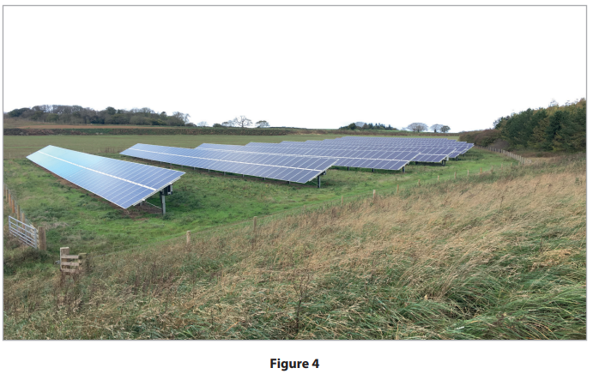
Exam Practice 2
Explain one advantage of the development of a named non-renewable energy resource (3)
Named non-renewable energy resource
1 State one reason why the global demand for energy is increasing. (1) ______________________________________________________________________________________ | 2
3
 | Feedback
____________________________________________________________________________________________________________________________________________________________________________________________________________________________________________________________________________________________________________________________________________________________________________________________________________________________________________________________
The photograph in Figure 4 provides some information about a renewable energy site. State two additional pieces of information that would help to investigate if this is a good location for the development of renewable energy (2)
________________________________________________________________________________________________________________________________________________________________________________________________________________________________________________________________________________________________________________________________________________________________________

Slide 9
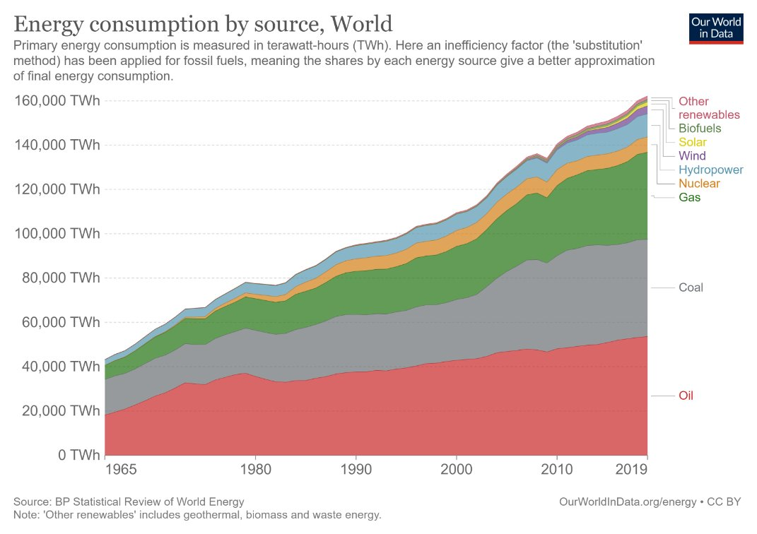



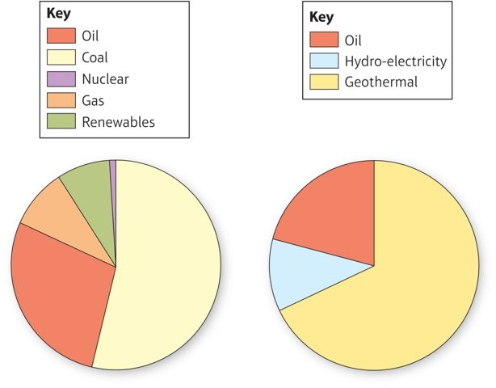
GCSE Resource Management
knowledge checkers
Lesson 5
The Energy Mix
The global energy mix is the mix of different energy sources that are used around the world. It is constantly changing as new technologies are developed and as countries work to reduce their reliance on fossil fuels. Whilst the global energy mix continues to be dominated by non-renewable sources (80%), it is expected to change in the coming years. As renewable energy technologies become more efficient and affordable, they are expected to play an increasingly important role. It is predicted that the use of non-renewable resources could drop to approximately 62% by 2025. The current reliance on fossil fuels is a global concern for the future of our planet and human life.
Core knowledge
Key words
The global energy mix- This is the mix of different energy sources that are used around the world/ how much of each energy type is used.
Take it further...
Knowledge Organiser
Energy in India
Energy in Iceland
The energy mix of a country is influenced by its level of development. Developed countries with strong economies and incomes, like Iceland, can invest in renewable energy sources. Developing countries, like India, prioritize economic growth and may rely more on traditional energy sources. India also has a much larger population than Iceland, so it needs to produce more energy. India also has lower average incomes, so it needs to use cheaper energy sources. Iceland, on the other hand, has a smaller population and higher average incomes, so it can afford to use more expensive renewable energy sources. It may also depend on what is accessible in the location: India has large reserves of coal and oil, which are relatively cheap to extract. Iceland has no fossil fuels, so it relies on renewable energy sources like geothermal and hydroelectric power.
India (Developing)
Iceland (Developed)

Slide 10






GCSE Resource Management
knowledge checkers
Lesson 6
Increased Energy Demand
Population
growth
Core knowledge
Key words
Economic growth
Wind Energy- Wind energy is a form of renewable energy that uses the power of the wind to generate electricity. Wind turbines convert the kinetic energy of the wind into electrical energy.
Solar Energy- Solar energy is a form of renewable energy that uses the sun's energy to generate electricity or heat. Solar energy can be used to power homes, businesses, and even entire communities.
Hydroelectric Power (HEP)- Hydroelectric power is a type of renewable energy that uses the power of falling water to generate electricity. HEP is generated by dams, which store water in reservoirs. When the water is released, it flows through turbines, which turn generators to produce electricity.
How and why has demand for and supply of energy changed?
Technological development
Population growth and rising incomes have led to increased energy demand. By 2035, the world's population is expected to reach 8.7 billion, meaning an additional 1.6 billion people will need energy. Developed countries consume much more energy per person than developing or emerging countries. Technological advances have both increased energy demand and created new opportunities for energy supply, including fossil fuel extraction and renewable energy (which is on the rise).
Knowledge Organiser
The amount of renewable energy is increasing as it becomes more accessible and affordable, having greater benefits for both people and the environment, even though it still has its drawbacks.
 | Impacts on people | Impacts on the environment
Wind Energy- Positive | Generate a vast amount of energy. | Doesn't produce CO2 or greenhouse gases.
Wind Energy- Negative | Visual and Noise pollution | Constructing them uses CO2
Solar Energy- Positive | This industry is creating thousands of jobs globally. | Does not produce CO2 or greenhouse gases.
Solar Energy- Negative | Solar sites could be taking up valuable farming land. | The panels are made of silicon and other toxic metals.
Hydroelectric Power- Positive | Reduces dependency on non-renewable energy. | A reliable and clean source of energy, reducing CO2 emissions.
Hydroelectric Power- Negative | People forced to relocate to make room for dams. | Destroys large areas of land, harming wildlife and habitats.
Take it further...
Renewable energy- advantages/disadvantages

Slide 11





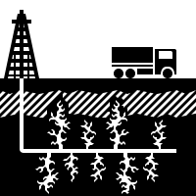



GCSE Resource Management
knowledge checkers
Lesson 7
The future of non-renewable energy
Core knowledge
Key words
Economic Factors
Oil Extraction- Oil extraction is the process of removing oil from the ground. It involves drilling a well into the ground to reach an underground reservoir of oil. The oil is then pumped to the surface and processed to remove impurities.
Fracking- Fracking, or hydraulic fracturing, is a method of extracting oil and gas from deep underground. It involves injecting water, sand, and chemicals at high pressure into rock formations to create cracks, allowing oil and gas to flow out.
Nuclear Power- Nuclear power is a type of energy that comes from splitting atoms, a process called nuclear fission. This process releases a lot of heat, which is used to boil water and create steam. The steam turns a turbine, which generates electricity.
Why is the use of non- renewable energy declining?
Environmental Concerns
Depleting Resources
Nonrenewable energy sources are those that take millions of years to form and cannot be replaced quickly enough to keep up with our current rate of use. The most common nonrenewable energy sources are fossil fuels, such as coal, oil, and natural gas. The use of nonrenewable energy sources is decreasing for a number of reasons, including environmental concerns, depleting resources, economic factors, and government policies. As a result, the use of nonrenewable energy sources is expected to continue to decline in the years to come
Knowledge Organiser
The amount of non-renewable energy is decreasing as it becomes more accessible and affordable, having greater benefits for both people and the environment, even though it still has its drawbacks.
 | Impacts on people | Impacts on the environment
Oil Extraction- Positive | Extracting oil and production processes provide employment. | None :(
Oil Extraction- Negative | Oil spills release chemicals harmful to humans. | Uses lots of water and produces lots of greenhouse gases.
Fracking- Positive | Fracking has made fuel prices much cheaper in the USA. | Releases half as many (a lot less) emissions than coal.
Fracking- Negative | Can be dangerous and cause damage, e.g. gas leakage or subsidence. | Leakages may contaminate groundwater, damaging wildlife.
Nuclear Power- Positive | Once operational they produce relatively cheap, reliable and plentiful electricity. | Nuclear power produces much less CO2 than burning fossil fuels.
Nuclear Power- Negative | Nuclear power plants are very dangerous and can cause disasters. | Waste products of nuclear energy are highly radioactive.
Take it further...
Future of Energy
Increased Energy Demand

Slide 12
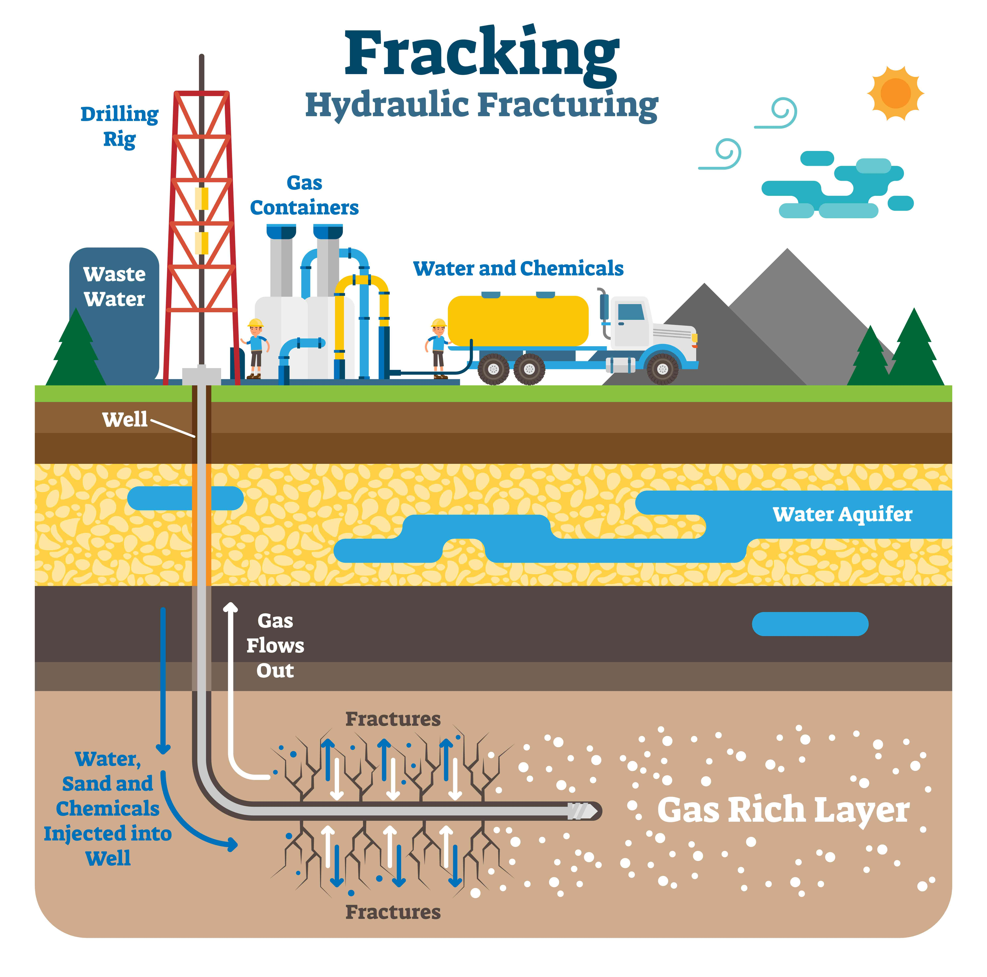


GCSE Resource Management
knowledge checkers
Lesson 8
Fracking
Core knowledge
Key words
Fracking is a complex process, which has been broken down into 5 steps below:
Fracking: a process that involves drilling down into the Earth and using a high pressure water mixture to release gas trapped inside rock.
Hydraulic fracturing, or fracking, is the method used to obtain shale gas.
2. Boreholes are drilled down to the shale deep underground.
3. When the shale is reached, horizontal shafts are drilled and pipes inserted.
4. High pressure water, sand and chemicals are blasted into the rock to break it apart.
5. The gas is then sucked out of the rock, together with the wastewater.
Knowledge Organiser
Advantages​
Increased energy supply: Fracking can access previously unreachable oil and gas reserves, potentially reducing reliance on foreign energy sources.​
Economic benefits: Fracking can create jobs in the energy sector and stimulate local economies.​
Lower energy costs: Increased domestic energy production could lead to lower energy prices for consumers.
Disadvantages
Environmental impact: Fracking can cause water contamination, air pollution, and damage to local ecosystems.
Earthquakes: The process of fracking can trigger small earthquakes.
Water usage: Fracking requires large amounts of water, which can deplete local water supplies.
Health risks: Some studies suggest potential health risks associated with fracking, such as respiratory problems and cancer
These videos show:
What fracking is and how it is done, why it is being used and the advantages and disadvantages of it.
Take it further...

Slide 13
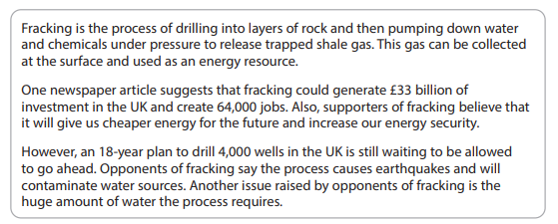
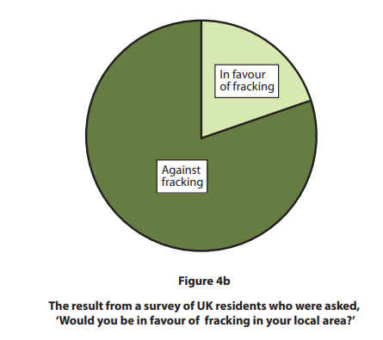
Exam Practice 3
 | Study figure 4a and Figure 4b. (I) State one advantage of fracking Only use evidence from Figure 4a in your answer _________________________________________________________________________________________________________________________________________________________________________________ (ii) Identify the percentage (%) of UK residents in Figure 4b who are in favour of fracking in their local area. 20% 40% 60% 80%
 | Feedback

Slide 14








GCSE Resource Management
knowledge checkers
Lesson 9
Sustainable Energy Management
Core knowledge
Key words
The global demand for energy is expected to increase by 37% between 2013 and 2035, mainly due to population growth in emerging and developing economies. While there are technological solutions to increase fossil fuel supply, continued reliance on fossil fuels could lead to catastrophic climate change. To avoid this, we need to develop more sustainable energy use, including increased renewable energy use and reduced energy waste.
Carbon footprint- Measurement of all the​ greenhouse gases an individual produces expressed as tonnes (or kg) of carbon dioxide equivalent.
Ecological footprint- Measure of the impact of human activities, expressed as the area​ of productive land and water required to produce the goods consumed and the wastes generated.
 | How is energy consumed? What is the latest situation? | How can energy be saved?
Individuals | Domestic heating contributes 15% to an individual carbon footprint. A lot of heat is lost through walls, windows and roofs. Powering homes is12% of a carbon footprint, and most homes use fossil fuel electricity. Private transport contributes 10% to a footprint. | Domestic energy can be reduced by installing insulation in walls/roofs and double glazing for windows. Solar panels could be installed or choosing energy suppliers who use renewable energy. This can be reduced by using public transport, walking or riding a bike instead of using a car, or by car-pooling.
Organisations | An example of an organisation is McDonald's and they consume energy by running vast amounts equipment and heating buildings, and they use a lot of transportation to deliver food and produce. | They have a range of environmental goals: McDonald's is committed to sourcing 100% of its primary guest packaging from renewable, recycled, or certified materials by 2025. They're also reusing their used cooking oil as biodiesel fuel in their vehicles.
Governments | The UK government attended UN Climate Change Summit in Paris (2015), they have pledged to not let the global temperature rise over 2°C. The UK are investing in low-carbon energy technologies and aim to have reduced carbon by 80% in 2025 compared to 1990. | The government needs to subsidize renewable energy to encourage its development and use by individuals and organisations, especially until it becomes more cost-effective than non-renewable sources, because currently majority of people can't afford to make the change.
Stakeholders- Individuals or groups (e.g., communities, organisations, governments) who have an interest in a matter, this could be a project or business.
Knowledge Organiser
Take it further...
Carbon footprint
How individuals can save energy
How organisations save energy
What can governments do?

Slide 15
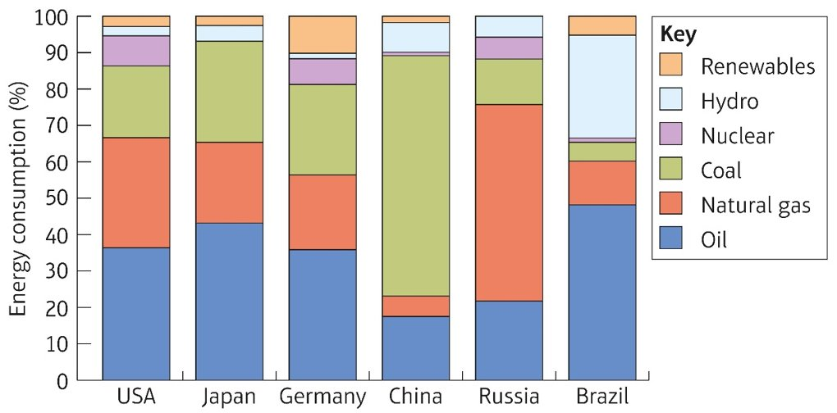


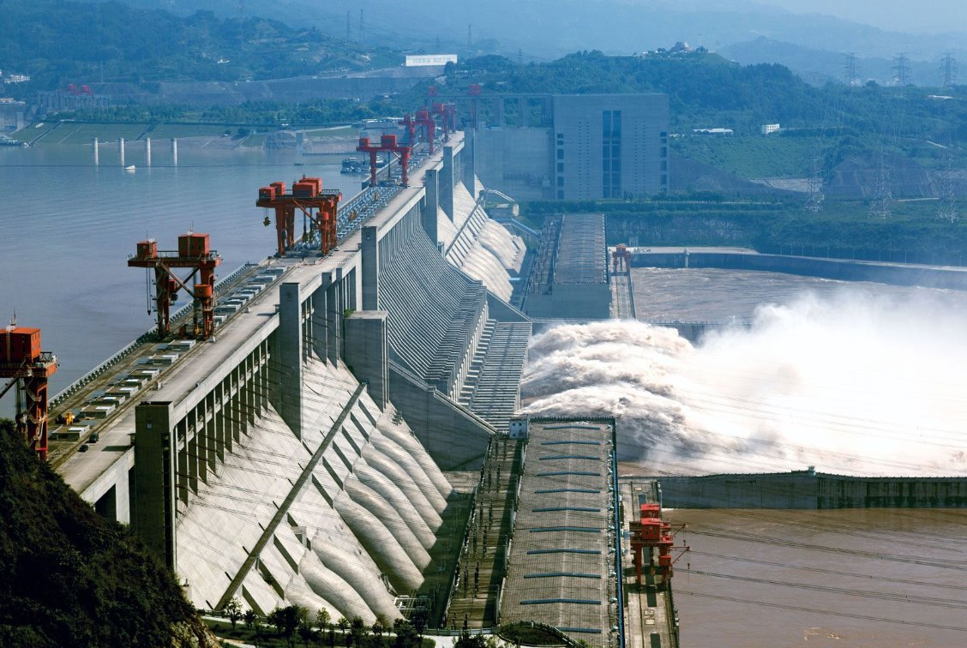
GCSE Resource Management
knowledge checkers
Lesson 10
China
Core knowledge
Key words
China's rapid industrialization has led to significant environmental challenges, including air and water pollution. The country's heavy reliance on coal for energy production contributes to high levels of greenhouse gas emissions, which contribute to climate change. While China has made efforts to address these issues, such as investing in renewable energy and stricter environmental regulations, the scale of the problem remains significant.
Dam- they're massive barriers built across rivers and streams to confine and utilise the flow of water for human purposes such as irrigation, water supply and generation of hydroelectricity. This confinement of water creates lakes or reservoirs.
In comparison to other countries, China is much more dependent on fossil fuels as an energy source and uses a much smaller portion of sustainable energy, such as HEP.
Take it further...
Knowledge Organiser
China is trying to use more renewable energy sources and an example of this is the Three Gorges Dam. The Three Gorges Dam is a large dam on the Yangtze River in China. It was built to generate electricity, improve navigation, and control flooding. Construction began in 1994 and was completed in 2006. Construction of the dam caused the displacement of at least 1.3 million people and the destruction of natural features and countless rare architectural and archaeological sites. The dam’s reservoir is blamed for an increase in landslides and earthquakes in the region.
Different stakeholders have different opinions on the Three Gorges Dam depending on their own interests and investments. The Chinese government has viewed the dam as a major achievement, whereas environmentalists have raised concerns about the dam's impact on the environment. Individuals who have been relocated (some to less desirable areas), some have experienced economic hardship and social disruption. The international community has had mixed reactions to the dam. Some have praised its engineering feat and potential benefits, while others have expressed concerns about its environmental and social impacts.

Slide 16

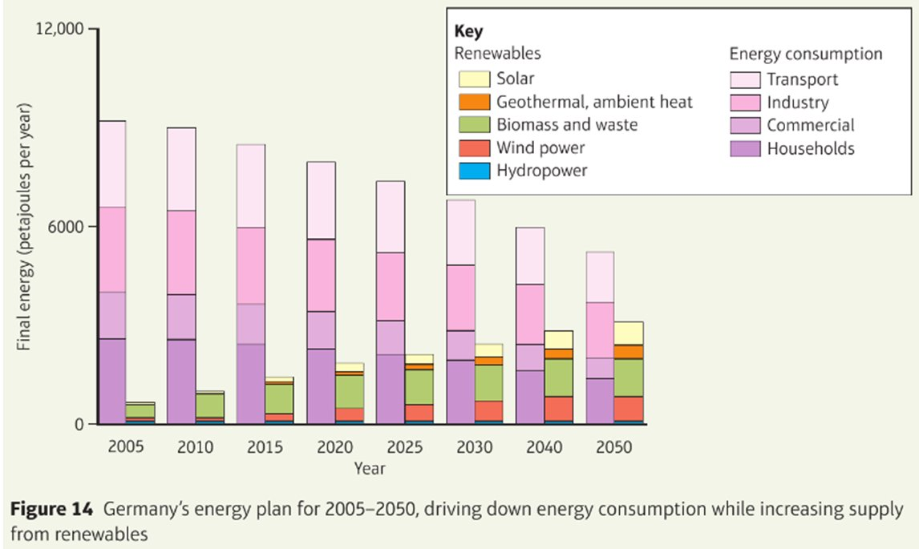
Lesson 11
How can Germany manage its energy sustainably?
GCSE Resource Management
knowledge checkers
Core knowledge
Take it further...
Germany aims to cut their total energy consumption between 2005 – 2050. They aim to cut it from approximately 10,000 petajoules per year to below 6,000 petajoules per year. They are also aiming to continually increase the portion of the energy produced by renewable sources, aiming for over half their energy to be produced sustainably by renewables by 2050.
Since 2001, the German government has been working to replace nuclear power with renewable energy and reduce greenhouse gas emissions. The Fukushima disaster in 2012 accelerated this process, leading to the closure of eight nuclear plants by 2022.
Germany aims to reduce greenhouse gas emissions by 40% by 2020 and 80% by 2050. To achieve this, the government is investing in a range of renewable energy, such as solar power, and encouraging energy efficiency.
Knowledge Organiser
Wind Turbines
Germany has plans to wind energy production of around 6500 MW by 2020. Whilst some were originally against the idea, changing attitudes and new better technology has seen planning barriers removed in Baden-Wurttemberg to allow installation of turbines on hillsides and forests. By 2014, 8% of it’s electricity came from wind power.
Solar Power
Germany's solar power comes from a combination of large solar farms and providing incentives for smaller installations on homes and businesses. The Bavaria Solarpark, in Germany, is a large solar farm that covers 26 hectares and uses nearly 60,000 photovoltaic panels. It is expected to reduce CO2 emissions by more than 100,000 tonnes over the next 30 years.

Slide 17
Exam Practice 4
First let's plan this answer.
Assess the following statement.
The aim of reducing greenhouse gas emissions is the main reason why countries are developing renewable resources
1 | 2
Now answer it.
_________________________________________________________________________________________________________________________________________________________________________________________________________________________________________________________________________________________________________________________________________________________________________________________________________________________________________________________________________________________________________________________________________________________________________________________________________________________________________________________________________________________________________________________________________________________________________________________________________________________________________________________________________________________________________________________________________________________________________________________________________________________________________________________________________________________________________________________________________________________
Reasons why
The significance
Feedback

