Slide 1


GCSE Rivers
It is your responsibility to make sure that you are able to answer each of the questions set in the tasks below. This will be based on what you are taught in lessons and the information included the knowledge organisers.
Task 1 What are the different types of erosion? How does lateral and vertical erosion differ? How is sediment moved in a river? Where does deposition occur and why? | Task 2 What is a cross profile? What is a long profile? How does a river change as it moves from source to mouth? What are interlocking spurs? How are they formed? | Task 3 How is a waterfall formed? How does this link to the formation of a gorge? What is a meander? What does the cross section of a meander look like? How is an ox bow lake formed?
Task 4 What is a flood plain and how is it formed? How is a levee formed? How can they be beneficial? | Task 5 Can you explain the natural causes of flooding? Can you explain the human causes of flooding? What is a hydrograph? How can a drainage basin affect the shape of a hydrograph? | Task 6 Explain the advantages of using hard and soft engineering methods.​ Explain the disadvantages of using hard and soft engineering methods.
Knowledge Expert

Slide 2

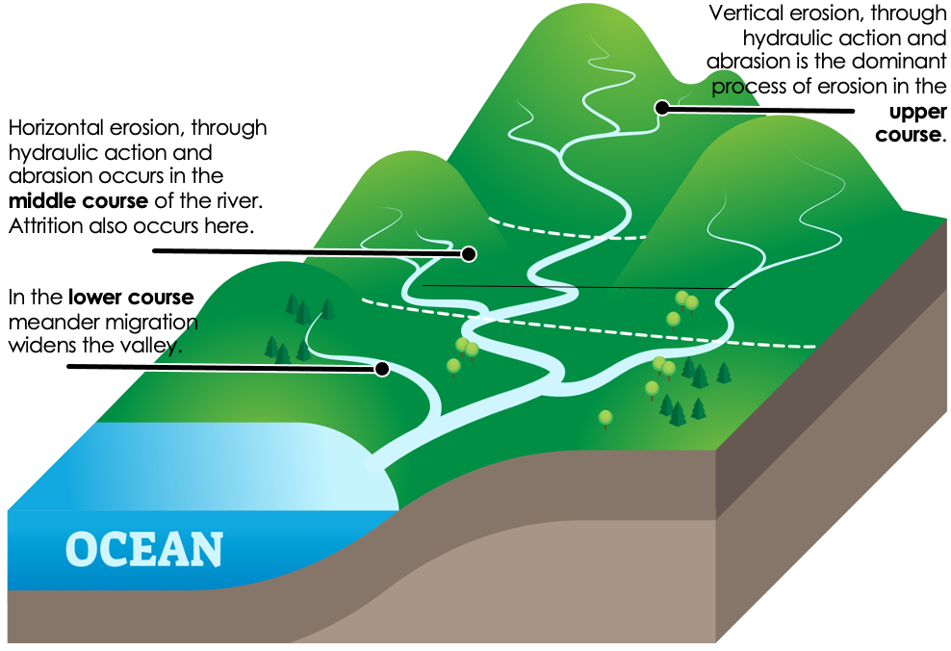





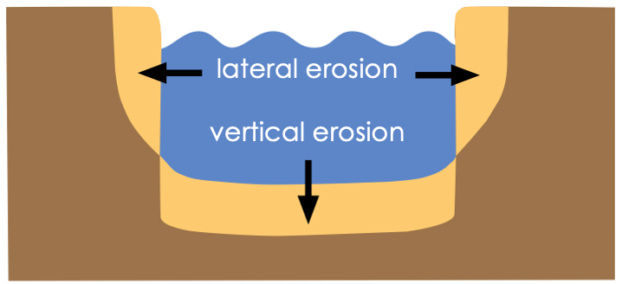
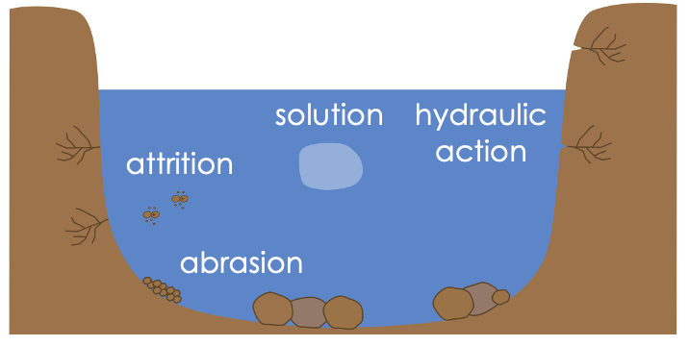


GCSE Rivers
knowledge checkers
Lesson 1
River Erosion
Core knowledge
Key words
Abrasion – Rocks carried along by the river wear down the river bed and banks.
Attrition – Rocks transported by the river collide and become smaller and rounded.
Erosion – The wearing away of rock and soil found along the river bed and banks.
Hydraulic Action – The force of water compressing air in cracks, weakening river banks.
Knowledge Organiser
Lateral erosion – Sideways erosion by a river on the outside of a meander.
Solution – Soluble particles are dissolved into the river.
Vertical erosion – Downward erosion of a river bed.
Take it further...
Time for Geography
Internet Geography

Slide 3
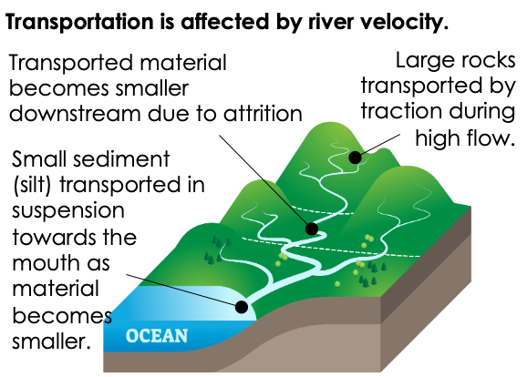
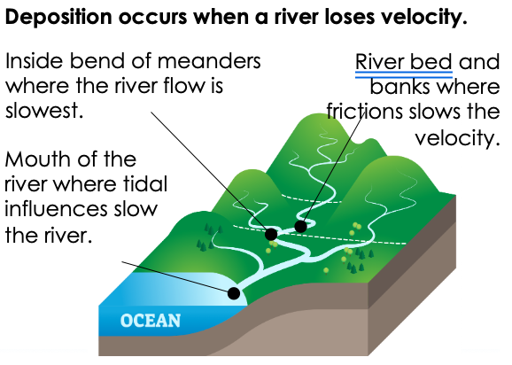




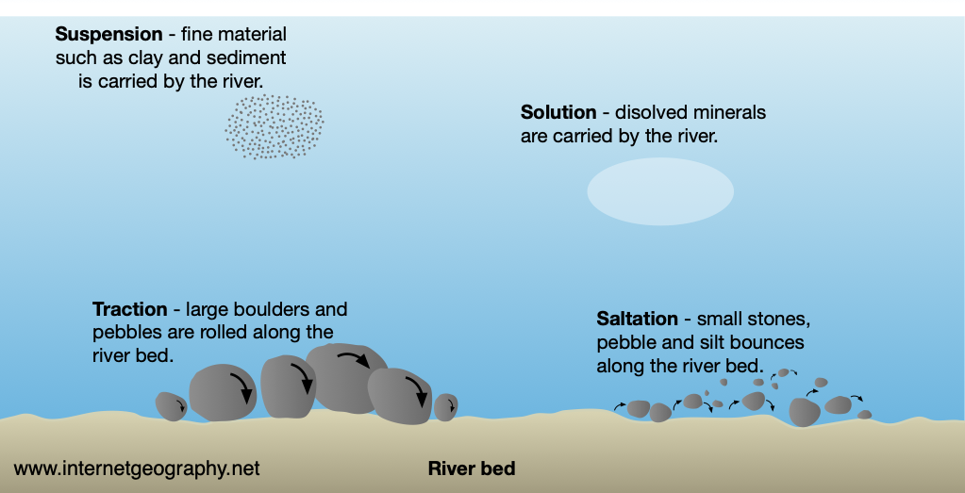



GCSE Rivers
knowledge checkers
Lesson 2
Transportation and Deposition
Core knowledge
Key words
Deposition – Material that is being transported by a river is dropped.
Transportation – The process by which a river carries its load.
Traction – The rolling of boulders and pebbles along the river bed.
Knowledge Organiser
Saltation – Particles bouncing along the river bed.
Solution– Soluble particles are dissolved into the river.
Suspension – Fine solid material held in the water while the water is moving.
Take it further...
Time for Geography
Internet Geography

Slide 4
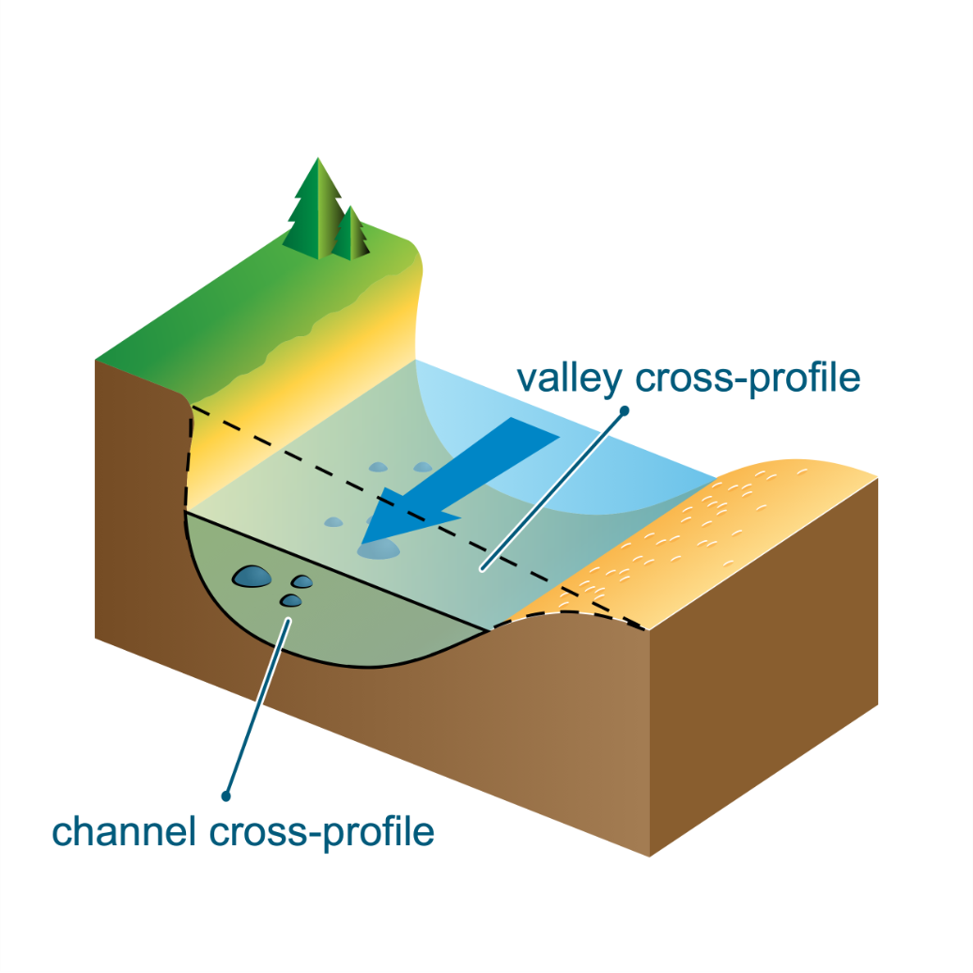
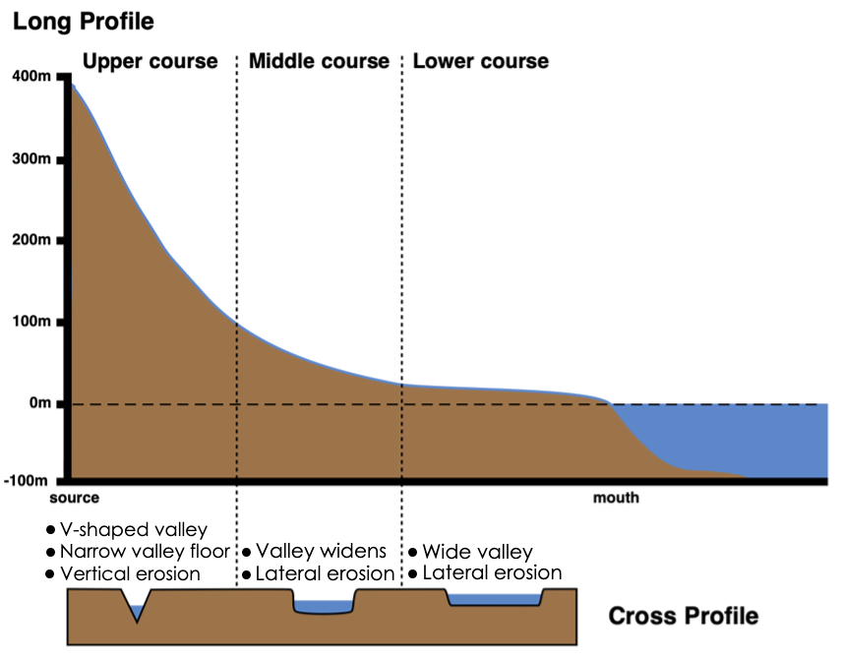



GCSE Rivers
knowledge checkers
Lesson 3
River Valleys
Core knowledge
Key words
River cross profiles are a cross-section, taken sideways, of a river’s channel and/or valley at certain points in the river’s course. A channel cross-profile only includes the river whereas a valley cross-profile includes the channel, the valley floor and the sides of the valley.
Cross profile – The side to side cross-section of a river channel and/or valley.
Long profile – The gradient of a river, from its source to its mouth.
River – A ribbon-like body of water that flows downhill from the force of gravity.
River valley – A low stretch of land between hills with a river flowing in it.
The long profile of a river is a way of displaying the channel slope (gradient) of a river along its entire length. It shows how a river loses height with increasing distance towards the sea. A river tries to achieve a smooth curve to reach its base level at sea; this is called a graded long profile. The gradient falls steeply from the source then becomes concave and then almost flat.
Knowledge Organiser
Misconceptions
Take it further...
A river can have more than one source, they often begin as surface run off in hilly areas.
River Valleys
Internet Geography

Slide 5
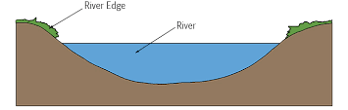
Exam Practice 1
1 | 2
 | 4
3
 | Feedback
Explain 1 erosional process (2 marks)
State the type of erosion that occurs the most in the upper course of the river. (1 mark)
______________________________________________________________________________________________________________________________________________________________________________________________________________________________________________________
___________________________
Explain how a river changes from source to mouth (4 marks)
___________________________________________________________________________________________________________________________________________________________________________________________________________________________________________________________________________________________________________________________________________________________________________________________________________________________________________________________________
Annotate this image to show where lateral and vertical erosion occurs (2 marks)

Slide 6
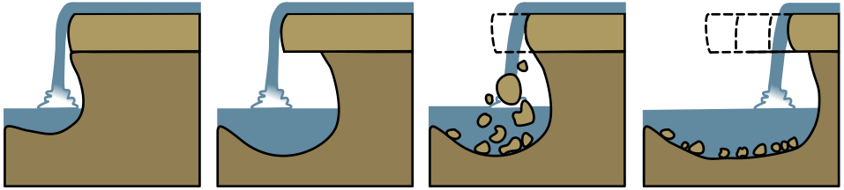



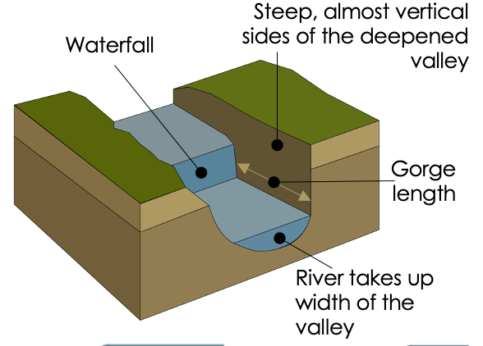
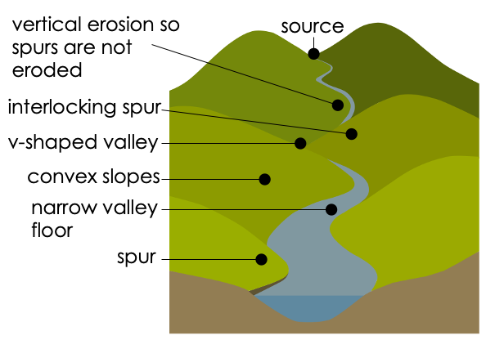



GCSE Rivers
knowledge checkers
Lesson 4
Erosional Landforms
Core knowledge
Key words
Fluvial landforms – Landforms formed by river processes.
Gorge – a narrow, steep sided valley, often formed as a waterfall retreats.
1. Waterfalls occur in the upper stage of a river where a band of hard rock overlies a softer rock. Falling water and rock particles erode the soft rock below the waterfall, creating a plunge pool.
2. The soft rock is
undercut by erosional processes e.g. hydraulic action and abrasion creating a plunge pool where water and debris swirl around eroding the rock creating an overhang.
3. The layer of hard rock overhang above the plunge pool collapses as its weight is no longer supported.
4. Erosion continues and the waterfall retreats upstream leaving behind a gorge.
Interlocking spurs – Ridges projecting out on alternate sides of a valley.
Knowledge Organiser
Plunge pool – A deep depression at the base of a waterfall.
Vertical erosion – Downward erosion of a river bed.
Waterfall – A sudden descent of a river or stream over a vertical or very steep slope in its bed.
Misconceptions
Take it further...
Not all waterfalls are created in this way. In glaciated areas they are created from hanging valleys.
Time for Geography
Internet Geography

Slide 7
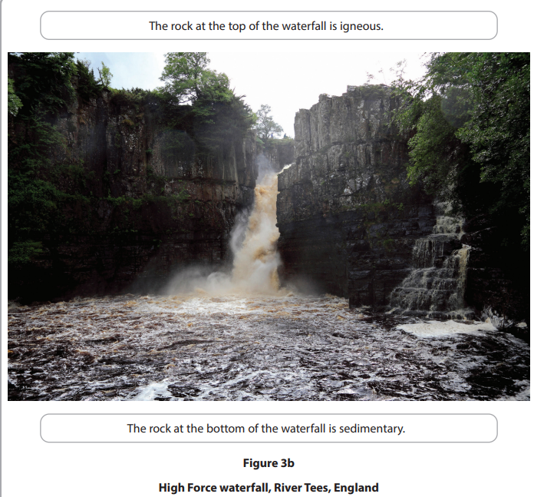
Exam Practice 2
First let's plan this answer.
Examine the role of erosion processes and geology in the formation of the waterfall (8 marks)
1 | 2
Now answer it.
_________________________________________________________________________________________________________________________________________________________________________________________________________________________________________________________________________________________________________________________________________________________________________________________________________________________________________________________________________________________________________________________________________________________________________________________________________________________________________________________________________________________________________________________________________________________________________________________________________________________________________________________________________________________________________________________________________________________________________________________________________________________________________________________________________________________________________________________________________________________
The rock at the top of the waterfall is igneous
The rock at the bottom of the waterfall is sedimentary
What key words should be included in this answer?
Feedback

Slide 8
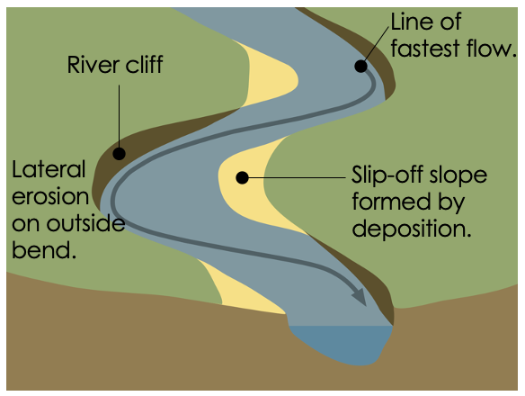

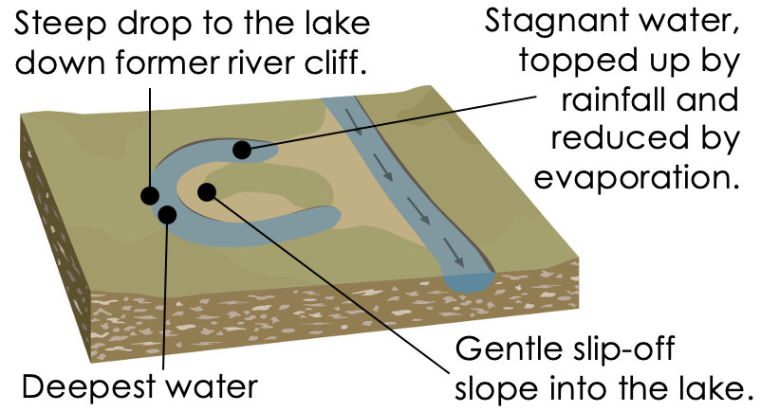

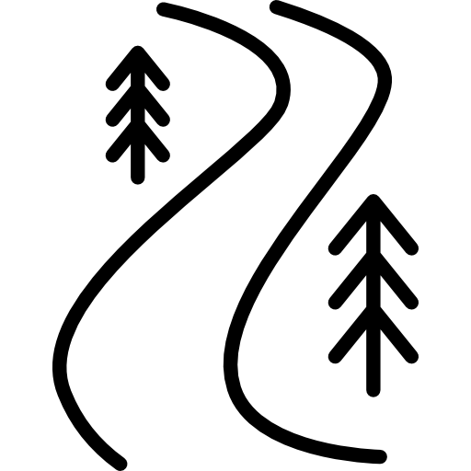


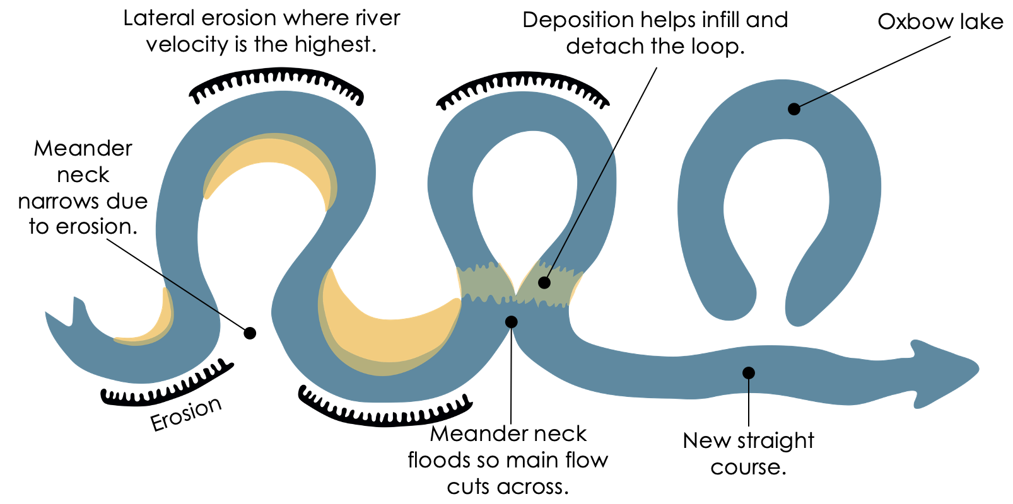



GCSE Rivers
knowledge checkers
Lesson 5
Landforms of erosion and deposition
Core knowledge
Key words
Mender characteristics
Oxbow Lake characteristics
Helicoidal flow – The cork-screw-like flow of water in a meander.
Meander – One of a series of bends in a river.
Oxbow lake – A curved lake formed when a river cuts off a meander.
Knowledge Organiser
The formation of an oxbow lake
River cliff – Cliff formed by lateral erosion on the outside bend of a meander.
Slip-off slope – A gently sloping river beach formed on the inside of a meander.
Take it further...
BBC Bitesize
Meanders and Oxbow Lake

Slide 9
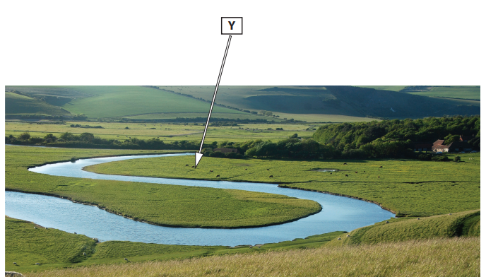
Exam Practice 3
1 | 2
 | 4
3
 | Feedback
Study figure 3a. Identify landform Y (1 mark)
  Flood plain
  Gorge
  Interlocking spurs
  Oxbow lake
Define meander (1 mark)
___________________________________________________________________________________________________________________________
Explain why there is more horizontal erosion in the lower parts of the river than the higher (4 marks)
___________________________________________________________________________________________________________________________________________________________________________________________________________________________________________________________________________________________________________________________________________________________________________________________________________________________________________________________________
Explain the formation of an oxbow lake (4 marks) You may use an image to help
___________________________________________________________________________________________________________________________________________________________________________________________________________________________________________________________________________________________________________________________________________________________________________________________________________________________________________________________________

Slide 10
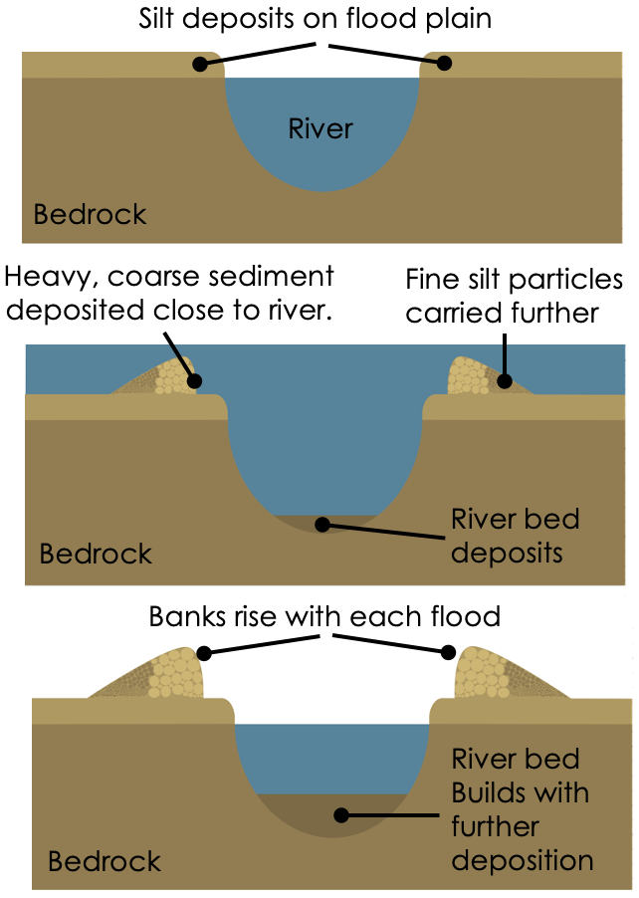
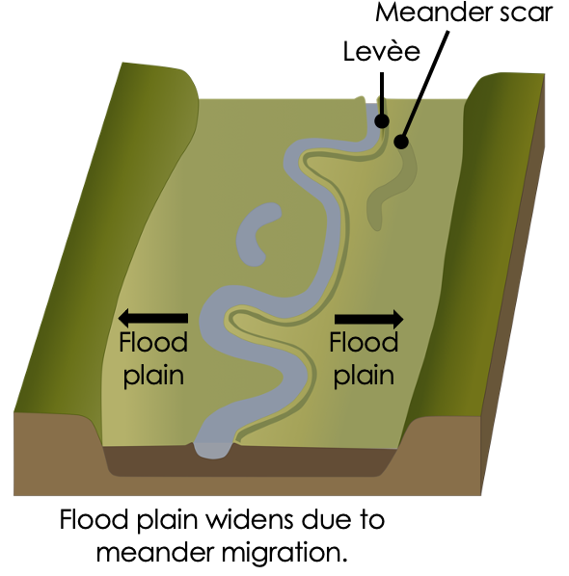





GCSE Rivers
knowledge checkers
Lesson 6
Landforms of deposition
Core knowledge
Key words
Levee formation
Flood plain characteristics
Deposition – The process of transported material being dropped.
Estuary – The tidal mouth of a river where it meets the sea.
Flood plain – The flat area forming the valley floor either side of a river.
Knowledge Organiser
Levèe – An embankment of sediment along a river caused by flooding.
Silt – fine sand and clay carried by a river and deposited as a sediment.
Misconceptions
Take it further...
Levees can also be made artificially, not all levees are natural.
Time for Geography
Internet Geography

Slide 11

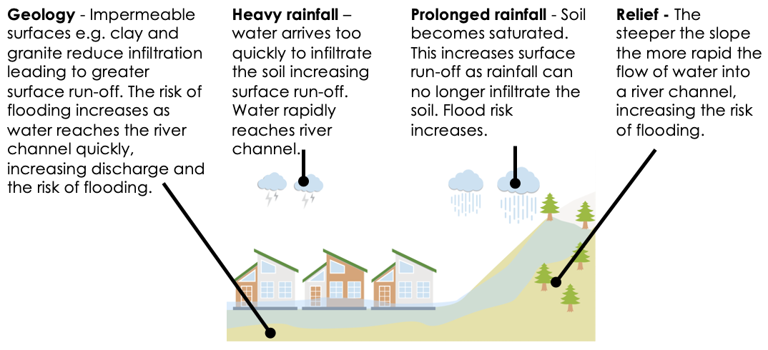



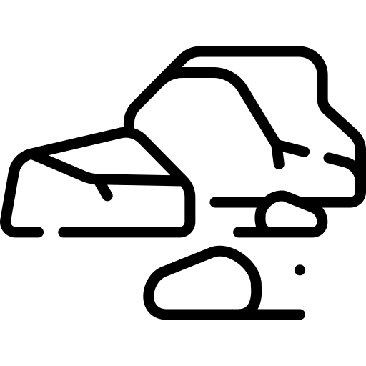

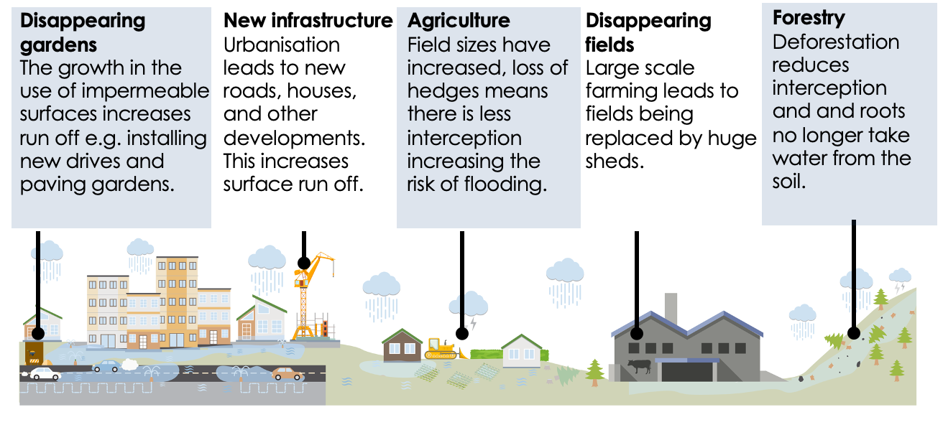




GCSE Rivers
knowledge checkers
Lesson 7
Flood Risk
Core knowledge
Key words
Physical Causes
Agriculture – Farming, including growing crops and rearing animals.
Deforestation – The action of clearing an area of trees.
Flood risk – The probability of flooding and the impact if it occurred.
Greenfield site – Land that has not been built upon previously.
Knowledge Organiser
Geology – The composition and structure of the Earth.
Infrastructure – The built environment including transport, buildings and services.
Human Causes
Relief – The shape of the land including height and steepness.
Urban sprawl – The growth of urban areas into rural surroundings.
Take it further...
The Rivers Trust
Internet Geography

Slide 12
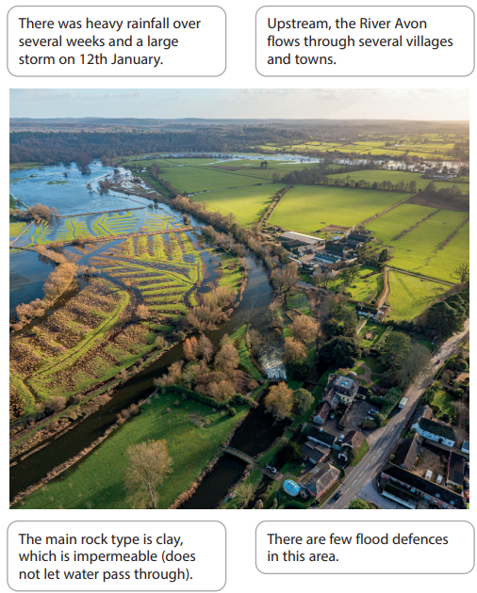
Exam Practice 4
Examine the causes of the river flooding shown in source. You must use evidence from the source in your answer.
List three natural causes of flooding (3)
1 | 3
2
4
Annotate the source to explain the causes of flooding (6)
List three human causes of flooding (3)
Write an opening paragraph for this answer that explains one cause of flooding shown in the source. (3)
_______________________________________________________________________________________________________________________________________________________________________________________________________________________________________________________________________________________
Without flood defences houses are much more vulnerable to flooding. This means that if river levels were to rise there is nothing to protect the properties. This could result in loss of life, loss of precious possessions as well as high insurance claims.

Slide 13

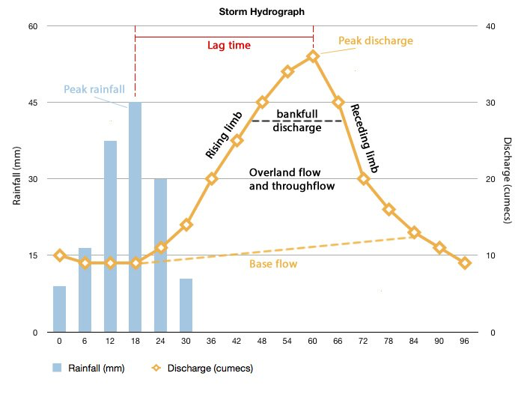






GCSE Rivers
knowledge checkers
Lesson 8
Hydrographs
Core knowledge
Baseflow – The normal flow of a river when sustained by groundwater flow.
Bankfull discharge – Level of discharge above which a flood will occur.
Falling limb – The reduced discharge following the peak discharge.
Hydrograph – A graph showing river discharge, related to rainfall, over time.
Knowledge Organiser
Lag time – The time difference between peak rainfall and peak discharge.
Peak discharge – The highest recorded discharge following a rainfall event.
Peak rainfall – The highest amount of rainfall per time unit (highest bar).
Flashy vs Flat Hydrograph
Take it further...
Flashy – rapid response hydrograph posing a high flood risk.
Steep slopes
Impermeable rock
Heavy/prolonged rainfall
Urbanisation
Deforestation
Flat – slow response hydrograph posing a low flood risk.
Gentle slopes
Permeable rocks
Drizzle
Deep, dry soils
Afforestation
BBC Bitesize
Internet Geography

Slide 14
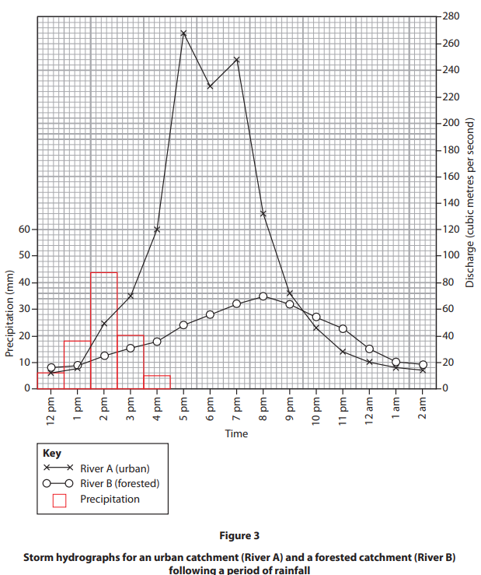
Exam Practice 5
Examine how land use affected the storm hydrographs for River A and River B
shown in the source.
What is the peak rainfall? _________________
What is the peak discharge? River A _________________ River B _________________
What is the lag time? River A _________________ River B _________________
1 | 2
 | 3
 | 4
 | 5
 | 6
Describe how River A changes between 12pm and 2am
____________________________________________________________________________________________________________________________________________________________________________________________________________________________
Why might River A change in this way?
____________________________________________________________________________________________________________________________________________________________________________________________________________________________
Describe how River B changes between 12pm and 2am
____________________________________________________________________________________________________________________________________________________________________________________________________________________________
Feedback
Why might River B change in this way?
____________________________________________________________________________________________________________________________________________________________________________________________________________________________

Slide 15


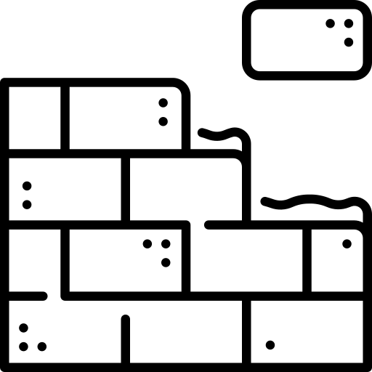





GCSE Rivers
knowledge checkers
Lesson 9
River Management​
Core knowledge
Key words
Hard engineering river management involves the construction of structures built to control the flow of water and reduce flooding. Hard engineering strategies work against nature.
Soft engineering river management involves adapting to a river and learning to live with it. The strategy involves working with nature. It is cheaper, but often less effective than hard engineering strategies.
Channel straightening – Removing meanders to straighten a river channel.
Dam – A structure across a river to control the flow of water.
 | Description | Advantages | Disadvantages
Dams and reservoirs​ | Barriers constructed to hold back water in artificial lakes.​ ​ The natural river valley is flooded.​ | Store large volumes of water until needed​ ​ Long lasting; can be used to generate hydro-electric power (HEP)​ | ​Expensive to build​ ​ Sediment can build up in reservoirs.​
Channelisation​ | ​Deepening or widening the river channel.​ ​ Replaces the natural meanders and floodplain with an artificial channel​ ​​ | Allows water to flow more quickly away from areas of flood risk.​ ​ | ​Visually unattractive​ ​ More water is taken downstream, increasing the floodrisk to other settlements.​
Floodplain zoning​ | Prevents development in areas most prone to flooding next to rivers.​ ​ Preserves the natural floodplain.​ | Reduces the number of homes at risk of flooding.​ ​ Allows infiltration so surface runoff takes place and flooding is reduced.​ | Restricts the growth of settlements.​
Washlands​ | Areass next to rivers that are deliberately flooded to avoid flooding residential or important agricultural areas.​ ​ Preserves the natural floodplain in the mid and lower river courses.​ | Creates an area for floodwater to go​ ​ Allow natural river processes such as deposition​ | Might limit the use of land​
Embankments – Building up the banks of a river creating levees or building walls.
Reservoir – An artificial lake where water
is stored.
Knowledge Organiser
Afforestation – The establishment of trees in an area with no previous cover.
Flood warnings and preparation – An alert system to the risk of flooding.
Take it further...
Hard Engineering
Soft Engineering

Slide 16
Revision Notes
___________________________________________________________________________________________________________________________________________________________________________________________________________________________________________________________________________________________________________________________________________________________________________________________________________________________________________________________________________________________________________________________________________________________________________________________________________________________________________________________________________________________________________________________________________________________________________________________________________________________________________________________________________________________________________________________________________________________________________________________________________________________________________________________________________________________________________________________________________________________________________________________________________________________________________________________________________________________________________________________________________________________________________________________________________________________________________________________________________________________________________________________________________________________________________________________________________________________________________________________________________________________________________________________

