Slide 1
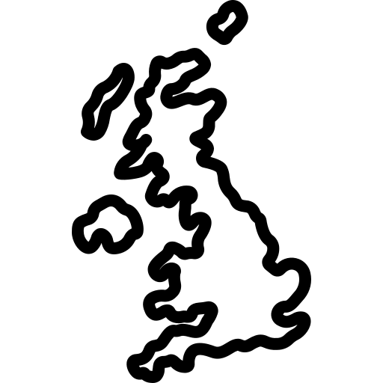

GCSE UK Landscapes
It is your responsibility to make sure that you are able to answer each of the questions set in the tasks below. This will be based on what you are taught in lessons and the information included the knowledge organisers.
Task 1 What are the three types of rock? How are sedimentary rocks formed? Two examples of sedimentary rocks Name three characteristics of sedimentary rocks Where are sedimentary rocks found in the UK? | Task 2 How are metamorphic rocks formed? Two examples of metamorphic rocks Name three characteristics of metamorphic rocks Where are metamorphic rocks found in the UK? | Task 3 How are igneous rocks formed? Two examples of igneous rocks Name three characteristics of igneous rocks Where are igneous rocks found in the UK?
Task 4 How are limestone pavements formed? How are granite tors formed? How are chalk escarpments formed? | Task 5 How did the last Ice Age affect the geology in the UK? | Task 6 How has forestry changed the UK landscape? How have settlements changed the UK landscape? How has agriculture changed the UK landscape?
Knowledge Expert

Slide 2
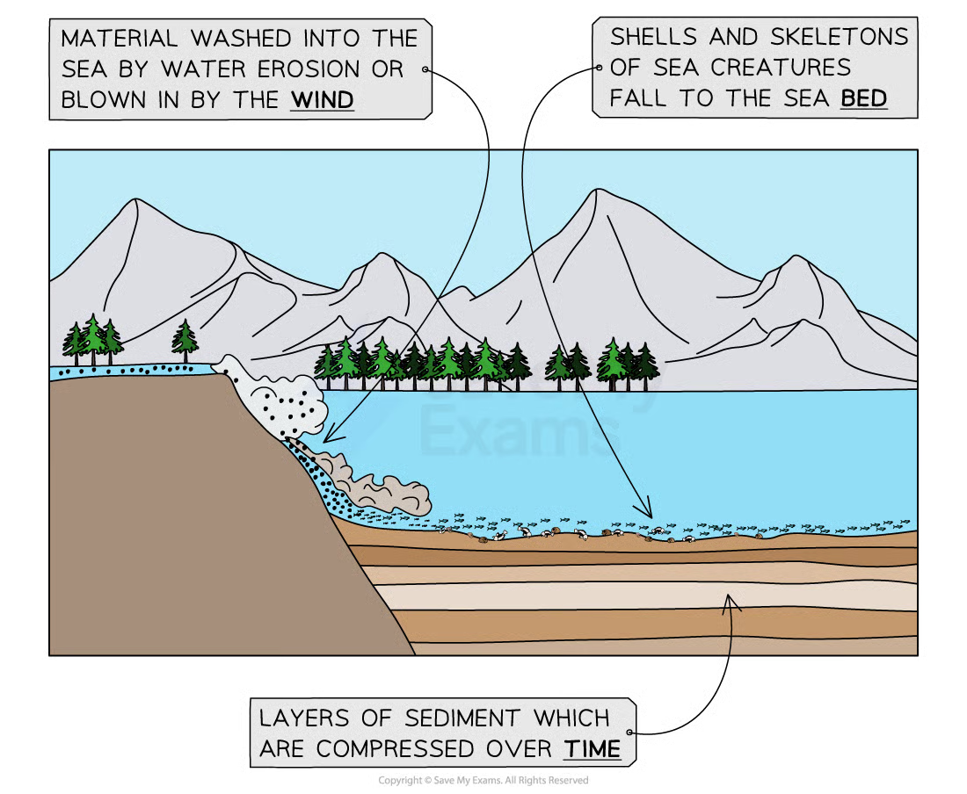
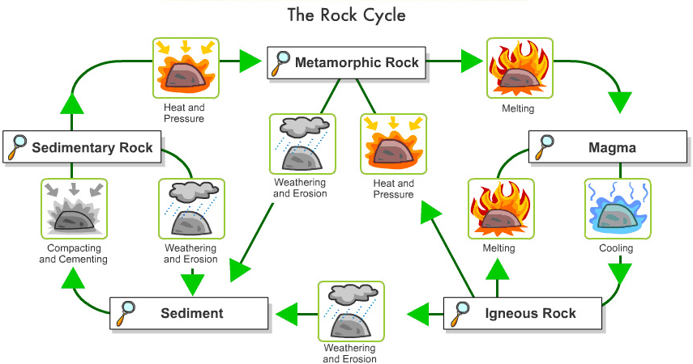
GCSE UK Landscapes
knowledge checkers
Lesson 1
Rock Types
Core knowledge
Sedimentary Rock
Formed from sediments and the remains of plants and animals which have settled at the bottom of a lake or ocean
The layers of sediment are compacted together until they become solid rock
There are two main types of sedimentary rocks in the UK:
Limestone and chalk come from the tiny shells and skeletons of dead sea creatures
Limestone is harder than chalk, but both are less resistant to erosion (softer compared to granite)
Limestone and chalk are relatively strong and permeable
Clays and shales are made from mud and clay minerals. They are:
Softer than limestone and chalk
Impermeable
Knowledge Organiser
Metamorphic rock
When rock (igneous, sedimentary or older metamorphic rock) is put under pressure and heated (but not melted)
The original rock becomes a new type of rock
This new rock becomes harder and more compact e.g. shale becomes slate and with more pressure and heat, slate becomes schist
Found within the upland areas of the UK
Very strong and resistant to erosion or weathering
Igneous rock
Igneous rock forms when magma from the mantle cools and hardens
As it cools, crystals form in the rock
Igneous rocks are hard and more resistant to erosion, e.g. granite and basalt
Mostly found in the northern upland areas of the UK

Slide 3
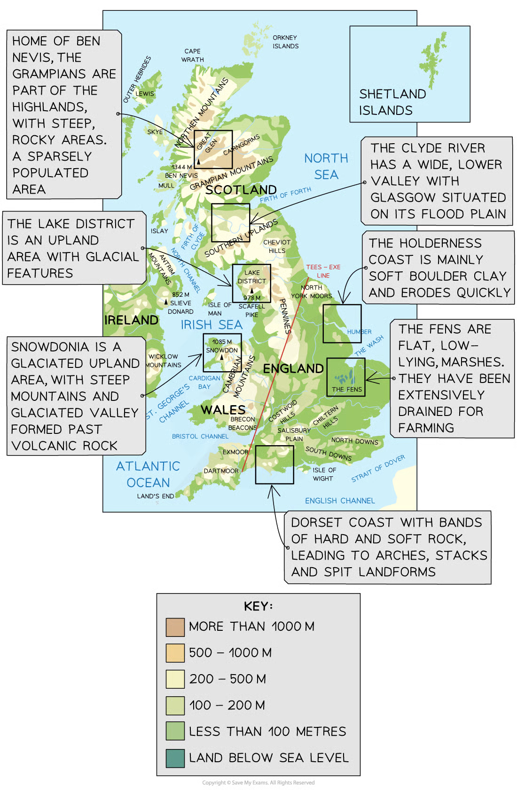
GCSE UK Landscapes
knowledge checkers
Lesson 2
Upland and Lowlands
Core knowledge
The impact of geology on landscape
Stronger, more resistant rocks tend to produce highland areas
Weaker rocks tend to form lowlands
Permeability is whether a rock allows water to pass through it
    Water will pass through permeable rocks
    But impermeable rocks won't let water through
The permeability of rocks determines how wet or dry the surface of a landscape is
    Limestone is a permeable rock that tends to form dry upland areas with few streams and thin soils
    Clay is impermeable and often produces wet lowland areas
    Granite landscapes are usually boggy and badly drained, as granite is impermeable
Knowledge Organiser
Role of tectonic processes
Past tectonic activity has shaped the UK's landscape:
    Plate movement has moved the UK from the tropics
    In the tropics, it was partially submerged in warm, shallow water
    This formed the limestones of the Peak District, parts of south Wales and south-west England
    The chalks and clays of England are the youngest rocks in the UK
    These formed in the swamps and shallow seas before the tectonic plates moved the UK to its present position
When tectonic plates collided 520 million years ago, it forced the rocks to fold and uplift. This created the mountain ranges of the uplands: Scottish Highlands, Snowdonia, and the Lake District
The pressure and heat created the slate, shale and schist of the uplands
The UK used to be much closer to a plate boundary than it is now, and volcanic activity formed the granite (igneous rock) of the upper landscape:
    The Giant's Causeway in Northern Ireland is made of huge hexagonal columns of basalt
    Tors in Dartmoor formed as the less resistant rock around the granite was weathered and eroded

Slide 4
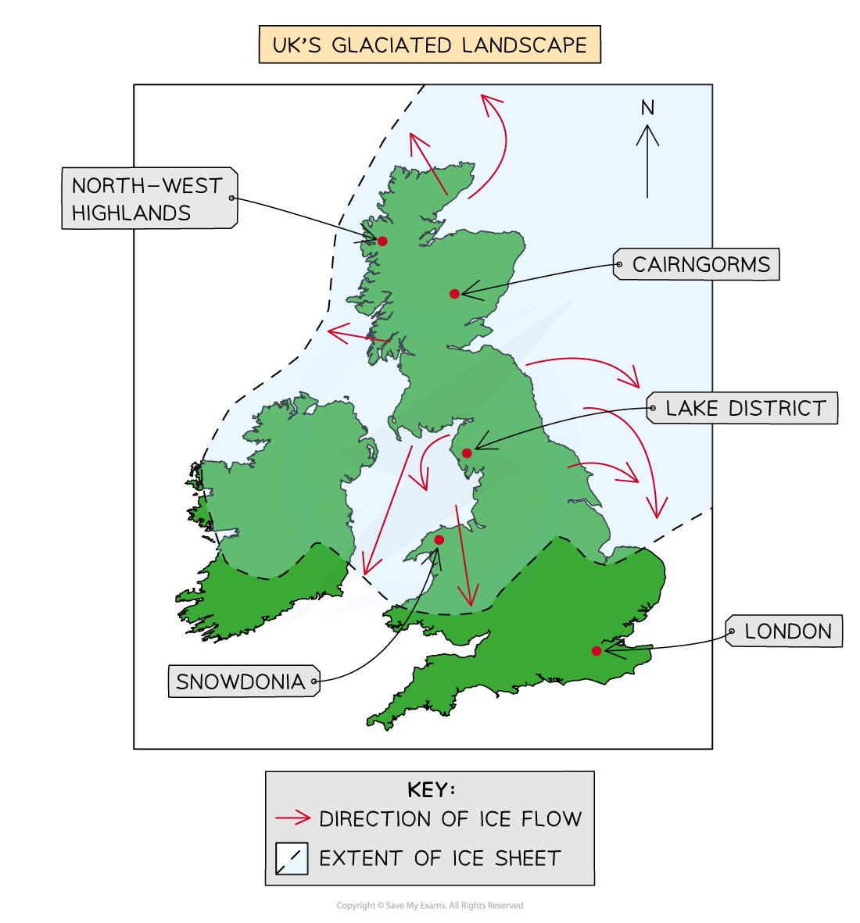
GCSE UK Landscapes
knowledge checkers
Lesson 3
Human Activities in UK Landscapes
Core knowledge
Settlements
Settlements developed where the landscape offered advantages such as:
    Rivers
        Meanders in rivers provided good defensive locations as well as transport links and freshwater
    Natural harbours were sites for fishing and trading
    Natural springs brought reliable freshwater
Over time, these settlements have developed, forming towns and cities
In upland landscapes, there are fewer settlements as the land is less suitable for building
Agriculture
The UK landscape has been changed through farming
    Drainage ditches are built to drain water from low-lying land
    Trees and hedges are cleared away to make room for large agricultural machinery
    Small fields are combined to make it more profitable for farming but also to use large machinery
Forestry
Planting, managing, and care of forests for:
    Conservation
    Natural windbreaks
    Landscaping
    Recreation
    Timber production
Many upland areas have been planted with trees
    To make the trees easier to manage, they are usually planted in straight lines
Knowledge Organiser
During the last ice age, large areas of the UK were covered with ice
The erosive power of the glaciers formed many landforms which remain in the landscape of Scotland, Wales and the Lake District today
The differences between upland and lowland landscapes are the result of the interaction of different physical processes

Slide 5
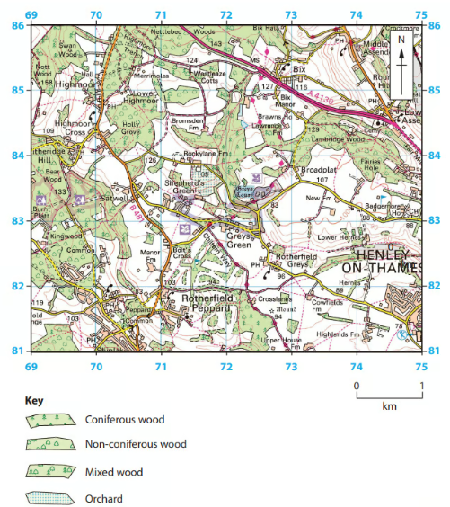
Exam Practice 1
1
2
3
4
Identify which one of the following is an igneous rock (1)
Basalt
Chalk
Sandstone
Slate
State one characteristic of a sedimentary rock (1)
_____________________________
Name one type of metamorphic rock (1)
_____________________________
Explain one reason why igneous rocks often have large crystals (2)
________________________________________________________________________________________________________________________________________________________________________
5 Identify the type of woodland in grid square 7084
___________________________
6 Name the settlement at 723828
____________________________

