Slide 1


GCSE Weather Hazards and Climate Change
It is your responsibility to make sure that you are able to answer each of the questions set in the tasks below. This will be based on what you are taught in lessons and the information included the knowledge organisers.
Task 1 What is air pressure? What controls whether air pressure is high or low? What are the three air circulation cells? Why is the Equator warmer than the Poles? How do oceans affect heat distribution? | Task 2 What is eccentricity and how does it affect the climate? What is axial tilt and how does it affect the climate? What is precession and how does it affect the climate? How do volcanic eruptions affect the climate? How does solar variation affect the climate? | Task 3 What can ice cores tell us about past climate? Reliable? What can pollen analysis tell us about past climate? Reliable? What can tree rings tell us about past climate? Reliable? What can books and paintings tell us about past climate? Reliable? What can data records tell us about past climate? Reliable?
Task 4 How does the enhanced greenhouse effect differ from the greenhouse effect? What are some human causes of climate change? | Task 5 How are people in the Maldives be affected by climate change? How is the environment in the Maldives affected by climate change? How is the economy of the Maldives affected by climate change? What are the political impacts of climate change in the Maldives? | Task 6 How does the climate differ across the UK? Why are some areas warmer than others? Why are some areas wetter than others?
Knowledge Expert

Slide 2
GCSE Weather Hazards and Climate Change
It is your responsibility to make sure that you are able to answer each of the questions set in the tasks below. This will be based on what you are taught in lessons and the information included the knowledge organisers.
Task 7 What are the key features of a hurricane? How are they formed? What conditions are needed? What does the Saffir Simpson scale tell us about storms? What are the effects of tropical storms? | Task 8 Which areas were affected by Hurricane Sandy? When? What were the social, economic and environmental impacts? What was the response to the storm? | Task 9 Which areas were affected by Typhoon Haiyan? When? What were the social, economic and environmental impacts? What was the response to the storm?
Task 10 What is the difference between an arid area and an area experiencing drought? What are the different kinds of drought? What are the main hazards associated with droughts? | Task 11 What is the extent of the drought in California? What caused the drought? What were the impacts of the drought in California? What were the responses to the drought? | Task 12 What is the extent of the drought in Ethiopia? What caused the drought? What were the impacts of the drought in Ethiopia? What were the responses to the drought?
Knowledge Expert

Slide 3

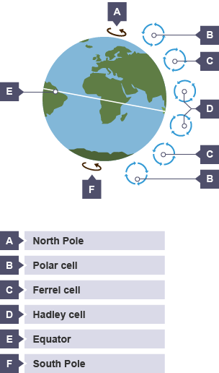
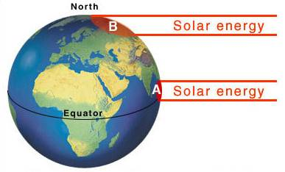







GCSE Weather Hazards and Climate Change
knowledge checkers
Lesson 1
Atmospheric and Oceanic Circulation
Core knowledge
Key words
Air rises this creates low pressure so surrounding air moves in to replace it.​
​When the air has risen high into the sky it cools so sinks back down to earth. This creates areas of high pressure.​ Differences in pressure make wind. Winds redistribute heat.​
Coriolis - Apparent force, due to the spinning of the Earth, which deflects movement of particles and wind.
Air pressure - When gravity acts on the air, the air exerts a force upon the earth called pressure
Redistribute - move
Equator - the Equator is an imaginary line around the middle of Earth. It is halfway between the north pole and the south pole, at 0 degrees latitude.
Latitude - The distance north or south of the Equator.
Temperature range increases with distance from the equator. Also, temperatures decrease as you move away from the equator because the sun’s rays are dispersed over a larger land area as you move away from the equator due to the Earth’s curved surface.
Knowledge Organiser
Heat from the tropics can be transferred to the cold polar regions, by large-scale water movement within the oceans. Each ocean has its own circular pattern of currents. Heat is transferred by warm ocean currents, such as the North Atlantic Drift in the Atlantic Ocean, from low latitudes to high latitudes. Ocean currents are set in motion by the prevailing surface winds associated with the general atmospheric circulation. The direction of water movement is also deflected by the Coriolis force.
Misconceptions
Take it further...
The Equator is not hotter because it is closer to the sun! Due to the curvature of the Earth it has a smaller surface area and so the sun's radiation is more concentrated there.
Air Circulation
Ocean Currents

Slide 4
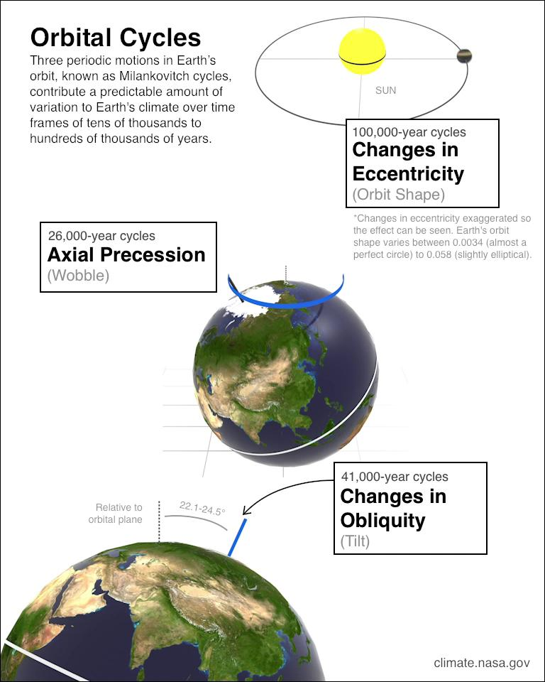
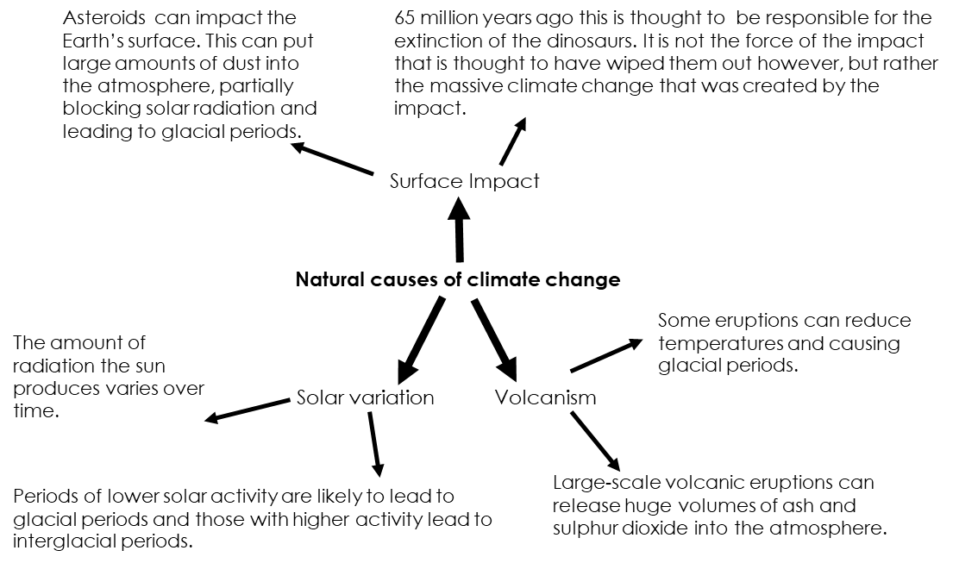







GCSE Weather Hazards and Climate Change
knowledge checkers
Lesson 2
Natural Causes of Climate Change
Core knowledge
Key words
Weather - is the day to day condition of the atmosphere
Climate - the long term (30 years) average of the local daily weather – it is what we would expect!
Natural causes – not caused by humans
Solar – energy from the sun
Volcanism- volcanic eruptions influencing the climate
Obliquity – another word for axial tilt
Knowledge Organiser
Precession | Axial Tilt | Eccentricity
The Earth wobbles on its axis.​ This affects the direction in which the axis is facing.​ This impacts on our seasons and creates greater or smaller differences between summer and winter.​ This can happen over a period of 24,000 years approximately. | Earth is tilted about 23° from a vertical position.​ Every 40,000 years the tilt can change.​ Seasons are created north and south of the Equator.​ When the earth’s tilt is closer to the Sun then the difference in seasons is less.​ When tilt is further from the Sun then the difference in seasons is more.​ | Every 100,000 years approximately the orbit of the Earth changes shape.​ The earth’s orbit can be circular making us warmer (interglacial).​ The earth’s orbit can be elliptical, making us cooler (glacial).​
Misconceptions
Take it further...
The climate has always been changing, even before humans existed. Human induced climate change (anthropogenic) has speed up the pace at which the climate is changing.
NASA
MET Office

Slide 5
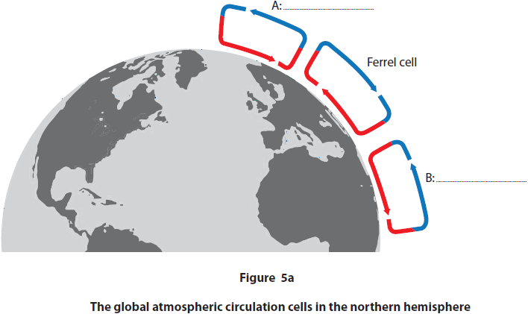
Exam Practice 1
Explain one reason why more heat energy is received at the Equator than at the poles.(3)
1 | 2
3 | 4
 | Feedback
_________________________________________________________________________________________________________________________________________________________________________________________________________________________________________________________________________________________________________________________________________________________________________________
Complete Figure 5a by labelling cells A and B. (2)
Explain one way in which the Milankovitch cycles can affect global temperature.(3)
State one cause of natural climate change.(1)
_________________________________________________________________________________________________________________________________________________________________________________________________________________________________________________________________________________________________________________________________________________________________________________
___________________________

Slide 6



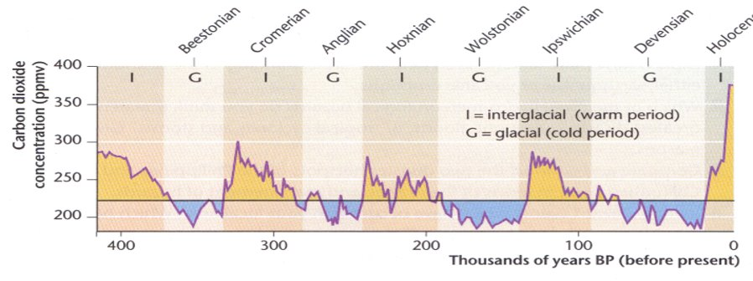
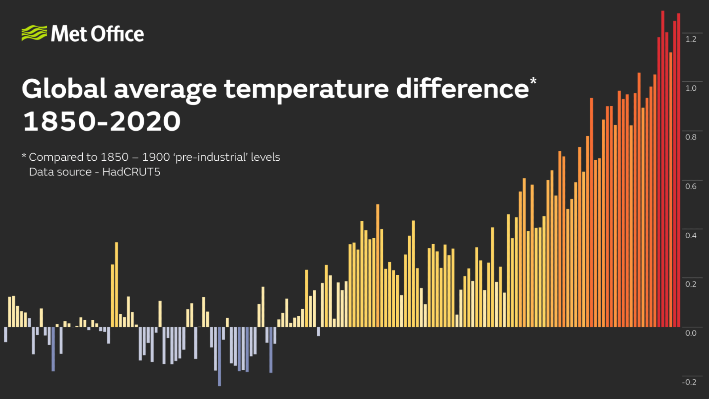


GCSE Weather Hazards and Climate Change
knowledge checkers
Lesson 3
Evidence of Climate Change
Core knowledge
Key words
Ice Cores | Ice cores are a frozen record of past climates. Within these layers the ice contains air bubbles which contain carbon dioxide and oxygen gas. Low concentrations of CO₂ occur during glacial periods High concentrations of CO₂ link with warmer periods of time- like the Holocene interglacial period we are going through now.
Pollen Analysis | Pollen is produced by all plants and is extracted from sediment cores in peat bogs and lake beds. Pollen grains are preserved in waterlogged sediments. By analysing pollen we can see how ecosystems have changed in response to climate change. Not as reliable as ice - accurate pollen reconstructions rely on good preservation of pollen. Long pollen sequences are rare, and vegetation change may lag behind “climate change”.
Dendrochronology | Tree rings. Many trees are sensitive to changes in temperature, sunlight and precipitation. In warmer years trees have wider rings. When it is cooler the rings are narrower.
Painting/ Written accounts | The written word is also good evidence. Literature can tell us what the climate was like at the time of writing. These sources did not set out to record climate but instead tell a story, and therefore they must be used with care.
Data Collection | We collect data on current weather conditions. Today the Earth is 0.8-1.28 oC warmer than pre-Industrial temperatures The last 10 years have been the hottest ever recorded.
Concentration (of gas) - how much of a gas is present at a certain time and at a certain location
Interglacial - warmer times in our history, little to no ice on the land
Glacial- colder periods of the Earth's history with ice covering the land. An Ice Age.
Sediment - small pieces of soil, rock or plant and animal remains.
Knowledge Organiser
Take it further...
Ice cores
Tree rings

Slide 7

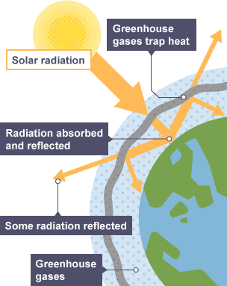


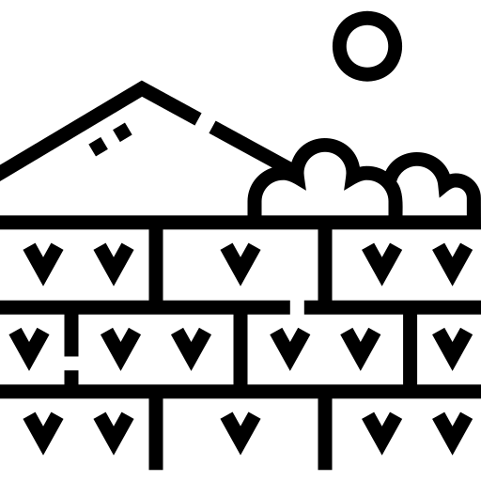



GCSE Weather Hazards and Climate Change
knowledge checkers
Lesson 4
Human causes of climate change
Core knowledge
Key words
Greenhouse effect | Enhanced greenhouse effect
Solar radiation passes through Earth's atmosphere. | Greenhouse gases allow more solar radiation to pass through Earth's atmosphere
The Earth absorbs most of the radiation and warms up.
The Earth radiates heat energy.
Some heat escapes into space. | Less heat escapes into space.
Some heat is absorbed by greenhouse gases in the atmosphere. | More heat is absorbed by greenhouse gases in the atmosphere.
Greenhouse gases radiate heat in all directions
The lower atmosphere remains warm. | The lower atmosphere heats up
Deforestation - The cutting down of trees and forests to allow a different land use.
Fossil Fuels - a natural fuel such as coal or gas, formed in the geological past from the remains of living things
Absorb - take in or soak up
Paddy fields - fields used to grow rice
Atmosphere - The air that surrounds the planet
Knowledge Organiser
The human causes of climate change are largely responsible for increasing the Earth’s temperatures. These causes of global warming have been in the media a lot in recent years. Human factors are the result of growing world population and economic developments.
They include:
The burning of fossil fuels for transport, industry and power, producing carbon dioxide and increasing global warming
Increased car exhaust emissions have resulted in more nitrous oxide in the atmosphere. Nitrous oxide is 200-300 times more effective in trapping heat than carbon dioxide
The increased production and use of fertilisers to meet worldwide food demands also adds to the amount of nitrous oxide in the atmosphere
Worldwide deforestation, often involving rainforest burning, produces carbon dioxide.
Methane gas is released from landfill sites as waste decomposes; because methane is a stronger greenhouse gas, small increases have a larger impact on climate change
The increase in paddy fields to feed rapidly growing populations in Asian countries has increased the amount of methane
The demand for beef has increased methane levels produced from both ends of cattle and animal dung
Take it further...
MET Office
Video

Slide 8
Exam Practice 2
First let's plan this answer.
Evaluate the following statement. (8)
Human activity is the main cause of global climate change.
1 | 2
Now answer it.
_________________________________________________________________________________________________________________________________________________________________________________________________________________________________________________________________________________________________________________________________________________________________________________________________________________________________________________________________________________________________________________________________________________________________________________________________________________________________________________________________________________________________________________________________________________________________________________________________________________________________________________________________________________________________________________________________________________________________________________________________________________________________________________________________________________________________________________________________________________________
Human causes of climate change
Natural causes of climate change
Feedback

Slide 9







GCSE Weather Hazards and Climate Change
knowledge checkers
Lesson 5
Negative Impacts
Core knowledge
Key words
More frequent and intense drought, storms, heat waves, rising sea levels, melting glaciers and warming oceans can directly harm animals, destroy the places they live, and wreak havoc on people's livelihoods and communities. As climate change worsens, dangerous weather events are becoming more frequent or severe
Social impacts - how people are affected
Economic impacts - how jobs and the way the country makes money is affected
Environmental impacts – how nature is affected
Political impacts - how the government runs the country is affected
Tourism - people visiting another country, holidays.
Maldives Case Study
Social Impacts ​​
Houses could be damaged or destroyed, and severe flooding could make entire communities homeless. ​​
Supplies of freshwater are already low on many of the Islands. If supplies are polluted with salty seawater during floods then less freshwater will be available.
Economic Impacts of Rising Sea Levels ​​
Loss of tourism (the largest industry in the Maldives, producing about 33% of GDP) ​​
More than 1 million international tourists visited the Maldives in 2015. ​​
Coastal flooding may also damage fish processing plants, reducing the Maldives fish exports. Fish are the Maldives' largest export (producing about 10% of GDP), so this will also massively decrease the country's income.
Environmental Impacts ​
Coastal flooding wears away beaches on the islands at a rapid rate. This destroys habitats and exposes the land behind the beach to the effects of flooding. ​
The soil on most of the islands is shallow (20cm deep or less), and the soil layer could be easily washed away by coastal flooding, so most plants won't be able to grow.
Knowledge Organiser
Political Impacts ​
The Maldives Government had to ask the Japanese Government to give them $60 million to build the 3m high sea wall that protects Malé, the capital city. ​
Environmental policies are changing as increased flooding is caused by the rising sea level, which is caused by global warming, The Maldives Government has pledged to be carbon neutral so it doesn't contribute to global warming, and is encouraging other countries to do the same. ​
Long-term plans are also changing. The Government is considering buying land in countries like India and Australia and moving Maldivians there before the islands become uninhabitable.
Take it further...
Personal Account
Video

Slide 10
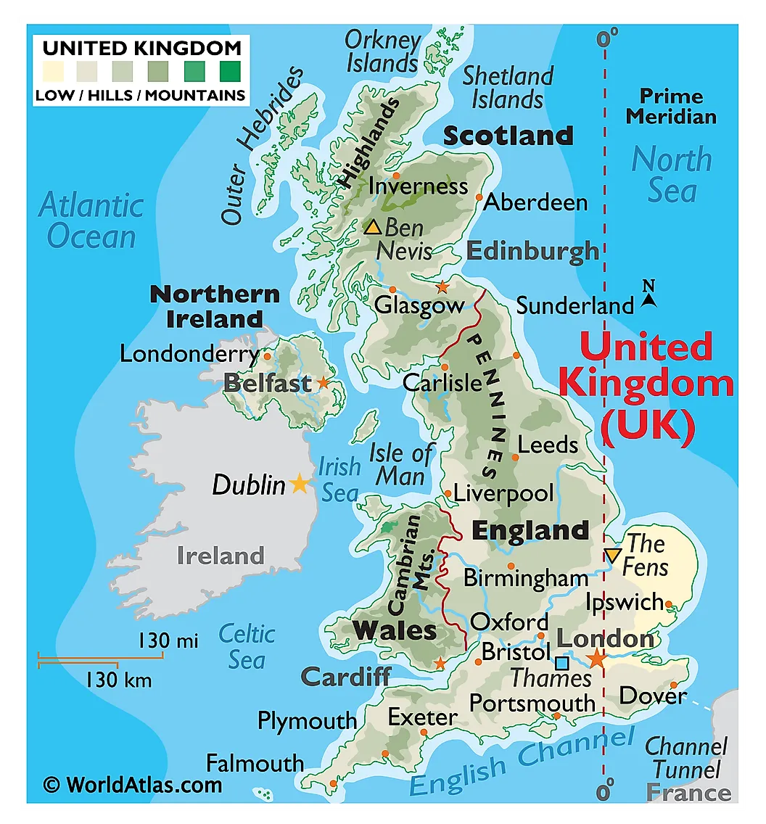






GCSE Weather Hazards and Climate Change
knowledge checkers
Lesson 6
UK Climate
Core knowledge
Key words
Different parts of the UK experience differences in rainfall and temperature . One reason for this due to latitude. The more north you are the colder the temperature due to the curvature of the Earth. The areas that have high rainfall are generally in the west side of the UK. This means that it is more likely to rain due to prevailing wind coming from the south west over the Atlantic ocean bringing moist air.
Latitude - The distance north or south of the Equator.
North Atlantic Drift - an ocean current that travels past the UK
Depressions – low pressure areas that bring storms
Precipitation - rain, hail, sleet and snow.
Maritime Influence | As the UK is surrounded by sea, most of the air that reaches us contains a large amount of moisture, resulting in consistent rainfall throughout the year.
Prevailing Wind | The prevailing wind is the most common wind direction which in the UK is from the south west It has travelled over large expanses of warm ocean, so this air is warm and contains a lot of moisture. The prevailing wind reaches the western areas of the UK first and releases this moisture as rain there. This leaves the eastern side of the UK relatively dry.
North Atlantic Drift | A warm ocean current called the North Atlantic Drift brings warm water north to the UK from the Gulf of Mexico driven by the prevailing wind. This current of warm water has a particular effect during the winter, making the UK climate milder than would be expected for our latitude.
Circulation Cells | The UK is located near the ‘boundary’ between the northern Ferrel and Polar circulation cells. At this boundary, warm air from the south and cooler air from the north meet, leading to the formation of depressions and unsettled weather.
Altitude | The higher the altitude of an area, the cooler it will be: 1oC lost for every 100 metres higher above sea level. Also, as the air is forced to rise over the high land it is cooled, causing more of the moisture in the air to condense and fall as precipitation on the hill tops.
Knowledge Organiser
Take it further...
BBC Bitesize
Video

Slide 11
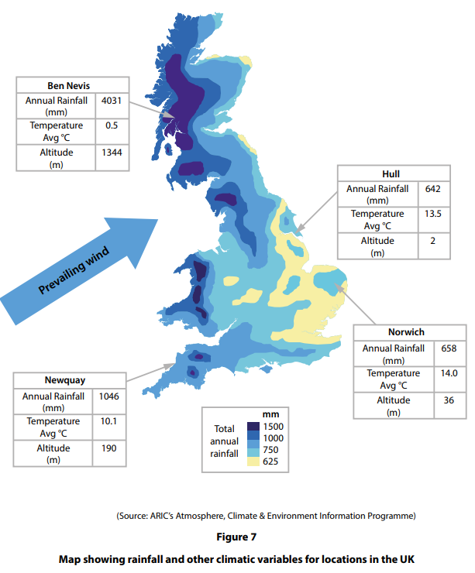
Exam Practice 3
 | State one natural cause of climate change in the past.
 | 2. State two sources of evidence for natural climate change in the past.
 | 3. Calculate the range of average temperatures for the four locations in Figure 7.
 | 4. The prevailing wind, which is shown in Figure 7, influences the climate of the UK. Explain one way prevailing wind affects the climate of the UK
_____________________________________________
__________________________________________________________________________________________
________________________________________________________________________________________________________________________________________________________________________________________________________________________________________________________________________________________________________________________________________________
Feedback

Slide 12







GCSE Weather Hazards and Climate Change
knowledge checkers
Lesson 7
Tropical Cyclones
Core knowledge
Key words
Tropical cyclones are large, rotating storms that form over the oceans in tropical areas. Depending on where in the world they form, they are known as hurricanes, cyclones or typhoons. They can be devastating if they move over land. ​​
​
Tropical cyclones are easily identifiable because of their distinctive features. The most well-known of these features is the eye, located at the centre of the storm. Surrounding the eye the eye wall; high density cloud covers the remaining area of the storm.​​
Eye - centre of the storm, it is calm here
Eye wall – the side of the eye, the winds here are the most powerful
High density clouds - thick clouds
Dissipate – break apart
Converging - meeting
Formation:
The sun warms water to at least 26.5°C.
Evaporation occurs, and warm moist air will cool, condense and form clouds.
Eventually, large storm clouds will form over the ocean (low pressure).
The air begins to spin due to the rotation of the Earth (Coriolis effect).
As the air rises, winds converge at the ocean surface causing even more air to rise.
Winds accelerate inwards and upwards to form a tropical cyclone.
As a tropical cyclone hits land, its fuel source is lost and it will begin to die (dissipate).
Knowledge Organiser
​Must Haves...
A source of moist, warm air. ​​
Ocean water must be at least 26.5ºC ​​
The time of year (season) when ocean water is at its warmest​​
Winds converging at the ocean surface, causing the air to rise​​
Formation some distance from the Equator so the Coriolis effect will cause the storm to rotate
Misconceptions
Take it further...
Cyclones, hurricanes and typhoons are all the same thing, their name depends on which ocean they are formed over.
Met Office
Internet Geography

Slide 13





GCSE Weather Hazards and Climate Change
knowledge checkers
Lesson 8
Impacts of Tropical Storms
Core knowledge
Key words
Cat | Sustained winds-km/h | Damage​ | Storm ​Surge - metres
1​ | 119-153​ | Minimal: unanchored mobile homes, plants and signs​ | 1.2 - 1.7​
2​ | 154-177​ | Moderate: All mobile homes, roofs, small vehicles, flooding​ | 1.8 - 2.6​
3​ | 178-208​ | Extensive: small buildings, low lying roads cut off.​ | 2.7 - 3.8​
4​ | 209-249​ | Extreme: Roofs destroyed, trees down, roads cut off, mobile homes destroyed. Beach homes flooded.​ | 3.9 - 5.4​
5​ | More than 250​ | Catastrophic: Many buildings destroyed. Vegetation destroyed. Major roads cut off. Homes flooded.​ | Greater ​ than 5.4​
Saffir Simpson - the scale used to measure hurricanes based on their wind speed. 1-5 with 5 being the strongest
Storm surge - an abnormal water level rise generated by a storm
Landslide - the downhill movement of cliff material under the influence of gravity
High Winds​ | Intense Rainfall​ | Storm Surges​ | Coastal Flooding​ | Landslides​
Winds can reach over 119 km/h. Severe damage can be caused.​ Force of wind can uproot trees, and sheds/beach huts can be moved. Very high winds can cause objects to be moved, which can cause damage, injury and deaths. | Flash flooding may be caused which can leave people stranded and homeless Intense rainfall can lead to flooding, damage to property and injury.​ Can contaminate clean water supplies and sewage may overflow | Areas of low pressure can cause the sea level to rise. Flooding can occur when high winds combine with a large mass of water which is forced inland. If the sea flows inland, it can contaminate farmland and fresh water. Storm surges can erode beaches and habitats and can damage sea defences. | Coastal areas are at risk from intense rain and storm surges. Coastal sea defences can be destroyed and impact the tourism industry Impacts on people, property, farming and tourism can result from coastal flooding. | High levels of rain can saturate soils which can lead to landslides.​ Transport routes cut off, habitats destroyed, rivers flood if blocked with debris.​ Settlements at the base of slopes are at risk from mass movement. Rivers can become blocked.​
Knowledge Organiser
Take it further...
BBC Bitesize
Met Office

Slide 14
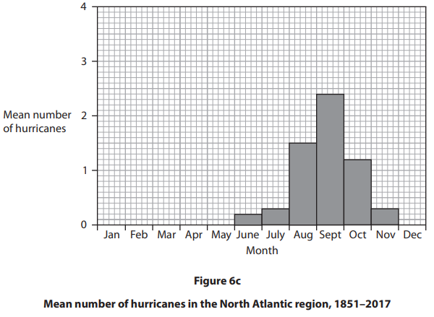
Exam Practice 4
1 | 2
 | Feedback
Explain one reason why some tropical cyclones lead to more deaths than others. (4)
________________________________________________________________________________________________________________________________________________________________________________________________________________________________________________________________________________________________________________________________________________________
Tropical cyclones (hurricanes and typhoons) are extreme weather events that develop under specific conditions.
Study Figure 6c
Suggest one reason why the frequency of hurricanes varies monthly in the North Atlantic region.
Use evidence from Figure 6c in your answer. (3)
__________________________________________________________________________________________________________________________________________________________________________________________________________________________________________________________________

Slide 15
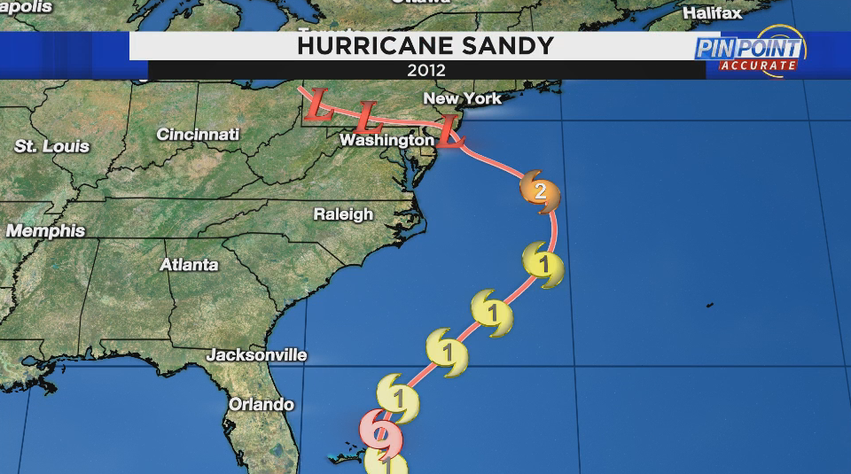






GCSE Weather Hazards and Climate Change
knowledge checkers
Lesson 9
Hurricane Sandy
Core knowledge
Key words
On October 24th 2012 a storm that had formed earlier in the month was officially registered as hurricane (Cat1) on the Saffir-Simpson Scale. This hurricane, officially named as Hurricane Sandy, swept through the Caribbean Sea, making landfall on the island nations of Jamaica, Cuba and the Bahamas before moving north and eventually reaching the USA.
Stock Exchange - Where shares in companies are bought and sold – very important for the economy
Nature reserves – protected areas of nature
Relief – providing help to people in need
Legislation - laws
Effects | Response
Out of a total death toll of 150, 72 people were killed directly by the hurricane in the US Around 200,000 homes were destroyed, with New York declaring that 30–40,000 people were made homeless Electricity lines were damaged, affecting around 8 million residents and forcing many to evacuate their homes Schools were closed for days Estimated property damage of around US$65 billion. The government had to pay for diesel and petrol to be brought in as supplies ran out Loss of income from cancelled events: the New York Marathon had to be cancelled, impacting many businesses Businesses were lost due to the damage, with an estimated job loss of 30,000. Many businesses did not have insurance to cover floods and storm damage 15,000 flights were cancelled into New York 1.5 billion tonnes of untreated sewage from flooded areas around New Jersey and New York City contaminated the Raritan river The storm surge caused significant damage to coastal nature reserves such as the Prime Hook National Wildlife Refuge in Delaware In parts of New Jersey, 10 meters of beach was lost, exposing the coast to future coastal erosion and damaging habitats 300,000 gallons of oil spilled into the New Jersey waterways when industrial sites were flooding | Residents evacuated The 12-12-12 Concert for Sandy Relief with Bruce Springsteen and Bon Jovi Donations to the Red Cross Communities supported each other and helped with rescue and rebuilding Blood was needed and many people donated Flight cancellations were put in place National park service closed at least five sections Power companies attempted to prevent long-term power failures by being prepared to repair storm damage and by having employees work longer hours American Red Cross provided 7,000 emergency shelters across the region Direct Relief provided medical supplies to support medical relief and recovery efforts FedEx transported medical supplies to affected areas for free Federal Emergency Management Agency (FEMA) provided 7,000 people to establish 65 Disaster Recovery Centres and gave over US$600 million in direct assistance to individuals impacted by the storm National Guard and U.S Air Force put as many as 45,000 personnel in at least seven states on alert for possible duty in response to the preparations and aftermath of Hurricane Sandy Closures and cancellations of activities in schools Metro services: rail and buses were cancelled US$50.5 billion Hurricane Sandy relief bill was passed through legislation to help rebuild and support victims
Knowledge Organiser
Take it further...
Met Office
Story Map

Slide 16
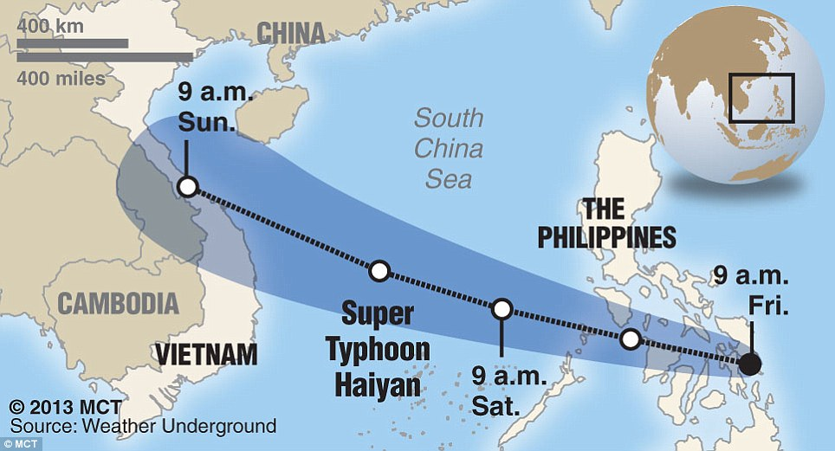
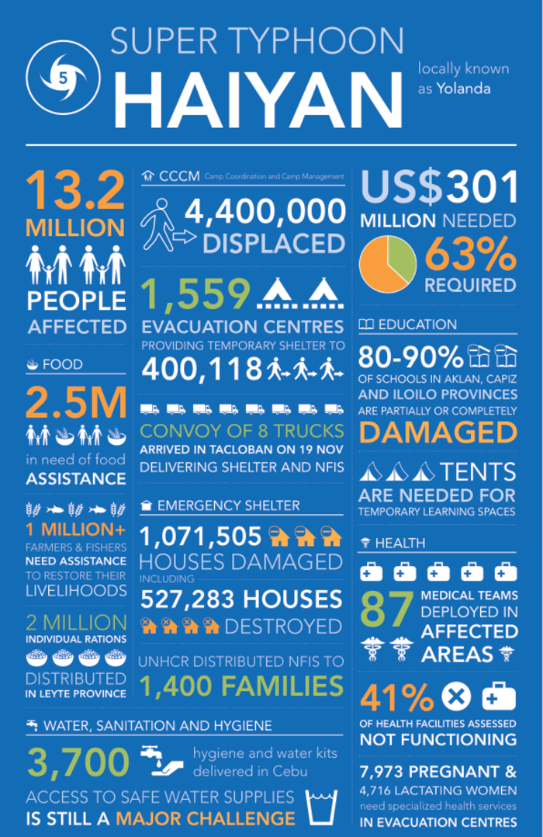


GCSE Weather Hazards and Climate Change
knowledge checkers
Lesson 10
Typhoon Haiyan
Core knowledge
Typhoon Haiyan, a category five typhoon, struck the Philippines, close to Tacloban on 8th November, 2013 at 4.40 am. The tropical storm originated in the northwest Pacific Ocean. It is one of the most powerful typhoons to affect the Philippines. Wind speeds of 314 kilometres per hour (195 miles per hour) were recorded.
Effects | Response
6201 people died, and 1.1 million homes lost More than 4 million people were displaced. Casualties: 28,626 from lack of aid. The UN feared possibility of the spread of disease due to a lack of food, water, shelter and medication Overall, over 16 million people were affected Estimated at $13 billion, Tacloban city was decimated Major sugar and rice-producing areas were destroyed Between 50,000 and 120,000 tonnes of sugar and over 130,000 tonnes of rice were lost The government estimated that 175,000 acres of farmland was damaged (worth $85 million) Loss of forests and trees, and widespread flooding Oil and sewage leaked into local ecosystems. Lack of sanitation in days following led to a higher level of pollution Fishing communities were severely affected | 'Cash for Work' schemes gave locals money to help clear the debris Money was donated towards the relief effort, although 5 days went by before any aid was received and only 20% of victims received aid An increased number of cyclone shelters have been built further away from coastal areas The Philippines Red Cross delivered basic food aid, e.g. rice and canned food International aid agencies responded quickly with food, water and temporary shelters The UN donated financial aid, supplies, and medical support. The UN admitted its response was too slow amid reports of hunger and thirst among survivors Oxfam helped finance replacement of the fishing boats The Philippines declared 'a state of national calamity' and asked for international aid the next day UK sent shelter kits to provide emergency shelter for a family The French, Belgians, and Israeli's set up field hospitals to help the injured US$475 million sent as aid and US sent 13,000 soldiers
Knowledge Organiser
Take it further...
Story Map
Video

Slide 17
Exam Practice 5
First let's plan this answer.
Evaluate the following statement. (8)
Responses to tropical cyclones are more successful in developed countries than in emerging or developing countries.
1 | 2
Now answer it.
_________________________________________________________________________________________________________________________________________________________________________________________________________________________________________________________________________________________________________________________________________________________________________________________________________________________________________________________________________________________________________________________________________________________________________________________________________________________________________________________________________________________________________________________________________________________________________________________________________________________________________________________________________________________________________________________________________________________________________________________________________________________________________________________________________________________________________________________________________________________
Responses in a developed country
Developed country ________________________
Responses in a developing country
Developing country ________________________
Feedback

Slide 18




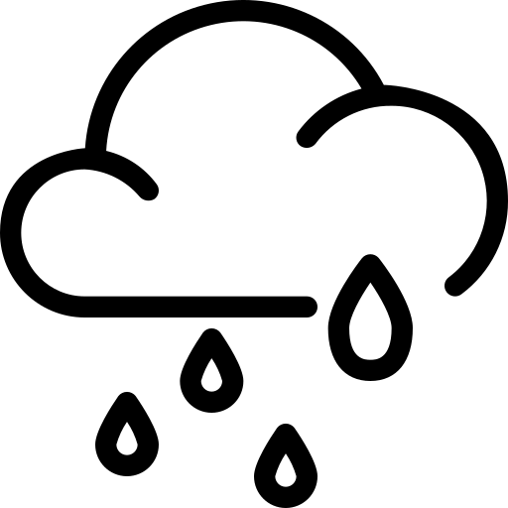



GCSE Weather Hazards and Climate Change
knowledge checkers
Lesson 11
Droughts
Core knowledge
Key words
Arid environments normally have very low rainfall, such as deserts. Many arid environments are hot, causing water to evaporate faster than it can be replaced.
Although arid environments are challenging, plants, animals and humans living there have adapted to cope with limited water supplies.
A drought is a severe shortage of water in a particular location. There are many causes of drought, but they often happen when rainfall is below average for a long time (weeks, months and years).
When a drought occurs, water supplies such as lakes and rivers become depleted, often because people continue to extract water and there is insufficient rainfall to replace it. Droughts are typically accompanied by high temperatures, which increase the rate of evaporation and extraction, depleting water supplies even faster.
Droughts can cause hazards for people and ecosystems, which rely on water for survival.
Droughts lead to water depletion in rivers, lakes and reservoirs, causing aquatic life and vegetation to die. In addition, due to a lack of water entering lakes and reservoirs, water becomes stagnant due to less freshwater diluting waste material. This increases the risk of contamination of water supplies and waterborne diseases such as cholera.
Agriculture can be affected by drought as a lack of water can damage crops and harm livestock. This can cause food shortages and increase malnutrition. Farmers are also at risk of losing their livelihoods.
When vegetation dies, and the soil is bare, it is at risk of erosion by wind and rain. When erosion occurs, it removes the topsoil layer, which means it can be difficult to grow crops in the future even when the rain returns. This can lead to further food shortages and famine.
During periods of drought, vegetation can become very dry, making wildfires more likely. Wildfires can destroy property, crops, forests and wildlife.
Arid - naturally dry areas
Stagnant – water that is not flowing, it is still
Malnutrition - becoming unwell due to a poor diet
Livelihood - how people make money to live their lives
Precipitation - rain
Irrigation - the channelling of water from rivers and streams to fields in order to help crops grow
Knowledge Organiser
Types of Drought
Meteorological drought – when the amount of precipitation received in a specific area is less than the average.
Hydrological drought – when reduced precipitation impacts on water supply, eg there is decreased streamflow, soil moisture, reservoir and lake levels, and groundwater.
Agricultural drought – when the above two types of drought impact on agricultural activities, eg reduced soil moisture or reservoir levels required for irrigatoin .
Take it further...
BBC Bitesize
Met Office

Slide 19
Exam Practice 6
Explain one human cause of drought. (2)
Explain one meteorological cause of drought.(3)
1 | 2
3 | Feedback
_________________________________________________________________________________________________________________________________________________________________________________________________________________________________________________________________________________________________________________________________________________________________________________
_________________________________________________________________________________________________________________________________________________________________________________________________________________________________________________________________________________________________________________________________________________________________________________
Suggest one impact of drought for people living in a developed country.(3)
_________________________________________________________________________________________________________________________________________________________________________________________________________________________________________________________________________________________________________________________________________________________________________________

Slide 20




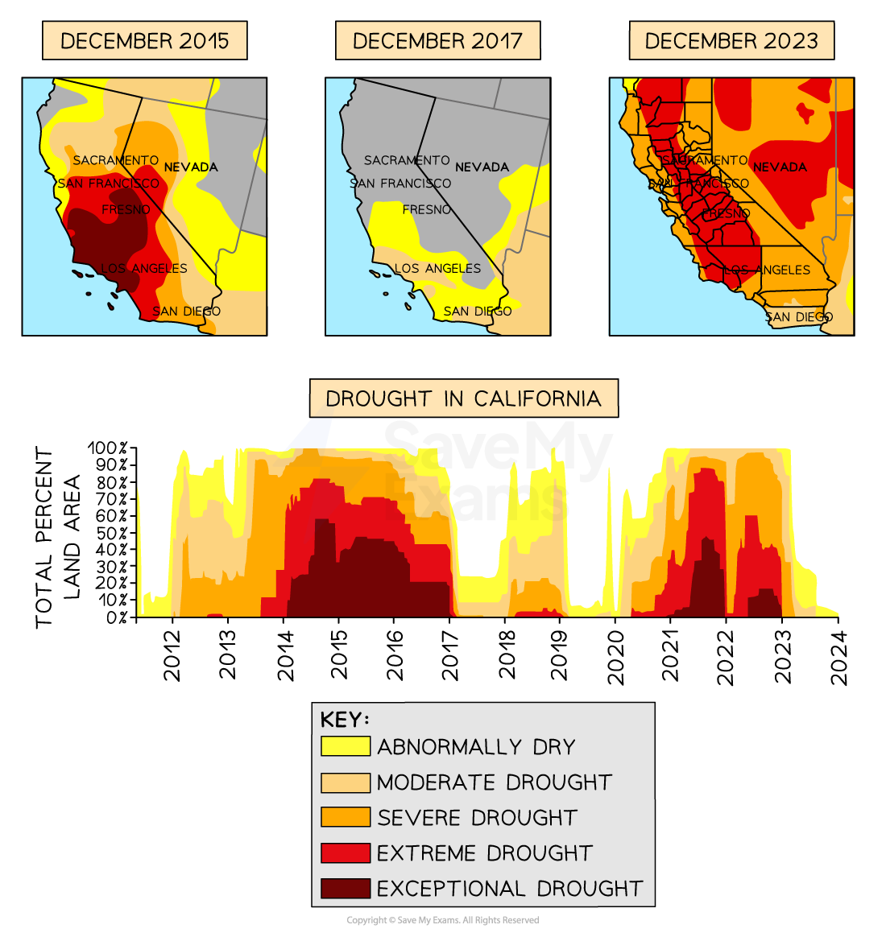



GCSE Weather Hazards and Climate Change
knowledge checkers
Lesson 12
California Drought
Core knowledge
Key words
California is situated on the west coast of the USA. It has a population of around 39 million people. It has a Mediterranean-like climate with warm, dry summers and mild, wet winters
It has deserts to the east, with south-westerly winds from the Pacific Ocean bringing rain in winter. Annual precipitation is between 200-500 mm. 50% of precipitation falls between November and March, leading to seasonal shortages
Threat
California has approximately 24 million acres (or 9.7 million ha) of farmland
The state supplies 40% of the USA's vegetables, fruit and nuts, which generates around $50 billion each year
However, these crops need a lot of irrigation and freshwater supplies are in constant demand
Rising temperatures, falling rainfall levels and a growing population also place high demands on fresh water supplies
Cause
California relies on winter rain and snow to carry its water supply through the year
High pressure systems over the Pacific Ocean diverted the south-westerly winds away from the California coast
Keeping a dry air mass above the state for a long time
This prevented normal winter storms from reaching California
Drought - A long period of low rainfall that creates a major shortage of water.​
Groundwater - Where water is stored in rocks beneath the ground.
Subsidence - A fall in land levels.
Aquifers- Naturally occurring underground water stores.
Ecosystem - A community of animals, plants and microorganisms, together with the habitat where they live.
Knowledge Organiser
Response
Government | State government ran campaigns to educate people to save water State laws were brought in to reduce water use in California by 25%
Organisations | Research projects by the University of California helped investigate ways to effectively manage groundwater
Individuals | Farmers were encouraged to use water efficient irrigation such as drip irrigation Homeowners were advised to check for water leaks Protestors campaigned against companies selling bottled local water
Take it further...
Drought Monitor
Video

Slide 21
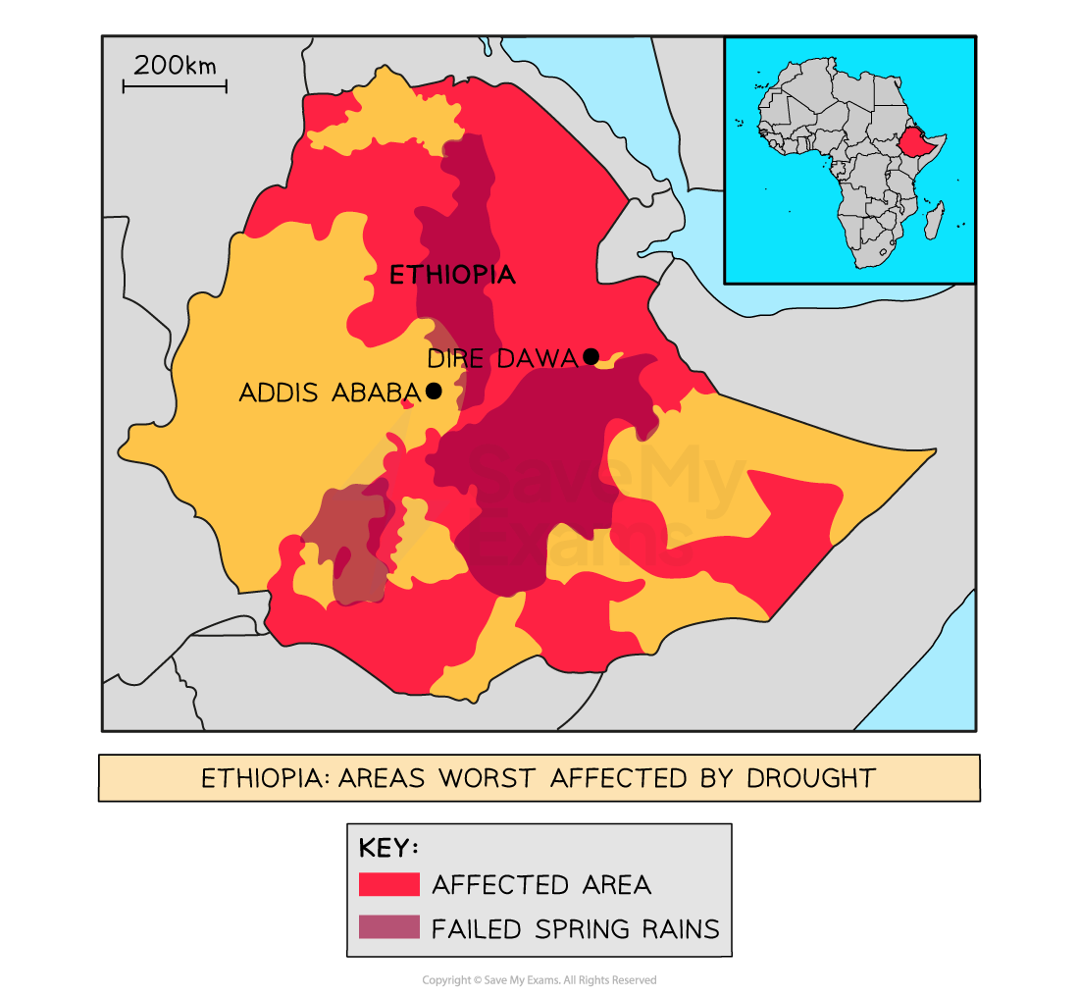






GCSE Weather Hazards and Climate Change
knowledge checkers
Lesson 13
Ethiopia Drought
Core knowledge
Key words
Background
Ethiopia is an emerging country located in the Horn of Africa, on the east coast of Africa
Since the 1980s, the country has experienced many droughts, leading to famines and huge loss of life
85% of the population live in rural areas, rely on agriculture and are dependent on rainfall and traditional technologies
The worst droughts were 1984, 1994 and 2014–2016
The 2015 drought was the worst in 30 years - The threat is still ongoing.
Threat
Ethiopia relies on two rainy seasons throughout the year
Short season - afternoon showers become more frequent from February to May
Long season - rains nearly every day through the summer months and accounts for 50–80% of annual rainfall
Emerging country - A country whose economy is not yet fully developed but very likely will be in the near future.
Famine – not enough food
Rural areas - the countryside
Crops – plants grown
Groundwater - Where water is stored in rocks beneath the ground.
Knowledge Organiser
Ethiopia's first crop season depends on the short rains, while the main agricultural season relies on the summer long rains.
Since the 1980s, the short season has been getting shorter and increasingly delayed
The longer season has become unpredictable. Where it used to rain for weeks, this has now reduced to days and this fails to supply enough water for the country.
There are not enough wells to access groundwater to provide irrigation when the rains fail
Since 1985, 77% of tree cover has been cut down, reducing transpiration into the air.
Ongoing conflict in northern Ethiopia damages infrastructure and food supplies.
Take it further...
Government | Overseas governments have given aid In 2015, the USA gave $128.4 million in food aid
Organisations | Aid agencies such as Oxfam and UNICEF are helping to secure water supplies Education charities are helping people secure jobs in urban areas
Individuals | Large charity events such as Live Aid helped raise awareness and money
Response
Article
BBC News

Slide 22
GCSE Weather Hazards and Climate Change
knowledge checkers
Lesson 12/13
Drought impacts
California Impacts
Ethiopia Impacts
Social | Economic | Environmental
Subsidence: as groundwater levels dropped, land settled to lower levels, damaging properties People were asked to conserve water and hosepipe bans were put in place Farmers were unable to grow crops on thousands of acres of land, leaving many farmers unable to support themselves and abandoning their farms People paid private companies to drill private wells to extract precious groundwater supplies Wildfires burned many homes, leaving thousands homeless. People found it difficult to rebuild their homes and insurance premiums became too expensive | The cost of the drought has been approximately $2.7 billion a year, meaning less state money to spend on services such as schools and hospitals California has the largest agricultural industry in the country, worth around $50 billion each year. In 2014 alone, the industry lost $5 billion Wine production was particularly affected and 17,100 agricultural workers lost their jobs Prices of beef and grain rose due to a supply shortage. Food prices also increased by 6% Hydroelectric dams stopped producing electricity | Rivers dried up and prevented fish, such as salmon, from reaching their breeding grounds Wetlands were drained to secure water supplies, altering natural habitats and reducing fish populations Wildfires: vegetation became very dry, and fires started and spread quickly. Intense heat, such as lightning strikes, can easily set vegetation alight In dried-up forest areas, wildfires destroyed plant and animal habitats and killed wildlife Sea water ingress: land and drinking water became contaminated by seawater
Social | Economic | Environmental
85% of the population live in rural areas and depends on farming The lack of rain led to crop failure and widespread loss of livestock, as high as 40%–60% in some areas, which decreased milk production as well as increasing a poor harvest People suffered hunger and malnutrition, exposing them to disease Many women and children had to walk up to 20 km to collect water, leaving less time for farming and school Wood and grasses used for building became scarce, leaving many people without protection from the weather | Cereal prices rose to record levels, while livestock prices and wages fell, reducing purchasing power across the region Many people migrated from rural to urban areas, increasing economic costs to the country Food and water aid needed for 20 million people Conflict in northern Ethiopia caused $22.7 billion worth of damage to infrastructure and a further $6 billion of productivity losses The ongoing food and water insecurity costs Ethiopia US$1.1 billion per year | Overgrazing and over-cultivation of drought-prone areas led to desertification and degradation of land There was an increase in diseases in wildlife due to reduced water and food supplies Wildfires: vegetation became very dry, and fires started and spread quickly. Over 200,000 hectares of forest were lost each year In dried-up forest areas, wildfires destroyed plant and animal habitats and killed wildlife
Knowledge Organiser

Slide 23
Exam Practice 7
First let's plan this answer.
Evaluate the following statement. (8)
The impacts of drought are much greater in developing or emerging countries than in developed countries
1 | 2
Now answer it.
_________________________________________________________________________________________________________________________________________________________________________________________________________________________________________________________________________________________________________________________________________________________________________________________________________________________________________________________________________________________________________________________________________________________________________________________________________________________________________________________________________________________________________________________________________________________________________________________________________________________________________________________________________________________________________________________________________________________________________________________________________________________________________________________________________________________________________________________________________________________
Impacts to a developed country
Developed country ________________________
Impacts to a developing country
Developing country ________________________
Feedback

