Slide 1
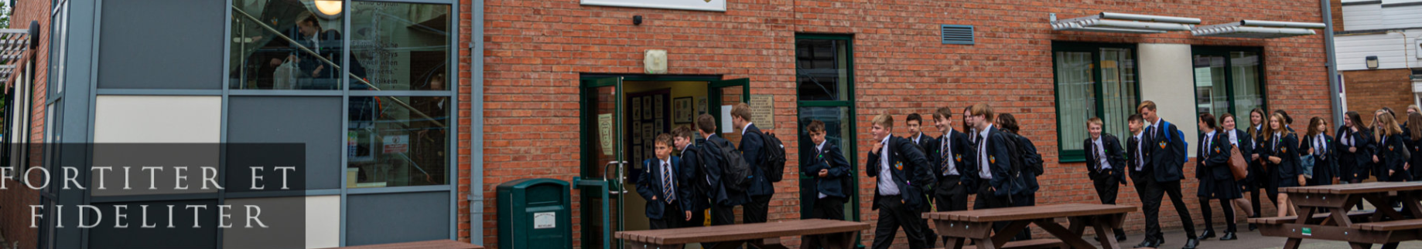


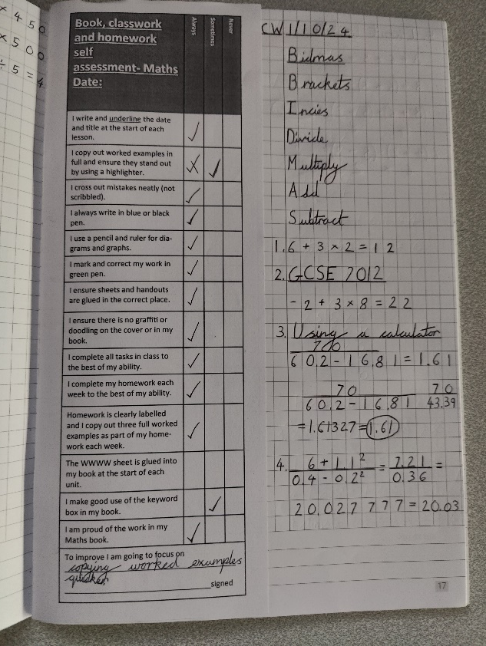

Improving Independent Study Skills
Mr Hosker (Head of Department)
Miss Mann (Second in Department)

Slide 2

Today’s agenda
Independent learning – then and now
Homework
Online learning – Sparx, Mathswatch & Pinpoint
Books
Rewards
Assessments
Student Groupings
Rationale
Best Practice

Slide 3
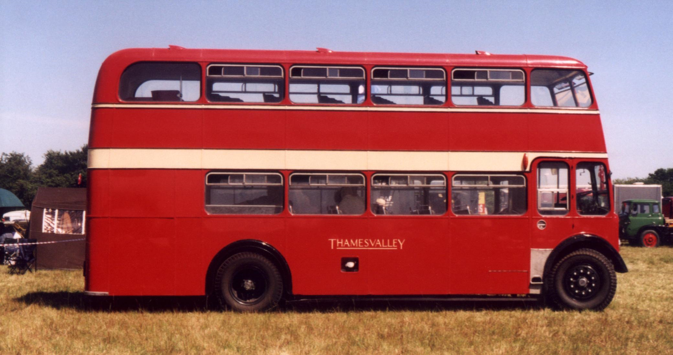

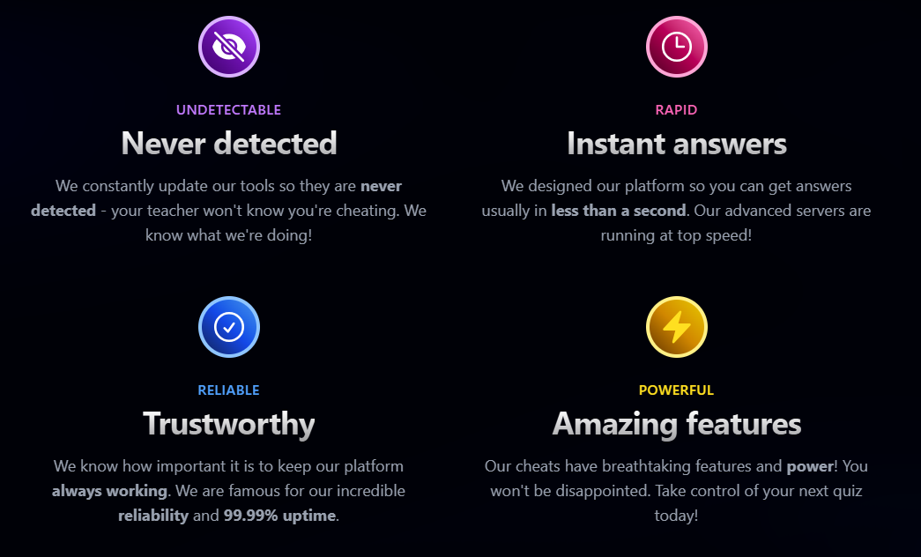

Cutting corners – then and now!
Sparxext

Slide 4
When will homework be set?
FRIDAY

Slide 5

When will homework need to be completed?
FRIDAY

Slide 6
What will the homework be?
Sparx Maths tasks (25 weeks)
Mathswatch revision assignments (9 weeks)
Pinpoint re-tests (3 weeks)
Teacher discretion (2 weeks)

Slide 7



What will the content of the homework be?
Sparx - 3 week/6 week review
Mathswatch – revision
Pinpoint – diagnostic following assessment

Slide 8
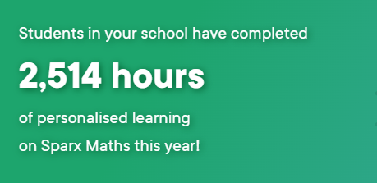
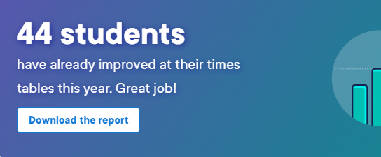
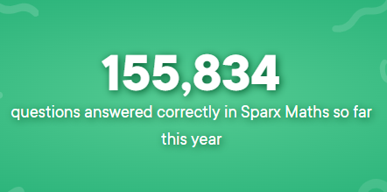

Improving Independent Study Skills

Slide 9
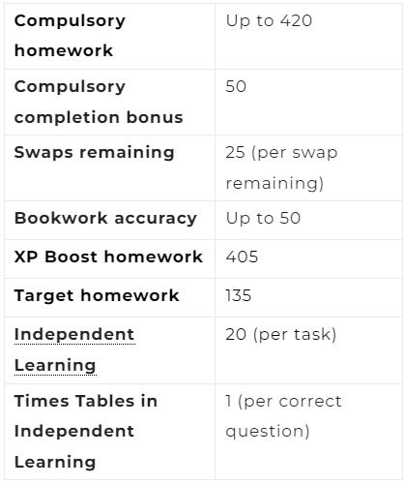
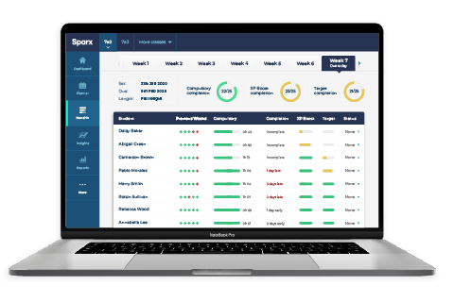
How do you earn XP?

Slide 10
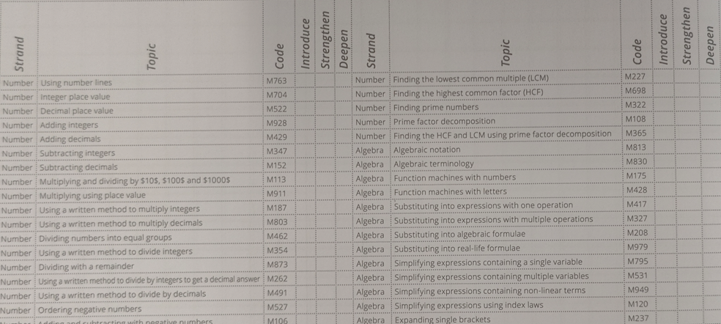
Independent Learning
Grab a book – pages 78 and 79

Slide 11
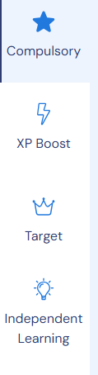
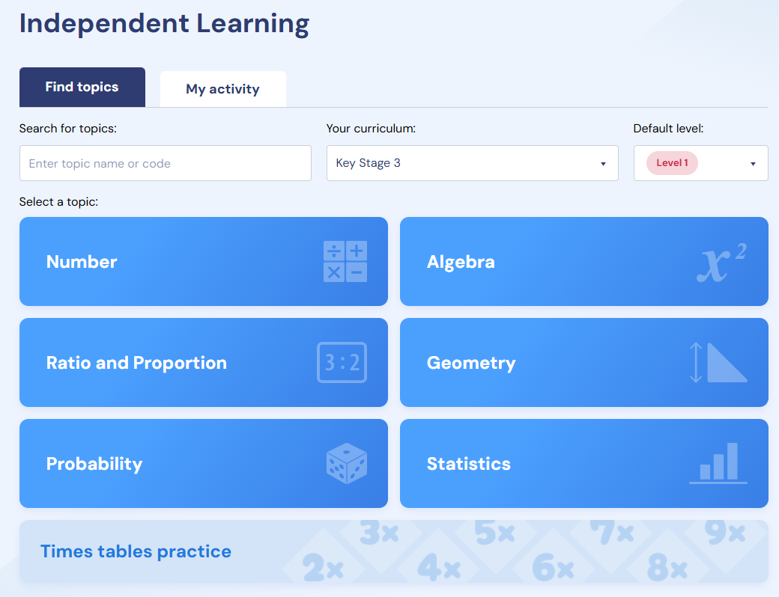
Independent Learning on Sparx

Slide 12
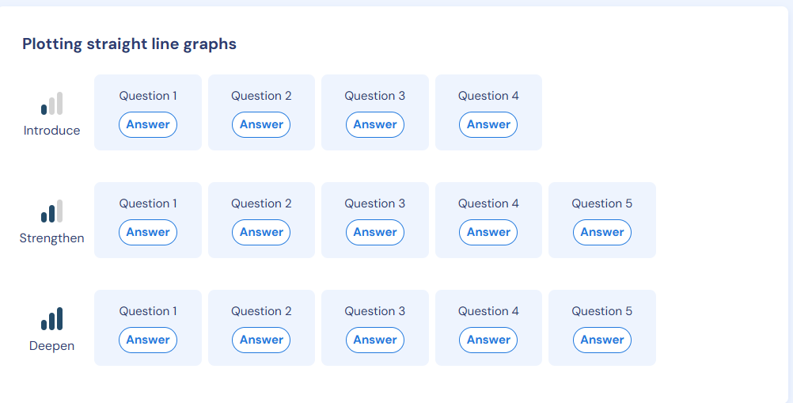
Independent Learning on Sparx

Slide 13

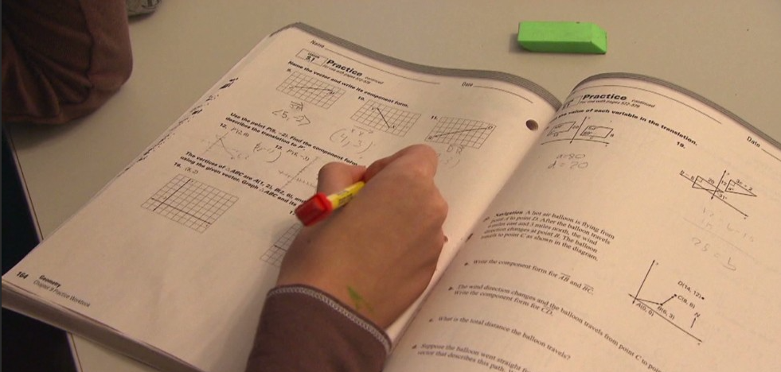
Good Habits
Work area
3 detailed worked examples
Tackling early
Seeking help

Slide 14
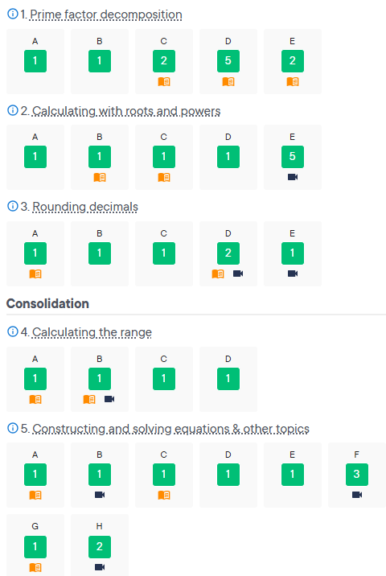
Analysis – good example

Slide 15
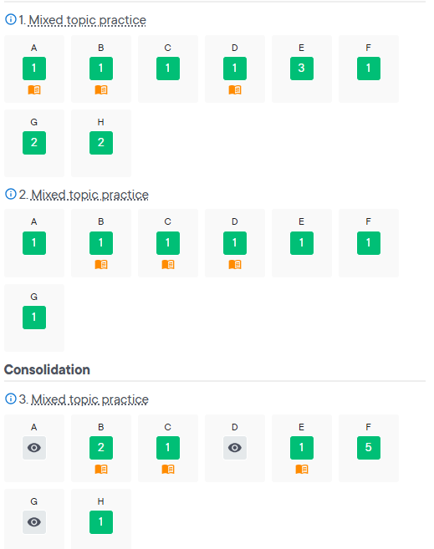
Analysis – NOT so good example

Slide 16

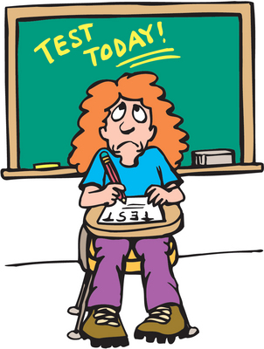

Quizzes

Slide 17
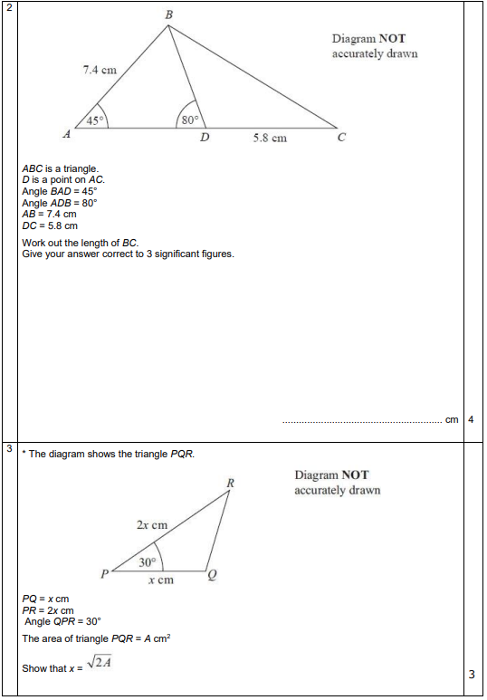
Year 11 quiz example

Slide 18
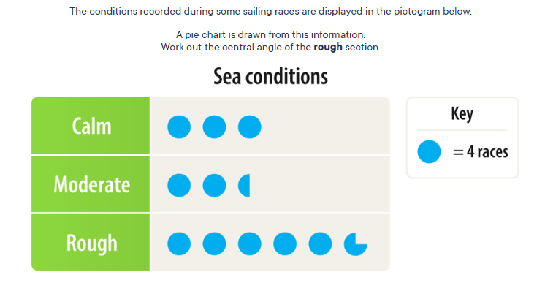

Countdown!

Slide 19
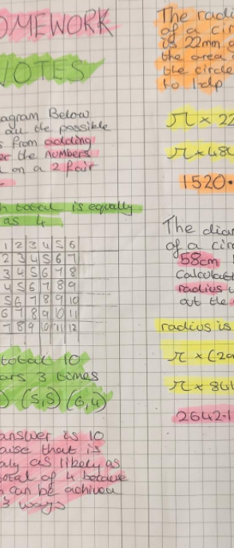

New and Improved Books!

Slide 20
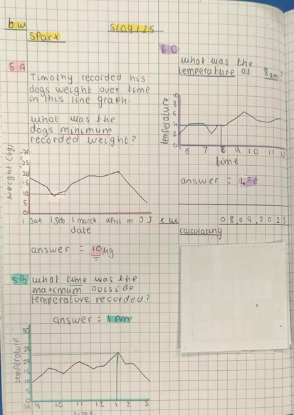
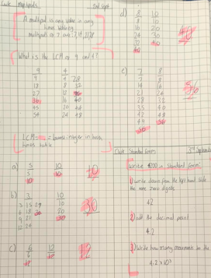
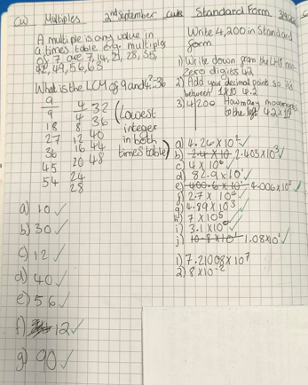
How should should student books be used?
Students should complete a minimum of three useful worked examples in their books
Students to record title and date
Bring into school every Friday – we will reward the best examples.

Slide 21

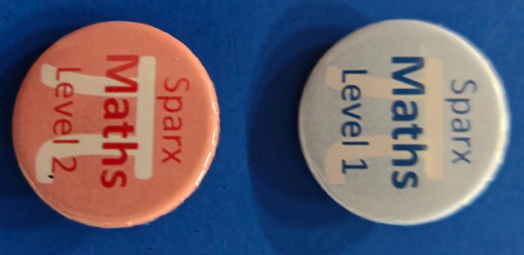
Rewards

Slide 22

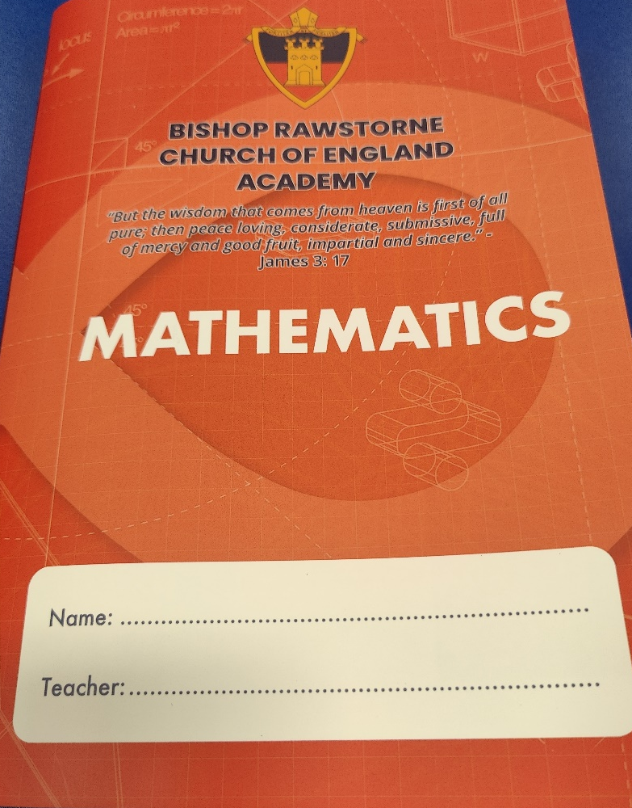


How to prepare for formal assessments?
Homework Club

Slide 23
Assessment Dates Year 10
Autumn Assessment
6th/7th November – 2 papers
Spring Assessment
19th - 30th January – 2 papers
Summer Assessment
w/c 23rd June – 4 x 45 minutes papers

Slide 24
Assessment Dates Year 10
Mock Exam
Autumn assessment in November
Spring assessment in January
Tier Of Entry

Slide 25
Assessment Dates Year 11
Mock Exam
3 full 90 minute papers
Paper 1 – 13th November
Paper 2 – 17th November
Paper 3 – 19th November
Equipment
Preparation

Slide 26

Year 11 Mock Preparation
Each compulsory homework will be a full GCSE paper. They may take up to 90 minutes.
This however, is their revision for the mock.
Any further preparation is optional.
Sparx assignment (set weekly Friday to Friday – now optional until after mocks)

Slide 27
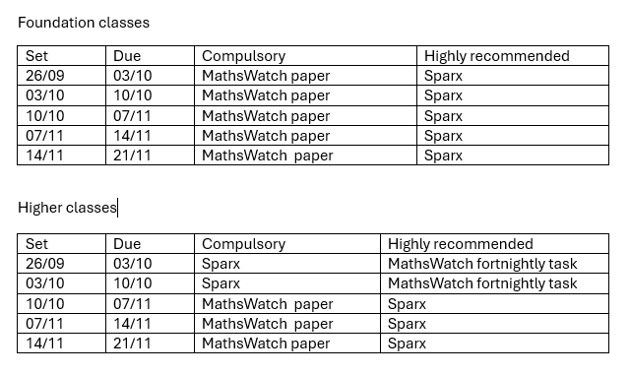
Mock preparation

Slide 28
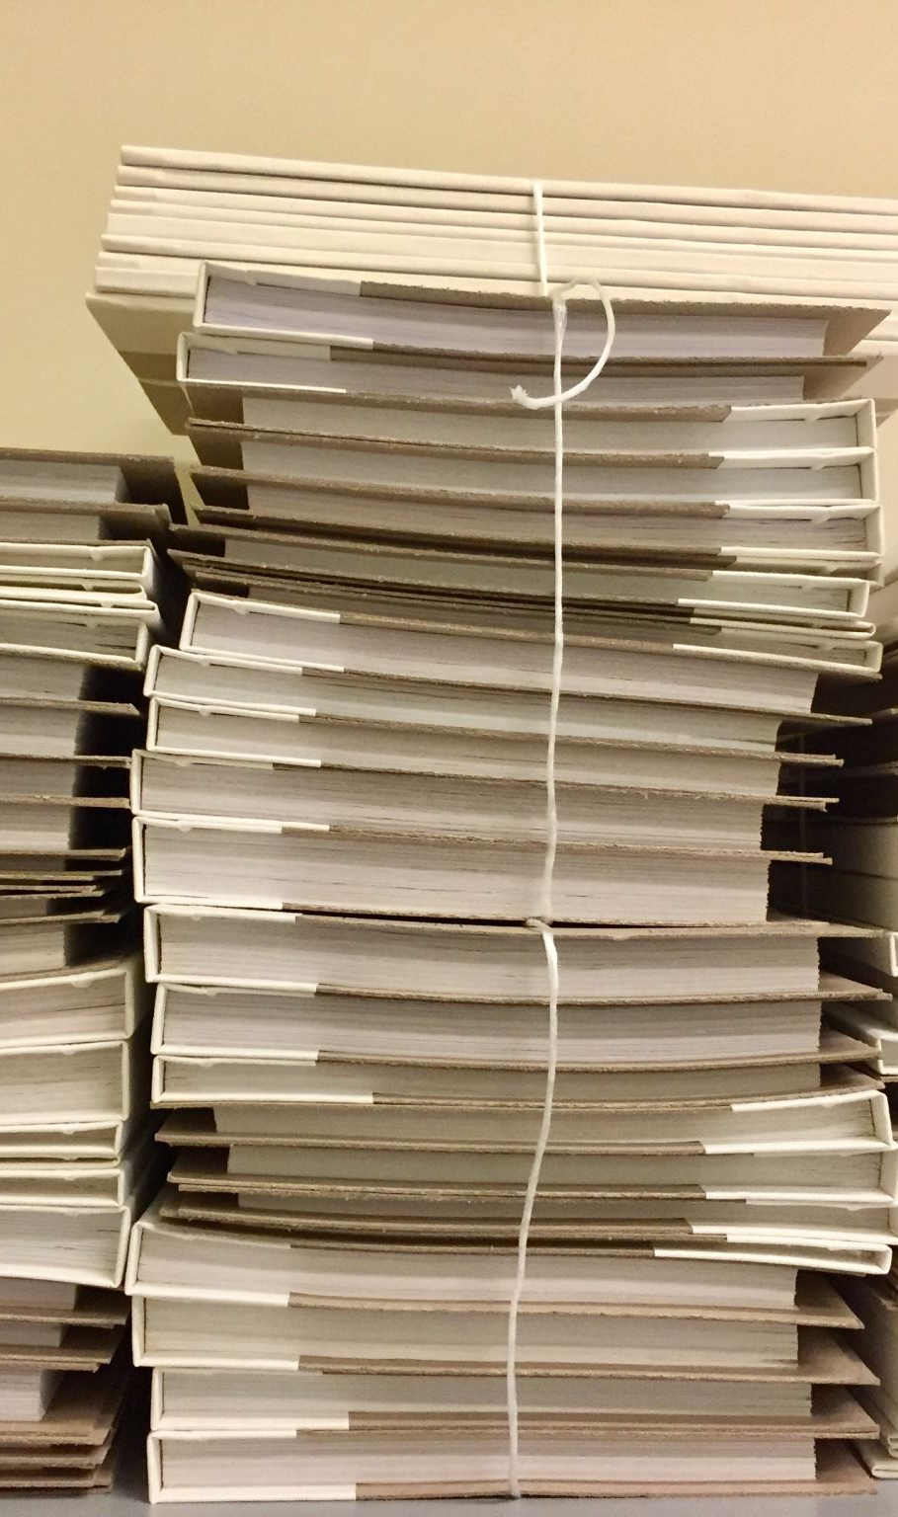
GCSE preparation
Past paper booklets
Wednesday drop-in revision from November 5th
Pinpoint
Mathswatch assignment
  Regular updates
Full schedule of revision from November 26th
Wednesdays from 3:30-4:15pm

Slide 29
GCSE’s 2025
20 students failed to gain a Grade 4+ in 2024/25
14 ‘Higher’ students failed to gain a strong pass in 2023/24
20.1% students achieved at least a Grade 8
89.5% achieved a Grade 4+ in Maths
72.3% achieved a Grade 5+ in Maths
31.4% achieved a Grade 7+ in Maths
87.5% achieved a Grade 4+ in Maths & English

Slide 30
Exam Dates Year 11
GCSE Maths Exam
Thu. 14 May
Paper 1
Wed. 3 June
Paper 2
Wed. 10 June
Paper 3

Slide 31
Exam Dates Year 11
GCSE Further Maths Exam
Paper 1: Monday 8th June
Paper 2: Monday 15th June

Slide 32
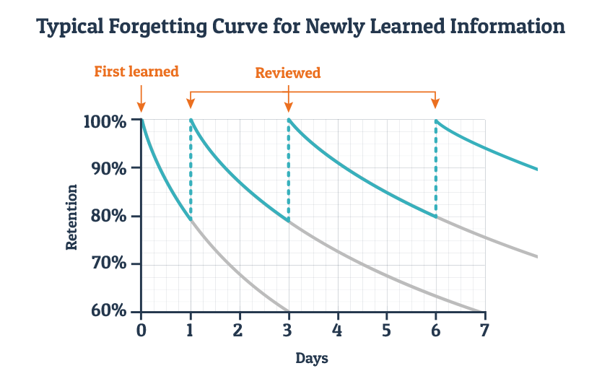
Why revise?

Slide 33
Student Groupings – Year 10
Mrs Clare, Mrs Brady/Mrs Poole, Mr Anglim & Mr Hosker
Higher
Aiming to achieve grades 5-9
Mrs Whitton, Mr Bushell & Mr Ward/Mrs Poole
Foundation Advanced
Aiming to achieve grades 4-5
Miss Mann
Foundation Basic
Aiming to achieve grade 4

Slide 34
Student Groupings – Year 11
Mr Anglim, Mr Hosker, Mrs Whitton
Higher Advanced
Aiming to achieve grades 7-9
Mr Bushell
Higher Basic
Aiming to achieve grades 5-6
Mr Ward/Mrs Poole/Mr Cowley, Miss Mann, Mrs Clare
Foundation Advanced
Aiming to achieve grades 4-5
Mrs Brady/Mrs Poole
Foundation Basic
Aiming to achieve grade 4

Slide 35
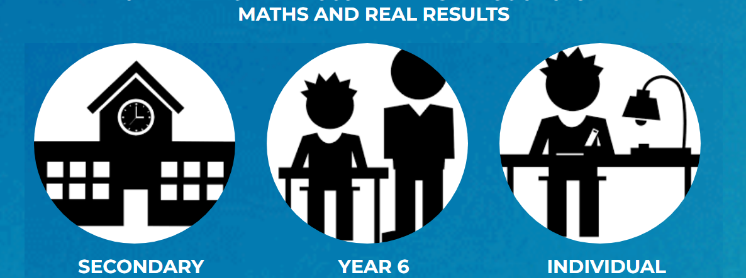
Pinpoint Learning
Personalised post-assessment booklet
Linked to Mathswatch videos
Virtual exam folder
Notes:
After all assessments from year 7 through to year 11 we will input the data into pinpoint. Pinpoint creates a personalized booklets for each pupil focusing on the five topics which they need to work on next. Easy, medium and hard questions are given to guide them through with the support of Sparx Maths videos. This is designed to support every individual pupil to progress and learning from each assessment. Pupils over their time here will grow a virtual exam folder and this will support them in selecting topics for revision ensuring revision is focused to have the maximum impact.

Slide 36

Resources

Slide 37

Thank you! Any questions?

